Slide 1

State-of-the-Art Traffic Modeling for Cowboys Stadium
Kristen Torrance and Bob Brooks
Parsons Brinckerhoff
May 11, 2011
TRB Planning Applications Conference 2011

Slide 2

Cowboys Stadium- Arlington, TX
Texas Stadium
Northwestern University- Ryan Field
2010 World Equestrian Games
Patriot’s Place – Foxborough, MA
Super Bowl XL Detroit
Dolphin Stadium - Super Bowl MP
Alabama Motorsports Park, Mobile
Dubai AutoDrome Dubai, UAE
Cleveland Grand Prix
Charlotte Bobcats - Bobcat’s Arena
Birmingham Convention Center
Florida Marlins - New Ballpark
St. Louis Cardinals – Bush Stadium
Pittsburgh Steelers – Heinz Field
Pittsburgh Pirates – PNC Park
Pittsburgh Penguins – New Arena
Cincinnati Bengals - Brown Stadium
Cincinnati Reds – Great America Ballpark
Gillette Stadium – NE Patriots
New Jersey Nets - New Arena
Cleveland Browns – Browns Stadium
Cleveland Cavaliers – Gund Arena
Cleveland Indians – Jacob’s Field
Seattle Mariners – Safeco Park
Seattle Seahawks – Quest Field
Oakland A’s – New Ballpark
New Orleans Saints – New Stadium
Philadelphia Phillies – New Ballpark
Washington Nationals
Churchill Downs
Rock ‘n Roll Hall of Fame
Truman Center – Chiefs and Royals
Canada’s Wonderland Theme Park
Univ of West Virginia Mountaineer Stadium
Colorado State Univ – Hughes
Stadium
Univ of Louisville – Papa John Stadium
Ohio State - Value City Arena
Univ of Minnesota –New Stadium
Kentucky Fair and Exposition Center
Cincinnati Riverfront Master Plan
East St. Louis Riverfront Stadium Plan
Brian Lara Cricket Stadium - Trinidad
South Louisville Mater Plan
Disneyland Theme Park, CA
Kentucky Kingdom Theme Park
Carowinds Theme Park
Great America Theme Park
Boston Celtics – New Arena
AA Toronto Blue Jays – Ballpark
TRB Planning Applications Conference 2011

Slide 3
Outline
Overview of Location
Application of the Four Step Model
Implementation of the Model
Benefits
Lessons Learned
TRB Planning Applications Conference 2011

Slide 4
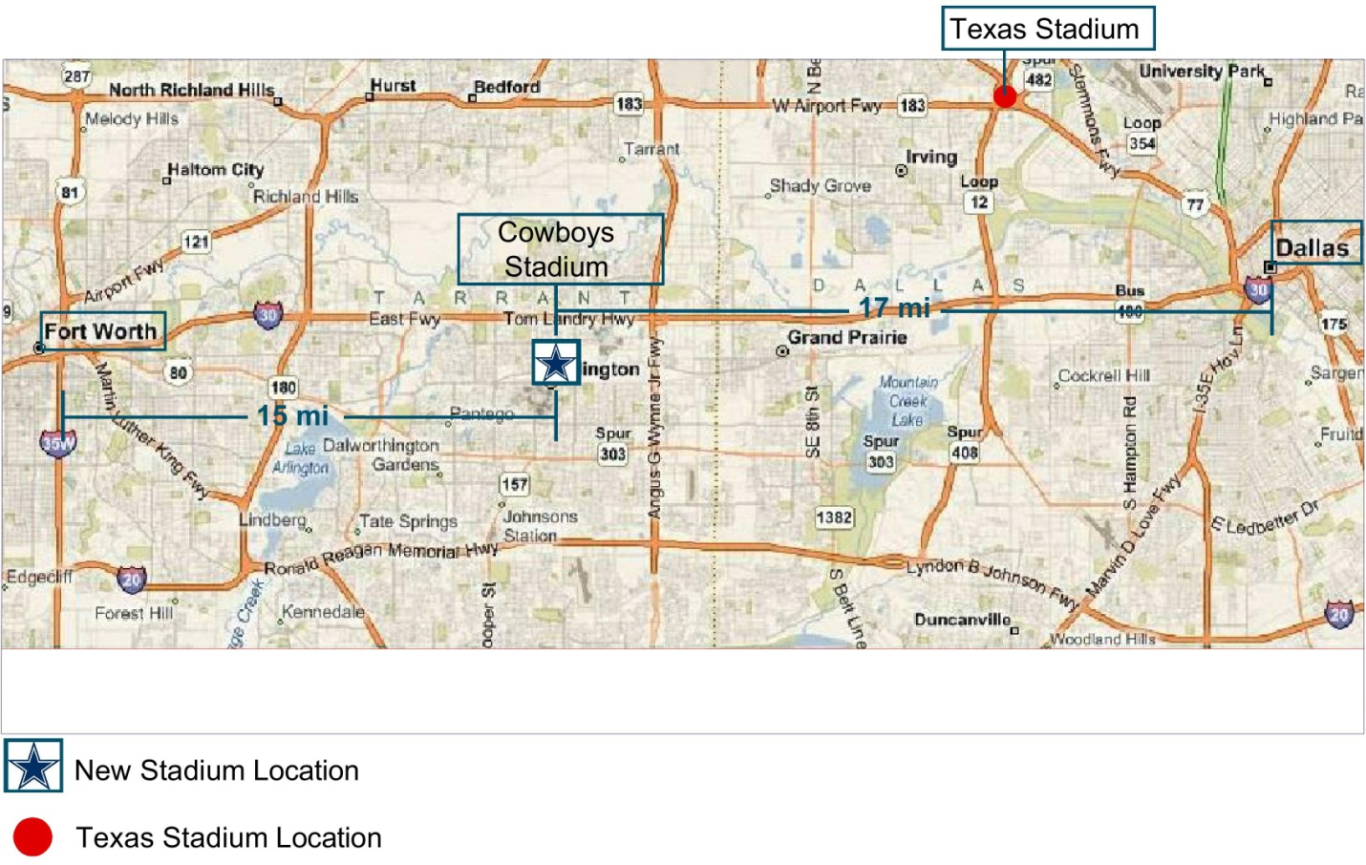
Project Location
TRB Planning Applications Conference 2011
Notes:
Located in Arlington, TX, approximately 17 miles from Dallas and 15 miles from Fort Worth
12 miles from Texas Stadium in Irving
In Entertainment District in Arlington (1/2 mile from Texas Rangers BP, 1 mile from Six Flags Over Texas and the Arlington Convention Center, and 2 miles from Hurricane Harbor); As a result of multiple generators traffic planning is critical to maintaining traffic flow on surround roadways

Slide 5
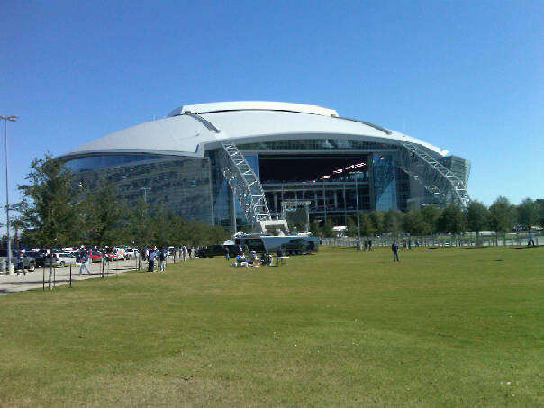
Cowboys Stadium
Over $1.3 Billion Dollar Stadium
3 Million Square Feet
World’s Largest HD Video Screen
World’s Longest Single Span Roof Structure
Capacity of 85,000 (Expands to +105,000)
NEEDED A STATE-OF-THE-ART TRAFFIC PLAN
TRB Planning Applications Conference 2011
Notes:
Largest HD Video Screen- 162’ wide by 72’ high and weighing 1.2 million pounds (from 20 yard line to 20 yard line)
One of the most expensive sports venues ever built- expected every aspect of the stadium to be constructed and to operate at the highest caliber.

Slide 6
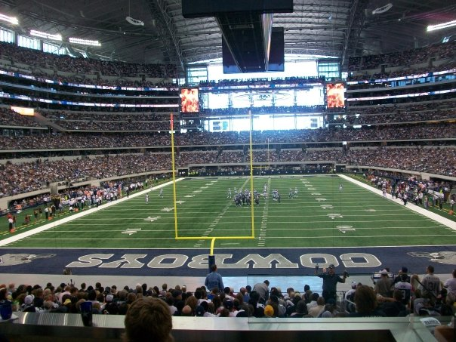
Challenges
Vehicular Access and Egress Route
Utilization of Available Roadway Capacity
Parking Supply
Parking Management
Safe Pedestrian Corridors
TRB Planning Applications Conference 2011
Notes:
Congestion (anytime in which demand exceeds capacity), has significant impacts on safety, travel time reliability, the concentration of mobile source emissions, and overall gameday experience
From the interstate, 7 primary access routes with 14 different interchanges and 19 access routes

Slide 7
Four Step Model
PREDICT EVENT TRAFFIC FLOW BY APPLYING
THE FOUR STEP MODEL
Trip Generation
Trip Distribution
Mode Choice
Traffic Assignment
TRB Planning Applications Conference 2011

Slide 8
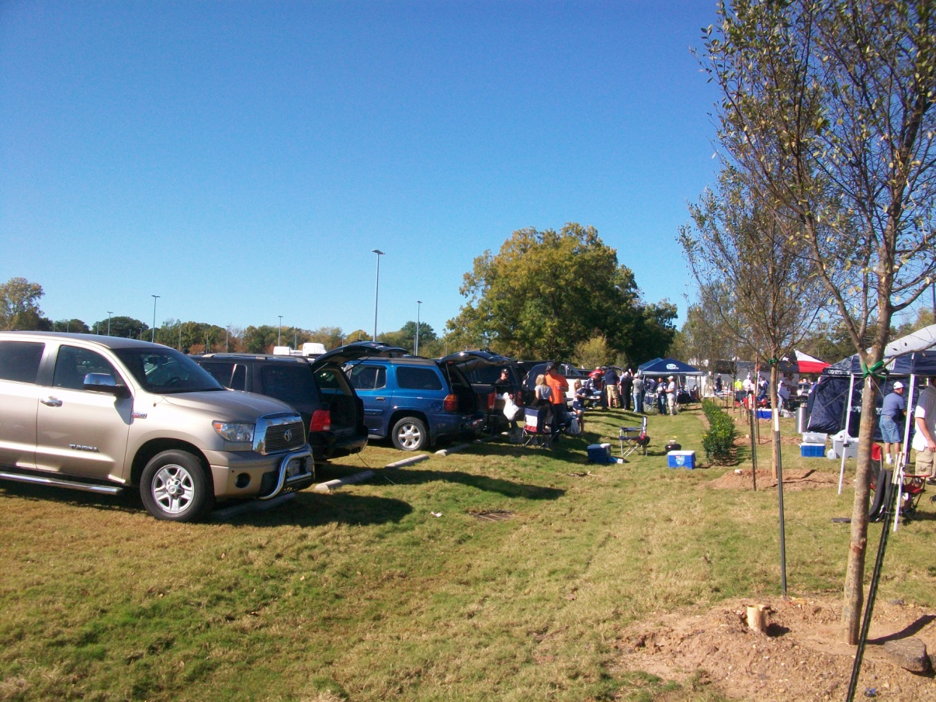
Trip Generation
Capacity of the Venue
80,000-105,000
Patrons
Vehicle Occupancy
3.2 Persons/Vehicle
UP TO 32,800
VEHICLES
TRB Planning Applications Conference 2011
Notes:
Ultimately, the Cowboys constructed 12,000 spaces, have an agreement for up to 11,000 spaces at Texas Rangers Ballpark, Employee parking at Six Flags, and rely on entrepreneur parking

Slide 9
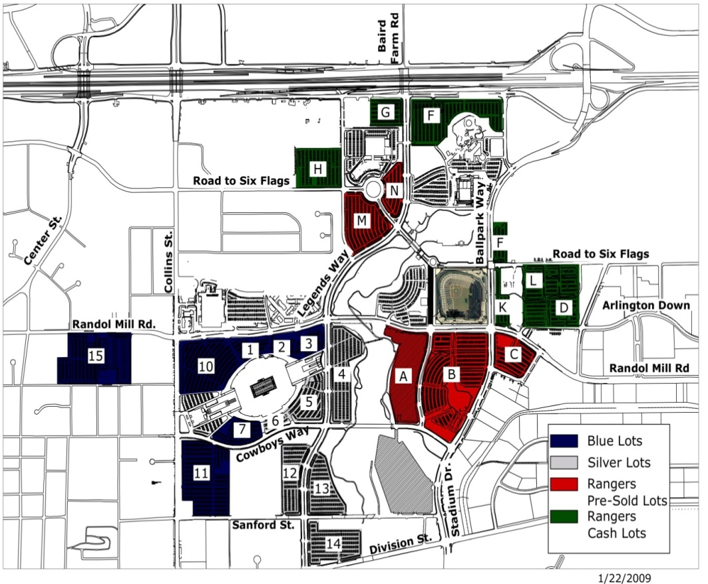
Trip Distribution
Determine Origin of Trips
2008 Texas Stadium Season Ticket Sales
50 Mile Radius of Venue
Determine Destination
of Trips
Unknown Parking
Locations
Recommended Pre-Sale
of Parking
TRB Planning Applications Conference 2011
Notes:
Thru Ticketmaster, patrons were given the opportunity to purchase parking passes at the time of purchasing a ticket; Cowboys were able to pre-sell all of their 12,000 spaces and 6,000 Ranger Spaces → Provides a known destination based on ticket sales!

Slide 10
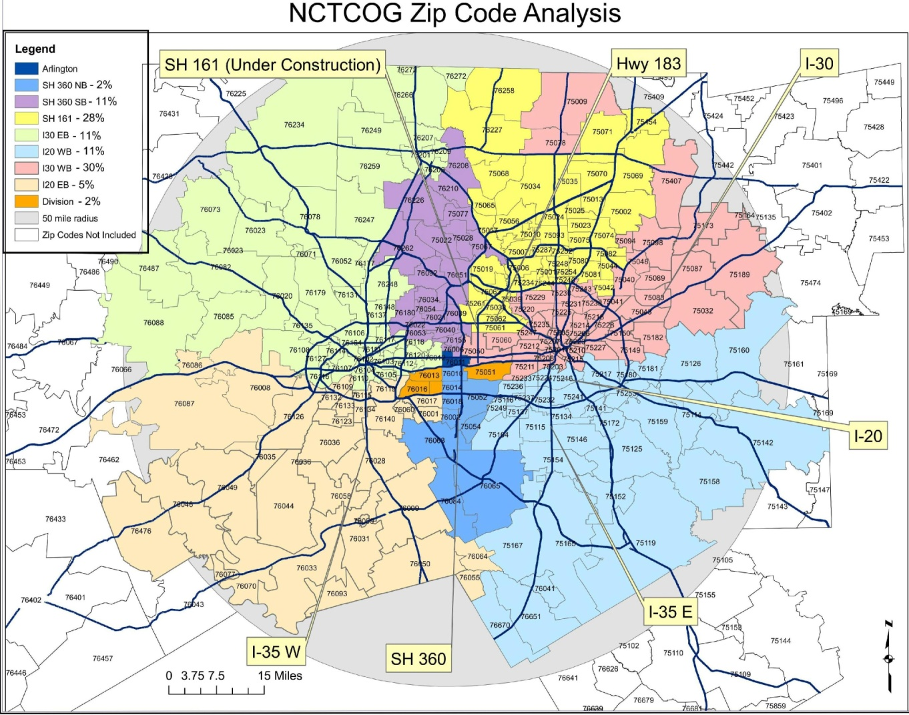
Zip Code Analysis
TRB Planning Applications Conference 2011
Notes:
Eight primary access routes; each zip code analyzed to determine the primary interstate/highway access

Slide 11
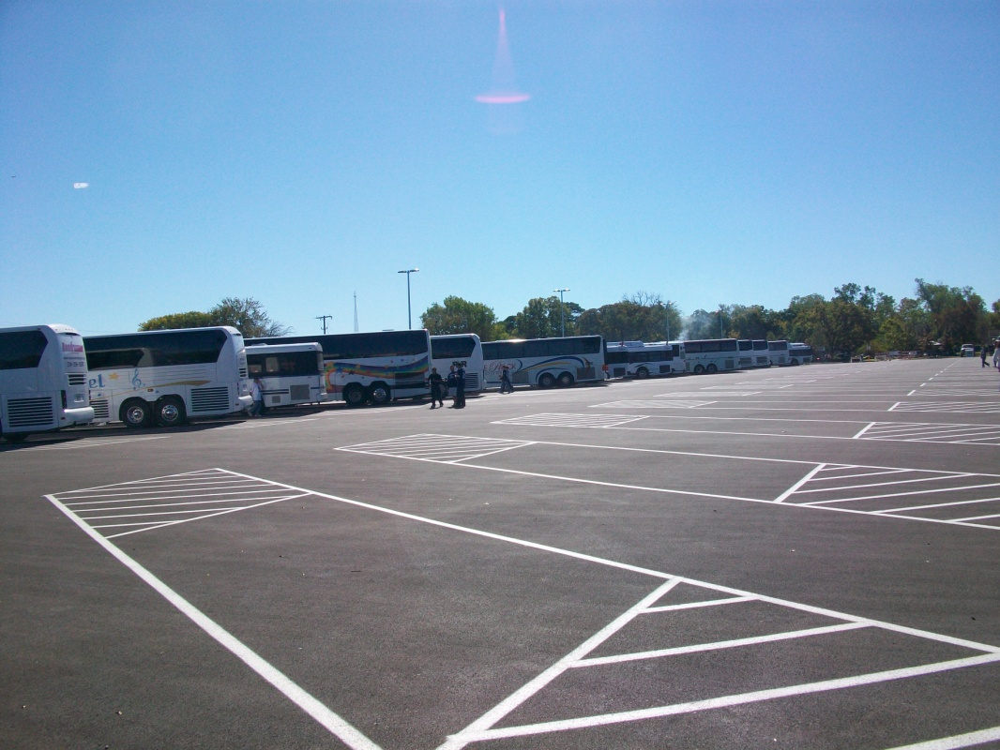
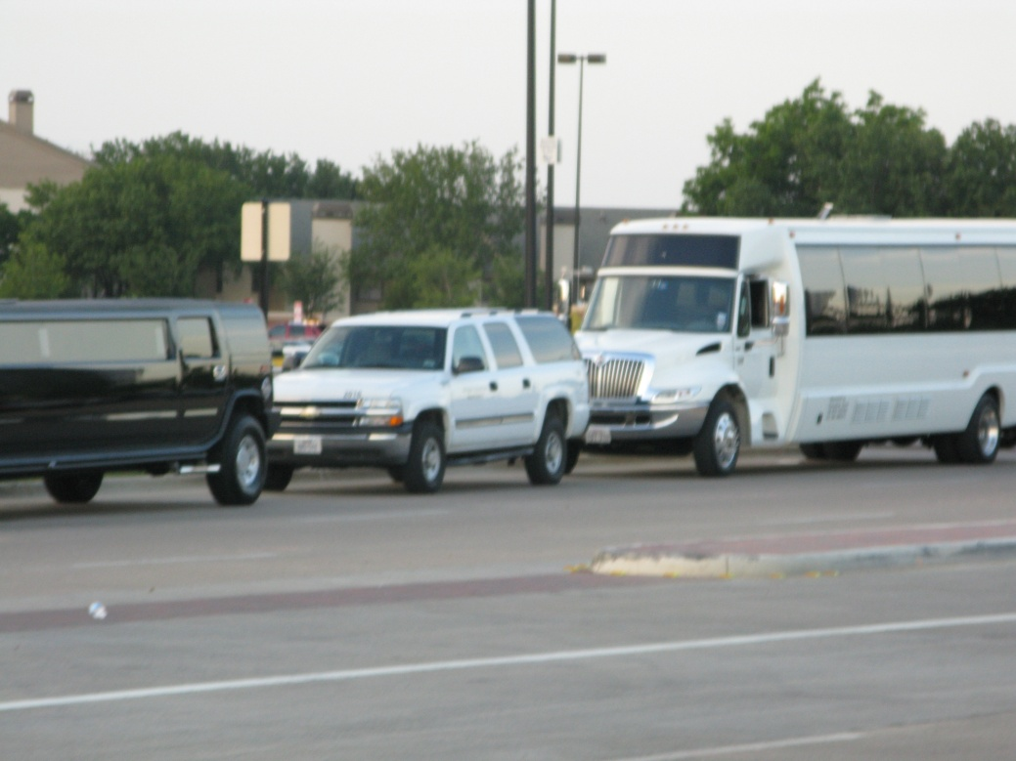
Mode Split
Limited Public Transportation
Charter Bus Service
120 Bus Parking Spaces
TRB Planning Applications Conference 2011
Notes:
Less than 5% Transit

Slide 12
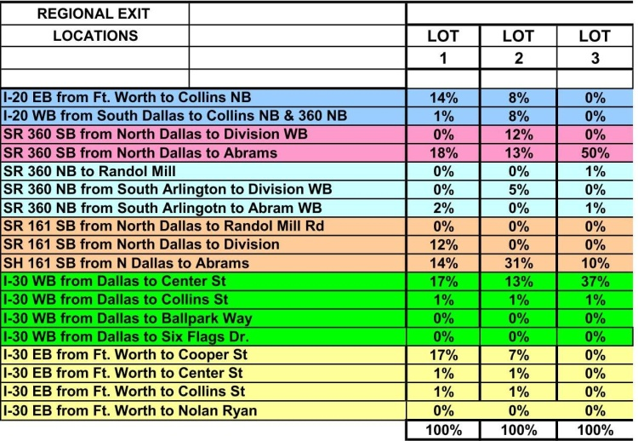
Traffic Assignment
Determine Access and Egress Routes by Lot
Develop Distribution by Lot
Assign Traffic Based on Shortest Path
TRB Planning Applications Conference 2011
Notes:
Starting Point- Apply pre-sold ticket sales by lot to each of the access routes; assume that patrons use shortest route (in terms of distance)

Slide 13
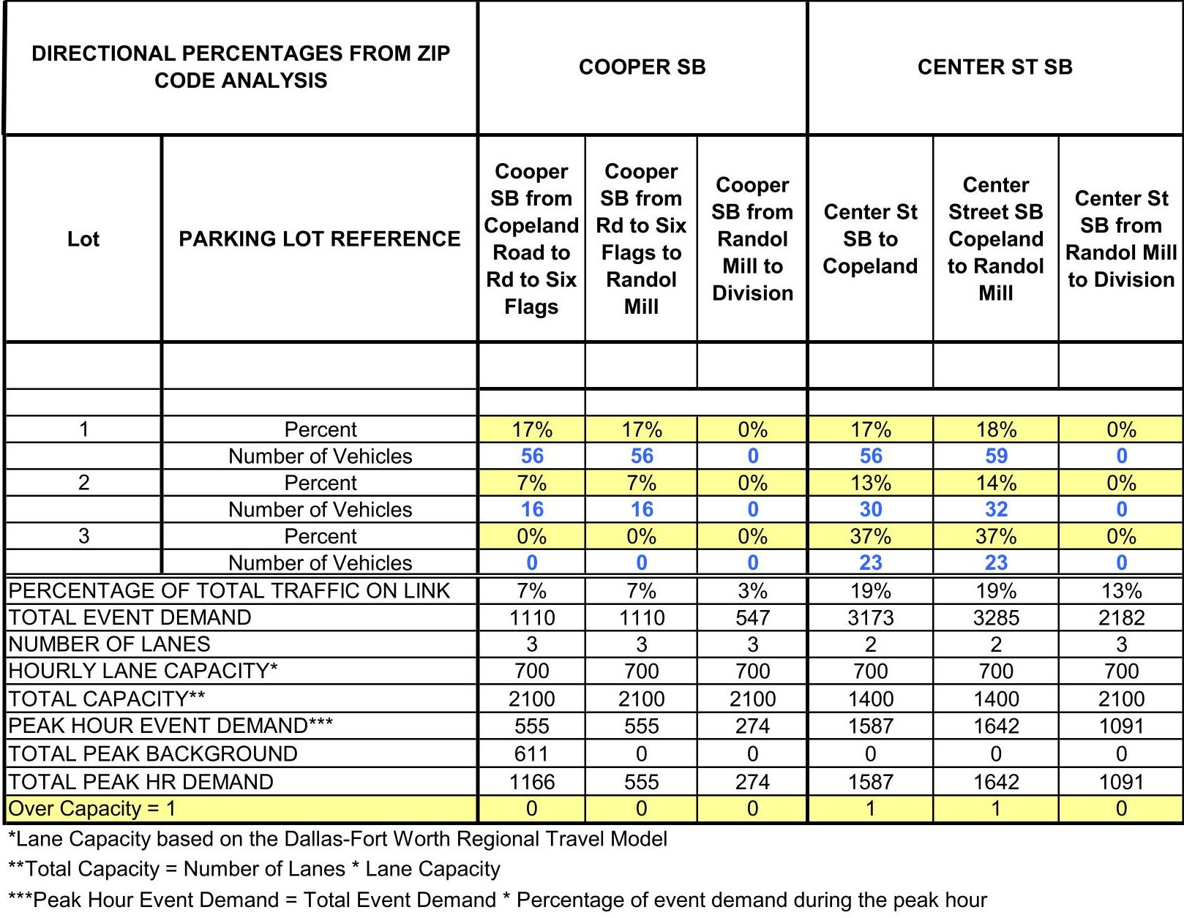
Traffic Assignment
Determine Total Traffic on Each Link
Sum Paths for Each Lot
Apply Peak Hour Factor
Add Background Traffic
Compare Event Demand to Available Capacity
Re-Assign Traffic from Over Capacity Routes
TRB Planning Applications Conference 2011
Notes:
See what links could potentially be over capacity for an event, and also allows us to re-assign O-D pairs to roadway links that have available capacity; Instantaneously, model will output new traffic volumes and turning movement counts (input into VISSIM/Synchro)
As a result, many patrons may travel a distance greater than their shortest path, but as a result of balanced traffic across the roadway network, they will receive a route that will get them from their origin to their destination in the shortest possible time.
Infrastructure in Arlington is constantly being updated, so model can be re-run and modified to adjust for construction traffic and closures

Slide 14
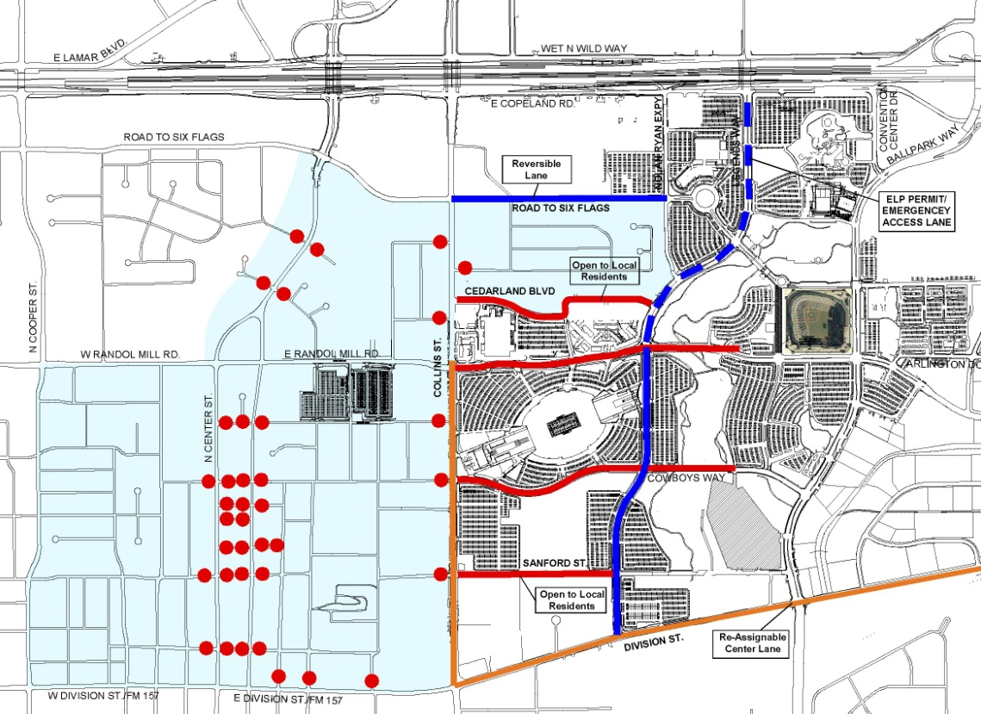
Alternatives to Re-Routing
Reversible Lanes
Re-Assigned TWLTL
Neighborhood Parking Restrictions
Police Control

Slide 15
Implementation
How do we communicate these preferred routes with patrons?
www.DallasCowboysMaps.com
TRB Planning Applications Conference 2011
Notes:
Patron Education and Public Outreach is critical to manage event traffic

Slide 16
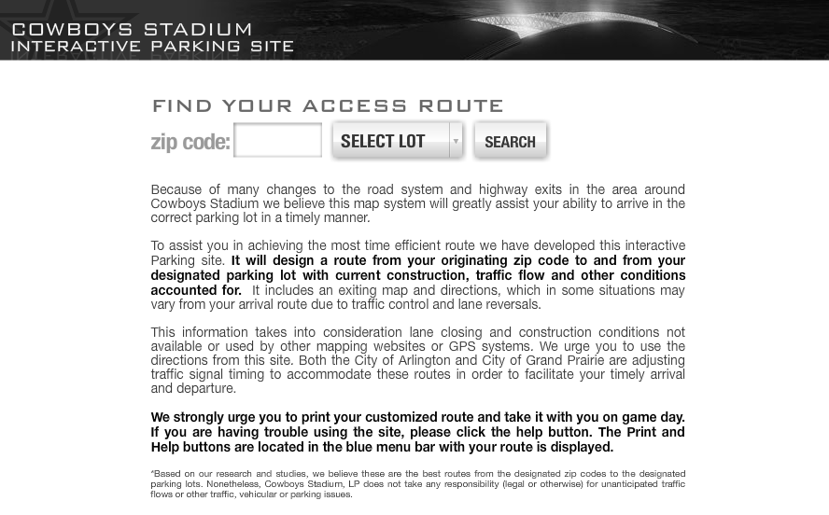
DallasCowboysMaps.com
TRB Planning Applications Conference 2011
Notes:
Disclaimer explaining the purpose behind mapping

Slide 17
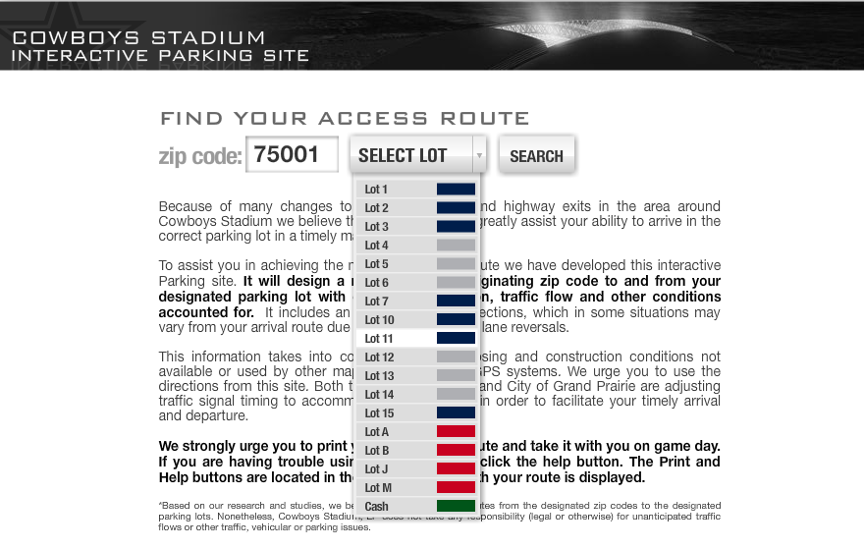
DallasCowboysMaps.com
TRB Planning Applications Conference 2011

Slide 18
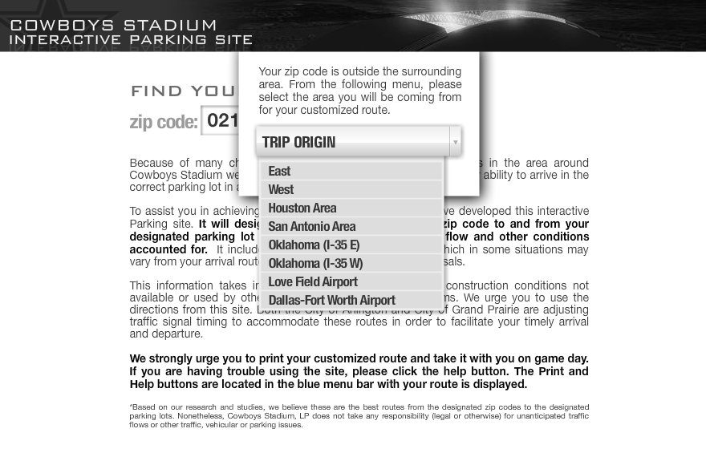
DallasCowboysMaps.com
TRB Planning Applications Conference 2011
Notes:
Zip Codes not Within 50 Miles of Stadium

Slide 19
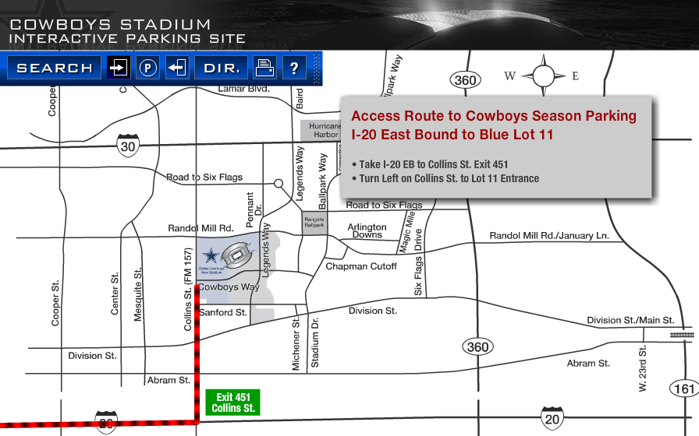
DallasCowboysMaps.com
TRB Planning Applications Conference 2011

Slide 20
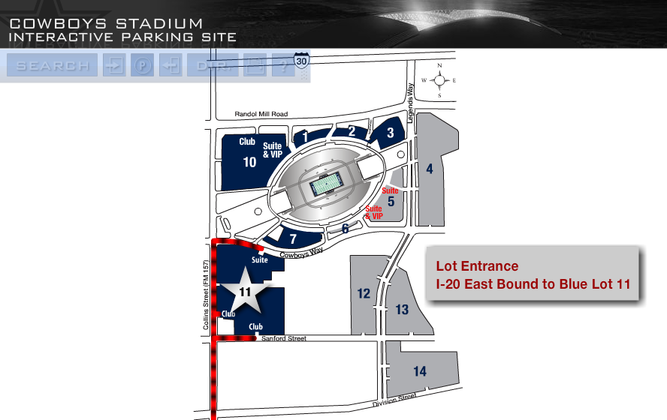
DallasCowboysMaps.com
TRB Planning Applications Conference 2011
Notes:
Driveway Access

Slide 21
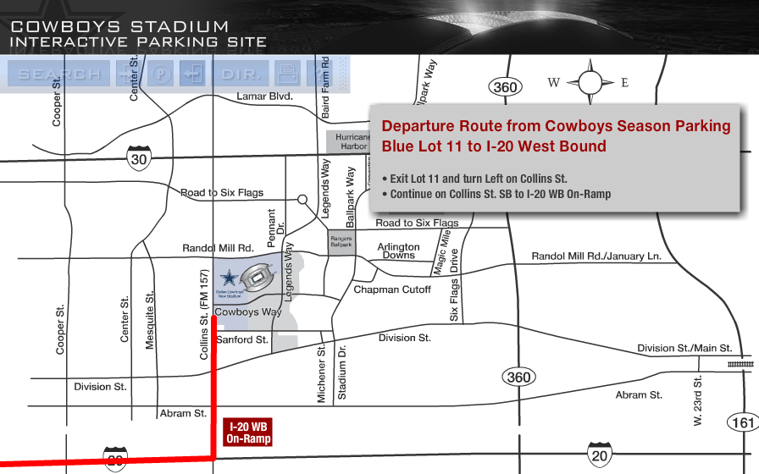
DallasCowboysMaps.com
TRB Planning Applications Conference 2011
Notes:
Departure Route

Slide 22
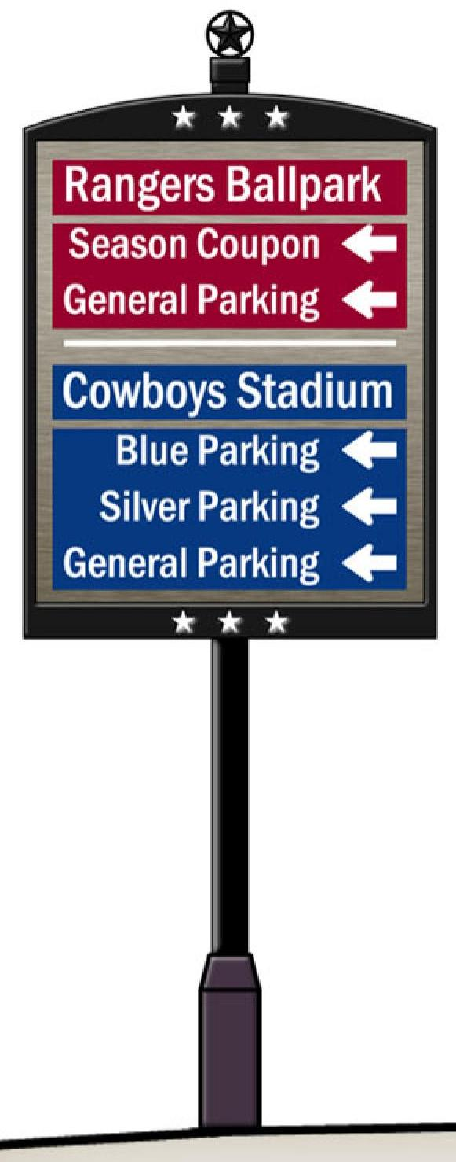
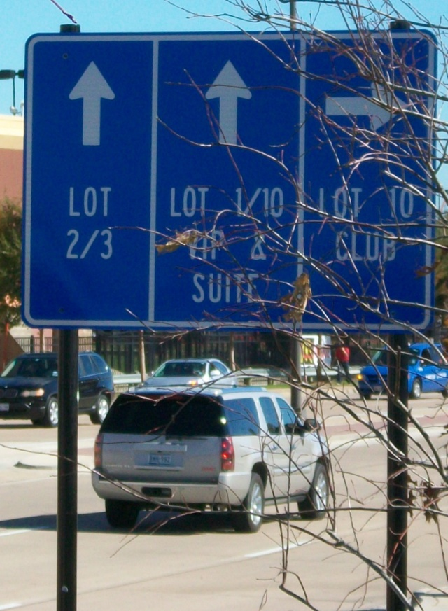
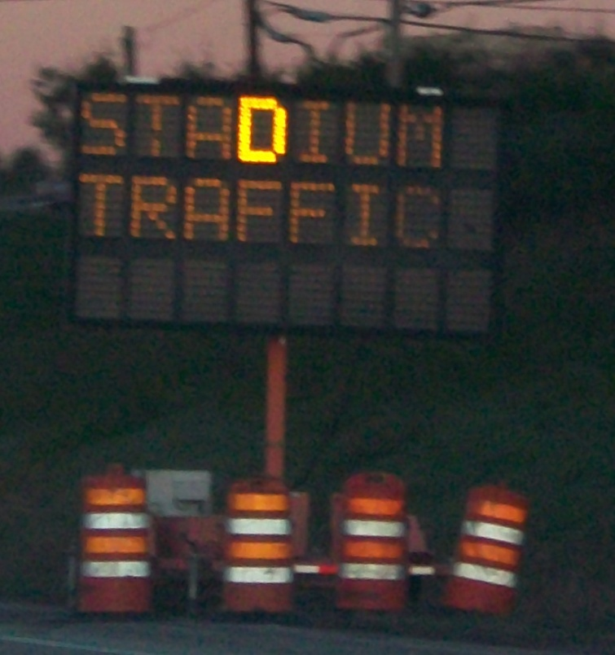
Supporting Signage
Increase Driver Confidence in Routes
TRB Planning Applications Conference 2011
Notes:
Increase confidence that the drivers were using the correct route
Over 100 AED Wayfinding Signs Installed
6 DMS Signs on the Interstate; 20 on Local Roads
Approximately 30 Permanent Parking Signs

Slide 23
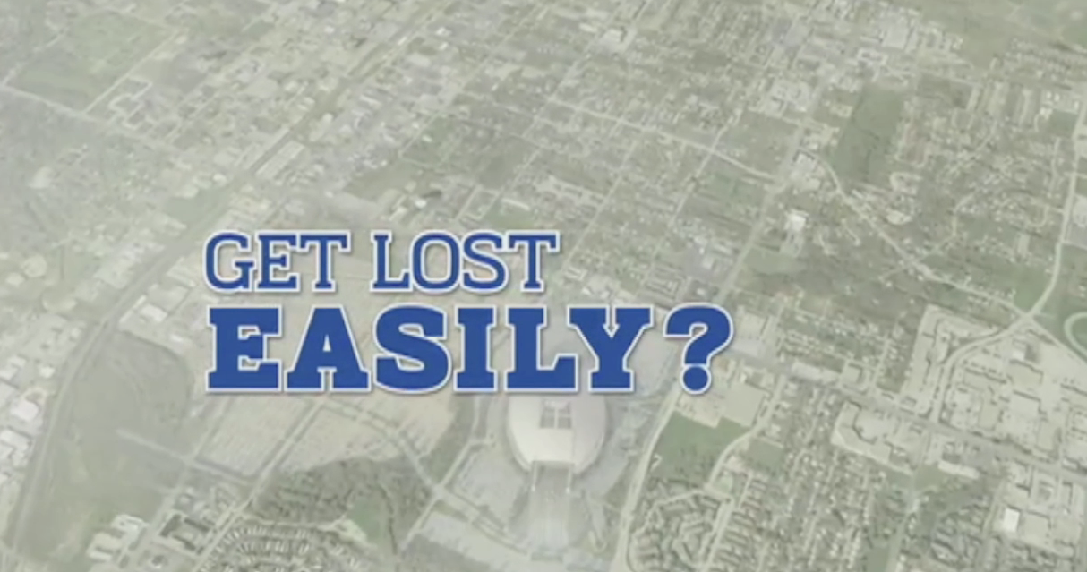
Public Outreach
Press Conferences
Newspaper Articles
Mailings to Season Ticket Holders
Video During Game

Slide 24
Benefits
Quickly & Easily Predict Congestion Levels for all Size Events
Output of Traffic Assignment Model Used as Input to VISSIM/Synchro
Predict Queues
Implement Event Signal Timing
Implement a Gameday Transportation Management Plan
Reversible/Re-Assignable Lanes
Pedestrian Corridors
TRB Planning Applications Conference 2011
Notes:
Reverse/Re-Assign lanes of traffic on gameday on routes we knew would be congested to matter how traffic was routed

Slide 25
Results
Ultimate Test is Smoothness of Gameday Traffic and Parking
2009 NFL Season:
All Lots Full 30 Min Before Event
All Lots Empty in 70 Min (80% in 50 min)
High Compliance with Online Mapping
“The people that did the traffic planning should plan the offensive line for the season…”
Dallasnews.com
TRB Planning Applications Conference 2011

Slide 26
Conclusions
Pre-Sale of Parking Reduces Driver Uncertainty
Flexibility of Traffic Assignment Model is Critical to Manage Event Congestion
Impact of Traffic on Overall Gameday Experience
Traffic Planning Pays Off!
TRB Planning Applications Conference 2011

Slide 27
Questions?
Kristen Torrance, EIT
Torrancek@pbworld.com
617-960-4958
Bob Brooks, PE
Brooksr@pbworld.com
617-960-4860
TRB Planning Applications Conference 2011

