Slide 1
New Findings from the Application of Accelerated UE Traffic Assignments
Howard Slavin
Jonathan Brandon
Andres Rabinowicz
Paul Ricotta
Srini Sundaram
Caliper Corporation
May 2011

Slide 2
Accelerated UE Assignment Methods
Multi-threaded Frank-Wolfe (FW)
Multi-threaded Bi-conjugate FW – BFW (Daneeva and Lindberg)
Origin User Equilibrium (OUE), Dial’s Algorithm B on which OUE is based, Bar-Gera’s OBA and TAPAS, and other Origin and Path-based Methods
To varying degrees, all provide faster and tighter convergence

Slide 3
Previous Empirical Testing of Faster Algorithms & Convergence Impacts
Established the achievability of unprecedented convergence levels
Demonstrated speed enhancements through distributed processing and multi-threading
Illustrated the practicality of OUE and warm start efficiency
Indicated some of the benefits of tighter convergence

Slide 4
New Empirical Tests
Use of More Threads from newer hardware
Further testing of BFW and OUE
Warm start tests emphasizing Feedback Loop Cases
Investigation of very large test problems using 64-bit implementations
Examination of Irrelevant, Small, and Major Project Impacts
Select Link Analysis with OUE and Most Likely Route Flow Estimates

Slide 5
Test Cases- From Small to Large
Victoria BC Regional Model-550 zones, 8500 links, 2 classes
A regional model for greater Washington metro area DC that Caliper developed for MNCPPC-Prince George’s County with 2,500 zones, 6 purposes, 3 time periods, 5 assignment classes, 57,000+ links
NYMTC Updated 2011 BPM-3586 zones, 4 time periods, 6 assignment classes, 88,000+ links

Slide 6
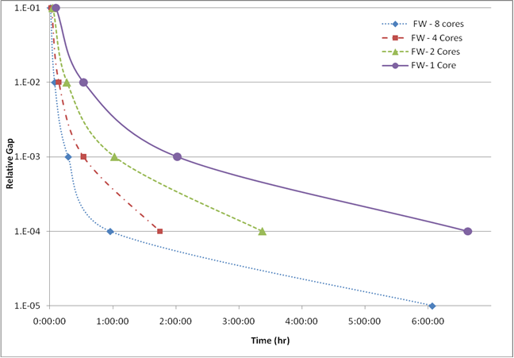
FW Convergence with 1, 2, 4 & 8 Cores
DC Regional Network

Slide 7
Comparison of FW, BFW, & OUE
DC Regional Net with 8 Cores

Slide 8
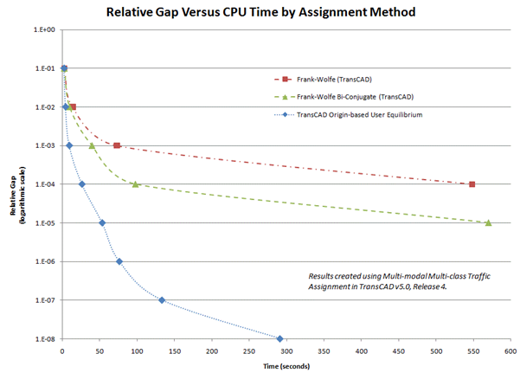
Convergence Graphs for Victoria BC

Slide 9
Bi-conjugate NYMTC runs-8 cores
Model Steps | Loop 1 | Loop 2 | Loop 3 | Loop 4
AM Assignment | 26.0 | 25.0 | 26.5 | 25.0
MD Assignment | 29.0 | 25.0 | 27.0 | 24.0
PM Assignment | 22.0 | 21.0 | 23.0 | 22.0
NT Assignment | 8.0 | 9.0 | 9.0 | 9.0
Total Time (min) | 85.0 | 80.0 | 85.5 | 80.0

Slide 10

NYMTC Feedback Loop OUE Assignments with and without a Warm Start (Rg=${10}^{−4}$)
Warm Start Run
Model Steps | Loop 1 | Loop 2 | Loop 3 | Loop 4
AM Assignment | 38 | 17.5 | 10.5 | 11
MD Assignment | 33 | 17 | 10 | 10.5
PM Assignment | 43 | 19.5 | 13.5 | 10
NT Assignment | 12 | 9.5 | 9 | 9
Total Time (Min.) | 126 | 63.5 | 43 | 40.5
Cold Start Run
Model Steps | Loop 1 | Loop 2 | Loop 3 | Loop 4
AM Assignment | 38 | 51.5 | 52 | 52.5
MD Assignment | 33 | 43.5 | 42 | 43
PM Assignment | 43 | 54 | 55 | 55.5
NT Assignment | 12 | 14 | 14 | 14
Total Time (Min.) | 126 | 163 | 163 | 165

Slide 11
NYMTC OUE Warm Start Savings

Slide 12
Convergence Levels & Project Impacts
Three Examples Examined
An Irrelevant network change-eliminating a remote minor link
A capacity expansion in a central location in Victoria
A Transit Improvement –DC Metro

Slide 13
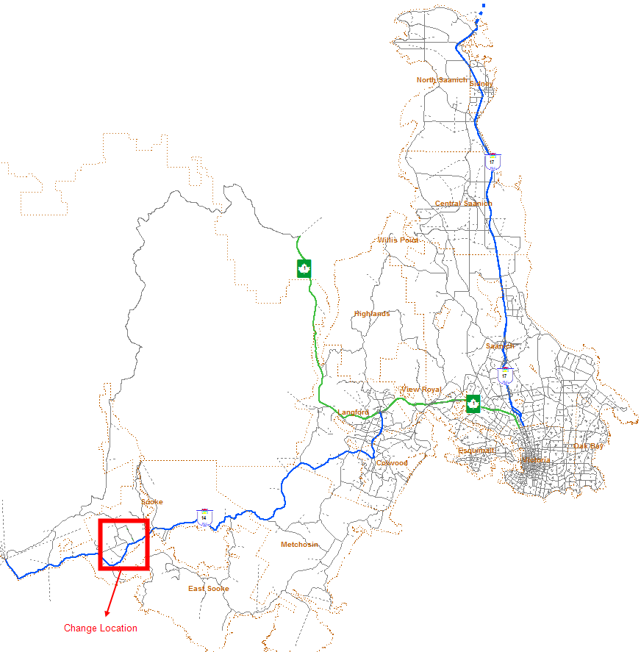
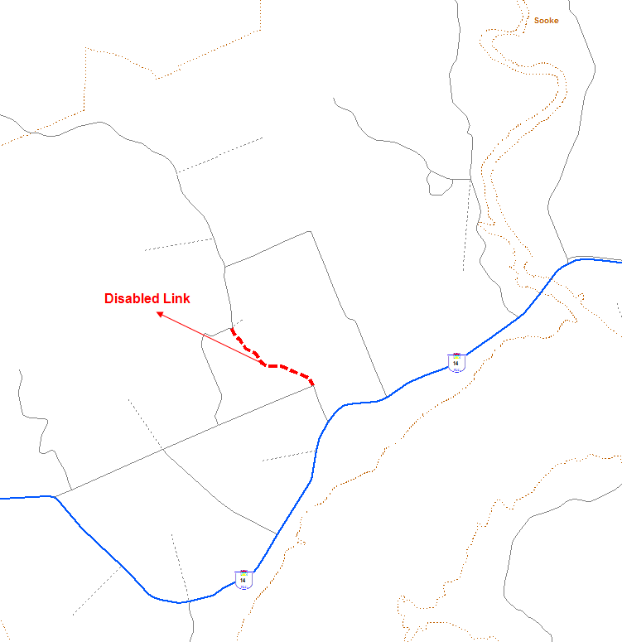
INSIGNIFICANT CHANGE

Slide 14
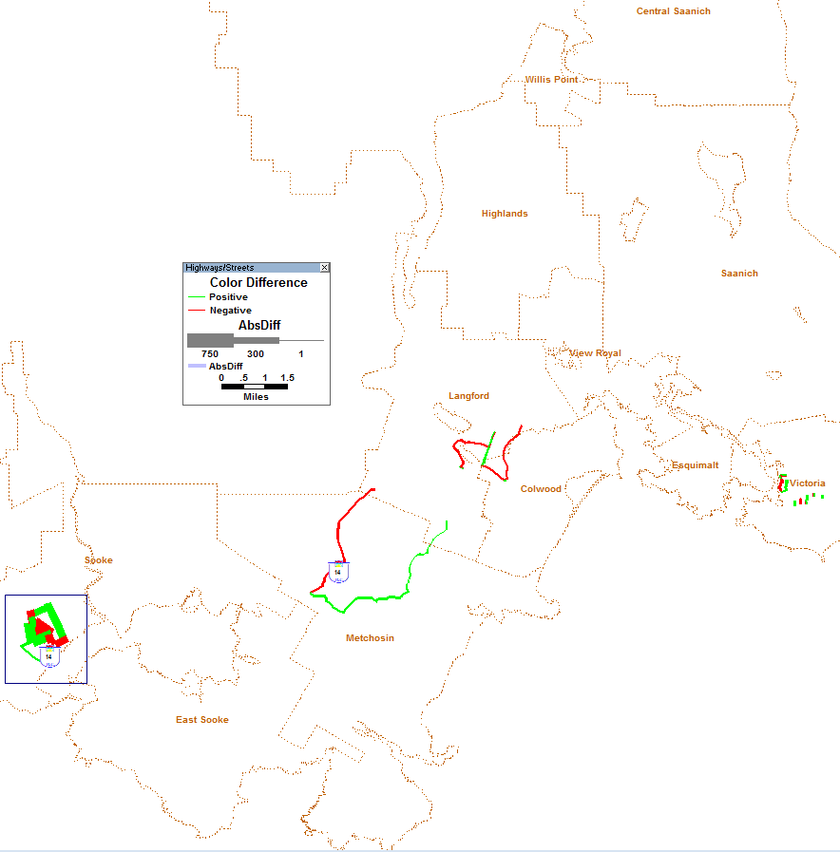
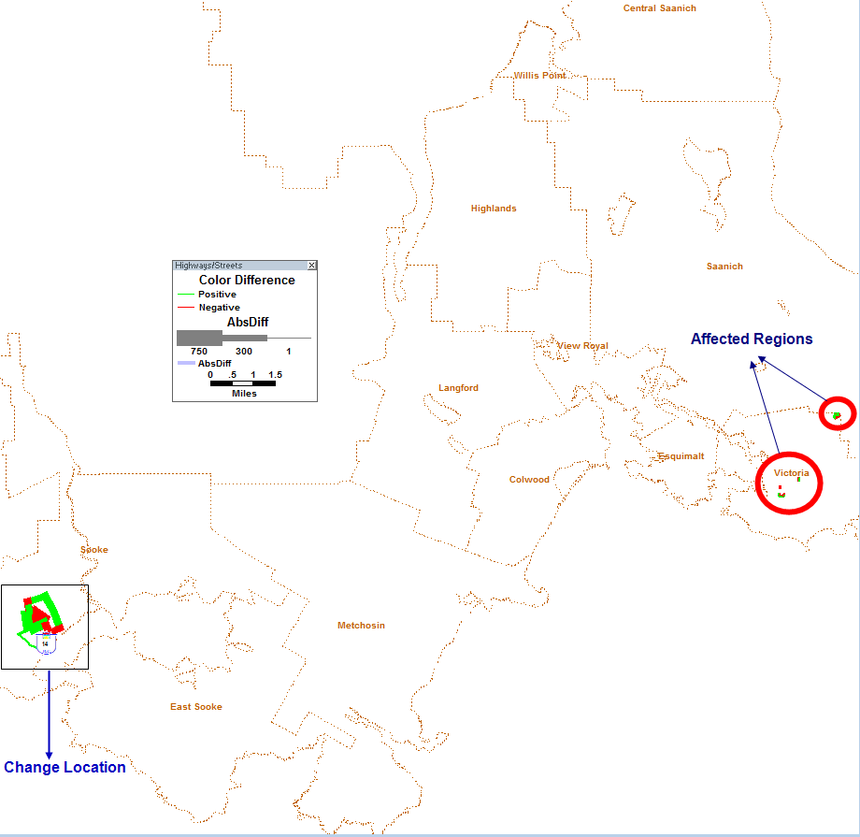
INSIGNIFICANT CHANGE
Relative Gap of 0.01
Relative Gap of 0.001
Non-localized effects present through Relative Gap of 0.001 – need to go lower!

Slide 15
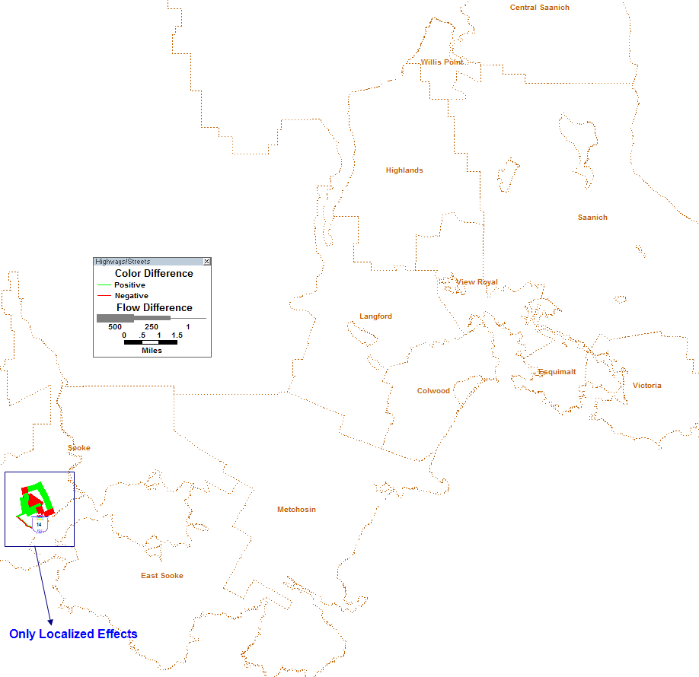
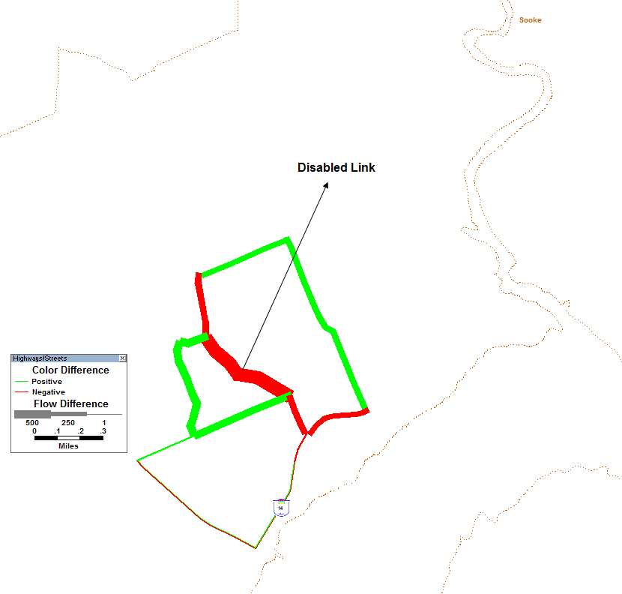

INSIGNIFICANT CHANGE
OUE at Relative Gap of ${10}^{−4}$
Only localized effects remain

Slide 16
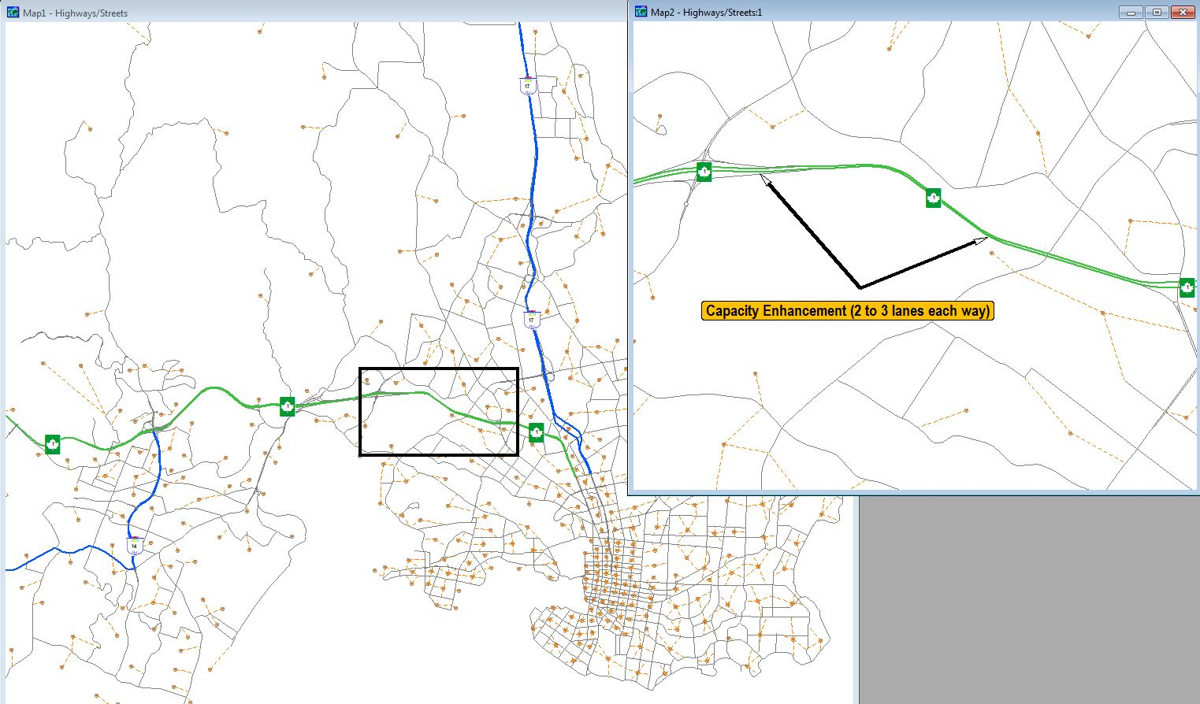
PROJECT DIFFERENCES

Slide 17
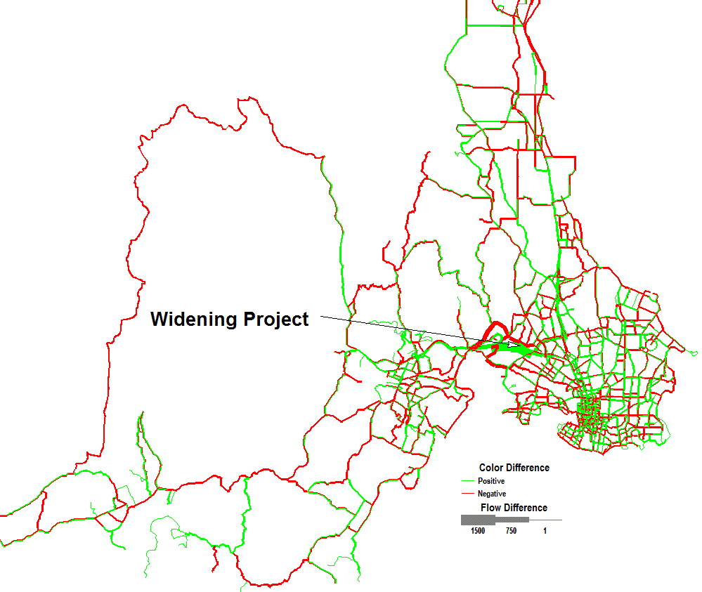
PROJECT DIFFERENCES
Frank-Wolfe at 0.001 Relative Gap

Slide 18
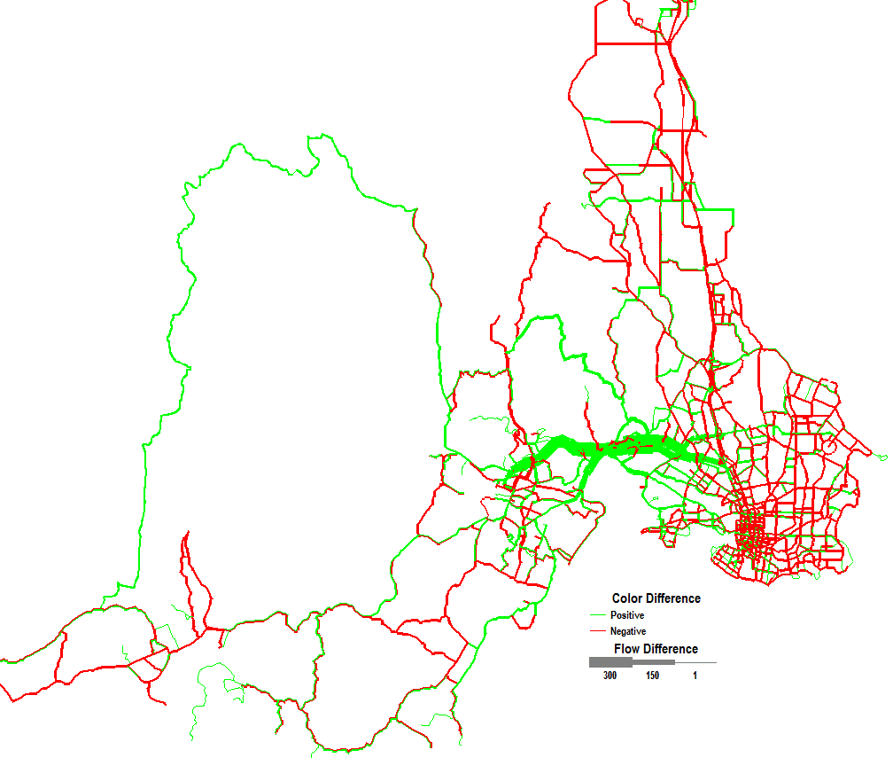
PROJECT DIFFERENCES
TransCAD – OUE at 8.2 E-08 Relative Gap

Slide 19
Hypothetical DC Rail Improvement
Improvement to the Blue Line
Peak and Off-peak headway and run-time improvements
2600 Riders diverted to transit from driving
Examination of resulting highway impacts

Slide 20
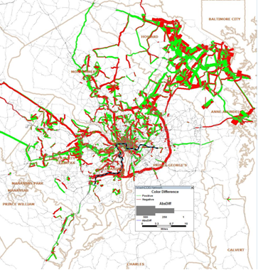
Flow Differences from FW at RG=.001

Slide 21
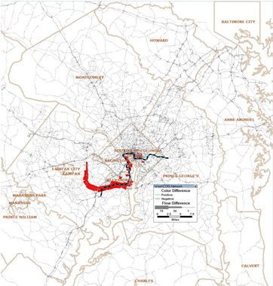
Flow Differences (OUE) at RG=.000001

Slide 22
Highway Travel Time Savings from Transit Improvement
Assignment Gap | VHT_Base | VHT_Build | VHT_Benefits
1e-6 | 2,461,243 | 2,460,597 | 646
1e-3 | 2,462,616 | 2,462,084 | 532

Slide 23
Select Link Analysis
Only the total link flows from a UE assignment are uniquely determined
Select link analysis may be biased especially when derived from order dependent assignment methods
Most likely route flows or “proportional” route flows can be computed for OUE to provide more dependable estimates

Slide 24
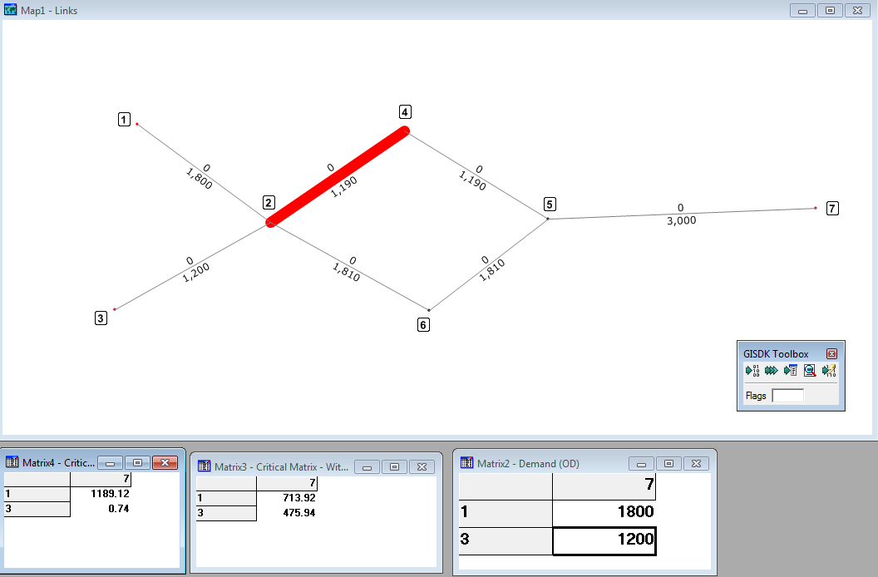
Proportionality Example

Slide 25
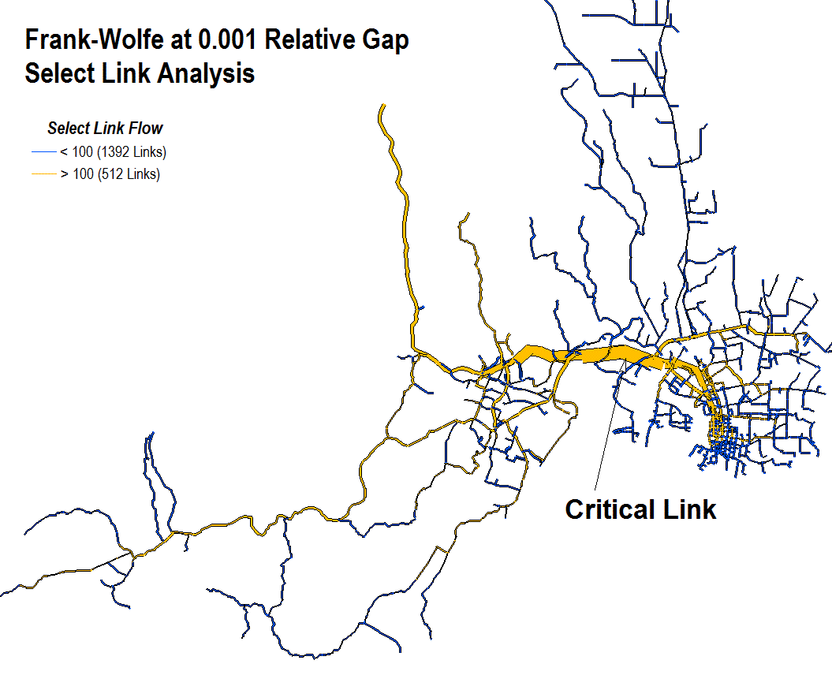
SELECT LINK ANALYSIS

Slide 26
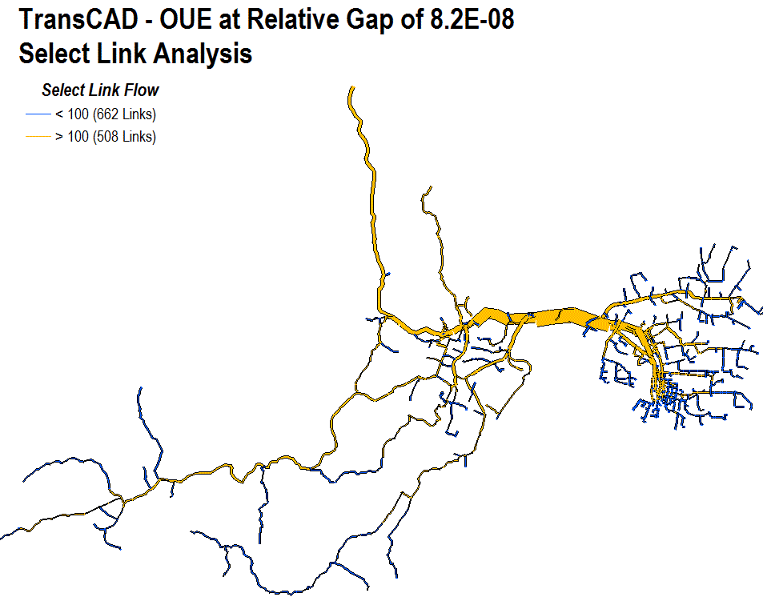
Select Link Analysis with OUE and Proportionality

Slide 27
Conclusions
Static UE assignments no longer need be a computing bottleneck
Orders of magnitude greater convergence can be achieved quickly
BFW dominates FW
OUE is superior for very small gaps
Warm starts make OUE very attractive
Greater convergence can reduce errors in models and estimated project impacts
Most likely route flow estimates from OUE appear to make select link analysis more reliable
There is little risk in taking advantage of these developments

