Slide 1

Feedback on Feedback: CAMPO’s Findings from Testing Various Feedback Approaches
TRB Applications Conference
May 11, 2011
Session 18B
Notes:
1

Slide 2
Feedback on Feedback: CAMPO’s Findings from Testing Various Feedback Approaches
Kevin Lancaster
Capital Area Metropolitan Planning Organization
Jonathan Avner
Wilbur Smith Associates
Karen Lorenzini
Texas Transportation Institute

Slide 3
Feedback on Feedback: CAMPO’s Findings from Testing Various Feedback Approaches
Why Feedback?
What Did We Test?
What Did We Find?
Where To Next?

Slide 4
The CAMPO Model
Capital Area Metropolitan Planning Organization
Five Counties Encompassing the Austin – Round Rock, Texas Metropolitan Area
Auto, Truck, Fixed Route and Bus Transit, Bicycles, and Pedestrians
Generalized Cost Assignment Including Tolled Facilities
1413 Internal, 49 External Traffic Analysis Zones
16628 (2035), 14480 (2005) Links
11575 (2035), 10443 (2005) Nodes
Notes:
Context

Slide 5
Why Feedback?
Recommended by previous peer reviews
Intuitively justified because inputs into earlier steps of the model could be inconsistent with the model outputs at later stages

Slide 6
Original CAMPO Process
Traditional Four-Step Sequential Process
Notes:
Four-step , sequential model
Historically, the CAMPO model has been a 24-hour model, following convention in Texas, continuing for many Texas models to this day.
The 1997 CAMPO model did have a “sketch” type peak period aspect, prior to mode choice
This feedback implementation for the CAMPO 2005 model is a stepping-stone in the interim. The next model update will include a time-of-day model.

Slide 7
How Did We Approach Feedback?
We Need to Decide:
What gets fed back?
What convergence criteria to use?
How We Decided:
Research literature
Research State of Practice (TMIP and other Texas MPOs)

Slide 8
Various Common Approaches
Different Possible Approaches | Options for What Gets Fed Back | Typical Convergence Measures
Naïve (Direct) Fictive Costs Methods of Successive Averages (MSA) Constant Weight Methods | Link Time Link Volumes (converted to time) Trips Skims | Absolute or Percentage Differences Typically system-wide measures Total Misplaced Flows Typically trip matrices or link volumes Root Mean Square Error (RMSE) Typically skims or trip tables GEH Statistic Empirical formula typically applied to link volumes

Slide 9
What CAMPO Tested – Feedback Approaches
Approach | What Gets Fed Back
Method of Successive Averages (Caliper’s MSA Implementation) | Link Volumes Processed into Time Values
Constant Weight Method - 50 – 50 - 70 – 30 - 80 – 20 | Trip Tables Processed Prior to Assignment

Slide 10
What CAMPO Tested
Notes:
MSA Method:
Implemented Using TransCAD’s MSA Method
Following Assignment, MSAFlow value is calculated, MSATime value is derived from MSAFlow using BPR equation
MSATime is value skimmed for Trip Distribution in subsequent loop
Constant Weights Method:
Prior to assignment, the trip table is averaged with the trip table from the prior loop
In the calculation, the two trip tables are weighted, for CAMPO we tested:
50% Current – 50% Prior
75% Current – 25% Prior
80% Current – 20% Prior
Note that HBW trip purposes were treated differently than other trip purposes

Slide 11
MSA Method Formula
Notes:
Broad level likely too coarse a measure of system stability
Matrix-level measures might be sufficient to base convergence criteria on
But the link-level statistics would provide the comfort level that the system was truly stabilizing at the project-level

Slide 12
What CAMPO Tested – Convergence Criteria
Aggregate
Total number of trips
Matrix Level
Trip and skim table changes
Link Level
GEH statistic
Maximum link flow change
Notes:
Broad level likely too coarse a measure of system stability
Matrix-level measures might be sufficient to base convergence criteria on
But the link-level statistics would provide the comfort level that the system was truly stabilizing at the project-level

Slide 13
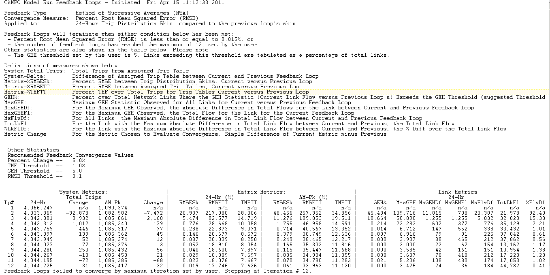
Feedback Report
Notes:
TRANSITION ON THIS SLIDE…Jonathan will explain the fine print.
For each feedback run, CAMPO generates a report like this one, which tabulates the measures we presented above. In the settings, only one convergence criteria controls the feedback looping and when it stops, but these other measures are available for the user to examine.

Slide 14
Measures for Convergence Criteria
Total Number of Trips
Absolute value, percent change
Trip and Skim Table Changes
Percent RMSE, Percent Total Misplaced Flow
Link Level
Total link flow change, maximum link flow change, GEH statistic
Notes:
Again, we looked at different levels of detail with regard to convergence criteria. For each criterion, a different measure might be appropriate.

Slide 15
GEH Statistic
What is it?
Empirically-based, not true statistic test
Typically applied to link volumes
Invented in the 1970s
Notes:
Where M is the assigned traffic volume and C is the count
The purpose of using the GEH Statistic instead of simple percentage differences is because of the variation of scale of volumes, for example examining a link with volumes in the 10,000 order of magnitude versus 50. The GEH statistic is non-linear, so one can apply a single acceptance threshold that is applicable to the different orders of magnitude. We chose to use as a threshold that at least 85% of the volumes in our traffic model have a GEH less than 5.0.

Slide 16
What Did We Find?
For All Approaches, the Measures of Convergence We Tested Tended toward Stability
Some Converged Faster than Others
Notes:
An additional finding early on regarded Mode Choice….elaborate here.

Slide 17
Daily / 24-Hour Metrics
Percent Change Total Trips
Skim Table Change - % RMSE
Trip Table Change - % RMSE
Maximum Link Flow Difference

Slide 18
Daily / 24-Hour Metrics - GEH

Slide 19
2-Hour / Peak Period Metrics
Percent Change Total Trips
Skim Table Change - % RMSE
Trip Table Change - % RMSE
Maximum Link Flow Difference
Not evaluated for peak period

Slide 20
Skim Change – % RMSE 24-Hour Versus Peak Period
Notes:
Same pattern, slower convergence of peak measures, our current assessment is that it is the peak proportion of the trips that are influencing the most change as a result of feedback, which intuitively makes sense.

Slide 21
Decision Matrix
Consideration | MSA | Constant Weights
Performance | No significant difference
Mathematical Rationale | Mathematically proven to converge | Empirically-demonstrated performance
Implementation and Maintenance | Supported in TransCAD GISDK | Coded using GISDK, not explicitly supported
State of Practice | Seems that MSA might have a slight edge in the modeling community discussions

Slide 22
CAMPO’s Chosen Feedback Method
Convergence
Criteria:
% RMSE of
Skim
< .1
Notes:
MSA Method:
Implemented Using TransCAD’s MSA Method
Following Assignment, MSAFlow value is calculated, MSATime value is derived from MSAFlow using BPR equation
MSATime is value skimmed for Trip Distribution in subsequent loop
Constant Weights Method:
Prior to assignment, the trip table is averaged with the trip table from the prior loop
In the calculation, the two trip tables are weighted, for CAMPO we tested:
50% Current – 50% Prior
75% Current – 25% Prior
80% Current – 20% Prior
Note that HBW trip purposes were treated differently than other trip purposes

Slide 23
Lessons Learned
Opportunity to address other inconsistencies
For testing, run many, many iterations
Be cognizant of assignment convergence issues that affect feedback
Running mode choice for each iteration was appropriate (and defensible)
Run time was a factor in our decisions
Notes:
Project-level implications…we are interested in an approach we saw taken at NCTCOG, where they have looked at link-level changes how they compare to single-lane capacity.
Was this interim step valuable? Addressed the peer-review concern, addressed consistency through model stream.

Slide 24
Where To Next?
For the 2005 Model, CAMPO Continues to Investigate Project- and Link-Level Implications of Modeling with Feedback
CAMPO is Working Toward a Time Period Modeling Approach for its 2010 Model
Long-term, Investigating Incorporating Accessibility into Trip Generation, and Looping Feedback to Trip Generation
Notes:
Project-level implications…we are interested in an approach we saw taken at NCTCOG, where they have looked at link-level changes how they compare to single-lane capacity.

Slide 25
Feedback on Feedback: CAMPO’s Findings from Testing Various Feedback Approaches
For further information, please contact:
Kevin Lancaster, Capital Area Metropolitan Planning Organization
512/974-2251
kevin.lancaster@campotexas.org
Jonathan Avner, Wilbur Smith Associates
512/592-3842
javner@wilbursmith.com
Karen Lorenzini, Texas Transportation Institute
512/467-0952
k-lorenzini@ttimail.tamu.edu

