Slide 1

Development and Application of a
Parcel Based Statewide Travel
Demand Model for the Assessment
of the Travel Impacts of Smart
Growth Strategies and
Sidewalk Investments

Slide 2
Why Model Small Areas w/a Statewide Model?
ISTEA is Now 20 Years Old and We are Still Searching for the
Land Use-Transportation Connection.
Actually, Analysis of that Connection Has Been Sought for Much Longer:
“How Can You Know What to Try With Traffic Until You Know How the City Itself Works, and What Else it Needs to Do With Its Streets ?”
- Jane Jacobs, The Death and Life of Great American Cities, 1961,
Quote Reprinted in ITE Journal, April 2011.
But, We’re Coming Around:
“ . . . Communities are Starting to Realize that Transportation Must Address Accessibility Rather than Mobility and They are Looking for Solutions to Improve Their Transportation” Networks.
- Todd Littman, ”American Needs Complete Streets”,
Quote Printed in ITE Journal, April 2011.

Slide 3
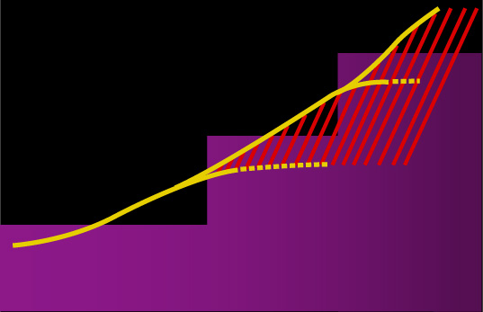
Why Model Small Areas w/a Statewide Model?
The problem with current practices
Congestion
Widen
Traffic
Congestion
Capacity
Years

Slide 4
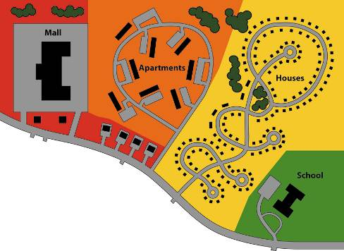
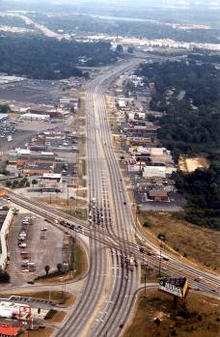
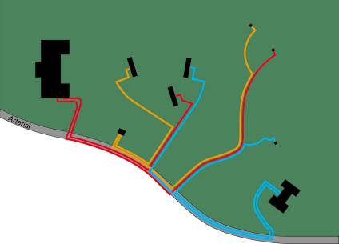
Why Model Small Areas w/a Statewide Model?
Common Development Trends

Slide 5
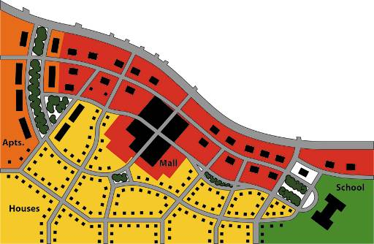
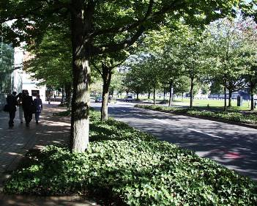
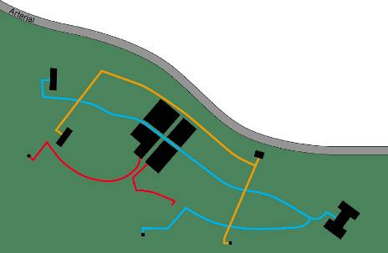
Why Model Small Areas w/a Statewide Model?
Smart Growth Goals

Slide 6
Why Model Small Areas w/a Statewide Model?
Project Need:
DelDOT routinely conducts transportation and land use studies for corridors and communities
DelDOT conducts scenario planning for it’s Statewide and MPO Long Range Transportation plans that include land use alternatives and various modal investments
A tool needed to be developed to evaluate the impacts of various growth strategies and transportation investments on transportation demand and air quality

Slide 7
Why Model Small Areas w/a Statewide Model?
Current Options to evaluate the impacts of land use form on transportation needs:
GIS
3-D Visualization (Sketch Planning)
Travel Demand Models
Microsimulation Models

Slide 8
Why Model Small Areas w/a Statewide Model?
GIS
Pros:
  Easy to work with
  Readily available
  Excellent Relational Data Analysis Tool
Cons:
  Can’t Evaluate Travel Demand Impacts of Transportation and Land Use Decisions
  Would not produce the detailed data needed for operational analyses

Slide 9
Why Model Small Areas w/a Statewide Model?
3-D Visualization and Scenario Planning (Sketch Planning) Concept Tools
Pros:
  Visually Exciting
  Readily available
  Rapid Scenario Evaluations
Cons:
  Can’t Evaluate Travel Demand Impacts of Transportation and Land Use Decisions
  Wouldn’t reflect the impacts of small study areas within the context of the overall region
  Would not produce the detailed data needed for operational analyses

Slide 10
Why Model Small Areas w/a Statewide Model?
Travel Demand Models
Pros:
  Readily available
  Rapid Scenario Evaluations
  Good For Evaluating travel demand impacts of land use and transportation decisions
  Can produce the detailed data needed for operational analyses
  Reflects the impacts of changes in small study areas within the context of the overall region
Cons:
  Not visually exciting for the public without post-processing
  Aggregate TAZ’s usually too large to be sensitive to smart growth scenario testing

Slide 11
Why Model Small Areas w/a Statewide Model?
Microsimulation Models
Pros:
  Visually Exciting
  Readily available
  Rapid Scenario Evaluations
Cons:
  Can’t Directly Evaluate Travel Demand Impacts of Transportation and Land Use Decisions
  Wouldn’t reflect the impacts of small study areas within the context of the overall region
  Data intensive with long lead times makes scenario testing difficult

Slide 12
Why Model Small Areas w/a Statewide Model?
DelDOT chose to use their Statewide Travel Demand Model because of its geographic coverage and ease of implementation.

Slide 13
DelDOT Micro-Model
DelDOT’s Travel Demand Model Policy:
Develop Standard Applications.
New Features Must Integrate with Entire Model Chain.
Leverage Model Development Funds:
  Delaware Travel Monitoring System (DTMS):
Ongoing Trip, Mode, O-D Data Collection
250 Households/Month, CATI Polling Method
Over 32,000 Surveys in Database Since 1998

Slide 14
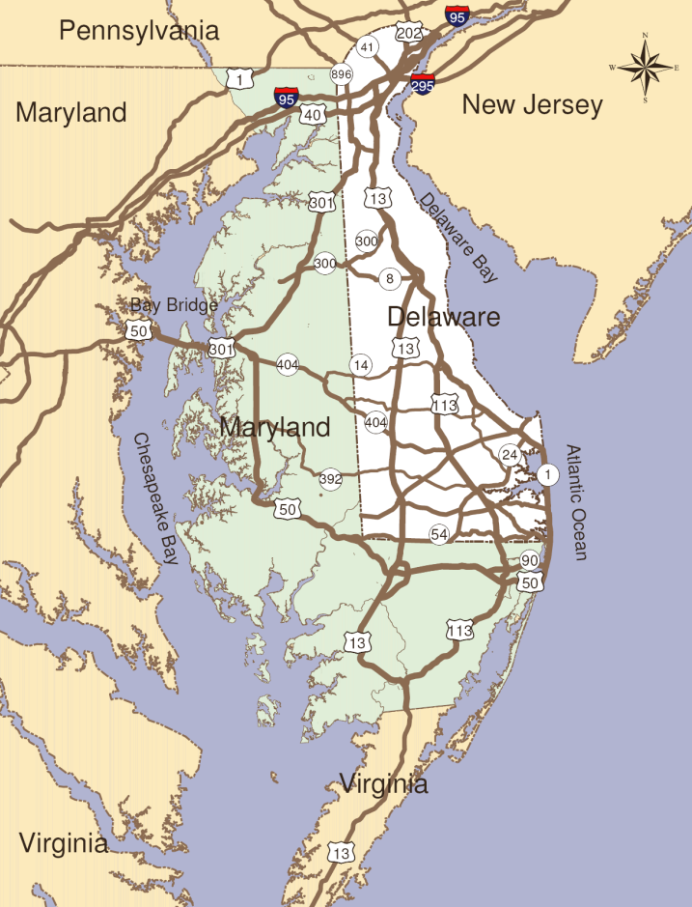
DelDOT Peninsula Model Background
Background:
  Delaware plus Maryland’s “Eastern Shore”
  Population of 1.2 Million
  Area of 5,375 miles2

Slide 15
DelDOT Peninsula Model Background
Model Maintenance
(Network, TAZ, &
Count Update Utilities)
Micro-Model
Core Model
(5-Step Travel Demand Model Equations)
Single Network Processor
GIS TAZ Land Use Layer
Feature Models
Air Quality Conformity
EZPass Toll/Mode Split Model
“Build/No Build” Model
Statewide Evacuation Model
Seasonal Tourist Model
Junction Model
TIS Model (Extra P’s & A’s)
Outputs
(Reports, GIS Files,
Loaded Networks, etc)

Slide 16
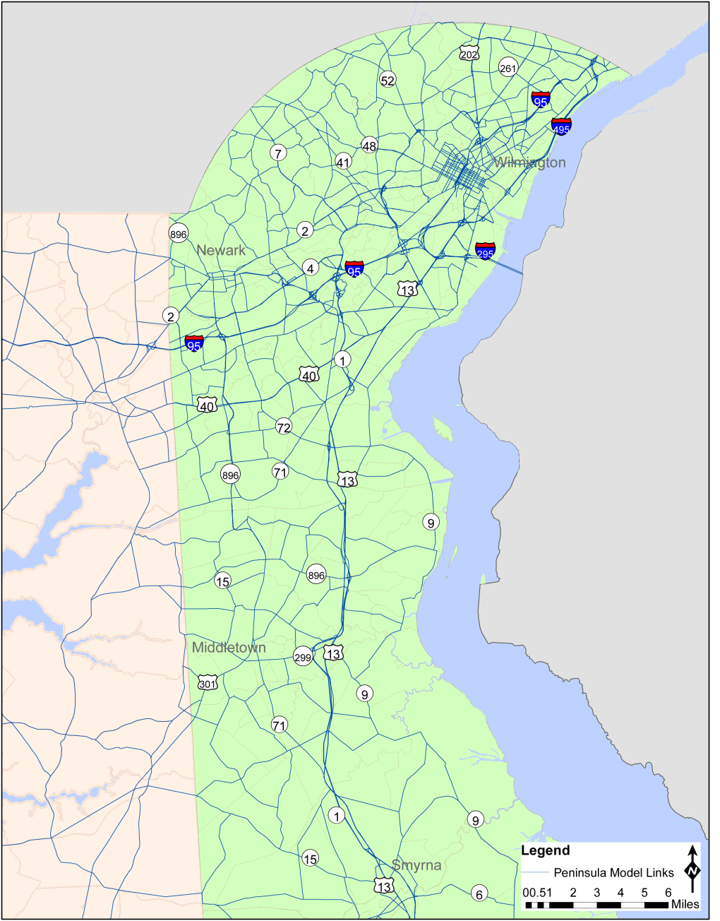
DelDOT Peninsula Model
  13,491 Links in the Travel Network
2108 TAZ’s

Slide 17
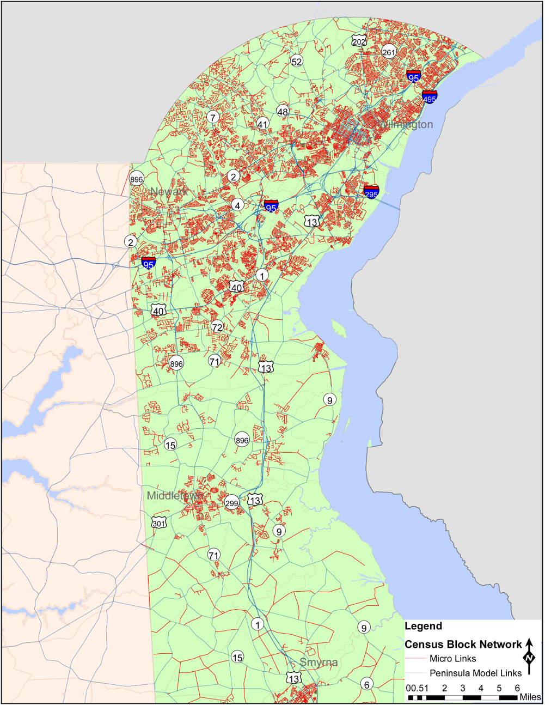
DelDOT Micro Model
  177,211 Links in the Travel Network
  19,640 TAZ’s

Slide 18
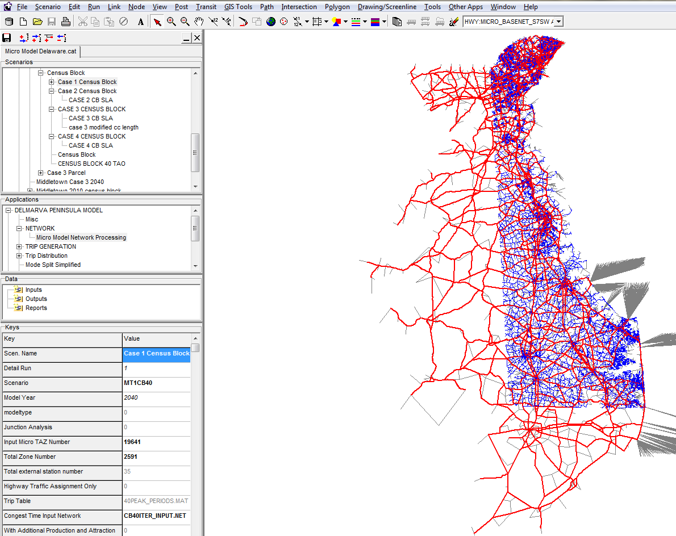
DelDOT Micro Model Process

Slide 19
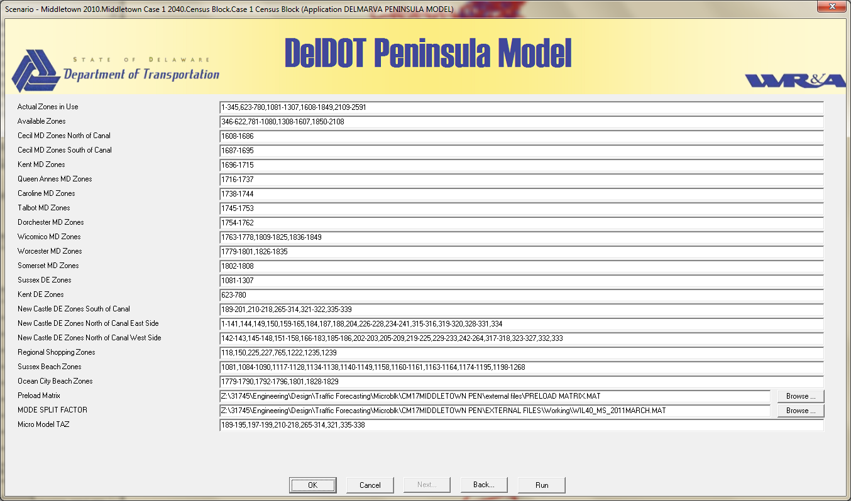
DelDOT Micro Model Process

Slide 20
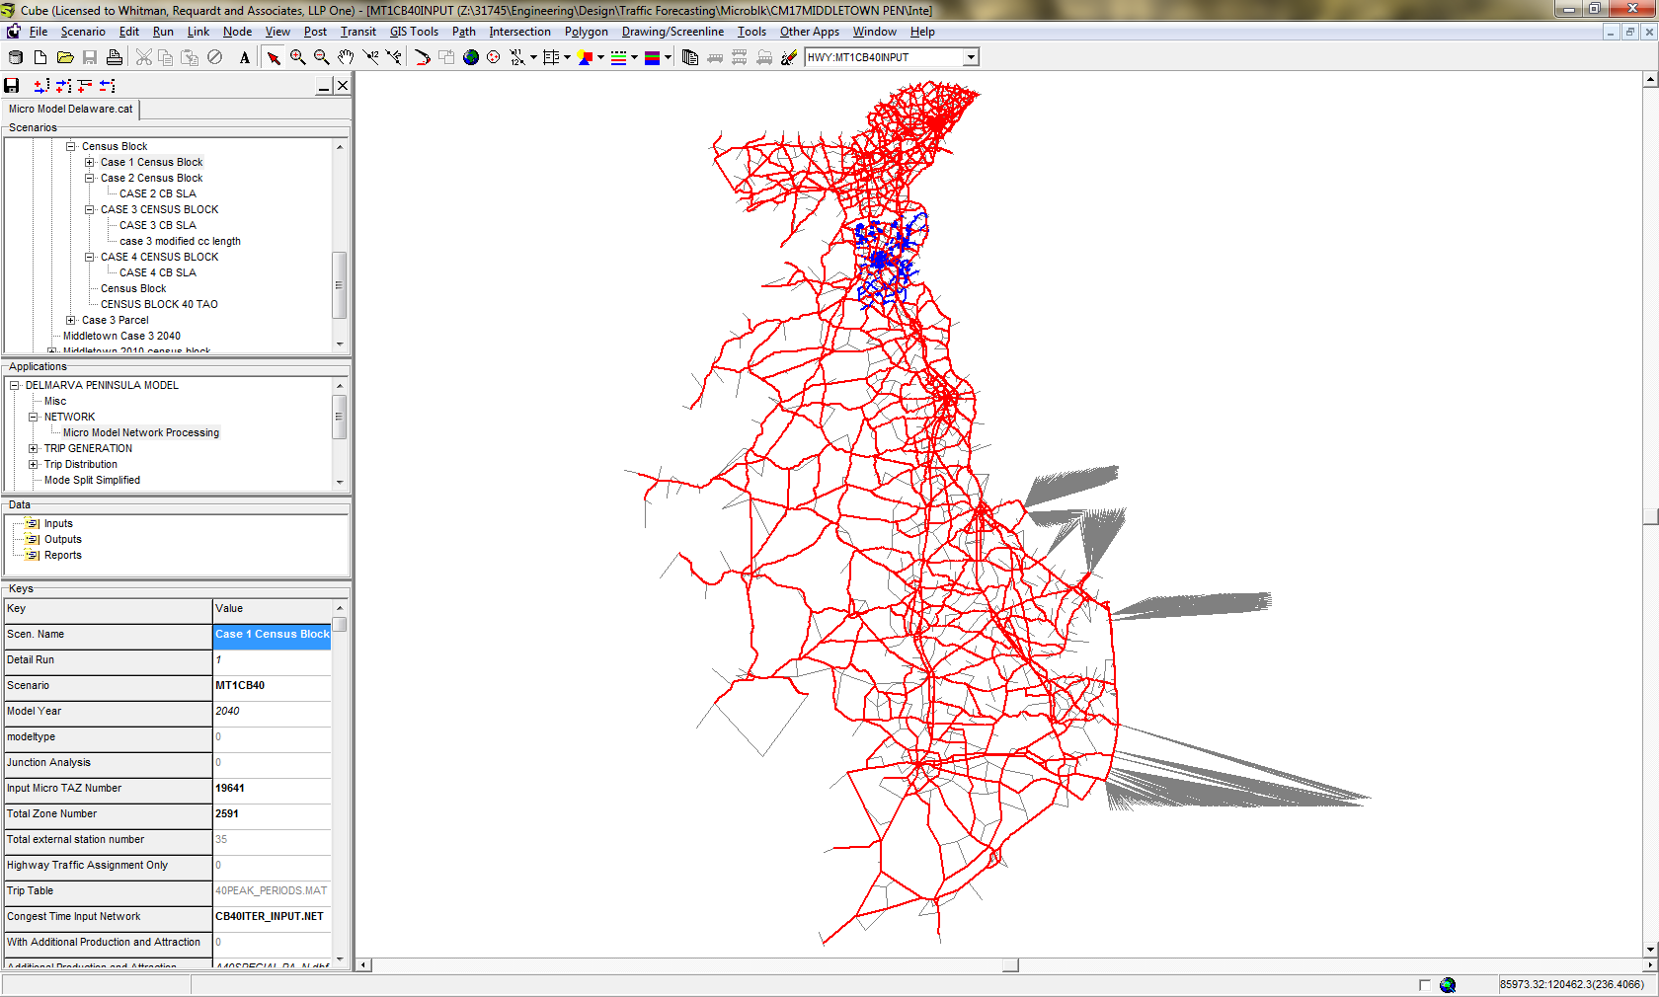
DelDOT Micro Model Process

Slide 21
DelDOT Micro Model Process
Peninsula Model TAZ Demographic Data
Census Block Demographic Data
Choose TAZ for Micro Modeling
Demographic Data Processor
Mode Split Factor from Peninsula Model
Micro Model Demographic Data
Trip Generation
Trip Distribution
Model Split
Traffic Assignment
Define Micro Links to include in Micro Model in GIS
Network Processor
Micro Model Network
Master Input Network with Peninsula Model Network links and statewide Local links

Slide 22
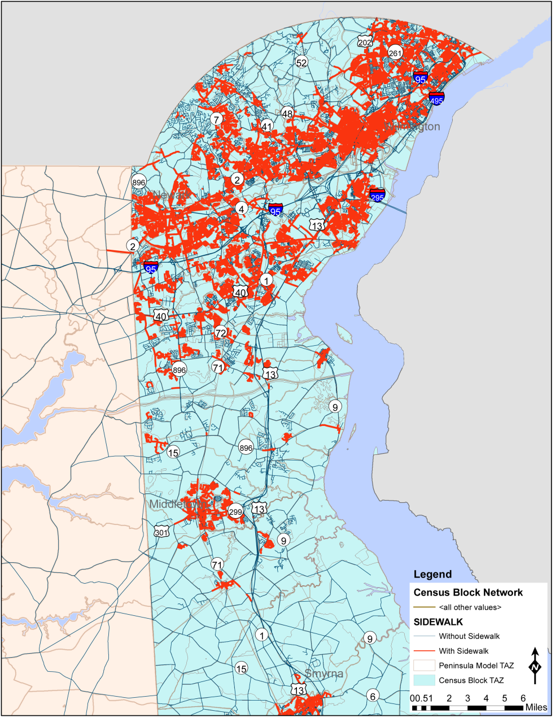
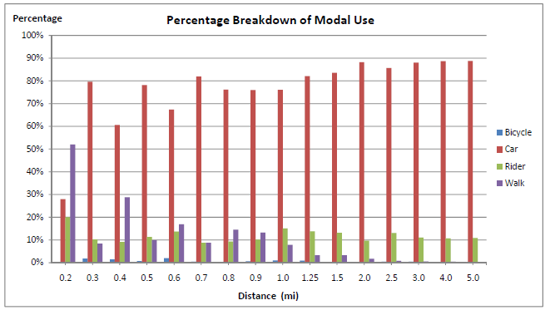
DelDOT Statewide Sidewalk Network

Slide 23
Micro Model Mode Split Process
Sidewalk walking distance
Bicycle traveling distance
Transit User
SOV: Non-toll/Cash/EZ-Pass
HOV: Non-toll/Cash/EZ-Pass
Motorized/Non-Motorized Split
Mode Split
Walk
Bike
Motorized
Mode Split Factor

Slide 24
Case Studies
200 unit subdivisions in Southern New Castle County
  Suburban Middletown
    Case Studies 1 and 2
  Urban Middletown
    Case Studies 3 and 4

Slide 25
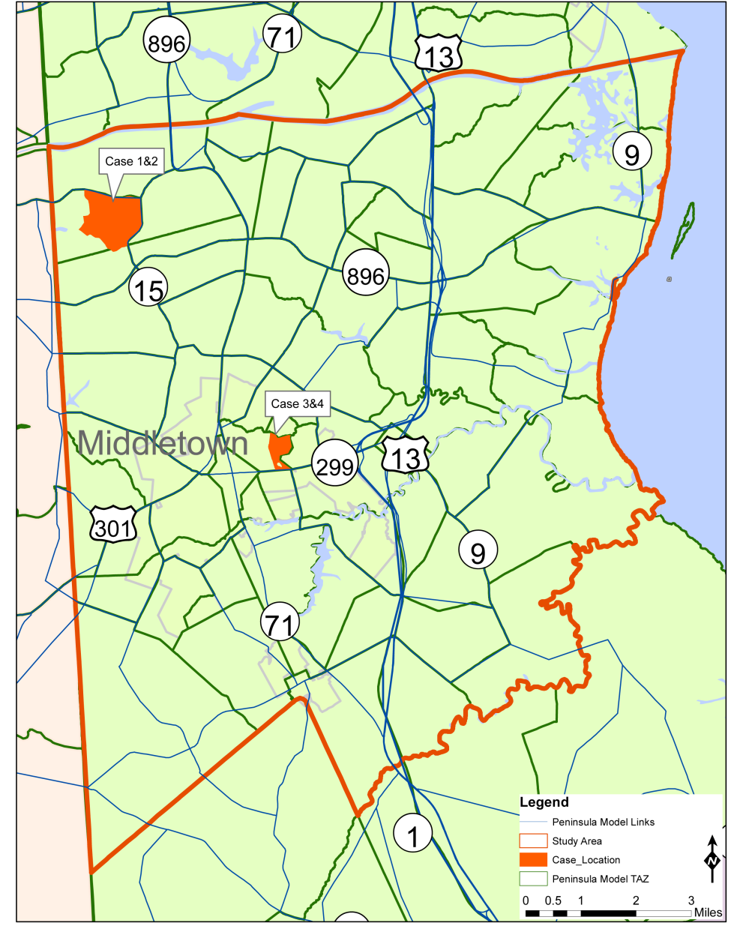
Case Study
Detailed Study Area from South of the Canal to the Kent County Border

Slide 26
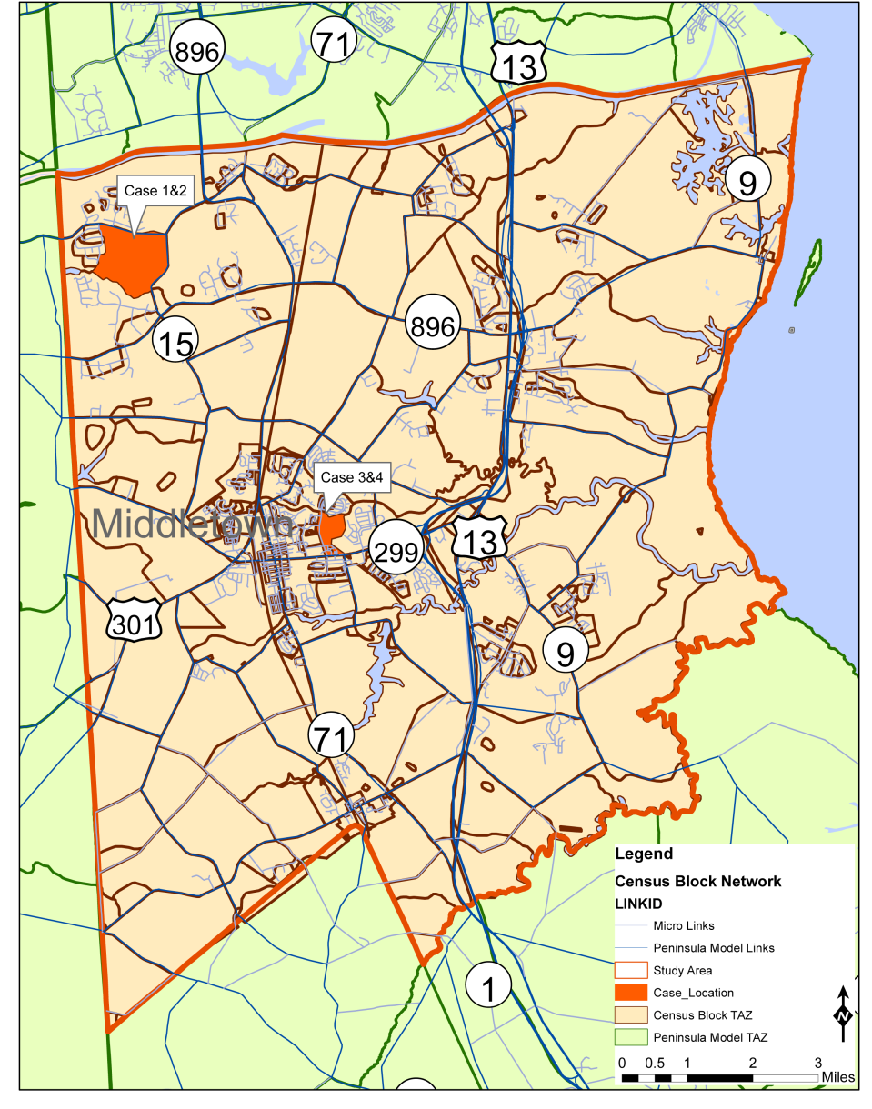
Case Study Scenarios
Test the impacts of “Grid vs. Cul-de-Sac” development patterns on travel patterns, mode choice, and emissions

Slide 27
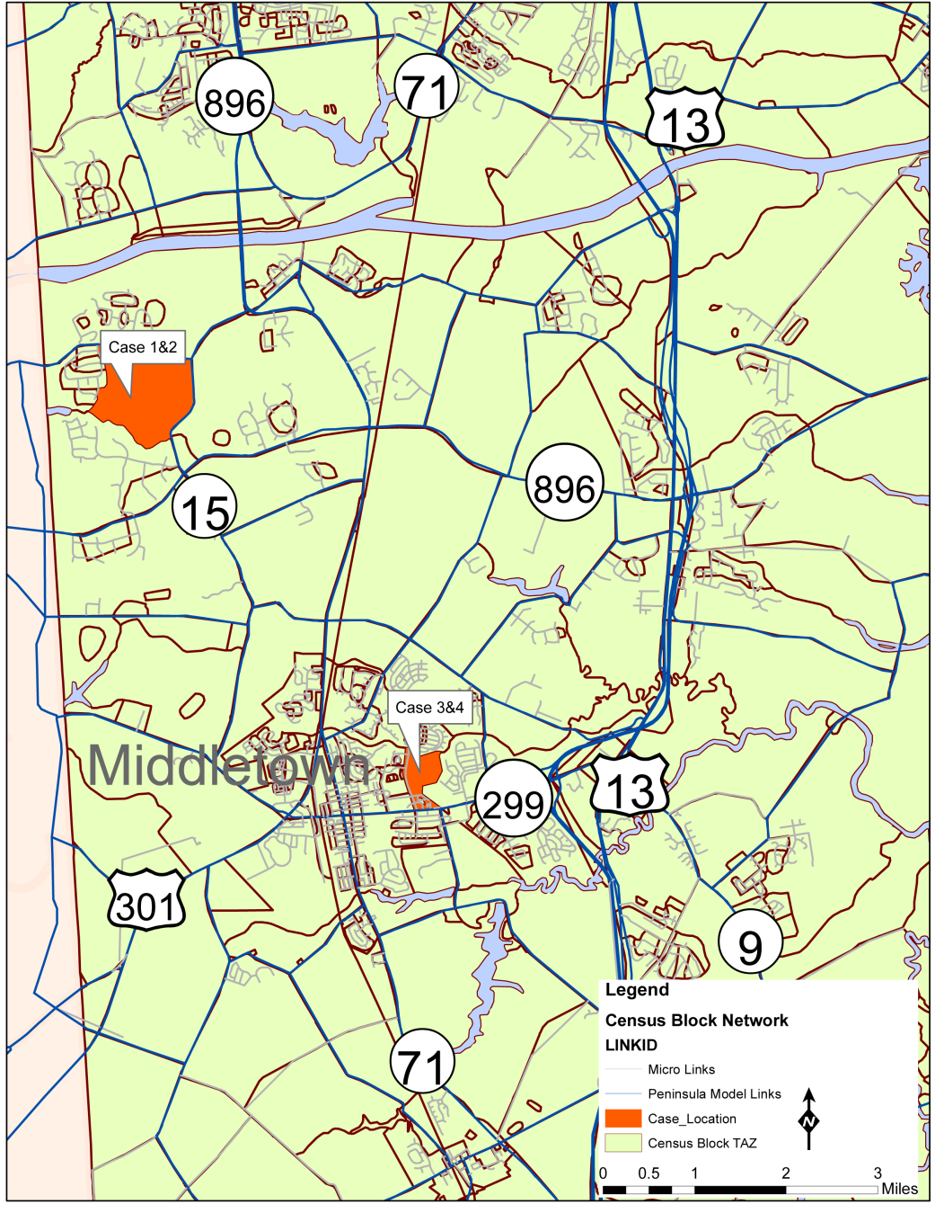
Case Study Scenarios
Evaluate Scenarios using:
  Peninsula Model TAZ’s
  Micro-model TAZ’s
  Individual Parcels as TAZ’s for subdivision

Slide 28
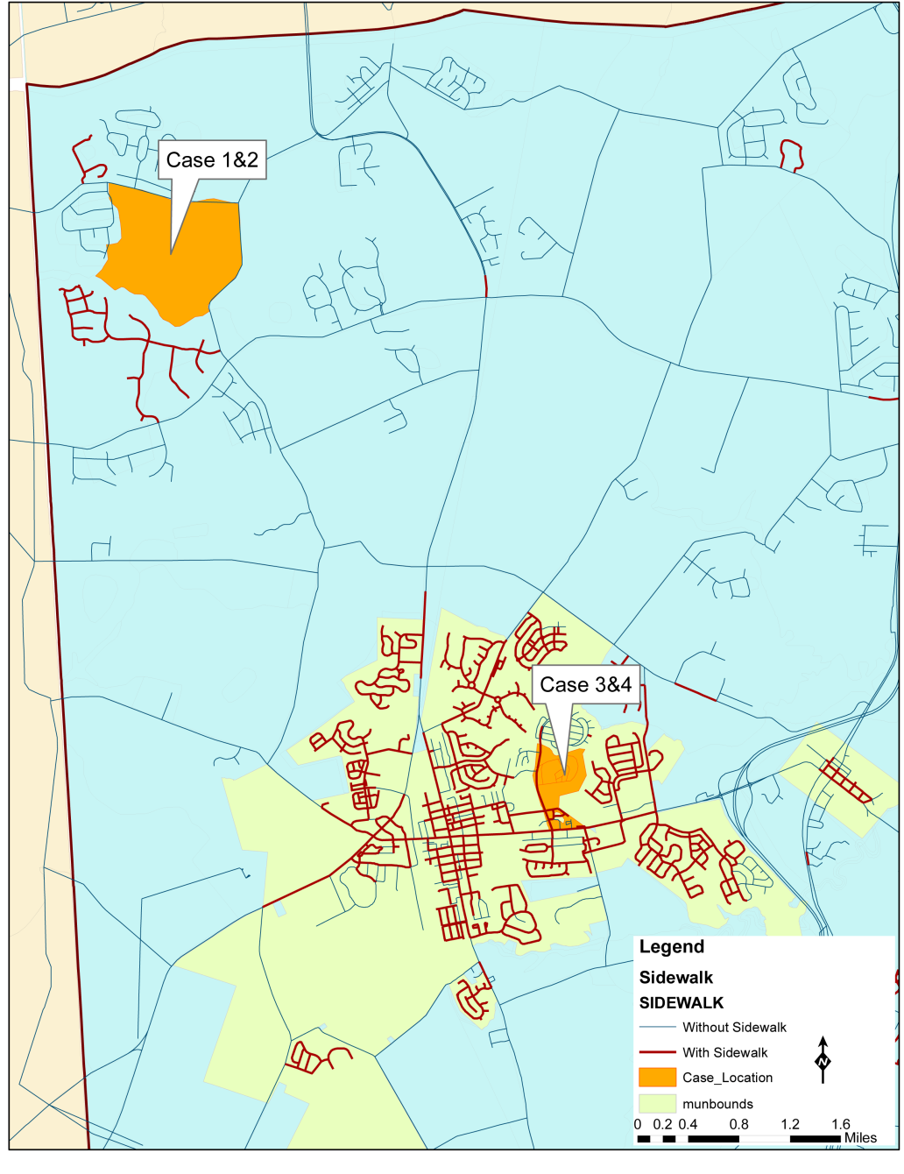
Existing Study Area Sidewalk Connections
Assume Sidewalks on all new roads and centroid connectors

Slide 29
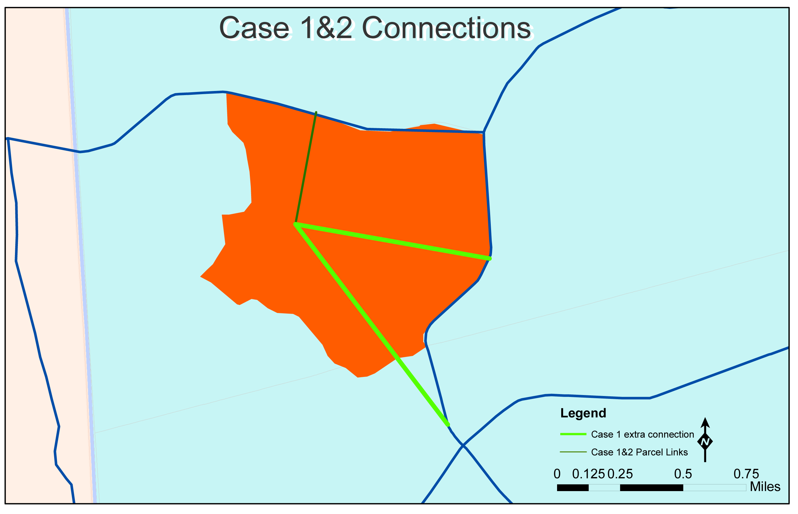
Peninsula Model TAZ Connections

Slide 30
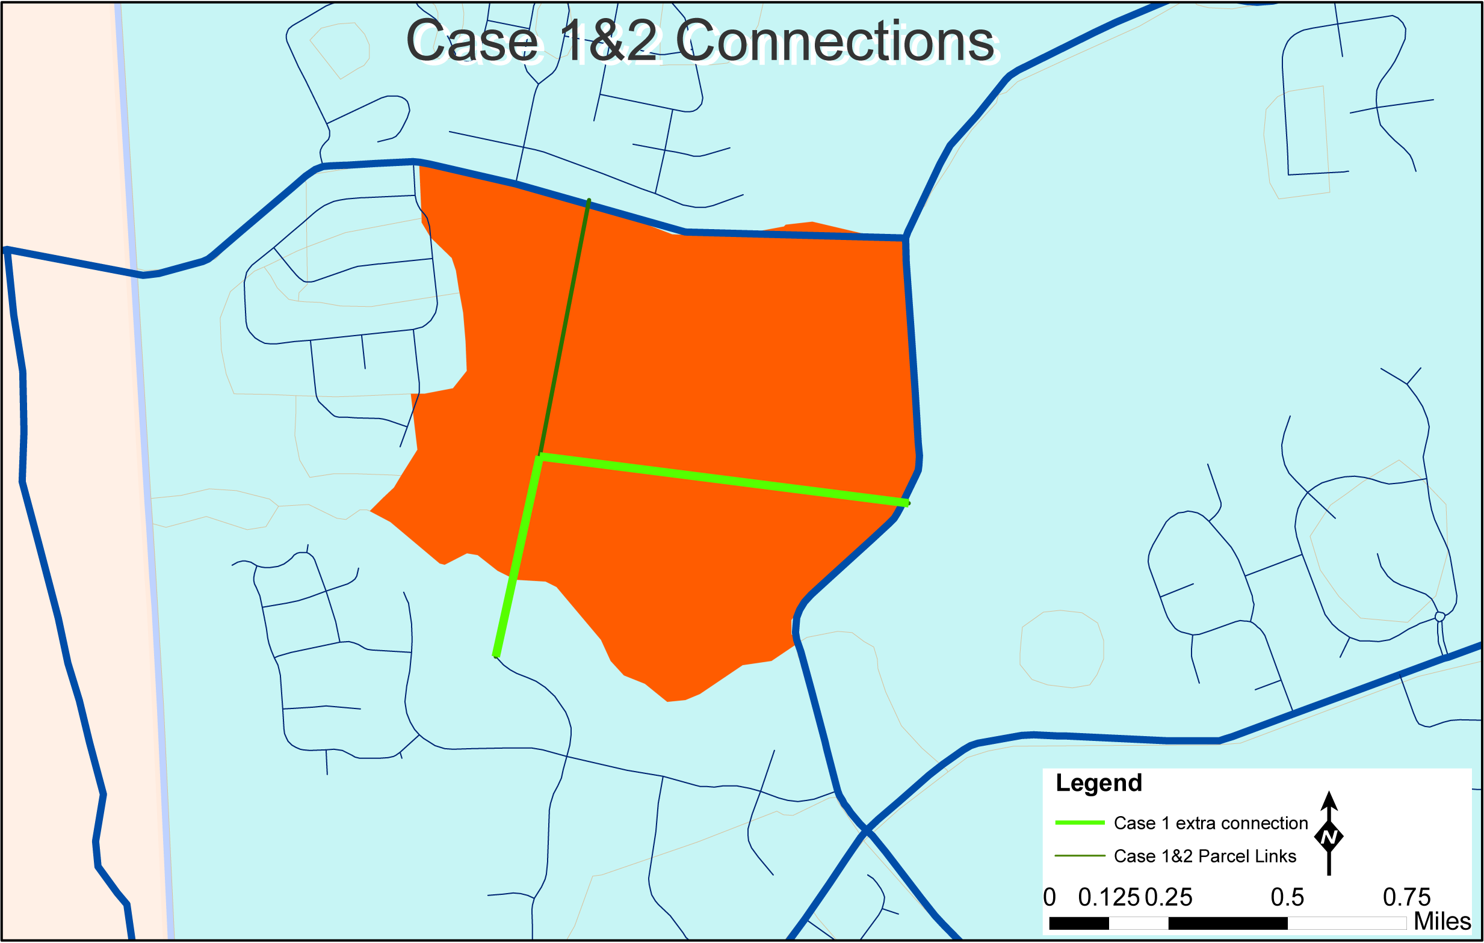
Micro Model TAZ Connections

Slide 31
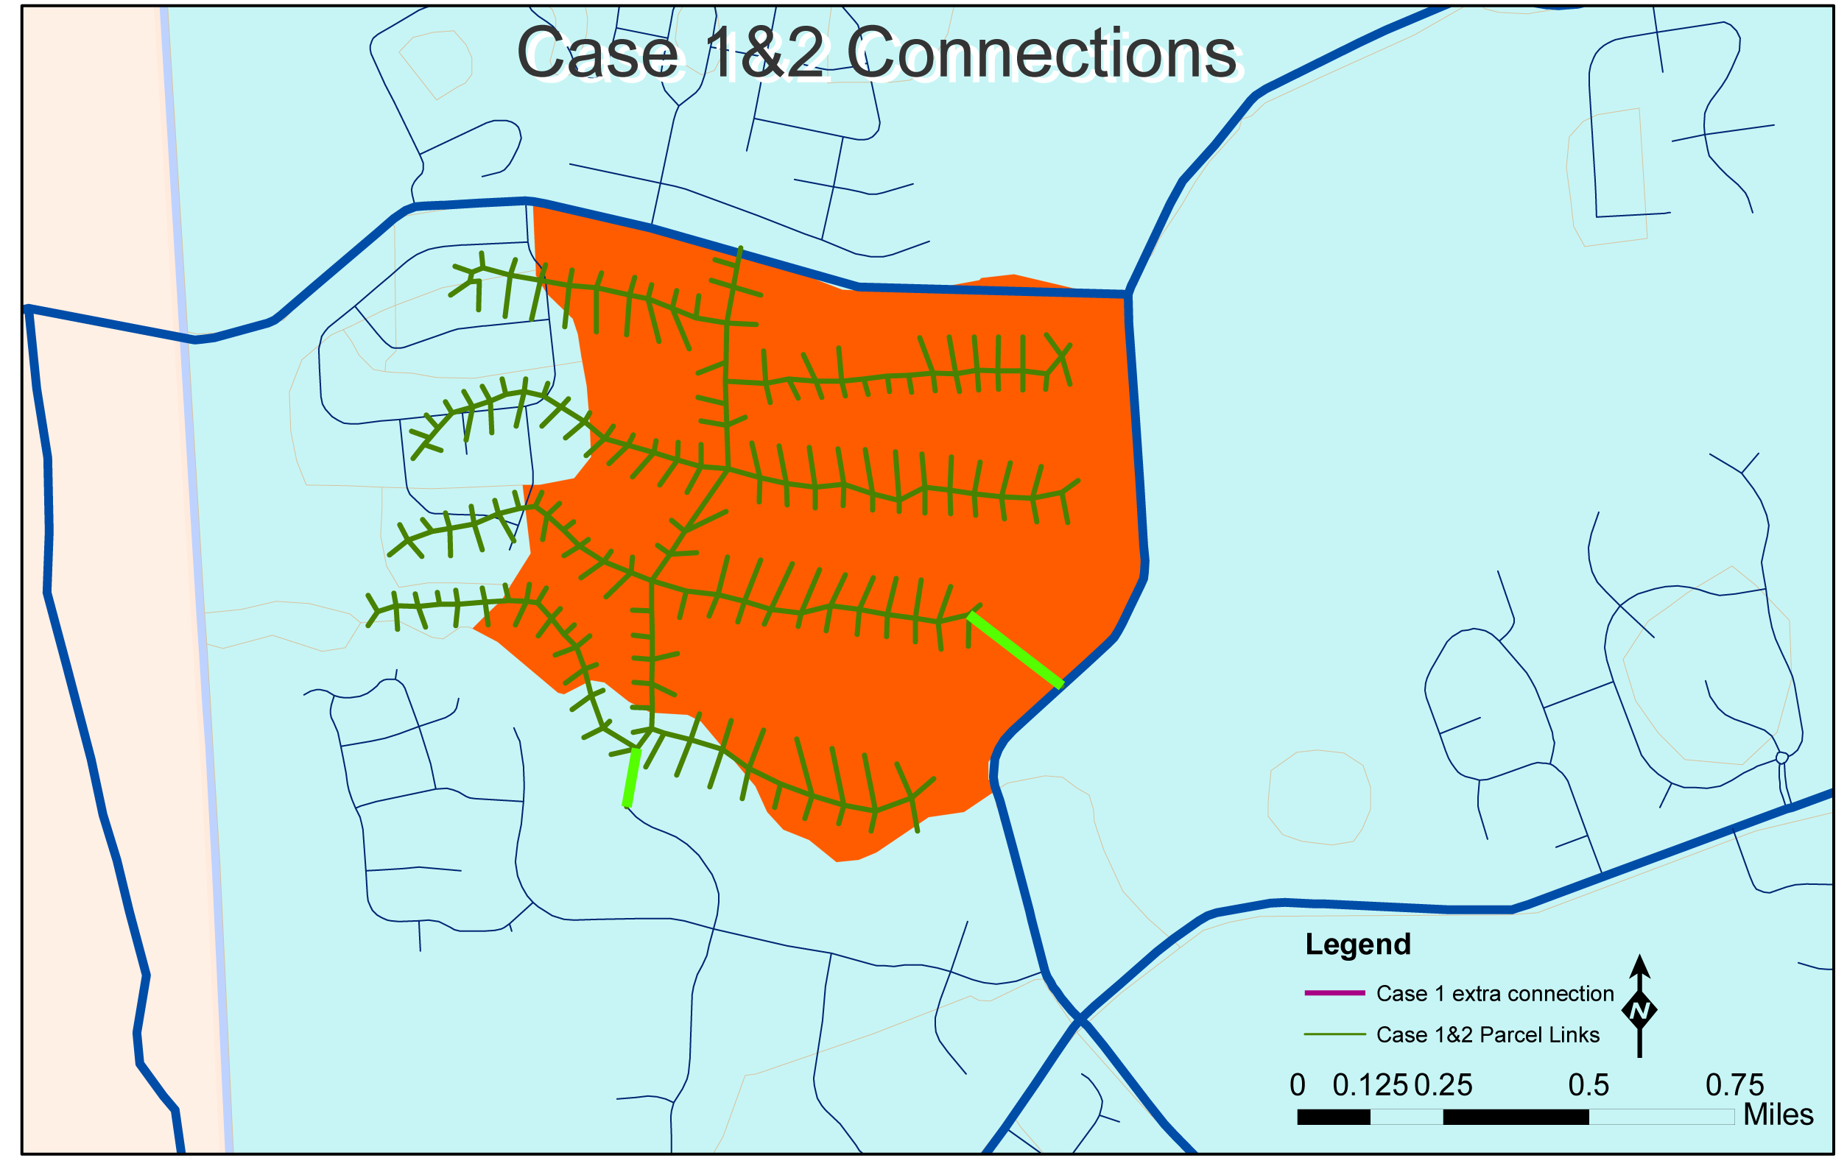
Parcel Model TAZ Connections

Slide 32
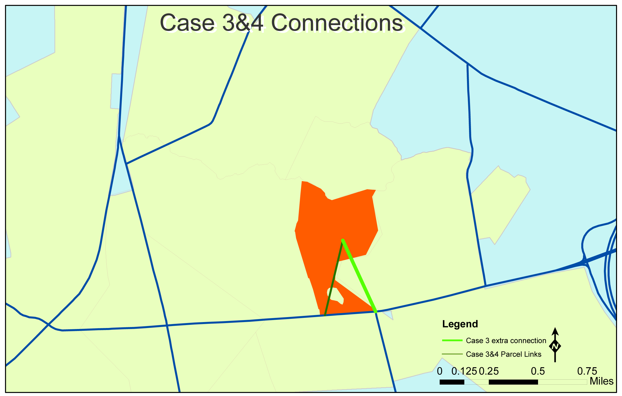
Peninsula Model TAZ Connections

Slide 33
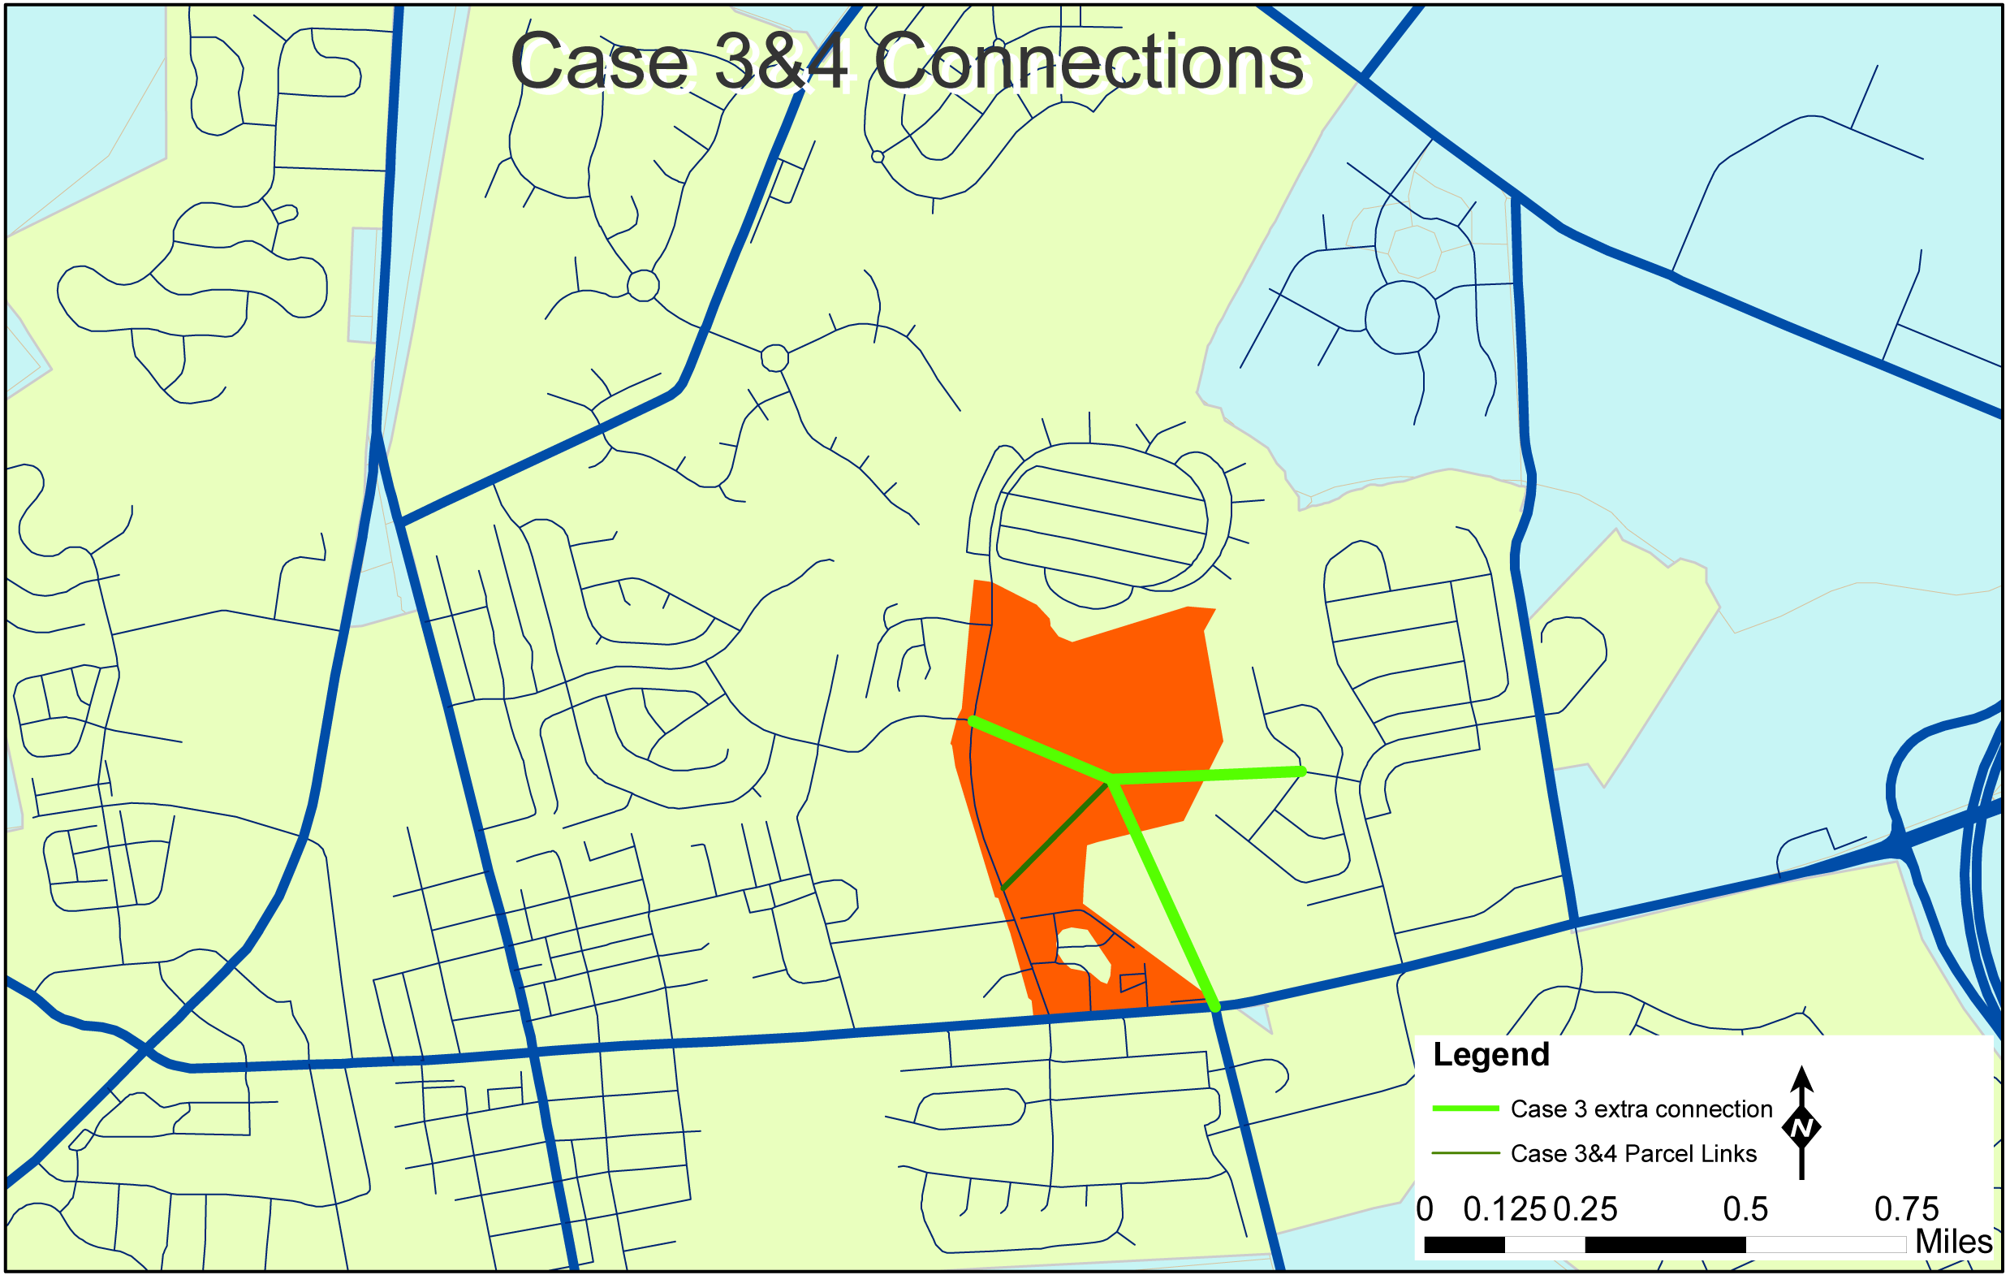
Micro Model TAZ Connections

Slide 34
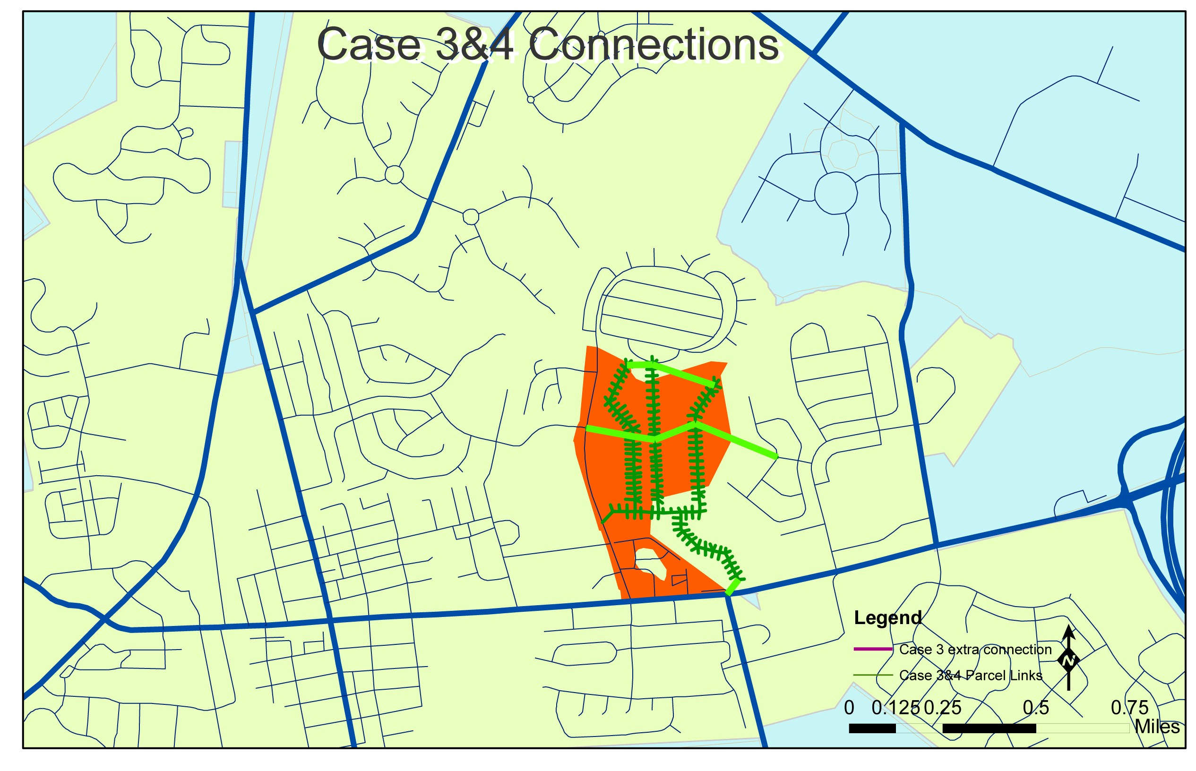
Parcel Model TAZ Connections

Slide 35
Model Results for Subdivision Trips

Slide 36
Model Results for Subdivision Trips

Slide 37
Model Results for Study Area Trips

Slide 38
Conclusions
All three models were sensitive to the location of the subdivision
The Micro Model and Parcel Model were sensitive to the “Smart Growth” vs. “Traditional Growth” evaluation

Slide 39
Conclusions
The Parcel Model was most sensitive to the location of the subdivisions on both motorized and non-motorized travel.
The models produced data needed for more detailed operational analyses.

Slide 40


Questions?
Scott Thompson-Graves
724-779-7940
sthompson-graves@wrallp.com
Mike DuRoss
302-760-2110
michael.duross@state.de.us
Li Li
703-293-7423
lli@wrallp.com

