Slide 1
Managing Complexity with
Multi-scale Travel Forecasting Models
Jeremy Raw
Office of Planning
Federal Highway Administration
May 11, 2011

Slide 2
Roadmap
Why Multiple Scales?
Processes and Models
Building Multi-Scale Models

Slide 3
Why Multiple Scales?
Computational speed
Data resolution
Multi-scale phenomena

Slide 4
1. Computational Speed
Modeling at high-resolutions is time consuming
  3000 (3e3) zones, 9000000 (9e6) zone pairs
  200000 (2e5) zones (parcels), 40000000000 (4e10) zone pairs
Each zone may have many households
Excessive run time impedes
  Calibration
  Scenario evaluation
  Rapid policy response
Notes:
Old computer science adage: You can only get a small improvement in speed by speeding up the computations you’re already doing; You can get huge improvements by inventing better algorithms.

Slide 5
2. Data Resolution
Travel data collected at various resolutions
  Geographic scale
  Temporal scale
  Incompatible scales
Problem compounded by
  Disclosure rules
  Geocoding imprecision
  Intrinsic variability
  Measurement limitations
Notes:
Certain details only available at certain geographies.
Geocoding imprecision may be intentional / unintentional

Slide 6
3. Multi-Scale Processes
Multi-scale processes:
  Things appear to work differently at different scales
Paradigmatic example:
Newtonian Mechanics ⟺ Quantum Physics

Slide 7
3. Multi-Scale Processes
The scale of a process is a function of adjacency
How “near” or “far” are the factors that are influential?
Large scale processes operate over wide distances and long periods of time
Small scale processes operate over short distances and times

Slide 8
3. Multi-Scale Processes
Reality is effectively represented as a mixture of processes operating at different scales
At each scale:
Outcomes may differ
Influential factors may differ
Relationship with other scales may be loose or tight

Slide 9
Multi-Scale Process Example
Temporal variation in household trip making:
  Within a Day – Standard work hours
  Across a Week –Standard work days
  Seasonally –Holidays, vacations, school schedules

Slide 10
Multi-Scale Process Example
Trips within the neighborhood
  Walking destinations, Personal characteristics (e.g. age), Accessibility, Local culture
Trips within the urban region
  Employment, Retail, Household structure, Transit accessibility
Trips outside the urban region
  Inter-regional commerce, Vacation patterns, Air/Rail/Highway accessibility

Slide 11
Processes and Models
Multi-Scale Modeling Strategies
“Maximum Resolution Modeling”
Challenges of High-Resolution Modeling

Slide 12
Multi-Scale Modeling Strategies
Nesting (Aggregation)
Hierarchical Models
Latent variables
Emergent properties
Many others…
Multi-scale approaches can take excellent advantage of parallel processing
Notes:
Hierarchical models – nesting not presumed (dimensions overlap)
Latent Variables – hierarchical models with some levels imputed
Emergent property – scales are conditionally independent and cannot be predicted simply by adding up the behaviors of constituent elements (Chemistry versus Physics)

Slide 13
Myths of Multiple Scales
Behavioral processes only happen at one scale
Larger scales simply summarize smaller scales
Better forecasts require higher resolution data and models

Slide 14
Myths of Multiple Scales
Behavioral processes only happen at one scale
Larger scales simply summarize smaller scales
Better forecasts require higher resolution data and models

Slide 15
Maximum Resolution Modeling
Modeling everything at the highest resolution available sounds good
However:
  Large scale processes get lost in small scale noise
  Estimating small scale models from large scale data introduces error
  Computational intensity limits model application
  Validation targets are still measured aggregates
Notes:
Using measured aggregates as validation targets means we can’t directly validate the high-resolution model specification.

Slide 16
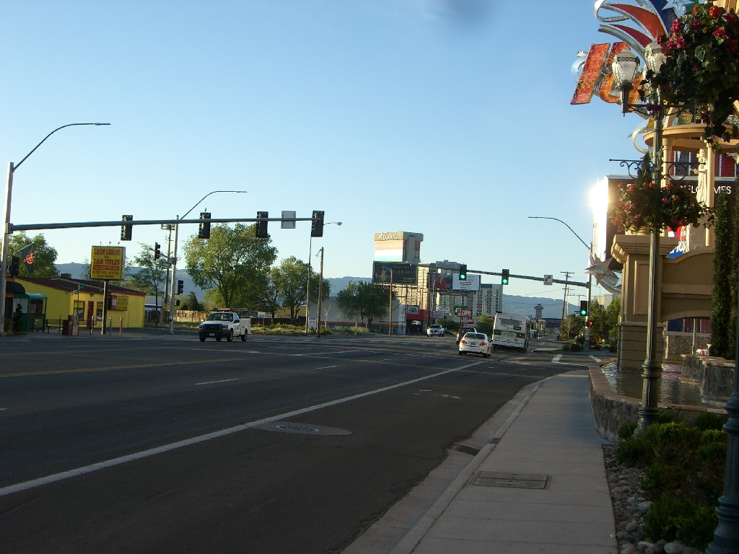
Multiscale Phenomena

Slide 17
Using The Right Scale
Erasing detail may add more clarity than adding detail
Some models are more effective at larger scales
Save the computing power for places it really matters

Slide 18
Using The Right Scale
Model quality is not measured by how much detail we can fit in
The real issue is how effectively we can eliminate the details that are irrelevant

Slide 19
Hierarchical Models
Move in to study small scale elements
Move out to study the larger patterns
Model the interactions between effects at adjacent scales

Slide 20
Travel Model Hierarchy
Travel models can be multi-scale hierarchies...
Pedestrian environment
Regional Model
Statewide Greenhouse Gas Analysis

Slide 21
Travel Model Hierarchy
Travel models can should be multi-scale hierarchies...
Pedestrian environment
Regional Model
Statewide Greenhouse Gas Analysis

Slide 22
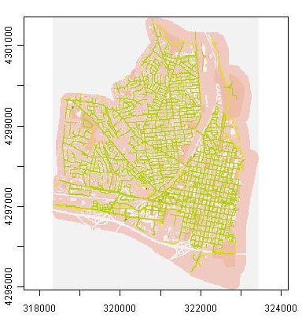
Pedestrian Accessibility
Pedestrian Accessibility (15 Meter grid cells)

Slide 23
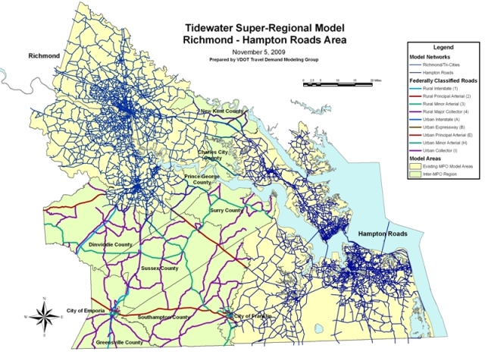
Inter-Regional Travel

Slide 24
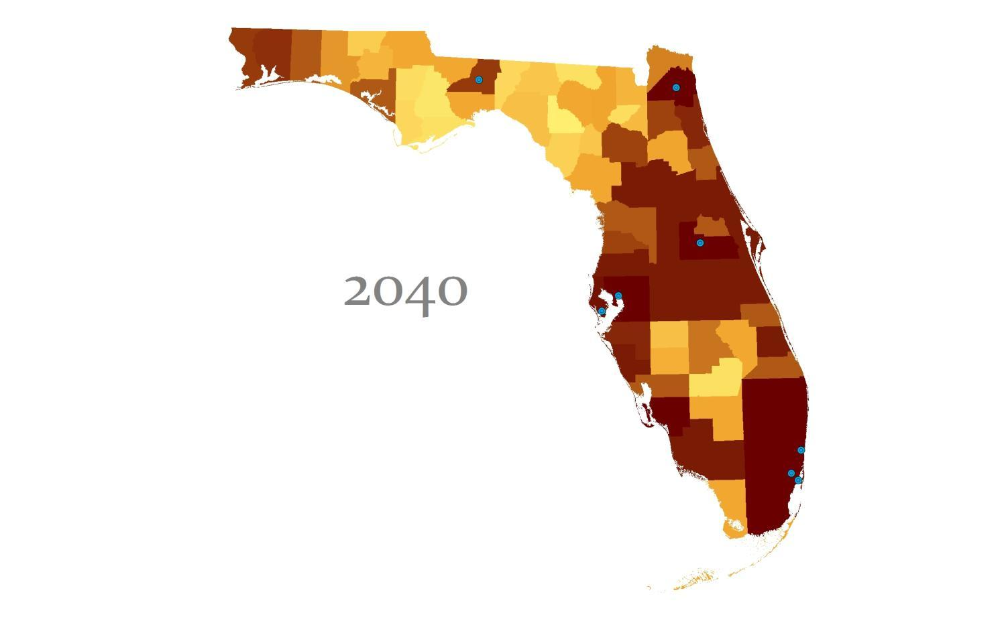

Statewide Greenhouse Gas Estimation
Source: RSG Inc., STEEP Florida Pilot Project

Slide 25
A Visual Example
Image Analysis makes extensive use of multi-scale techniques
Find the right scale(s)
Remove small scale details to get the big picture
Supplement the big picture with close-ups of key locations
Use the close-ups to clarify the big picture

Slide 26

A Visual Example
Resolution: 10 x 12
(Probably Not Good Enough)

Slide 27

A Visual Example
Resolution: 164 x 196
(Better)

Slide 28

A Visual Example
Resolution: 328 x 391
(Probably Wasted Resources)

Slide 29
A Visual Example
Resolution: 328 x 391
Notes:
But wait, what’s that down in the circle?

Slide 30

A Visual Example
Base Resolution: 328 x 391
(Not good enough to see...)

Slide 31

A Visual Example
Base Resolution: 1638 x 1953
(That’s “Better”)

Slide 32

Visual Example
... it takes much less effort to see what’s happening at a large scale
Once we know what’s going on at a small scale...
Notes:
This slide looks like a mess, but that’s because of the animation effect...

Slide 33
Summary
Model quality is not measured by how much detail we can fit in
The real issue is how effectively we can eliminate the details that are irrelevant

Slide 34
Questions?
Jeremy Raw
jeremy.raw@dot.gov

