Slide 1


On Road Vehicle Activity GPS Data and Privacy
Vetri Venthan Elango
Dr. Randall Guensler
School of Civil and Environmental Engineering
Georgia Institute of Technology

Slide 2
Overview
Introduction
Background
Data
Methodology
Case Study
Conclusions and Future Work

Slide 3
Introduction
The use of GPS devices in travel behavior studies continues to increase in frequency and depth
GPS devices can provide accurate and detailed spatial and temporal data
High resolution GPS data are useful in studying
Travel behavior
Driver behavior
Safety
Emissions
Etc.

Slide 4
Objective
High resolution GPS data have a significant potential to compromise privacy
Aggressive driving (speed/acceleration) - lawsuits
Home departure and arrival - home security
Locations visited
Methodological goal
Post-process high resolution GPS data and ensure privacy of participants
Retain enough detailed data to be useful to various research communities
Notes:
Ensure participants cannot be identified

Slide 5
GPS-based Travel Study Examples
Lexington travel data demonstration 1997
GPS for personal travel surveys
Georgia Tech comprehensive electronic travel monitoring system 1999-2000
The Rätt-Fart Borlänge GPS study 1999-2001
California Statewide Household Travel Survey GPS study, 2001
Commute Atlanta Study, 2004-2006
University of Minnesota, I-35 Bridge use study, 2008-2009
Cobb County School District, GPS-based anti-idling study 2010 - ongoing

Slide 6
Travel Survey Methods using GPS
Active handheld systems replicating traditional travel-diaries
GT comprehensive electronic travel monitoring system study
Longitudinal studies with vehicle-based GPS systems installed in participant vehicles
Commute Atlanta Study
A hybrid of longitudinal passive GPS data collection coupled with intermittent online travel surveys
University of Minnesota, I-35 Bridge Crossings Study

Slide 7
Commute Atlanta Study
Instrumented vehicle research collecting high-resolution GPS (2004-2006)
Assess the effects of converting operating costs into variable per-mile driving costs
Approximately 500 vehicles in 270 households
More than 1.8 million vehicle trips
Baseline data from 270 households
Approximately 100 households in the pricing study

Slide 8
Proposed Commute Atlanta Dataset for Public access
Travel Diary Data (trip-level travel data)
95 households that had complete data for the study period
Summary of trips including origin/destination TAZs, distance, duration, date, time etc.
Second-by-second data withheld
Onroad Vehicle Activity Data (second-by-second)
Approximately 175 households that did not have complete data for study period
Trip summary data (distance, duration, etc.) withheld

Slide 9
On Road Vehicle Activity Data
Characteristics
Second by second vehicle speed and position data
Data are tied to specific roadways
FHWA highway functional classification, number of lanes, lane width, etc.
Uses
Safety studies
Driver behavior
Emissions analysis

Slide 10
Attributes
GPS data
Latitude and Longitude, speed, heading, date and time
Number of satellites, position quality information, etc.
Roadway Characteristics
HPMS attributes
Georgia Tech Household Classification Group (income, vehicle ownership, and household size)
Vehicle Characteristics
Fuel Type, Engine Type, Body Type and Model Year Group
Driver Characteristics
Age group and Gender

Slide 11
Privacy Concerns
High resolution GPS data can identify participant’s
Home, and work locations
Shopping, recreational and social preferences
Driver risk parameters
High resolution GPS data + Vehicle Characteristics + Driver Characteristics, will yield the identity of individual participants
Recent news about public access to location data
Iphone location tracking
TomTom selling GPS data to Police
Notes:
Driver Risk Parameters are Significant in defining crash risk groups over demographic variables

Slide 12
Identifying Home Locations
Characteristics
Most frequent trip end
Usually the last trip end of the day
Methodology
Pool the data based on vehicle/driver characteristics, location, and date-time from vehicle activity datasets
Identify frequent trip ends by time of day
Spatially analyze the most frequent trip ends and the last trips in each day

Slide 13
Data Filtering Techniques I
Filter using buffer around the home location
Center of the buffer is the home location
Filter using a polygon around the home location
Polygon centroid is the home location
Notes:
Insert a graphic in the blank space

Slide 14
Data Filtering Techniques II
Filter using a random polygon with its centroid away from home
Define random centroid from household
Random distance (minimum 500 ft and maximum 750 ft) from the household in a random direction
Generate a random six sided polygon
Vertices at a minimum distance of 0.5 miles and maximum distance of 0.75 miles from the centroid
All GPS data that are within this polygon are trimmed
Notes:
Remind audience No trip distance, and duration information provided with this dataset

Slide 15
Case Study
One month of activity data for 2 households
Onroad vehicle activity data were filtered using a randomly generated polygon for each household
Post-analysis of the filtered dataset (detective work)
Identify home location using filtered data with a trip ends algorithm
Spatially identify clipped trip endpoints
Find the centroid of these last known points
Do a Network Analysis of clipped trip endpoints
Notes:
Eliminate all records that fall within the random polygon around the household.
Because a the randomized polygon employed to clip the data cannot be predicted
Create Service Area from each trip end point. Intersecting Service Area contains home location

Slide 16
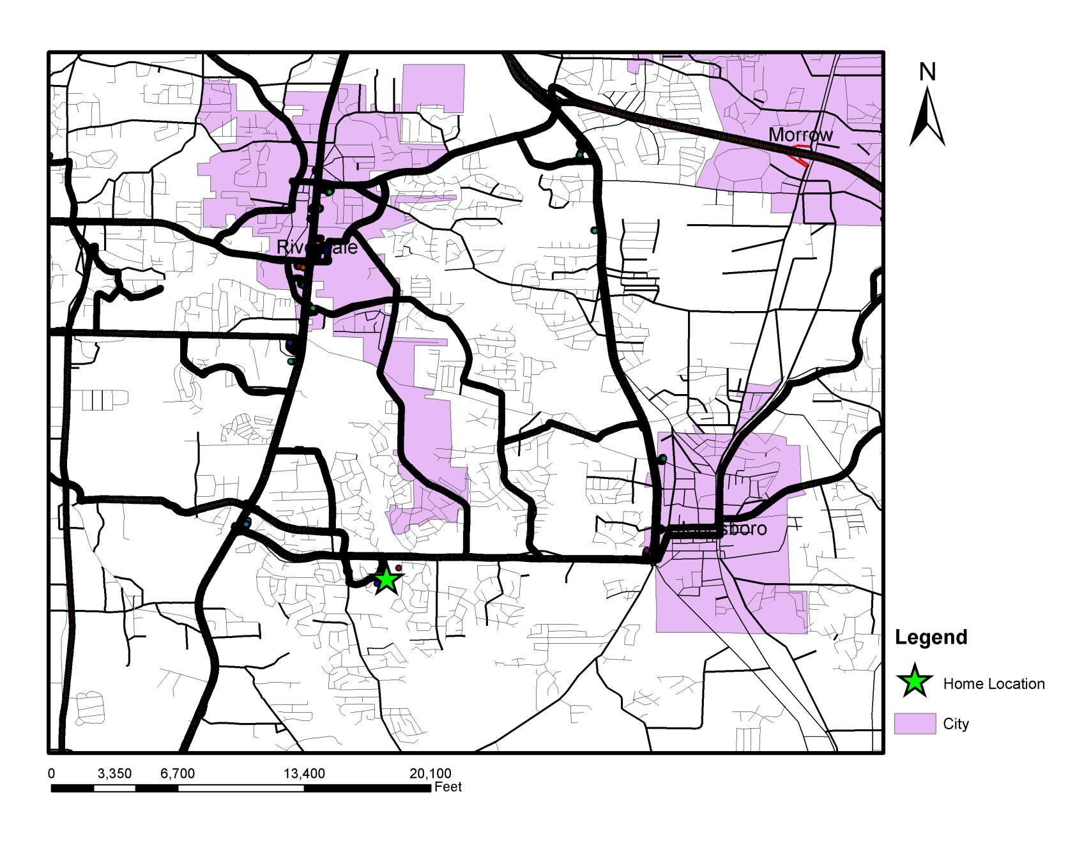
Household 1 All GPS Data near Home

Slide 17
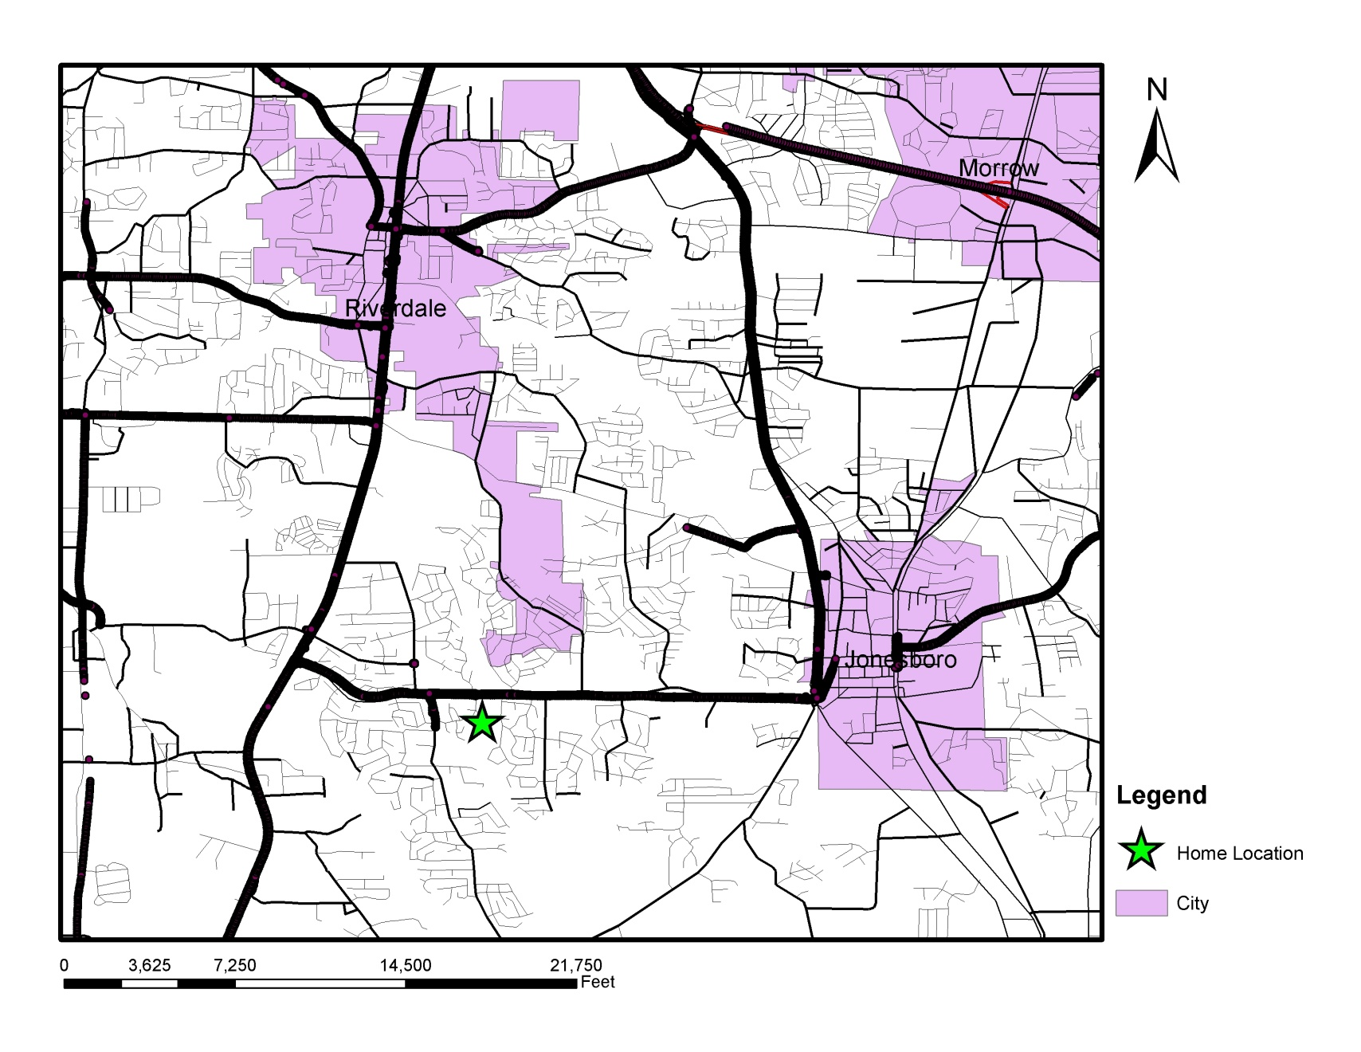
Household 1 On-Road Vehicle Activity Data

Slide 18
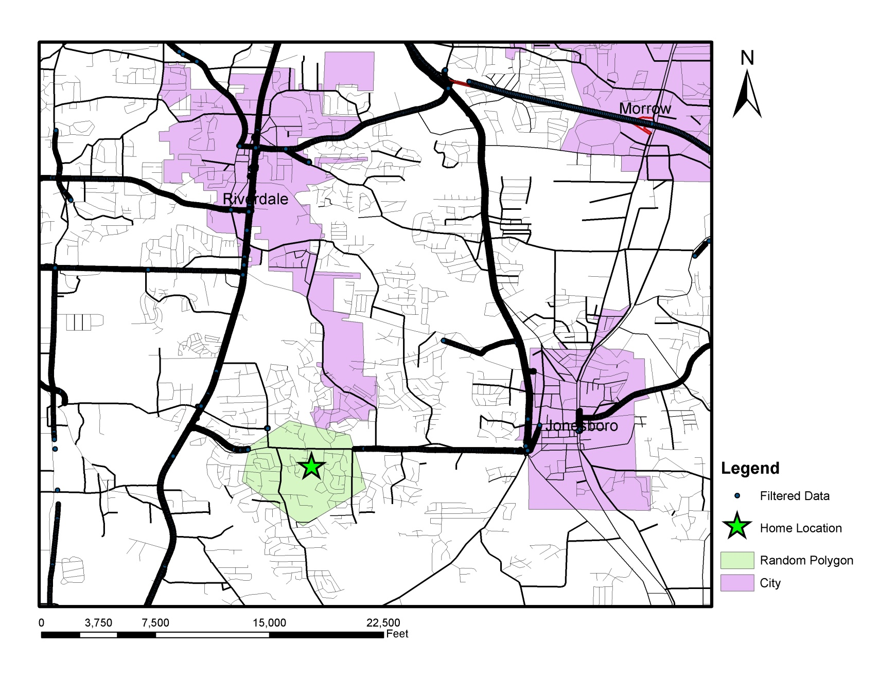
Household 1 Actual Filter Polygon
More than 1000 parcel centroids within filter Polygon

Slide 19
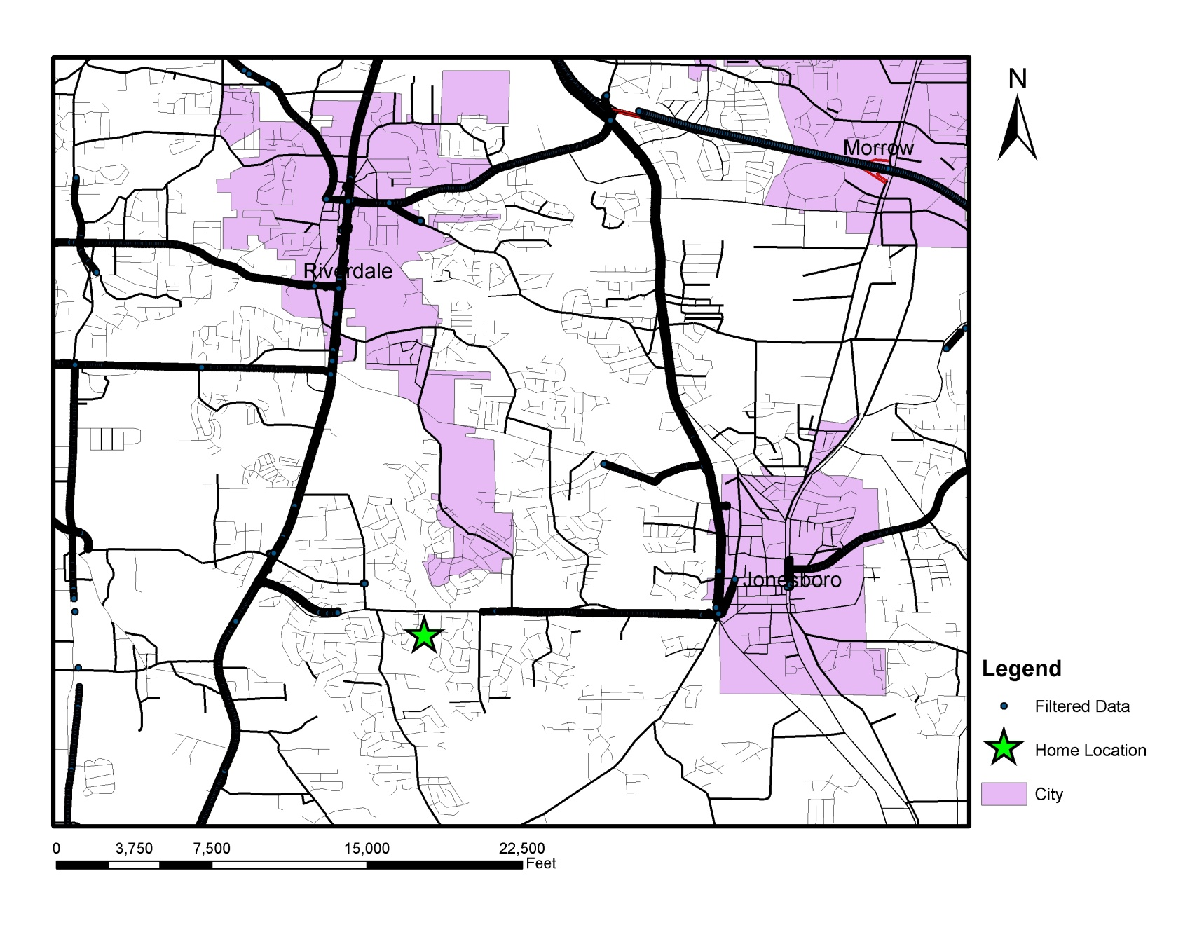
Household 1 Home Location Estimate from Dataset
Estimated Home Location

Slide 20
Household 1 Home Location from Spatial Analysis
Estimated Home Location

Slide 21
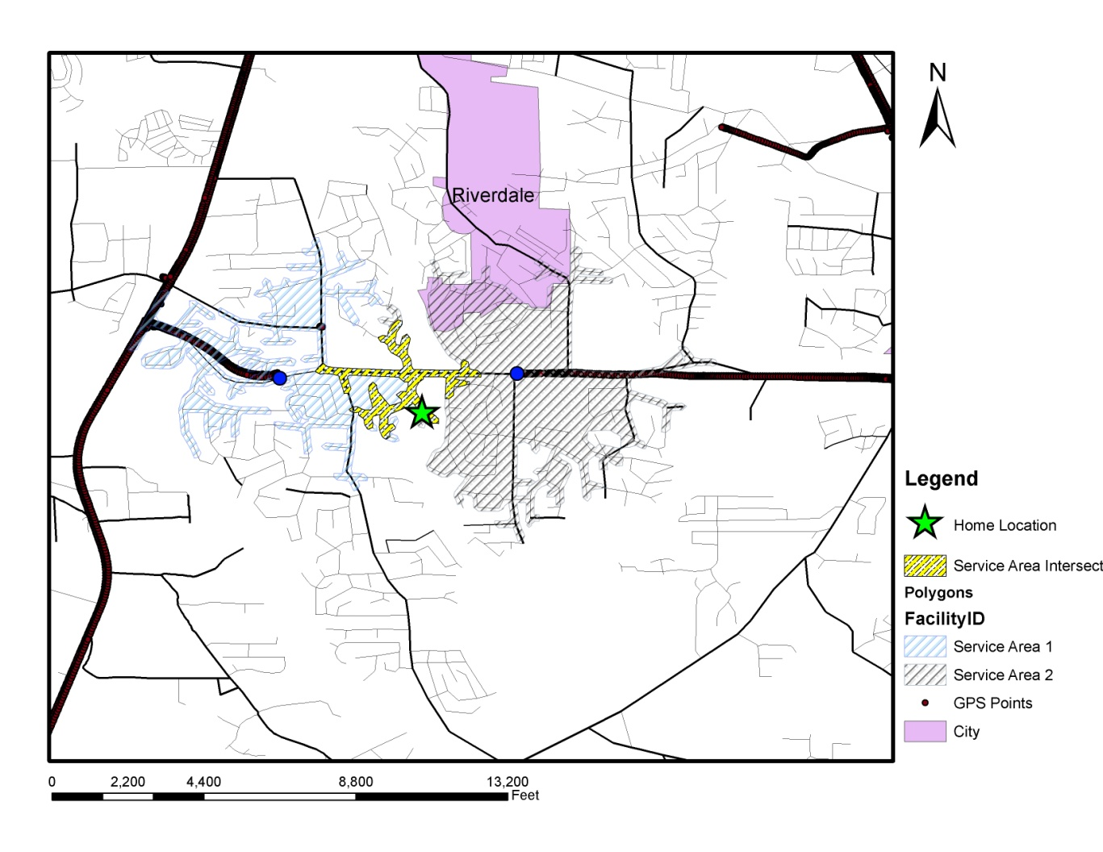
Household 1 Network Analysis
137 parcel centroids within Intersect Area

Slide 22
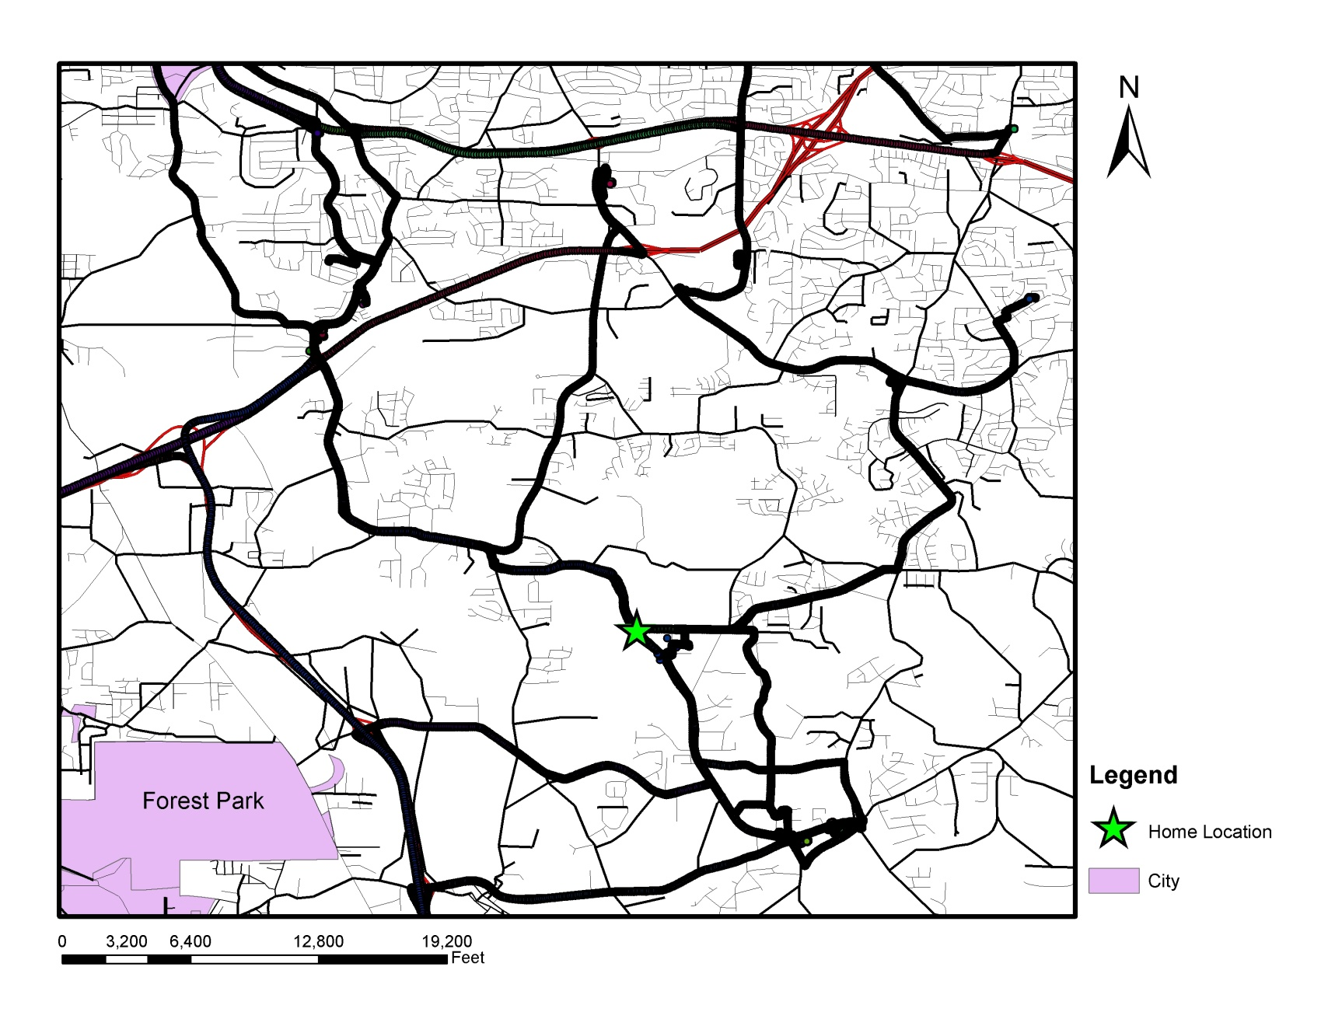
Household 2 All GPS Data near Home

Slide 23
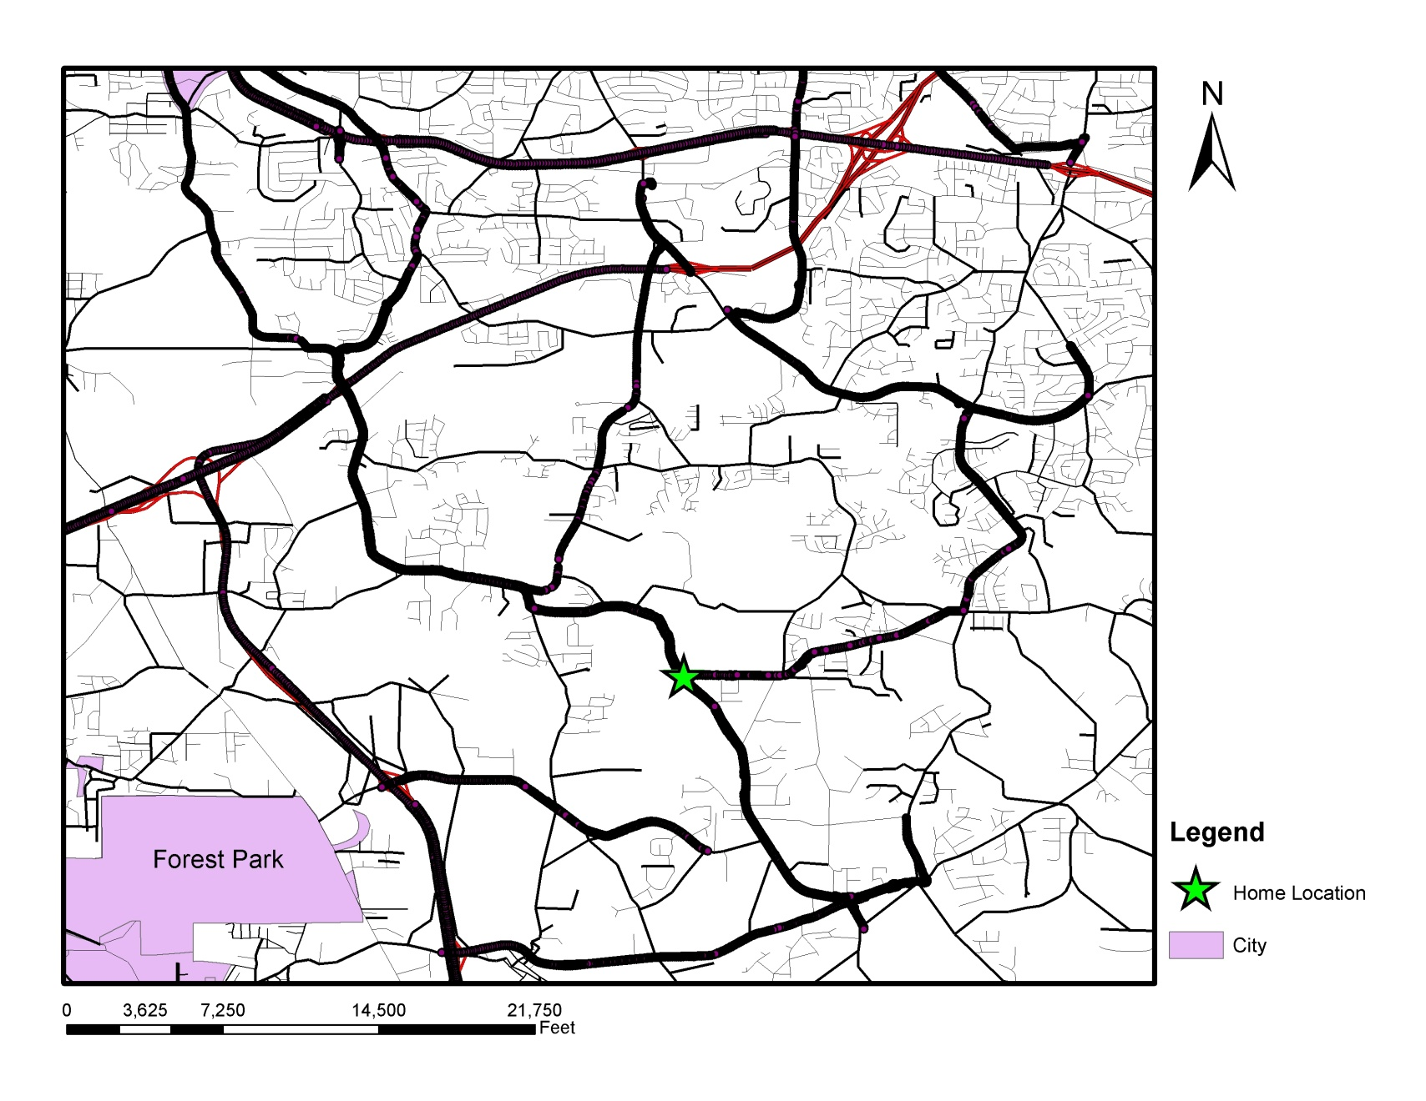
Household 2 On-Road Vehicle Data

Slide 24
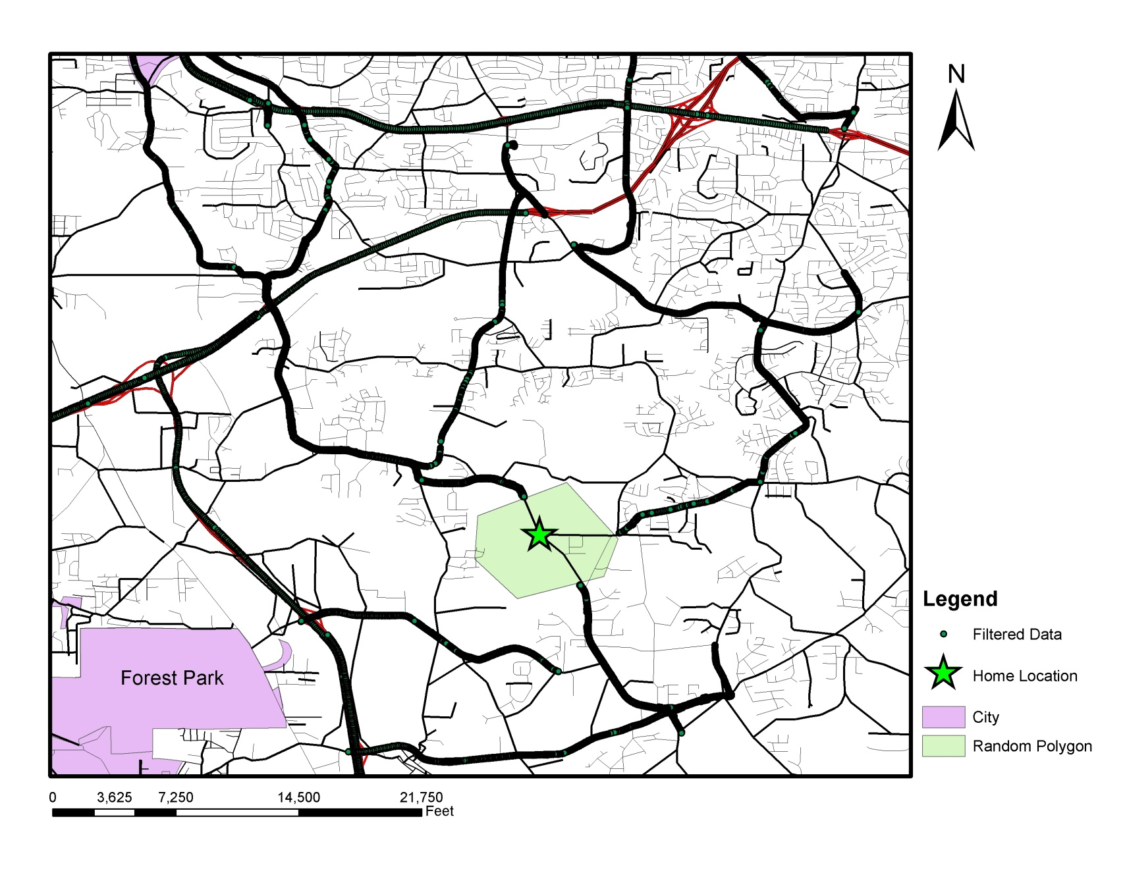
Household 2 Actual Filter Polygon
More than 300 parcel centroids within filter Polygon

Slide 25
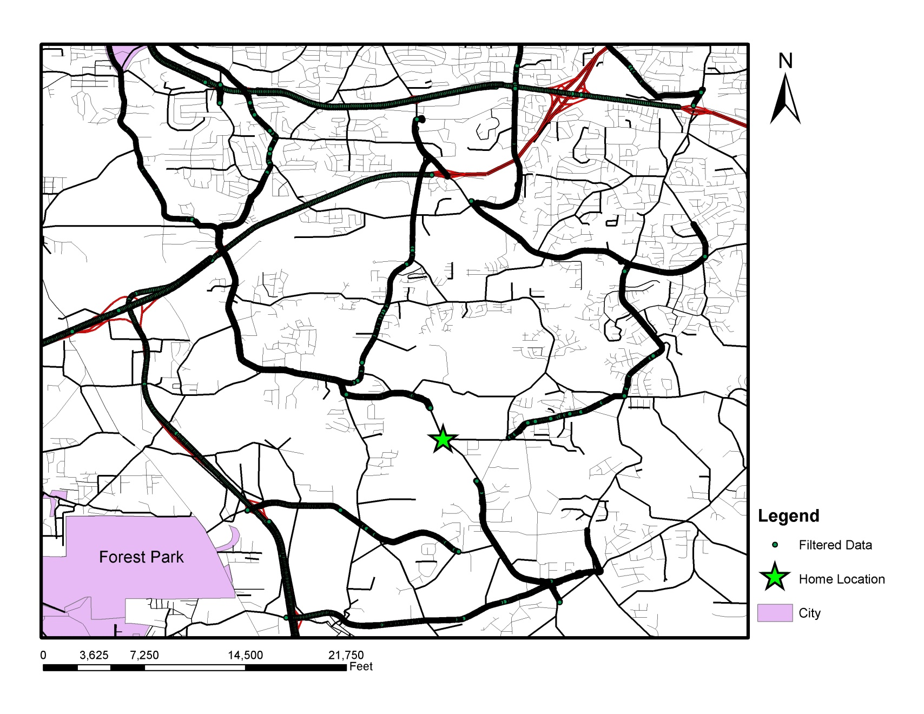
Household 2 Home Location Estimate
Estimated Home Location

Slide 26
Household 2 Home Location from Spatial Analysis
Estimated Home Location

Slide 27
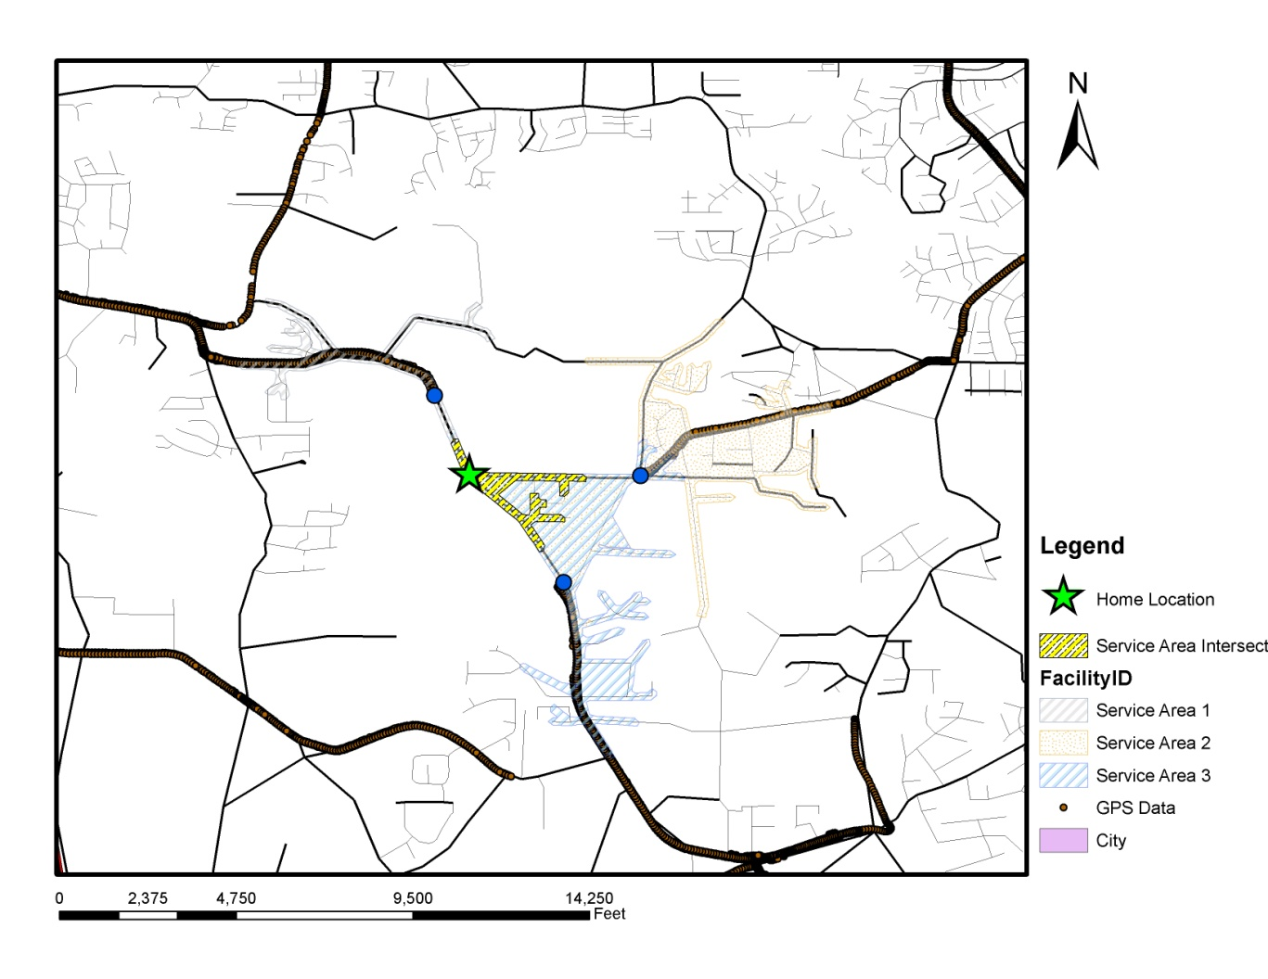
Household 2 Network Analyst
22 parcel centroids within Intersect Area

Slide 28
Access to Vehicle Registration Data Improves Matching
Household zip code = 30306
Household has exactly 2 vehicles registered
Both vehicles are SUVs
One vehicle is 1995-1999 model year
One vehicle is 2000-2004 model year
Notes:
Note that insurance company records also have vehicle registration and demographic data
So do credit reporting bureaus

Slide 29
Query Statistics
Registered Vehicles: 16,071
SUVs: 3,718
HH with 2 SUVs: 418
HH with 2 SUVs and specified model year groups: 19

Slide 30
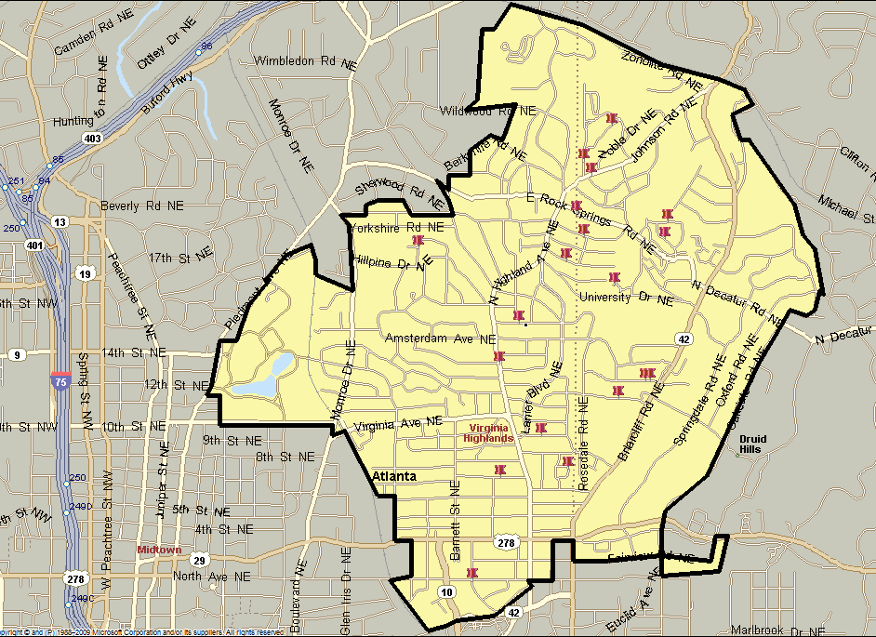

19 Potential Household Locations among 16,000 residences
Zip Code 30306

Slide 31
Conclusions
High-resolution GPS data need to be filtered before data are shared to prevent loss of privacy
A filtering method that uses a random polygon around the home location was applied
However, using network and available on-road vehicle activity data, home locations can be identified
Using vehicle registration data and other data sources make it even easier to identify households
Liability associated with participant privacy protection lies with data collector
Notes:
Under Federal law

Slide 32
Ongoing Activities
Continue work to develop post-processing methods that ensure travel diary data and high resolution GPS data do not compromise participant privacy
Unfiltered data remain available for research only at Georgia Tech through 2011
Other researchers can visit Tech and do their research in partnership
Notes:
You can mention that a fellowship program is forthcoming

Slide 33
Questions?
Vetri Venthan Elango vetri@gatech.edu
Randall Guensler randall.guensler@ce.gatech.edu

