Slide 1
Investigating the Relationship of Service Headway to Wait Time in Dallas-Fort Worth Metropolitan Area
Kathy Yu, Arash Mirzaei, Behruz Paschai
North Central Texas Council
of Governments (NCTCOG)

Slide 2
Background
In an aggregate transit demand model, initial wait time and transfer wait time are set to:
  Wait Time = Min (0.5*Headway, Max_Wait)
Headway could be a combined headway (as it is defined in Optimal Strategy Algorithm).
Max_Wait is typically in the order of 15 to 30 minutes.

Slide 3
Problem
Misrepresentation of infrequent service in the model
Unrealistic wait time estimation in transit path builder
Drastic effect on mode choice estimation (estimation usually uses model outputs)
  Magnitude of coefficients
  Adding constraints on coefficients
  Assert coefficients
Decrease quality of transit assignment

Slide 4
Objective
Statistically measure or estimate the transit initial wait and transfer wait times for various types of service and trip purposes

Slide 5
Other Studies
O’Flaherty and Mangan (Leeds, 1970)
Seddon and Day (Leeds, 1974)
Fan and Machemehl (Austin, 2002)
where :
  E(w) = Expected value of wait time
  E(h) = Expected value of service headway

Slide 6
Variability
Transit service variability caused by service reliability and unknown traffic conditions.
Passenger arrival variability created by trip-planning to minimize initial wait time.

Slide 7
Passenger Arrivals
Non-Random Arrivals
    users of longer trips
    longer service headways
    regular users of transit services
    plan their arrival based on the service headway
Random Arrivals
    users of shorter trips
    shorter service headways
    do not necessarily plan their arrival, due to the frequent availability of transit vehicles

Slide 8
Wait Time
Wr = Wait time for a randomly arriving passenger
h = Bus headway
E() = Expected value of a random variable
V() = Variance of a random variable
Seddon and Day (Leeds, 1974)

Slide 9
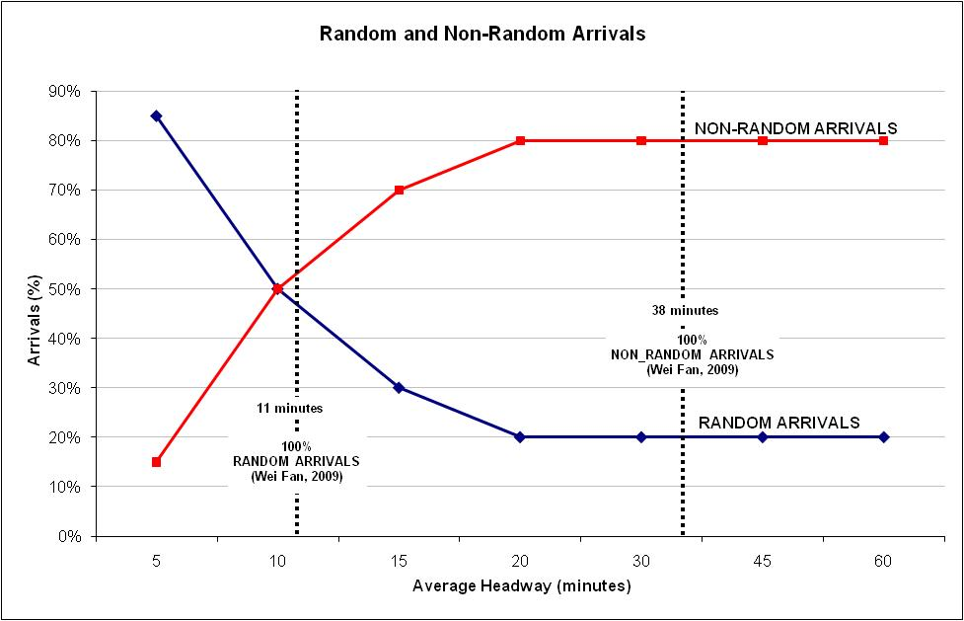
Passenger Arrivals
[4]
[2]
[4]
[2]

Slide 10
Methods
Use of surveillance camera at the stations
  Measures the wait accurately
  Sampling and management challenges
  Very labor intensive for the first study of wait time
Counting and time recoding of passengers at the stations
  Measures the wait accurately
  Sampling challenges
  Labor intensive
  Difficult to track passengers
Interview survey
  Asks for the estimated wait
  Sampling at the route level
  Manageable for this first wait time study

Slide 11
Sample Size
Universe : DART bus and rail service, TRE
Stratification : based on service headways
  10-15 30-45 Light Rail
  15-20 >45 Commuter Rail
  20-30
Confidence interval : 90%
Total non-express bus samples : 500
Total express bus samples : 170
Total light rail samples : 65
Total commuter rail samples : 170

Slide 12
Train Headway Variability
Time of Day | Light Rail | Commuter Rail
AM | 5-10 | 30
Midday | 20 | 60
PM | 10 | 30
Evening | 25 | 60

Slide 13
Route Selection
Rail Routes Selected
  Light Rail (LRT): Red Line and Blue Line
  Commuter Rail: TRE
Bus Routes Selected
  2 routes each from headway groups of
  10-15, 15-20, 20-30, 30-45 , > 45
  Selection based on highest ridership, and overall coverage of service area.

Slide 14
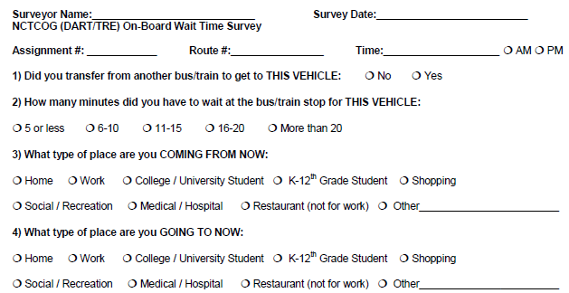
Wait Time Questionnaire

Slide 15
Wait Time Study Details
Data collection started and ended in May 2009.
1,933 completed surveys were received. The sample goals were reached.
  1,028 non-express bus, 321 express bus surveys
  392 LRT surveys
  192 TRE surveys
Initial and Transfer Wait Time Responses
  979 Initial Wait Time Responses
  954 Transfer Wait Time Responses

Slide 16
DART/TRE
Results by Headway Group
HdwyGroup | Avg Init Wait (min)* | Avg Transfer Wait (min)*
10-15 | 5.81 | 8.91
15-20 | 5.53 | 8.32
20-30 | 6.00 | 9.28
30-45 | 6.32 | 8.08
> 45 | 7.43 | 9.88
LRT | 5.68 | 5.96
TRE | 6.70 | 8.11
TOTAL | 6.20 | 8.07
* Wait Time from the headway ranges was calculated using the median value of each headway range(0-5, 6-10, 11-15, 16-20) and 25 minutes for the range of > 20 minutes.

Slide 17
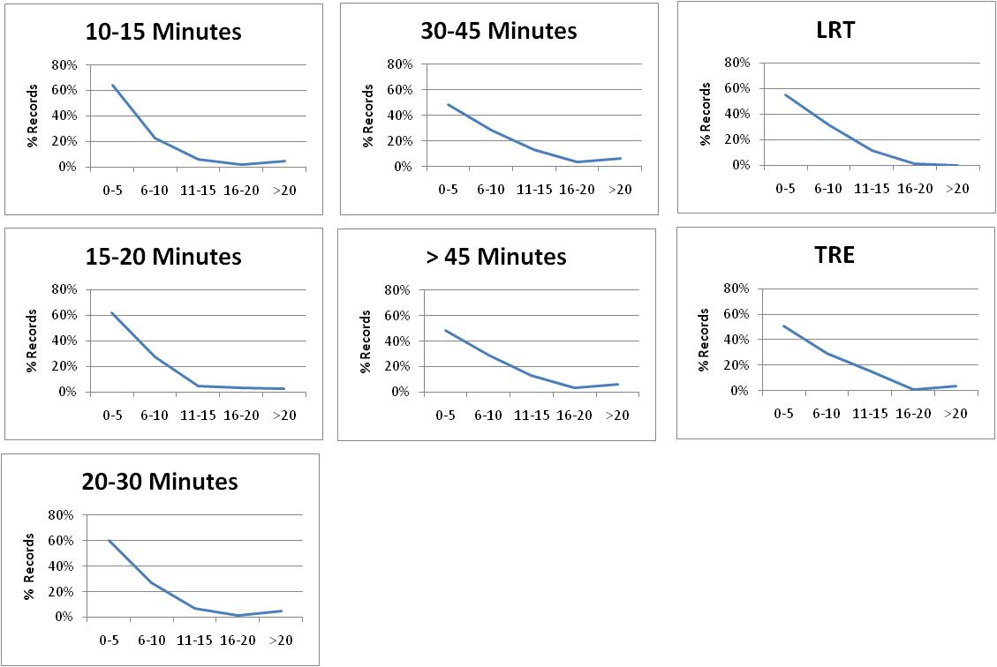
DART/TRE Initial Wait Time
Results by Headway Group

Slide 18
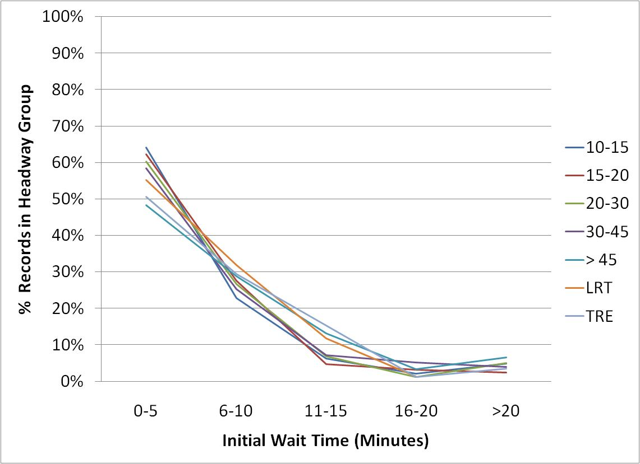
DART/TRE Initial Wait Time
Results by Headway Group

Slide 19
Headway and Initial Wait
Initial wait time does NOT vary meaningfully with variation in headway.
Most transit riders plan their trips in a way that the average initial wait time is around 6 min. with small variance.

Slide 20
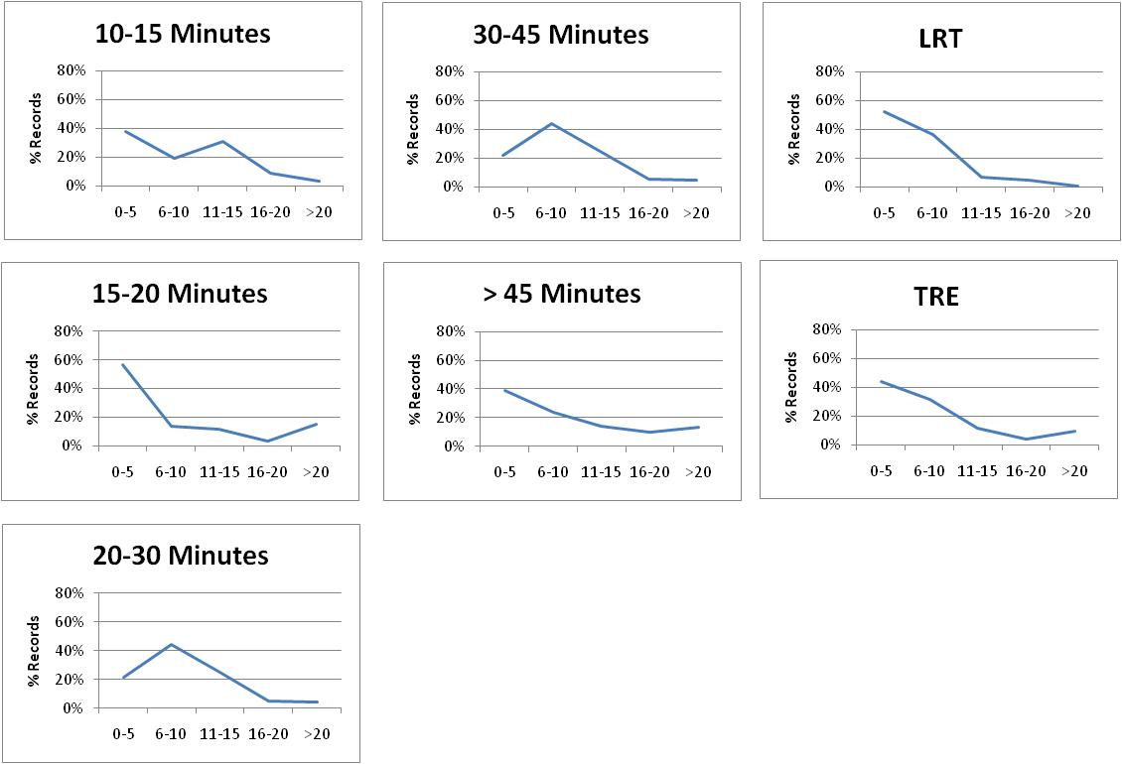
DART/TRE Transfer Wait Time
Results by Headway Group

Slide 21
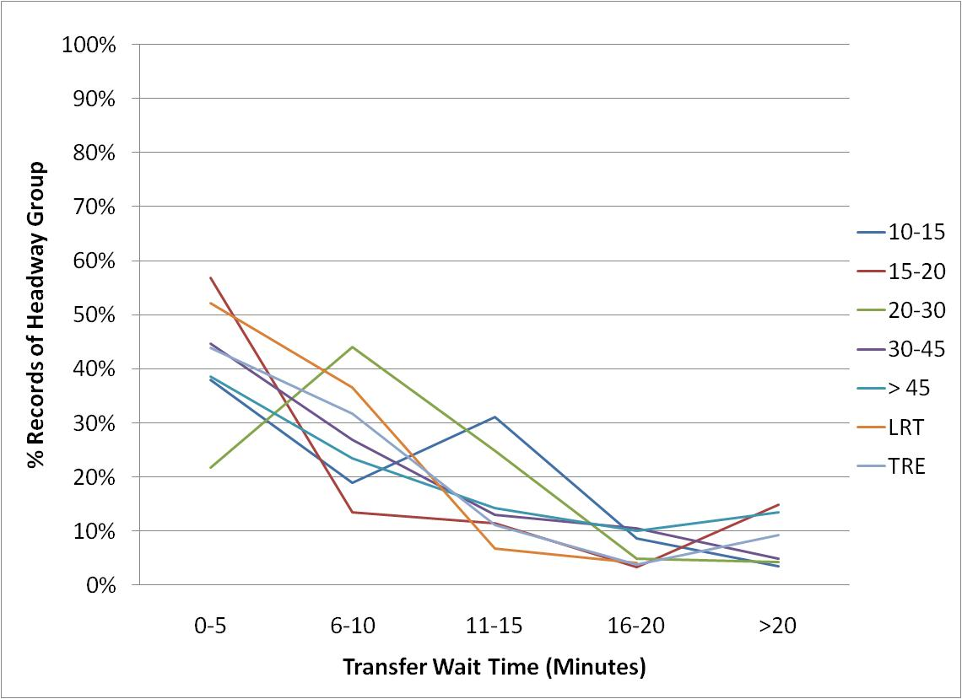
DART/TRE Transfer Wait Time
Results by Headway Group

Slide 22
Headway and Transfer Wait
Transfer wait time does NOT vary meaningfully with variation in headway but it varies more than Initial wait time
Most transit riders plan their trips as opposed to arriving randomly. The average transfer wait time is around 8 min. with small variance.

Slide 23
DART/TRE Results by Trip Purpose
Trip Purpose | Avg Init Wait (min)* | Avg Transfer Wait (min)*
HBW | 5.37 | 7.72
HNW | 6.88 | 8.48
NHB | 7.67 | 7.98
TOTAL | 6.20 | 8.07
* Wait Time from the headway ranges was calculated using the median value of each headway range(0-5, 6-10, 11-15, 16-20) and 25 minutes for the range of > 20 minutes.

Slide 24
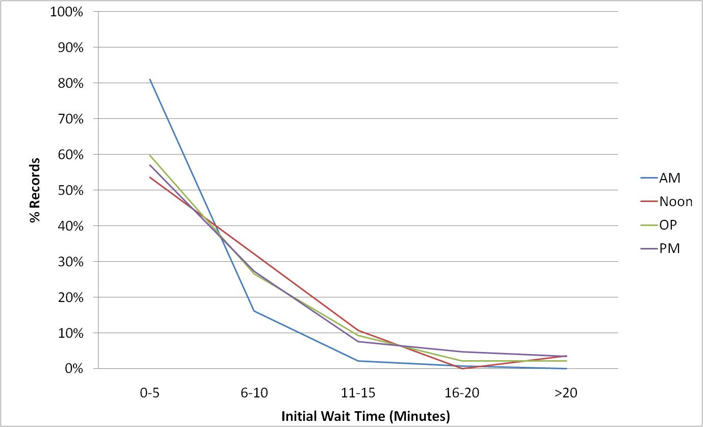
HBW Initial Wait Time
Results by Time of Day
Initial wait time for HBW trips in different time of day
periods follows the same pattern
Average initial wait time for HBW trips is 5 minutes

Slide 25
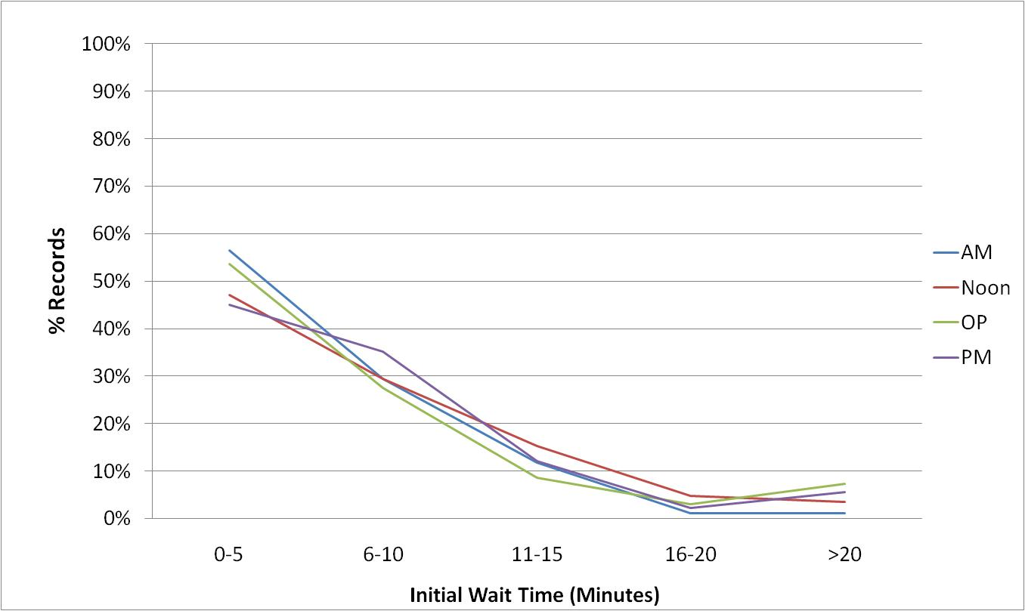
HNW Initial Wait Time
Results by Time of Day
Initial wait time for HNW trips in different time of day
periods follows the same pattern
Average initial wait time for HNW trips is 7 minutes

Slide 26
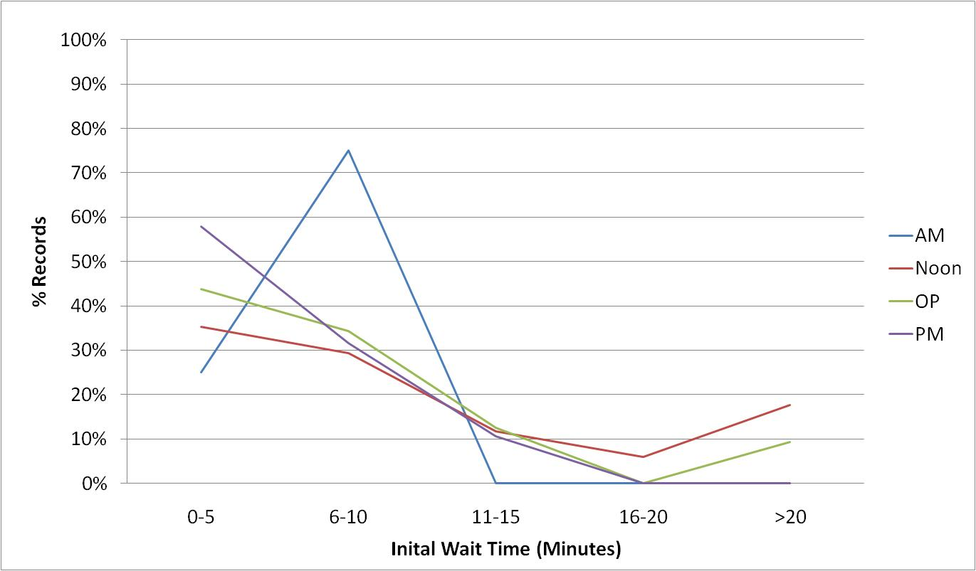
NHB Initial Wait Time
Results by Time of Day
Initial wait time for NHB trips in different time of day
periods follows almost the same pattern
Average initial wait time for NHB trips is 8 minutes

Slide 27
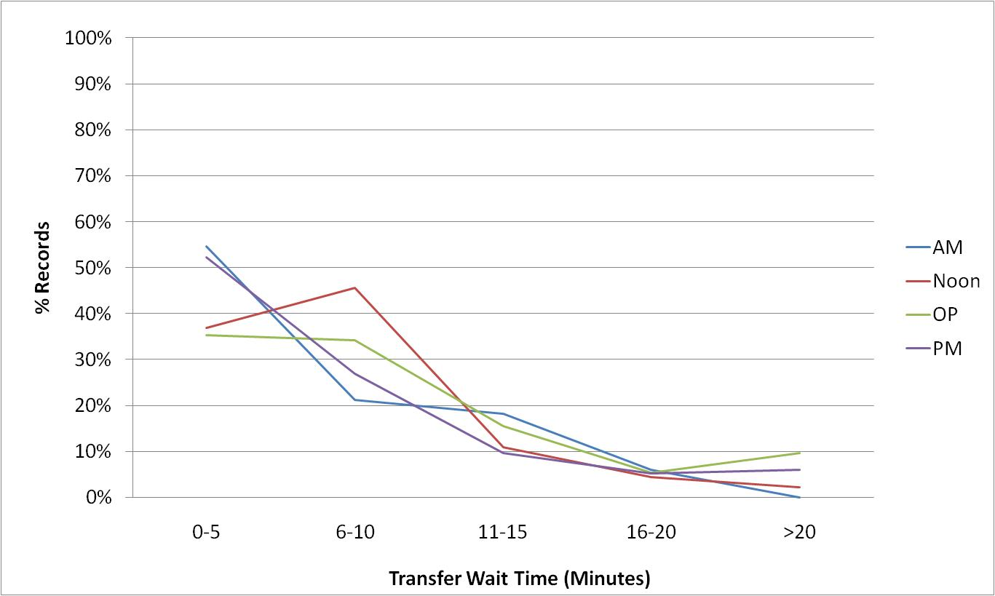
HBW Transfer Wait Time
Results by Time of Day
Transfer wait time for HBW trips in different time of day
periods follows the same pattern
Average transfer wait time for HBW trips is 8 minutes

Slide 28
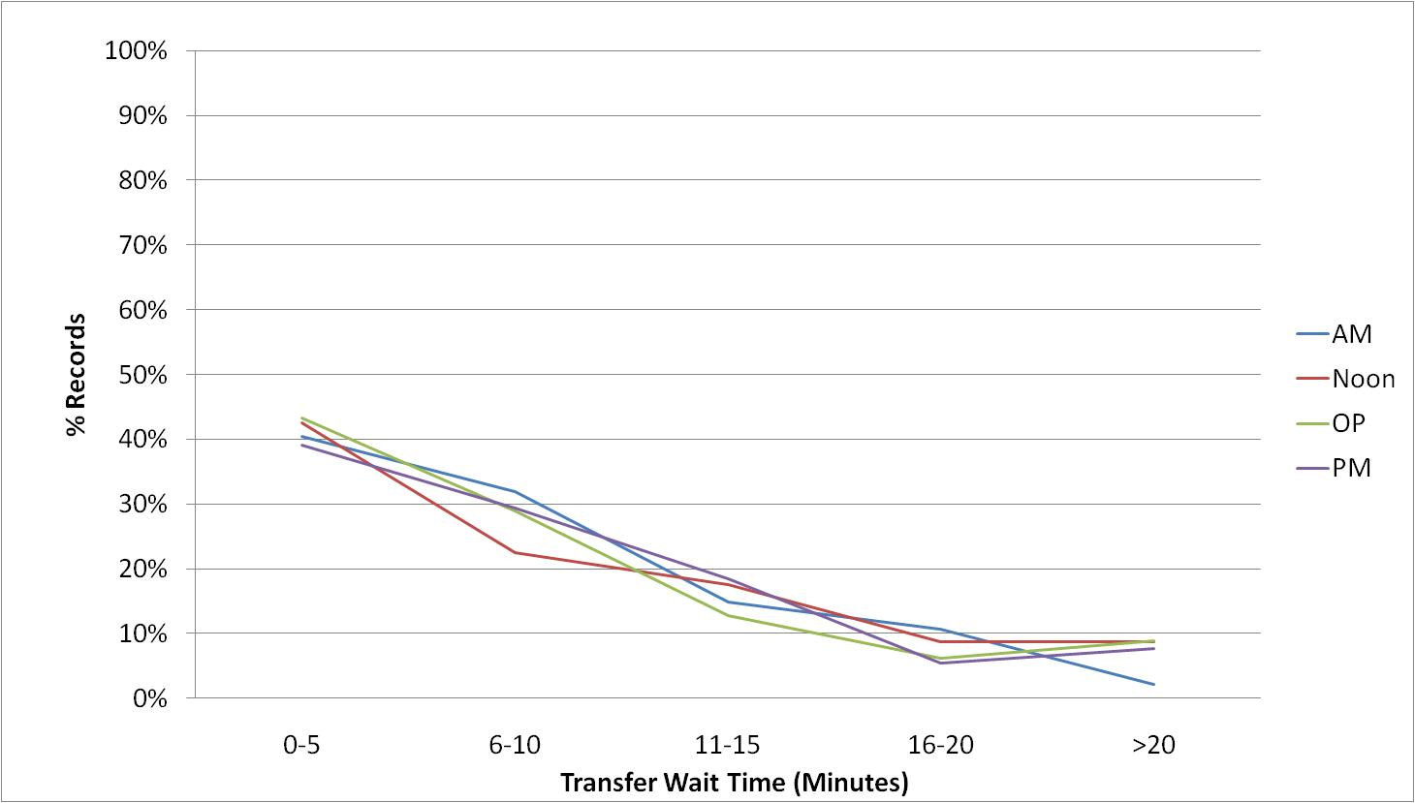
HNW Transfer Wait Time
Results by Time of Day
Transfer wait time for HNW trips in different time of day
periods follows the same pattern
Average transfer wait time for HNW trips is 8 minutes

Slide 29
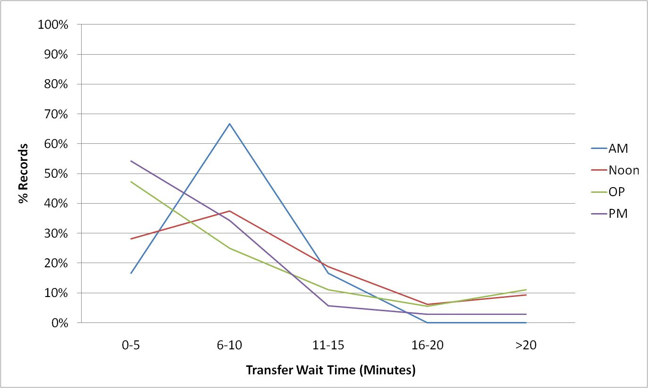
NHB Transfer Wait Time
Results by Time of Day
Transfer wait time for NHB trips in different time of day
periods almost follows the same pattern
Average transfer wait time for NHB trips is 8 minutes

Slide 30
DART/TRE
Results by Trip Purpose and TOD
Trip Purpose | TOD | Avg Init Wait (min) | Avg Transfer Wait (min)
HBW | AM | 3.71 | 6.52
HBW | NOON | 6.20 | 7.32
HBW | OP | 5.77 | 9.00
HBW | PM | 6.30 | 7.15
HBW | TOTAL | 5.37 | 7.72
HNW | AM | 5.80 | 7.95
HNW | NOON | 7.25 | 8.90
HNW | OP | 7.02 | 8.38
HNW | PM | 7.28 | 8.61
HNW | TOTAL | 6.88 | 8.48
NHB | AM | 6.63 | 7.92
NHB | NOON | 10.24 | 9.61
NHB | OP | 7.81 | 8.40
NHB | PM | 5.34 | 6.07
NHB | TOTAL | 7.67 | 7.98
TOTAL |  | 6.20 | 8.07

Slide 31
Wait Time Survey Conclusions
Regardless of the headway, an overwhelming
majority of :
  Transfer wait times are less than 10 minutes (average 8 minutes); and
  Initial wait times are less than 8 minutes (average 6 minutes).
As a result of the survey, it was determined that initial and transfer wait times have little to do with the average headway of the routes in the DFW region

Slide 32
References
1. Turnquist, Mark A., “A Model for Investigating The Effects of Service Frequency and Reliability on Bus Passenger Wait Time”, Transportation Research Record, Publication 663, pages 70-73, Transportation Research Board, Washington, D.C., 1978.
2. Fan, Wei, Machemehl, Randy B., “Do Transit Users Just Wait or Wait with Strategies for the Bus? Some Numerical Results You Should See as a Transit Planner”. Submitted for Publication in the 2009 Transportation Research Record and Presentation at the 88th Annual Meeting of the TRB, Washington, D.C., January 2009. (reference obtained directly from the corresponding author)
3. Mishalani, Rabi G., McCord, Mark M., Wirtz, John, “Passenger Wait Time Perceptions at Bus Stops: Empirical Results and Impact on Evaluating Real-Time Bus Arrival Information”, Journal of Public Transportation, Vol. 9, No.2, 2006.
4. Booz Allen Hamilton, “Measurement Valuation of Public Transport Reliability”, Land Transport New Zealand Research Report 339, 2007.

Slide 33
Contact Information
  Kathy Yu kyu@nctcog.org
  Arash Mirzaei amirzaei@nctcog.org
  Behruz Paschai bpaschai@nctcog.org

