Slide 1
Surveying and Modeling Long Distance Trips
Stacey Bricka, TTI
Erik Sabina, DRCOG
Catherine Durso, University of Denver
Julie Paasche, PTV NuStats
Presented at the 13th National TRB Transportation Applications Conference
May 11, 2011
-- Session 17 --

Slide 2
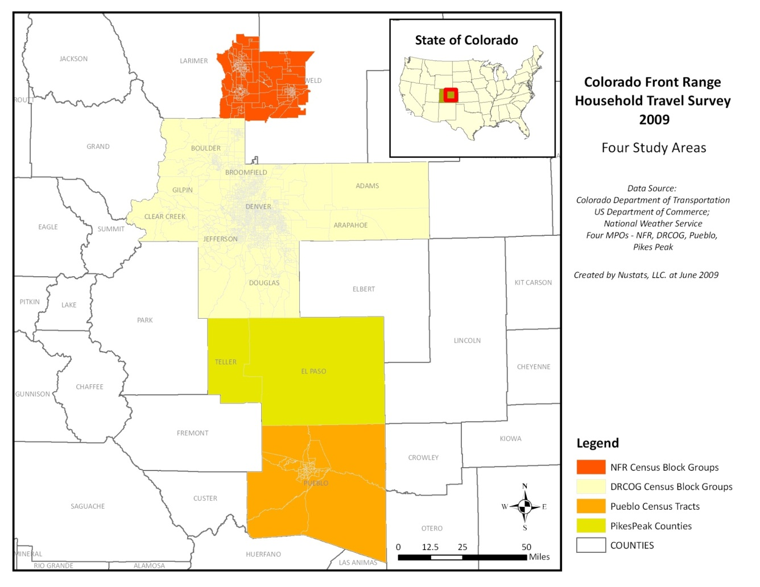
Front Range Travel Counts Project
4 MPO Regions
  NFRMPO
  DRCOG
  PPACG
  PACOG
Surveys
  Household
  Commercial Vehicle
  External Station
  Long Distance
NFRMPO
DRCOG
PPACG
PACOG

Slide 3
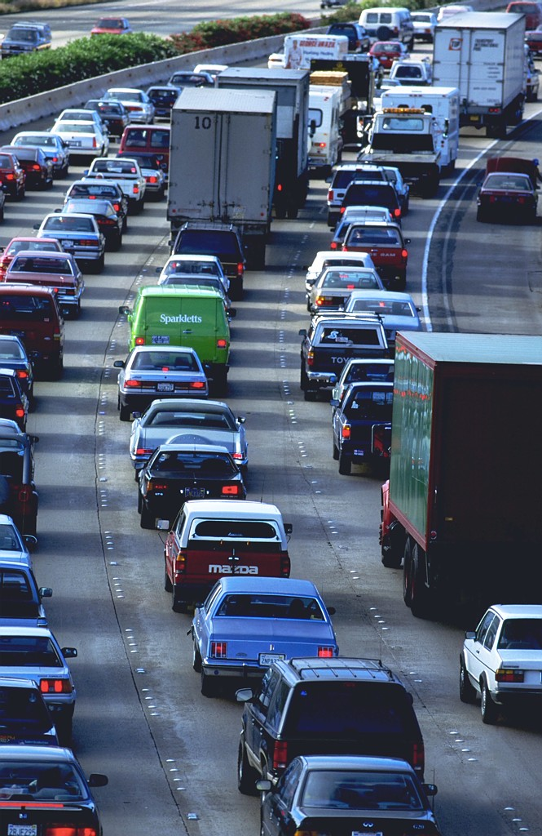
Why Study Long Distance Travel?
Estimate flow between neighboring regional areas
  Support model development for 4-MPO region and/or statewide
  Support current and expected multi-regional studies
Understand special travel markets
  Toll facilities
  Potential inter-regional transit

Slide 4
Research Questions
What type of long-distance travel do we get from a LD survey as compared to a 24-hour survey?
What can we learn from the DRCOG survey to inform the design of future travel surveys?
For the survey DRCOG conducted, what data work is needed to incorporate it into the model?

Slide 5
Presentation Overview
Methods to Capture Long Distance Travel
Front Range Travel Survey
  Long distance travel survey design
  Long distance travel survey results
DRCOG Model
  Incorporating long distance travel
Preliminary Conclusions

Slide 6
Methods Considered
Video license plate capture
Targeted sampling
Supplement to 24-hour diary

Slide 7

Video License Plate Capture
Three sites along I-25
Capture
  Both directions
  Sunrise to 9 am
Match plates
  Commuters
  Traveling into Denver
  Through trips

Slide 8
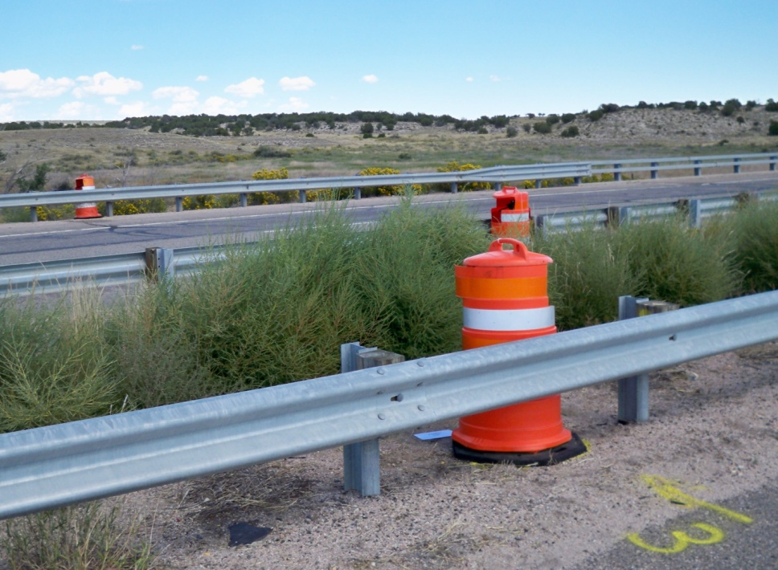
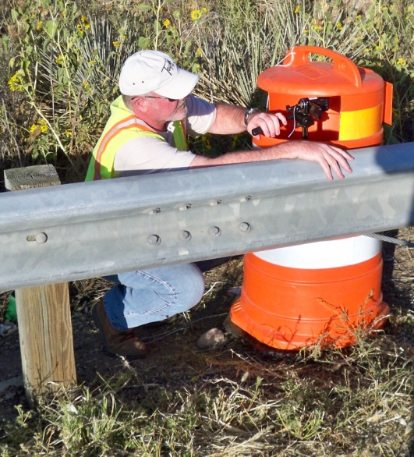
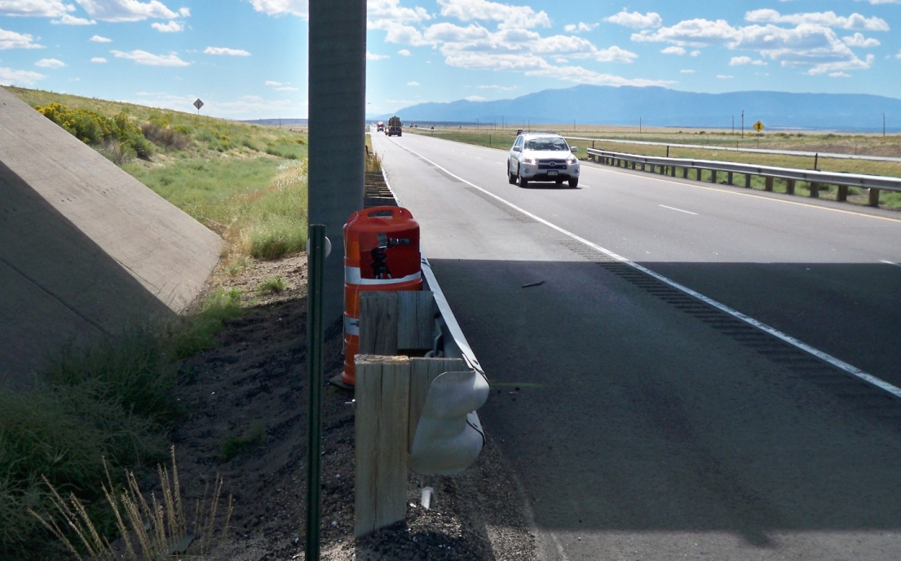
Source: Alliance Transportation Group

Slide 9
Targeted Sampling
Use Census Data to identify long-distance commuters
Randomly sample addresses from identified tracts/block groups
Screen for long distance travelers

Slide 10
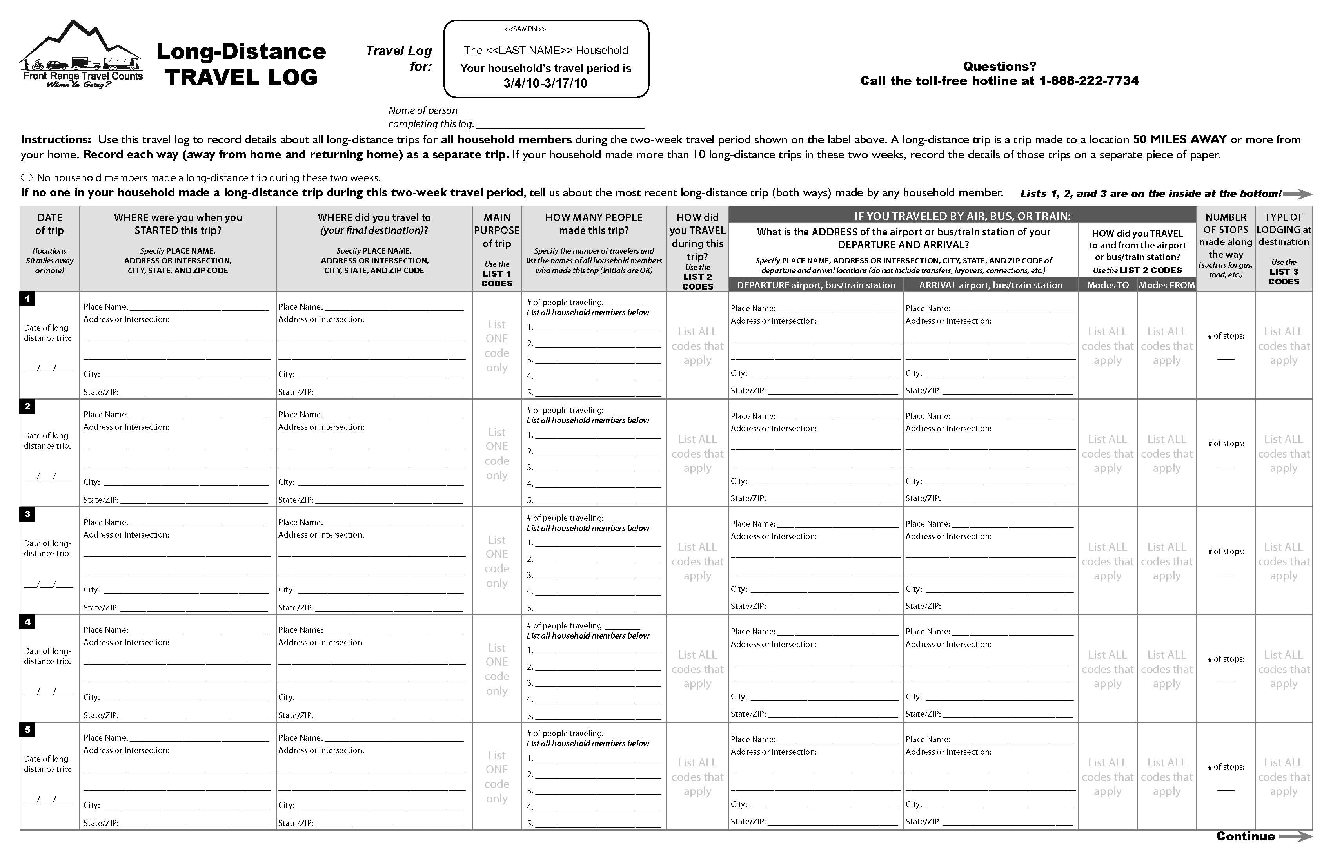
Long Distance Survey Supplement
Extend travel period to capture long distance travel

Slide 11
Long Distance Surveys
1995 American Travel Survey
2001 National Household Travel Survey
2001/2 Ohio Long Distance Survey
2004/2009 Michigan Travel Surveys
Retrospective or forecast?
Length of diary period?
Definition of long distance trip?
  Trip length
  Trip purpose
Data elements?

Slide 12
Front Range Long Distance Survey
2-week retrospective
  If no long distance trips reported, queried about most recent qualifying trip
Definition: 50 miles or more, one-way
Administration
  Integrated into 24-hr HH Survey
  Mailed to households already surveyed
  Provided with travel log for new travelers

Slide 13
Front Range Long Distance Survey
Region | 24-Hour Surveys | LD Surveys Mailed | LD Surveys Completed | Participation Rate
Fort Collins /Loveland | 1,505 | 894 | 212 | 23.7%
Denver | 7,317 | 6,120 | 1,714 | 28.0%
Colorado Springs | 2,601 | 2,366 | 838 | 35.4%
Pueblo | 989 | 864 | 368 | 42.6%
Total | 12,412 | 10,244 | 3,123 | 30.5%

Slide 14
Survey Results
Region | # Surveys | # Trips* | # LD Trips* | Avg. Distance
Fort Collins /Loveland | 212 | 631 | 342 | 246 miles
Denver | 1,714 | 4,320 | 3,130 | 405 miles
Colorado Springs | 838 | 2,502 | 1,866 | 284 miles
Pueblo | 368 | 1,227 | 781 | 214 miles
Total | 3,123 | 8,680 | 6,119 | 331 miles
*Per 2-week period

Slide 15
Survey Results
Preliminary Results
Unweighted Data

Slide 16
Survey Results

Slide 17
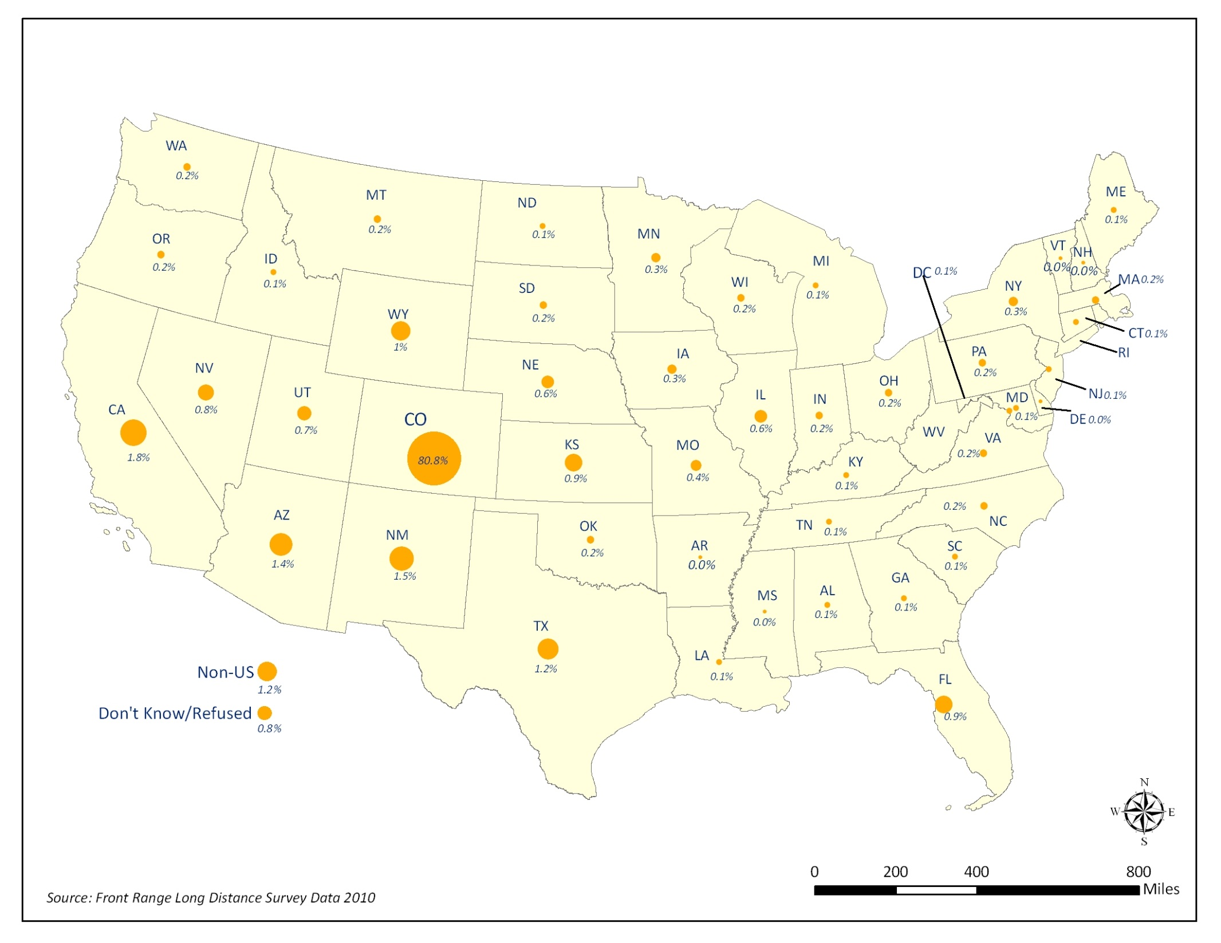
Survey Results

Slide 18
Survey Results

Slide 19
Survey Results

Slide 20
DRCOG Model
New activity-based model
“Portland – San Francisco - Sacramento Family” of models
“Fully” disaggregate (mostly)
  Demographics
  Geography (all HH and work locations get x/y point)
“Trip distribution” through tour destination and intermediate stop discrete choice models
  Accurate long-distance trips are crucial to estimating such models for large areas

Slide 21
Incorporating Data into Model
Establishing long distance trip rate
Enhancing origin-destination matrix
Questions:
Do we need to weight the long-distance trips differently?
What is the incidence of long distance trips?
  How does it differ from the incidence of trips in the 24-hour diary data?
How can this data enhance the origin-destination matrix?

Slide 22
Reweight Data?
Region | HH Size | HH Workers | Income
Fort Collins /Loveland | (no difference) | LD HH have more workers | (no difference)
Denver | LD HH larger | LD HH have more workers | LD HH reported higher incomes
Colorado Springs | (no difference) | LD HH have more workers | LD HH reported higher incomes
Pueblo | (no difference) | (no difference) | (no difference)
Reweight

Slide 23
Long Distance Trip Incidence?
24-hour diary
  “Record all places visited.”
  If travel outside the state, record city and state
14-day diary
  “Record all long distance trips made by household members for the two-week period.”
  “A long-distance trip is a trip made to a location 50 MILES AWAY or more from your home.”

Slide 24
Long Distance Trip Incidence?
N=3,132 HH completed 14-day diary
N=2,868 HH had both 24-hr and 14-day trips
24-HR DATA
14-DAY DATA
196 trips >= 50 miles
109 HH
1.79 trips per LD HH per 24-hr period
0.068 trips per HH per day
3,926 trips >= 50 miles
2,868 HH
1.36 trips per LD HH per 14-day period
0.097 trips per HH per day

Slide 25
Diversity of Travel?
→ Do we capture greater diversity of long distance travel in the LD survey?
Compare O-D between 24-hour data and 14-day data
6 geographies:
  4 MPO areas (NFRMPO, DRCOG, PPACG, PACOG)
  Outside the MPO areas but within Colorado
  Outside Colorado

Slide 26
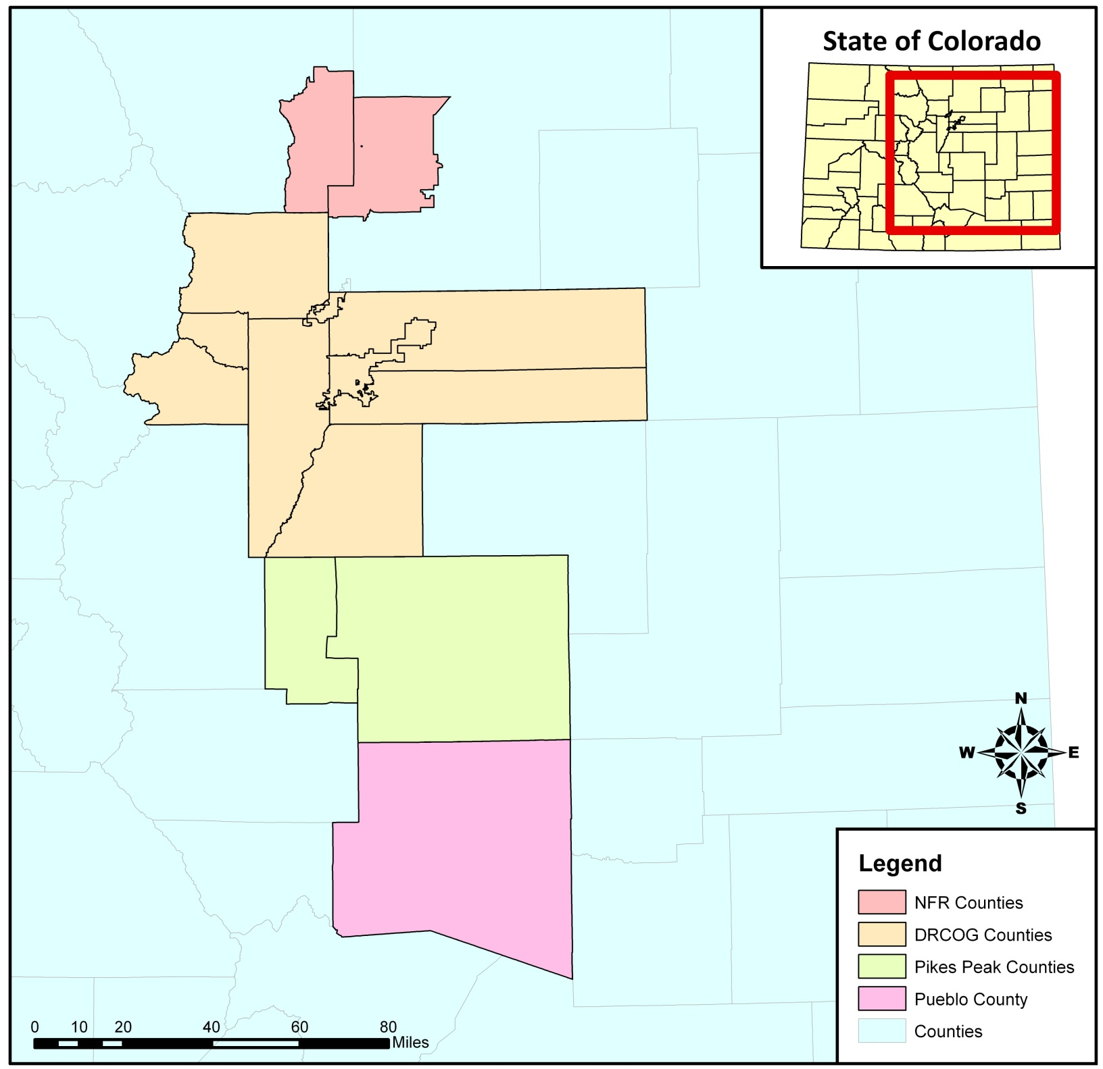
24-hour

Slide 27
14-day

Slide 28
Difference

Slide 29
Preliminary Conclusions
Long-distance data enhances travel models
  Estimates of long-distance trip making
  Provides insights into inter-regional and statewide travel
Best to include long-distance survey in design from the start.
  Higher response rates
  Easier to work with data
Pending: Most recent LD trip

Slide 30
Thank you!
Stacey Bricka – s-bricka@tamu.edu
Erik Sabina – esabina@drcog.org

