Slide 1
Origin-Destination Survey Data Collection A Comparison of Bluetooth vs. Traditional Methods
13th TRB National Transportation Planning Applications Conference
Reno, Nevada, May 11, 2011
Presented by:
Jaesup Lee, Paul Agnello, Ju-yin Chen, Virginia Department of Transportation
Ken Kaltenbach, Corradino Group Inc.

Slide 2
Overview
Introduction
Study Area, External O/D Stations
Data Collection Methods (Video Surveillance vs. Bluetooth)
Survey Processing & Survey Expansion
Survey Results (capture rate & E-E trips)
Observations
Questions
Notes:
2

Slide 3
Why VDOT did this
New models under development
Richmond/Tri-Cities, Hampton Roads, and Superregional Models
Compare methods to see which method worked better to assist with future data collection planning efforts
New travel characteristics data – NHTS Virginia Add-on
Provide a framework for analyzing regional transportation alternatives between Richmond and Hampton Roads

Slide 4
O/D Survey Methods
License Plate Survey
Roadside handout Survey (Mail Back)
Roadside Interview
Combined Roadside Interview and Handout Survey
Video License Plate Survey
Bluetooth methods

Slide 5
Video Surveillance vs. Bluetooth
Video License Plate Survey
Traditional
Generally reliable
More expensive
Restricted to daylight & weather condition
Bluetooth methods
New Technology with various researches
Cheaper
Not generally restricted by daylight and weather
Sample bias issue

Slide 6
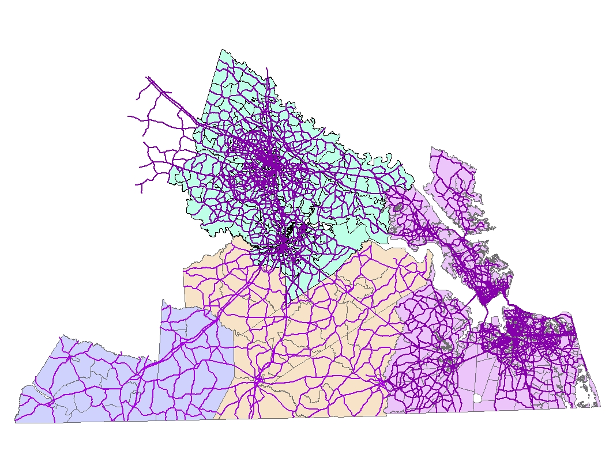

Study Area
Richmond
Hampton Roads
Inter-MPO Area
Notes:
6

Slide 7
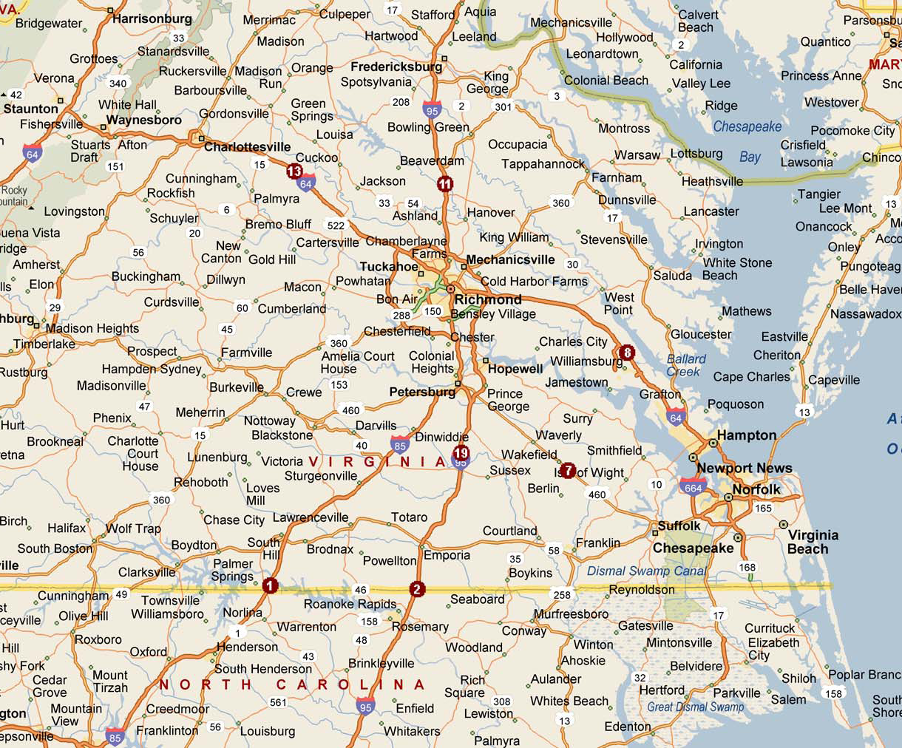
External O-D Survey Stations
12
10
9
11
8
7
14
13
6
1
5
3
2
4

Slide 8
Data Collection
External origin-destination study
Automatic License Plate Recognition (ALPR) infrared cameras
Bluetooth detectors
VDOT traffic counts
New networks from VDOT GIS sources
National Household Travel Survey (NHTS)

Slide 9
Video License Plate Survey
Conducted September 14, 2010 (Tuesday)
14 hours duration (5 AM – 8 PM)
Infrared cameras
Separate files for Passenger Cars and Commercial Vehicles
Recorded licenses of approximately 85% of vehicles
Assumed no random error or bias
Exclude samples
Leaving vehicles for first half hour
Entering vehicle for last half hour

Slide 10
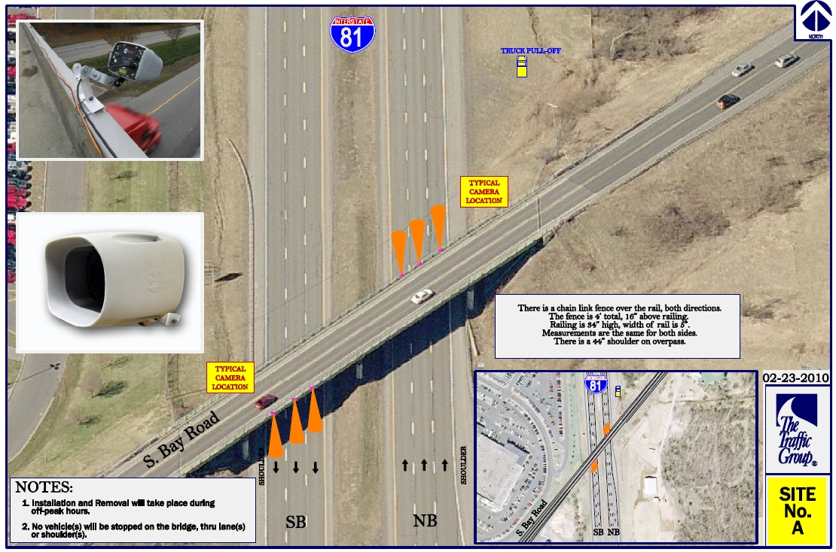
Example Infrared Camera Station

Slide 11
Bluetooth Survey
Detects “MAC” address (not phone numbers) of cell phones and vehicles
September 14 - 26, 2010 (24 hours including weekends)
Cannot distinguish between passenger cars and heavy vehicles
Compared to camera data to evaluate usefulness
Relatively low sample rates

Slide 12
Survey Processing
Four survey periods
AM: 6-9, MD: 9am-3pm, PM: 3-6, NT: 6pm-6am
Comparison: AM & PM
Vehicles detected only once treated as E-I/I-E trips
Vehicles entering and leaving the same station (pair) in a day treated as E-I/I-E trips.
Long travel time E-E trips (> Avg. + 1.5 S.D.) split into two E-I/I-E trips.
Separate processing for passenger cars (PC) and heavy vehicles (HV): ALPR
Processed with Cube

Slide 13
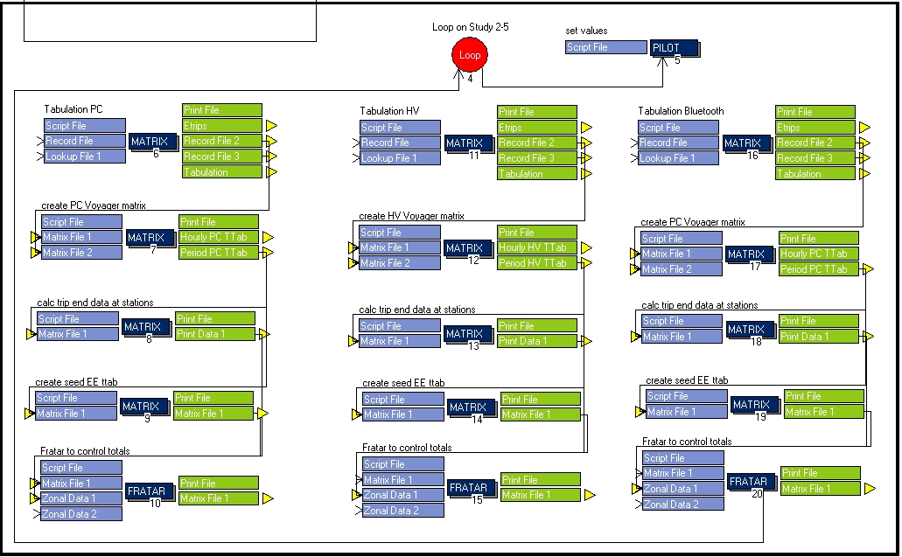
Survey Processing

Slide 14
ALPR camera Capture Rates
Station | Location | Recorded | Daily Count
1 | I-85 Northbound At North Carolina State Line | 80% | 8,307
1 | I-85 Southbound At North Carolina State Line | 79% | 8,284
2 | I-95 Northbound At North Carolina State Line | 52% | 11,629
2 | I-95 Southbound At North Carolina State Line | 80% | 13,156
7 | US 460 Eastbound | 88% | 4,498
7 | US 460 Westbound | 75% | 4,545
8 | I-64 Eastbound East of Richmond | 76% | 27,021
8 | I-64 Westbound East of Richmond | 84% | 26,724
11 | I-95 Northbound North of Richmond | 83% | 37,380
11 | I-95 Southbound North of Richmond | 84% | 38,660
13 | I-64 Eastbound West of Richmond | 67% | 11,881
13 | I-64 Westbound West of Richmond | 75% | 12,171
19 | I-95 Northbound South of Petersburg | 85% | 11,426
19 | I-95 Southbound South of Petersburg | 88% | 11,516
 | TOTAL | 79% | 227,198

Slide 15
Bluetooth Capture Rates
Bluetooth Capture Rates
(signals/count) September 14 - 26, 2010
 | Station
I-85 at N.C. State Line | 1 | 5.82%
US 460 | 5 | 5.14%
I-64 E. of Richmond | 7 | 6.82%
I-95 N. of Richmond | 9 | 5.71%
I-64 W. of Richmond | 11 | 3.73%
I-95 S. of Petersburg | 13 | 5.43%

Slide 16
% EE Trips (ALPR)
Percent Passenger Car Trips Between Surveyed Stations (RTC)
 |  |  | Productions |  |  |  |  | Attractions
 | Station | P/A | AM | Midday | PM | Night |  | AM | Midday | PM | Night
I-85 NB at N.C. State Line | 1 | P | 24.37% | 32.85% | 24.16% | 3.43% |  | - | - | - | -
I-85 SB at N.C. State Line | 2 | A | - | - | - | - |  | 16.41% | 25.79% | 15.92% | 5.56%
I-95 NB at N.C. State Line | 3 | P | 0.00% | 0.00% | 0.00% | 0.00% |  | - | - | - | -
I-95 SB at N.C. State Line | 4 | A | - | - | - | - |  | 0.00% | 0.00% | 0.00% | 0.00%
US 460 EB | 5 | A | - | - | - | - |  | 2.16% | 5.26% | 1.88% | 5.71%
US 460 WB | 6 | P | 3.65% | 7.69% | 4.57% | 2.15% |  | - | - | - | -
I-64 EB E. of Richmond | 7 | A | - | - | - | - |  | 16.09% | 17.08% | 6.64% | 4.41%
I-64 WB E. of Richmond | 8 | P | 12.38% | 24.42% | 12.62% | 4.82% |  | - | - | - | -
I-95 NB N. of Richmond | 9 | A | - | - | - | - |  | 18.10% | 22.24% | 10.13% | 8.38%
I-95 SB N. of Richmond | 10 | P | 16.69% | 24.24% | 7.71% | 5.44% |  | - | - | - | -
I-64 EB W. of Richmond | 11 | P | 8.33% | 12.99% | 4.60% | 13.41% |  | - | - | - | -
I-64 WB W. of Richmond | 12 | A | - | - | - | - |  | 7.99% | 14.12% | 6.67% | 0.80%
I-95 NB S. of Petersburg | 13 | P | 38.79% | 50.52% | 22.93% | 12.66% |  | - | - | - | -
I-95 SB S. of Petersburg | 14 | A | - | - | - | - |  | 10.31% | 13.69% | 3.47% | 13.81%
 | Note: | This is the percentage of trips detected entering the study area
 |  | at a surveyed station, and existing at another surveyed station.
 |  | One minus these numbers is the percentage EI/IE. Also, trips
 |  | counted as EI/IE could have entered or exited on a road that was
 |  | not surveyed. Stations 3 & 4 not used for RTC.

Slide 17
% EE Trips (Bluetooth)
Percent Vehicle Trips Between Surveyed Stations (RTC)
 |  |  | Productions |  |  |  |  | Attractions
 | Station | P/A | AM | Midday | PM | Night |  | AM | Midday | PM | Night
I-85 NB at N.C. State Line | 1 | P | 8.81% | 9.75% | 10.66% | 9.23% |  | - | - | - | -
I-85 SB at N.C. State Line | 2 | A | - | - | - | - |  | 20.79% | 22.93% | 27.28% | 22.91%
I-95 NB at N.C. State Line | 3 | P | 0.00% | 0.00% | 0.00% | 0.00% |  | - | - | - | -
I-95 SB at N.C. State Line | 4 | A | - | - | - | - |  | 0.00% | 0.00% | 0.00% | 0.00%
US 460 EB | 5 | A | - | - | - | - |  | 1.58% | 5.34% | 5.83% | 4.39%
US 460 WB | 6 | P | 5.03% | 6.61% | 4.63% | 3.98% |  | - | - | - | -
I-64 EB E. of Richmond | 7 | A | - | - | - | - |  | 5.26% | 6.80% | 5.63% | 7.23%
I-64 WB E. of Richmond | 8 | P | 5.30% | 7.64% | 6.83% | 5.16% |  | - | - | - | -
I-95 NB N. of Richmond | 9 | A | - | - | - | - |  | 12.74% | 13.61% | 11.56% | 11.12%
I-95 SB N. of Richmond | 10 | P | 13.78% | 15.70% | 14.63% | 14.99% |  | - | - | - | -
I-64 EB W. of Richmond | 11 | P | 3.76% | 5.39% | 4.63% | 5.20% |  | - | - | - | -
I-64 WB W. of Richmond | 12 | A | - | - | - | - |  | 18.21% | 21.16% | 17.66% | 15.87%
I-95 NB S. of Petersburg | 13 | P | 12.20% | 11.34% | 10.00% | 11.37% |  | - | - | - | -
I-95 SB S. of Petersburg | 14 | A | - | - | - | - |  | 3.09% | 4.64% | 5.16% | 4.01%
 | Note: | This is the percentage of trips detected entering the study area
 |  | at a surveyed station, and existing at another surveyed station.
 |  | One minus these numbers is the percentage EI/IE. Also, trips
 |  | counted as EI/IE could have entered or exited on a road that was
 |  | not surveyed. Stations 3 & 4 not used for RTC.

Slide 18
E-E Trips in AM
AM | 1 | 2 | 3 | 4 | 5 | 6 | 7 | 8 | 9 | 10 | 11 | 12 | 13 | 14 | Total
1 | 0 | 0 | 0 | 0 | 0 | 0 | 93 | 0 | 159 | 0 | 0 | 4 | 0 | 0 | 255
2 | 0 | 0 | 0 | 0 | 0 | 0 | 0 | 0 | 0 | 0 | 0 | 0 | 0 | 0 | 0
3 | 0 | 0 | 0 | 0 | 0 | 0 | 0 | 0 | 0 | 0 | 0 | 0 | 0 | 0 | 0
4 | 0 | 0 | 0 | 0 | 0 | 0 | 0 | 0 | 0 | 0 | 0 | 0 | 0 | 0 | 0
5 | 0 | 0 | 0 | 0 | 0 | 0 | 0 | 0 | 0 | 0 | 0 | 0 | 0 | 0 | 0
6 | 0 | 1 | 0 | 0 | 0 | 0 | 13 | 0 | 25 | 0 | 0 | 4 | 0 | 5 | 47
7 | 0 | 0 | 0 | 0 | 0 | 0 | 0 | 0 | 0 | 0 | 0 | 0 | 0 | 0 | 0
8 | 0 | 34 | 0 | 0 | 9 | 0 | 0 | 0 | 399 | 0 | 0 | 145 | 0 | 24 | 610
9 | 0 | 0 | 0 | 0 | 0 | 0 | 0 | 0 | 0 | 0 | 0 | 0 | 0 | 0 | 0
10 | 0 | 114 | 0 | 0 | 7 | 0 | 695 | 0 | 0 | 0 | 0 | 71 | 0 | 168 | 1056
11 | 0 | 1 | 0 | 0 | 1 | 0 | 109 | 0 | 86 | 0 | 0 | 0 | 0 | 5 | 202
12 | 0 | 0 | 0 | 0 | 0 | 0 | 0 | 0 | 0 | 0 | 0 | 0 | 0 | 0 | 0
13 | 0 | 6 | 0 | 0 | 0 | 0 | 147 | 0 | 491 | 0 | 0 | 36 | 0 | 0 | 680
14 | 0 | 0 | 0 | 0 | 0 | 0 | 0 | 0 | 0 | 0 | 0 | 0 | 0 | 0 | 0
Total | 0 | 156 | 0 | 0 | 17 | 0 | 1056 | 0 | 1160 | 0 | 0 | 259 | 0 | 202 | 2850
ALPR
(cameras)
AM | 1 | 2 | 3 | 4 | 5 | 6 | 7 | 8 | 9 | 10 | 11 | 12 | 13 | 14 | Total
1 | 0 | 0 | 0 | 0 | 0 | 0 | 0 | 0 | 92 | 0 | 0 | 1 | 0 | 0 | 94
2 | 0 | 0 | 0 | 0 | 0 | 0 | 0 | 0 | 0 | 0 | 0 | 0 | 0 | 0 | 0
3 | 0 | 0 | 0 | 0 | 0 | 0 | 0 | 0 | 0 | 0 | 0 | 0 | 0 | 0 | 0
4 | 0 | 0 | 0 | 0 | 0 | 0 | 0 | 0 | 0 | 0 | 0 | 0 | 0 | 0 | 0
5 | 0 | 0 | 0 | 0 | 0 | 0 | 0 | 0 | 0 | 0 | 0 | 0 | 0 | 0 | 0
6 | 0 | 0 | 0 | 0 | 0 | 0 | 0 | 0 | 32 | 0 | 0 | 9 | 0 | 0 | 41
7 | 0 | 0 | 0 | 0 | 0 | 0 | 0 | 0 | 0 | 0 | 0 | 0 | 0 | 0 | 0
8 | 0 | 0 | 0 | 0 | 0 | 0 | 0 | 0 | 198 | 0 | 0 | 37 | 0 | 0 | 236
9 | 0 | 0 | 0 | 0 | 0 | 0 | 0 | 0 | 0 | 0 | 0 | 0 | 0 | 0 | 0
10 | 0 | 174 | 0 | 0 | 10 | 0 | 268 | 0 | 0 | 0 | 0 | 343 | 0 | 37 | 831
11 | 0 | 0 | 0 | 0 | 1 | 0 | 9 | 0 | 58 | 0 | 0 | 0 | 0 | 1 | 69
12 | 0 | 0 | 0 | 0 | 0 | 0 | 0 | 0 | 0 | 0 | 0 | 0 | 0 | 0 | 0
13 | 0 | 0 | 0 | 0 | 0 | 0 | 0 | 0 | 190 | 0 | 0 | 5 | 0 | 0 | 195
14 | 0 | 0 | 0 | 0 | 0 | 0 | 0 | 0 | 0 | 0 | 0 | 0 | 0 | 0 | 0
Total | 0 | 174 | 0 | 0 | 11 | 0 | 277 | 0 | 571 | 0 | 0 | 395 | 0 | 37 | 1466
Bluetooth

Slide 19
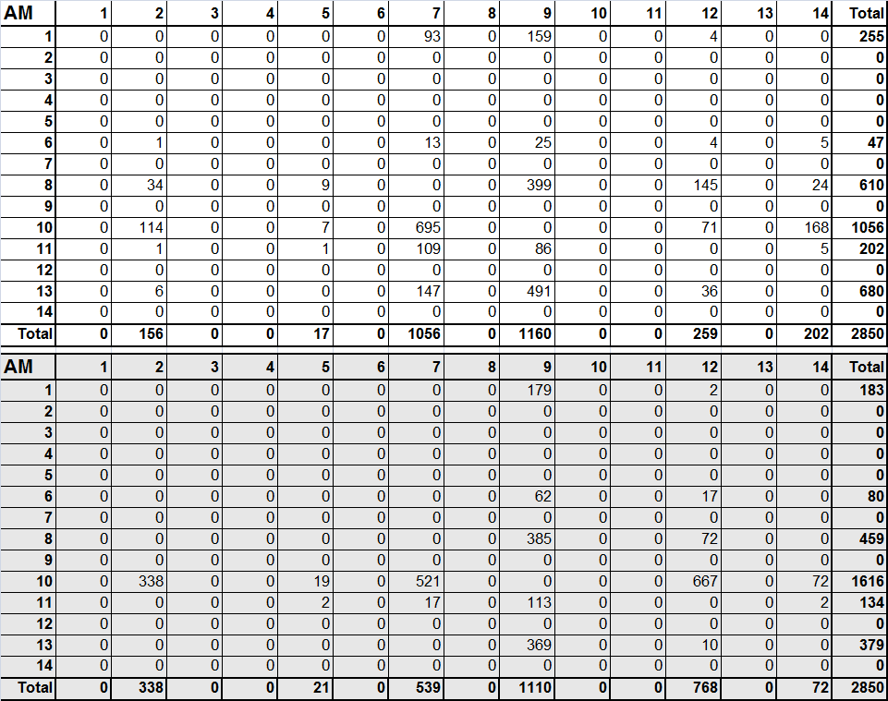
E-E Trips in AM
ALPR
(cameras)
Bluetooth
Adjusted

Slide 20
E-E Trips in PM
PM | 1 | 2 | 3 | 4 | 5 | 6 | 7 | 8 | 9 | 10 | 11 | 12 | 13 | 14 | Total
1 | 0 | 0 | 0 | 0 | 0 | 0 | 70 | 0 | 281 | 0 | 0 | 15 | 0 | 0 | 366
2 | 0 | 0 | 0 | 0 | 0 | 0 | 0 | 0 | 0 | 0 | 0 | 0 | 0 | 0 | 0
3 | 0 | 0 | 0 | 0 | 0 | 0 | 0 | 0 | 0 | 0 | 0 | 0 | 0 | 0 | 0
4 | 0 | 0 | 0 | 0 | 0 | 0 | 0 | 0 | 0 | 0 | 0 | 0 | 0 | 0 | 0
5 | 0 | 0 | 0 | 0 | 0 | 0 | 0 | 0 | 0 | 0 | 0 | 0 | 0 | 0 | 0
6 | 0 | 3 | 0 | 0 | 0 | 0 | 41 | 0 | 12 | 0 | 0 | 6 | 0 | 7 | 70
7 | 0 | 0 | 0 | 0 | 0 | 0 | 0 | 0 | 0 | 0 | 0 | 0 | 0 | 0 | 0
8 | 0 | 115 | 0 | 0 | 24 | 0 | 0 | 0 | 515 | 0 | 0 | 208 | 0 | 52 | 914
9 | 0 | 0 | 0 | 0 | 0 | 0 | 0 | 0 | 0 | 0 | 0 | 0 | 0 | 0 | 0
10 | 0 | 291 | 0 | 0 | 10 | 0 | 253 | 0 | 0 | 0 | 0 | 57 | 0 | 182 | 793
11 | 0 | 30 | 0 | 0 | 8 | 0 | 151 | 0 | 116 | 0 | 0 | 0 | 0 | 10 | 316
12 | 0 | 0 | 0 | 0 | 0 | 0 | 0 | 0 | 0 | 0 | 0 | 0 | 0 | 0 | 0
13 | 0 | 13 | 0 | 0 | 5 | 0 | 143 | 0 | 507 | 0 | 0 | 32 | 0 | 0 | 699
14 | 0 | 0 | 0 | 0 | 0 | 0 | 0 | 0 | 0 | 0 | 0 | 0 | 0 | 0 | 0
Total | 0 | 453 | 0 | 0 | 48 | 0 | 657 | 0 | 1431 | 0 | 0 | 317 | 0 | 252 | 3158
ALPR
(cameras)
PM | 1 | 2 | 3 | 4 | 5 | 6 | 7 | 8 | 9 | 10 | 11 | 12 | 13 | 14 | Total
1 | 0 | 0 | 0 | 0 | 1 | 0 | 0 | 0 | 156 | 0 | 0 | 9 | 0 | 0 | 166
2 | 0 | 0 | 0 | 0 | 0 | 0 | 0 | 0 | 0 | 0 | 0 | 0 | 0 | 0 | 0
3 | 0 | 0 | 0 | 0 | 0 | 0 | 0 | 0 | 0 | 0 | 0 | 0 | 0 | 0 | 0
4 | 0 | 0 | 0 | 0 | 0 | 0 | 0 | 0 | 0 | 0 | 0 | 0 | 0 | 0 | 0
5 | 0 | 0 | 0 | 0 | 0 | 0 | 0 | 0 | 0 | 0 | 0 | 0 | 0 | 0 | 0
6 | 0 | 2 | 0 | 0 | 0 | 0 | 0 | 0 | 30 | 0 | 0 | 14 | 0 | 0 | 46
7 | 0 | 0 | 0 | 0 | 0 | 0 | 0 | 0 | 0 | 0 | 0 | 0 | 0 | 0 | 0
8 | 0 | 3 | 0 | 0 | 0 | 0 | 0 | 0 | 304 | 0 | 0 | 150 | 0 | 0 | 457
9 | 0 | 0 | 0 | 0 | 0 | 0 | 0 | 0 | 0 | 0 | 0 | 0 | 0 | 0 | 0
10 | 0 | 429 | 0 | 0 | 45 | 0 | 250 | 0 | 0 | 0 | 0 | 223 | 0 | 117 | 1064
11 | 0 | 5 | 0 | 0 | 11 | 0 | 30 | 0 | 95 | 0 | 0 | 0 | 0 | 3 | 143
12 | 0 | 0 | 0 | 0 | 0 | 0 | 0 | 0 | 0 | 0 | 0 | 0 | 0 | 0 | 0
13 | 0 | 0 | 0 | 0 | 0 | 0 | 1 | 0 | 217 | 0 | 0 | 10 | 0 | 0 | 228
14 | 0 | 0 | 0 | 0 | 0 | 0 | 0 | 0 | 0 | 0 | 0 | 0 | 0 | 0 | 0
Total | 0 | 438 | 0 | 0 | 57 | 0 | 281 | 0 | 802 | 0 | 0 | 405 | 0 | 120 | 2103
Bluetooth

Slide 21
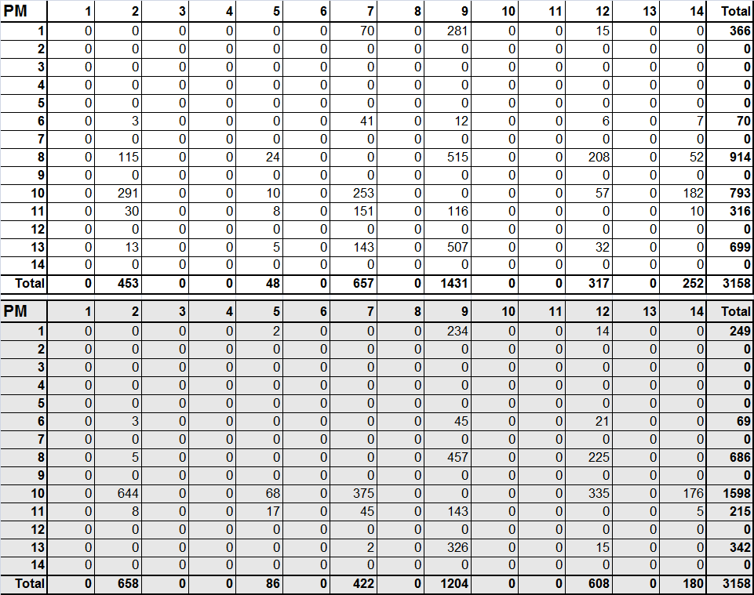
E-E Trips in PM
ALPR
(cameras)
Bluetooth
Adjusted

Slide 22
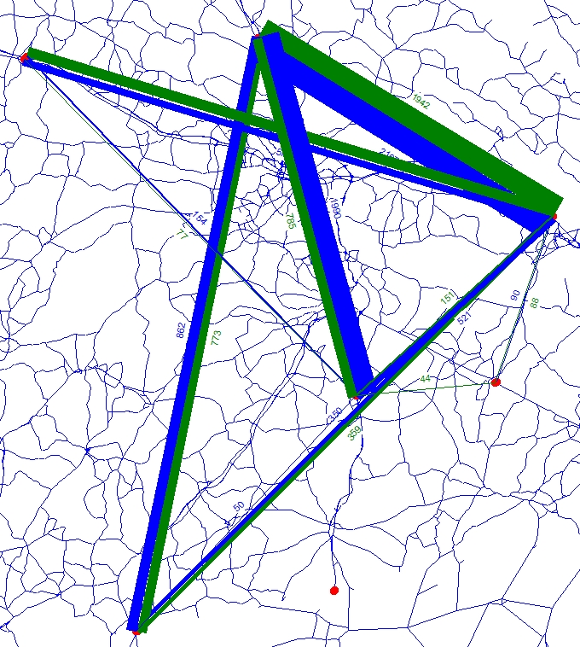
E-E Trip Patterns (ALPR)
9
12
10
RTC
Daily Passenger Cars
ALPR Cameras
11
8
7
6
14
13
5
2
1

Slide 23
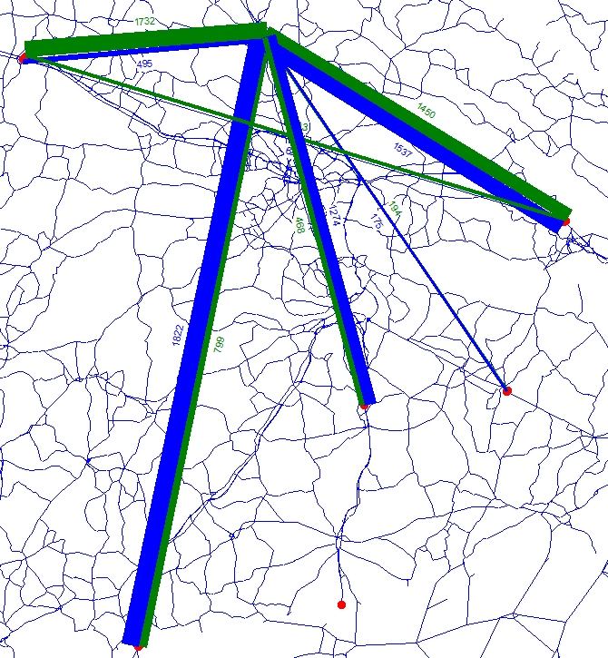
E-E Trip Patterns (Bluetooth)
12
10
9
RTC
Daily Vehicles
Bluetooth
11
8
7
6
14
13
5
2
1

Slide 24
Observations
Bluetooth detection rate generally 5.5% at most stations.
While similarities, ALPR cameras and Bluetooth seem to be different.
This true in terms of:
% EI/IE vs. % EE at each station.
Station-to-station travel patterns.
The bluetooth % EI/IE vs. % EE is highly dependent on # of signals “captured once”, compared to “matched” signals.

Slide 25
Observations (Cntd)
Spurious signals (side roads, cross streets, etc.) have a great impact.
Small bluetooth E-E trips (compared to the ALPR tables) lead
Two detectors per station to confirm directionality and to “filter-out” spurious signals.
ALPR method appears reliable (over 80% capture rate from ground count)
Travel time analysis using Bluetooth could be more useful with external travel analysis from NHTS

Slide 26
NHTS Data for Long Dist E-E Trips
Tried to use NHTS add-on data from FL, and NC to capture long distance E-E trips
Generated unreasonable results (paths and rates)
From FL to VA Beach and northward
Following data analysis is underway

Slide 27
Questions?
Thank You!

