Slide 1
Evaluating and Communicating Model Results: Guidebook for Planners
NCHRP Project 08-36, Task 89
13th TRB National Transportation Planning Applications Conference
Dan Goldfarb, P.E.
May 11, 2010

Slide 2
Background
AASHTO Requested
NCHRP Funded
Contributors
Dalia Leven, AICP
Rob Schiffer, AICP
Jay Evans, P.E., AICP
Project Manager
Lori Sundstrom, NCHRP Senior Program Officer

Slide 3
Why?
Evolving Roles of Travel Demand Forecasting Models
Stakeholder Involvement
Audience
Guidebook Objectives
Clear and concise
What questions to ask
Reasonableness and sensitivity
Communicating results

Slide 4
What’s Missing?
FHWA
Introduction to Travel Demand Forecasting Self Instructional CD-ROM (TMIP)
Introduction to Urban Travel Demand Forecasting (NHI)
Travel Demand Forecasting: A Compilation of Plans, Reports, and Data (BTS)
State
Florida Standard Urban Transportation Model Structure Online Training
MPO
PSRC – Transportation 2040 Guide
Non-Governmental Organizations (NGOs)
Inside the Black Blackbox: Making Transportation Models Work for Livable Communities (EDF)

Slide 5
Why?
Evolving Roles of Travel Demand Forecasting Models
Stakeholder Involvement
Audience
Guidebook Objectives
Clear and concise
What questions to ask
Reasonableness and sensitivity
Communicating results
Informative
Unbiased

Slide 6

Approach

Slide 7
Organization
Overview
Role
Process
Dissect
Applications
Results

Slide 8
Chapter 1 - Introduction
Purpose
Audience
Organization

Slide 9
Chapter 2 - Role of TDF Model
Definition of TDF Model
Model Uses
Model Classifications
Model Limitations
Basic Terminology

Slide 10
Chapter 2 (continued)
Travel Demand
Forecasting Model
Long Term
Regional
Corridor
Time Frame
Tool
Subarea
Site
Short Term
Growth Trends

Slide 11
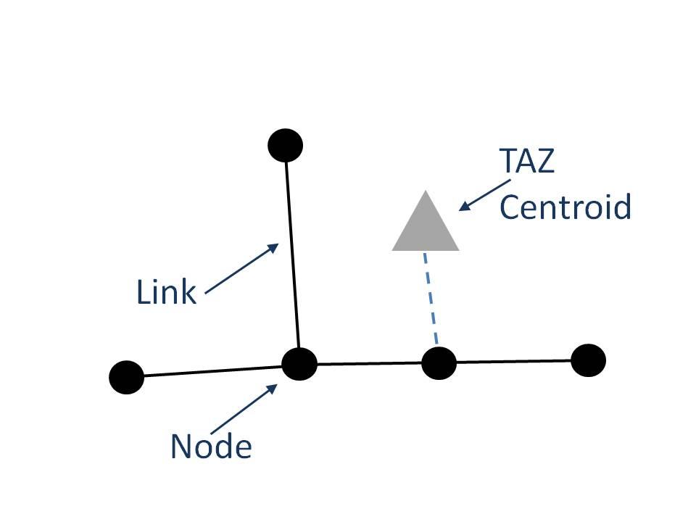
Chapter 2 (continued)
Terms
Links & Nodes
TAZ
Centroid Connector
Trip
Trip Ends
Trip Table
Glossary

Slide 12
Chapter 3 - TDF Model Process
TDF Model Structures
Current Practice
Model Development Process

Slide 13
Chapter 3 (continued)
 | Trip-End-Based | Tour-Based | Activity-Based
Accommodates latent demand based on changes in the transportation system |  |  | X
Accounts for complex intrahousehold travel interactions (limited vehicle availability, etc.) |  |  | X
Accounts for complex travel patterns and trip chains |  | X | X
Accounts for home end of trips | X | X | X
Advanced time-of-day analysis |  | X | X
Allows for more disaggregate data inputs and analysis |  |  | X
Analysis of nonmotorized trips | X | X | X
Ease of data collection | X
Minimizing computational resources | X

Slide 14
Chapter 3 (continued)
Reasonableness Checking
Estimation
Calibration
Validation
Application
Model Development Process

Slide 15
Chapter 4 - Sequential Travel Demand Forecasting
TDF Model Inputs
Trip Generation
Trip Distribution
Mode Choice
Assignment

Slide 16
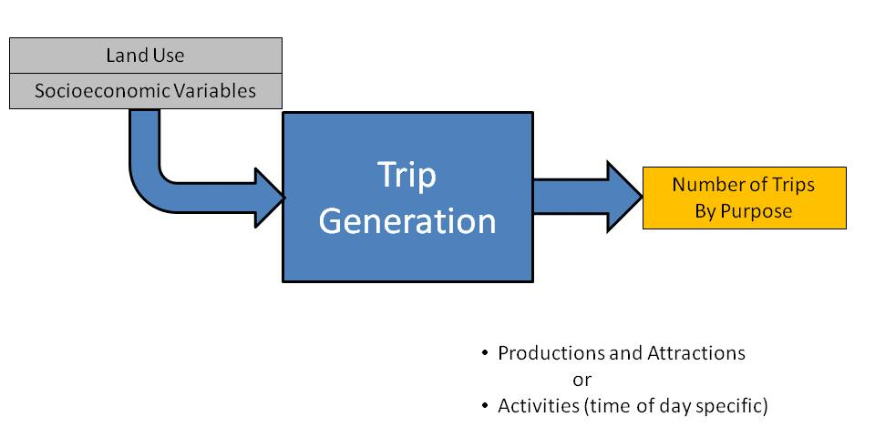
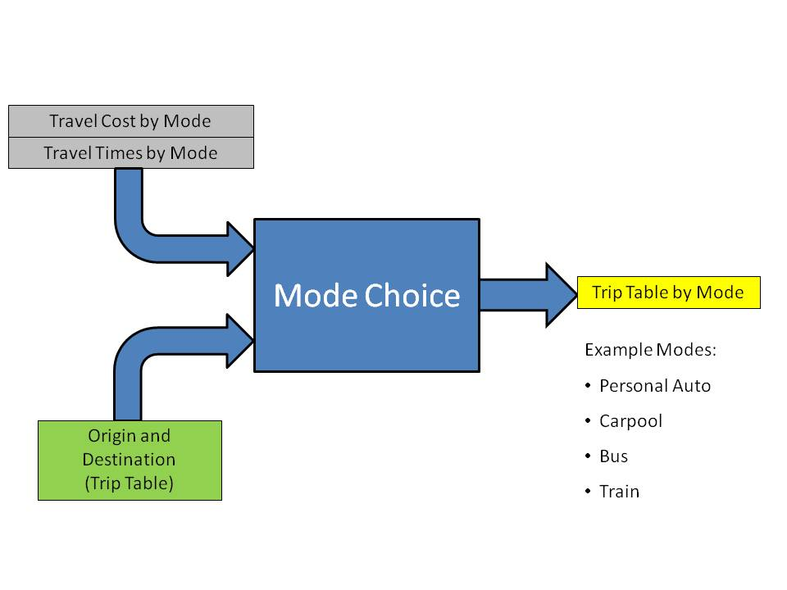
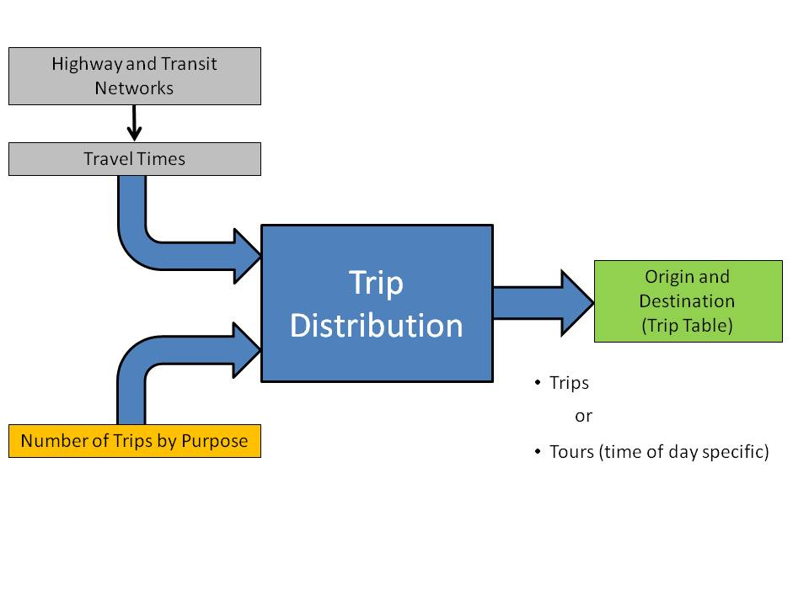
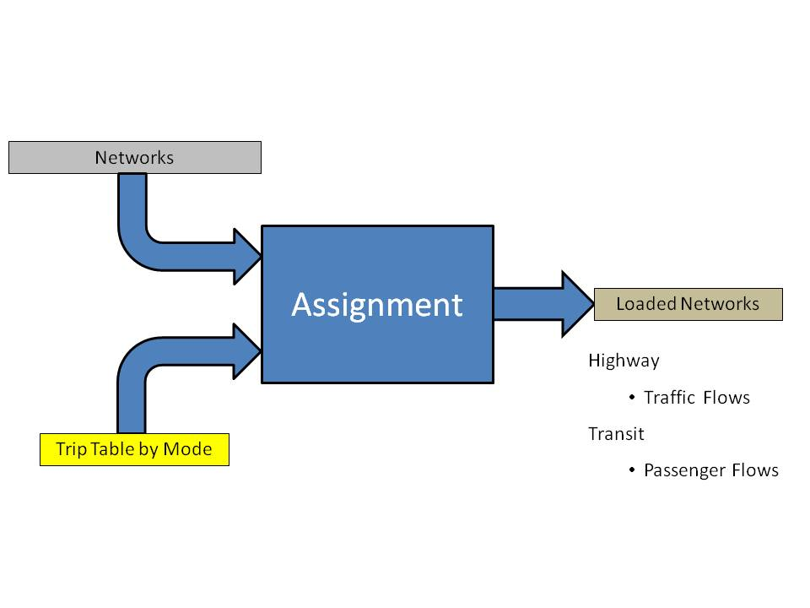
Chapter 4 (continued)

Slide 17
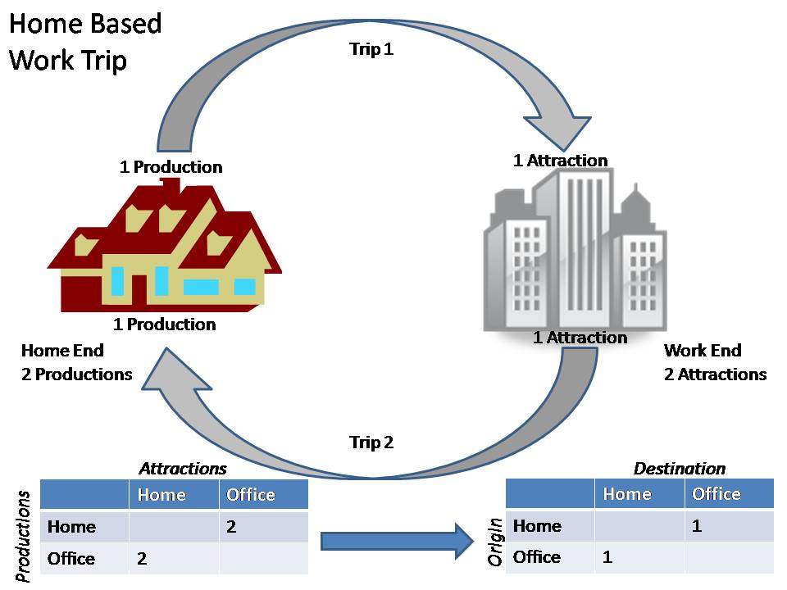
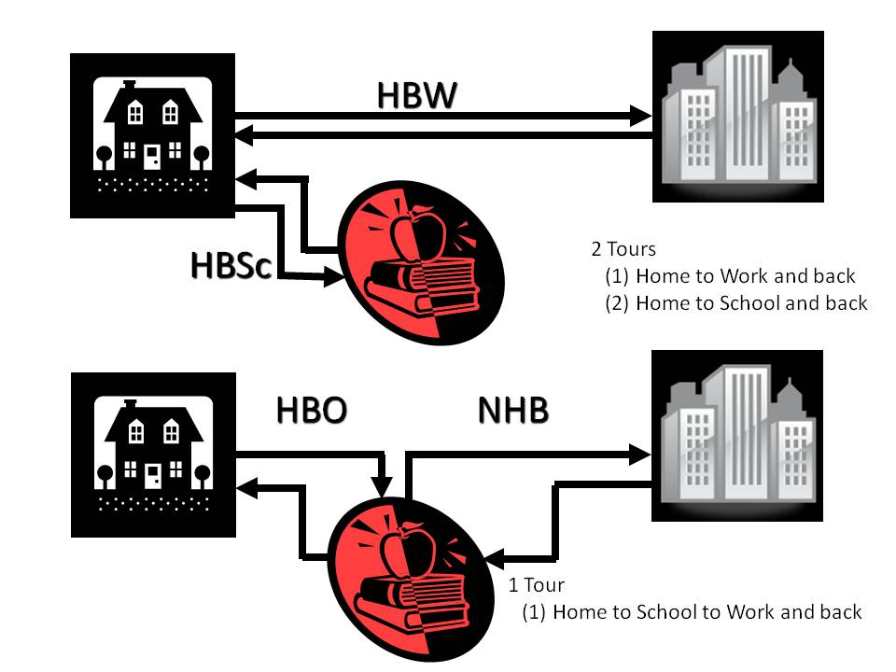
Chapter 4 (continued)

Slide 18
Chapter 5 - Applications of TDF Models
Historical Applications
Current Applications
Evolving Applications

Slide 19
Chapter 6 - TDF Model Results
Interpretation
Communicating

Slide 20
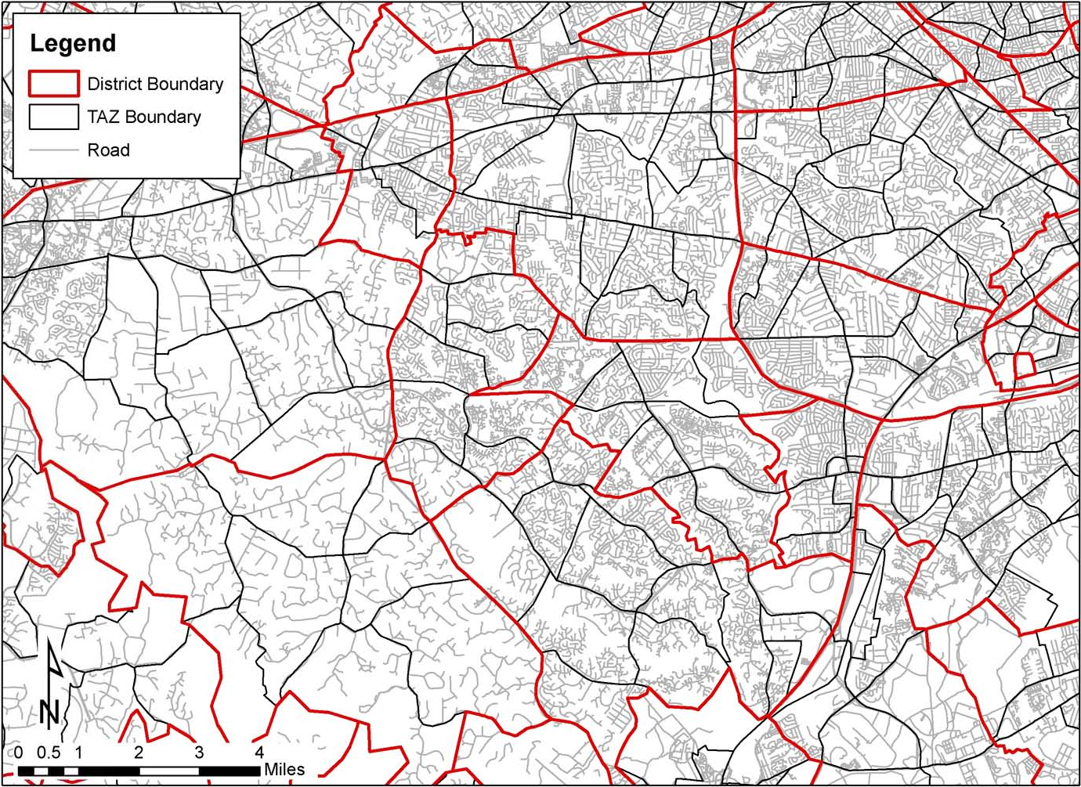
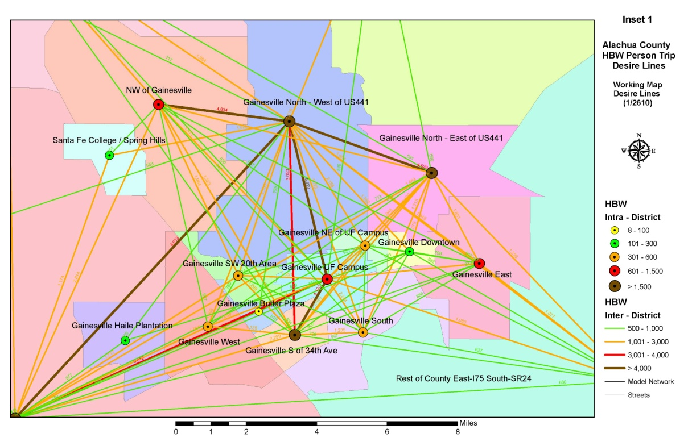
Chapter 6 (continued)

Slide 21
Chapter 7 - Reasonableness and Sensitivity
Reasonableness Checks
Sensitivity Tests
Additional Resources

Slide 22
Chapter 7 (continued)
Sources of Error
Coding Errors – Errors in coding the highway and transit networks, and errors in recording survey results.
Sample Errors – Errors from bias that occur in the survey sample frame. An example is a telephone survey where only land lines are reached for the survey calls. This would miss households without land lines, potentially resulting in a demographic bias in the observed travel patterns (i.e., missing low income housheholds with no phone, young or very active persons with cell phones only, etc.).
Computation Errors – Errors which occur in developing the model programs.
Specification Errors – Errors from improper structure of the model where key variables or parameters are overlooked in the estimation phase. Errors from transferring model parameters from one region to another.
Data Errors – Error in underlying model data or through aggregation of data where key elements are overlooked.

Slide 23
Chapter 7 (continued)
City | Transit | Carpool | Drive Alone
Dallas, Texas | 4% | 15% | 81%
Pasadena, California | 5% | 16% | 79%
Houston, Texas | 5% | 15% | 80%
Atlanta, Georgia | 10% | 14% | 76%
Baltimore, Maryland | 14% | 14% | 72%
Oakland, California | 15% | 15% | 70%
Pittsburgh, Pennsylvania | 20% | 13% | 68%
Boston, Massachusetts | 40% | 10% | 50%
San Francisco, California | 41% | 16% | 43%
New York City, New York | 61% | 9% | 30%

Slide 24
Chapter 7 (continued)
Average Wednesday Freeway Traffic by Month | Average | % of AADT
January | 87,580 | 89.28
February | 95,187 | 97.03
March | 100,925 | 102.88
April | 101,038 | 103.00
May | 100,278 | 104.84
June | 104,857 | 106.89
July | 107,144 | 109.22
August | 106,330 | 108.39
September | 100,586 | 102.54
October | 100,117 | 102.06
November | 101,430 | 103.40
December | 99,496 | 101.43

Slide 25
Chapter 7 (continued)
Elasticity for Wait Time to Mode Share

Slide 26
http://apps.trb.org/cmsfeed/TRBNetProjectDisplay.asp?ProjectID=2636

Slide 27
http://apps.trb.org/cmsfeed/TRBNetProjectDisplay.asp?ProjectID=2636

