Slide 1
Adapting a Four-Step MPO Travel Model for Wildfire Evacuation Planning: Practical Application from Colorado Springs
Travel Model
Simulation Support for Wildfire Evacuation Planning
TRB Transportation Planning Applications Conference
Reno, NV
May 11, 2011
Session 16
A Cooperative Project by the
City of Colorado Springs and the
PPACG Transportation Planning Program
Presented by:
Maureen Paz de Araujo - HDR Engineering
Craig Casper - Pikes Peak Area Council of Governments
Mary Lupa - Parsons Brinkerhoff
Bret Waters - City of Colorado Springs OEM
Paul Hershkowitz - Wilbur Smith Associates

Slide 2
Colorado Springs at Risk for Wildfires
A Changing Trend in Wildlife Experience
In the past wildfire incidence primarily affected rural areas
Recent fires signal a change in this pattern. This change is the result of drought conditions that have produced extremely dry vegetation (fuel availability), placing Colorado’s urban areas increasingly at risk from wildfires.
June 2010 – Wildfire burned 700 acres in area 14 miles northwest of Canon City, just north-northeast of Royal Gorge Bridge/Park. The Park was evacuated.
March 2009 – A fire on Fort Carson (US Army) burned more than 6,500 acres. The fire jumped the Post’s eastern boundary, threatened buildings and forced evacuation of the area between Fort Carson and Interstate 25.
February 2009 – Two grass fires burned 131 acres south of Colorado Springs but did not threaten residential areas.
January 2009 – The Orchard Canyon burned 131 acres on Fort Carson, on the south side of Colorado Springs.
August 2008 – A wildfire near Fort Carson burned 100 acres before being contained.
Fall 2007 – Wildfire in Manitou Springs, just south of US 24 burned more than 80 acres. The fire threatened homes, closed roads and the Pikes Peak Cog Railway and forced evacuation of hikers on Barr Trail. With military foam retardant drops, the fire was contained before reaching more populated areas.
September 2002 - The Hayman fire burned over 138,000 acres. Extremely fast-moving, the largest wildfire in Colorado history fire burned 60,000 acres in its first day. Ultimately, the fire cause over $40 million in damages, burning 600 structures (including 133 homes) and forcing evacuation of 5,340 persons.
Colorado Springs Area Wildfire Experience

Slide 3
Colorado Springs Office of Emergency Management Response
Response Elements
Urban Interface Wildfire Evacuation Plan
Evacuation Traffic Control Plan(s)
Neighborhood Communication/Evacuation Plans
Colorado Springs Office of Emergency Management (OEM) led development of an Urban Interface Wildfire Evacuation Plan
Colorado Springs OEM and Fire Department support development of neighborhood-level Emergency Notification/Evacuation Plans by at-risk neighborhoods
PPACG recruited to support evacuation modeling and Traffic Control Plan development
Key Partnerships

Slide 4
Evacuation Modeling Basis – Understanding the Problem
Analysis Framework - Data Requirements
Data Type | Characteristics or Attributes
Scenario | Impacted area, notice vs. no-notice, impact on transportation network and resources
Demographic Data | Automobile ownership, number of households, number of persons and age distribution of households, auto ownership levels, disabled representation within households
Land Use / Geography | Geographic characteristics of the focus area, terrain, elevation, wind conditions/ profiles, micro-climate
Road Network | Roadway geometrics, number of lanes, free flow speed/speed limits, other roadway characteristics for microscopic model
Traffic Control | Intersection control, signal preemption/emergency operation, route closures, traveler information system, contra-flow, route guidance and other ITS deployment
Background Traffic | Background (non-evacuating) traffic volumes
Evacuation Plan/Strategy | Designated evacuation routes, evacuation rate depending on hazard nature/type and evacuation order type, staged evacuation, time frame, shelters/reception centers, notification means
Evacuee Behavior | Mobilization time, activity sequence, vehicle occupancy rate
Assisted Evacuation Information | Transit routes, schedule, and capacity for transit-dependent evacuees
Special Facilities | Evacuation information (populations, procedures) for schools, jails, nursing homes, hospitals and other.

Slide 5
PPACG/Colorado Springs Modeling Strategy
Use PPACG 4-Step Travel Model for Scenario-Level Analysis
Use PPACG TDM - 2010 Model Scenario used to represent existing conditions
Adapt PM Peak Hour time-of-day model
Use embedded hourly roadway capacity to evaluate “time-to-evacuate” ( modeled link volume to capacity (V/C) ratios)
Assume background, no-evacuation traffic at PM Peak Hour levels (worst-case, highest traffic volumes)
Assume all households at home – requires full evacuation of all households (worst-case, most vehicles to evacuate)
Use U.S Census auto ownership data to estimate household vehicles to be evacuated
Assume each household evacuates two (2) vehicles – adopted after sensitivity testing was performed for one (1) vehicle per household, two (2) vehicles per household and all household vehicles
Assume evacuee destinations to one of four types of destinations as follows (based on Boulder survey of actual evacuation experience):
Official Shelters (15%)
Other households in the area (60%)
Motels (15%)
Out of the County entirely (Denver area, Pueblo area or other – 10%)
Areas west of Colorado Springs (e.g. Teller County – high wildfire threat areas) excluded as destinations for evacuees
Adapt PPACG Model for Evacuation Planning

Slide 6
Integrated Model Application and Screening Process
STEP 1
STEP 2
STEP 3
STEP 4
STEP 5
Create Inter-Agency Steering Committee
Establish Modeling & Evacuation Protocols
Develop Modeling Process & Adapt Model
Conduct District-Level Screening Analysis
Identify “pinch points”
Establish traffic control
plan or advance area to Neighborhood-Level
screening
Conduct additional
Neighborhood-Level
Screening Analysis
Conduct additional analysis of evacuation traffic control strategies:
Contra-flow operations
analysis
Travel restrictions
analysis (e.g. road
closures)
Prepare Traffic Control Plan for each of Eight (8) Colorado Springs Evacuation Districts plus Manitou Springs:
Prepare District-Level
traffic control plans for six (6) Districts and Manitou Springs
Prepare traffic control
plans for two (2)
Districts at the Neighborhood-Level

Slide 7
Step 1: Form Planning Team/Establish Modeling Protocols/Adapt Model
Establish Technical Steering Committee
Consultant Project Team
PPACG Modeling Staff
Colorado Springs Office of Emergency Management
Colorado Springs Engineering – TOC
Colorado Springs Police Department
Colorado Springs Fire Department
Choice of background traffic conditions
Population/vehicles to be evacuated – restrictions/shared responsibilities
Evacuee destinations – “shelter-in-place,” official shelters, other
Contra-flow/ no contra-flow
Required “time-to-evacuate”
Restrictions on residents to retrieve belongings?
Other
Establish Modeling/Evacuation Protocols

Slide 8
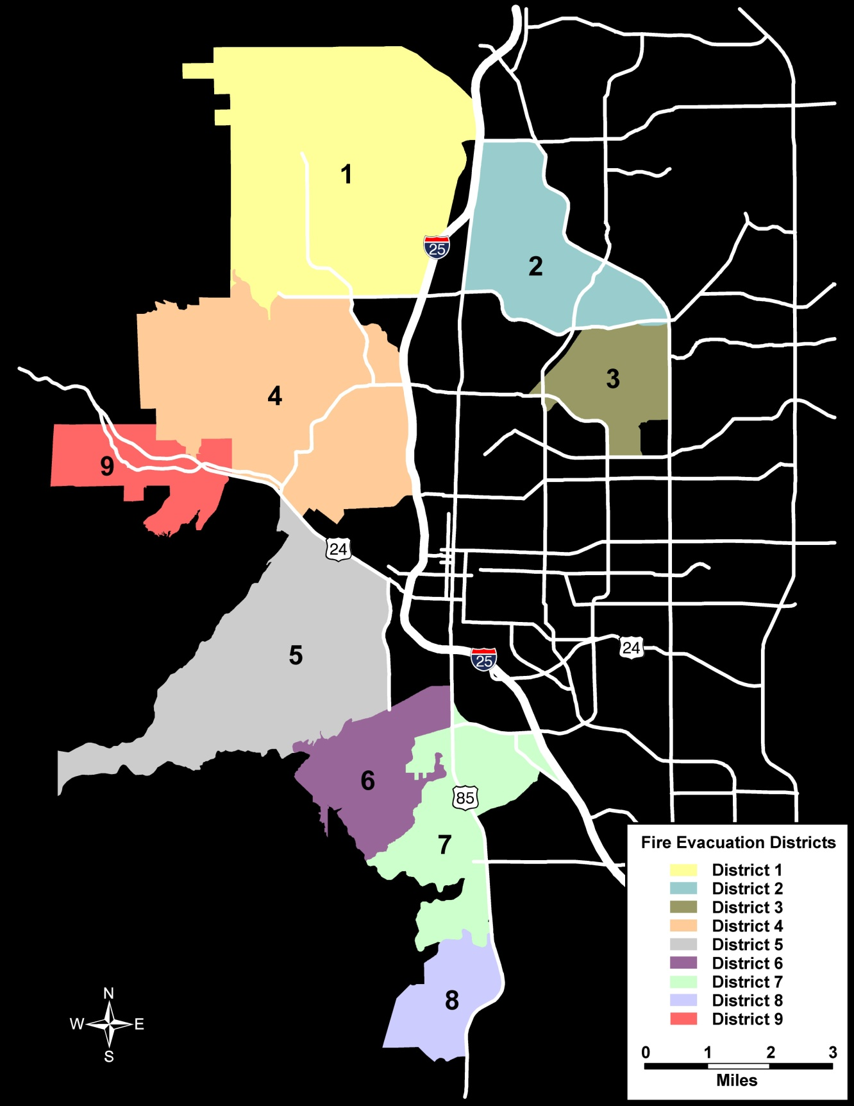
Step 2: Conduct District-Level Screening Analysis
Model / evaluate eight (8)
wildfire at-risk districts,
each incorporating multiple
emergency response
neighborhoods
Model “times-to-evacuate”
and screen for “pinch points” -
Use one-hour roadway capacity
as the reference criteria
Identify alternative routing
by district or select
districts to be advanced to more detailed neighborhood-level analysis

Slide 9
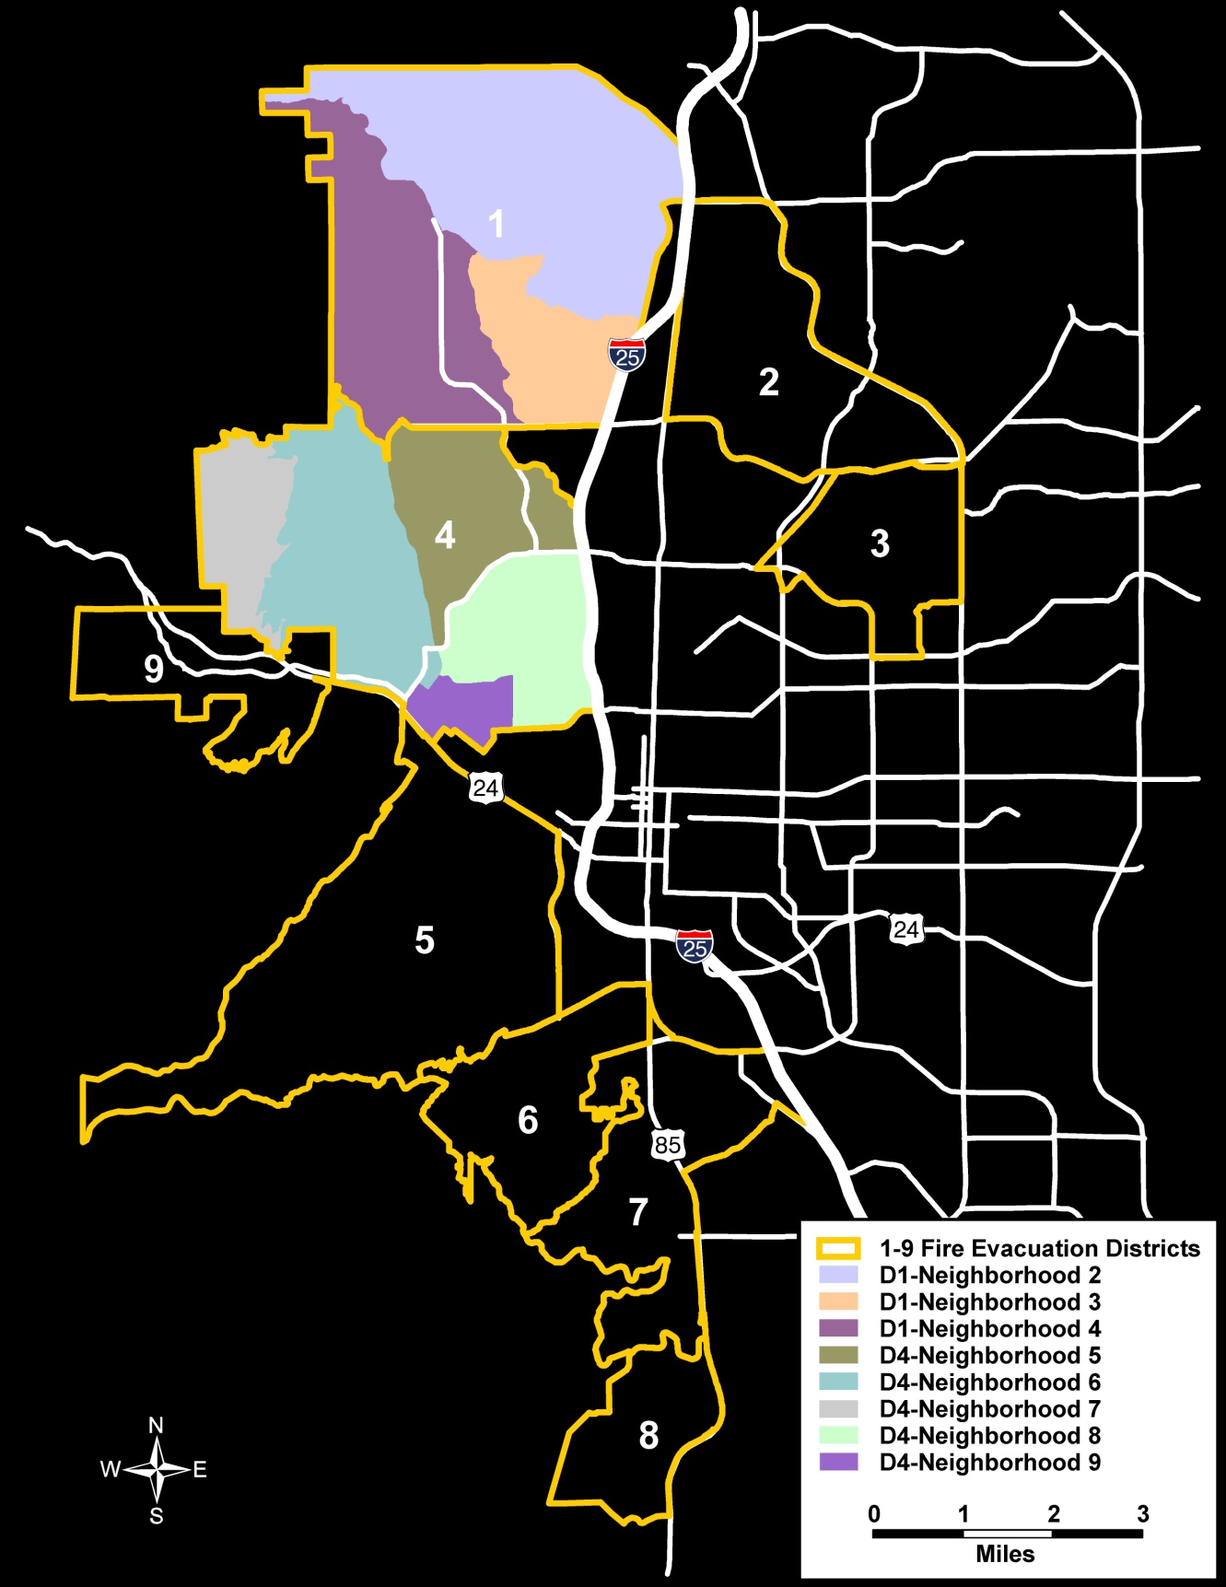
Step 3: Conduct Neighborhood-Level Screening Analysis
Model evacuation of selected
neighborhoods at risk for wildfire
Model “times-to-evacuate”
and screen neighborhoods relative
to one-hour roadway capacity reference
Identify neighborhood evacuation
“pinch-points” based on “times-to
evacuate” that exceed one hour
(based on one-hour V/C ratios > 1.0)
Identify alternative routing by
neighborhood and select neighborhoods
for additional operational analysis as
needed

Slide 10
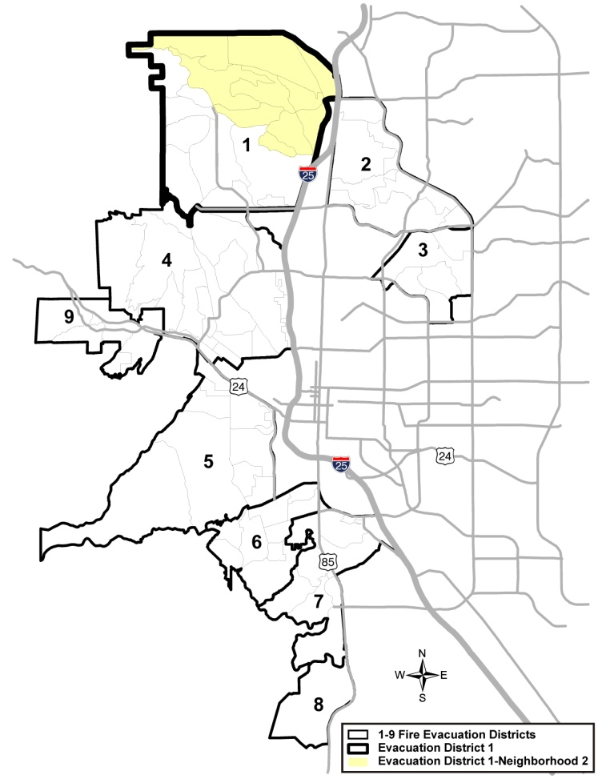
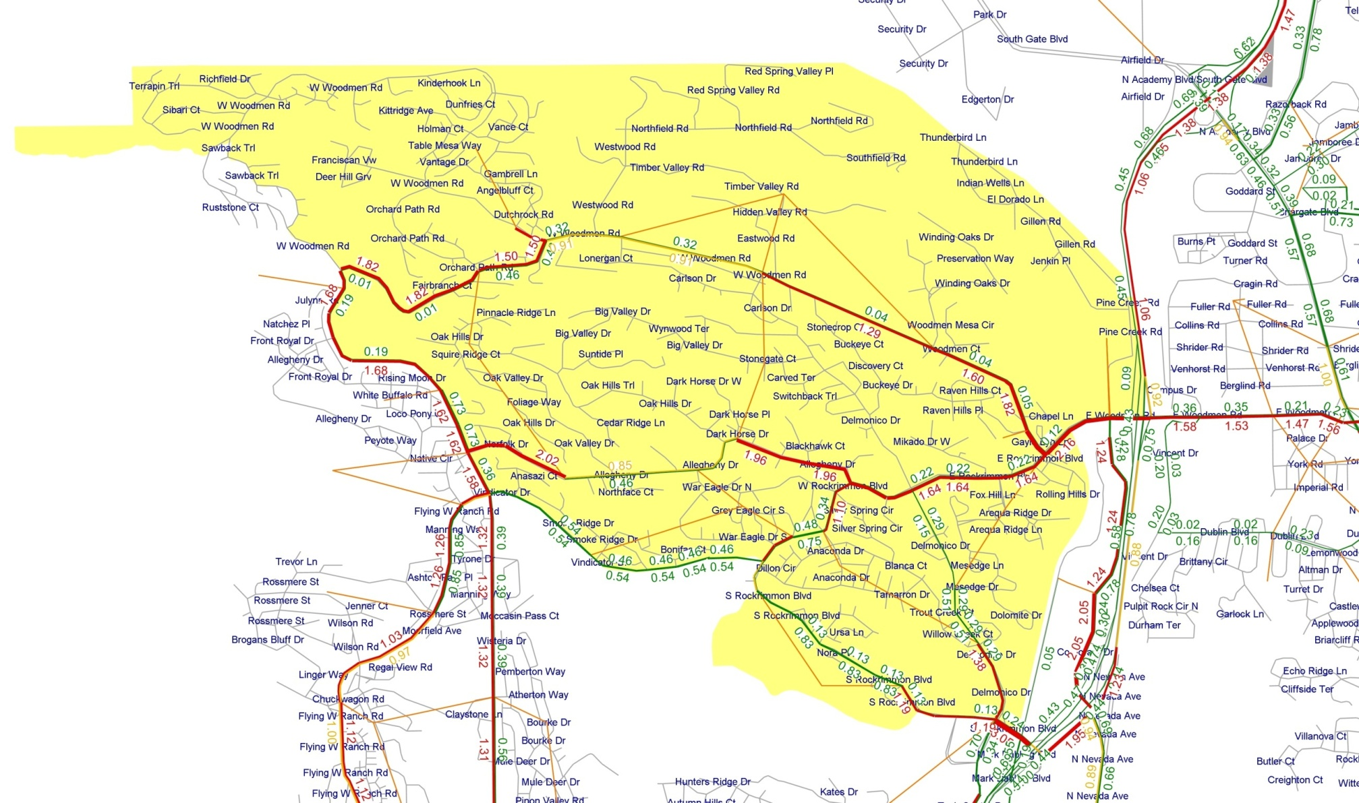
Step 4: Conduct District/Neighborhood Traffic Control Strategy Analysis
Conduct Indicated Detailed Operational Analysis
Contra-flow special operations analysis
Travel restriction – roadway closure analysis

Slide 11
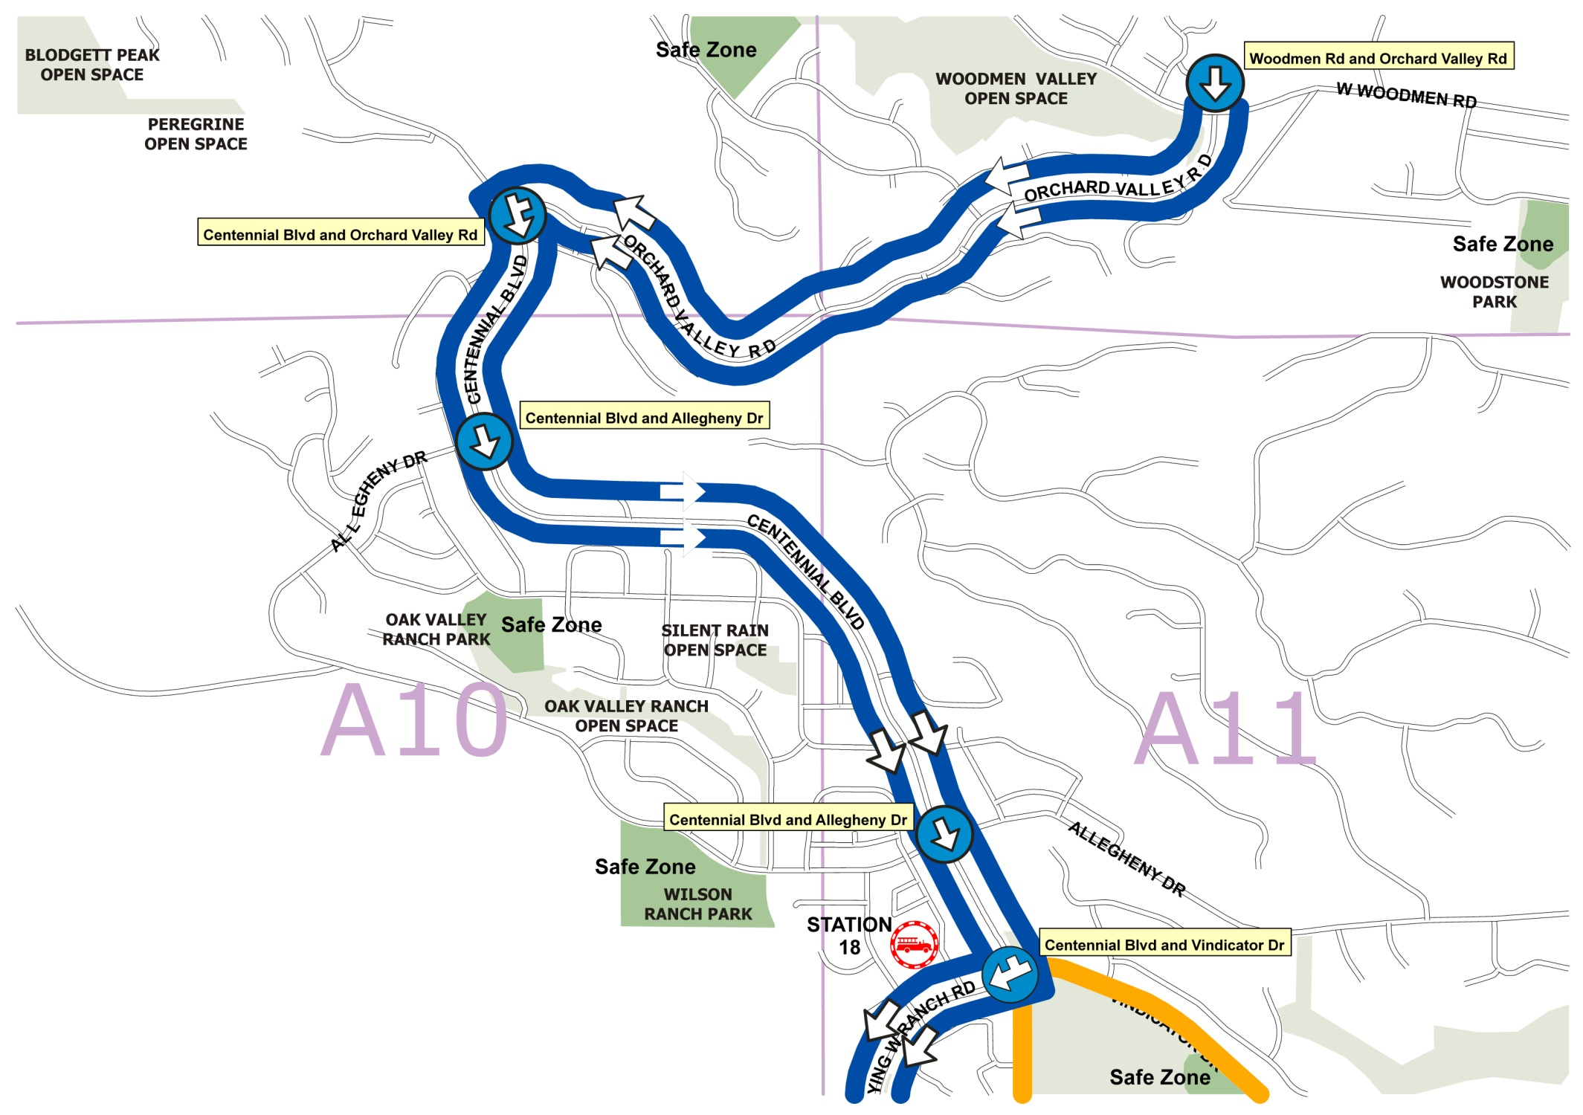
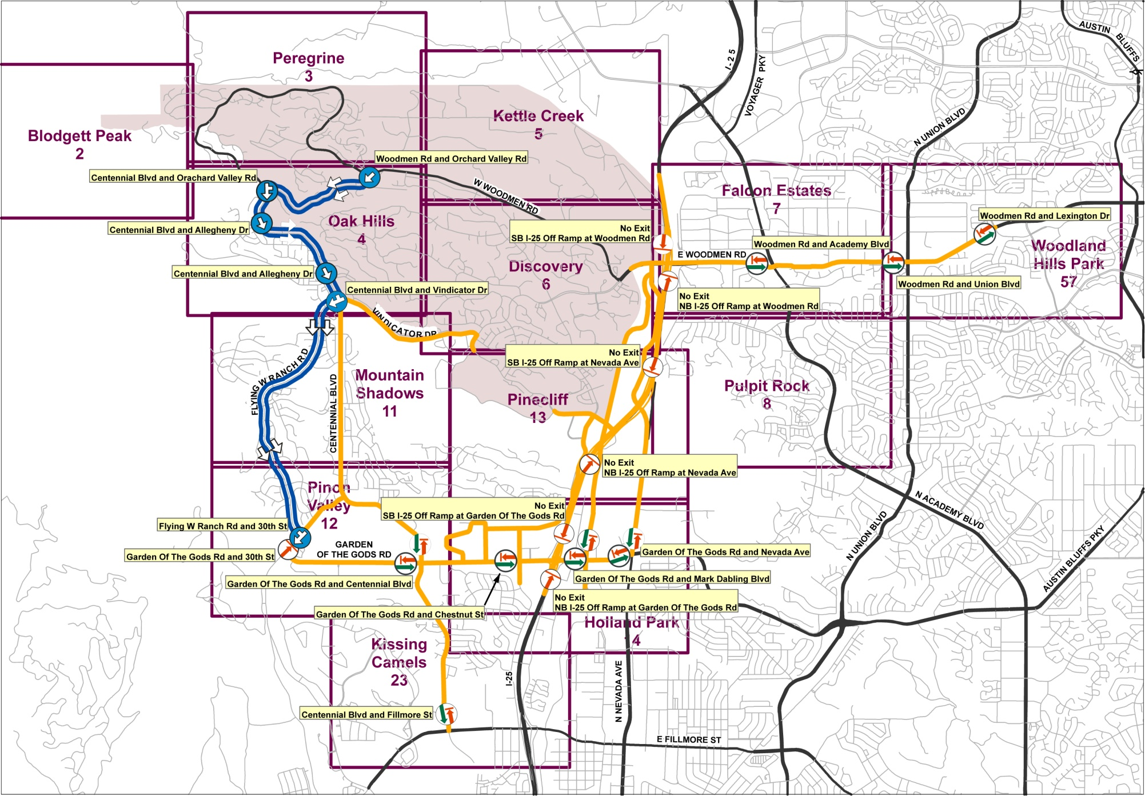
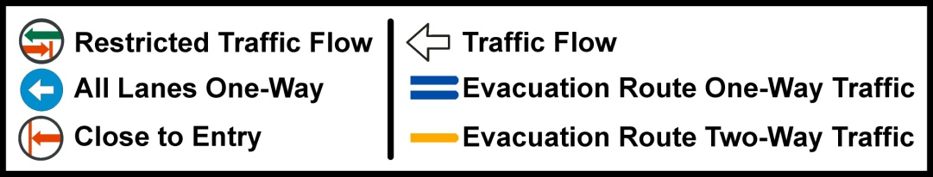
Step 5: Develop Subarea Evacuation Traffic Control Plans
Wildland Urban Interface – Woodman Area / Fire Evacuation Traffic Control Plan
Identify no-entry area
Identify egress route restrictions
Identify test contra-flow operations
Fire Evacuation Area Sheet 4
Fire Evacuation Area Overview

Slide 12
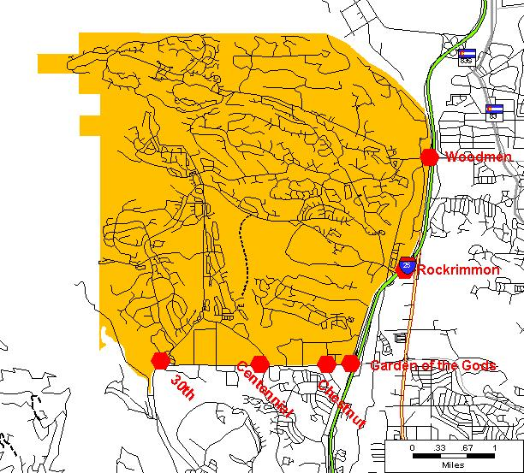
Example Step 2: District-Level Screening District 1
District 1 is bounded by the U.S. Air Force
Academy on the north, I-25 on the east,
Garden of the Gods Road on the south and the
foothills on the west.
The estimated number of households in
District 1 is 12,300.
The east-west distance across District 1 is about 4 miles; the north-south distance across the district is also about 4 miles.
Major portals for egress from District 1 are
30th Street, Centennial Boulevard, Chestnut Street,
Garden of the Gods Road, the Nevada-Rockrimmon
at I-25 and Woodmen Road.
I-25 will play a vital role in providing exit routes to evacuation traffic from District 1.
District Characteristics
Woodmen
Rockrimmon
Garden of the Gods
30th
Centennial
Chestnut

Slide 13
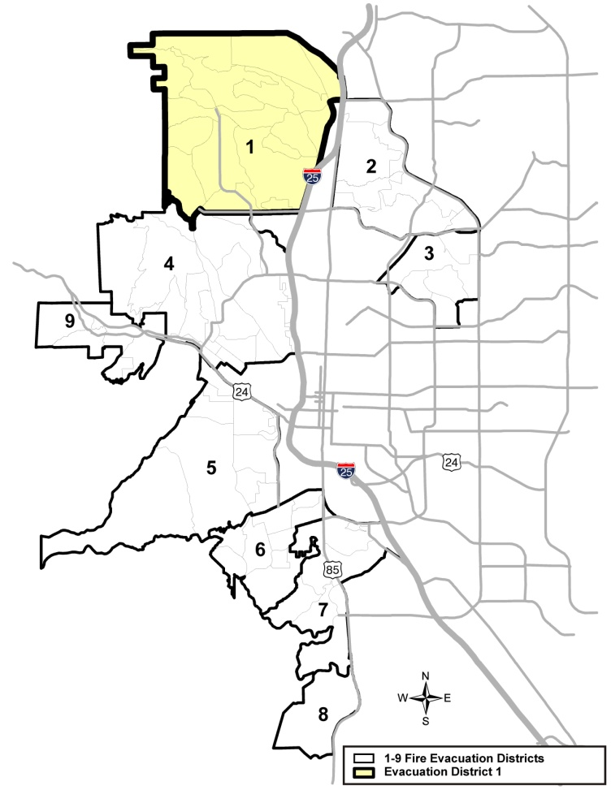
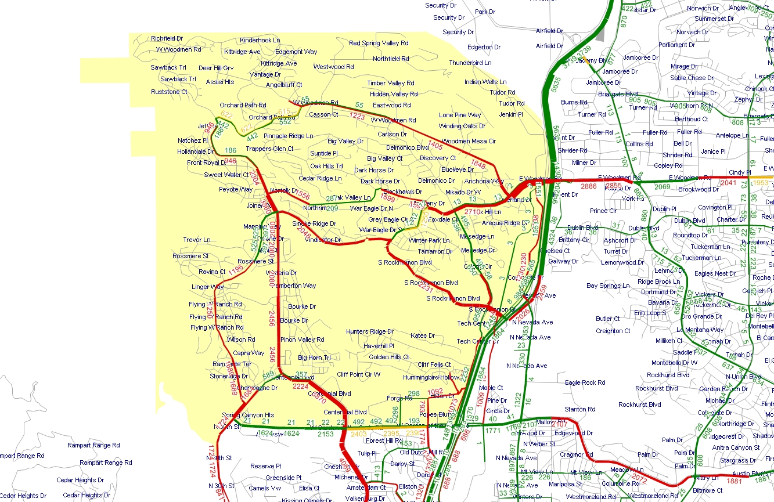
Fire Evacuation Model Study Year 2010 District 1
Evacuation Traffic Annotated with
Volume to Capacity Ratio (V/C) Color Coded
LEGEND
Volume to Capacity Ratio
> = 1
From 0.85 to 1
< = 0.85
Red links are over capacity with background and evacuation traffic
Green links have adequate capacity; gold links are near capacity with combined traffic
Annotated value is the is directional evacuation traffic volume only

Slide 14
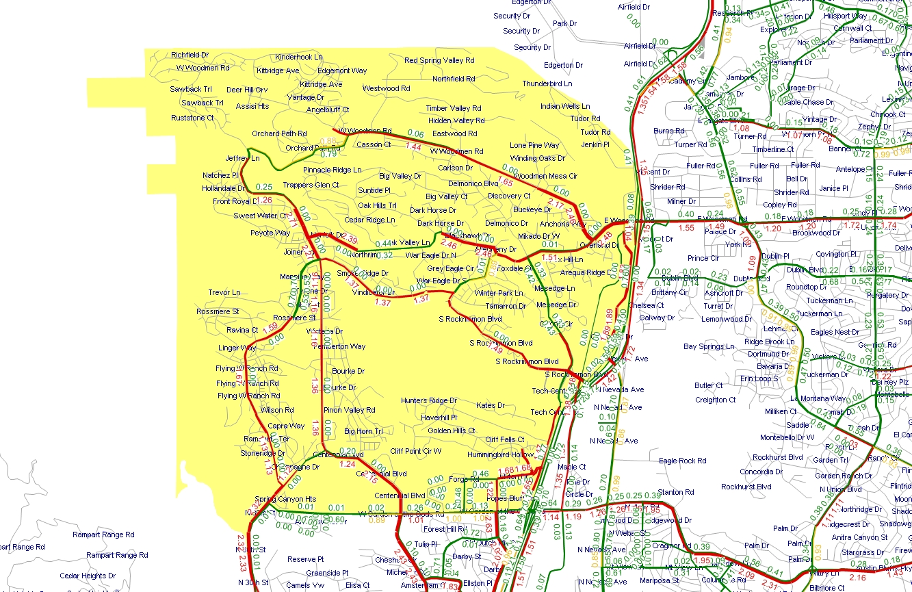
Fire Evacuation Model Study Year 2010 District 1
Evacuation and Background Traffic (Hourly PM) with
Volume to Capacity Ratio (V/C) Annotated
LEGEND
Volume to Capacity Ratio
> = 1
From 0.85 to 1
< = 0.85
Red links are over capacity with background and evacuation traffic
Green links have adequate capacity; gold links are near capacity with combined traffic
Annotated value is the V/C ratio for the combined directional link traffic volume

Slide 15
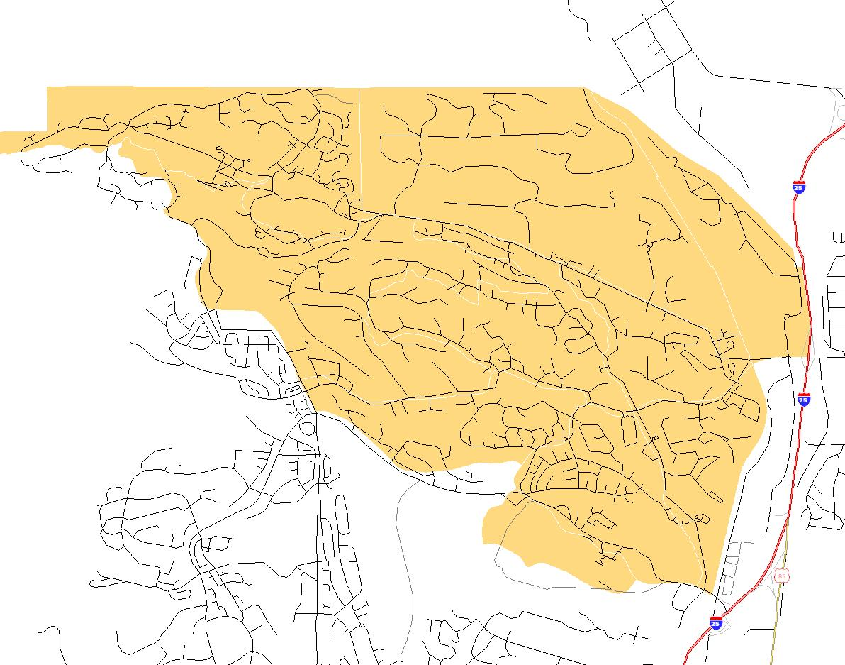
Example Step 3: Neighborhood-Level Screening District 1-Neighborhood 2
Neighborhood Characteristics
Neighborhood 2, in District 1 is bordered by the
US Air Force Academy on the north, I-25 on the east, Rockrimmon Boulevard on the south and the
foothills on the west.
The estimated number of households in
Neighborhood 2 is 6,700.
The east-west distance across Neighborhood 2
is about 4 miles; the north-south extent of the neighborhood is about 3 miles.
Major portals for egress from the neighborhood are: Centennial Boulevard and the Rockrimmon Boulevard and Woodmen Road I-25 interchanges.
I-25 will play a vital role in providing exit routes to neighborhood evacuation traffic.
Woodmen Road/
I-25 Interchange
Centennial Boulevard
at Vindicator Drive
Rockrimmon Boulevard/
I-25 Interchange

Slide 16
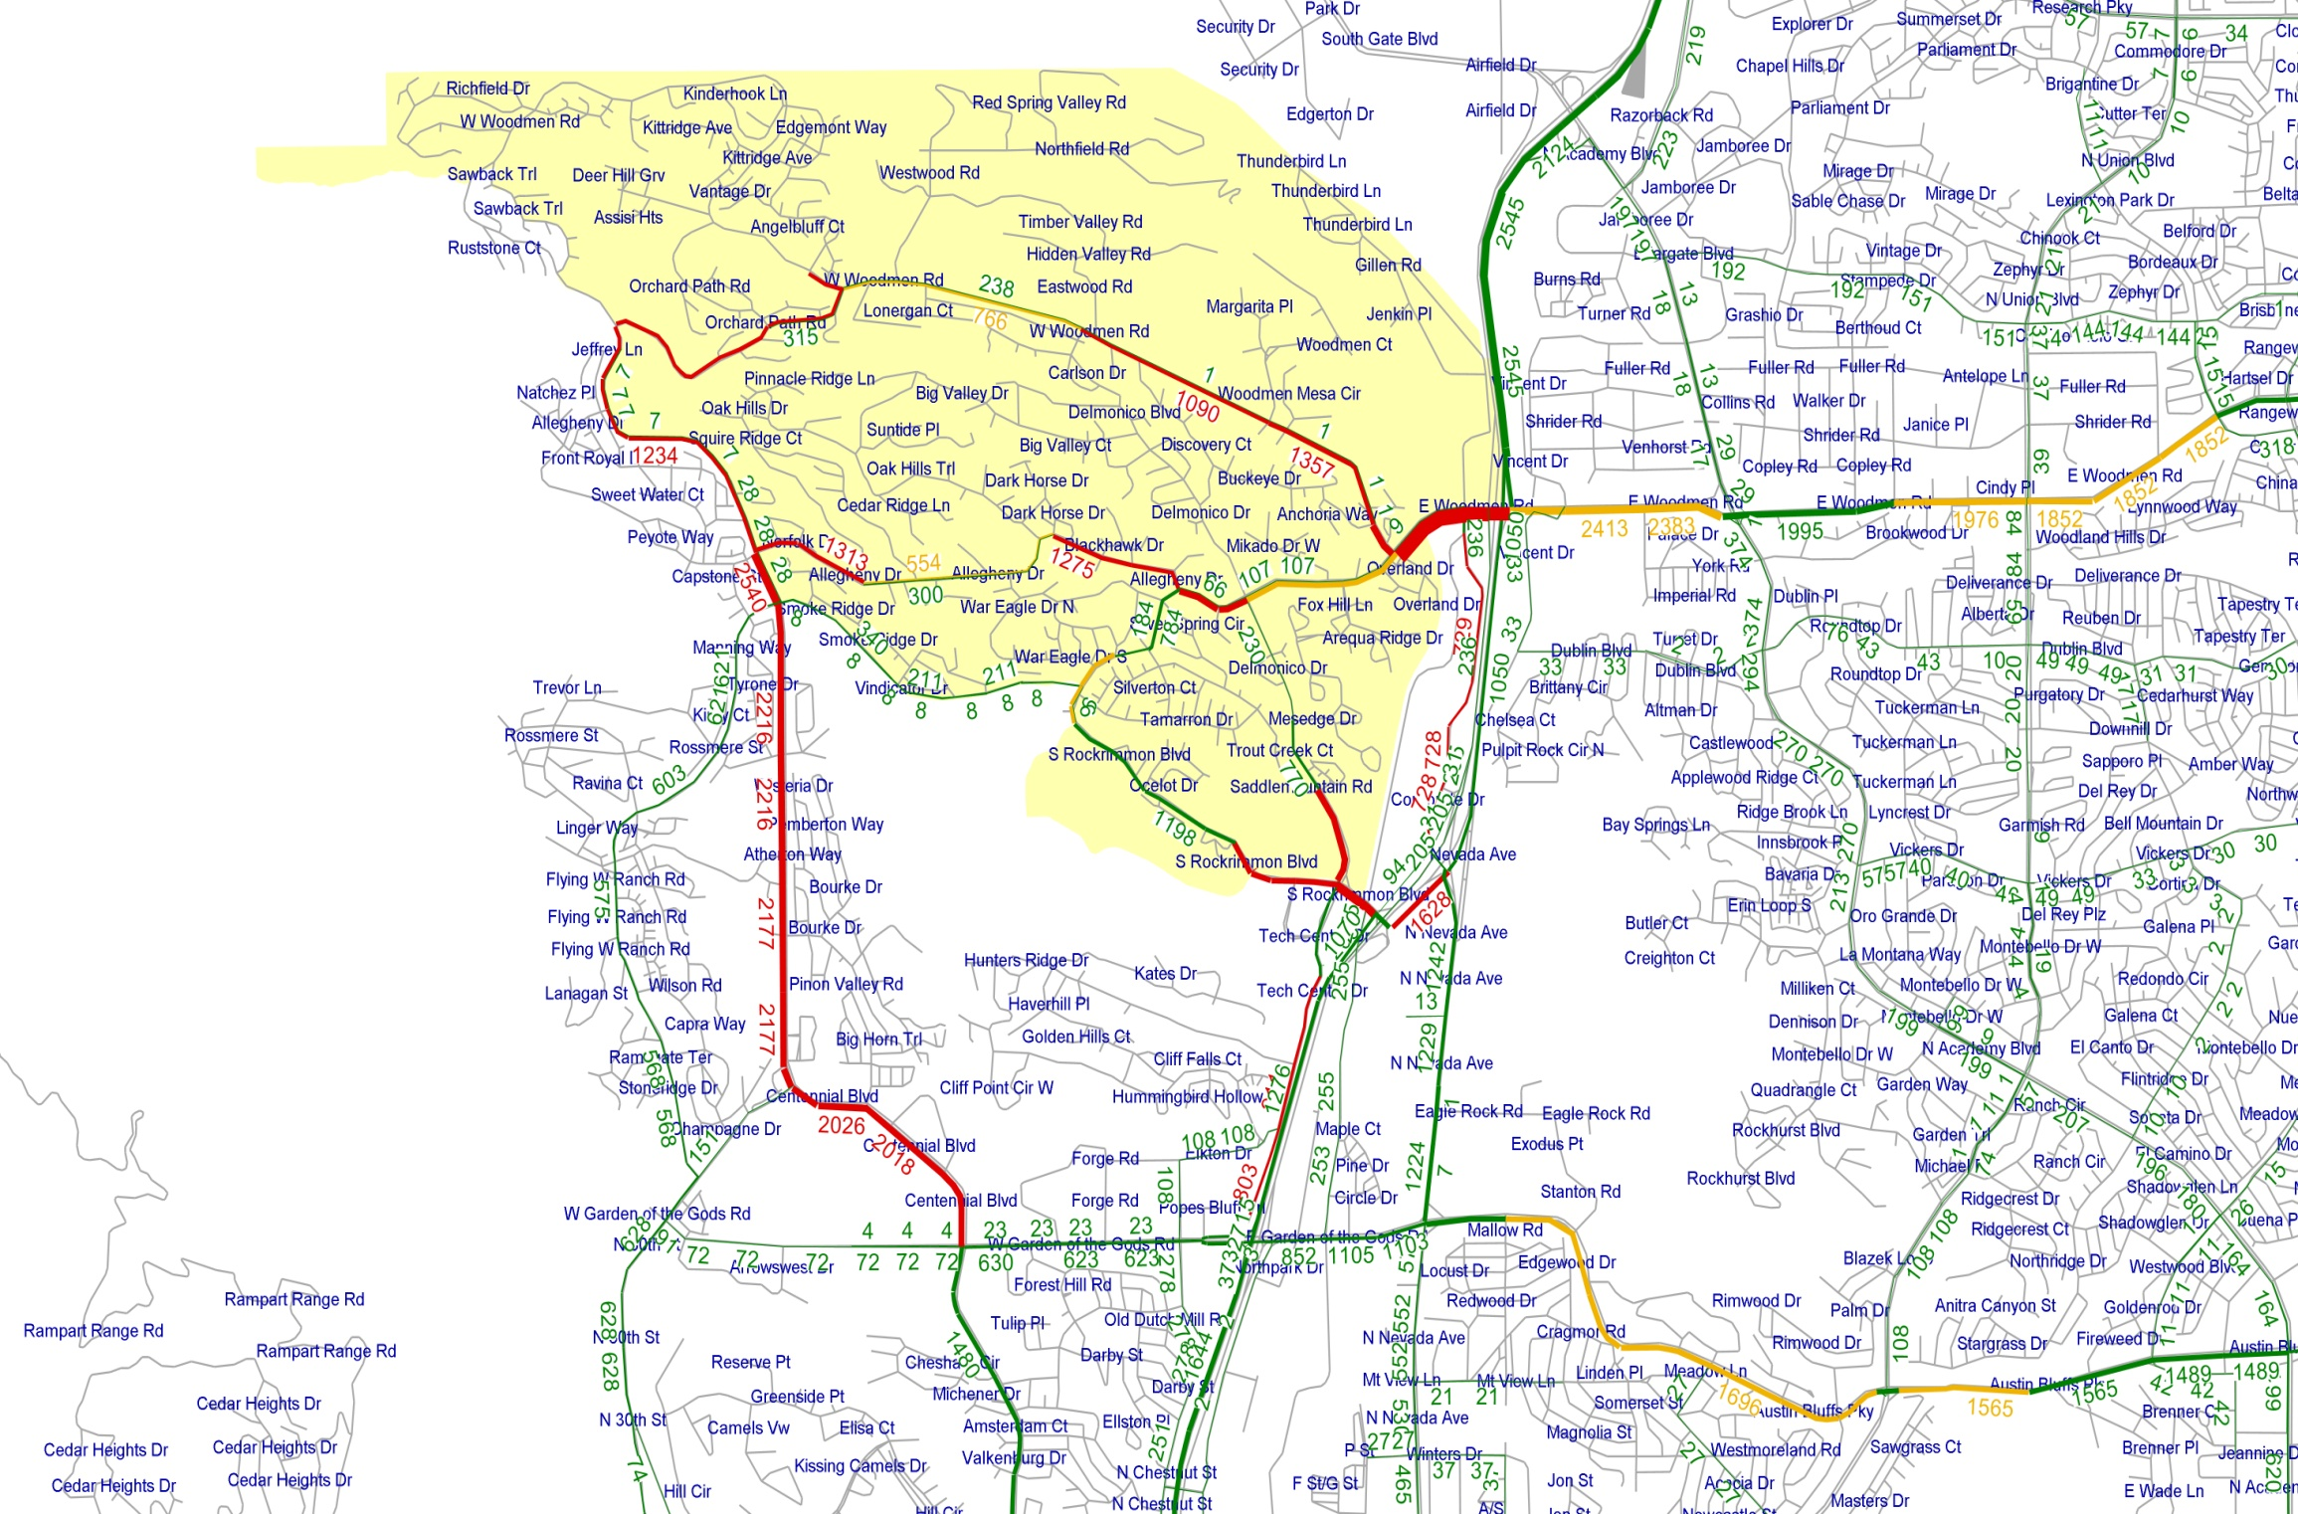
Fire Evacuation Model Study Year 2010 District 1-Neighborhood 2
Evacuation Traffic Annotated with
Volume to Capacity Ratio (V/C) Color Coded
LEGEND
Volume to Capacity Ratio
> = 1
From 0.85 to 1
< = 0.85
Red links are over capacity with background and evacuation traffic
Green links have adequate capacity; gold links are near capacity
Annotated value is the is directional evacuation traffic volume only

Slide 17
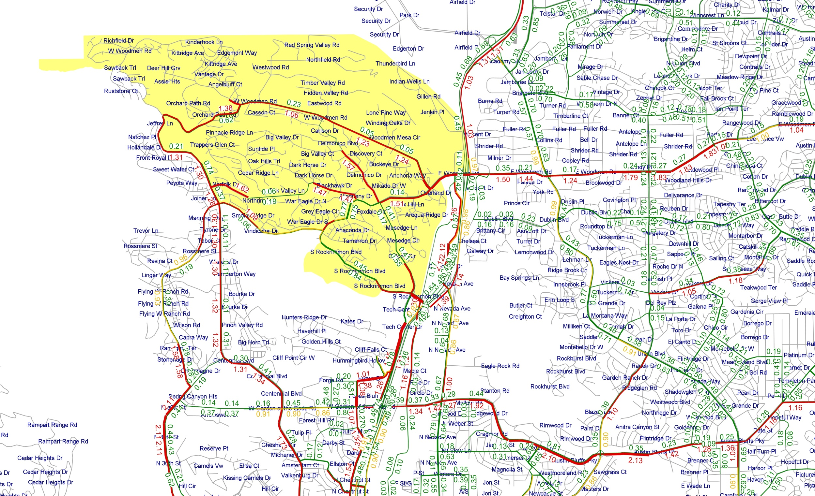
Fire Evacuation Model Study Year 2010 District 1-Neighborhood 2
Evacuation and Background Traffic (Hourly PM) with Volume to Capacity Ratio (V/C) Annotated
LEGEND
Volume to Capacity Ratio
> = 1
From 0.85 to 1
< = 0.85
Red links are over
capacity with background and evacuation traffic
Green links have adequate capacity; gold links are near capacity
Annotated value is the V/C ratio for the combined directional link traffic volume

Slide 18
Step 4: Traffic Control and Contra-flow Operations Analysis
Traffic Operations Analysis Process
Step 1: Review baseline modeling result to: 1) assess “time-to-evacuate” performance,
2) evaluate the role of background pass-through traffic in creating evacuation delay,
3) identify evacuation route restriction requirements, and
4) identify contra-flow operations opportunities.
Step 2: Model baseline operational scenario with pass-through traffic prohibition and
evacuation route restriction implemented.
Step 3: Model contra-flow alternatives iteratively (optional).
Step 4: Use micro-simulation to evaluate traffic operations performance (optional).
Step 5: Prepare traffic control plan for final evacuation scenario.

Slide 19

Example: Contra-flow Options District 1-Neighborhood 2
Refine modeled traffic control to eliminate any cut-through traffic
Identify remaining overburdened internal evacuation routes
Identify potential contra-flow routes
Iteratively test contra-flow options to achieve optimal result

Slide 20

Baseline Model Results District 1-Neighborhood 2
Cut-through traffic is eliminated in the baseline
Overburdened routes and potential contra-flow routes are identified

Slide 21
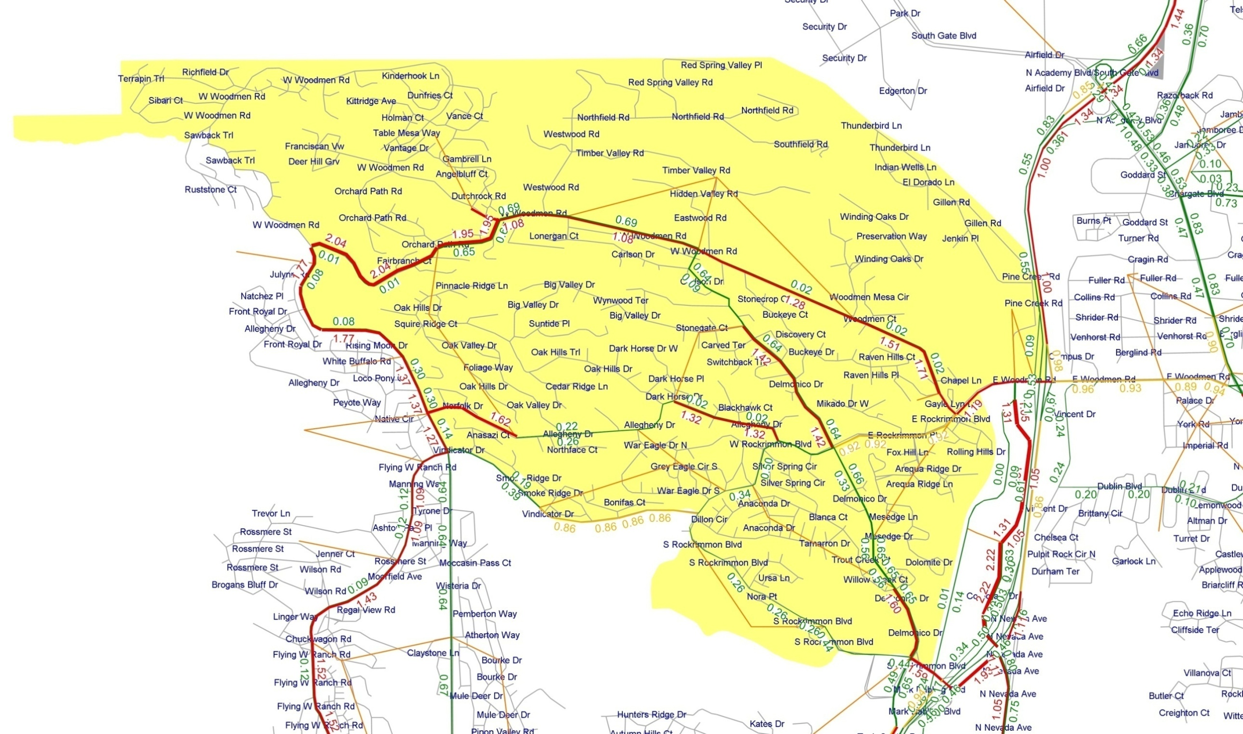
Initial Contra-flow Results District 1-Neighborhood 2
Iteration 1 contra-flow scenario results are examined as basis for developing the Iteration 2 contra-flow scenario

Slide 22
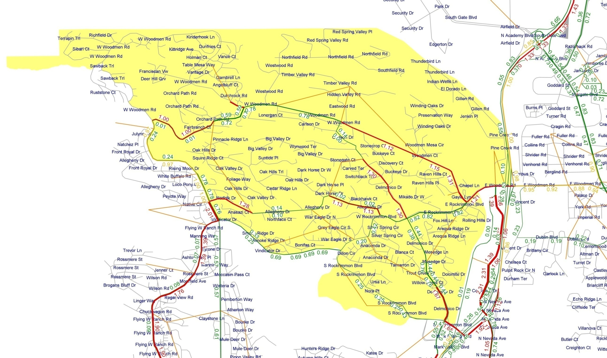
Contra-flow Option Results District 1-Neighborhood 2
Iterative modeling of refined contra-flow alternatives is used to identify a final “best result” contra-flow scenario for inclusion in the Traffic Control Plan

Slide 23

District 1-Neighborhood 2 –Traffic Control Plan Overview Sheet
Wildland Urban Interface – Woodman Area / Fire Evacuation Traffic Control Plan
Colorado Springs
Wildfire Evacuation Traffic Control Plan
PPACG Travel Model
Simulation Support
A Cooperative Project by the City of Colorado Springs and PPACG Transportation Planning Program
Colorado Springs, Colorado
January 2011
Presented by:
Pikes Peak Area Council of Governments
Wilbur Smith Associates & HDR, Inc

Slide 24
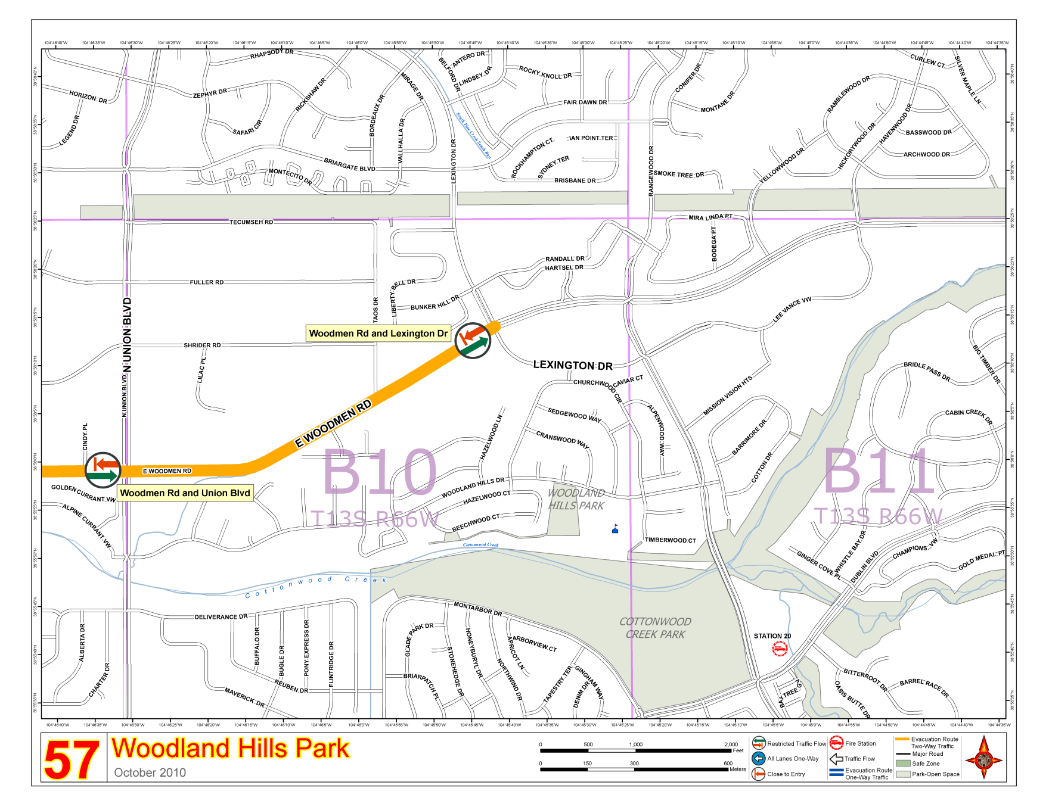
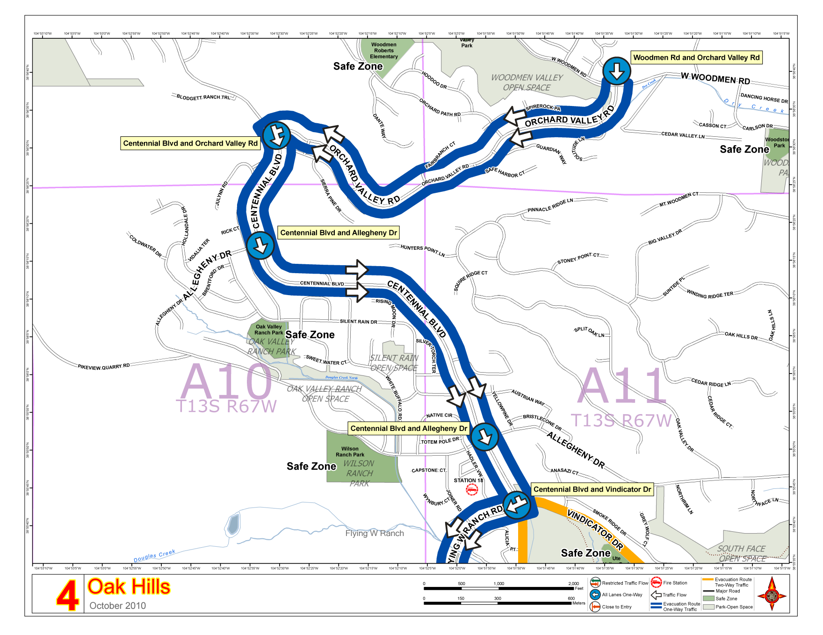
District 1-Neighborhood 2 Traffic Control Plan – Sample Map Sheets
Wildland Urban Interface – Woodmen Area / Fire Evacuation Traffic Control Plan

