Slide 1
Improving Modeling of Time-of-Day Effects in Activity-Based Models
Mark Bradley
Mark Bradley Research and Consulting
John Bowman
Bowman Research and Consulting

Slide 2
Time of day choice models
The “weakest link” in our current methods(?)
Change the use of network models…
  Run static assignments for more periods of the day
  Shift to dynamic assignment across the day (DTA)
Change the activity-based modeling methods…
  Modeling tours and trips: How does time of day choice fit in with the choices of mode and destination?
  Modeling other choices (tour and trip generation, auto ownership): How to capture accessibility effects that vary by time of day?

Slide 3
The behavioral context
The choice of when to travel depends on:
  The specific household and person context (joint activity schedules, time constraints, etc.)
  The transportation system context (congestion patterns, time-of-day tolls, transit service scheules, etc.)
Much work in activity-based modeling has focused on the first type of variables.
A greater focus is needed on the second type.
The activity-based framework can accommodate both.

Slide 4
Time window accounting/scheduling
Time-constrain and condition subsequent choices after scheduling each tour and trip
Person-day:
Notes:
SFCTA and NYMTC are both pretty weak in modeling time of day. They use so few time periods that the prior time-of-day outcomes provide little meaningful information to constrain subsequent time-of-day choices.
MORPC was the first to introduce a model with one-hour time periods, and to use a detailed accounting of time usage to constrain the timing of subsequently modeled tours.
SACOG reduced the size of the time periods to half hours and extended the use of time accounting to constrain time-of-day choice for intermediate stops on the tours.

Slide 5
Tour level models
Destination choice
Mode choice usually conditioned on destination choice
Mode choice logsum coefficients usually above 1.0 for non-work
“logsum”
Mode choice

Slide 6
Tour level models
Mode choice usually conditioned on destination choice
Mode choice logsum coefficients usually above 1.0 for non-work
Destination choice
“logsum”
Mode choice
Reasons for modeling them simultaneously:
  Can allow either direction of nesting
  Can include availability constraints (certain destinations rely on specific modes)

Slide 7
Where do we model time of day choice for tours?
Time of day choice
?
Destination choice
?
Time of day choice
“logsum”
Mode choice
?
Time of day choice

Slide 8
Existing AB models have used different strategies…
Time of day choice
Portland
San Francisco
?
Using more detailed time of day periods
Destination choice
?
Time of day choice
Columbus
Atlanta
“logsum”
Mode choice
?
Time of day choice
Sacramento
Denver
No clear “winner” – all have relative strengths and weaknesses

Slide 9
Tour destination, mode and time--Columbus
Notes:
MORPC uses full downward integration and partial upward integration.
Upward integration is implemented using logsums.
However, in the destination choice model,
--instead of taking a logsum across all possible time periods,
--it uses an assumed time of day that is the same for all similar cases in the population.
It does this because it is time consuming and impractical to calculate the logsums across both time and mode dimensions.
But it comes at a cost.
Suppose that it uses peak period for the logsum for all work tours. Now suppose that a forecast scenario introduces off-peak congestion to an area that is already fully congested during the peak period. The logsum won’t reflect the change, and destination choice will be unaffected.

Slide 10
Tour destination, mode and time--Sacramento
Notes:
SACOG also uses partial upward integration, but introduces simulation of time-of-day in an effort to overcome the drawback just illustrated.
The destination choice also uses a mode choice logsum and an assumed time of day. However, instead of using the same assume time of day for all similar cases,
it draws a time of day according to a time-of-day distribution that applies to those cases.
In most work cases, it draws peak-period times, but for some cases it draws other times. At an individual level, the destination choice is responsive only for one time period, but across the population there is responsiveness to all time periods.
This approach isn’t perfect, but short of full upward integration with logsums, it is the best technique I have seen for integration among these three model components.

Slide 11
Joint models of time of day choice and mode choice
In the US and Europe
Using Stated Preference (SP) and Revealed Preference (RP) data
Tour level and trip level models
Some agreement in general findings….

Slide 12
Best nesting structure depends on the size of the time periods…
Broad time period
(AM peak, midday, PM peak, etc.)
Mode
(Auto, transit, walk, etc.)
Narrower time period
(e.g. hours or half-hours)
Path type / sub-more
(e.g. toll vs. non-toll, bus vs. rail)

Slide 13
Another type of “nesting” in AB models: Trips within tours
In general, tour-level models deal with main aspects: primary activity location and timing, main mode used
Trip-level models “fill in” the remaining details – exact destination, mode and departure time for each trip

Slide 14
Another type of “nesting” in AB models: Trips within tours
Meal
Stop
Home
Work
Shop stop
When a tour includes multiple stops, the O-D used in the tour-level model no longer represents the actual trip O-D’s along the tour ….
So, the choices predicted by the tour-level models should not be too constraining, particularly for the effects of path-specific aspects such as congestion and pricing

Slide 15
Strategy for PSRC and other current AB model development
Joint mode / time of day choice model
Main mode: Auto, transit, walk, etc.)
Broad periods: AM peak, midday, PM peak, etc.
TOUR LEVEL
Intermediate stop generation & location
constraints
logsums
TRIP LEVEL
Joint mode / time of day choice model
Narrower period: Half-hour
Trip mode: toll vs. non-toll, bus vs. rail, etc.
Nesting order estimated (not asserted) at each level
Both mode and time of day influenced by travel times and costs at the trip O-D level

Slide 16
For tours that do not go to fixed work or school locations…
Joint destination / mode / time of day model
Primary activity location: Parcel or zone
Main mode: Auto, transit, walk, etc.
Broad periods: AM peak, midday, PM peak, etc.
TOUR LEVEL
Intermediate stop generation & location
constraints
logsums
TRIP LEVEL
Joint mode / time of day choice model
Narrower period: Half-hour
Trip mode: toll vs. non-toll, bus vs. rail, etc.
Nesting order estimated (not asserted) at each level
Requires efficient sampling of destination alternatives

Slide 17
Accessibility measures in upper level models in AB systems
Mainly influence models of:
Out of home activity participation (tour generation)
Auto ownership/availability
Residence location (integrated land use model)
Ideally, they will reflect changes in travel times or costs in a balanced way across all relevant:
Destinations
Modes
Times of day

Slide 18
What measures have been used in activity-based models?
How many attractions can be reached within X minutes by mode Y? (e.g. How many jobs can be reached by car within 30 minutes?)
What is the accessibility-weighted total of attractions that can be reach by mode Y?
What is the accessibility-weighted total of attractions that can be reached by all modes?

Slide 19
Problems with the first type of measure…
How many attractions can be reached within X minutes by mode Y?
The threshold X is vital, and it is arbitrary
The measure only considers travel time, and not cost

Slide 20
An illustrative experiment
Using Dallas-Ft.Worth travel time skim matrices, created three measures for each of 5,400 zones…
  Number of retail and service jobs that can be reached within 30 minutes in the midday period
  Number of retail and service jobs that can be reached within 45 minutes in the midday period
  Sum across all zones of ……………………………………….. (retail + service jobs) / exp (midday travel time / 20)
Decreased the auto travel time for every O-D pair by 20% and recalculated all three accessibility measures.
Analyzed how the measures changed across zones.

Slide 21
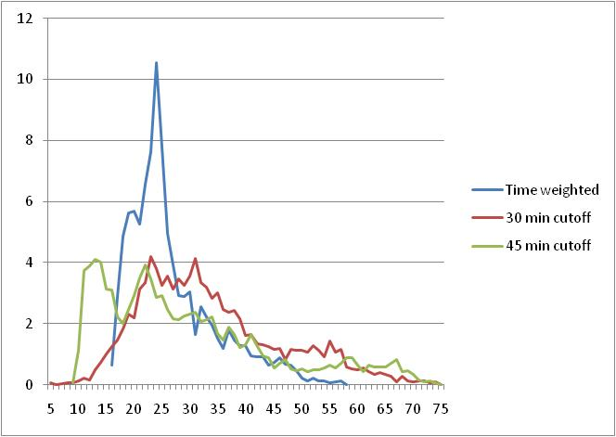
Results – Probability distribution
% of
Zones
Percent change in accessibility measure

Slide 22
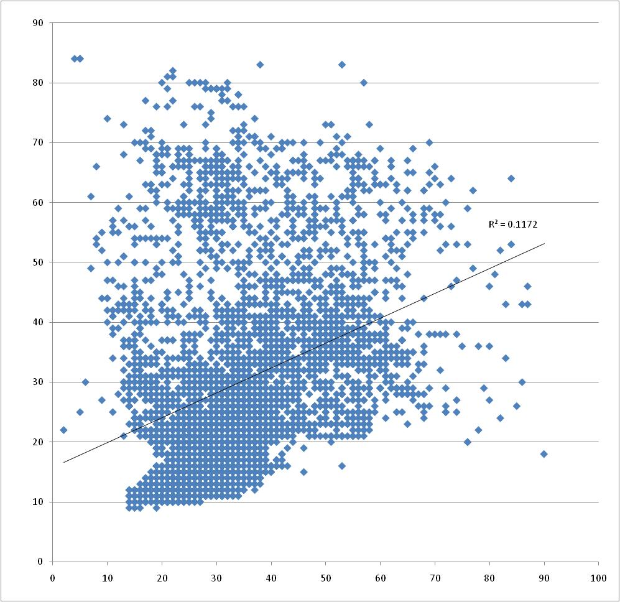
Results – scatterplot
% change in 45 minute measure
% change in 30 minute measure

Slide 23
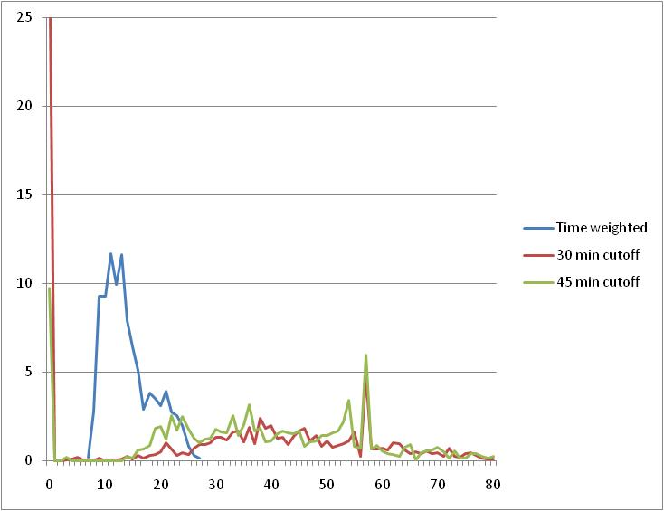
Same test for transit accessibility
% of
Zones
Percent change in accessibility measure

Slide 24
The second type of measure…
What is the accessibility-weighted total of attractions that can be reach by mode Y?

Slide 25
Problem with the second type of measure…
High correlations between measures for different modes
    Transit Walk
  Auto 0.62 0.54
  Transit 0.57
Multi-collinearity > Very difficult to estimate separate accessibility effects for each mode

Slide 26
The third type of measure…
What is the accessibility-weighted total of attractions that can be reached by all modes?
Issue
How does one weight the influence of different modes?
Approach
Use a choice logsum across all modes and destinations
Segment the logsum by key mode choice dimensions (income, auto availability, distance to transit, purpose)
Pre-calculate accessibility logsums for each combination of dimensions for each zone in the region

Slide 27
The third type of measure …
Issue
How does one incorporate the differences in travel times and costs by time of day?
Approaches
Assume a fixed, representative period for each purpose
  (Not very accurate)
Use a weighted average across periods for each purpose
  (Better, but still some problems – especially with transit)
Use a choice logsum across all modes and destinations and times of day
  (Should be best. We shall see….)

Slide 28
Conclusions
Activity-based models have given us the tools to model realistic responses to time-of-day specific changes in travel times and costs, but…
The best methods for doing so are still evolving.
We recommend modeling destination, mode and time of day choices jointly to the greatest extent possible, at the tour and trip levels, and in “upper level” accessibility measures.
Empirical results coming soon…

Slide 29
Questions?

