Slide 1

Destination choice model success stories
TRB Transportation Planning Applications 2011 | Reno, NV
Rick Donnelly & Tara Weidner | PB | [donnellyr, weidner]@pbworld.com

Slide 2
Overview
Concepts
Albuquerque HBW example (urban)
Maryland example (statewide)
Portland (freight)
Pros and cons
Discussion

Slide 3
Competing theories
Gravity model: Humans spatially interact in much the same way that gravity influences physical objects. Any given destination is attractive in proportion to the mass (magnitude) of activity there, and inversely proportion to separation (distance).
Destination choice model: Humans seek to maximize their utility while traveling, to include choice of destinations. A potentially large number of factors influence destination choice, to include traveler and trip characteristics, modal accessibilities, scale and type of activities at the destination, urban form, barriers, and in some cases, interactions between these factors.

Slide 4
Quick review
Gravity model formulation
Analogous DC model utility function?

Slide 5
Albuquerque
Notes:
Metro area population 887,077 in 2010, up 20.8 percent from 702,565 in 2000

Slide 6
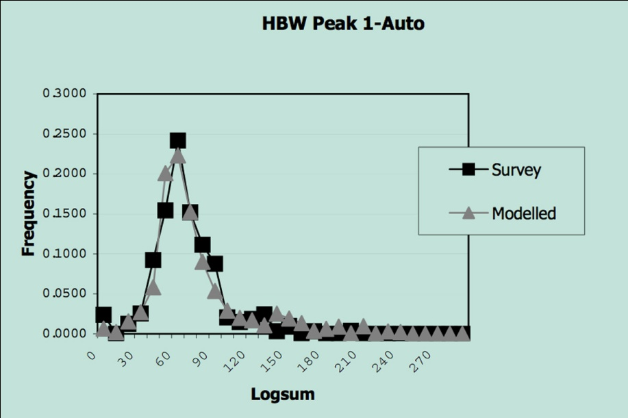
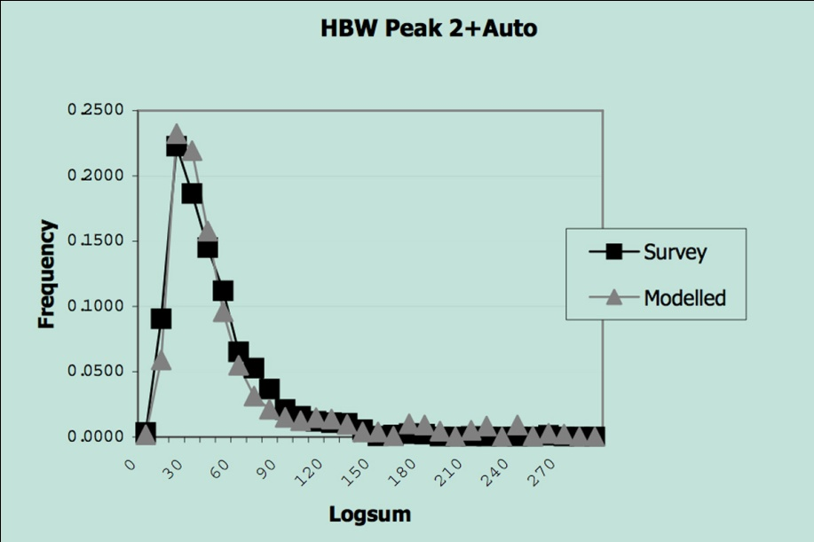
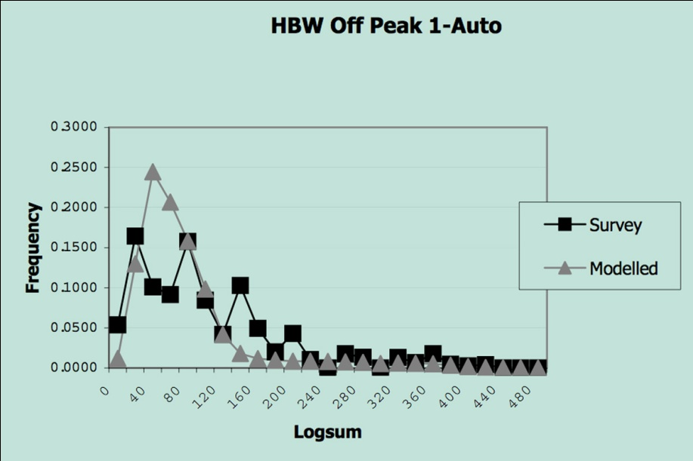
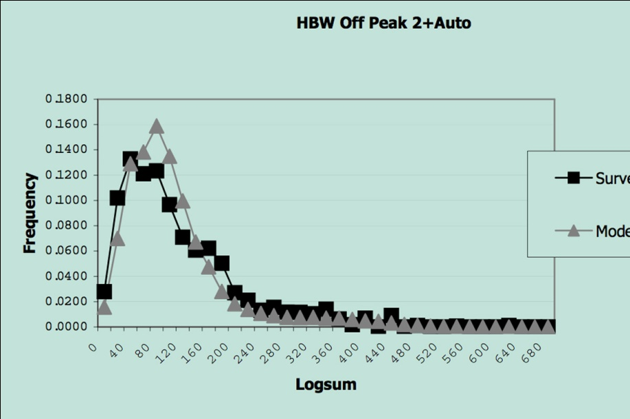
HBW logsum frequencies

Slide 7
Simple DCM formulation

Slide 8
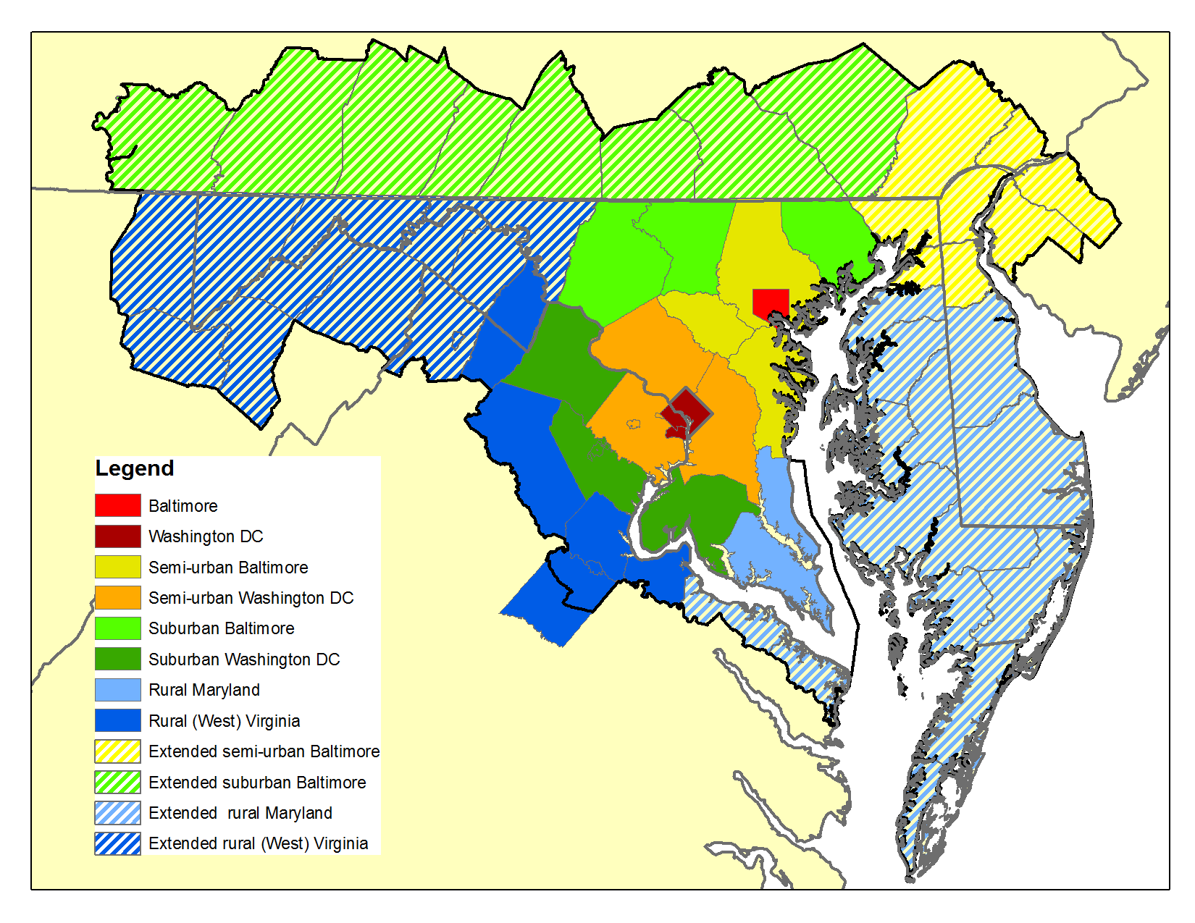
Maryland statewide model

Slide 9
HBWx trip length frequency distributions

Slide 10
Utility function structure
Size term
Distance term
Zonal characteristics
Logsum
Interaction of distance and household/zonal characteristics
Compensation for sampling error

Slide 11
Estimation summary by purpose
Variable(s) | HBW | HBS | HBO | NHBW | NHBO
Mode choice logsum | S | S | S | S | S(C)
Distance* | -S | -S | -S | -S | -S
Income | distance* | S | S | S
Intrazonal dummy | S |  | S | S | S
CBD dummy* | -S | -S | -S | -S | -S
Bridge crossing dummy | -S | -S | -S | -S | -S
Semi-urban region dummy* | -S
Suburban region dummy* | -S
Employment exponentiated term* | S | S | S | S | S
Households exponentiated term |  |  | S | S | S
* Multiple variables in this category (e.g., distance includes distance, distance squared, distance cubed, and log[distance])

Slide 12
HBW estimation results
Mode choice logsum coefficient ~0.8 (reasonable)
Distance, distance cubed, and log(distance) all negative and significant
Distance squared was positive (?)
Income coefficients positive and significant, but not steadily increasing with higher income
Intrazonal coefficient positive and significant
CBD coefficients for DC and Baltimore negative and significant
Bridge coefficient negative and significant
Households and retail, office, and other employment used for size term

Slide 13
HBWx model comparison
Doubly-constrained gravity model
Destination choice model
Adjusted r² = 0.47
Adjusted r² = 0.79

Slide 14
Another way of looking at it

Slide 15
Portland

Slide 16
Destination choice
For each firm:
Decide whether to ship locally or export
Choose type of destination establishment*
Sample ideal distance from observed or asserted TLFD
Calculate utility of relevant destinations
Ensure utility threshold exceeded (optional)
Normalized list of cumulative exponentiated utilities
Monte Carlo selection of destination establishment
* Establishment in {firms, households, exporters, trans-shippers}

Slide 17
Utility function

Slide 18
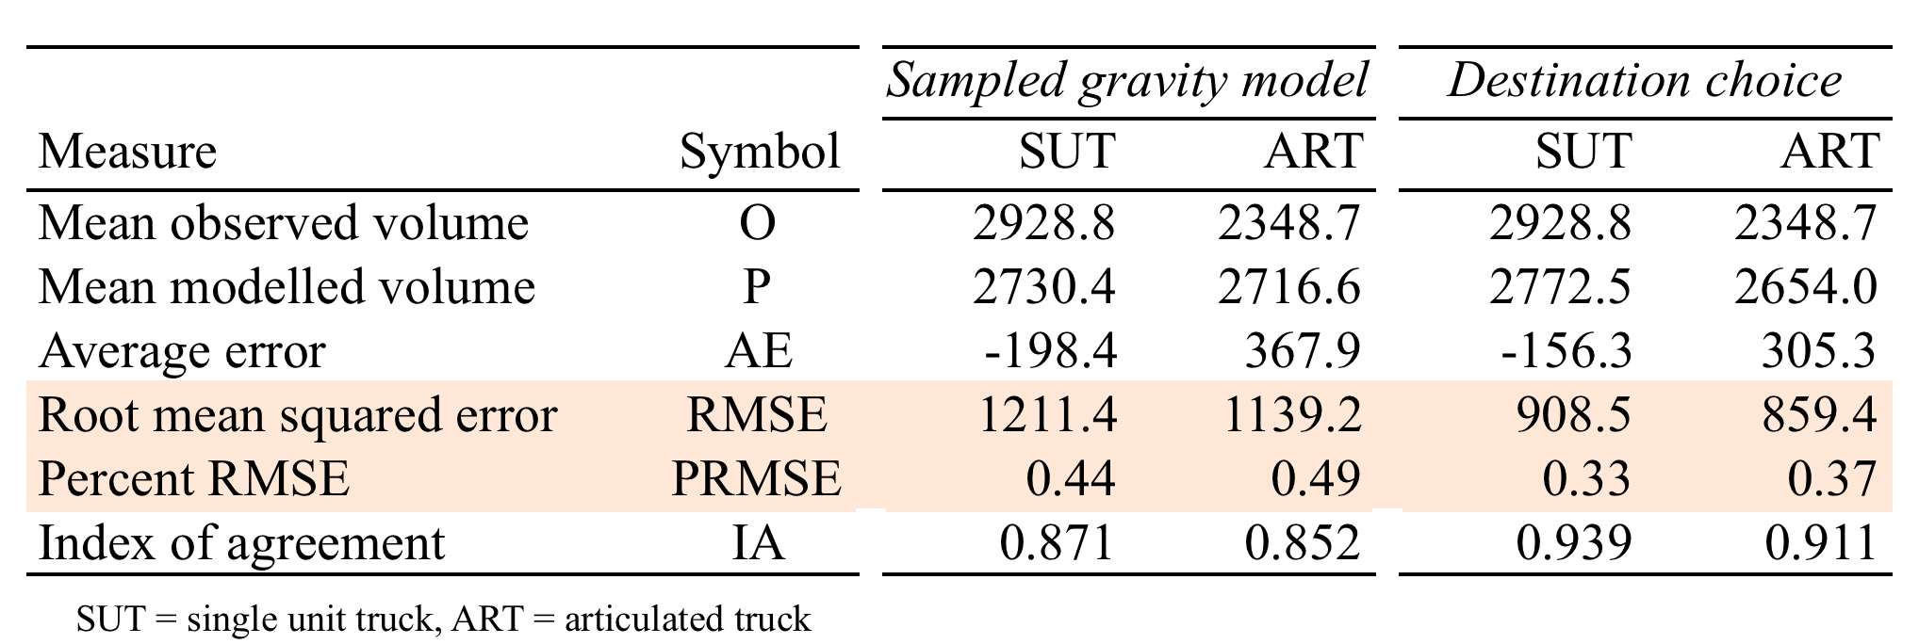
Circumstantial evidence

Slide 19
Objections
Non-intuitive interactions
Harder to estimate and tune
Not doubly-constrained
Explicit error terms
?

Slide 20
Bottom line
Matches as well as k-factors but without their liabilities
Far more flexible specification than gravity models
Finer segmentation in gravity models avoided
Ditch k-factors = stronger explanatory power
Represents heterogeneity
Fits nicely in tour-based modeling and trip chaining
Interpretation of ASCs more straight-forward than k-factors
Flexible estimation

Slide 21
The real proof

Slide 22
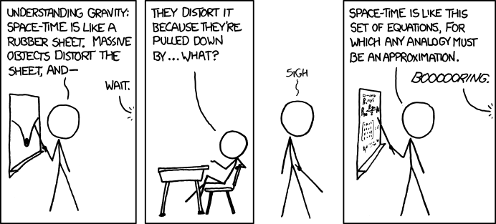
<comic/>
Source: “Teaching physics”, http://www.xkcd.com

