Slide 1
Modeling Active Traffic Management for the I-80 Integrated Corridor Mobility (ICM) Project
Terry Klim, P.E.
Kevin Fehon, P.E.
DKS Associates
D

Slide 2
Simulation of Active Traffic Management Elements
Adaptive Ramp Metering
Variable Speed Limits (VSL)
Incident Lane Management/Lane Control Signs

Slide 3
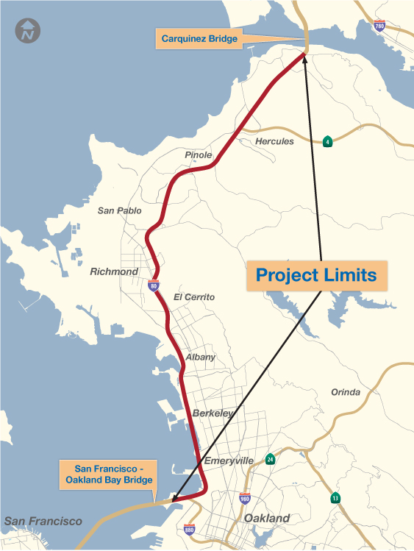
The I-80 Corridor
21-mile segment from Carquinez Bridge to Bay Bridge
Major parallel arterial (San Pablo Avenue)

Slide 4
Project Need
One of most congested
corridors in Bay Area
Extensive congestion AM, PM and weekends
High accident rate along the freeway
Projected 30-45% demand increase by 2035
Limited room for physical improvements

Slide 5
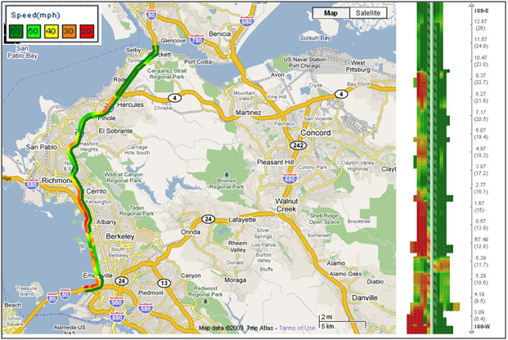
AM Peak Congestion Map

Slide 6
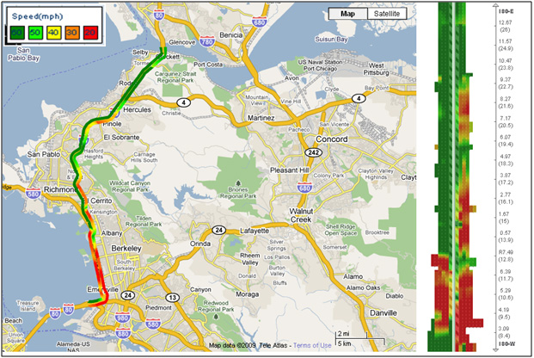
PM Peak Congestion Map

Slide 7
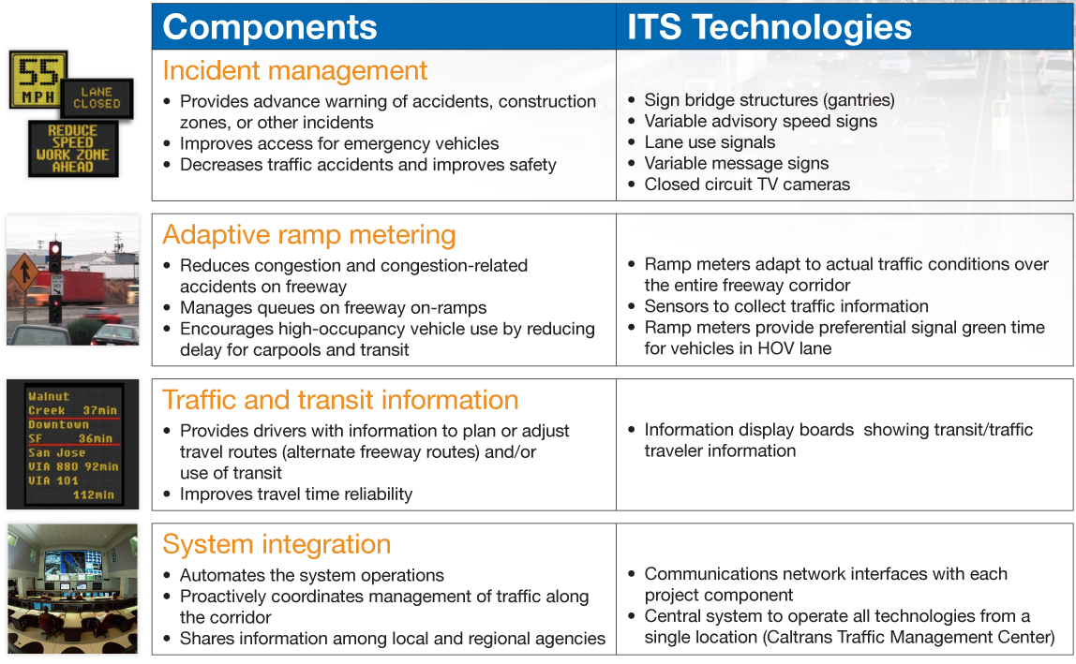
I-80 ICM Project

Slide 8
ATM Project Elements
Area-wide adaptive ramp metering
  Meters installed at all ramps in both directions
Variable speed limits
  Signs installed throughout corridor in both directions
Overhead lane control signals
  Signs installed in westbound direction, within high-incident segment only

Slide 9
Simulation Approach
Corridor modeled using Paramics
Multi-hour AM (6 to 10 AM) and PM (2 to 7 PM) peak periods
Simulated both recurring and incident conditions
Involved application of:
  New Ramp Metering and Lane Management plug-ins
  Recently-added VSL module

Slide 10
Model Network
Over 25 miles of Freeway
92 ramps
Over 50 miles of arterial roadway
55 signalized intersections

Slide 11
Model Network (con’t)

Slide 12
Analysis Scenarios
2015 Condition | Recurring Congestion | Incident Condition
No-Build | ✓ | ✓
Ramp Metering | ✓ | ✓
Ramp Metering + Variable Speed Limit | ✓ | ✓
Ramp Metering + Variable Speed Limit + Lane Use Management |  | ✓

Slide 13
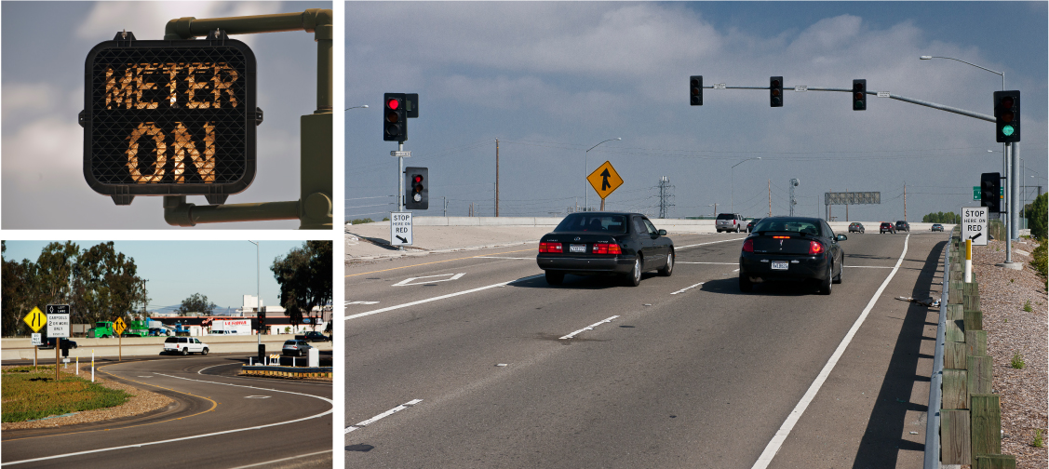
Adaptive Ramp Metering
Plan is for area-wide adaptive metering
Exact algorithm still being defined

Slide 14
Ramp Metering - Testing
Applied existing algorithm used by Caltrans District 4 (TOS 2.0)
  “Locally adaptive”
  Requires rate-vs-occupancy look-up tables
  Includes “queue detection/override” capability
Metering active only WB in AM, both directions in PM

Slide 15
Ramp Metering – Plug-in
15
Developed by CLR Analytics
Requires user-supplied input file in XML format
  Rate look-up tables
  Start-up and shutdown control parameters
  Queue override parameters

Slide 16
Ramp Meter – Modeling Insights
16
Additional network coding
  Detectors
  Splitting of multi-lane ramps
Development of metering rate-vs-occupancy look-up tables
Plug-in limitations:
  Lack of automated “all green”
  Number of meter lanes

Slide 17
Ramp Metering – Results
Ramp Metering provides improvement to the freeway without degrading arterial operation
  I-80 hours of delay decrease by 20% in the westbound direction
  Limited benefit eastbound due to pattern of congestion – most heavily congested at start of corridor
  System wide hours of delay decreases by 8%
  Negligible change in arterial hours of delay

Slide 18
Variable Speed Limits
General philosophy:
  Modify upstream speed limits based on downstream conditions
Strategy objective evolved during study
  Speed harmonization - slow traffic approaching bottlenecks to smooth speed profile and improve flow
  End-of-queue warning during incidents

Slide 19
VSL - Testing
Examined as stand-alone “speed harmonization” strategy for AM westbound direction only
  Tested over 30 VSL scenarios
Included in incident analysis for both directions and peak periods

Slide 20
VSL Module
Added to Version 6 at our request for this project
Allows for adjustment of speed limit based on lookup tables and monitored conditions
Requires coding of:
  VSL routes - segments where VSL can be applied
  VSL rules – if/then rules identifying under what conditions speed limits will be modified
  Mainline detectors
Notes:
20

Slide 21
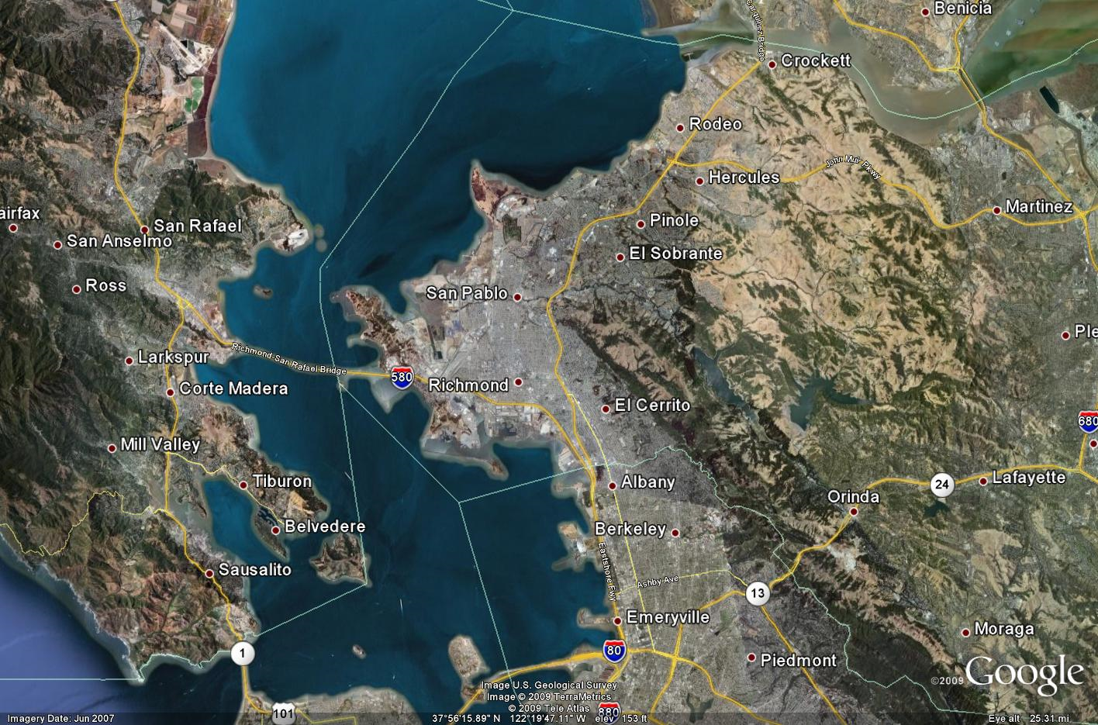
VSL Module - Routes
VSL Route 1
Detector Group 1
VSL Route 2
Detector Group 2
VSL Route 3
Detector Group 3

Slide 22
VSL Module - Rules
Detector polling interval: allows the user to set how often data is gathered from loop detectors
Transition time: the period of time to go from the current speed limit to the new target speed
Settling time: the time that must elapse between two concurrent changes to speed limits

Slide 23
VSL – Modeling Insights
Module was easy and straightforward to use
Challenge:
  Defining appropriate rules and parameters
Module limitations:
  Inability to set segment-to-segment rules
  Enforceable vs advisory speed limits – driver response
  HOV Lane speed limit

Slide 24

VSL – Results
Produced an increase in average freeway travel time and delay
  One scenario yielded a decrease
Reduced delay within congested, downstream segment
Key benefit is expected reduction in rear-end accidents

Slide 25
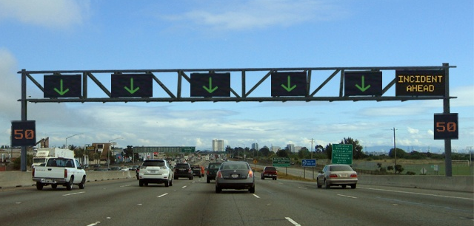
Incident Lane Management
General philosophy:
  “Close” lane(s) upstream of incident
  Use overhead gantry signs to provide warning of downstream incident/lane closure
Objective is to provide for earlier and smoother transition/lane changing in advance of incident
Notes:
25

Slide 26
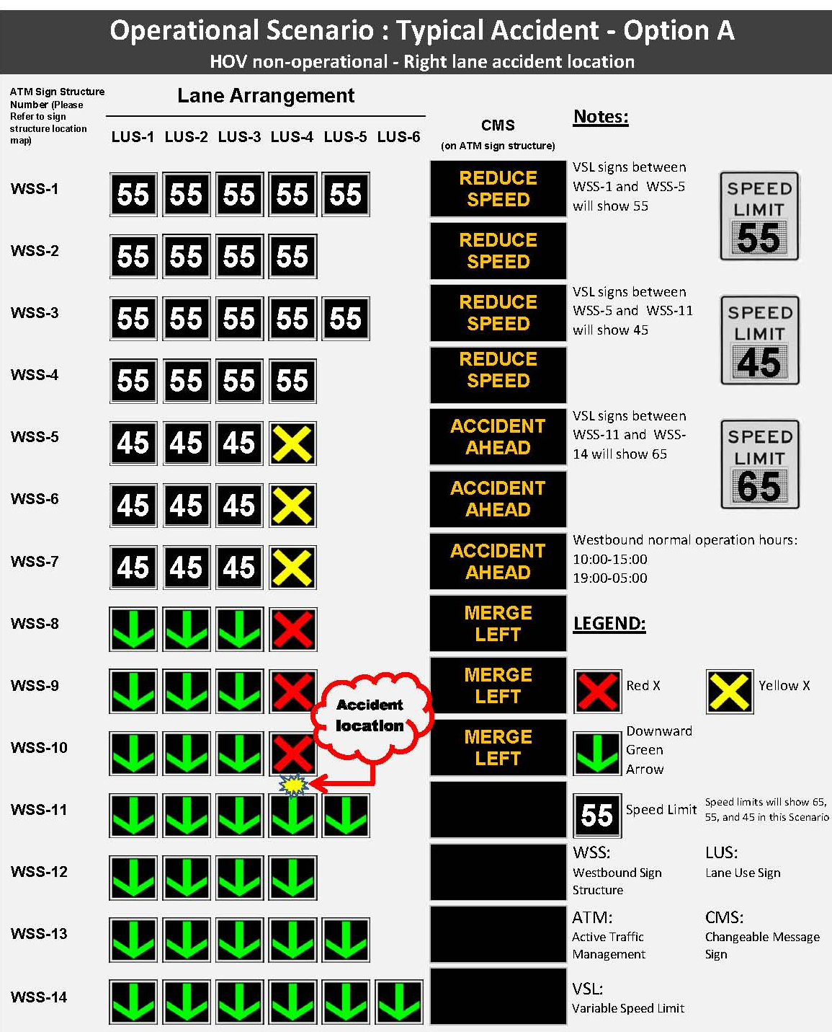
Incident Lane Management
Sample Lane Control Sign and VSL combination

Slide 27
Lane Management - Testing
Focused on AM westbound
Involves:
  Initiating incident directly within Paramics
  “Activating” lane management after a short delay to simulate time to detect incident
Tested several incident scenarios

Slide 28
Lane Management – Plug-In
Developed by CLR Analytics
Requires XML input file
  Lane closure zone/links
  Decision zone/links in which drivers change lanes
  CMS messages
  Start/end time
Notes:
28

Slide 29
Lane Management – Plug-In Model
Closure Link
Decision Link
Decision Link
Closure Link
Right lane closed ahead
Right two lanes closed ahead

Slide 30
Lane Management – Modeling Insights
Plug-in was easy and straightforward to use
Challenge:
  Validation of results
Limitation:
  “Zones” are defined by links rather than distance

Slide 31
Lane Management Results
Improved flow past incident location in all cases
Reduced delay on freeway, as well as arterials
Level of benefit varied significantly based on incident details

Slide 32
Institutional Challenges/Issues
Lack of ATM experience
  Uncertainty about how to apply/use the ATM elements
Stakeholder skepticism
Desire for “exact” results

Slide 33
Conclusions
Paramics provided excellent vehicle to simulate active freeway management strategies
New VSL module and plug-ins worked as expected – but have limitations
ICM Project is moving forward with all ATM elements, although objectives have evolved

Slide 35
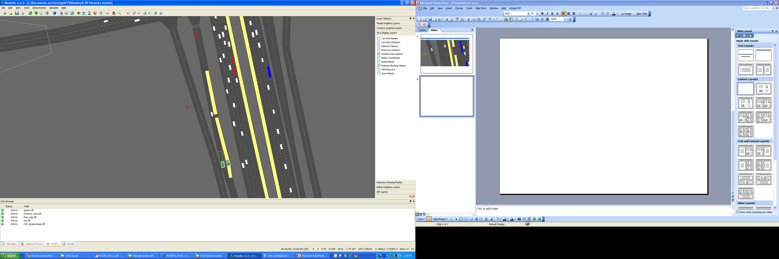

Slide 36
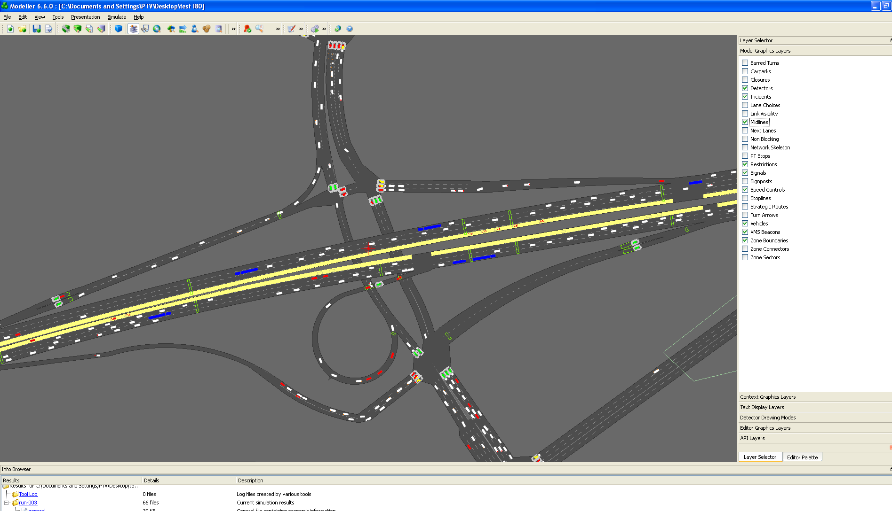

Slide 37
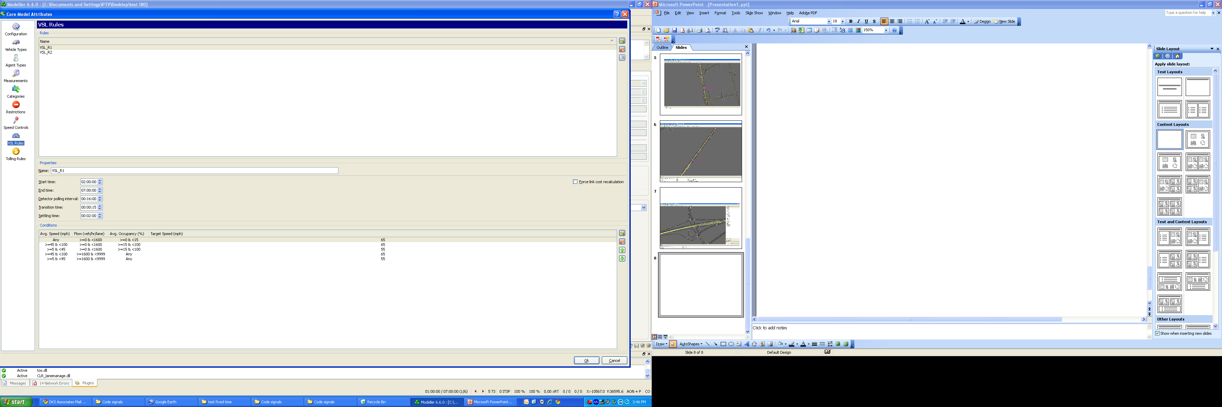

Slide 38
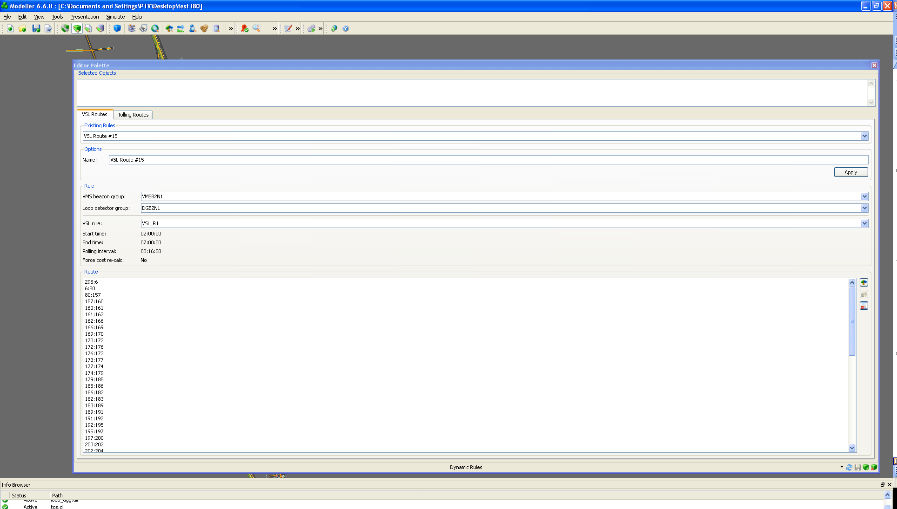

Slide 39
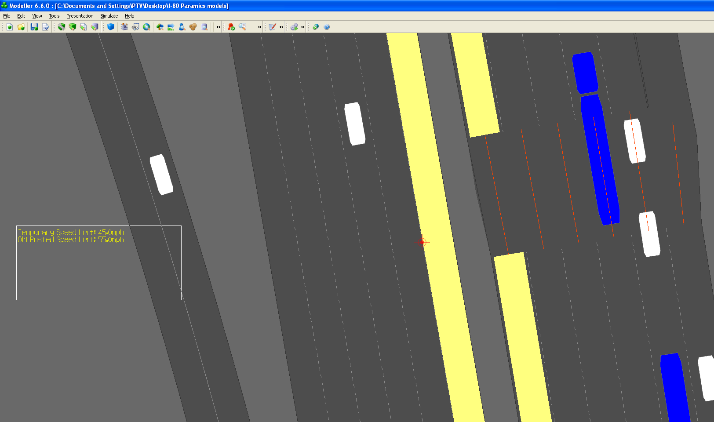

Slide 40
