Slide 1
13th TRB National Transportation Planning Applications Conference Development of a Large Scale Traffic Simulation Model to Improve the Flow of Commercial Vehicles from Maquiladora Industry to International Border-Crossings
Jose O Vidana-Bencomo, Ph.D. Candidate.
Graduate Research Assistant
Center for International Intelligent Transportation Research
Texas Transportation Institute
Rajat Rajbhandari PhD. P.E.
Associate Research Engineer
Center of International Intelligent Transportation Research
Texas Transportation Institute
Reno, Nevada May 10th, 2011

Slide 2
Agenda
Manufacturing Industry (Maquiladoras)
Mobility issues in Ciudad Juarez
Problem Statement
Goals and Objectives
Methodology
Results
Conclusions

Slide 3
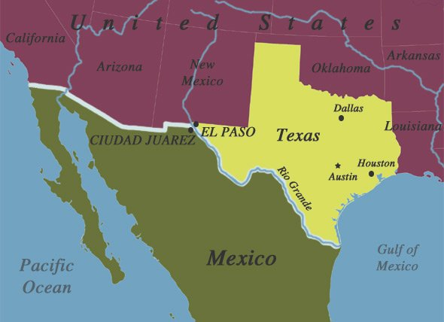
Manufacturing Industry (Maquiladoras)
The City of El Paso, Texas together with Ciudad Juarez, Chihuahua comprise the largest metropolitan area on the United States - Mexico border. POP. 2,043,514 million
The El Paso/Ciudad Juarez borderplex economy depends highly on the trade between both cities
Maquiladora industry has an important role in the economy of the borderplex
Locations of El Paso, Texas and Ciudad Juarez, México
Source: http://www.learner.org/workshops/geography/wkp1map2.html
Maquiladora industry: manufacturing twin plants
U.S side factory ship raw material and equipment to Mexico and Mexican side factory (Maquiladora) ship goods produced to El Paso
A crucial element in its process is reliable transportation of goods

Slide 4
Manufacturing Industry (Maquiladoras)
The demand for trucks crossing the border is directly related to high or low production by the maquiladoras
350 Maquiladoras (manufacturing plants)
29 Industrial Parks
Borderplex is 7th largest manufacturing center in U.S. ( 207,641 persons employed)*
El Paso is ranked 6th in truck crossing to U.S. (758,856 trucks)*
$71 Billion in trade crossed the border between El Paso and Ciudad Juarez in 2010 (Import: $41.9 Billion, Export: $29.2 Billion)**
18% trade of all trade between U.S. and Mexico**
* Source: El Paso Regional Economic Development Corporation
* * Source: Research and Innovative Technology Administration Bureau of Transportation statistics, U.S Department of Transportation, April 2011
*** Source: Texas Center for Border Economic and Enterprise

Slide 5
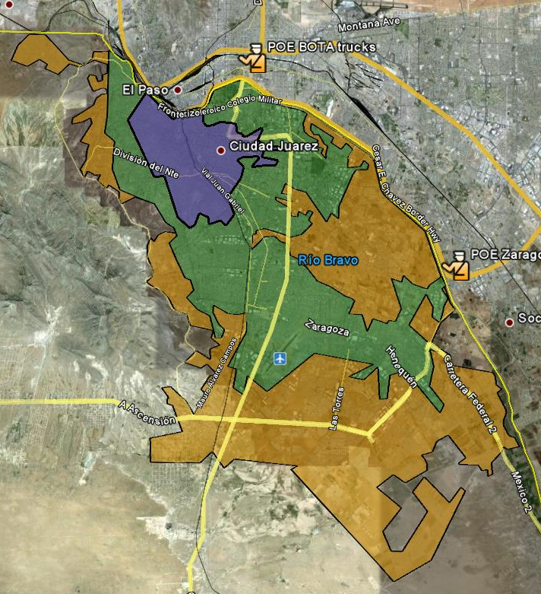
Mobility issues in Ciudad Juarez
Maquiladoras industry growth after 60’s
Ciudad Juarez could not keep up with the urban planning process.
Lack of planning due to fast expansion of the city between the 60’s and 90’s
Overloaded traffic network with mobility decreased.
In spite of the growing security issues, new companies continue to set up factories in Ciudad Juarez which attract people migration
1960
1990
2010
Ciudad Juarez growth 1960- 2011
Source: Google Map and CIG UACJ

Slide 6
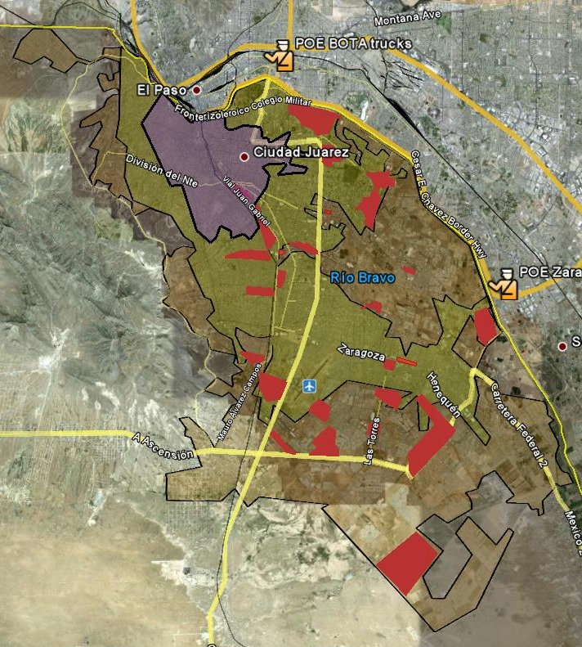
Mobility issues in Ciudad Juarez
The industrial parks that were once outside the city are now inside the city core.
Trucks delays due to the use of local and often congested inner city streets to transport products and supplies from/to the maquiladoras between Ciudad Juarez/El Paso
This situation affects the whole maquila industry
Hence, the city needs to evaluate the current traffic network and evaluate how it affects the accessibility of personal and commercial vehicles, especially to industrial parks and to the ports of entry
1980’s
1967
1970’s
1980’s
1970’s
1980’s
1990’s
1990’s
2004
Location of industrial parks in Ciudad Juarez 2010
Source: Google Map and IMIP

Slide 7
Problem Statement
Delays for truck traffic within Ciudad Juarez have increased significantly.
The delay for trucks has been exacerbated by the increasing number of accidents, limited roadway capacity, and other traffic controls.
The efficient and reliable transportation of goods is an integral part of the production process of the maquiladoras industry, so this situation affects the whole maquila industry.
Worsening mobility within the city imposes a high transportation cost to companies producing and moving goods across the border.

Slide 8
Objective
A larger goal of the project is to develop a bi-national traffic simulation model for the Ciudad Juarez-El Paso region.
The objective of this particular project is to develop a traffic simulation model for the Ciudad Juarez to highlight the importance of using a large scale microscopic traffic simulation model to analyze the mobility of commercial vehicles within the city, especially between the industrial parks in Ciudad Juarez and both freight Ports of Entry (POEs)

Slide 9
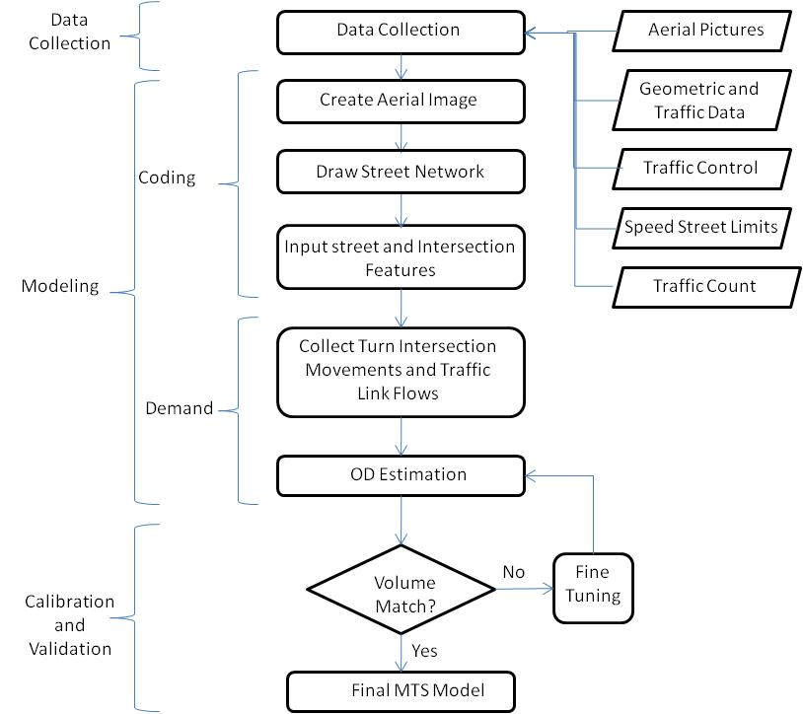
Methodology

Slide 10
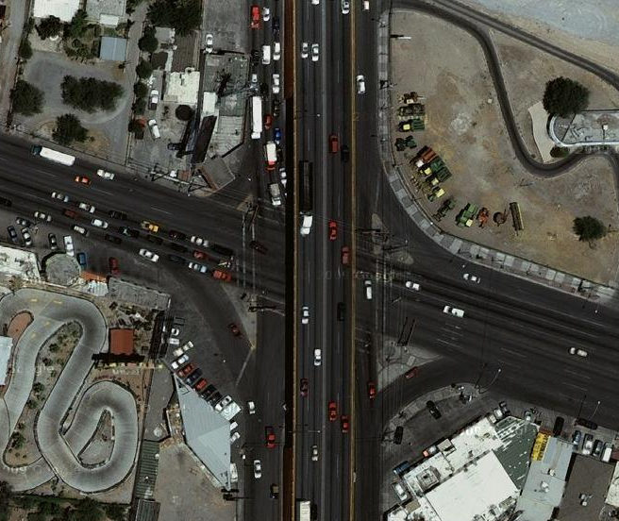
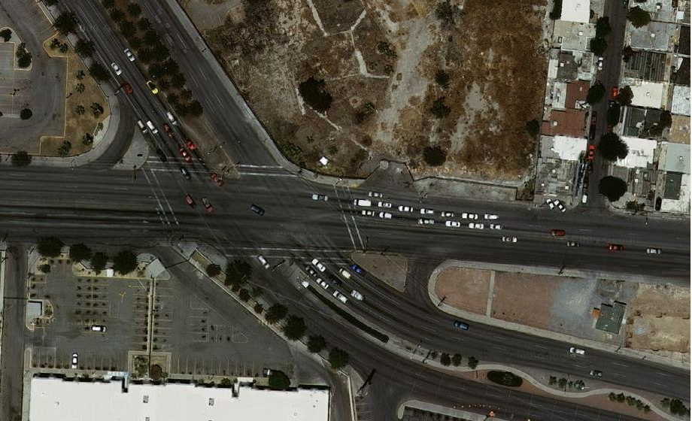
Methodology: Data Collection
Street Geometry Data
Field studies
Aerial picture views from web sources like Google earth and Google map
Aerial view of Vicente Guerrero Ave. and Tomas Fernandez Ave. intersection
Source: Google map
Aerial view of Gomez Morin Ave. and Tecnológico Ave. intersection
Source: Google map

Slide 11
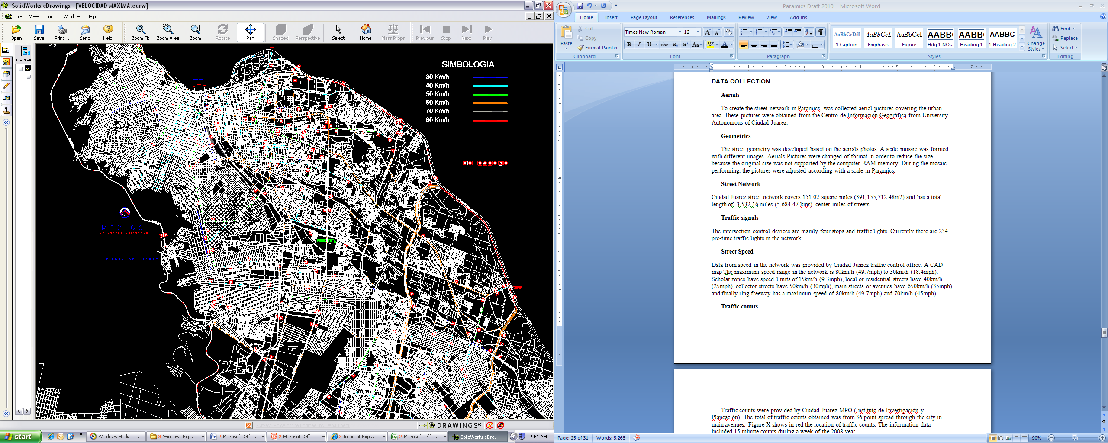
Methodology: Data Collection
Speed data
Range in the network is 80km/h (~50mph) to 15km/h (~9mph)
School zones: 15km/h (~9mph)
Downtown: 30km/h (~19mph)
Local or residential streets: 40km/h (~25mph)
Collector streets have 50km/h (~31mph)
Main streets or avenues have 65km/h (~40mph)
Independence freeway and Avenida de las Torres have 70km/h (~44mph)
Border and Camino Real freeways: 80km/h (~50mph)
Speed limit of streets in Ciudad Juarez.
Source: Traffic Control department, Municipality of Ciudad Juarez

Slide 12
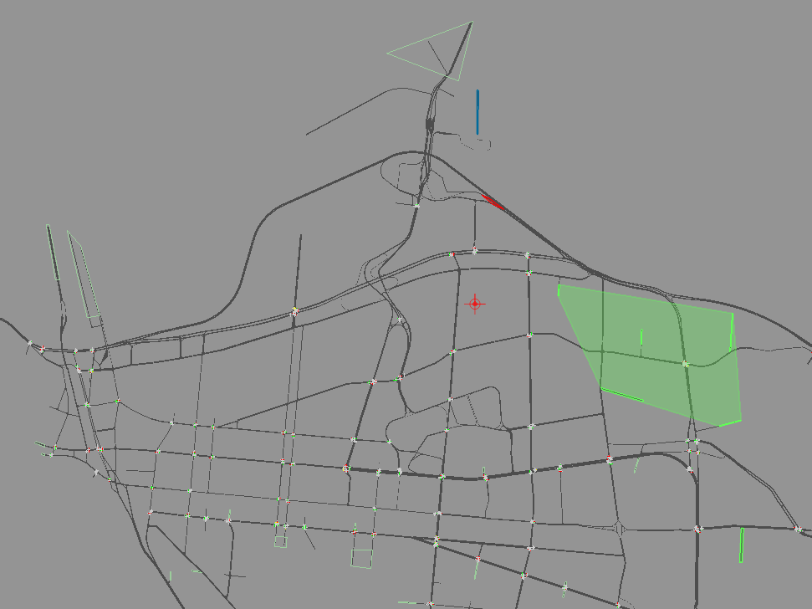
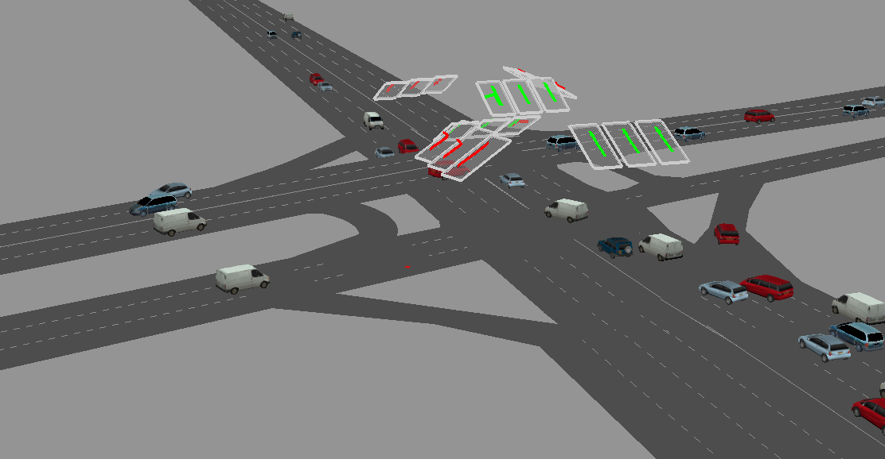
Methodology: Data Collection
Traffic Signals
The data on signal timing of traffic lights were obtained from the traffic control office.
204 pre-timed traffic lights (238 total in the city)
Snapshot of traffic light modeled .
Snapshot of the network modeled with traffic lights intersections

Slide 13
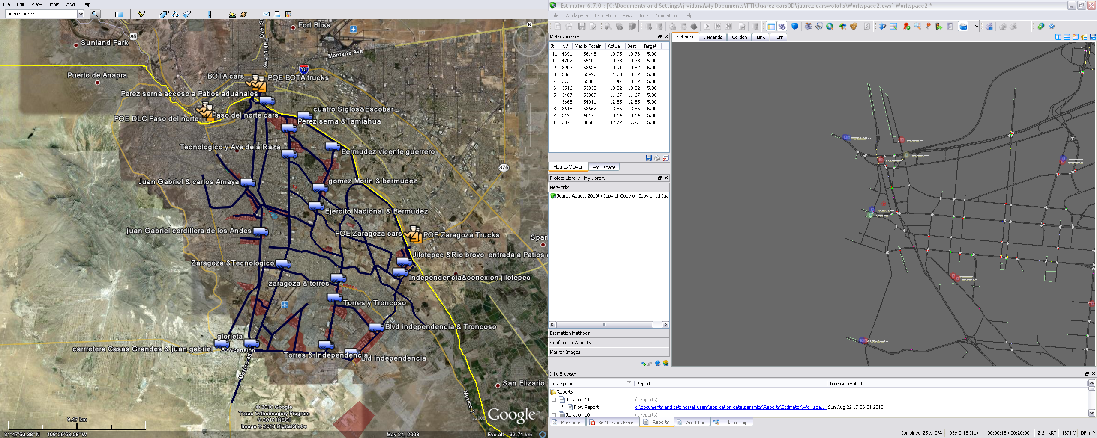
Methodology: Data Collection
Traffic volumes
19 turning movement data collections
Intersection locations with trucks routes from maquiladoras and ports of entry with access to trucks.
Obtained during typical days in the morning peak-hour (7:00-8:00).
Classification of vehicles including the categories of cars, buses, trucks.
Intersection Movement Count Locations in Ciudad Juarez.
Source: Google Maps

Slide 14
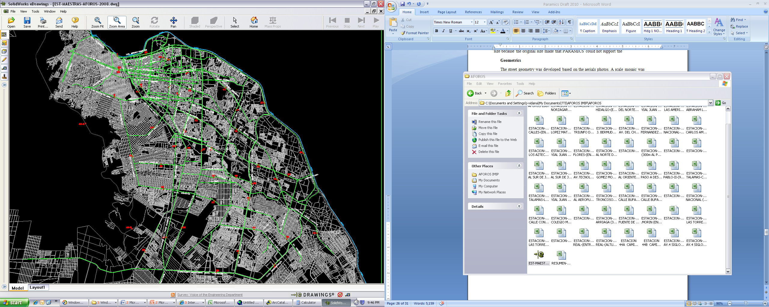
Methodology: Data Collection
Traffic volumes
Traffic counters data base provided by IMIP (Ciudad Juarez MPO).
This data was used in links where trucks are not allowed to travel such as downtown and minor streets.
Traffic from BOTA and Ysleta ports of entry were obtained from field studies.
Traffic Count Locations in Ciudad Juarez network
Source: IMIP

Slide 15
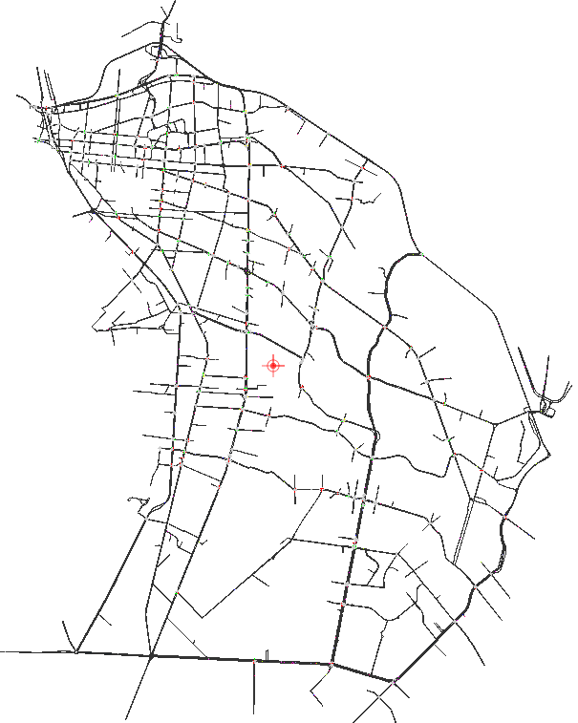
Methodology: Modeling
Coding the street network
Traffic lights and signal timings other traffic control locations
Turning movement of each lane of intersections
Roundabouts
Traffic restrictions on certain vehicle types
5,513 links
Total distance of 560miles
204 traffic signals
Snapshot of Ciudad Juarez Roadway Network in Paramics.

Slide 16
Methodology: Modeling
Obtaining O-D
Obtaining the demand (origin-destination) matrix to assign the traffic flow in the MTS model
The traffic demand was obtained as a function of an estimated O-D_{m}.
Data used:
126 traffic counts obtained from the intersection movement field data collection
Ports of entry traffic counts
Data base provided by IMIP
Two O-Ds obtained: Vehicle and Trucks
Snapshot of Ciudad Juarez Roadway Network in Paramics.

Slide 17
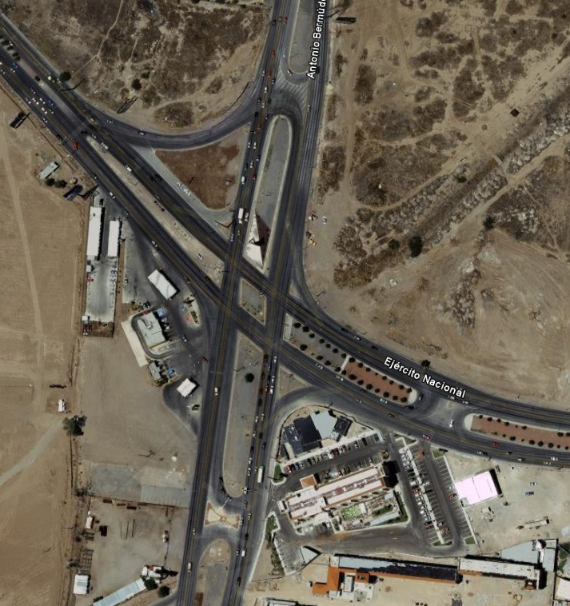
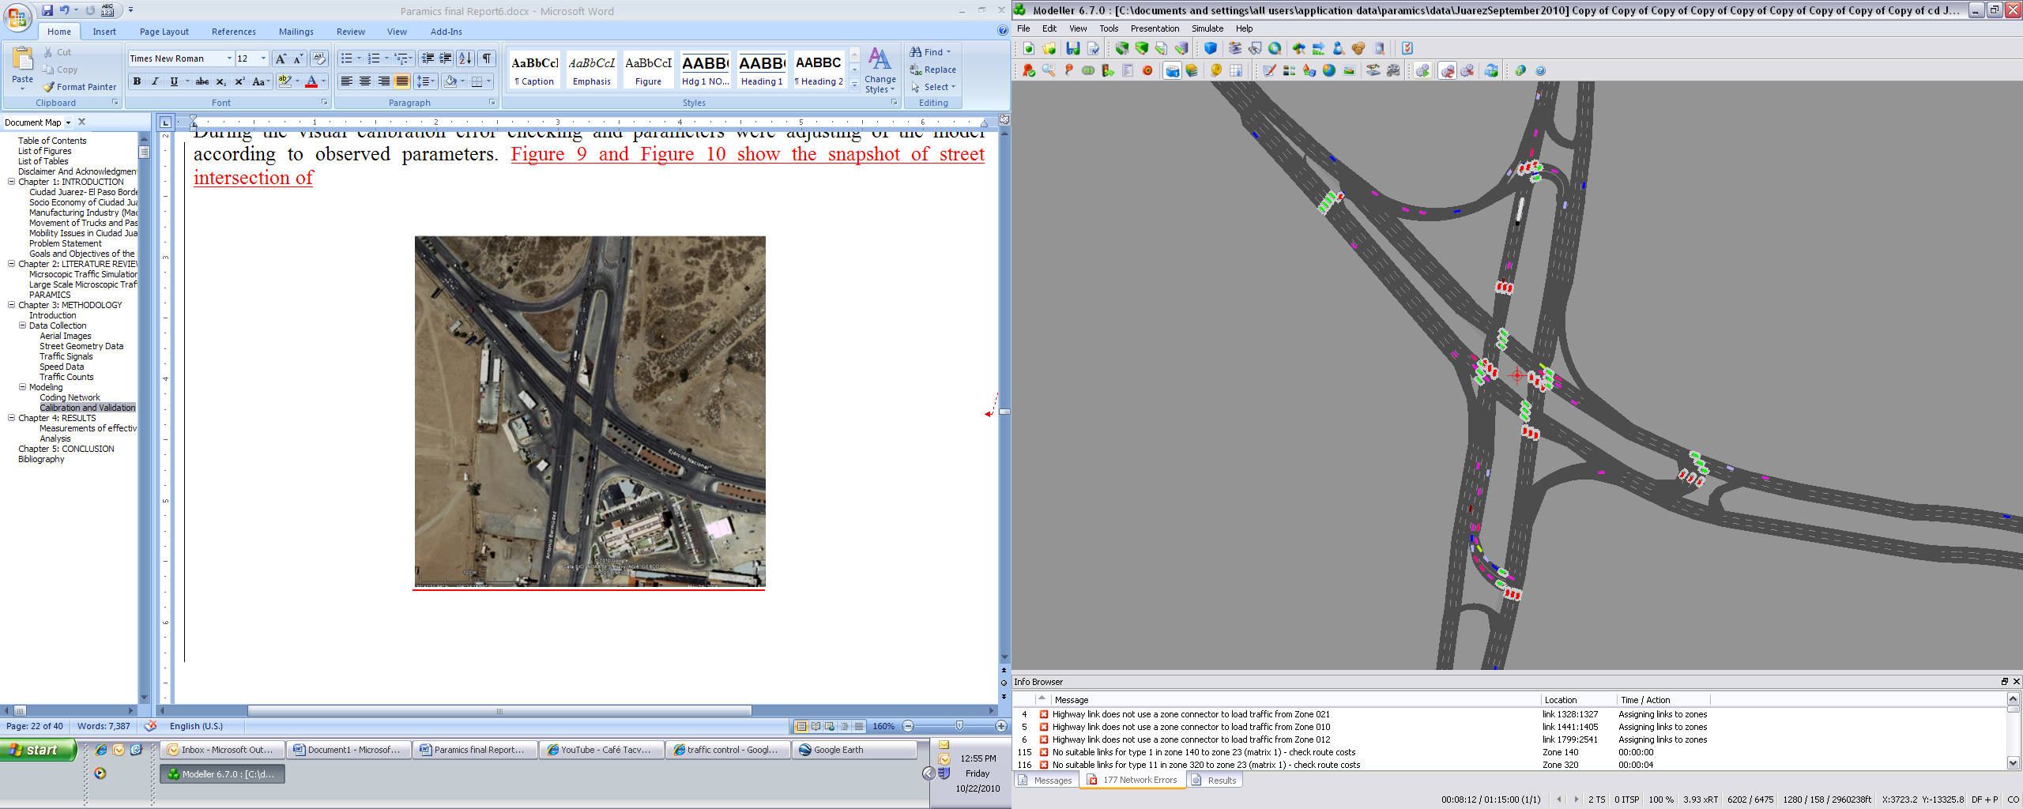

Methodology: Modeling
Calibration
Visual Process
Evaluate the behavior of the traffic in the network
Identify not precise O-D paths to represent movements of the traffic in the network
Detect inappropriate behavior of vehicles in the network
This evaluation applied to:
Intersections
Freeways
Forbidden movements
Traffic lights
Traffic flow calibration
Compare and fine-tuning traffic flow in the model.
Traffic Observed and estimated is compared using GEH (Geoffrey E. Havers)
Aerial view of an Median U-Turn Intersection Treatment (MUTIT)
Source: Google
Snapshot of MUTIT Intersection

Slide 18
Results
Analysis
Evaluate the commercial freight movement between various industrial parks in Ciudad Juarez and the two main entrances for trucks from the city to both ports of entry.
Origins: traffic zones which included the industrial parks
Destinations: traffic zones located at the entrance of the Mexican customs facilities at the ports of entry.
Defined truck routes represent the shortest time path available as result of assignment network process (dynamic feedback).
MOEs: Simulated travel time and delay.
Modeled travel time: total truck average travel time from origin to the destination.
Delay: difference between the modeled travel time and free-flow travel time. Delay includes the average delay due to traffic congestion and traffic control devices.

Slide 19
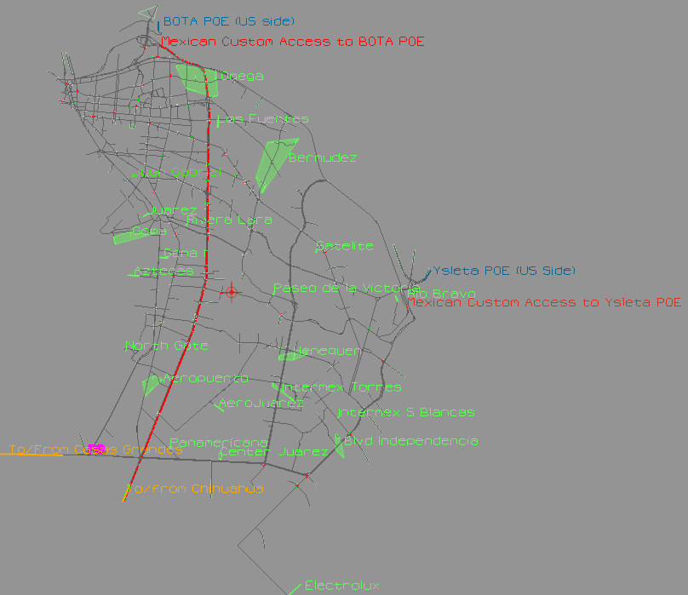
Results
Truck paths
Different paths obtained of trucks traveling from industrial parks of Ciudad Juarez to the entrance of Mexican custom facilities in the POEs: Ysleta and BOTA.
The truck traffic from Chihuahua and Casas Grandes highways entering Ciudad Juarez with destination to both ports of entry also were evaluated
Industrial parks coded in the MTS model of Ciudad Juarez

Slide 20
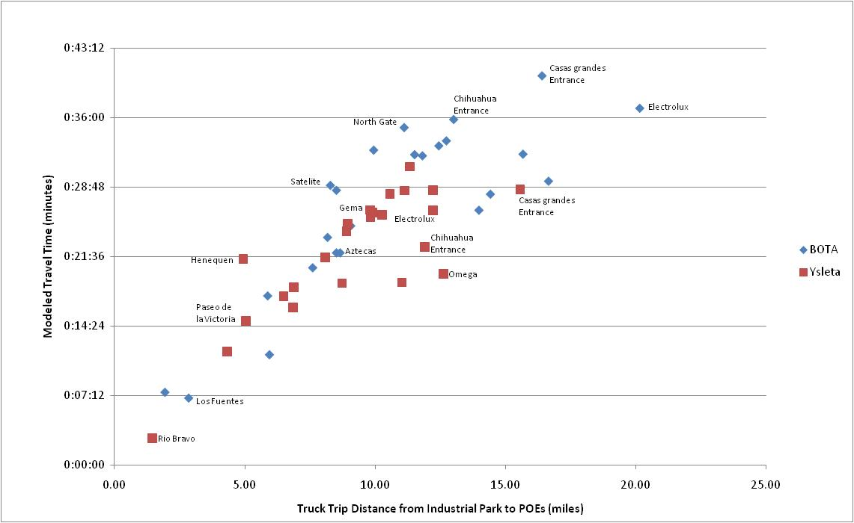
Results
Delay caused by minor streets
Total modeled travel time indicate that the longer the travel distance connecting them the longer the travel time
Comparison of simulated travel of commercial vehicles between individual industrial parks and both ports of entry

Slide 21
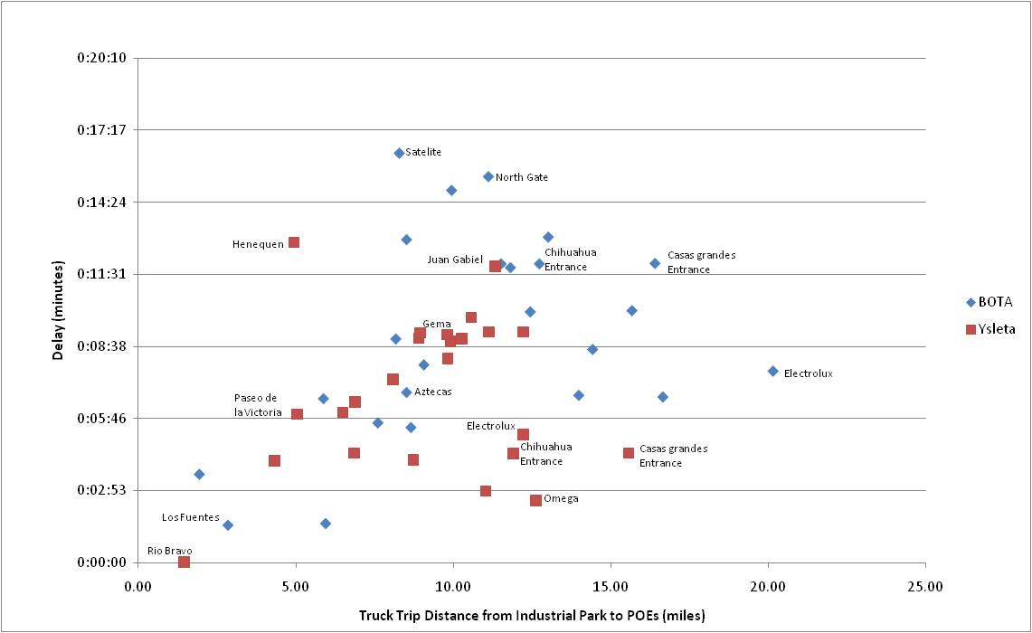
Results
Delay caused by minor streets
Delay is not correlated with the travel distance
Delay is caused by the traffic of the network particularly in minor streets.
Trucks with longer trips using freeway corridors have lower delay than trucks with shorter distance trips that use urban streets which are usually congested.
Comparison of delay of commercial vehicles between individual industrial parks and both ports of entry.

Slide 22
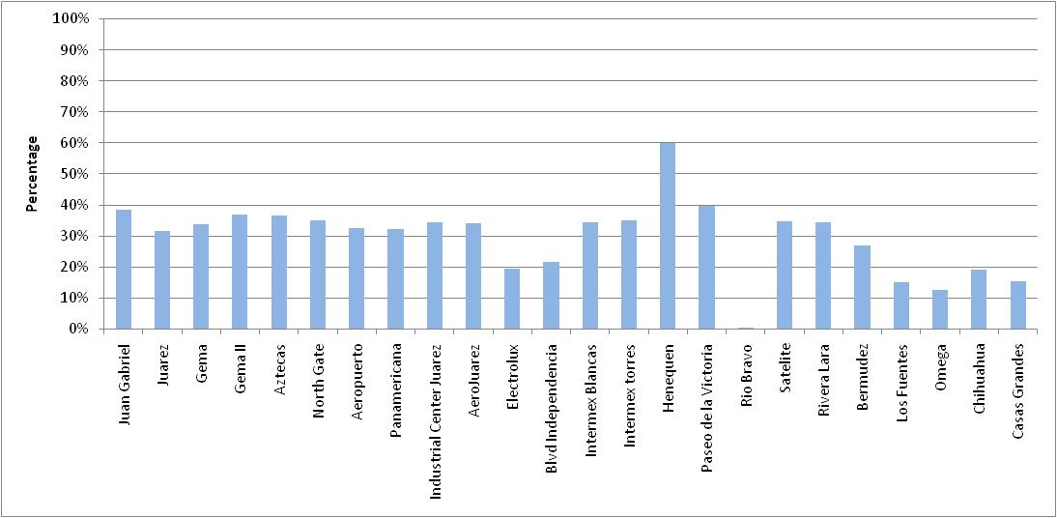
Results
Average Percentage of delay
Average percentage of delay incurred to trucks traversing between industrial parks and the Ysleta port of entry is approximately 32% of the total travel time.
Percentage of delay incurred to trucks originating from different industrial parks and both highway entrances to Ysleta (Zaragoza Bridge) port of entry

Slide 23
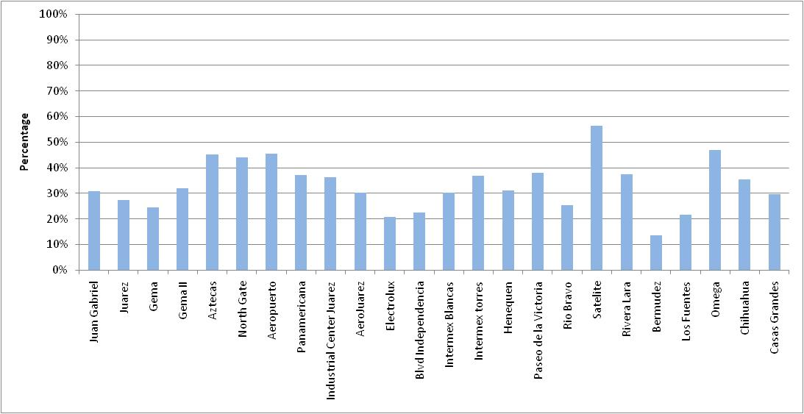
Results
Average Percentage of delay
In the case of the port of entry BOTA, delays represent a 35% of the total travel time.
Percentage delay incurred to trucks originating from different industrial parks and both highway entrances to BOTA (Americas) port of entry

Slide 24
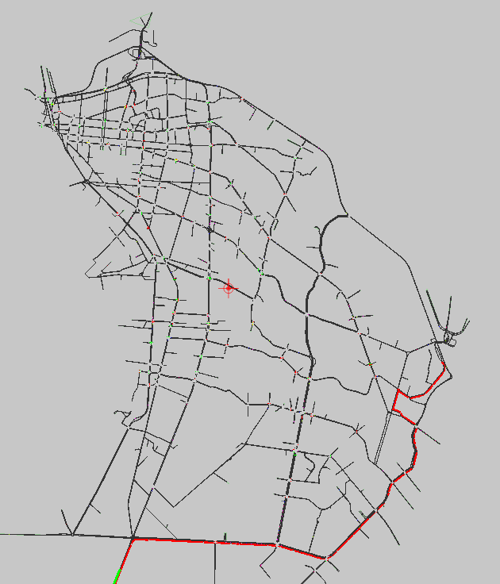
Results
Delay on truck paths segments
The simulation model also provides delay incurred by trucks on different segments that form a path of trucks traveling from the industrial parks and highway entrances to both ports of entry.
Chihuahua highway entrance to the Ysleta port of entry path.
Delay on segments of a path from the Chihuahua highway entrance to the Ysleta port of entry.
Path of trucks traveling from the Chihuahua highway entrance to the Ysleta port of entry

Slide 25
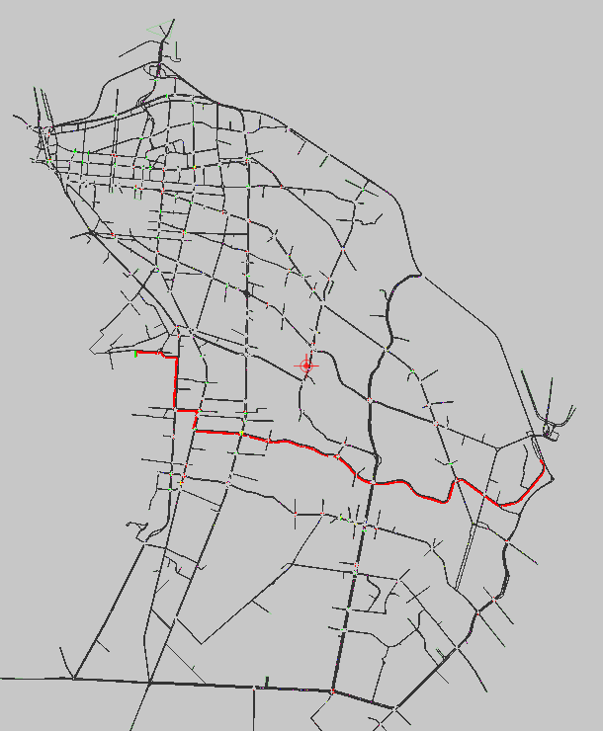
Results
Delay on truck paths segments
I.P. Gema and Ysleta POE path
Delay on segments of a path from Gema to the Ysleta port of entry
Path of trucks traveling from Gema to theYsleta port of entry

Slide 26

Results
Delay on truck paths segments
I.P. Independencia to the BOTA port of entry
Delay on segments of a path from Independencia to the BOTA port of entry
Path of trucks traveling from Independencia to the BOTA port of entry

Slide 27
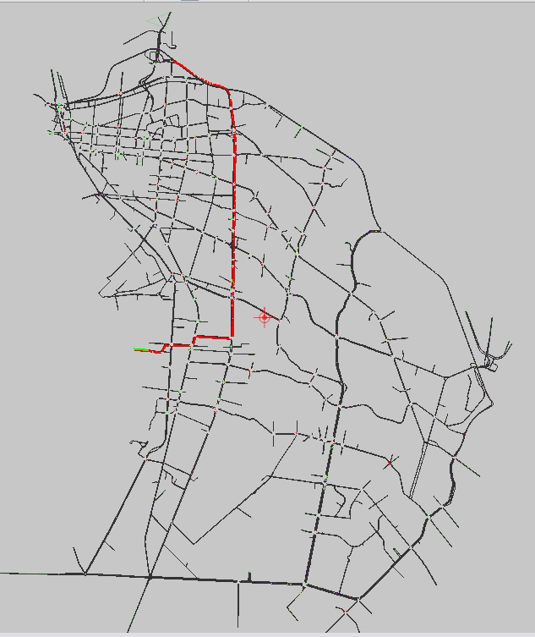
Results
Delay on truck paths segments
I.P. Aztecas to BOTA port of entry
Link delay of the path of trucks traveling from I.P. Aztecas to BOTA port of entry
Path of trucks traveling from Aztecas to BOTA port of entry

Slide 28
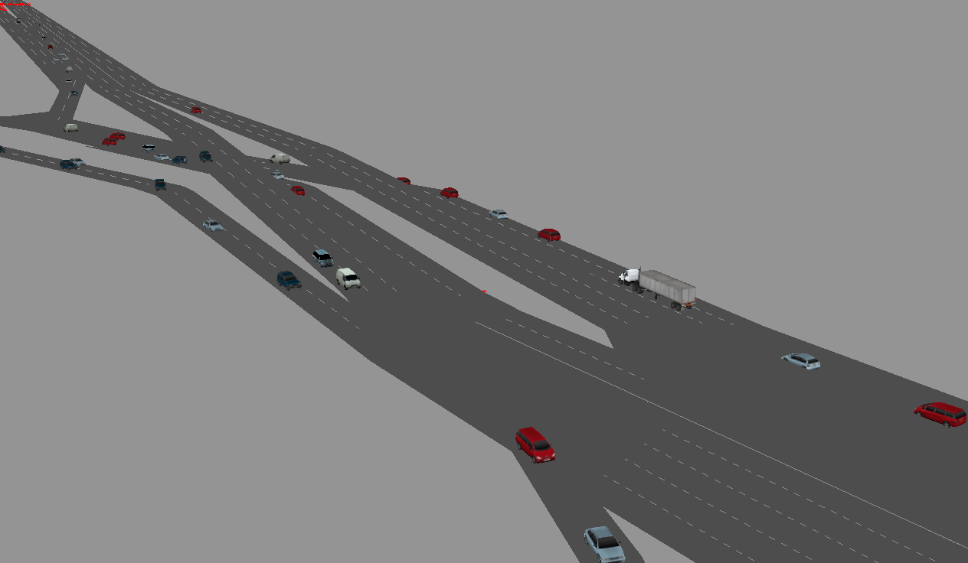
Results
Visualization

Slide 29
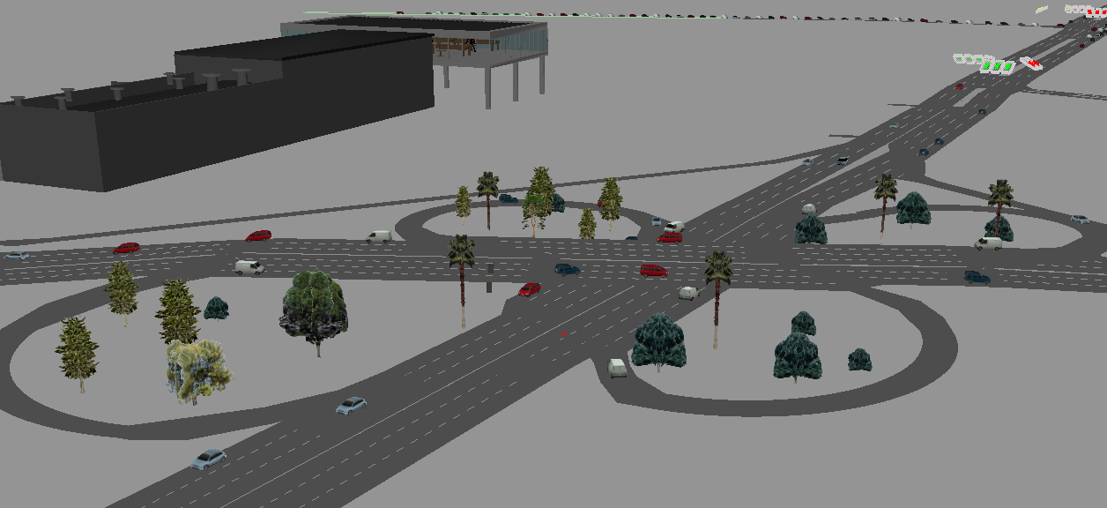
Results
Visualization

Slide 30
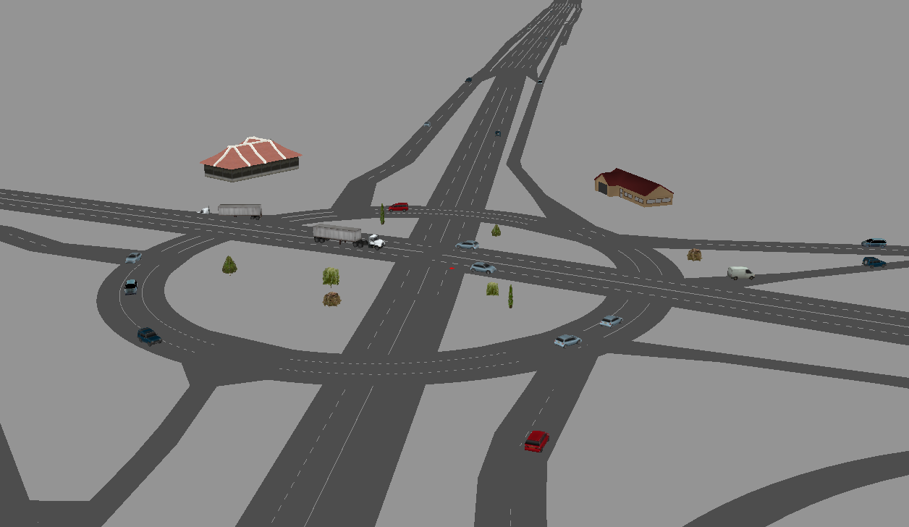
Results
Visualization

Slide 31
Conclusion
The simulation model developed in this research demonstrated various scenarios of truck paths connecting industrial parks to ports of entry.
The analysis showed that the delay on truck paths is attributed to congestion in the inner urban areas, while freeways surrounding the city provide reliable access to the ports of entry
Delay contributes to 30-40% of the travel time of trucks moving between industrial parks and the ports of entry
Delay translates into higher cost of shipping and moving goods
The results derived from the model will relay a strong need for improved planning and operation of transportation infrastructure in Ciudad Juarez
The MTS model provides to planners and decision makers tools to improve the flow of trucks and develop infrastructure improvement plans benefiting the borderplex economy

Slide 32
Thank you
Contact:
Jose Osiris Vidana Bencomo
Graduate Assistant Research
Center of International Intelligent Transportation Research
Doctoral Student at University of Texas at El Paso
(915) 532-3759 Ext. 14102 · fax (915) 532-376
jovidana@miners.utep.edu
Rajat Rajbhandari PhD. P.E.
Associate Research Engineer
Center of International Intelligent Transportation Research
(915) 532-3759 Ext. 14102 · fax (915) 532-376
rajat@tamu.edu

