Slide 1
An Integrated Travel Demand, Mesoscopic and Microscopic Modeling Platform to Assess Traffic Operations for Manhattan, New York
TRB 13th Transportation Applications Conference
Vassilis Papayannoulis, Ph.D.
with
New York City Department of Transportation
Michael Marsico, P.E.
May 10, 2011

Slide 2

Manhattan Network Complexity
Congestion
Grid structure
Parking
Pedestrians and bikes
Buses
Taxis

Slide 3

Manhattan Network Complexity (continued)
Truck deliveries
Traffic enforcement agents
Managed-use lanes
Traffic signal coordination
Bridge and tunnel operations

Slide 4
Available Models
The Regional Activity-Based Travel Demand Model (NYMTC’s Best Practice Model (BPM))
Other agency activity or four-step travel demand models
Individual project-based microsimulation models that cover a subarea or an individual corridor

Slide 5
The Genesis of the Model
Traffic stipulations historically were based on knowledge of the network and the anticipated impacts
There are programmed and existing major construction projects throughout the network
It became apparent to NYCDOT that there was a need for an analytical tool that would permit the assessment of network-wide cumulative impacts
The first application is the proposed 34th Street Transitway

Slide 6
34th Street Transitway Modeling Goals and Objectives
Develop a modeling platform to assess operational conditions in the Manhattan CBD, emerging from the proposed 34th Street Transitway design
Develop a modeling platform to assist in the refinement of proposed design for the 34th Street Transitway
Develop a modeling platform that could be used in the assessment of cumulative impacts on other current/future regional and local projects
Develop a base network that could be a cornerstone for future analyses and or expansion to other boroughs

Slide 7
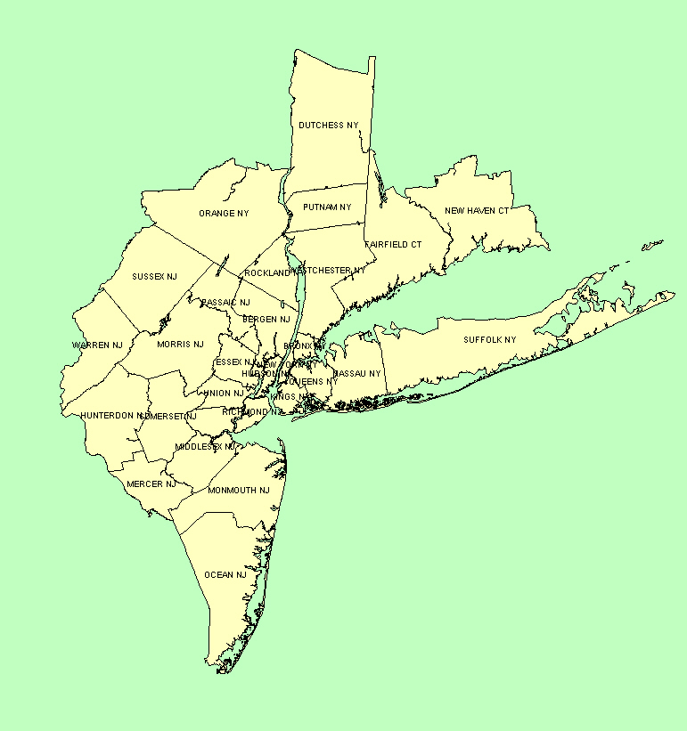
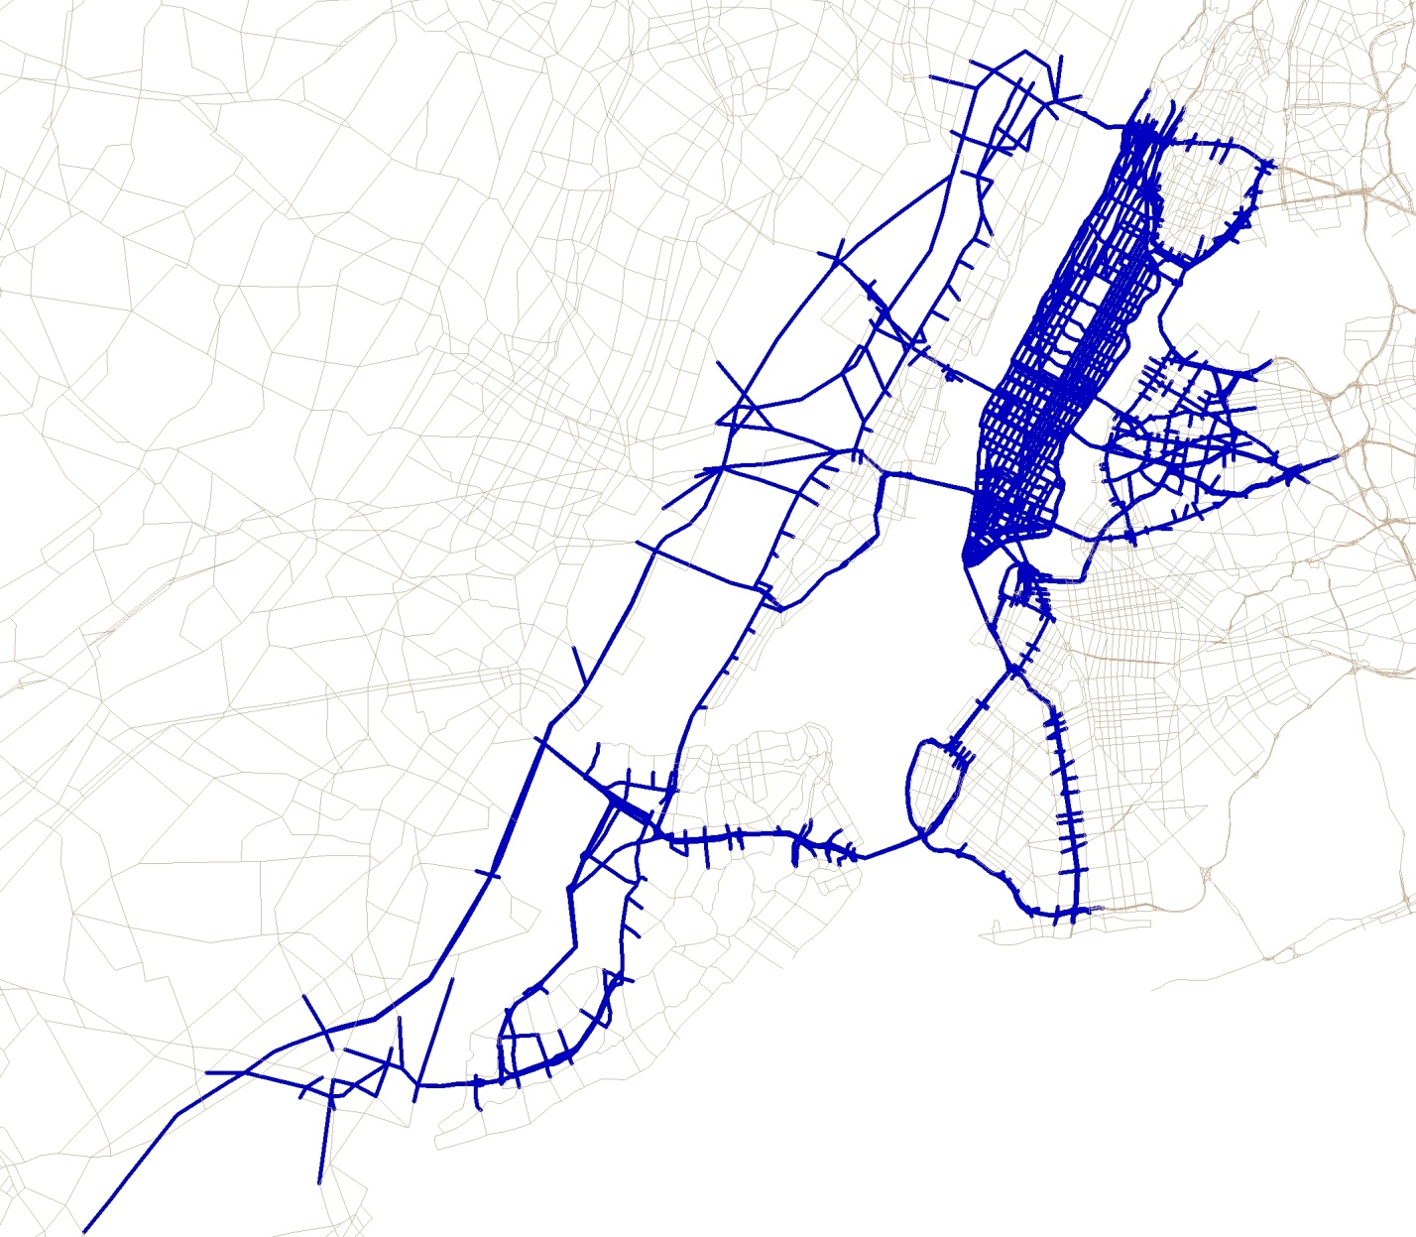
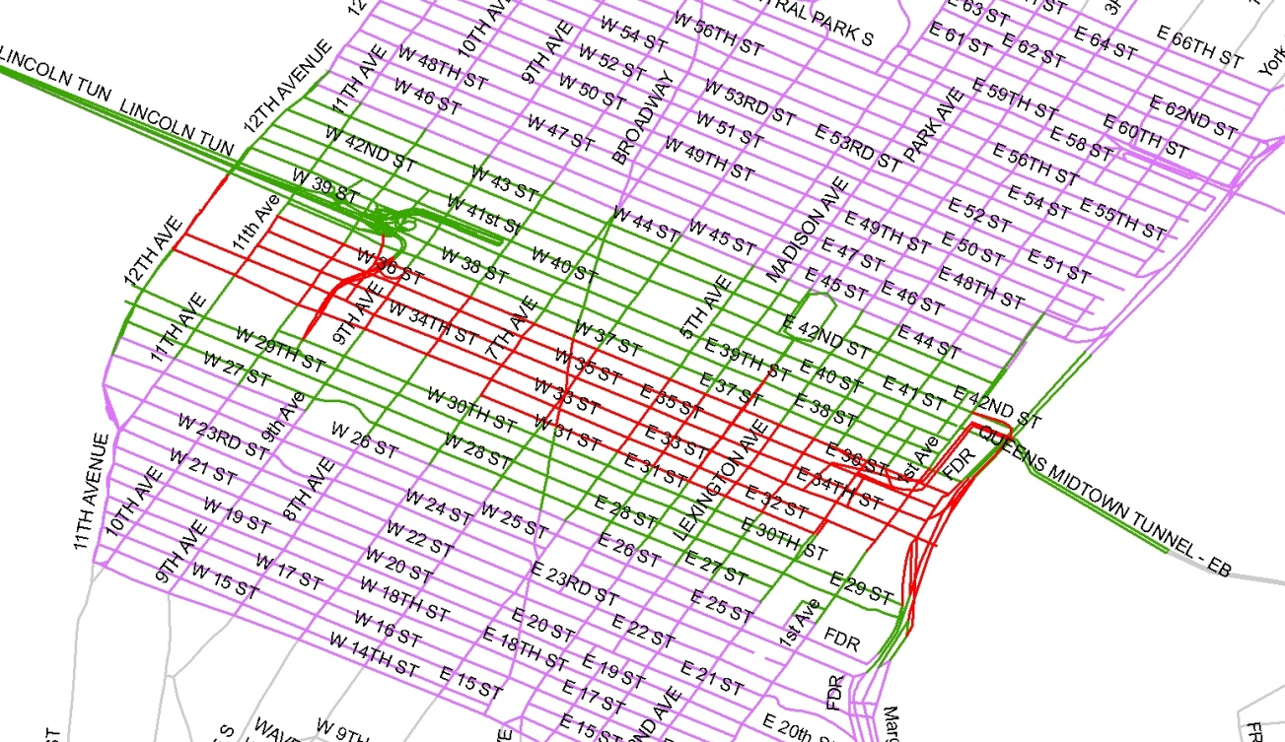
Multiresolutional Model Benefits
“Step-down” from the regional model (BPM)
Link travel demand forecasting
and traffic operations
Align program and project development processes
Better support robust and inform decisions
Provide the basis for a decision-support system
MACRO
MESO
MICRO
Notes:
7
7

Slide 8
Benefits of Utilizing a Mesoscopic Model
Data from mesoscopic model can be fed directly into microsimulation/traffic operations analysis
Used where the operational capabilities are needed but a microsimulation model may not be feasible due to
  Network size
  Limited resources available
More precise and cost-effective method of alternatives screening without microsimulation of every alternative
Notes:
8

Slide 9
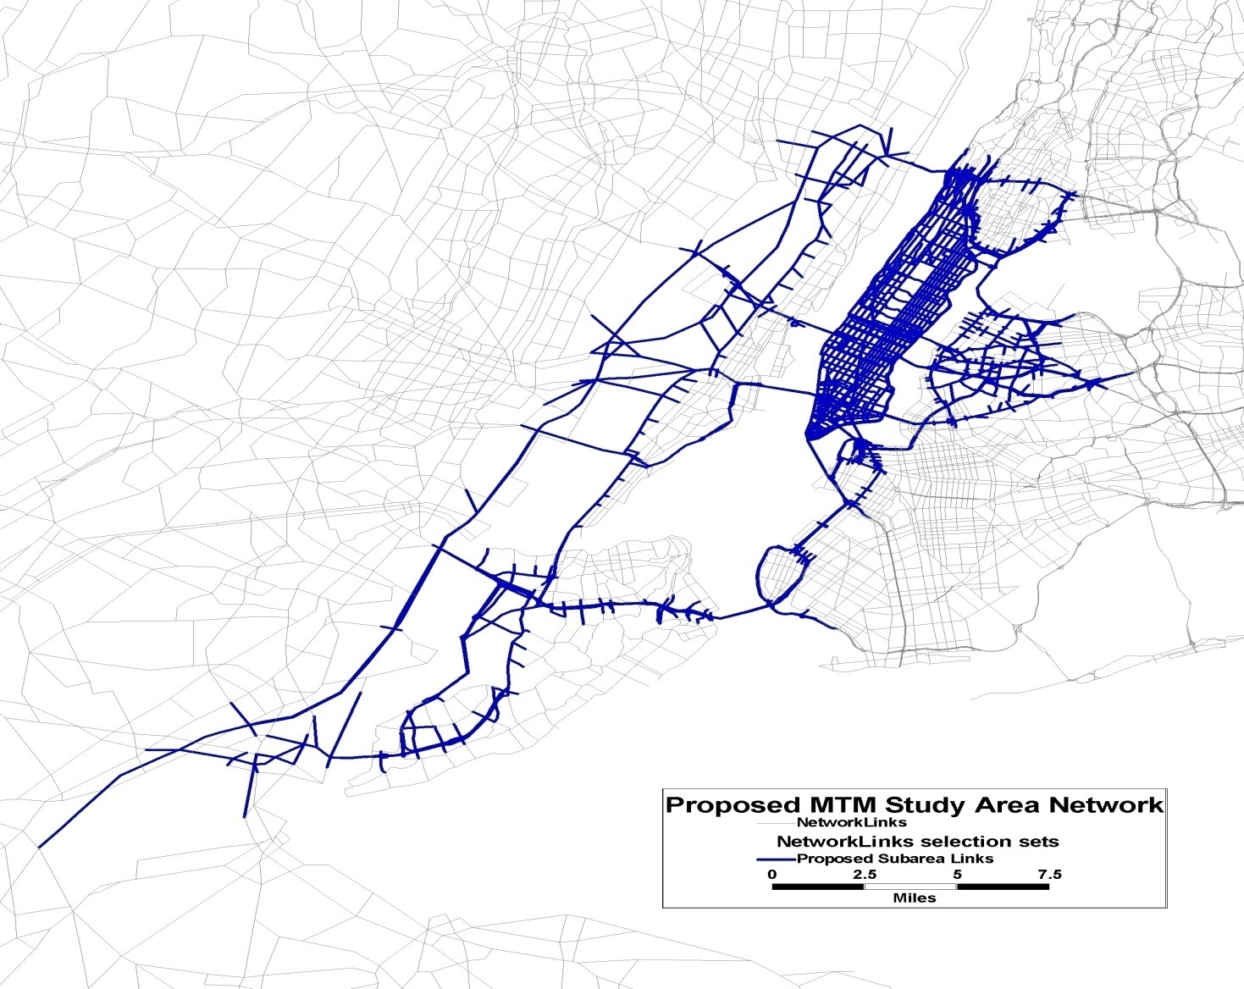
Manhattan Traffic Model Study Area

Slide 10
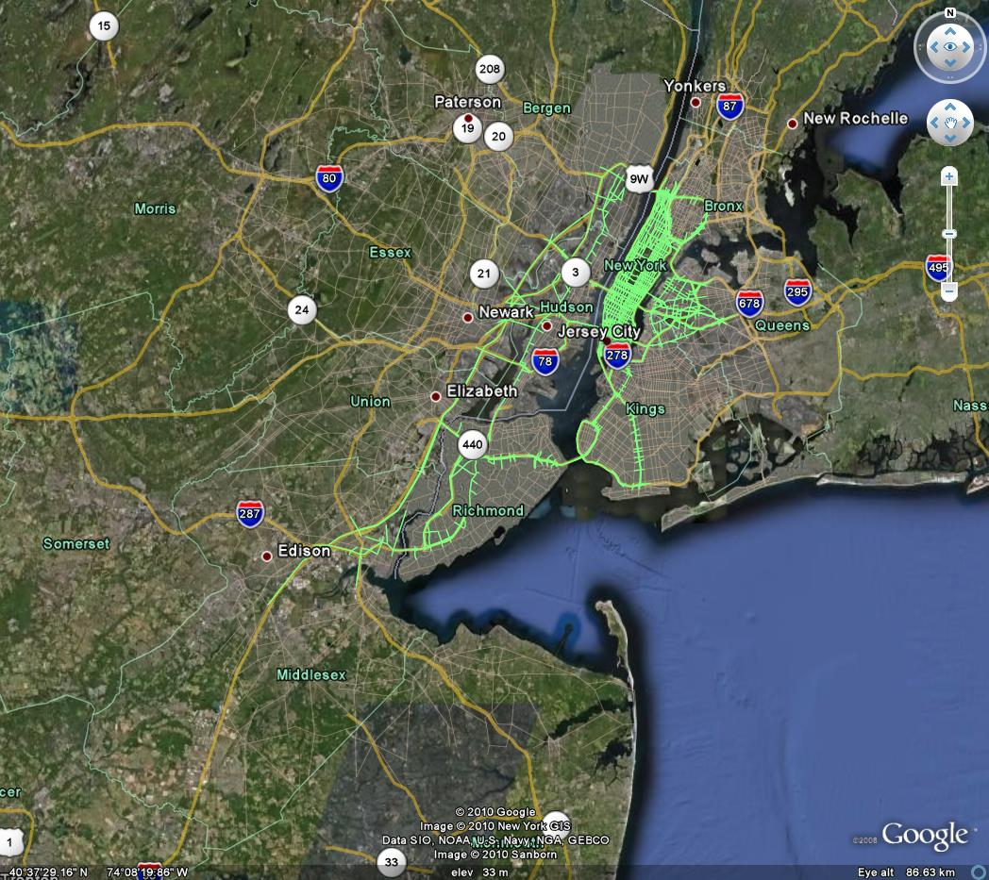
Manhattan Traffic Model Geography

Slide 11
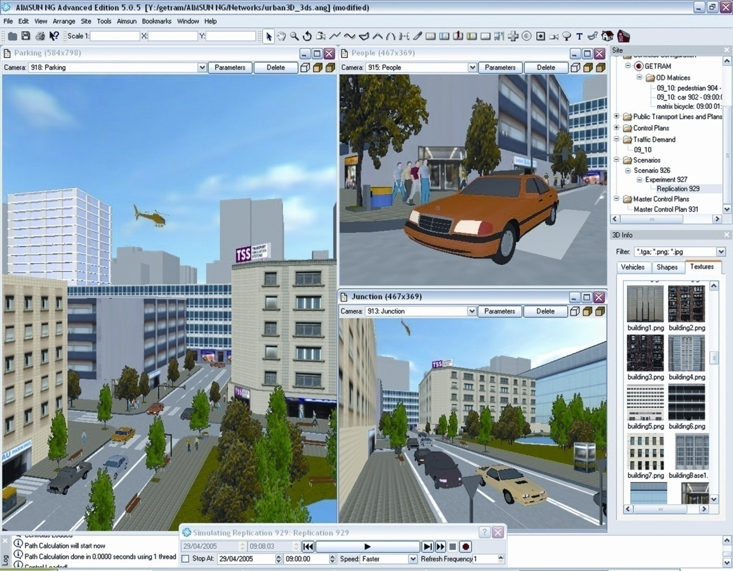
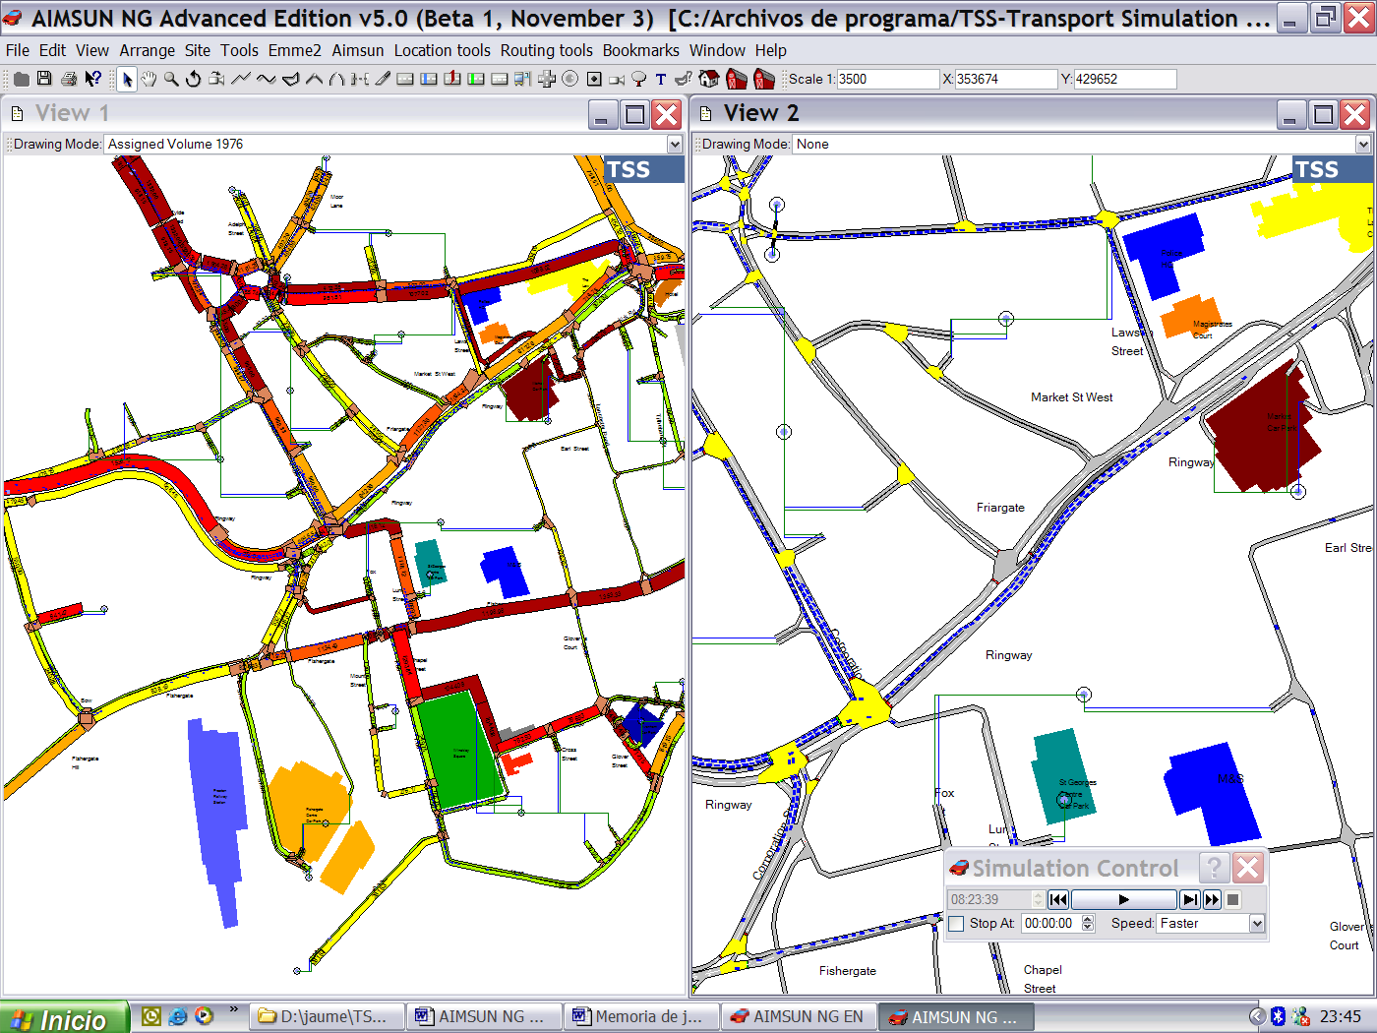
Aimsun
Integrated Transport Modeling
Macro, Meso, and Micro
Simulation Management Forecasting
Planning Control Visualization
Notes:
Aimsun 6 features a new mesoscopic simulator integrated with TSS’s existing macroscopic and microscopic models into a single software application. Having a range of models at their fingertips will enable Aimsun users to tackle problems of any size and complexity: from a single intersection to a large regional network. The tight integration between the three models opens up the possibility to mix and match different modeling approaches during the same project: increasing granularity in congested areas but maintaining overall consistency.

Slide 12
Large Scale Model Challenges
Data availability
Data collection
OD matrices
Model structure
Coding procedures
Temporal distribution

Slide 13
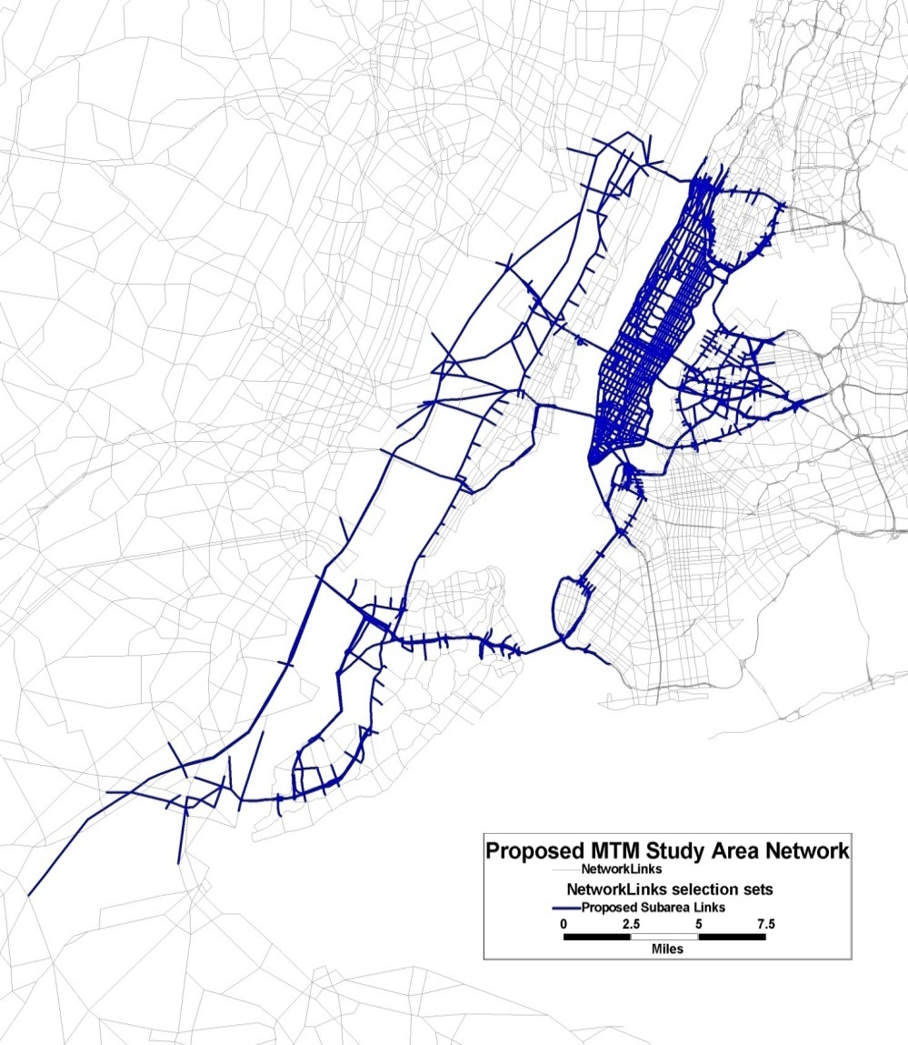
Large Scale Model Challenges (continued)
Validation
Calibration
Mode shift
Tunnel and bridge operations
Impact of various scheduled projects

Slide 14
Analytical Issues
Origin-destination (OD) matrix estimation
Network geometry and coverage detail
Duration of simulation
Vehicle types to be modeled
Level of validation (strategic versus local)
Temporal distribution data source
Software adaptation

Slide 15
Meso Trip Table Development
Validation of NYMTC’s BPM model at the boundaries
of the mesoscopic study area
Extracted trip table for meso model will need adjustment
Origin-destination matrix estimation techniques (ODME)
OD surveys to enhance “seed” table available
Vehicle types (autos, taxis, and trucks)
Taxi GPS data
Initial temporal distribution based on the BPM

Slide 16
Manhattan Traffic Model
OD Trip Table Development
BPM (TransCAD)
Peak-Period Trip Tables
Subarea Extraction
Trip Table Disaggregation
PLUTO Data
Taxi GPS Survey
Origin Destination
Matrix Estimation
Bridge and Tunnel Survey Data
Count Data
Time of Day
(Diurnal Distribution)
Simulation Model (Aimsun)

Slide 17
Network Development
Review of network and zone characteristics of the BPM model, the Broadway model, the Lower Manhattan model, and the Canal model, and the potential for conversion to Aimsun
Network coverage, zone structure, and loading methodology
Consistency of meso- and micro-networks
Review of available topological databases

Slide 18
Network Development (continued)
Data availability or new data collection efforts to support the operating characteristics of the meso- and micro-models (e.g., signal timings, saturation flow rates, etc.)
Field data collection, including parking regulations

Slide 19

Primary Study Area Data Collection
Parking regulations
Number of lanes
Intersection geometry
Signal timings
ATRs
Turning movement counts
Travel-time observations
Curbside activity

Slide 20
Calibration/Validation
Key Issues
Strategic versus Local
Selection of the calibration parameter values that best reproduce current route choice patterns
Selection of the appropriate calibration
parameter values to best match locally measured data
Validation of the microscopic model utilizing ODs
and routes from the mesoscopic model
Validation of the models against traffic counts and system performance measures, such as travel time and queues

Slide 21
Calibration/Validation
Network, Data, and Routing Activities
Migration of the regional travel demand highway and transit networks to the model proved to be more challenging than originally anticipated
Field data and model traffic operations consistency
Trip table adjustments
Differentiating reaction times by study area
Reconciliation of field observed turning movements
and driver behavior

Slide 22
Calibration/Validation
Network, Data, and Routing Activities (continued)
Incorporation of toll and distance variables in the Initial and Dynamic Cost function
Development of Initial and Dynamic Cost functions
by vehicle type
Testing of route choices utilizing one or more previous travel-time intervals
Testing a variety of values for the toll, distance, and capacity attractiveness coefficients in the cost functions
Local look-ahead distance adjustments

Slide 23
Calibration/Validation
Model Application
Testing the Dynamic User Equilibrium (DUE)
with a variety of number of iterations (10-100)
Testing One-Pass Dynamic Traffic Assignment (DTA)
Testing combinations of DTA and DUE
Testing one and multiclass assignments

Slide 24
Calibration/Validation
Software Adaptation
Custom script development to deal with dynamic parking regulations
Custom scripts to deal with dynamic lane connection (turning movements)
Modified-lane distribution to better accommodate short and wide sections
Custom view scripts
Custom feedback of paths as an initial starting point
for the DUE

Slide 25
Manhattan Traffic Model Team
NYCDOT
STV
Cambridge Systematics, Inc.
Transport Simulation Systems

Slide 26

An Integrated Travel Demand, Mesoscopic
and Microscopic Modeling Platform to Assess Traffic Operations for Manhattan, New York
Thank You
Questions?

