Slide 1
GIS-Based Framework for Modeling
Non-Motorized Transportation
Jeremy Raw
Brian Gardner
Office of Planning
Federal Highway Administration
March 29, 2011

Slide 2
Roadmap
Motivation
Purpose and Need
Analysis Techniques
Toolbox Design

Slide 3
Roadmap
Motivation
Purpose and Need
Analysis Techniques
Toolbox Design

Slide 4
Motivation
US DOT Focus on Livability
  Support Effective Non-Motorized Planning
Provide Useful Tool
  Low cost
  Easy entry
  Powerful capabilities
Disseminate Research
  Extensible: Easy to add new analytic methods
  Framework takes care of “housekeeping”
  Simple path from research to deployment

Slide 5
Roadmap
Motivation
Purpose and Need
Analysis Techniques
Toolbox Design

Slide 6
Planning Applications for
Non-Motorized Modeling
Neighborhood accessibility
Transit access
Latent demand
Corridor improvements
“Livability”

Slide 7
Non-Motorized
Performance Measures
Various “D’s”
  Density, Demand, Design, Destinations, Demographics, ...
Environmental Indices
  Route availability
  Connectivity
  Accessibility
  Sociological factors (e.g. crime, long blocks)
  Topography
Notes:
Where models meet planning applications...

Slide 8
Non-Motorized Modeling Approaches
Elasticity Models
  Cumulative effect of influential factors
Direct Demand
  Demographics
  Environmental measures
Network Models
  Connectivity
  Facility Quality

Slide 9
Non-Motorized Modeling Approaches
Spatial models
  Destination locations
  Demographic distribution
  Environmental indices
Travel models
  Classical trip based methods
  Activity-based

Slide 10
Roadmap
Motivation
Purpose and Need
Analysis Techniques
Toolbox Design

Slide 11
NCHRP Project 08-78
Research on Non-Motorized Forecasting Techniques
“Estimating Bicycling and Walking for Planning and Project Development”
apps.trb.org/cmsfeed/TRBNetProjectDisplay.asp?ProjectID=2707
  Review existing models and modeling techniques
  Recommend effective modeling practices
Completion expected by April, 2012
Toolbox to support the recommended techniques

Slide 12
Analysis Techniques
Accessibility
Shortest Path Analysis
Destination Access
Demand Evaluation
Origin / Destination Analysis

Slide 13
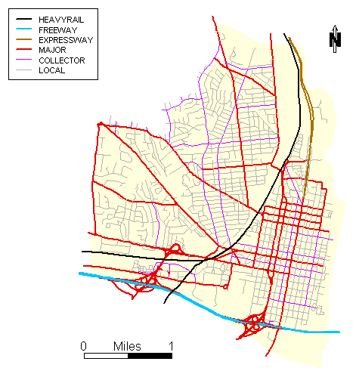
Accessibility
Study Area (Alexandria, VA, Eastern Portion)

Slide 14
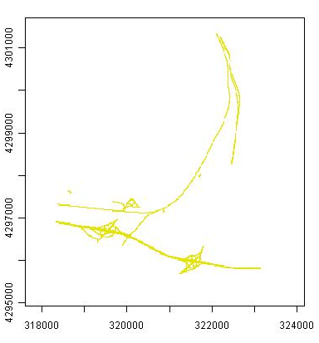
Accessibility
Areas Unsuitable for Walking
Notes:
Describe the process – input layers (sidewalks, buildings, impassable areas), and the completed raster (four images total)

Slide 15
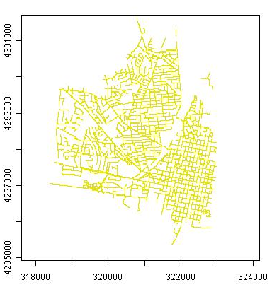
Accessibility
Areas Suitable for Walking

Slide 16
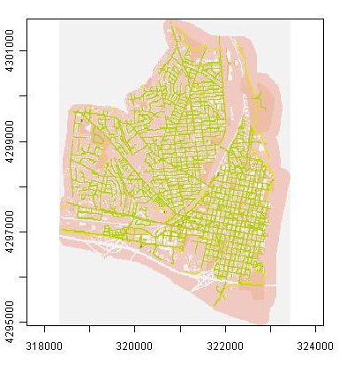
Accessibility
Generalized Accessibility

Slide 17
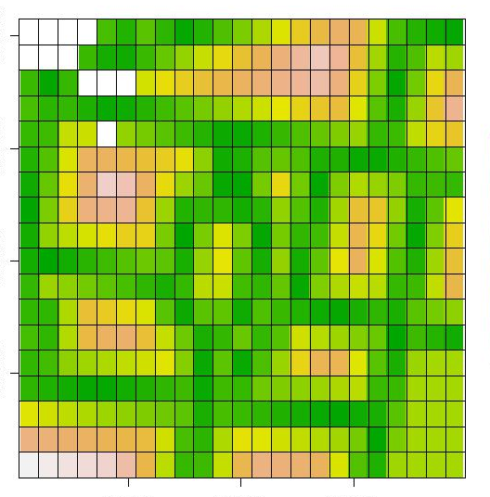
Accessibility
Raster surface
Indicates accessibility of cell and cost of movement

Slide 18
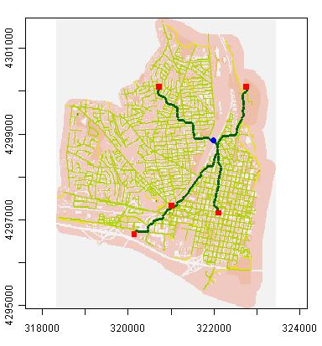
Shortest Paths
Shortest Paths using Accessibility Surface

Slide 19
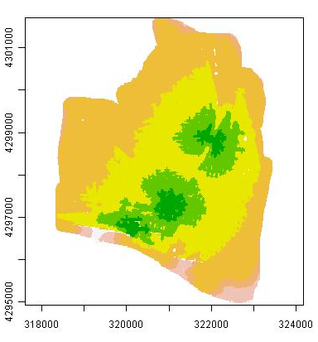
Destination Access
Generalized Accessibility to a set of Destinations
(Subway Stations)

Slide 20
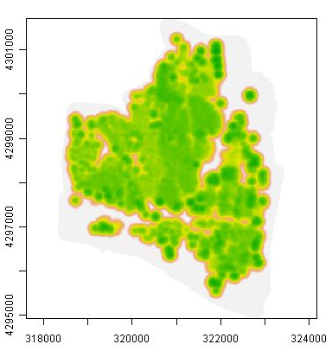
Demand Evaluation
Walking Demand at Residential Locations

Slide 21
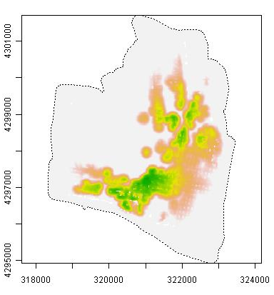
Origin / Destination Analysis
Compare Demand to Destination Accessibility

Slide 22
Roadmap
Motivation
Purpose and Need
Analysis Techniques
Toolbox Design

Slide 23
Project Goals
Open Source
  Low Cost
  Extensible
Easy Access
  Web-based
  Rapid deployment
GIS-Enabled
  Powerful analysis
  Support multiple analysis scales

Slide 24
Prototype Development
Prototype
  Working Example
  Test bed for application concepts
Project Timeline
  Initiated August, 2010
  Prototype Completion “Any Day Now”
  Full development (following NCHRP 08-78): mid-2012

Slide 25
Prototype Structure
User performs studies
Study includes
  Uploaded Data
  Analyses
Analysis uses
  Data
  Tools from toolbox
Toolbox may be extended
Analysis results may be compared
User
Toolbox
Study
Analyses
Data

Slide 26



Software Platform
Analysis Platform
  R Software Environment for Statistical Computing and Graphics www.r-project.org
Web Platform
  Python www.python.org
  Django www.djangoproject.com
  Apache web server
  projects.apache.org/projects/http_server.html
Supported Browsers:
  Internet Explorer
  Firefox
  Others ... (Few requirements beyond basic Javascript)

Slide 27
More about R
Premier open source environment for statistical analysis
Gentle learning curve
  Interactive computation
  Saved data and procedures
  Reusable scripts
  Redistributable packages cran.r-project.org
Conduit for cutting edge research in statistical analysis

Slide 28
GIS Analysis in R
Active Geospatial Research in R
Access to standard Open Source libraries:
  proj.4 trac.osgeo.org/proj/
  GDAL/OGR www.gdal.org
  GEOS (Geometry Engine Open Source) trac.osgeo.org/geos/
Vector and Raster Processing
General Overview: cran.r-project.org/web/views/Spatial.html

Slide 29
Future Plans
Complete extensible web application framework
Initial Set of Non-Motorized Modeling Tools
Standalone System
  No web server required
Deployment expected mid-2012

Slide 30
Questions
Jeremy Raw
jeremy.raw@dot.gov
Brian Gardner
brian.gardner@dot.gov

