Slide 1
Assessing the Marginal Cost of Congestion for Vehicle Fleets Using Passive GPS Data
Nick Wood, TTI
Randall Guensler, Georgia Tech
Presented at the 13th National TRB Transportation Applications Conference
May 10, 2011
-- Session 13A --

Slide 2
Overview
Purpose of assessing lost time
Methodology
  Recruiting participants
  GT Freight Data Collector
  Screening second-by-second GPS data
Reporting results
Implications for tolling
  Potential use of regional HOT lane network

Slide 3
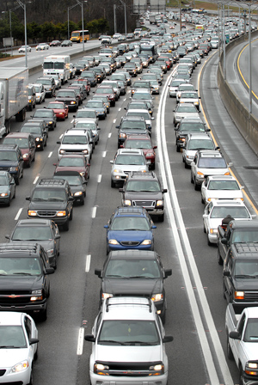
Purpose of the Research
Effects of congestion are not well known by users of the system
Quantify lost time experienced by vehicle fleets on the expressway system
Assess how fleets might respond the travel unreliability
Match delay to value of time to arrive at a cost of congestion
Photo Credit: Creating Loafing Atlanta

Slide 4
Scope of the Research
Collect second-by-second location and speed data
  12 vehicle fleets
  Between 1-5 vehicles per fleet
  Roughly 2 weeks per vehicle
  Speeds below 45 mph were defined as congestion
Screen GPS data
  Select trips that were made on the expressway system in the 13-county metropolitan region
  Created a trip dataset based on timestamps
Calculated percent of fleet activity lost
  Due to delay and travel time unreliability
  Unreliability defined as difference between the 50th and 95th percentiles
  Environmental and social externalities were not considered

Slide 5
Fleet Recruitment
Fleets were recruited by phone, letter, and in-person
Cold calling yielded a 10% success rate
Barriers to participating
  Understanding what the study was about
  Belief that time required would take away from business
  Lack of monetary compensation
  Privacy was only a secondary concern
Industry types recruited include:
  Exterminators
  Supermarkets
  General Merchandise Stores
  Fruit Wholesalers
  Concrete Ready-Mix Trucks
  Electric Power Utilities
  School Buses, Local and Express Transit Vehicles

Slide 6
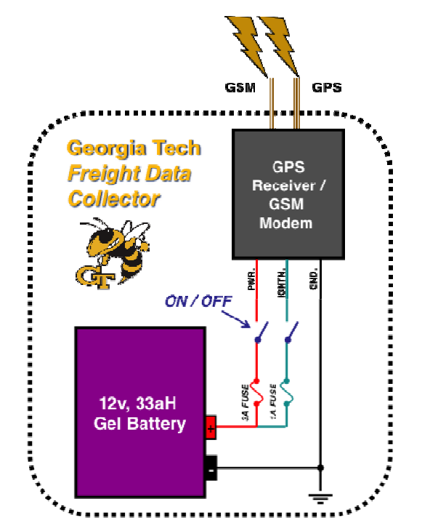
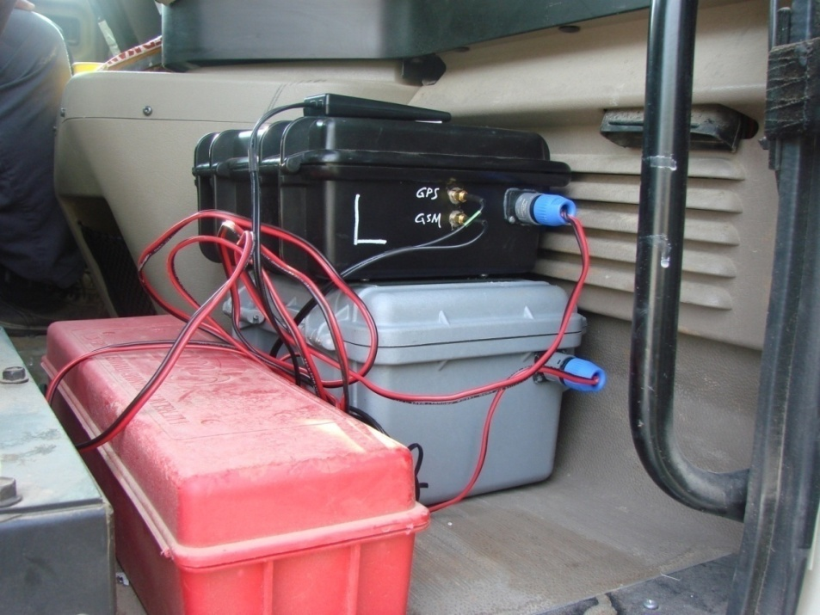
GT Freight Data Collector

Slide 7
Creating Individual Trip Records
Done by a GIS-based approach
  Date, time, lat, long, and vehicle speed recorded for each second of travel
  Buffer of the expressway network used to clip position data
Rules for segmenting trips from raw dataset
  Continuous records were labeled to identify the same trip
  Gaps of less than 10 sec. were assumed to be the same trip
  Eliminated trips of less than 60 sec. or traveled less than 1 mile
Reducing the significance of errors
  Roughly 89% of all the data collected was originally good
  Instance where 0 mph existed one second after 60 mph, physically impossible
  Applied a cubic spline fit to estimate speed using good data
  97% of the total data was used for analysis (inc. original and estimated speeds)

Slide 8
Applying a Cubic Spline

Slide 9
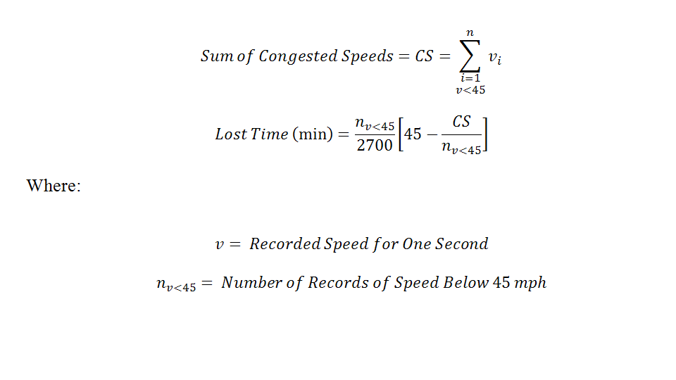
Calculating Lost Time
Congestion defined to be any travel speed below 45 mph
  Selected because 45 mph was the lower range of max sustained flow
Calculation steps
  Only records with a speed < 45 mph were summed to get a total of congested speeds per trip
  The congested speeds within each trip were divided by the number of records with a speed < 45 mph, or time duration of congestion per trip
  Difference of average speed during congestion taken with 45 mph
  Converted values from seconds to minutes

Slide 10
Results
Percent of Fleet Activity Lost to Unreliability per Fleet Vehicle
Fleet | Extra Time Needed per Week (hr) | Avg. Weekly Operation Time on All Roads (hr) | Percent of Fleet Activity Time Lost to Unreliability
School Bus Transportation | 0.73 | 18.8 | 3.9%
GRTA Express Transit | 8.29 | 20.4 | 40.6%
Gwinnett County Express Transit | 1.77 | 29.3 | 6.0%
Electric Power Distribution | 0.70 | 25.6 | 2.7%
Ready-Mix Concrete Manufacturing | 0.90 | 14.2 | 6.3%
Local Transit Service Vehicles | 0.29 | 57.5 | 0.5%
Exterminating and Pest Control | 0.12 | 23.3 | 0.5%
Department of Transportation | 1.79 | 18.1 | 9.9%
Supermarket and Grocery Stores | 2.48 | 49.7 | 5.0%
General Merchandise Store | 3.61 | 13.8 | 26.2%
Fruit and Vegetable Wholesalers | 3.61 | 29.8 | 12.1%

Slide 11
Linking Delay to Marginal Costs
Associated labor wage rates used to calculate costs due to delay and unreliability
  Assumed that value of time = 100% of the employment cost
  Included hourly rate along with benefits and taxes paid by employer
Each fleet matched to comparable profession class
  Used median wages from Georgia Department of Labor database
Fleets were observed to only have one driver

Slide 12
Unreliability Costs
Weekly Costs due to Unreliability per Fleet Vehicle
Fleet | Extra Time Needed per Week (hr) | Hourly Cost ($) | Weekly Cost due to Unreliability
School Bus Transportation | 0.73 | $85.00 | $62.05
GRTA Express Transit | 8.29 | $138.38 | $1,147.17
Gwinnett County Express Transit | 1.77 | $94.25 | $166.82
Electric Power Distribution | 0.70 | $27.32 | $19.12
Ready-Mix Concrete Manufacturing | 0.90 | $26.92 | $24.23
Local Transit Service Vehicles | 0.29 | $88.50 | $25.67
Exterminating and Pest Control | 0.12 | $27.32 | $3.28
Department of Transportation | 1.79 | $51.22 | $91.68
Supermarket and Grocery Stores | 2.48 | $26.92 | $66.76
Other General Merchandise Store | 3.61 | $20.06 | $72.42
Fruit and Vegetable Wholesalers | 3.61 | $20.06 | $72.42

Slide 13
Limitations
The sample size was relatively small in total and per fleet
Second-by-second data were only collected for a two-week period
The value of time estimates do not include the cost of needing additional vehicles to maintain services due to increasing travel delays
The analysis considered travel speeds on a system-wide basis
  Delays are corridor specific and do not occur uniformly across expressway network
Future efforts should be corridor-specific

Slide 14
Conclusions
Roughly 217 hours of raw data observed
Matching observed delay to employment costs was shown to be a reliable estimate for the marginal cost of congestion
Reducing the amount of time a fleet vehicle needs to be inoperable for GPS installation is key to participation
  Placing the assembly in a vehicle cab took less than 5 minutes
Median Toll Rates Across All Fleets
  Equating to the marginal cost due to travel unreliability
  $0.43 per mile for AM period
  $0.53 per mile for PM period

Slide 15
Nick Wood
Texas Transportation Institute nickwood@tamu.edu

