Slide 1


Integrated Systems Planning
13th TRB Planning Applications Conference
By
David Stroud, PE, AICP
May 2011

Slide 2
Presentation Summary
Introduction
Components of Integrated Systems Planning
Systems Analysis
Resulting High Asset Usage Locations
Next Steps

Slide 3
Introduction
“An individual ponders and through tedious efforts arranges seemingly unrelated observations into a logical sequence in the mind so that causal relationships become evident and new understanding emerges which can be justified by experiment or theoretical consideration”
J. Marvin Herndon, PhD

Slide 4
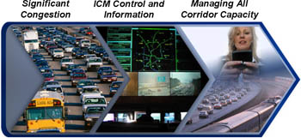
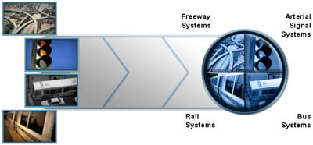
ITS – Integrated Corridor Management
Integrated Corridor Management (ICM)
Freeway ITS | Arterial ITS | Bus & Rail ITS
Today
Tomorrow
Notes:
Travel information today is fragmented, outdated or not completely useful. Travel modes are most often independently operated and efforts to date to "reduce congestion" have focused on optimization of individual network and modes.
Integrated Corridor Management (ICM) - The combined application of technologies and a commitment of network partners to work together have the potential to transform the way corridors are operated and managed. Thanks to recent advancements in intelligent transportation systems technologies, there is a tremendous opportunity today to integrate operations to manage total corridor capacity.
With ICM, the various institutional partner agencies manage the transportation corridor as a system—rather than the more traditional approach of managing individual assets. They manage the corridor as an integrated asset in order to improve travel time reliability and predictability, help manage congestion and empower travelers through better information and more choices.
In an ICM corridor, because of proactive multimodal management of infrastructure assets by institutional partners, travelers could receive information that encompasses the entire transportation network. They could dynamically shift to alternative transportation options—even during a trip—in response to changing traffic conditions. For example, while driving in a future ICM corridor, a traveler could be informed in advance of congestion ahead on that route and be informed of alternative transportation options such as a nearby transit facility's location, timing and parking availability.

Slide 5
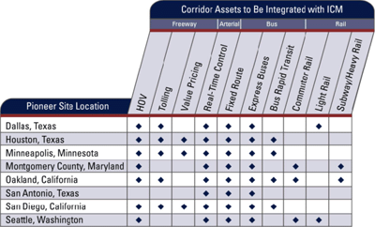
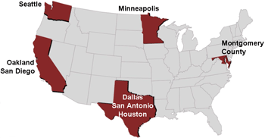
ITS – ICM Pilot Projects
ICM Networks and Modes
Notes:
The USDOT has selected eight "Pioneer Sites" to act as critical partners in the development, deployment and evaluation of Integrated Corridor Management (ICM) strategies designed to help manage congestion in some of our nation's busiest urban corridors as part of its 5-year ICM I
initiative. The ICM Pioneer Sites
Dallas is creating an operational entity responsible for all ICM activities. In this region, transit availability and capacity is being increased, park-and-ride facilities will be improved, and intelligent transportation system elements are being deployed in the field. In addition, HOV and HOT lanes will be added, and value-pricing strategies are being explored.
The Dallas US-75 ICM corridor was chosen as a site for Analysis, Modeling and Simulation (AMS) of ICM strategies.
The Dallas, Texas application proposed U.S. route 75 from downtown Dallas to SH 121 with the North Dallas Toll Way to the west and DART and various arterials to the east as their corridor. The Dallas Area Rapid Transit Authority was the lead agency, accompanied by the City of Dallas, the City of Richardson, the City of Plano, the City of University Park, the Town of Highland Park, the North Central Texas Council of Governments, the North Texas Tollway Authority, and the TxDOT Dallas District. In addition to the expected freeway and arterial capabilities, the corridor includes HOV, tolling, express bus, and light rail.
In Houston's Interstate 10 corridor, ICM will help to manage delays through intelligent transportation systems and congestion pricing strategies; will empower travelers to make decisions with multimodal, personalized information; and will improve incident management. Houston's ICM strategy will be enhanced by the strong institutional relationships its agencies have established in the region through the state of the art multi-agency emergency and traffic management center, TRANSTAR.
The Houston, Texas application proposed I-10 and U.S. route 290 with US 290 as the north border, the West Park Toll Road to the south and SH99 and IH 610 to the west and east, respectively as their corridor. The TxDOT Houston District was the lead agency, accompanied by the Houston Metropolitan Transit Authority of Harris County, Harris County, the City of Houston, and the Houston-Galveston Area Council. In addition to the expected freeway and arterial capabilities, the corridor includes HOV, tolling, value pricing, express bus, and BRT.

Slide 6
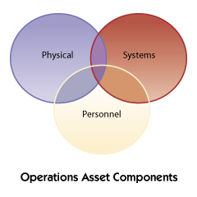
Asset Management
Objectives:
Establish an analytical foundation through development of analysis capabilities, life-cycle cost analyses, performance measures, and alternative investment scenarios
Create linkages that integrate operations and asset analysis into the transportation asset management process
Institutionalize operations asset management to advance the making of sound investments in operations, as well as overall transportation
Notes:
The ultimate objective is the adoption of operations asset management practices by operations professionals and their organizations. Our program goal is to provide the resources necessary for operations professionals to establish operations asset management. The program will concentrate efforts on the following objectives:
The first objective is to establish an analytical foundation through development of analysis capabilities, life-cycle cost analyses, performance measures, and alternative investment scenarios. The analytical foundation will enable transportation professionals to identify and evaluate strategic investment scenarios that enhance the capabilities and performance of operations assets.
The next objective is to create linkages that integrate management of operations asset analysis results into the transportation asset management process. The integration will facilitate the comparison and commingling of operations improvements with infrastructure and safety improvements by transferring and merging goals and results. The outcome will be information important to selecting a sound investment strategy and authorizing appropriate resource allocations.
To obtain the full benefits of transportation asset management, the process and its Achieving this third objective requires undertaking an education and outreach initiative. Institutionalizing an operations asset management process within an organization will greatly advance the making of sound investments in operations as well as overall transportation.

Slide 7
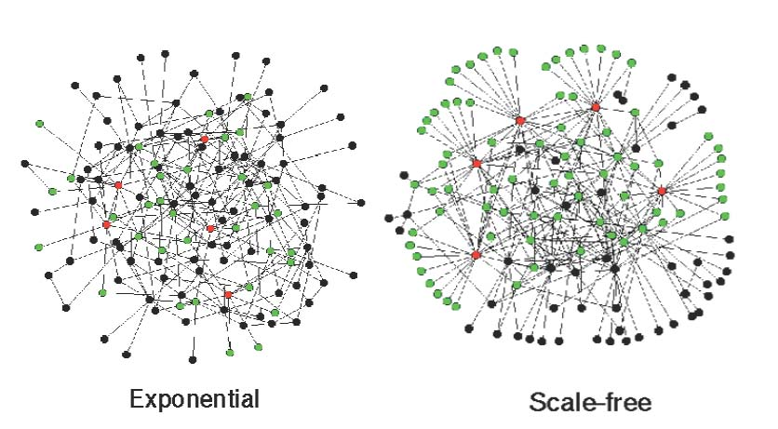
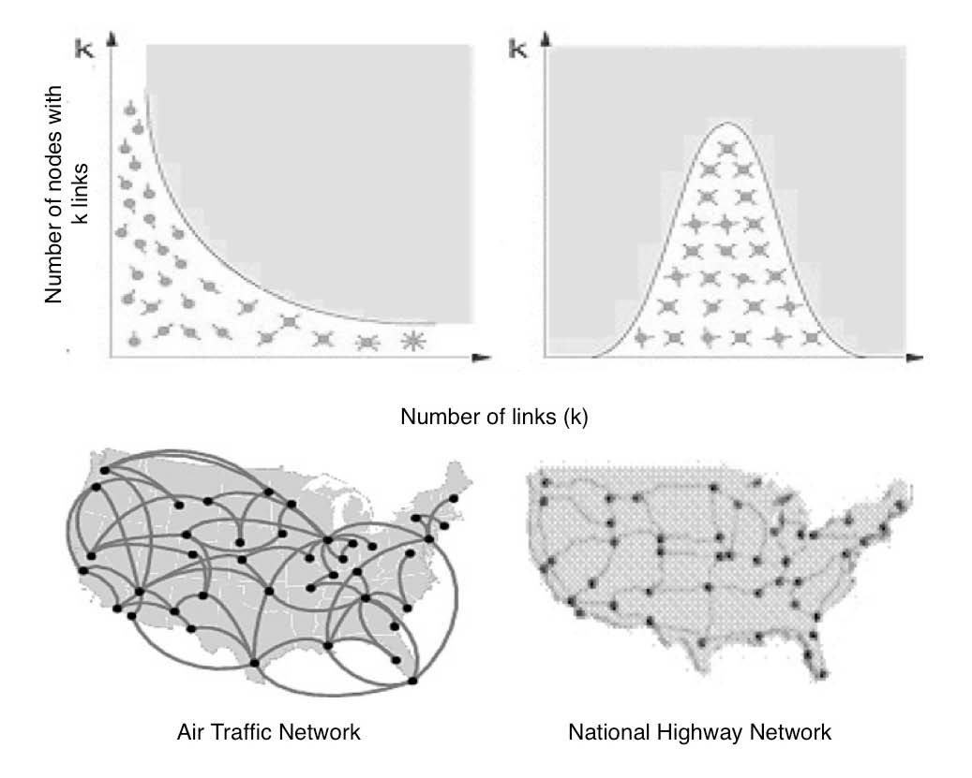
Contemporary Network Theory
Transportation Networks
Air Traffic System
National Highway System
Rail System
Network Typology
ATS – Scale Free
NHS- Exponential

Slide 8
Combined Components
ITS - ICM
Asset Mgmt.
Network Theory
Integrated Systems Planning

Slide 9
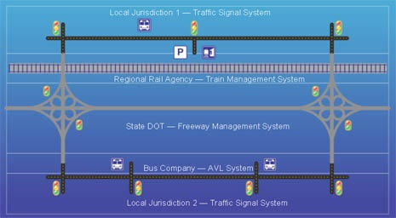
Integrated Systems Planning
Notes:
Integrated Corridor Planning (ICP) offers an opportunity to optimize the transportation system by simultaneously planning the multimodal networks instead of planning for individual modes and networks. ICP consists of decision making that considers various modes and their network connections so each can full fill its optimal role in movement of people and goods.
In conventional transportation planning modal improvements are identified independently by mode then these improvements compete for limited funding. ICP uses asset management techniques and statistical analysis to assess the usage of an asset (mode) to gauge its importance to the users of that mode.

Slide 10
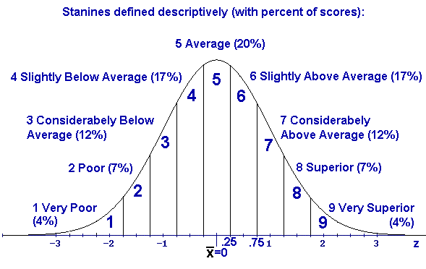
System Analysis
Stanine Statistical Analysis

Slide 11
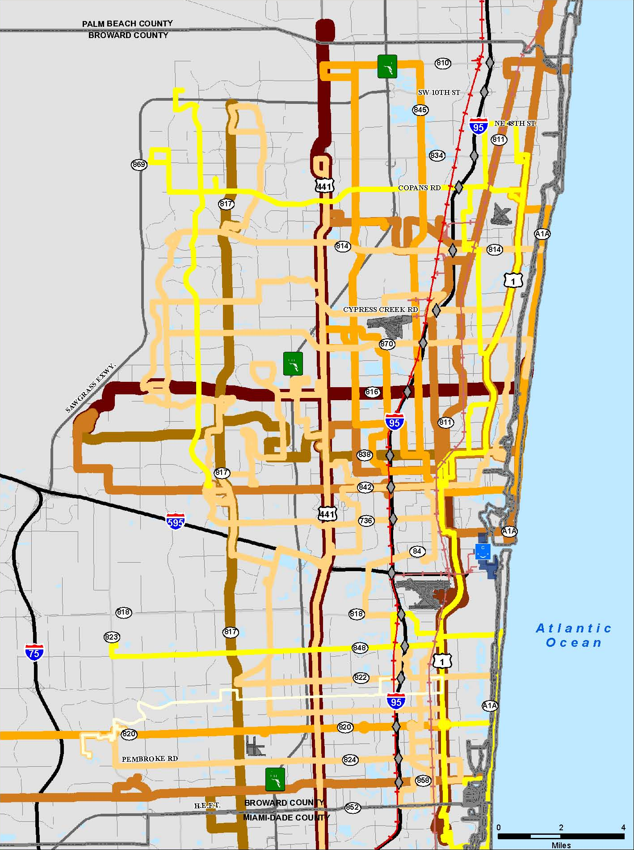
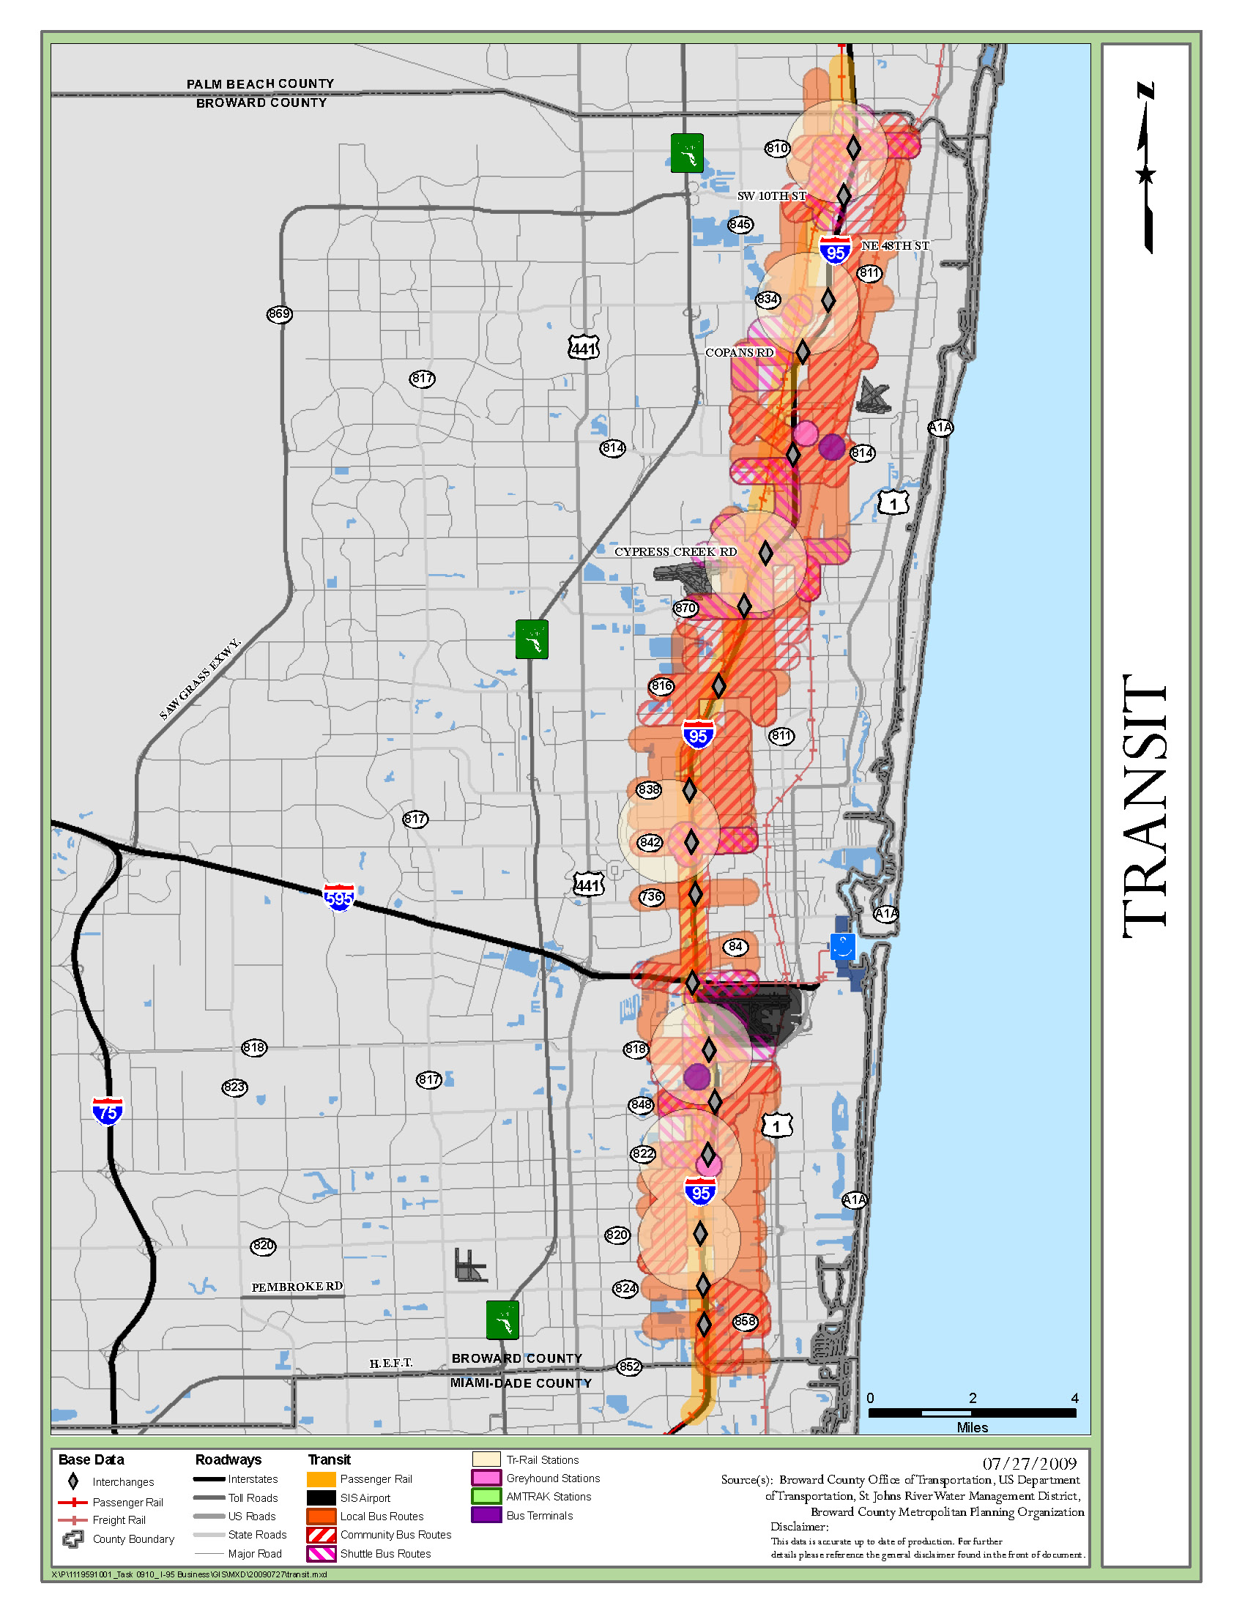
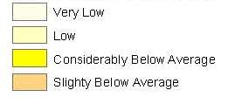
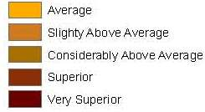
Bus Route Ridership
Statistical Analysis
Average annual route ridership is 4,529 passengers
Stanines

Slide 12
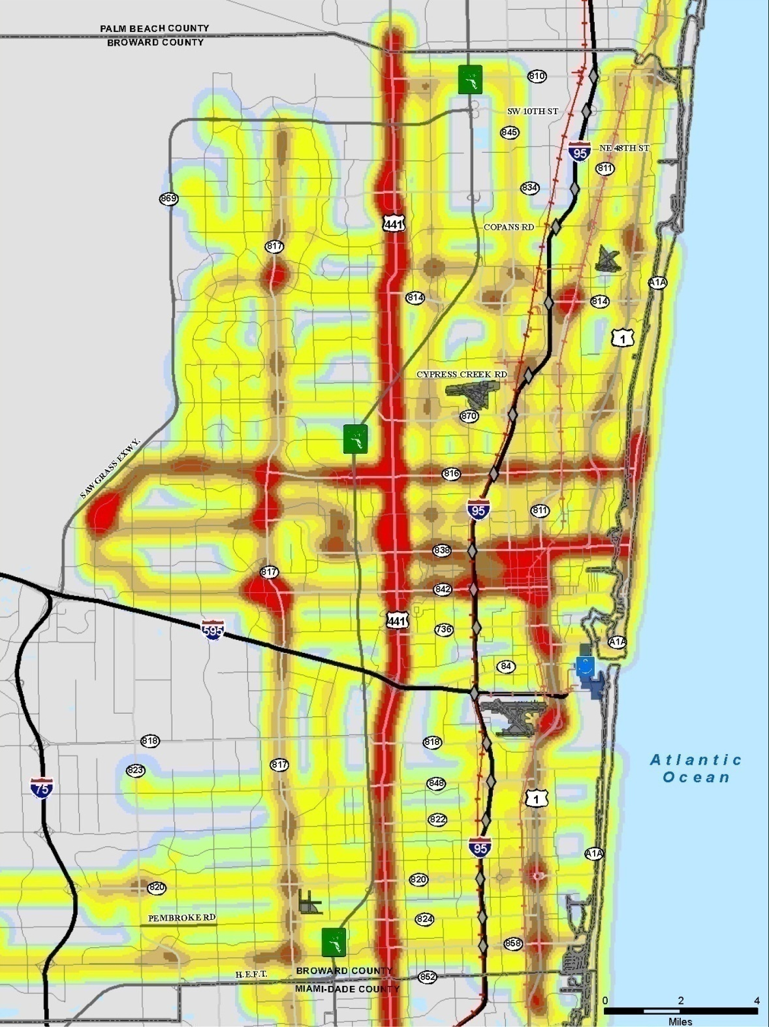

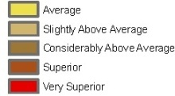
Bus Route Ridership
Intensity Analysis
Average annual route ridership is 4,529 passengers
Stanines

Slide 13
Bus Stops
Statistical Analysis
Daily Passengers 258 – 16,357
Stanines

Slide 14
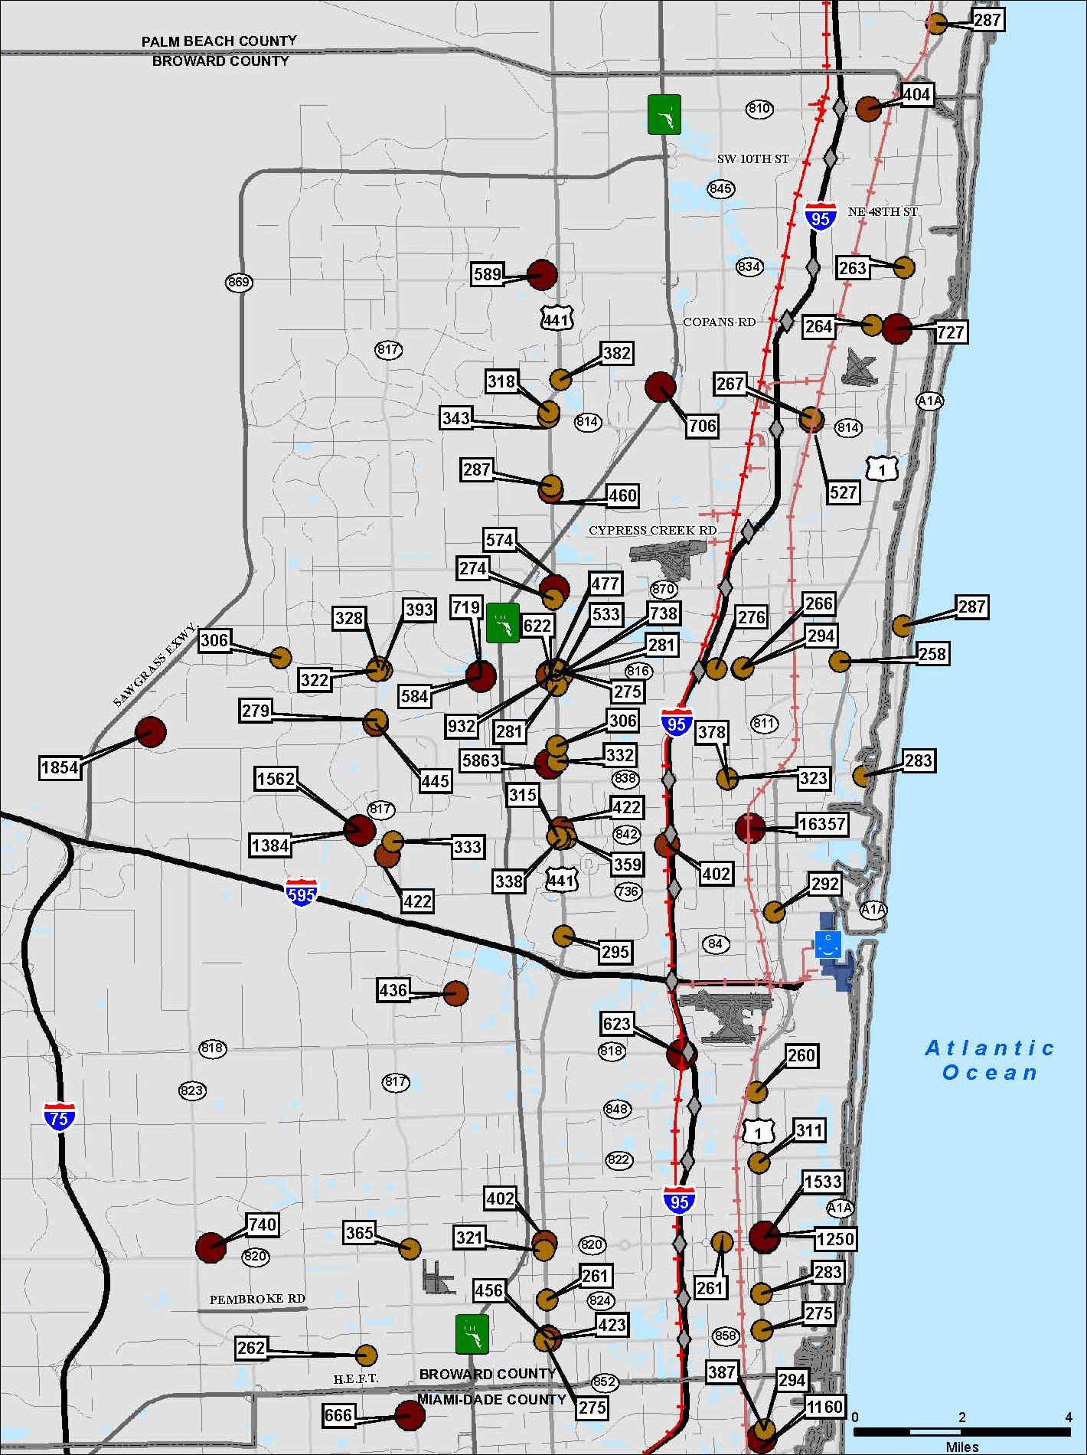
Bus Stops
3 Highest Categories
Daily Passengers 258 – 16,357
Stanines

Slide 15
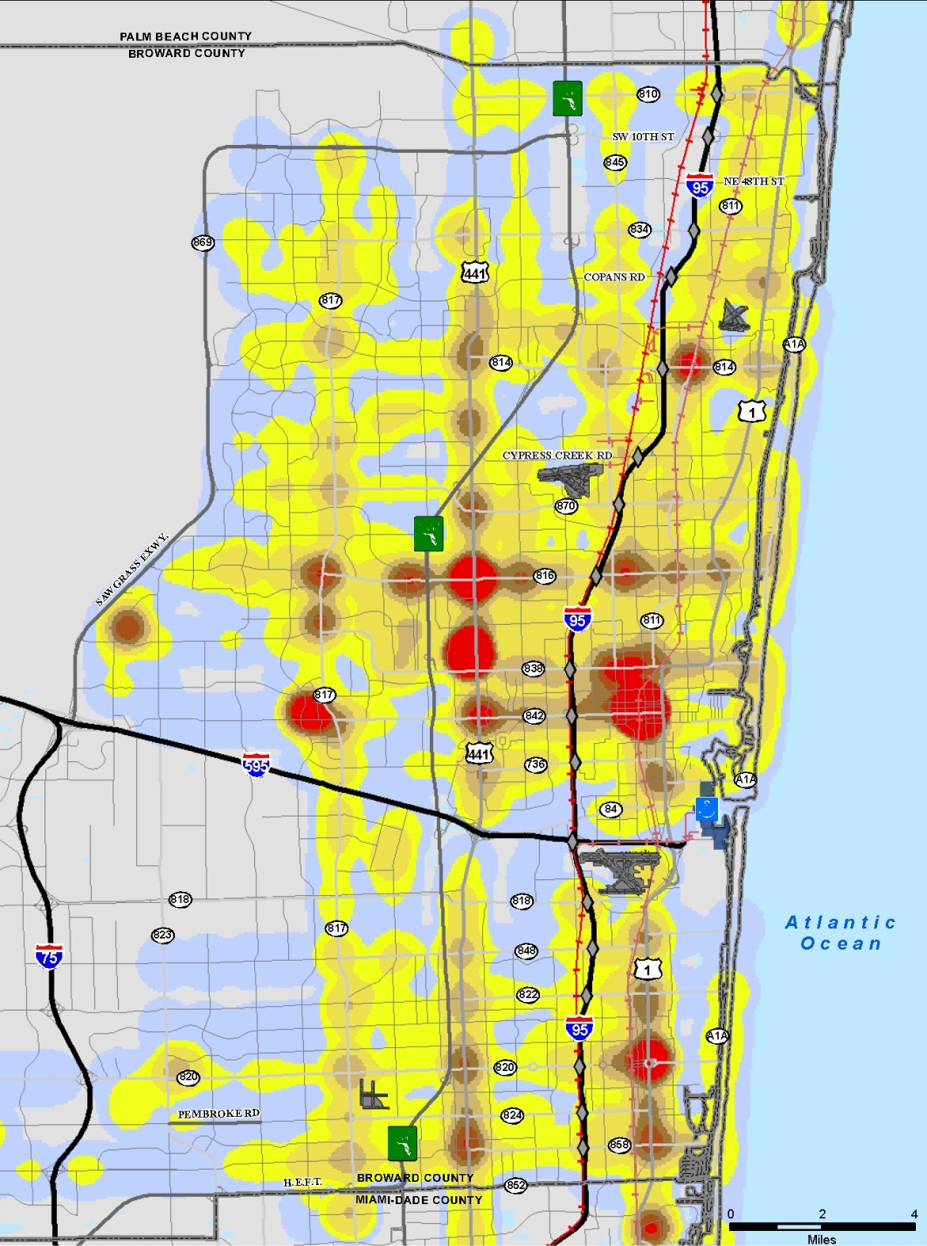
Bus Stops
Intensity Analysis
Daily Passengers 258 – 16,357
Stanines

Slide 16
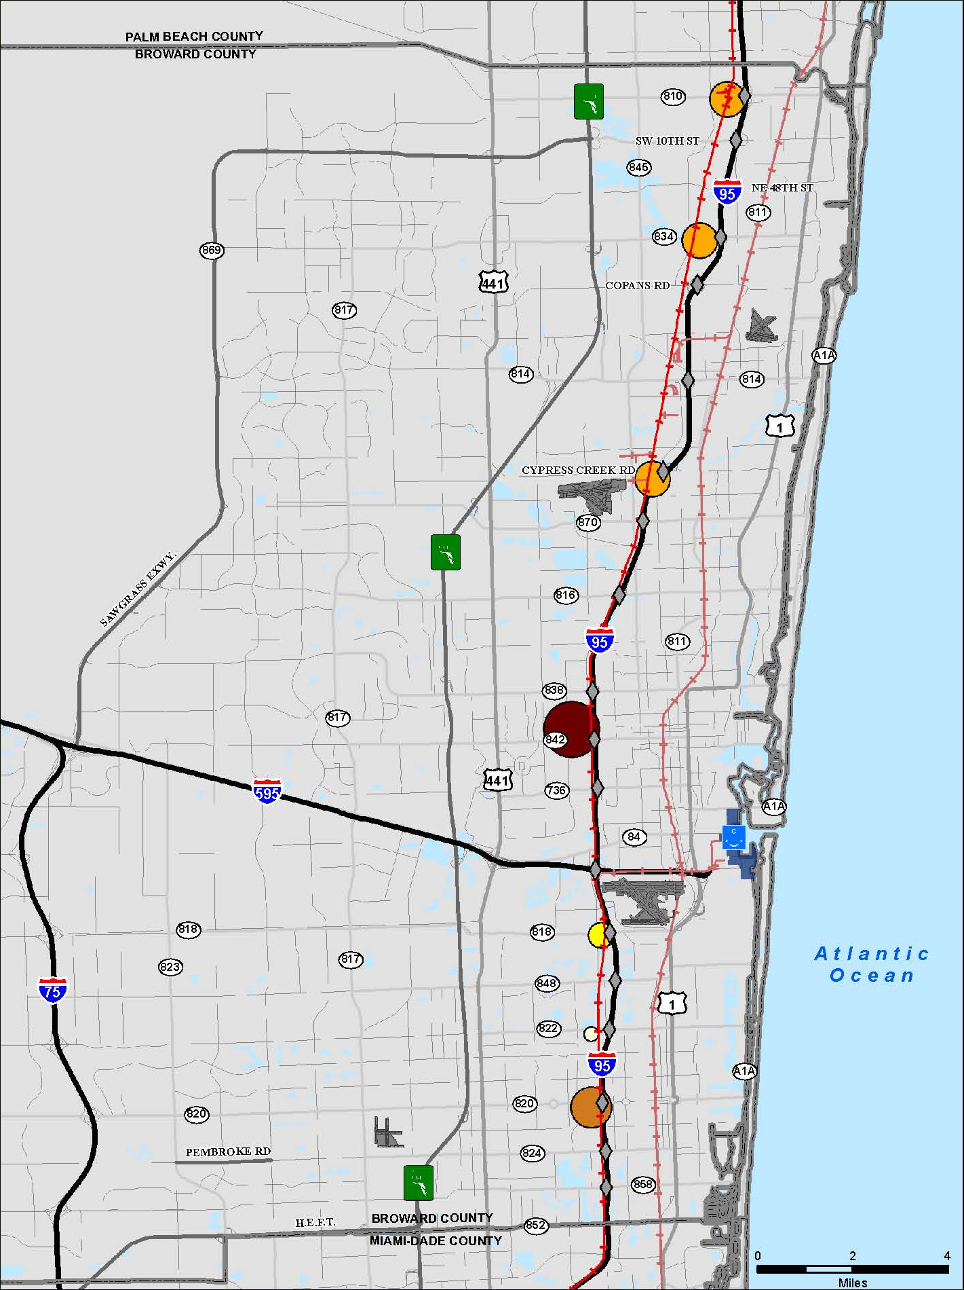
Tri-Rail Ridership
Statistical Analysis
Average Annual ridership is 140,575 passengers
Stanines

Slide 17
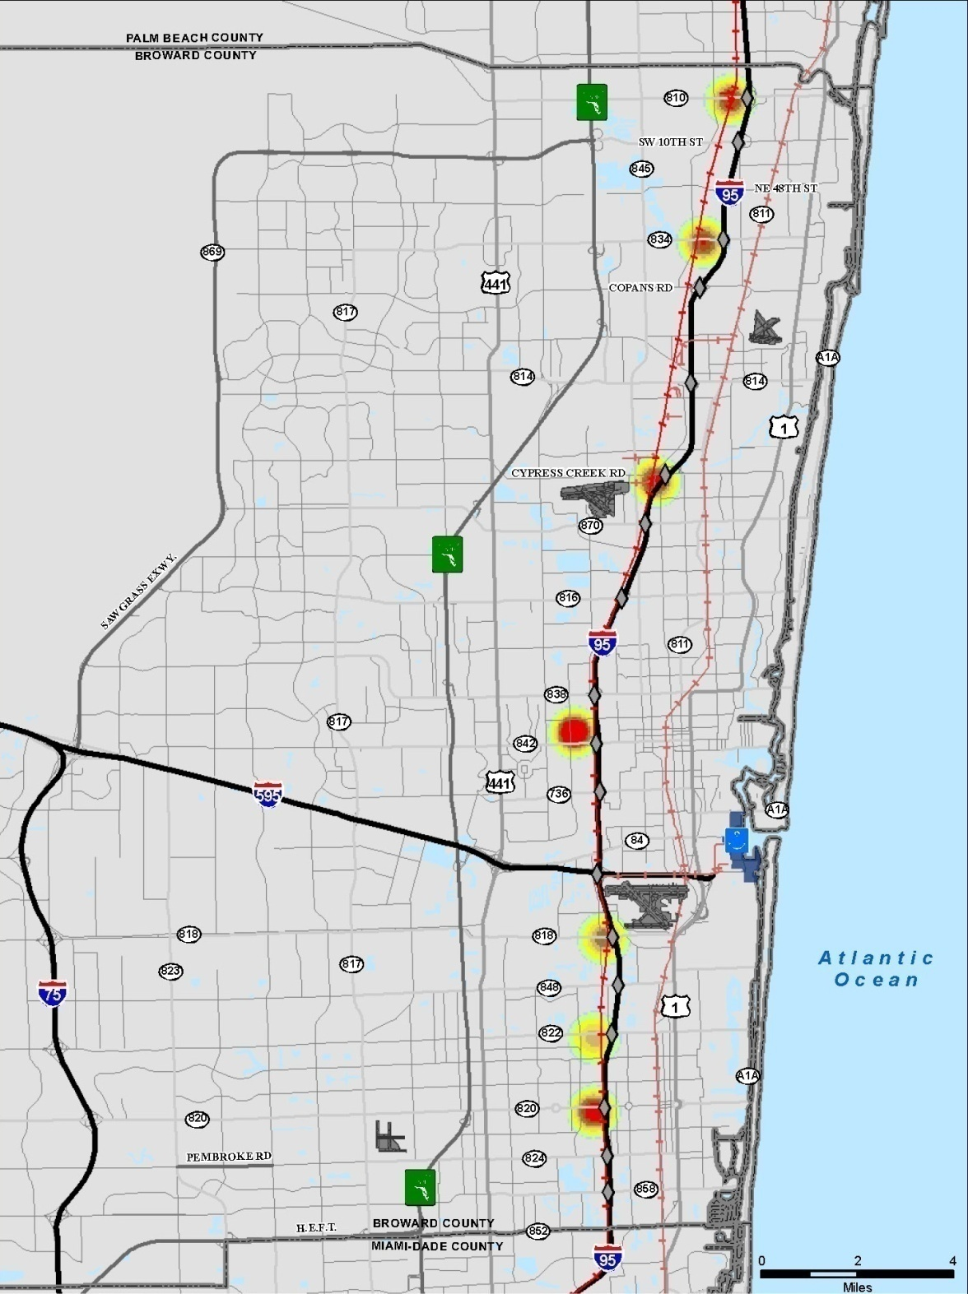
Tri-Rail Ridership
Intensity Analysis
Average Annual Tri-Rail ridership is 140,575 passengers
Stanines

Slide 18
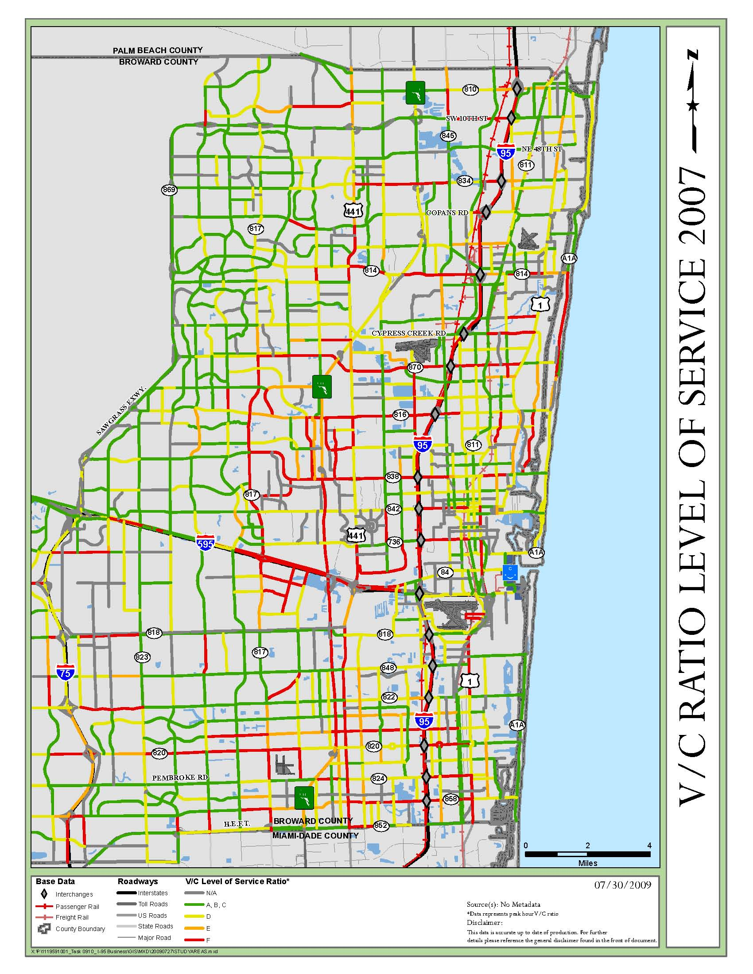
V/C Ratio
Analysis
Peak Hour V/C Ratio
Stanines

Slide 19
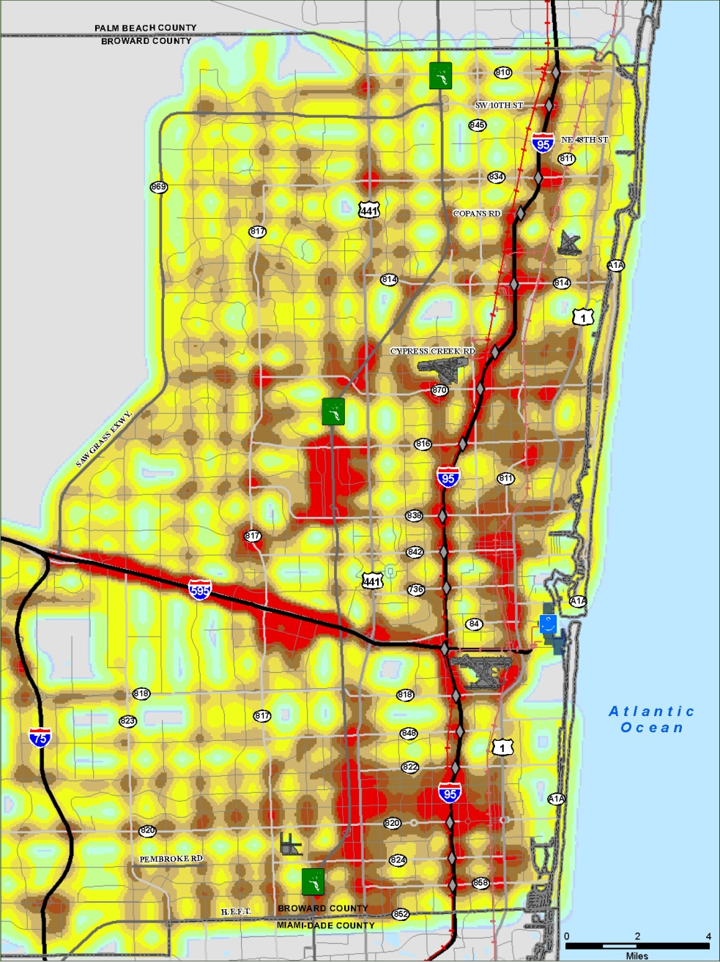
V/C Ratio
Intensity Analysis
Peak Hour V/C Ratio
Stanines

Slide 20
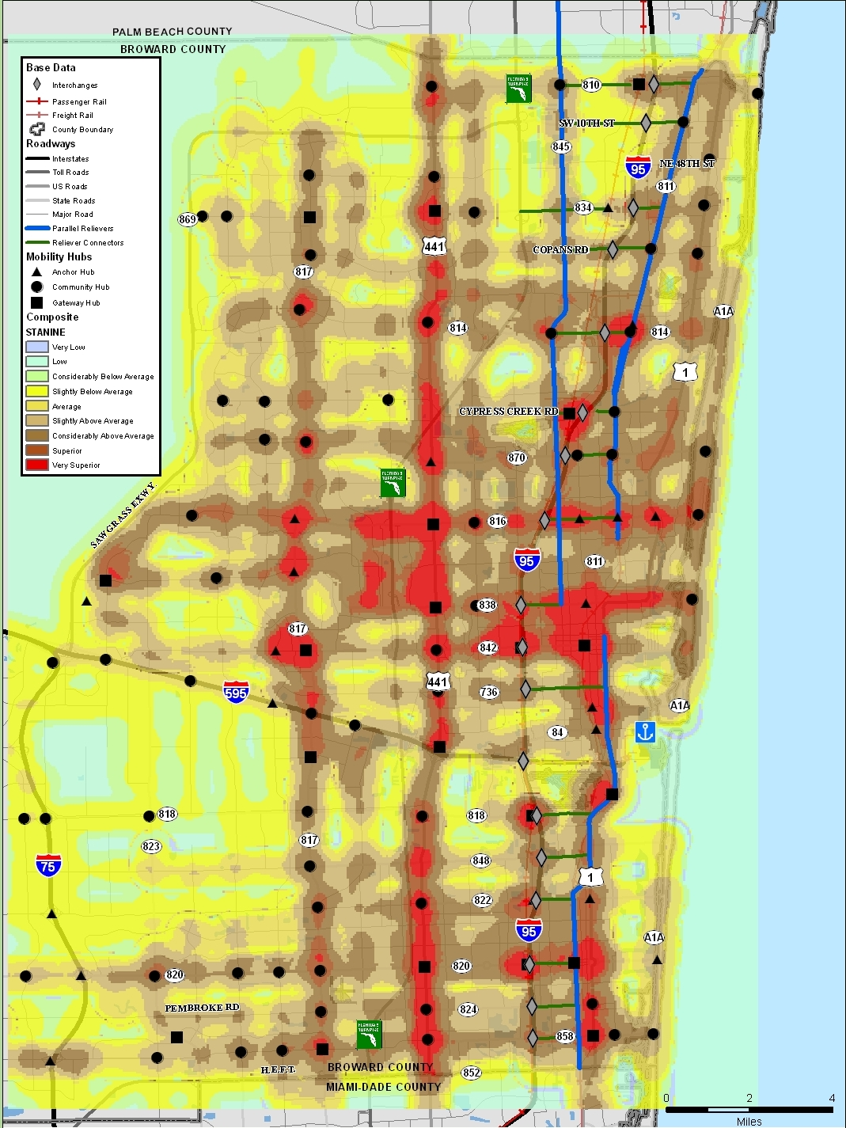
Composite Map
Intensity Analysis
High Asset Use Locations
Stanines

Slide 21
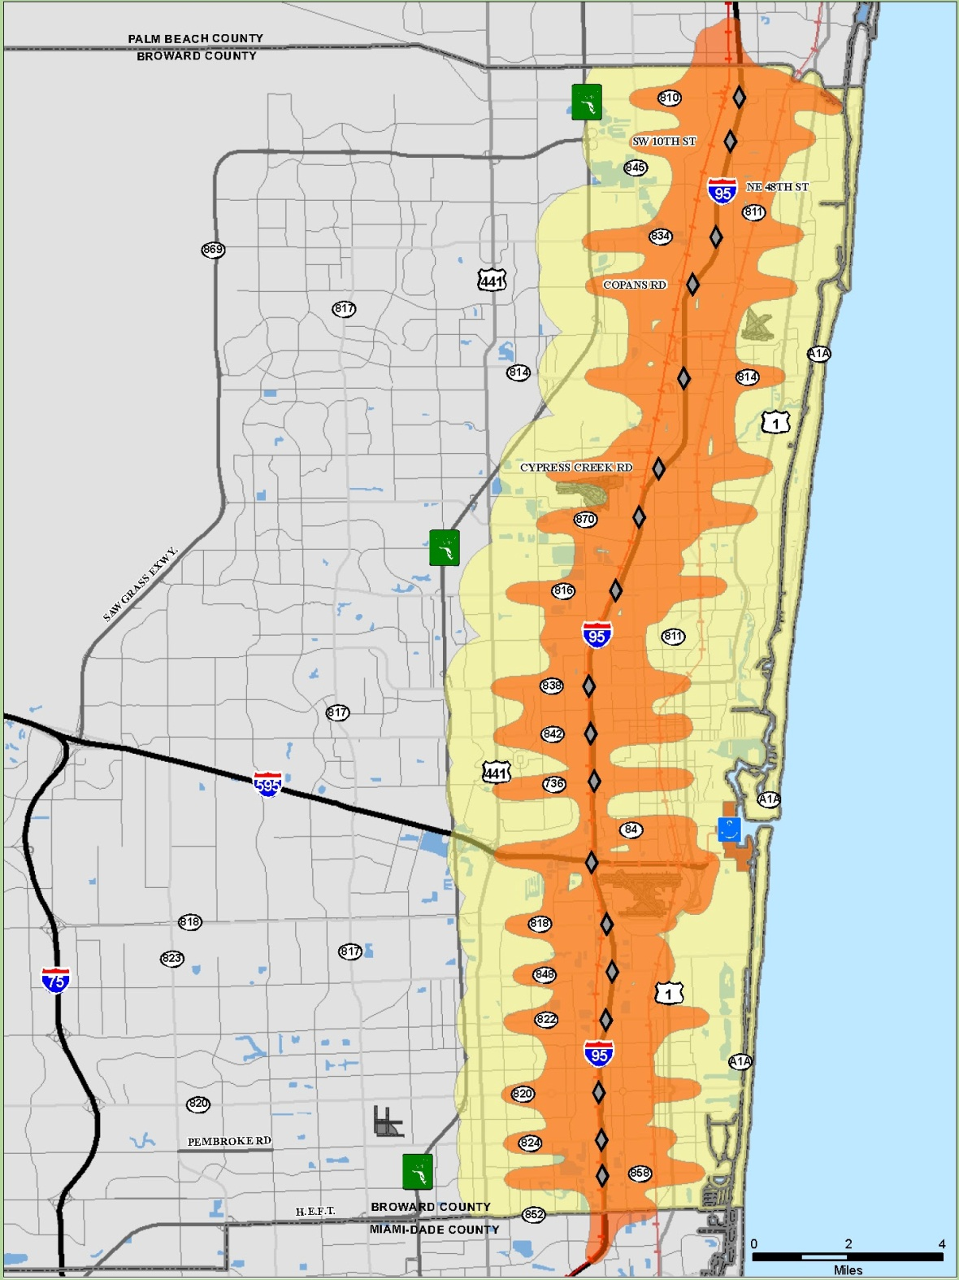
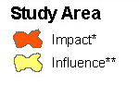
I-95 Corridor Area
Information:
Orange - Impact area created by buffering individual transportation service assets including SIS
Yellow – Influence area created by buffering impact area by 1 mile

Slide 22
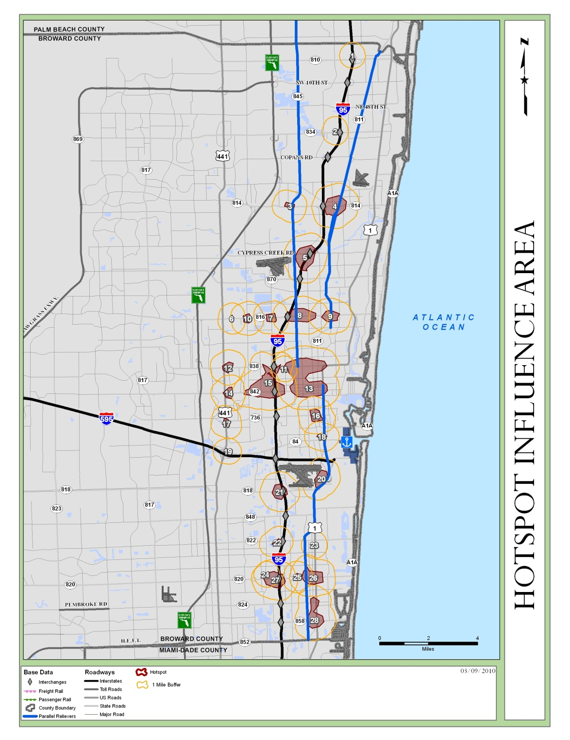
HAUL
HAULs in I-95 Corridor Influence Area

Slide 23
HAUL Goals & Objectives & Rating
Goals
Mobility and Safety
Community Livability
Supports Economic Vitality
Promotes Sustainability
Objectives Rating Score
0.0 = Objective Not Satisfied
1.5 = Minimally Satisfies
3.0 = Highly Satisfies

Slide 24
HAUL Goal – Mobility and Safety
Objective | Description | Score
Multiple Asset Improvement | Considers the extent that an HAUL improvement contributes/supports enhancements of multiple assets (multimodal enhancements) in the same location. | 0 1.5 3 | 0 or 1 asset 2 assets 3 or more assets
Safety Bicycle and Pedestrian Crashes (2005 – 2009) | Using FDOT’s standard safety criteria as determinant of roadway safety based upon incidents at a given location (the higher the number, the higher the score signifying a priority for improvement). | 0 1.5 3 | No crashes Less than 15 crashes 15 or more crashes
Emergency Evacuation Route | If HAUL is along or immediately adjacent to a designated emergency evacuation route, or facilitates mobility to a route, per the State Emergency Response Team (SERT) maps | 0 1.5 3 | No evacuation route 1 evacuation route 1 >evacuation route
Ramp Queuing Congestion at Interchanges | Using an FDOT recently completed I-95 Interchange Ramp Assessment report, identifies interchanges that require improvement to prevent vehicles from queuing onto the mainline lanes. | 0 1.5 3 | No ramp congestion Ramp congestion <.5mi. Ramp congestion

Slide 25
HAUL Goal – Community Livability
Objective | Description | Score
Local Government Policies in Support of TOD and Joint Development | Considers specific activities in support of Transit Oriented Development (TOD) and joint public/private developments | 0 3 | No regulations Municipality with supporting regulations
Support Local Planning Initiatives/Corridor Studies | Considers specific activities such corridor redevelopment plans, Transit Housing Oriented Redevelopment (THOR) program, Neighborhood Enhancement Plans, CRA’s, etc. | 0 1.5 3 | No activities 1 activity 2 or more activities
Support of Rail Passenger Service Development | Considers integrated modes, service connectivity between bus transit and rail modes. The project would consist of a high capacity, high‐quality premium transit service designed to provide an alternative to SOVs driving congested roadways. | 0 1.5 3 | No rail line Rail line is > 0.5 mi. Rail line is < 0.5 mi
Support of LRTP and CIP | Considers HAUL’s physical relationship to specific projects identified in the Long Range Transportation Plan and /or municipal Capital Improvement Program. | 0 1.5 3 | No LRTP projects LRTP projects > 0.5 mi. LRTP projects < 0.5 mi
Notes:
. This will be a qualitative assessment to help ensure that proposed improvements do not contradict or are in conflict with specific planning and urban design initiatives.
This will be a qualitative assessment to help ensure that proposed improvements do not contradict or are in conflict with specific planning and urban design initiatives.

Slide 26
HAUL Goal – Economic Growth
Objective | Description | Score
Side Street Access to Any SIS Hub | Measures the amount of streets with direct/indirect access to SIS Hub (the more access points, the higher the score) in a HAUL area. | 0 1.5 3 | No SIS corridor SIS corridor > 0.5 mi. SIS is within HAUL
“Mobility” Hub Development and Access | Verifies the extent to which the HAUL is part of a County identified transit mobility hub (i.e. Gateway, Anchor, Community, as defined in LRTP). | 0 1 2 3 | Not a Hub Community Hub Anchor Hub Gateway Hub
Anticipated TOD within ½ mile | Verifies HAUL’s potential to support development of TOD relative to transit improvements within 1/2 mile of a transit station. | 0 1.5 3 | No transit improvement Transit < 1 mi. Transit < 0.5 mi.
Development Regional Impact (DRI) commitment | Verifies whether HAUL is within proximity to overlays a DRI with committed multimodal improvements. | 0 1.5 3 | No DRI Commitments DRI > 0.5 mile DRI <0.5 mile
Planned/Developed Community Redevelopment Agency (CRA) Project | Verifies whether HAUL is within proximity to or overlays a CRA. | 0 1.5 3 | No CRA Projects CRA Project > 0.5 mi. CRA Project < 0.5 mi.

Slide 27
HAUL Goal – Sustainability & GHG
Objective | Description | Score
Support Greenhouse Gas Reduction/Energy Conservation | Does the improvement facilitate the reduction of greenhouse gases and/or promote energy efficiency? | 0 1.5 3 | No improvement Improvement > 0.5 mi. Improvement < 0.5 mi.
Transportation Demand/System Management (TDM/TSM) Strategies | Projects that include transit signal priority, queue jumping, signal timing coordination, or other non-capacity enhancements (i.e. TSM), as well as those projects that may be on a designated carpool/vanpool (i.e. TDM) corridor and/or BRT/local bus improvement so as to reduce VMT. | 0 1.5 3 | No project or program Project > 0.5 mi. Project < 0.5 mi.
Congestion Mitigation | References presence of an identified parallel arterial reliever route(s) and a check to confirm adequate capacity exists along reliever route to accommodate diverted trips to this segment from I-95 as congestion mitigation. | 0 1.5 3 | No reliever capacity Moderate capacity High capacity
Notes:
(For example, a transit improvement that reduces single-occupancy vehicle (SOV) travel and delay, thereby contributing to reducing CO2, measured against a road capacity project, with additional through lanes, would result in more SOV reliance and congestion long term).

Slide 28
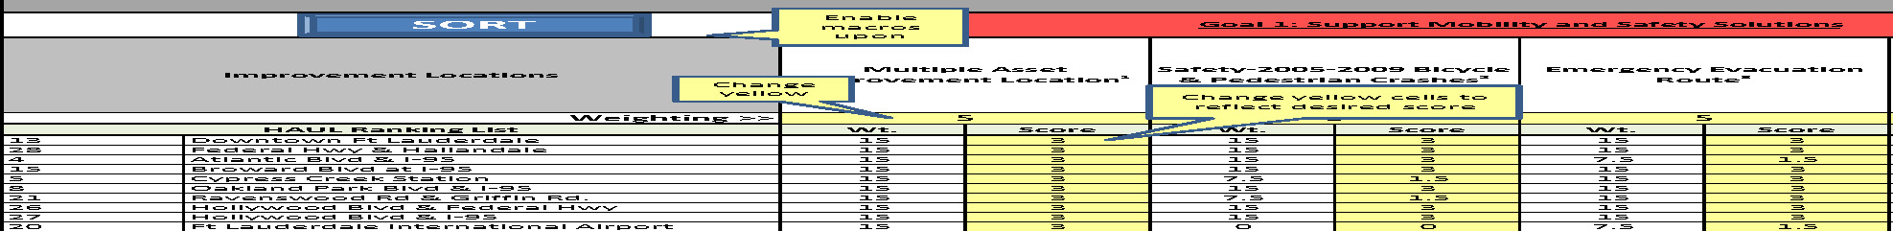
HAUL Ranking Matrix

Slide 29
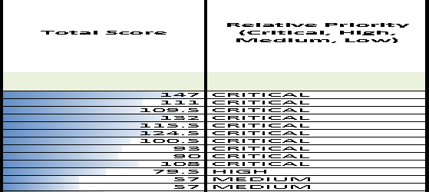
HAUL Priority
Relative Priority
Low = 0 to 30 points
Medium = 31 to 60 points
High = 61 to 90 points
Critical = 91 to 150 points

Slide 30
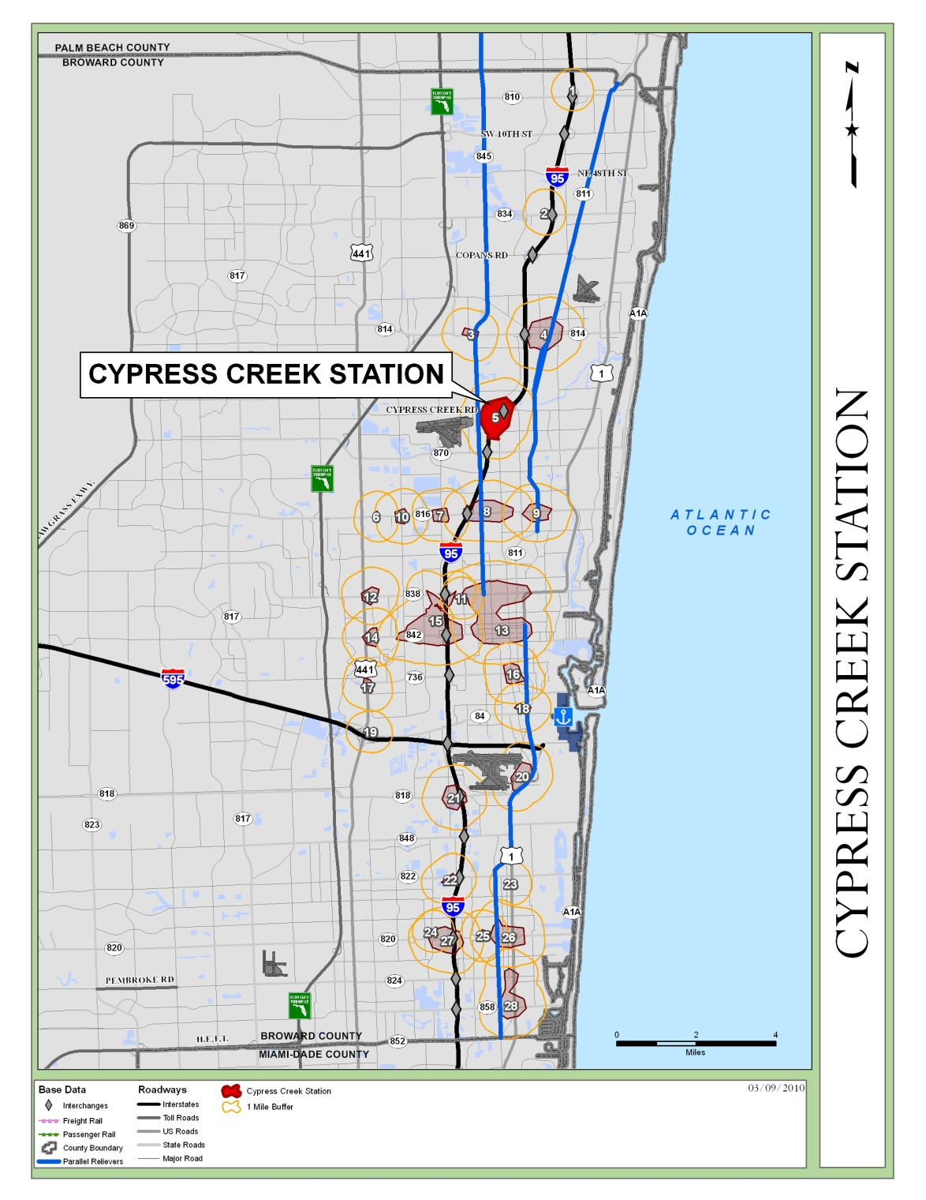
Interstate 95 HAUL Ranking
Cypress Creek

Slide 31
Next Steps Multimodal Assets
Cypress Creek -
Performance Study
Pedestrian
Bike
Bus
Highway
Park and Ride
Rail
Land Use

Slide 32
Thank You!
Contact Information:
David Stroud, PE, AICP
Reynolds, Smith and Hills, Inc.
David.Stroud@rsandh.com

