Slide 1
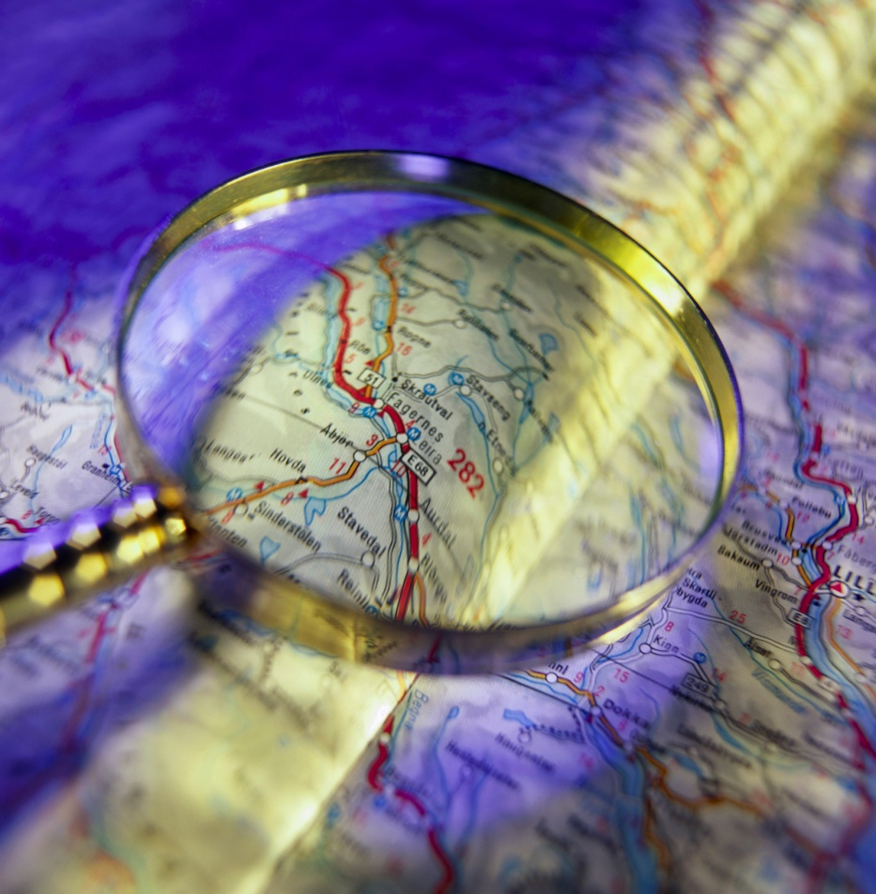
Evaluating Small-Scale Results of Activity-Based Models
Suzanne Childress
Erik Sabina
Robert Spotts
Denver Regional Council of Governments
Transportation Planning Applications Conference
Reno
May 2011

Slide 2
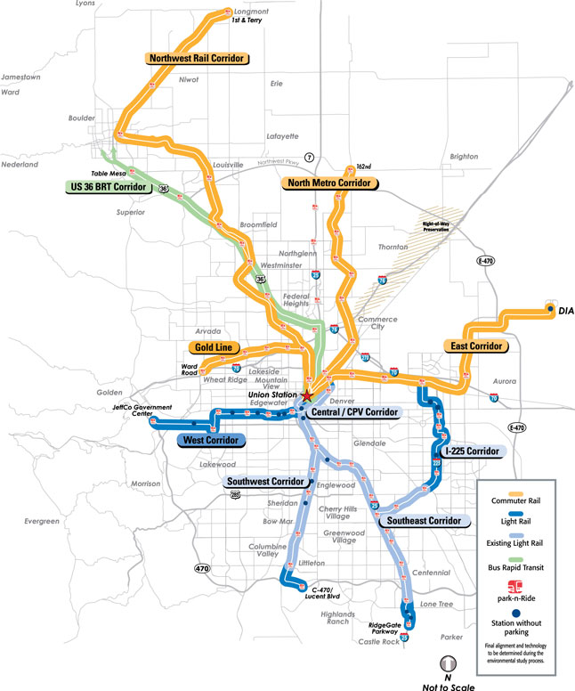
Denver
2010
  Pop 2.9m
  Emp 1.6m
2035
  Pop 4.5m
  Emp 2.6m
Planning Goals
  Urban Centers
  Urban Growth Boundary
  New regional light rail
  Transit Oriented Development

Slide 3
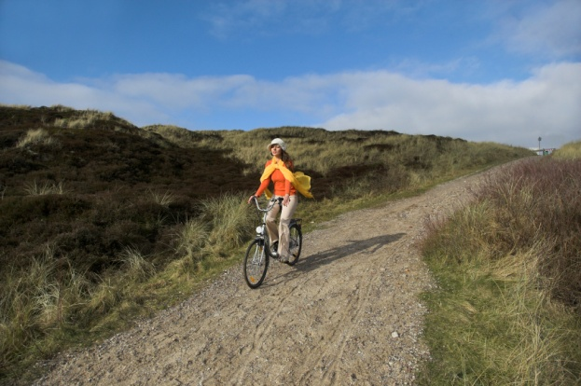
Why small areas in Denver?
Long-term planning goals 2010 to 2035
10% VMT per capita reduction
10% single occupancy vehicle mode share reduction
50% of new housing/75% of new jobs in urban centers
Transportation Improvement Program (TIP) Fund Allocation
-Planning Funds for Transit-Oriented
Developments And Urban Centers
-Bicycle-Pedestrian Project
Funds
Notes:
-this topic is coming up all the time urban center, tod, metro vision implementation, aq effects

Slide 4
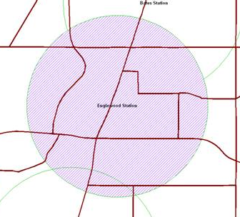
Why activity-based models
Disaggregation allows for greater control and summarization (can slice and dice)
More variables =
more sensitivity
Tracking households and people
with unique characteristics

Slide 5
All models are wrong.
Some models are useful.
In what ways is Denver’s activity-based model useful at depicting travel behavior on a small geography?
In what ways is it not useful?
Notes:
Regional averages in the past were okay to show; small areas less confidence.

Slide 6

Useful Models Tell Stories.
The input variables cause outputs consistent with research and logic.
Match reality in the base year
(makes for a believable story)
Tell a story across time, space,
and types of people.
Notes:
Absolute vs relative numbers. Does it depict a rational relationship in terms of what the planning literature has estabilished are relationships between density and transit use? Input-output- planner’s perspective- what we put in get out – does it make sense?
Does it tell a story

Slide 7
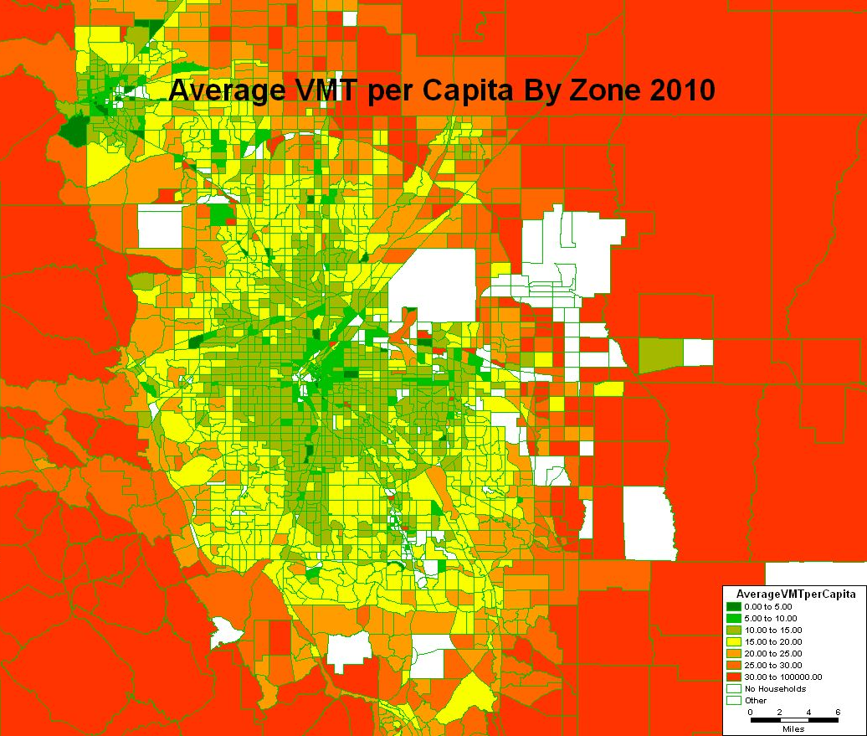
Story Across Space
Notes:
Example People near the center of the city drive less due to congestion, transit availabiltiy, walkability, general accessibility and income effects. T
Aggregate story is working pretty well. But what about any particular small area?

Slide 8
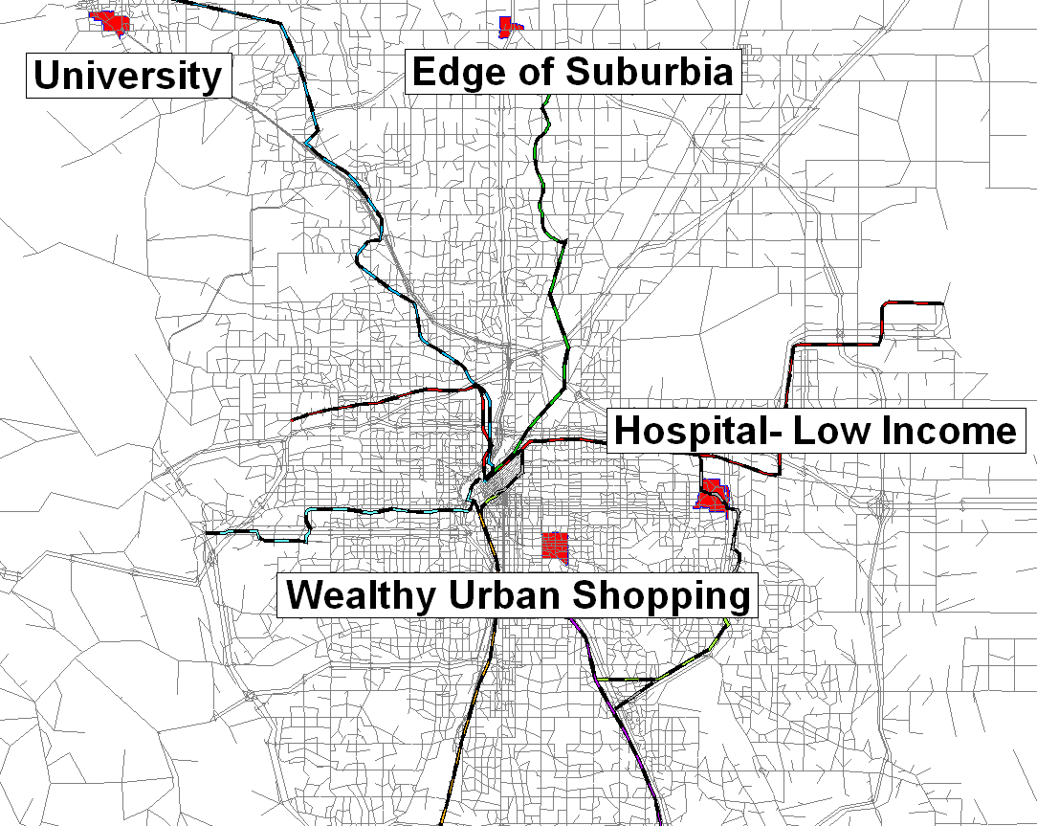
Small Areas
Story Across Space

Slide 9
Introducing the characters:
2010 Small Area Demographics
Description | Average Household Income (2000$) | Average Household Children
University | $ 23,000 | 0.1
Hospital – Low Income | $ 33,000 | 0.8
Edge of Suburbia | $ 69,000 | 0.6
Wealthy Urban Shopping | $ 89,000 | 0.2
Denver Region | $ 69,000 | 0.6
Notes:
Many ways to slice; age?

Slide 10
Setting the scene:
2010 Small Area Characteristics
Notes:
Redevelopment in hospital area.

Slide 11

The action begins:
Auto Ownership Story
Description | Share of 0 car Households | Share of 3 + Car Households
University | 30% | 12%
Hospital - Low Income | 18% | 16%
Edge of Suburbia | 0% | 28%
Wealthy Urban Shopping | 16% | 16%
Denver Region | 8% | 24%
Notes:
Wealthier people in less accessible areas have more cars. Poorer people in more accessible areas have less cars.
Not perfect; order maybe not magnitude; validation; leave in the same order; this small area thing helps with calibration validation; synthetic pop; compare to census

Slide 12
Mode Story
Notes:
In the areas where people have less cars they walk and take transit more. Wealthier in less accessible areas walk and take transit less. Poorer people in more accessible areas walk and take transi tmore.

Slide 13
VMT Story- The Denouement

Slide 14
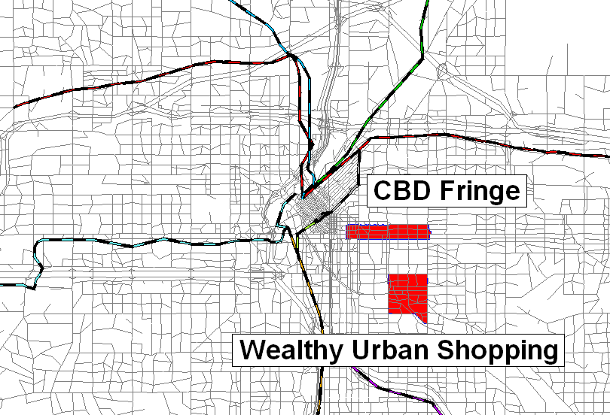
Is this story fiction?:
Observed Versus Modeled Areas
Notes:
More zoomed in

Slide 15
Observed Vs Modeled Trips By Mode
CBD Fringe
1104 Observed Trips For Households in the Area
Notes:
IS THE STORY REALISTIC? Not perfect; indicates areas for improvement; but relatively good; comparative great; absolute okay; transit/walk vs shared ride; captures differences between places;

Slide 16
Observed Vs Modeled Trips By Mode
Wealthy Urban Shopping
832 Observed Trips For Households in the Area
Notes:
Again too much transit / walk not enough shared ride; but captruign the difference as compared to East Colfax. More Driving Alone; Less Walk; transit/SR

Slide 17
More complex story:
Across Time and Space

Slide 18
Demographic Shifts
Description | % Change in Population | % Change in Employment
University | 55% | 8%
Hospital - Low Income | 59% | 188%
Edge of Suburbia | 675% | N/A
Wealthy Urban Shopping | 34% | 8%
Denver Region | 55% | 67%
Notes:
the hospital area is adding a lot of jobs and more employment. Light rail will expand. North suburban place will grow a ton. Do all of them? Urban centers targeted for development; why central ones are still showing growth

Slide 19
Transportation Shifts

Slide 20
Transit Share over time
Notes:
Walk and transit shares will increase as the city densifies and transit expands. Give an example

Slide 21
VMT per capita over time
Notes:
The greatest change is happening the areas of greatest change. Especially along the edges. Scale?!; we could dive deeper. Land use.

Slide 22
Small area analysis with ABM is useful (non-fiction?).
Points out areas of weakness in the model
Tells a story across time,
space, and types of people.
Guides planners and
decision-makers
Observed and modeled
results in the same ballpark
Notes:
All models wrong. Not so wrong as to not be useful. Sufficiently accurate to be useful.

Slide 23
TIP Criteria
Urban Center/TOD Evaluation
Current VMT per Capita
Multi-modal potential-
Reduction in single occupancy vehicle percentage
(2035-2010)
Notes:
Higher VMT needs you need more help. Multi-modal potential means you have the most chance to reduce VMT, most helpable. Reasonable results; struck us; hard to sum up why; professional opinion-knowledge of area and growth

Slide 24
Bike and Pedestrian Project Evaluation
User Base-
Trips X-Y origins and destinations in 1.5 mile buffer
Cost Effectiveness-
Cost per Person Mile Traveled
Notes:
Number of bike t

