Slide 1
Developing a Regional GIS Enterprise & Decision Support Tool for Transportation Planning – TELUDE
Felix Nwoko, Durham-Chapel Hill-Carrboro (DCHC) MPO
13th TRB Planning Applications Conference Reno, Nevada.

Slide 2
Acknowledgment
Consultants
  PB America
  Geonetics
MPO Staff
  Leta Huntsinger, Technical Team Leader
  Gurmeet Virk
  Rakesh Malhotra
  Jeremy Raw (Geocoder) now with FHWA

Slide 3
Show me the Picture
“… dat ain’t planning, show me the picture not data albatross…”
“I spent enormous time to write this long letter because I don’t have the time to write a short one” Mark Twain.

Slide 4
Presentation Overview
Background
What is TELUDE
Rationale and impetus for TELUDE
Features of TELUDE
MPO & transportation planning applications
Live Demonstration of one application –employment geocoder

Slide 5
Introduction/Purpose
Develop an integrated geospatial data management system.
Develop GIS automation tools to integrate MPO data for transportation planning.
Enable data sharing among MPO partners
TELUDE – multi-year $750,000 GIS enterprise

Slide 6
What is TELUDE?
Transportation Environmental and Land-Use Data Enterprise = TELUDE
Centralized repository for enterprise data
Decision support for transportation planning
Three parts of TELUDE
  Data warehouse
  Web based tools
  Desktop tools for data automation
  Maintenance strategy and protocol
Notes:
Examples of decision support – talk about maintenance protocol

Slide 7
Impetus & Rationale for TELUDE
Organizational and technical challenges in obtaining data for myriad of multidisciplinary geospatial data for MPO planning functions.
  Travel model
  MPO UrbanSim Land Use Integration Model
  NEPA/Project planning (Purpose & Need)
  Project prioritization
  Transportation plan
  Congestion Management Process
  Etc.
Notes:
Set the stage 2 mpos 12 counties

Slide 8
Impetus & Rationale for TELUDE Cont’d
Data that MPO collects is voluminous and sometimes inaccurate and not timely.
MPO is primary consumer of data and not a primary producer (e.g. tax assessor’s data).
MPO must comb through member agencies’ GIS to find different pieces of information.
MPO agencies lack organization of data sources.
Many data sources are duplicated.
No authoritative sources for some data.

Slide 9
Impetus & Rationale for TELUDE Cont’d
MPO boundary ≠ Model boundary ≠ air quality non-attainment area ≠ scenario boundary.
An attitude of “Data is King”

Slide 10
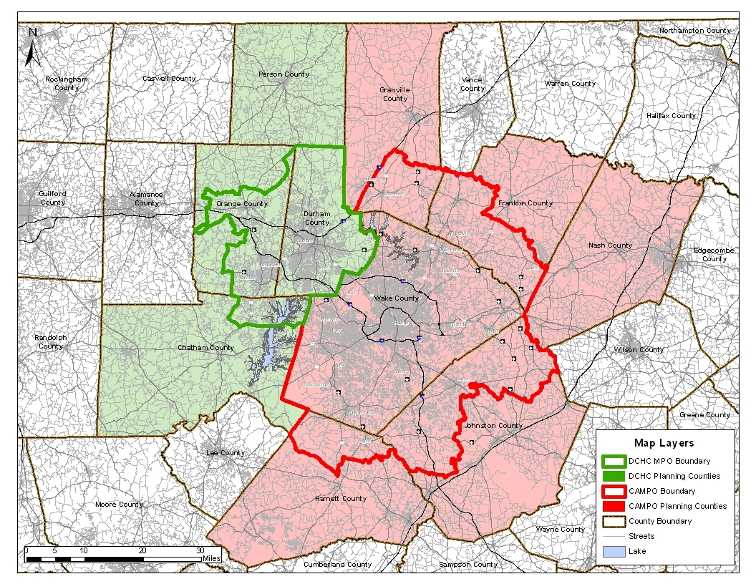
Travel Model Boundary

Slide 11
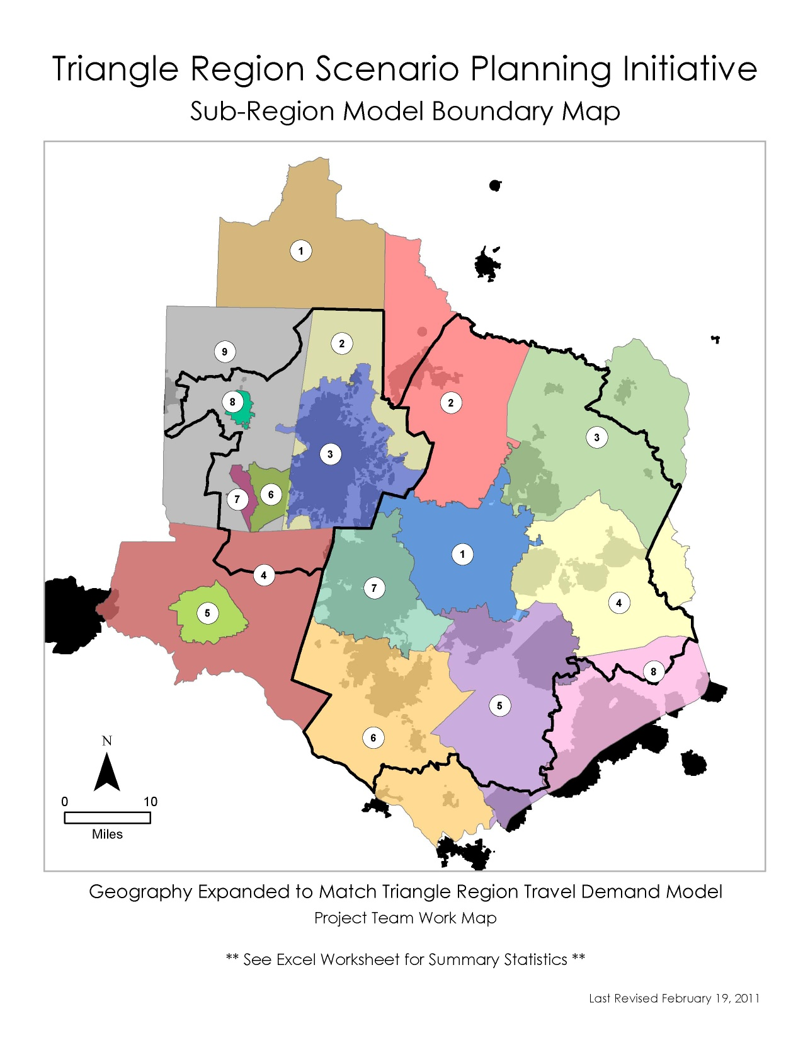

Slide 12
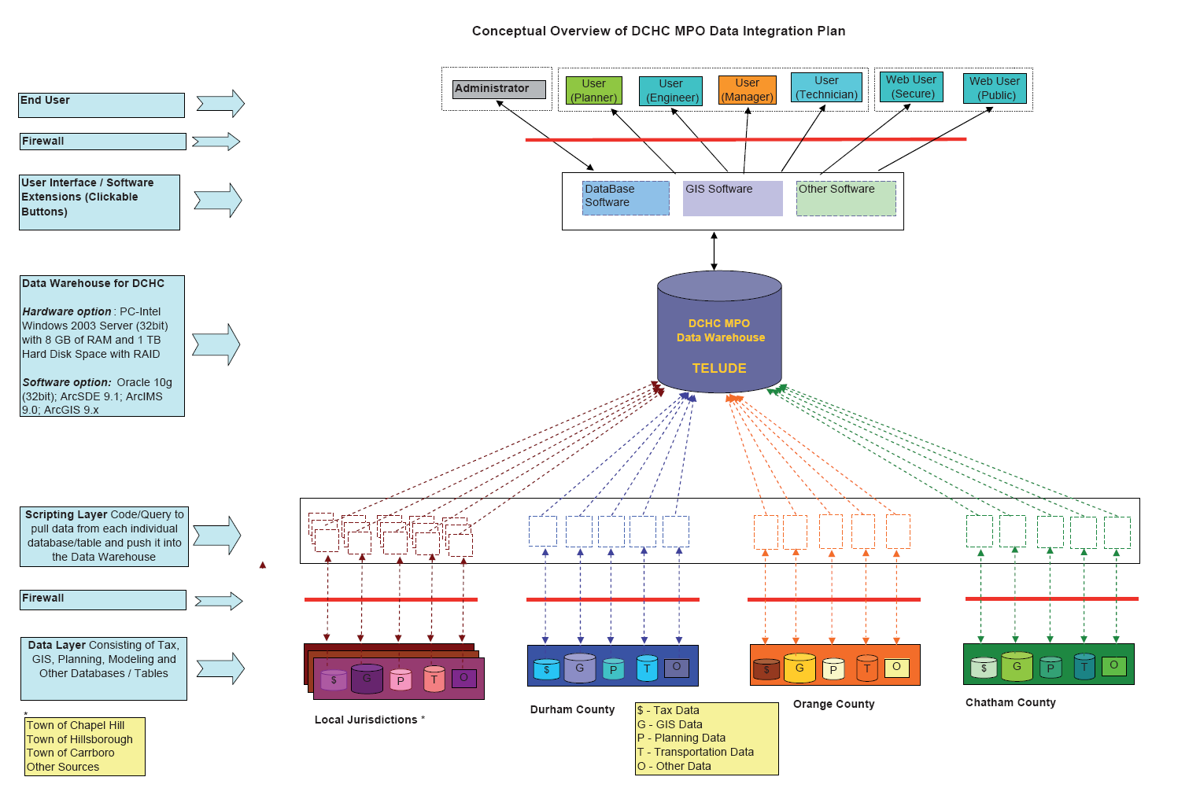
TELUDE Conceptual Model
Notes:
Member agencies use example ICI, TIP ranking – Web use interactive GIS TAZ to project info ADT protocol don’t upset the apple card – deal with privacy and security issues

Slide 13
TELUDE Conceptual Model
Part 1
Data Warehouse
Notes:
Do not upset the apple card – establishes protocol

Slide 14
TELUDE Conceptual Model
Part 2
Web Based Tools

Slide 15

TELUDE Conceptual Model
Part 3
Desktop Tool for GIS Automation
Notes:
Two way street for desk top and one-way street for web

Slide 16
TELUDE Applications
Employment Geocoder.
Travel model inputs.
Transportation Plan.
Congestion Management process.
Environmental Justice.
Project ranking and prioritization.
Data monitoring, surveillance of change & maintenance.
Integration of system planning and NEPA
Etc

Slide 17
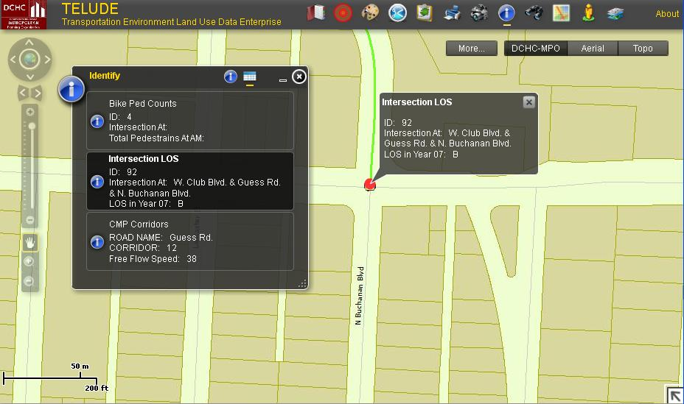
Features of TELUDE

Slide 18
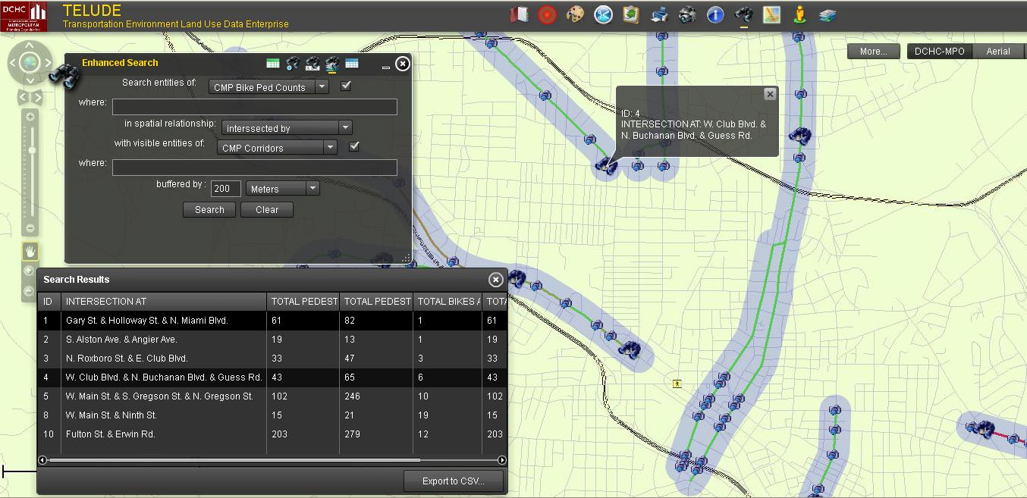
Features of TELUDE

Slide 19
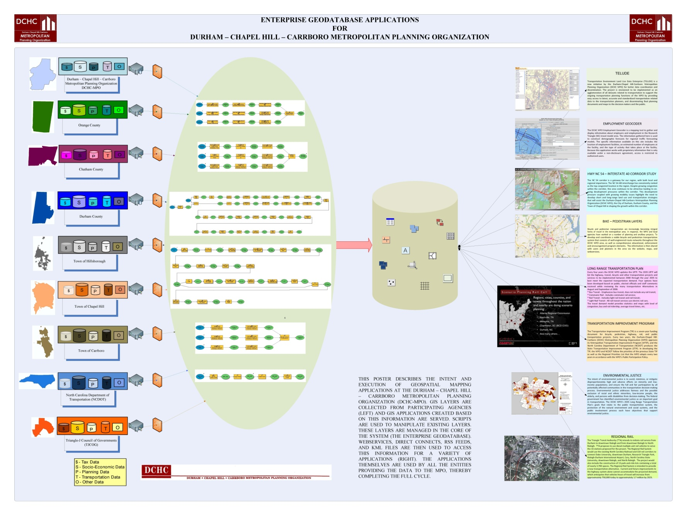
TELUDE Applications

Slide 20
Employment Geocoder Application in
TELUDE

Slide 21
Live Demonstration
Let’s take a quick ride through one of TELUDE aaplications

Slide 22
Questions
Thanks.
Hope I have taken the time to write a short letter.

