Slide 1

GIS Application for Transit Access Data Development:
A Case Study of the Chicago Metropolitan Agency for Planning (CMAP) Mode Choice Model
13th TRB Transportation Planning Application Conference May 2012
Ying Chen, AICP, PTP, Parsons Brinckerhoff
Ronald Eash, PE, Parsons Brinckerhoff
Mary Lupa, AICP, Parsons Brinckerhoff
Notes:
Thanks, Dr. Gan! I appreciate the opportunity to be here to present this little piece of work that I did for Chicago Metropolitan Agency for Planning Mode Choice Model about GIS application for Transit Access Data Development. I’m introducing my co-presenter, Mary Lupa. Mary is

Slide 2

Presentation Outline
Overview of Chicago Metropolitan Agency for Planning mode choice model
Transit access calculations in CMAP model
Traditional approach
Advanced transit accessibility measures
Data development with GIS application
Broader applications

Slide 3
CMAP Mode Choice Model
Originally developed in FORTRAN in the mid-1980s
Updated several times over the years to take advantage of new survey data, hardware and software
Current version is compatible with EMME databanks
Traditional trip based model

Slide 4
Model Characteristics
Early application of microsimulation
  Simulates the mode choices of individual travelers
  Cost and time characteristics of alternative choices
Monte Carlo simulations
  Mode choice: evaluate logit equation and compare mode choice probabilities against values randomly generated from probability distribution
  Submodels that determine the CBD parking, transit access mode, and transit egress mode characteristics
  Traveler’s household income
Notes:
Transit path skimming for line-haul transit cost and time characteristics
Submodels that determine the costs and times associated with parking in the CBD, access to and egress from line-haul transit

Slide 5
Transit Access-Egress Submodel
Estimates the additional in-vehicle time, out-of-vehicle time, and fares incurred from trip origin to line-haul transit and from line-haul transit to destination
Least costly (weighted time and cost) mode is selected from four alternative access modes
  Auto driver (park and ride)
  Auto passenger (kiss and ride)
  Bus (commuter rail station feeder bus)
  Walk

Slide 6
Additional Data Inputs for Transit Access-Egress Submodel
Zonal service characteristics
  Fares
  Average auto speeds and costs
  Rail Park/Ride availability and costs
  Bus headway to/from rail station
Zonal demographic characteristics
  Area Type
  Households
  Median income
  Destination auto occupancy
  Employment

Slide 7
Transit Access/Egress Distances
First and last transit modes obtained from transit paths
First step in access mode calculations is to determine distances from origin-destination to transit
 | First/Last Transit Mode
Possible Transit Access Point | Bus | Rail Transit | Commuter Rail
CTA/PACE Bus Stop | X | X | X
CTA Rail Transit Station |  | X
Metra Commuter Rail Station |  |  | X
PACE Feeder Bus Stop |  |  | X

Slide 8
Traditional Approach – Simplistic Measures
Distance to transit stations
Areas within 0.5 mile of the transit routes
Other

Slide 9
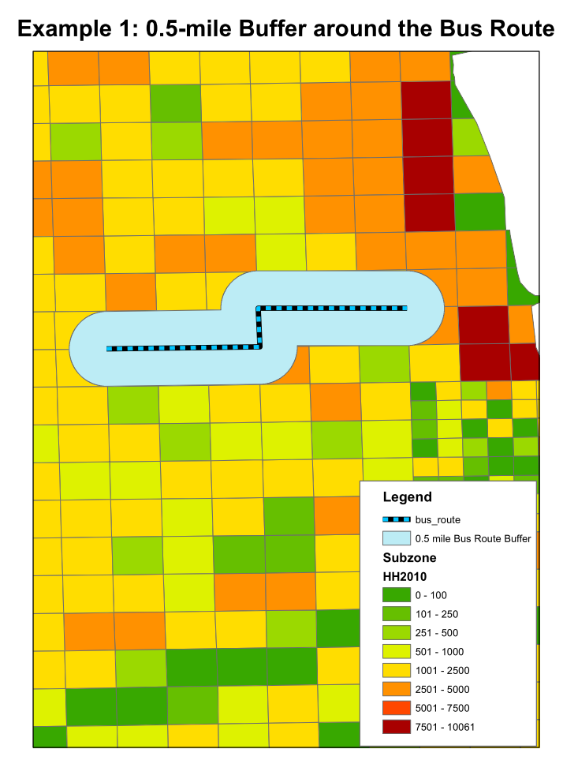
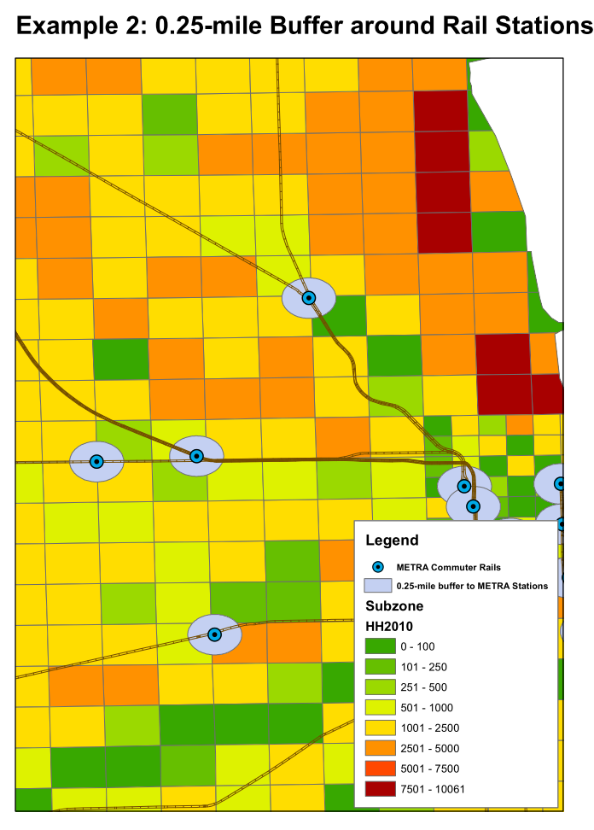
Traditional Approach Examples

Slide 10
Limitation of Traditional Distance Measures
Not accurate enough to reflect the complicated socioeconomic characteristics within the Traffic Analysis Zones (TAZ)
Average distances not suitable for microsimulation
The access/egress modes have different catchment areas

Slide 11
Distance Parameters used in CMAP Mode Choice Model
 | Attribute | Type | Unit | Description | Sample Entries
 | Zone Number | Integer | --- | Unique ID (2,233 internal zones for I-290 Study) | 1, 4, 1001, 2233
Commuter Rail | RR PAR 1 | Real | Miles | RR PAR 1: Mean Distance to Commuter Rail Stations (20 Mile Buffer) | .85, 2.05, 11.92 - no zeros
 | RR PAR 2 | Real | Miles | RR PAR 2: Standard Deviation of the Distance to Commuter Rail Station (20 Mile Buffer) | .27, .3, .78
 | RR PAR 3 | Integer | --- | Flag for Normal Distribution always set to 101 | 101
Bus | BUS PAR 1 | Real | Miles | BUS PAR 1: Minimum distance to the bus line band with a minimum of .1; 999 if there is nothing within 1.1 miles | .1, .2 .8, 999
 | BUS PAR 2 | Real | Miles | BUS PAR 2: Maximum distance to the bus line band with a maximum of 1.1; 999 if there is nothing within 1.1 miles | .6, .8, 1.1, 999
 | BUS PAR 3 | Real | Numerator and denominator are in Square miles | Ratio of area of zone with minimum band to area of zone with maximum band. 999 if there is 999 in the first two parameters | .301, .033, .007, 999

Slide 12
Distances to Rail Stations
Normal distribution assumed
  Mean and standard distribution input for each zone
  Estimated using a one-half mile grid with distances weighted by households in grid cell
Probability (y-axis) versus distance (x-axis)
Prob.
Distance to Station

Slide 13
Distances to Bus Stops
Uniform probability distribution
  Min and max walking distance to stop
  Fraction of zone’s area within min walking distance (Area_{Min})
Probability equals area under triangle defined by walking distance divided by total area under triangle
Given Probability, Area_{min}, Min, and Max can calculate WD
Area_{Min}
Min
WD
Max
Walking Distance

Slide 14
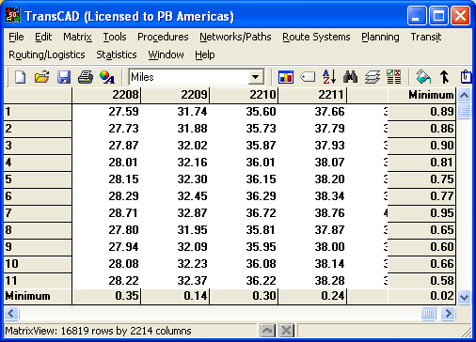
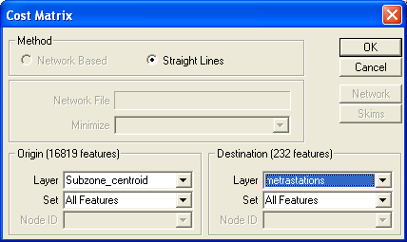
Computing the Mean Distance to the Rail Stations
Step 1: Develop subzones and get subzone centroids
Step 2: Develop “straight line” distance matrix from all subzone centroids to all the Metra rail stations using TransCAD “cost matrix” tool

Slide 15
Computing the Mean Distance to the Rail Stations (Continued)
Step 3: Calculate the Mean Distance to Commuter Rail Stations (RR PAR 1)
  Weighted by the Household of the Subzones within that TAZ; For areas with zero zonal household, the mean distance will be weighted by the area (the ratio of the subzone area to the entire TAZ)
  ArcGIS – Summarization Function
  TransCAD – Tag Function

Slide 16
Computing the Mean Distance to the Rail Stations (Continued)
Step 4: Calculate the Standard Deviation of the Distance to Commuter Rail Stations. (RR PAR 2)
  Inter-subzone Variance
    The variance of the distances between subzone centroids and the station and is weighted by household
  Intra-subzone Variance
    The variance of the distances from household locations within a subzone to the subzone centroid
    Assume all the households within a subzone are uniformly distributed

Slide 17
Parameters to Determine the Accessibility to Bus Routes
Bus Route Band
Minimum Distance to the Bus Route Band with a minimum of 0.1 mile
Maximum Distance to the Bus Route Band with a maximum of 1.1 mile
Ratio of the area of zone with minimum band to area of zone with maximum band

Slide 18
Data Needed
A Line GIS Layer of Bus Routes
An Area GIS Layer of TAZs

Slide 19
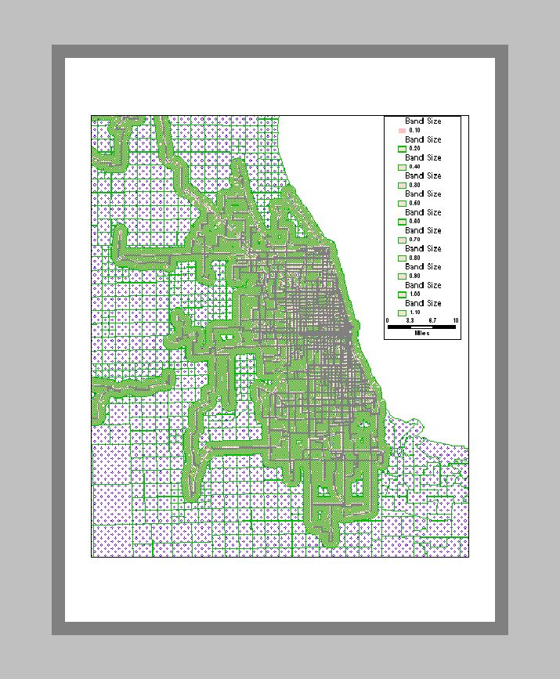
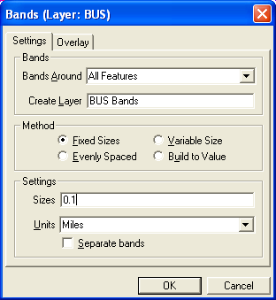
Computing Population within the Zone that Have Access to the Bus Routes (Continued)
Step 1: Build Bus Route Bands Incremented by 0.1 Mile

Slide 20
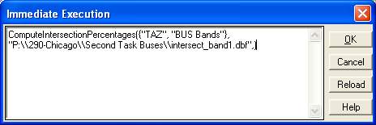
Computing Population within the Zones that Have Access to the Bus Routes (Continued)
Step 2: Calculate the Percentage of the Area of Each Zone Covered by Each Bus Lane Band
Zone 128 shows:
BAND1 | BAND2 | BAND3 | BAND4 | BAND5 | BAND6 | BAND7 | BAND8 | BAND9 | BAND10 | BAND11
0.3900 | 0.5677 | 0.6878 | 0.7738 | 0.8452 | 0.9147 | 0.9700 | 1.0000 | 1.0000 | 1.0000 | 1.0000

Slide 21
Computing Population within the Zones that Have Access to the Bus Routes (Continued)
Step 3: Calculate the Ratio of the Minimum Bus Route Coverage Area vs. the Maximum Bus Route Coverage Area
Area of Zone with Minimum Band
Area of Zone with Maximum Band
For Zone 128
Ratio (PT PAR 3) = 0.39/1
= 0.39
Ratio =

Slide 22
Special Capture
For all the TAZs with mean distance to the nearest rail stations more than 20 miles, the mean distances are set to 19.95 miles with the standard deviation set as 0.2.
For Zones that are entirely outside of the 1.1 miles band of the bus routes, all the parameters (BUS PAR1, BUS PAR2, BUS PAR3) are set to 999.

Slide 23
Conclusion
Advanced Transit Access/Egress Data – Integrate Spatial Distance and Zonal Socioeconomic Characteristics
More Objective, Accurate, Replicatable, and Responsive
GIS Tool – Powerful and Efficient in Data Development and Visualization
Application of Transit Access Database –Transit Modeling, Ridership Forecasting, Transit System Planning

Slide 24
Thank you!!!
Questions?
Ying Chen, AICP, PTP -- CHENYI@PBWORLD.COM
Ronald Eash, PE -- EASHRW@PBWORLD.COM

