Slide 1
Turning Model Data into Clear and Understandable Results
STATEWIDE MODEL INFLUENCE AREAS
John Stevens, Jonathan Avner, and Paul Hershkowitz of Wilbur Smith Associates
with
Walter Steinvorth, and Michael Fazio of UDOT

Slide 2
The Problem
In general people don’t think in terms of VMT, VHT
How can model data be displayed in a way that makes sense for the public and or decision makers?

Slide 3
Some Utah Issues
Need to look at certain rural subareas and the trade-offs between different scenarios
Want to be able to effectively communicate to the non-transportation professionals

Slide 4
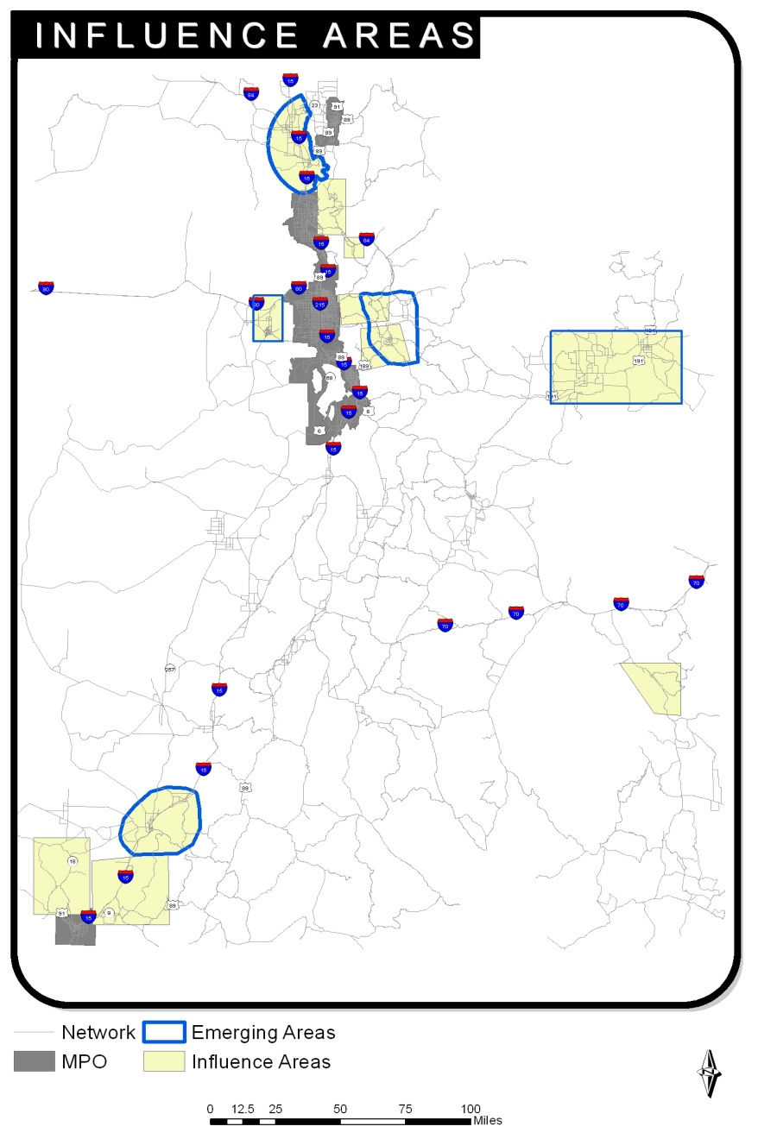
Question 1 – look at sub areas
We created the concept of influence areas, and generated reports for the specific rural areas we had questions about

Slide 5
Mobility Index
Index Measures
  Delay
  Time to work
  Time to Urban Areas
  Average Speed
  Congested Lane Miles
User Defined Weights
All compared to full build out conditions

Slide 6
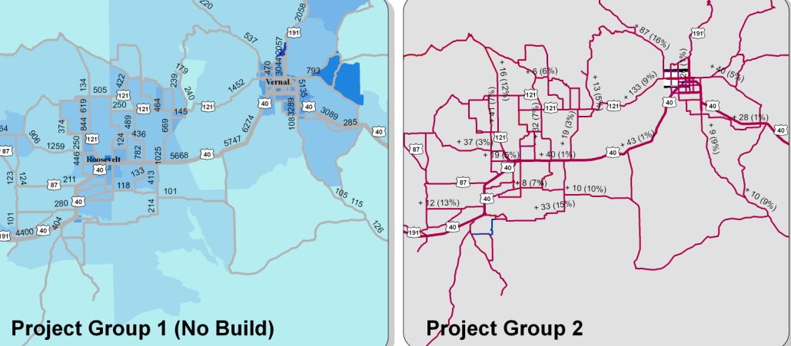
Process
Scenario Selection
Scenario 1
Scenario 2
Variable Weighting
___ Work Trips
Outputs
Buildout
Financially Constrained
Map Series
___ Delay
100 Points Remaining
Index Chart

Slide 7
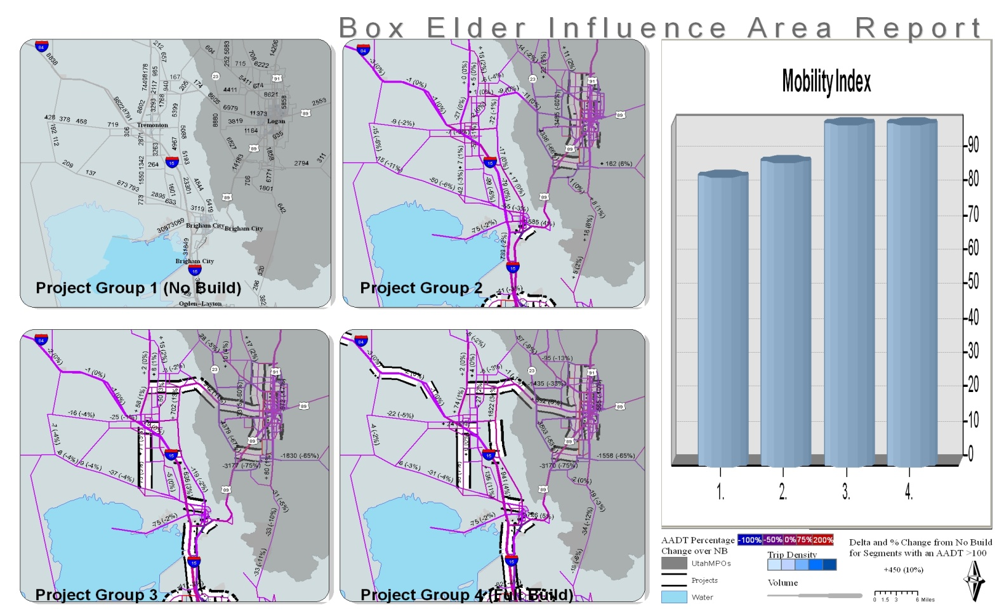
We then created some simple scripts to compare the different network performances in these areas
Some of the Elements Include:
Baseline of Trip Density
Indication of Project Location
Percentage Change in Volume
And a Mobility Index

Slide 8
So What
Provides Visual Representation of Model Data
Allows for Comparison between Scenarios
Raises the level of the discussion
  Instead of what, or how, we move to why, for what purpose, what are the goals

Slide 9
My Question – But what about the people
Focus on improving system performance
What does it mean to the population

Slide 10
Dynamic Influence Areas
Aggregated the modeled AADT difference between a scenario and the baseline to the TAZ level
Present the change in terms of the population and jobs that will see a difference due to any projects
Also works as a diagnostic tool to determine synergistic effects of projects

Slide 11
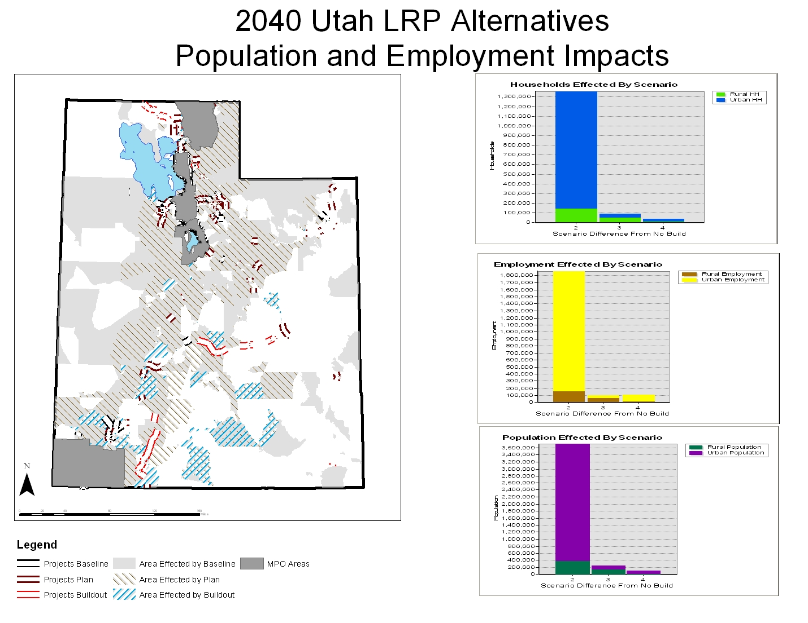

Slide 12
Summary
Standardized and flexible system for evaluation
Visual communication for comparing different scenarios
Putting the effects of projects in terms that the general population can understand
User generated weighting/priorities
  Changes the tone of the discussion

Slide 13
Future Applications
This can be used for series or individual projects, small or large areas
Take it to the cloud

