Slide 1
Congestion Mitigation Fee Program Nexus Study
GIS Based Fee Revenue and Growth Forecast Calculator
13th TRB National Transportation Planning Conference
Yushuang Zhou and Michael Snavely
5/10/2011

Slide 2


How the Nexus Process Works
California Mitigation Fee Act (AB 1600)
Allow government to levy fees on new developments to defray the cost of accommodating impacts on transportation networks
Need to show a clear nexus between the purpose of the fee, the improvements being funded by the fee, and development growth
Population and Employment
↓
Total Travel Demand
↓
Determine The Nexus between New Development and its Impact on Transportation Network
↓
Fee Per Trip of New Development
100%
7%

Slide 3
Work Flow
Funding
Gap
Projects
Fee
Employment
by SIC Code
2005 - 2035
Employment by Land Use
Trip Rates
by land use
Non
Residential
Land Use
Trips
Residential Dwelling Units
2005 - 2035
Residential
GHG
Outreach tool for 1 CMA; 8 Sub-regions; 88 Cities + Unincorporated Areas

Slide 4
Employment in Land Use (SIC 7 =Retail Trade)
% of Retail Trade Work Force Works in a Given Land Use Type
Source: Natelson Report, 2001

Slide 5
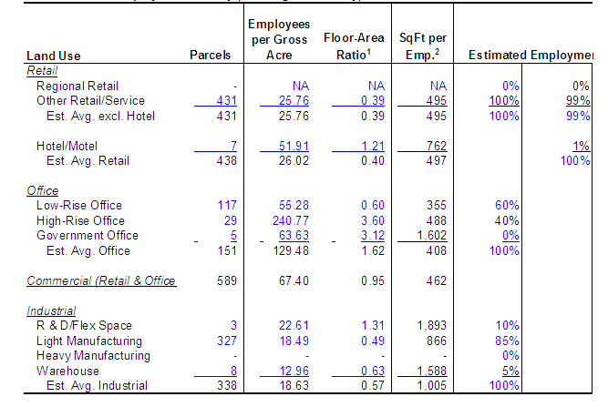
Urban Employment Density
Estimated Work Area Per Employee
Source: Natelson Report, 2001

Slide 6
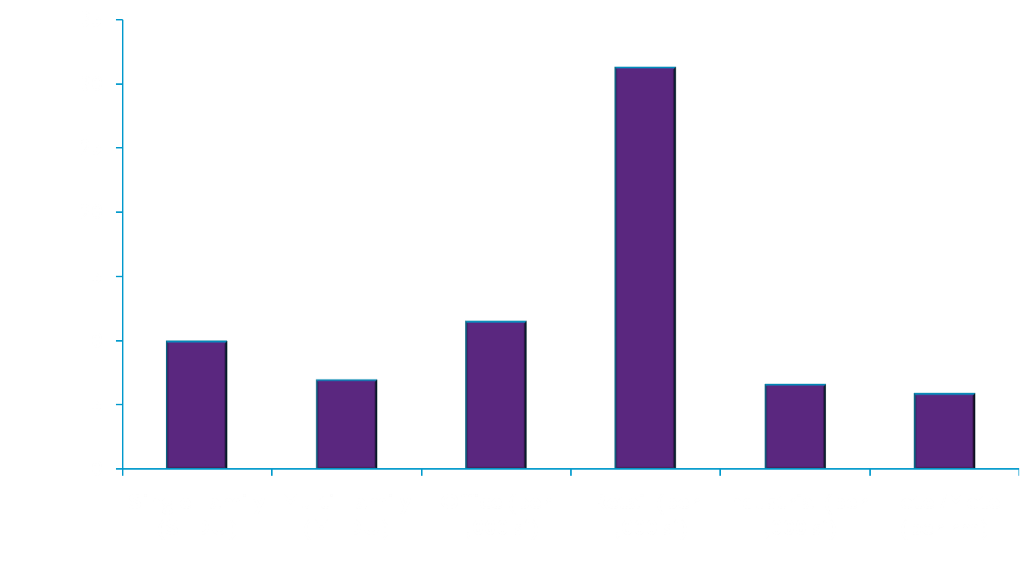
Trip Rates by Land Use Types

Slide 7
Web-Based Tool for Fee Program Development
Four Integrated Modules
GHG Reduction Analysis
Web-Based GIS Tool
Land Use & Socio-Economic Forecast
Fee Calculation & Revenue Projection
Project Entry & Editing

Slide 8
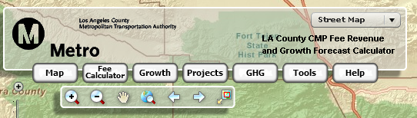

Tool Components
Growth Editor
Project Manager
Fee Calculator
GHG Calculator
Mapping Navigation Tools
Other Tools
Pop-up
Manager
Zoom Slider
Help Menu
Map Option

Slide 9
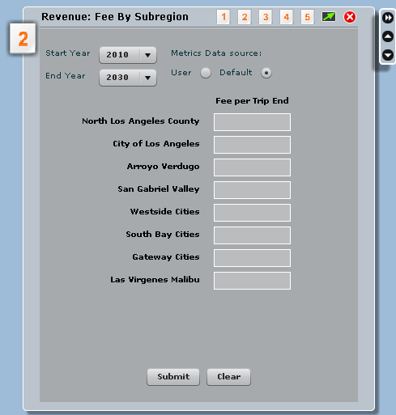
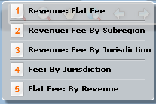
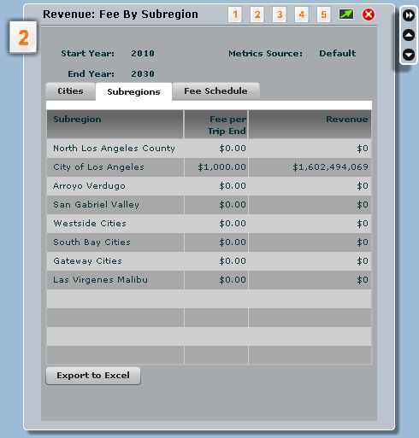
Fee Calculator
1000

Slide 10
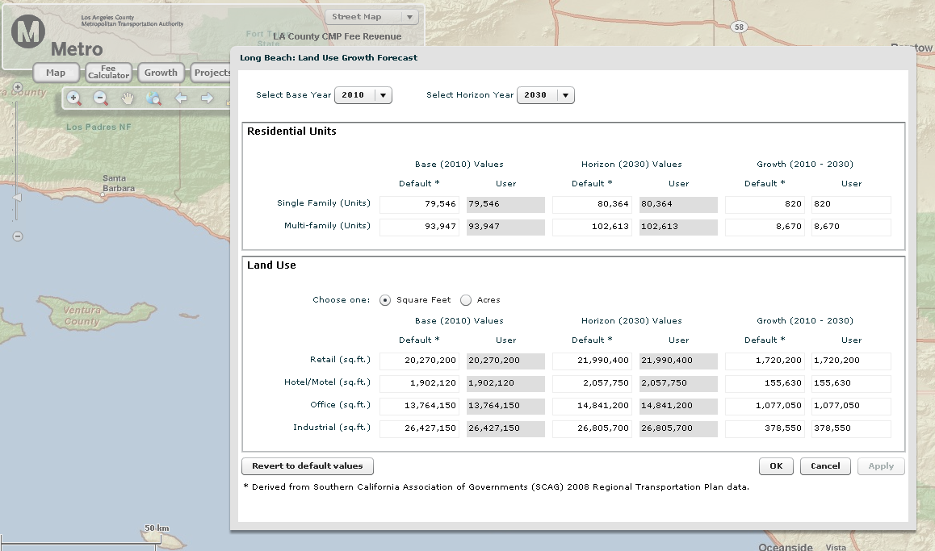

Growth Editor: Edit Land Use

Slide 11
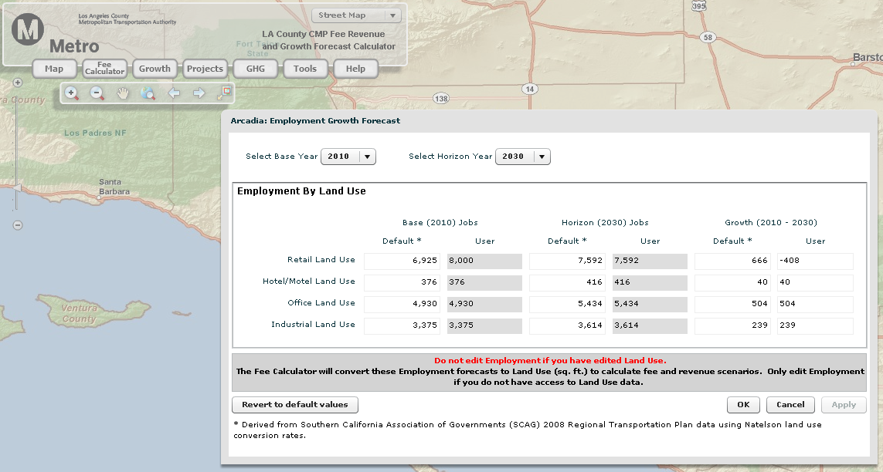
Growth Editor: Edit Employment

Slide 12
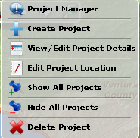
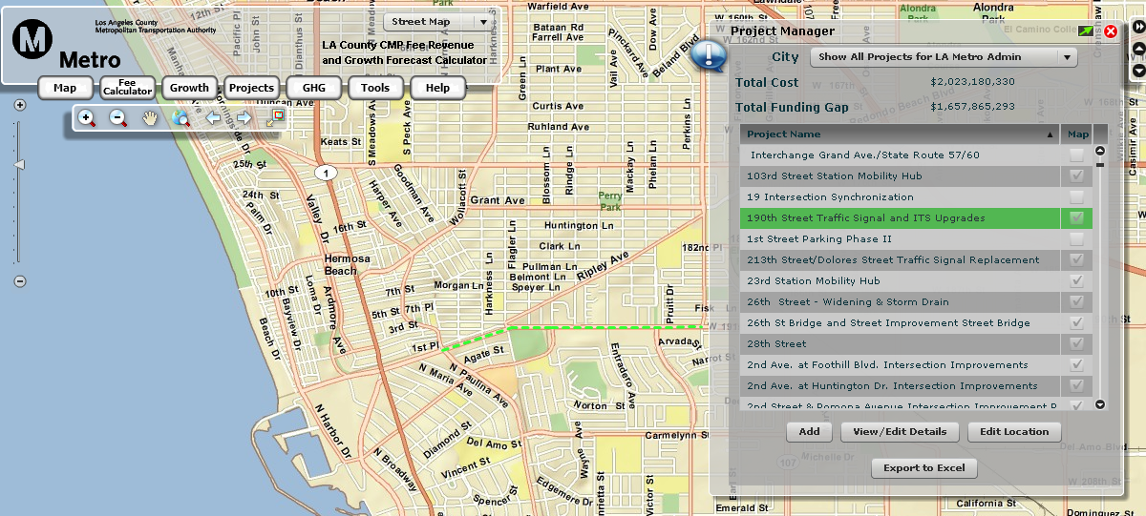
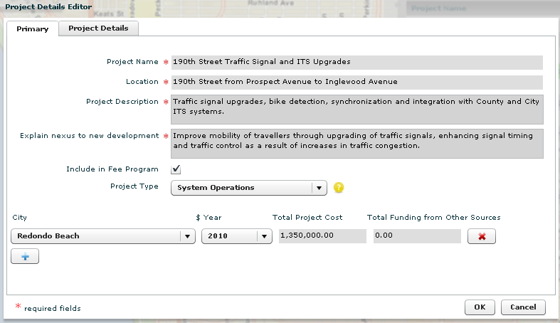
Project Manager

Slide 13
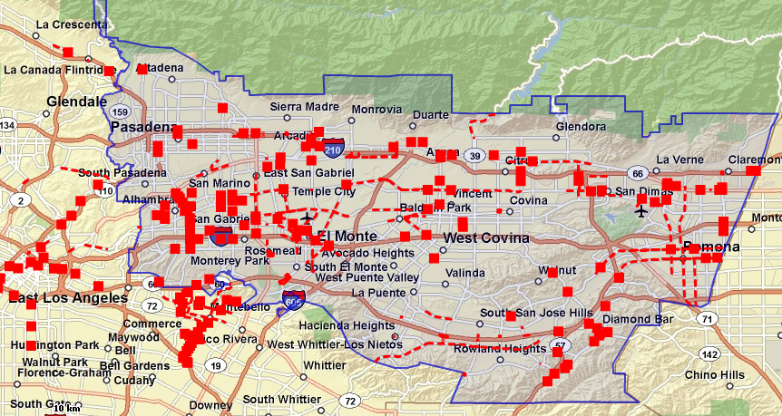
List of Projects by Sub-Region

Slide 14
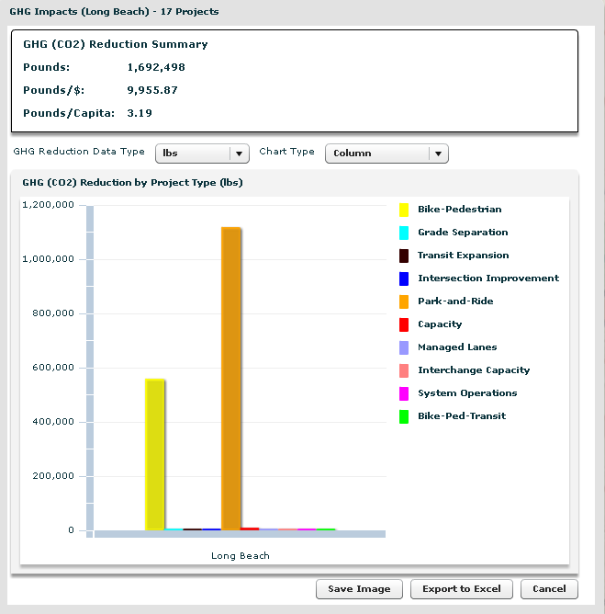

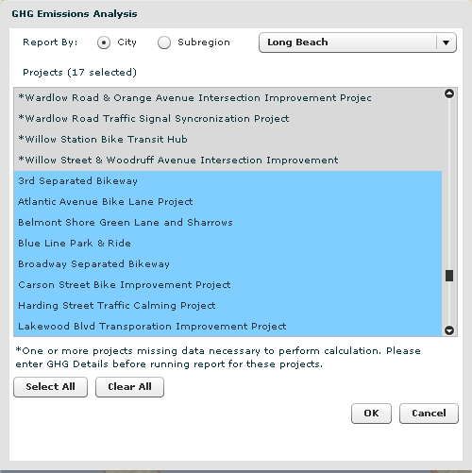
GHG Calculator

Slide 15
Annual GHG Reduction
Likely Measurements by Jurisdiction and Sub-region
Bike-Pedestrian
Bike/Pedestrian - Transit
Capacity
Capacity/Grade Separation
Capacity/Interchange
Intersection Improvement
System Ops/Management
Transit
Transit/Managed Lanes
Transit/Parking
-3,000
-2,000
-1,000
0
1,000
2,000
3,000
4,000
5,000
6,000
7,000
Reductions of Annual Grams of CO₂ per Capita

Slide 16
Revenue Generation
Fees Scenarios for Single Family Dwelling Units (2010-30)
Millions 0f Current Dollars
$300
$285
Million
$250
$228
Million
$200
$171
Million
$150
$100
$114
Million
$50
$0
$2,000 per SFDU
$3,000 per SFDU
$4,000 per SFDU
$5,000 per SFDU

Slide 17
Total Revenue Generation
Assumes $300 Fee per Trip-end from 2010 to 2030
Millions of Current Dollars
$60
$50
$40
~
~
~
~
~
~
~
~
~
~
~
~
$10
$8
$6
$4
$2
$0
By City

Slide 18
Pilot Study Procedure
1
2
3
Review/modify
regional network
Identify candidate projects
Verify/adjust land use forecast
4
Develop final project list
Nexus
Other Funding
Fee amount
5
6
Credit local impact
fee program revenue
Conduct nexus analysis
7
Draft Pilot
Congestion Fee Program

Slide 19



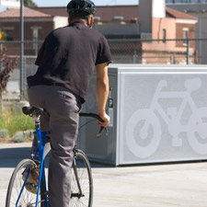
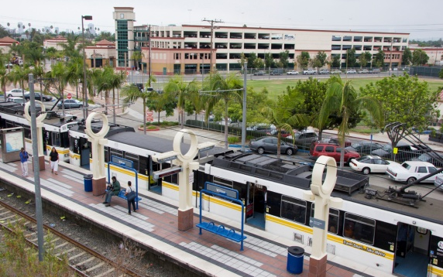
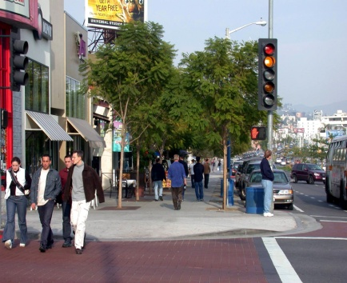

GIS Tool makes the exercise easy!
Congestion Mitigation Fee
New Revenue
Cities Collect New Funds
Cities Build Projects
Comply with CMP

Slide 20
Q & A
Contact
Robert Calix
Los Angeles County Metropolitan Transportation Authority
Phone: (213) 922-2563
Fax: (213) 922-2868
calixr@mta.net

Slide 21
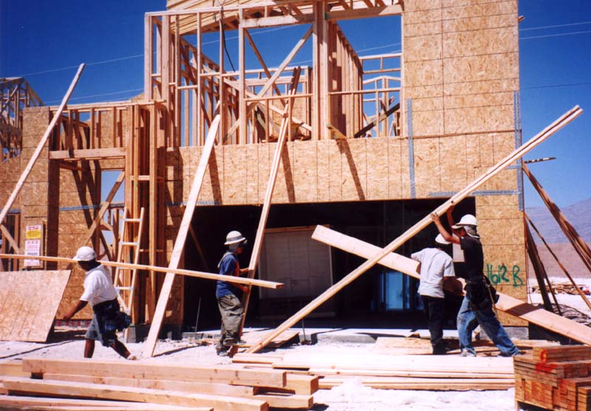

CMP Benefit to Developers
Countywide Fee Provides
  Consistency
  Predictability
  Certainty
Project-Specific Deficiency Plans Could Substantially Delay Project Approvals
Nexus Protects Developer From Paying
for Existing Deficiencies
CMP Land Use Exclusions Are Exempt
Notes:
Consistent Requirement between cities
Predictability in what’s expected
Removes Uncertainty risks, Environ doc are proj

Slide 22
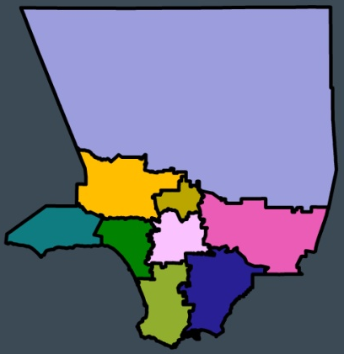


CMP Benefit to Cities
Generate New Funding Source for Transportation Projects
New Development Helps Pay Its Way
Geographic Linkage Between New Development Impacts and Fee Funded Projects
Eliminates likely return of “Bean Counting” Exercise

