Slide 1
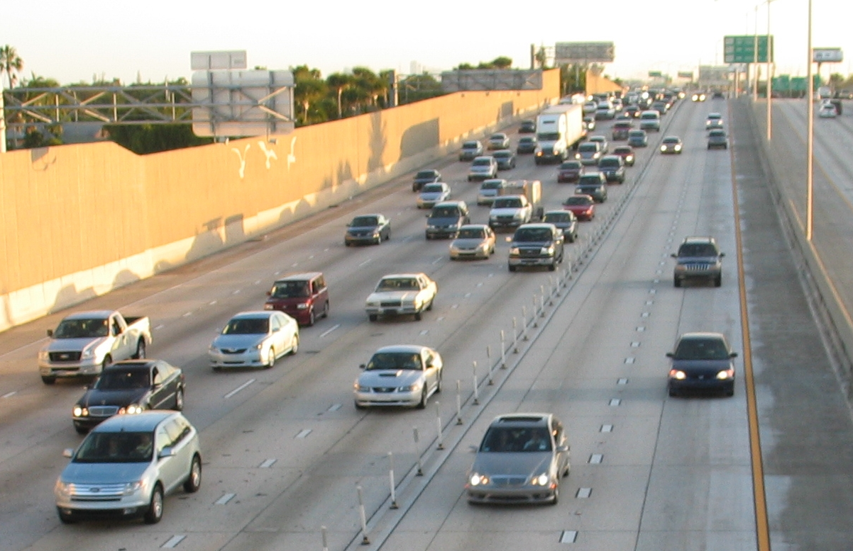
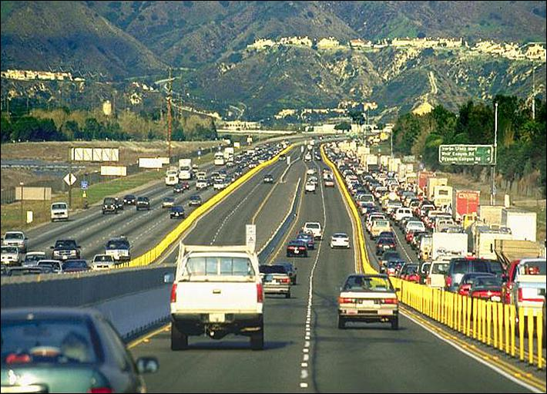
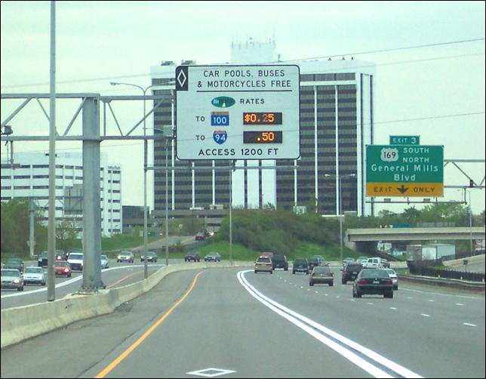
LONG-TERM DEMAND FORECASTING OF MANAGED LANES
Challenges in Addressing Key Influential Risk Parameters
Christopher Mwalwanda
13th TRB Transportation Planning Applications Conference
May 10, 2011

Slide 2
MANAGED LANE FORECASTING 101
More Complex than Traditional Forecasting
  Competition Conditions are immediately apparent
More Data for Operational Assessments
  Public Behavioral Characteristics
  Geometrical Consideration/Travel Speed Deterioration Analysis
  Time of Day Profiling
Eligibility and Pricing Options
  Operational Demand Management versus Revenue Generation

Slide 3














OPERATING MANAGED LANE PROJECTS
SR 167, Seattle, WA
2008
I-15, Salt Lake, UT
2006
Minneapolis, MN
I-394 , 2005
I-35W, 2009
I-680, Alameda, CA
2010
SR 91, Orange, CA
1995
I-25, Denver, CO
2006
I-95, Miami, FL
2008
I-15, San Diego, CA
1998
Houston, TX
US 290 QuickRide
1998
I-10 Katy Freeway
Managed Lanes, 2009

Slide 4
RECENT HOT/MANAGED LANE PROJECTS
I-405
I-25 North
Route 495 Lincoln Tunnel
I-580
SR 237
SR 85 & US 101
US 36
I-95 Section 100
IH-635 /LBJ
NTE
Atlanta (Various)
MoPac
Loop 1
US 290
Existing Managed Lanes Projects
Planned or Under Construction
I-595
Studied

Slide 5
FORECASTING CHALLENGES
New and Innovative Demand Management Techniques
  Dynamic Speed Limits/Dynamic Re-striping
  Shoulder Lane Utilization
  GPS/Dynamic Re-routing Procedures
How does one develop a forecast?
  Point forecasts for financial feasibility
  Ranges for procurement assessment

Slide 6
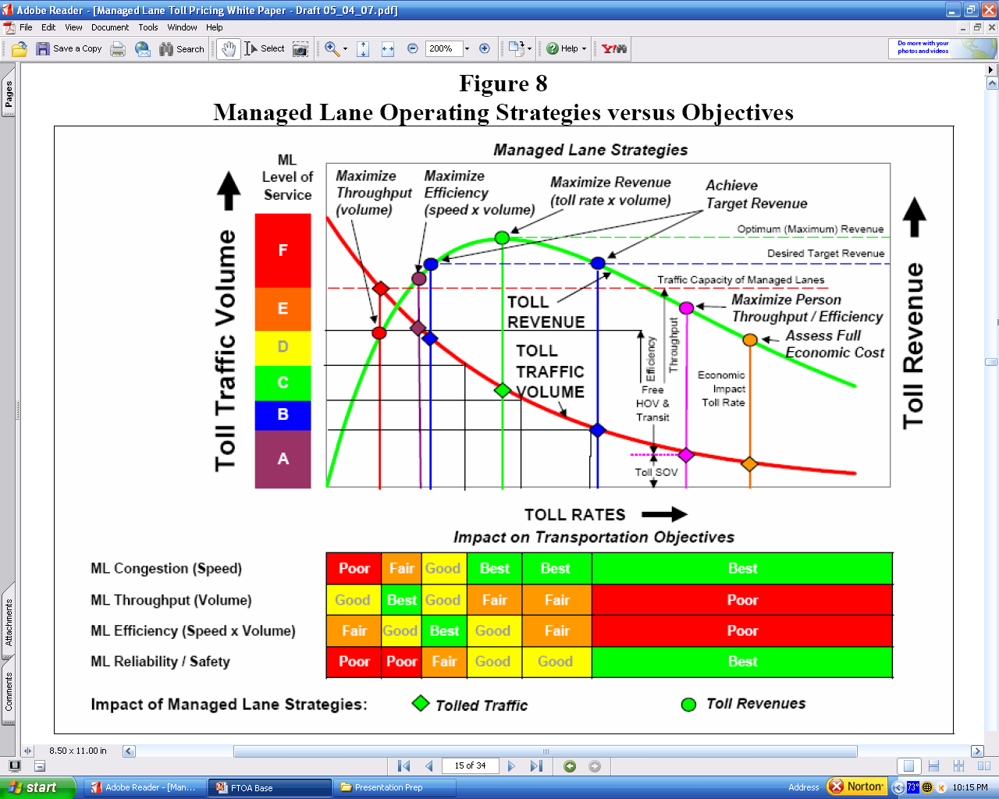
MANAGED LANE POLICIES
HOV’s
HOT’s
ETL’s
TOT’s

Slide 7
VARIABLE PRICING EXAMPLES
Facility Type
Pricing
Type
Facility
Location
Comments
Fixed Variable Rates
SR 91
Orange County, CA
ETL's
Preset
Varies by day of week and hour of day
I-25 HOT Lanes
Denver, CO
ETL's (HOT)
Preset
HOV's free – reversible/Free Flow for Buses
IH 10 Toll Lanes
Houston, TX
ETL's (HOT)
Preset
HOV's free during peak periods
Dynamic Pricing
I-15 Managed Lanes
San Diego, CA
ETL's (HOT)
Dynamic
Must keep free flow for HOV
I-394 MNPASS
Minneapolis, MN
ETL's (HOT)
Dynamic
Must keep free flow for HOV
SR 167
Seattle, WA
ETL's (HOT)
Dynamic
Must keep free flow for HOV
I-15 Managed Lanes
Salt Lake City, UT
ETL's (HOT)
Dynamic
Must keep free flow for HOV
I-95 Express Lanes
Miami, FL
ETL's (HOT)
Dynamic*
Registered HOV

Slide 8
EXISTING ML OVERVIEW
Project Name | Length | Lanes |  | Daily Volume |  | Annual Revenue (million) | Tolling Policy
 |  | ML | GP | ML (000) | GP (000)
SR 167_WA | 9 | 2 | 4 | 2 - 2.3 | 112 - 115 | $0.4 - $0.5 | HOV2+ free
I-394_MN* | 11 | 1/2 | 4 | 4 - 4.5 | 150 – 160 | $1.4 - $1.6 | HOV2+ free
I-25_CO* | 7 | 2 | 8 | 4 – 5 | 220 – 230 | $2.0 - $2.5 | HOV2+ free
IH 10_TX | 12 | 4 | 10 | 25 - 27 | 220 - 225 | $6.0 - $7.0 | HOV2+ free peak period
I-95_FL | 6 | 2 | 8 | 50 – 55 | 210 - 250 | $13 - $14.0 | HOV3+ free, Registered
SR 91_CA | 10 | 4 | 8 | 35 - 40 | 215 - 220 | $35 -$40 | HOV3+ discount in PM, free all other times
* Reversible facilities

Slide 9
EVOLUTION OF MANAGED LANES
Market Capture
  Attracting User Markets
  Peak Period HOV Discounting
  HOV 2+ or 3+ Market Segmentation
  Already Relatively Mature Corridors
Hyper-Congested
Peak Period Congested
Maturation of Targeted Demand
  Captures Sufficient Targeted Daily Demand
Moderately Congested
REVENUE
Management of Demand
  High Toll Rates
  Discourage excessive usage
# of Years

Slide 10
EVOLUTION IMPLICATIONS
Hockey Stick Revenue Achievable?? It Depends and requires:
  Detailed Assessment of the all key variables
  Focus on Future Operational Performances (GP & ML)
Key Risk Associated with Forecasts
  Competing Facilities
  Escalation of Toll Rates
  Maximum Demand Capture Rates
  Off-peak/Directionality Considerations
  Local Corridor Characteristics
  Future Geometrical and Network Connectivity

Slide 11
REVENUE GROWTH IMPLICAITON?
Annual Revenue growth has been very strong:
9.6% AAGR (1998 - 2004) [Inflation ~ 2.9%]
16.9% AAGR (2004 - 2007) [Inflation ~ 4.0%]
Recession effect:
-4.8% AAGR (2007 - 2010)
Overall nominal growth:
7.5% AAGR (1998 - 2010)
[Inflation ~ 2.8%]
Real Growth ~ 4.7% AAGR

Slide 12
REVENUE – POLICY IMPLICATIONS

Slide 13
MANAGED LANE TRAFFIC – KEY FACTORS
Corridor Demand (Peaking/ Directionality)
  Market/ OD pattern (Diversification)
  Weekend Traffic Profile
Traffic Conditions/Operations
  GP Lane Congestion, Queuing/Metering, Time Saving
Traveler’s Characteristics
  Willingness-to-pay, Value of Reliability, Safety
Toll Rate Pricing Structures, ML Access etc.

Slide 14
LONG-TERM CONSIDERATIONS
A good forecaster is not smarter than everyone else, they merely have their ignorance better organized
Anonymous
Economic Growth
  Long-term Cyclical Trends/ Diversification of Growth
Traffic Growth Profiles
  Seasonality/Weekly/Daily/Hourly Distributions
Values of Time
  Income Growth and Distributions

Slide 15
LONG-TERM CONSIDERATIONS
Mode Trends/Market Shifts
  HOV/Commercial Vehicle Market Trends
  Aging Population/Migration Patterns
Inflationary Trends
  Toll Rate Escalation and Disposable Income
Additional Influential Factors
  Incident Rates/ Fuel Prices
  Geometric/Operational Impedances on Speeds

Slide 16
ECONOMIC GROWTH
Risk Ranges (Tend to be Situational)
  Location Dependent (Mature vs Undeveloped/Corridor vs Regional)
  Economic Diversity
  Dependency on Single Markets/Industries
There are many ways to get to the same place
  Concave versus Convex Growth
The past does not repeat itself, but it rhymes. Mark Twain

Slide 17
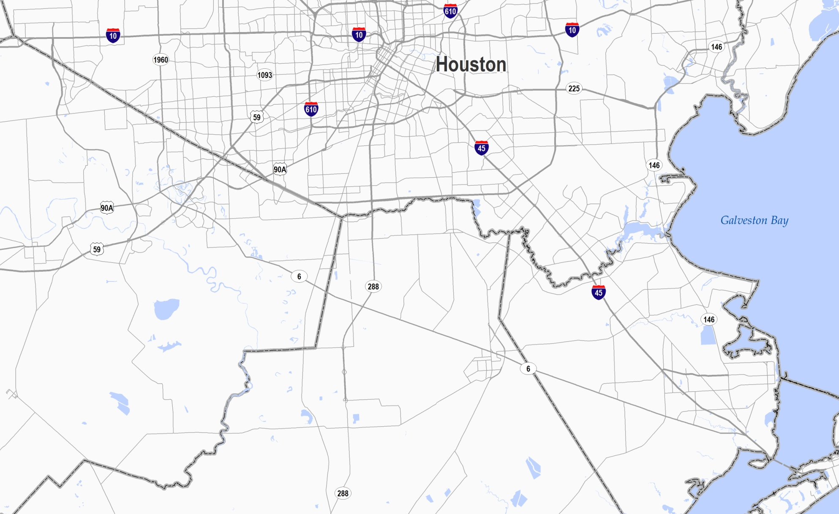
ECONOMIC GROWTH
“Forecasters tend to use historical data for support rather than illumination”
Harris Co.
Brazoria Co.
Fort Bend Co.
Galveston Co.

Slide 18
DETERMINING OPTIMUM TOLLS RATES
Key Factors:
  Motorist value of time (varied and situational)
  Anticipated time savings “Error of anticipation”
Equilibrium Sensitivity to Market Capture Rates
  Elasticity is 4.0 (not 0.4) i.e. A small 10% change in Traffic can result in 40% change in Revenues
  Major Revenue Declines with higher gas prices
    Short-term or Long-term?

Slide 19
TOLL RATE ESCALATION
Does it Necessarily Fall in Line with CPI?
  Traditional Toll Facilities have not kept up with inflationary trends
  What about managed lanes?

Slide 20
MAJOR REVENUE DETERMINANTS
Revenue Days/ Annualization Factors
  Difference between 275 and 365 can yield significant revenue changes
Ramp-up Assumptions
  Brownfield versus Greenfield
  Duration of Ramp-up (typically short for MLs)
Peak Spreading Characteristics
  Composition of Demand (Work versus Non Work)
  Radial versus Circumferential
  Corridor Volume Capacity

Slide 21
MARKET CAPTURE RATES
Are the Capture Rates Expected to be similar in both directions?
  Diversion to managed lanes is very situational…

Slide 22
MANAGED LANE MARKET SHARES
Note: Market Share reflects toll paying patronage only

Slide 23
MODAL UTILIZATION CONSIDERATIONS
Long-term Commercial Vehicle Trends
  Global/Local Effects of Trade Policies
  Just-in-Time Delivery
  Supply Chain Strategies
  Evolution in Truck Sizes
  Vehicle Operating Costs
Aviation and Intercity Rail Trends
  Competing versus Complementary Modes
  New Transportation Policies (fuel efficiency etc.)

Slide 24
RISK PROFILING
Defining Risk
  Where is the Risk
  How to Quantify
  How Significant is the Risk
  Discrete versus Ranges
Dependent on Data Availability
  Historical Profiling
  Accuracy/Variability of Forecast Sources
  Data Filtering
  New Modeling Approaches
  Value of Reliability
Incorporate all the Key variables to create realistic ranges
  Correlation Dependency
  Unknown/Unforeseen Variability
  Prioritization of Key Factors

Slide 25
MANAGED LANE RISK PROPAGATION
Base Case Estimate
Early Occurrence
Late Occurrence
Moderately Congested
To expect the unexpected shows a thoroughly modern intellect. Oscar Wilde

Slide 26
UNCERTAINTY RANGES
f( Full Universe of Variables)
f( Key Subset Variables)
BASELINE
REVENUE
f( Key Subset Variables)
f( Full Universe of Variables)
# of years

Slide 27
RECENT MANAGED LANE FINANCINGS
Managed Lane Project | Financing Method | Miles (Ultimate) | Project Costs | Public Grant /Subsidy | TIFIA | Financial Close
Capital Beltway (Washington D.C.) | PPP/DB | 14.0 | $1.9B | $409M* | $589M | Dec 2007
I-595 Express Lanes (Miami) | Availability/DBFOM | 10.5 | $1.8B | $232M** | $603M | Marc h 2009
North Tarrant Express (Fort Worth) | PPP/DBFOM | 13.0 | $2.0B | $573M | $650M | June 2009
IH 635 LBJ (Dallas) | PPP/DBFOM | 13.0 | $2.7B | $489M | $850M | June 2010
* Commonwealth of Virginia grant
** FDOT qualifying development funds

Slide 28
MANAGED LANE REVENUE RISK
4.8%
2.3%
3.6%
1.5%*
4.7%
*Escalated from 2040 results

Slide 29
INTERPRETATION AND CONCLUSIONS
Quantification may unintentionally create an aura of precision and confidence
  Clear Understanding of the Assumptions is a MUST.
Context of how will the ranges be utilized
  Project Feasibility
  Bonding/Capital Improvement Plans
  Identification of Subsidy Requirements
How to narrow the likely ranges?
  Detailed data on current ranges
  Assessment of Key Variables
  Explore Alternative/New Influential Variables

Slide 30
THANK YOU
Christopher Mwalwanda
Vice President
Wilbur Smith Associates
cmwalwanda@wilbursmith.com

