Slide 1
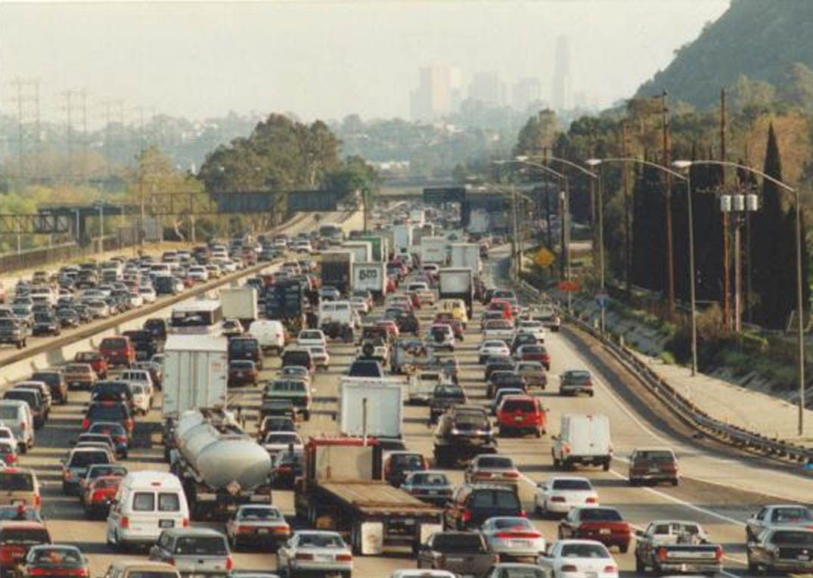
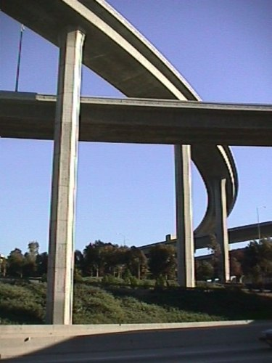
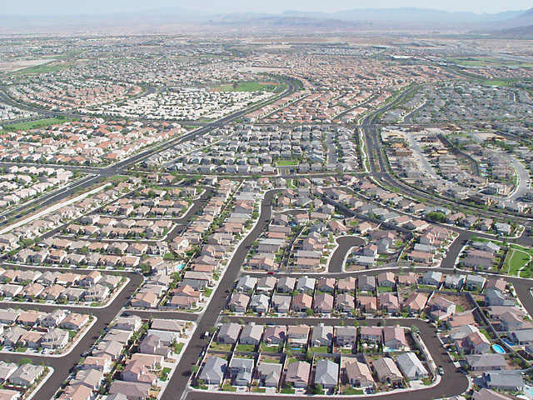
Web-Based Impact Fee Analysis
Developing a Multi-Jurisdictional Congestion Mitigation Fee Program in Los Angeles County
Presented by:
Michael Snavely, Cambridge Systematics, Inc.
and
Robert Cálix, Los Angeles County Metropolitan Transportation Authority
May 10, 2011

Slide 2
Agenda
Background/Need
Impact Fee Solution
Implementation Problem
Web-based Analysis
Results/Applications

Slide 3
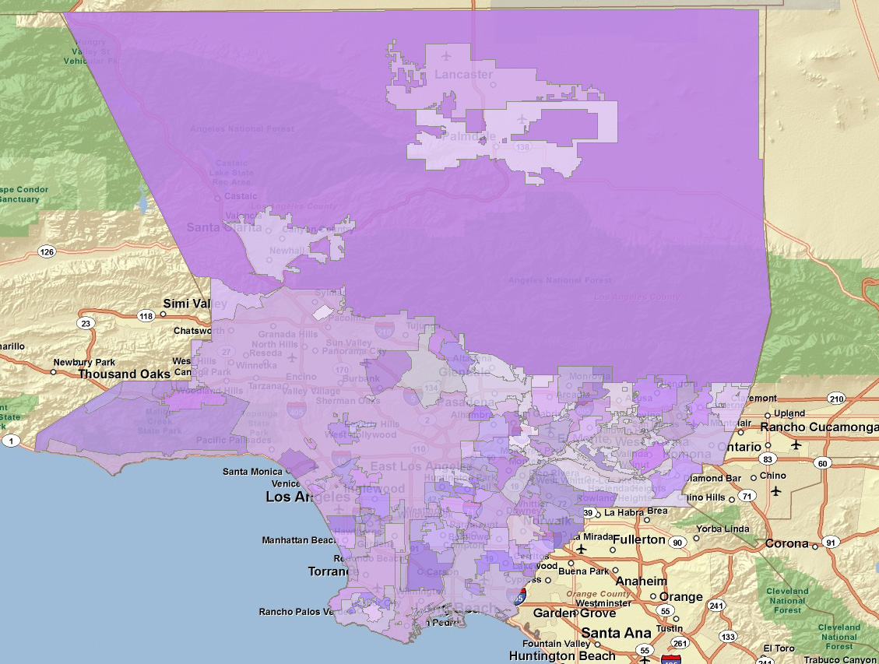
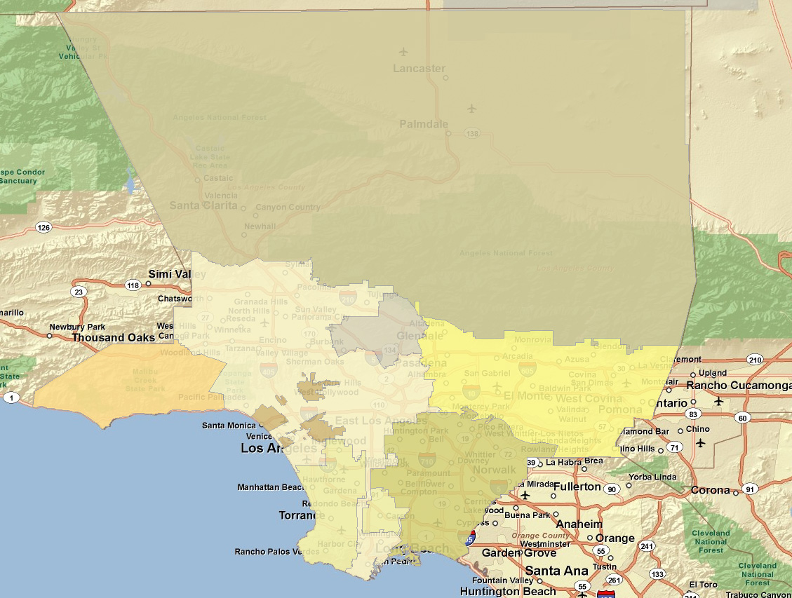
Background
Los Angeles County
88 Cities + Unincorporated Areas
8 Subregional COGs

Slide 4

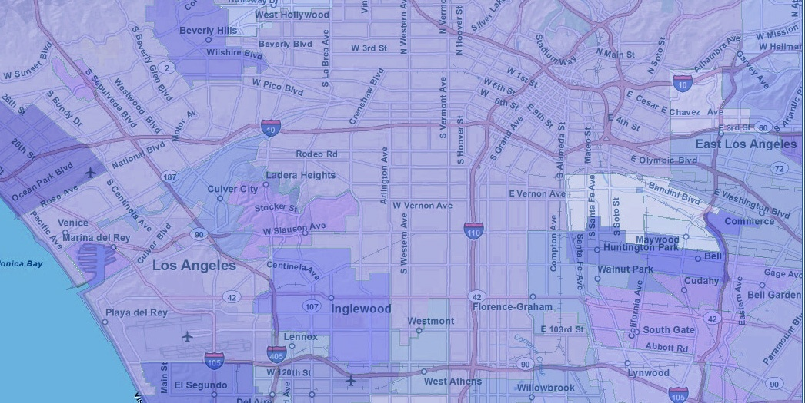

Background
Los Angeles County Growth 2010 - 2030
Population Growth
Development Growth
20%
25% / 7.5%
2 million
new residents
250,000 new housing units
400 million sq. ft. non-residential
10 million
existing residents
3.4 million existing housing units
1.6 billion sq. ft. non-residential

Slide 5
Background:
Los Angeles County: Strained Infrastructure
Estimated Growth Through 2035

Slide 6
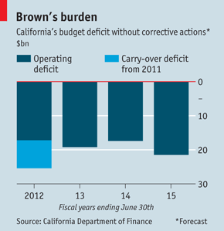
Los Angeles County:
Transportation Funding Gap
Limited Federal Revenue Streams
California Budget Crisis
Local Revenue Streams Necessary
(Figure: The Economist)

Slide 7
Solution: Congestion Mitigation Fee
Modest fee on new development based on projected impact on regional arterials
Directly funds transportation projects intended to mitigate impacts (improve capacity/reduce congestion)

Slide 8
Solution: Congestion Mitigation Fee
Countywide & Regional Mitigation Fees
Placer
Shasta
El Dorado*
Yolo
San Joaquin
Solano
Stanislaus
Contra Costa*
Merced
Alameda*
Madera
Santa Clara*
Fresno
Kings
Tulare
San Luis
Obispo
Kern
Los Angeles
Ventura
San Bernardino*
Orange*
Fees Adopted
Riverside*
San Diego*
Fees Attempted
Fees Under Study
* Transportation fees only
Notes:
Fee

Slide 9
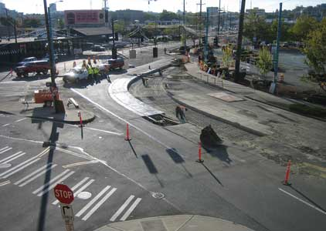
Congestion Mitigation Fee
Limitations
Projects must:
  Be specified at outset of program
  Be located on the regional network
  Mitigate new regional development impacts (add capacity)
  Be financially constrained, i.e., fully funded with projected fees and other reasonably anticipated revenues
Projects can not:
  Remedy existing deficiencies
  Fund maintenance or operating expenditures

Slide 10
Solution: Congestion Mitigation Fee
Program Details
Fee Collection
  Fee administered and collected directly by each jurisdiction from new development projects
Project Implementation
  Funds allocated only to capital projects specified in program
  Project constructed when sufficient funds are accumulated
  Encourage subregional collaboration

Slide 11
How a Development Impact Fee Is Calculated
Four Basic Steps
Step 1
Step 2
Verify population & employment forecast and convert to land use
Convert new development to trip ends
# new housing units
new building sq. ft.
# new trip-ends
existing housing units
existing building sq. ft.
Adjust trip generation for
exempt development

Slide 12
How a Development Impact Fee is Calculated
(Continued)
Step 3
Divide project cost by total number of new trip ends
to determine cost per average daily trip
Project
Cost
$679 per trip end
$1.025 Billion
1,511,000 trip-ends

Slide 13
How a Development Impact Fee is Calculated
(Continued)
Step 4
Generate a fee schedule based on each land use category’s generation of
average daily trips
Average Daily
Trip Generation Fee
Land Use Rate Amounts
Single Family (per unit) 9.38 $6,369
Multifamily (unit) 5.75 $3,904
$679 trip end
Office (1,000 sq. ft.) 11.32 $7,686
Retail (1,000 sq. ft.) 14.58 $9,900
Industrial (1,000 sq. ft.) 7.16 $4,862
Hotel/Motel (1,000 sq ft) 12.32 $8,365
Step 5
Revise and Refine to Reach Acceptable Level

Slide 14

Implementing a CMF in LA County
Problems:
  Diversity
  Complexity
  Cost
Solutions:
  Rolling Subregional Pilot Studies
  Web-based CMF Tool

Slide 15
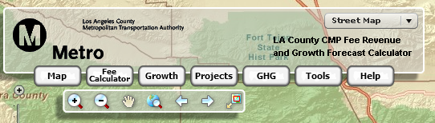
Solution: LA Metro CMF Web Tool
Fee Revenue and Growth Forecast Calculator
Growth Editor
Project Manager
Fee Calculator
Mapping Navigation Tools
Other Tools
Help Menu
GHG Analysis
Map Options

Slide 16
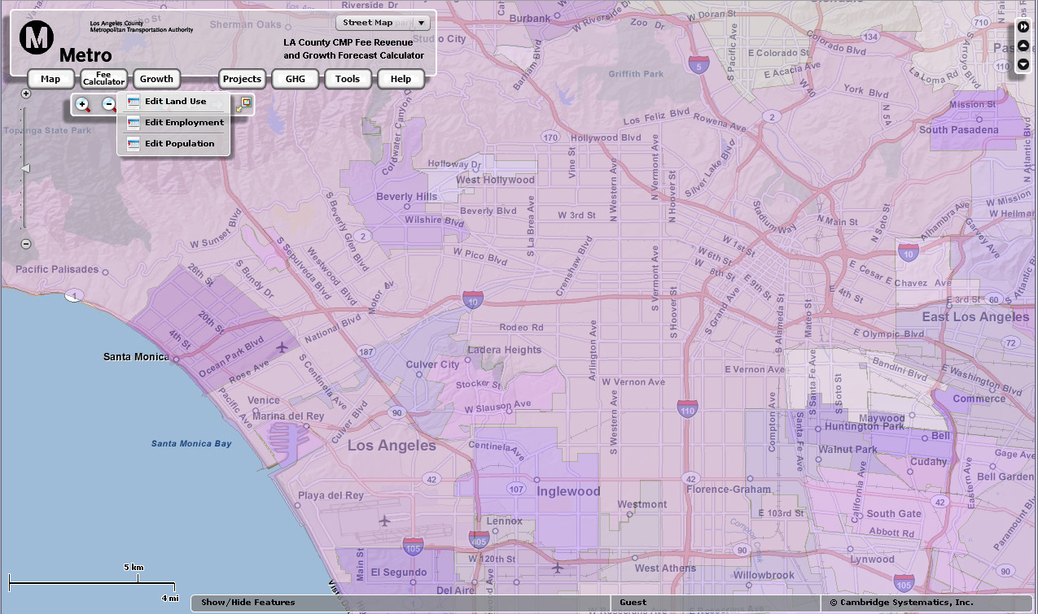
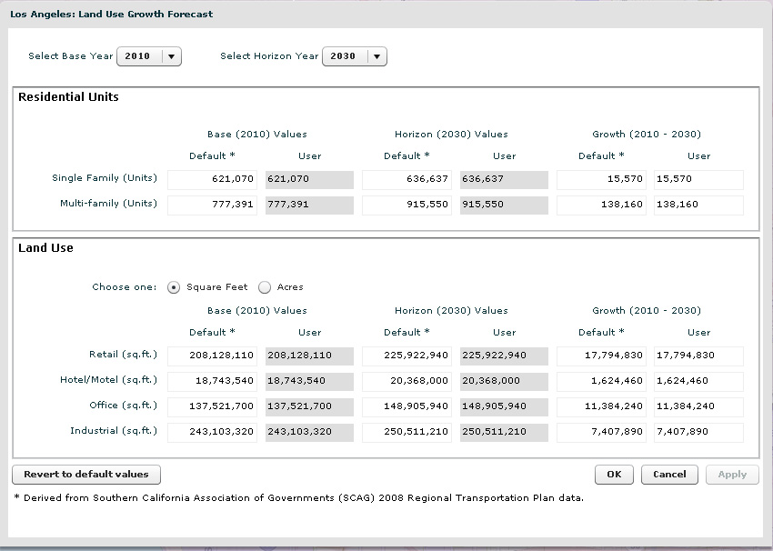
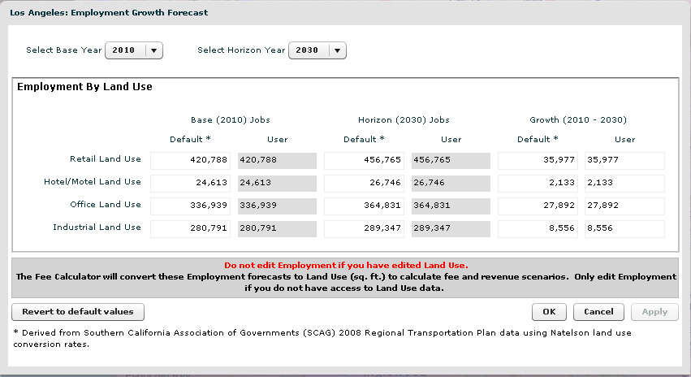
Growth Editor
Edit and Save Socioeconomic Forecasts

Slide 17
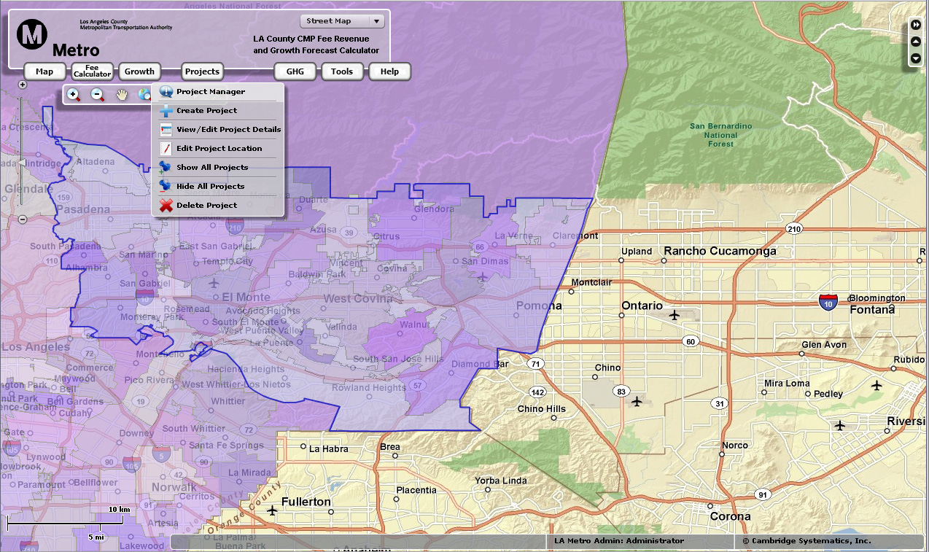
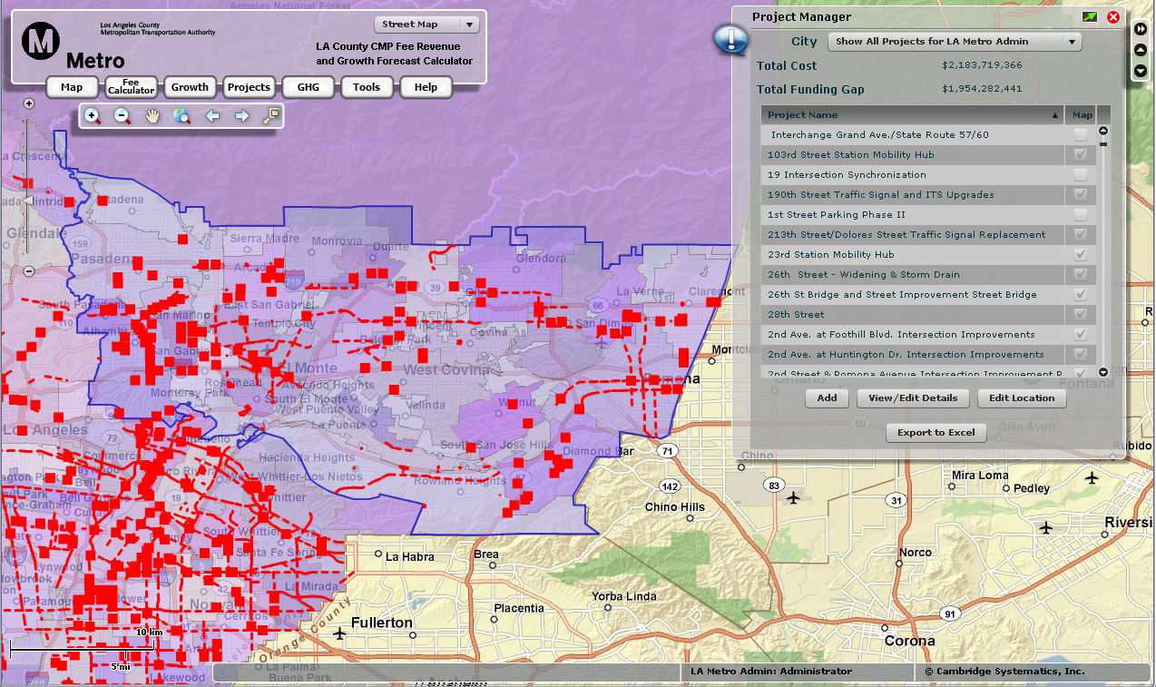
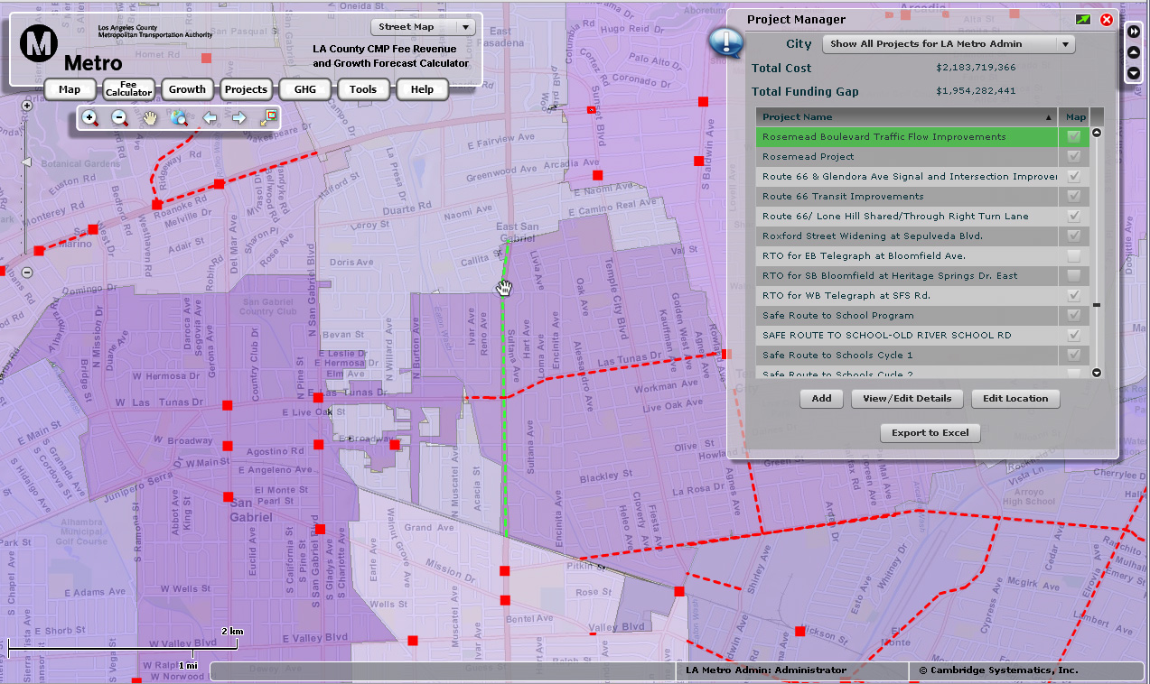
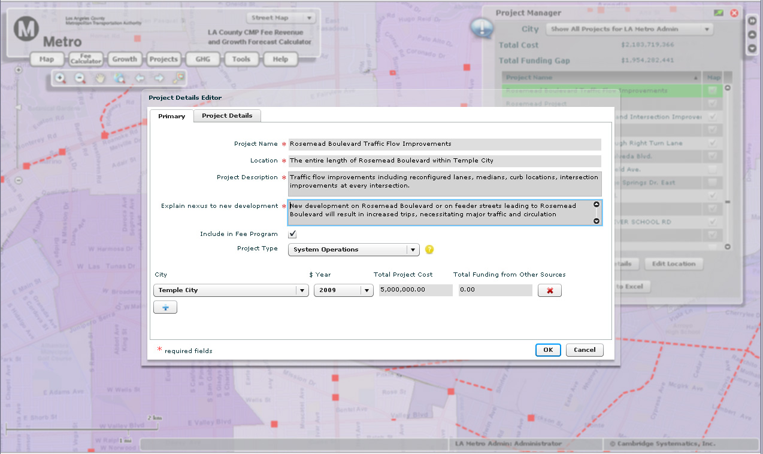
Project Manager
Store Project Details, Costs & Locations

Slide 18
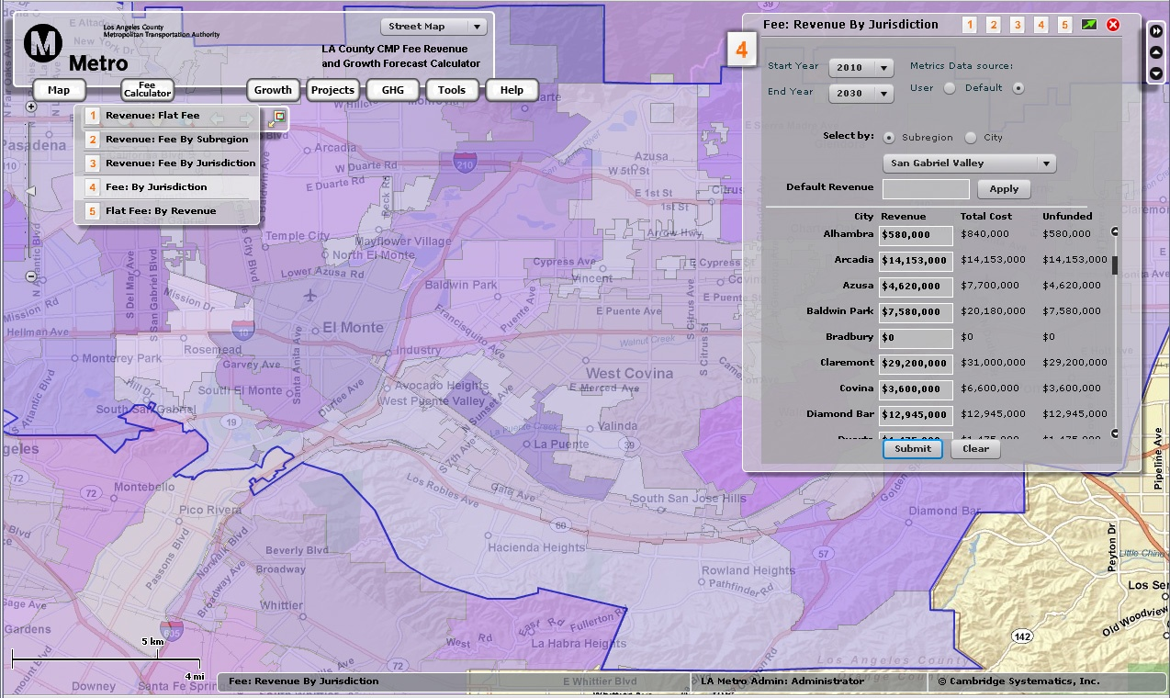
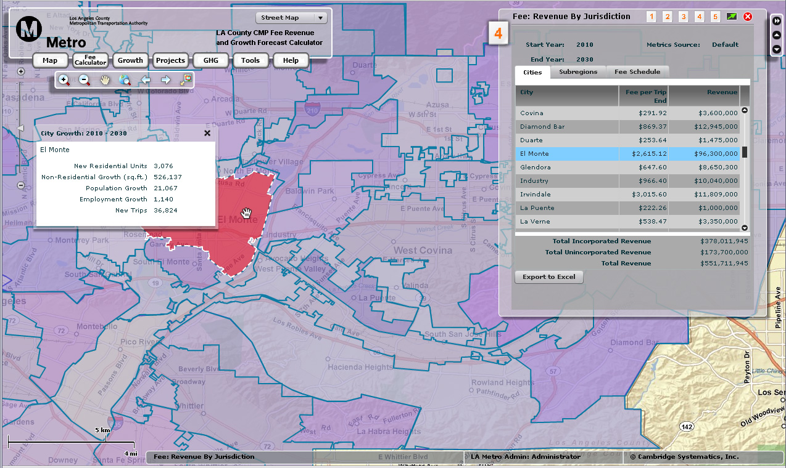
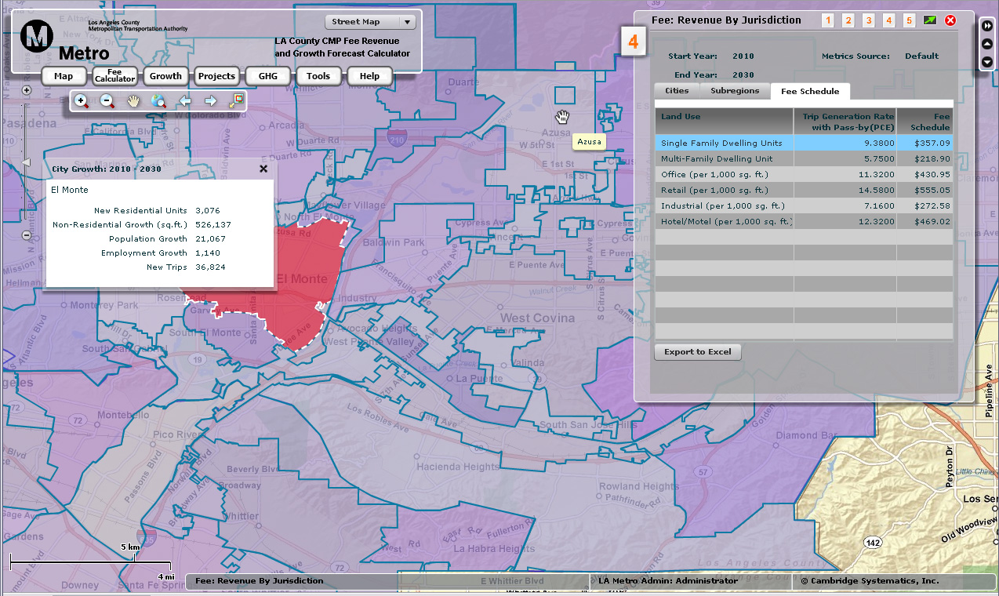
Fee Calculator
Calculate & Refine Fee/Revenue Levels

Slide 19
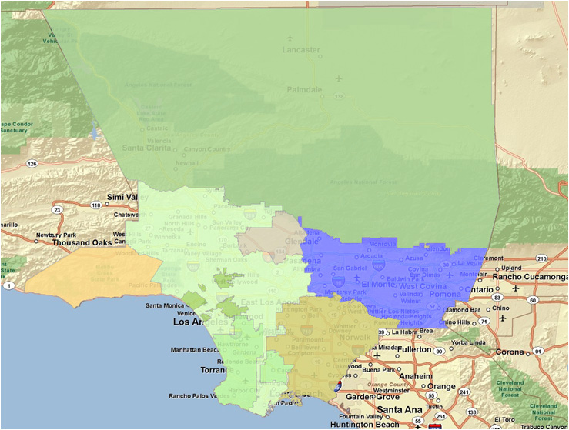
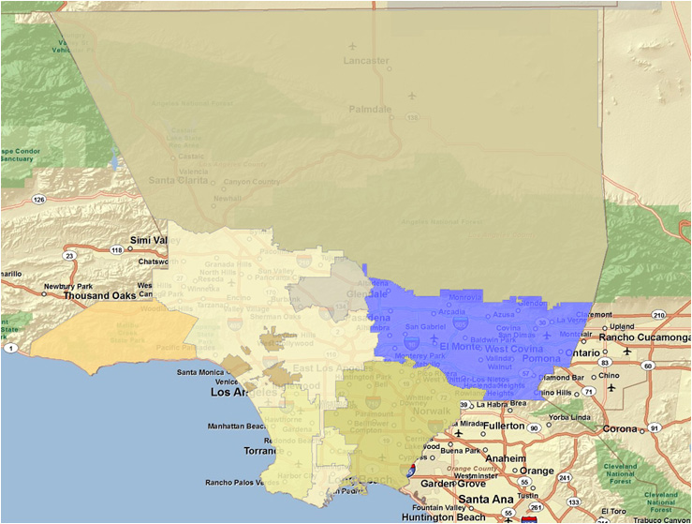
CMF Pilot Study Progress
5 of 8 Subregions Complete or Underway

Slide 20

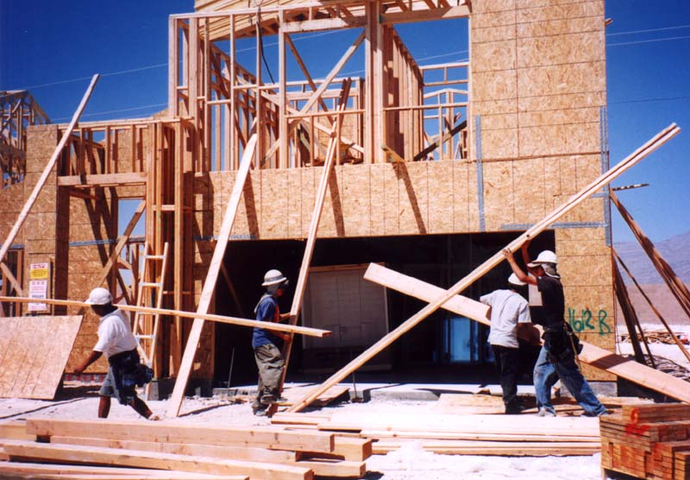
Recap
CMF Benefit to Developers
Countywide Fee Provides
  Consistency
  Predictability
No longer require CMP deficiency plans, speeding up project approvals
Developers don’t pay for existing deficiencies
Notes:
Consistent Requirement between cities
Predictability in what’s expected
Removes Uncertainty risks, Environ doc are proj

Slide 21
Recap
Web-Based Congestion Mitigation Fee Program
Generates new funding source for transportation projects
Allows Metro to bring all cities in compliance with state Congestion Management Program
Web tool offers:
  Spatial project database
  Growth projections
  Fee level refinements
  Easy CMF revisions every 5 years
Off-model analysis capabilities

Slide 22
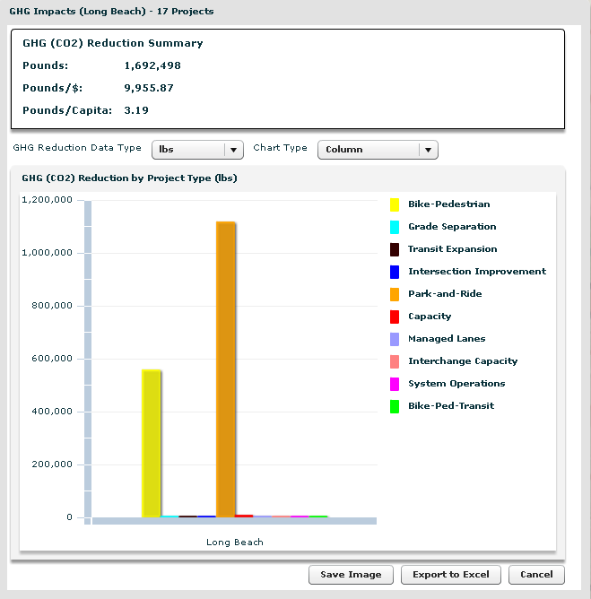
Other Potential Applications
Accessible Project Database & Planning Tool
Call for Projects
GHG Calculator

Slide 23
CONTACT
Michael Snavely
Cambridge Systematics, Inc.
Oakland, CA
510-873-8700
Robert Cálix
Los Angeles County Metropolitan Transportation Authority
213-922-5644

