Slide 1


AUSTIN STRATEGIC MOBILITY PLAN
W. Gordon Derr, P.E., City of Austin
Kurt Schulte, AICP, Kimley Horn

Slide 2
Background
June 2009 - Council directed City Manager to procure team with experience in the development of local and regional multi-modal, build-able strategic mobility plans that are :
  Coordinated with other local agencies
  Inclusive of the entire community
  Includes both short term and long term projects
Budget authorized for Plan in 2009-2010
RFQ process initiated August 2009

Slide 3
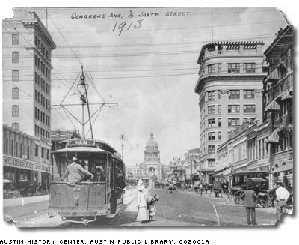
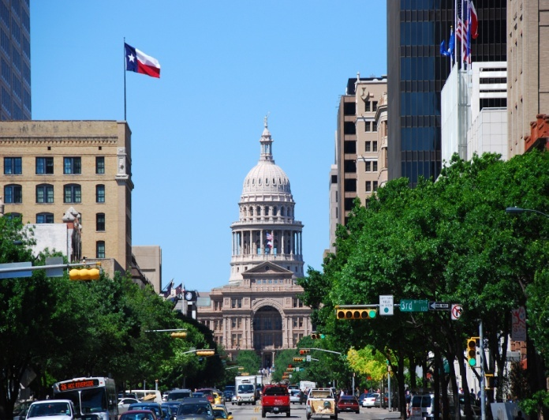
What is a Strategic Mobility Plan?
A roadmap for future investment.
A plan that looks at current system problems or gaps, develops projects to address the gaps, which can be low cost, and quick, or expensive and longer term.
The plan will produce a ranking system to compare projects throughout the community and a variety of modes. Goal to ensure that each investment produces the maximum benefit to the citizens.

Slide 4
Project Schedule – Key Milestones
Consultant team selected - November, 2009
Public Kickoff – Winter 2009
Gap analysis produced by May 2009, candidate projects for a mobility bond election in November 2010

Slide 5
Priorities – the Austin Way
Objectives
  Efficiency – 15 points maximum
  Regional Coordination – 15 points
  Mobility Choices – 18 points
  Sustainable Growth – 15 points
  Investment and Economic Growth – 11 points
  Safety – 8 points
  Environmental Stewardship – 13 points
  Neighborhood Connectivity – 8 points

Slide 6
Results of the Objectives
Objectives Ranking
 | Online Survey | Public Forums | Project Team | Ranked Average
Efficiency | 20.1 | 12.7 | 9.6 | 14.1
Environmental Stewardship | 10.7 | 9.2 | 14.0 | 11.3
Investment & Economic Development | 11.5 | 9.3 | 10.1 | 10.3
Mobility Choices | 12.9 | 19.8 | 21.7 | 18.1
Neighborhood Coordination and Connectivity | 7.3 | 7.3 | 7.6 | 7.4
Regional Integration | 18.2 | 14.5 | 11.5 | 14.7
Safety | 7.9 | 11.1 | 7.3 | 8.7
Sustainable Growth | 11.5 | 16.1 | 18.3 | 15.3
 | 100 | 100 | 100 | 100
Notes:
Answers Needed for Transportation Investments/
What is the best use for our next transportation dollar?
Need to put all modes on even footing
How to compare safety improvements to capacity enhancement projects
What will be the impact on carbon footprint?
What kind of community will this create?
Who will it serve?

Slide 8
Efficiency
1 |  | 2 |  | 3 |  | 4
Implementability |  | Person Capacity Added |  | Capital Cost per Person Trip per Day |  | Operating Cost per Person Trip per day
Use Engineering Judgement |  | VERY HIGH | Transit | VERY HIGH | Transit | VERY HIGH | Transit
 |  | HIGH | Multi-Modal | HIGH | Bicycle or Pedestrian | HIGH | Roadway or Traffic
 |  | MEDIUM | Roadway or Traffic | MEDIUM | Roadway | MEDIUM | Multi-Modal
 |  | LOW | Pedestrian | LOW | Traffic | LOW | Pedestrian or Bicycle (with a bridge)
 |  | VERY LOW | Bicycle | VERY LOW | Multi-Modal | VERY LOW | Pedestrian or Bicycle

Slide 9
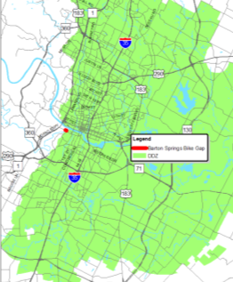
Environmental Stewardship
1 |  | 2 |  | 3 |  | 4 | 5
Within Desired Development Zones (DDZ) |  | Fuel Consumption (Reduction in VMT) |  | Design Consistent with Best Management Practices |  | Access to Recreation & Green Space | Access to Neighborhood Retail Centers
"Yes" if project is within or partially within DDZ |  | VERY HIGH | Transit | If Sustainable Development (SD)* = Yes |  | "Yes" if project is within 1/2 mile of : | "Yes" if Bike, Ped, Multi-Modal, Great Streets or Transit project located within 1/2/ mile of Commercial or Mixed Use Parcels
 |  | HIGH | Pedestrian or Bicycle | or |  | Golf Courses
 |  | MEDIUM | Multi-Modal | Sustainable Development Patterns (SDP)* = Yes |  | Marinas
 |  | LOW | Roadway or Traffic (with connections to TODs) |  |  | Parks/Greenbelts
 |  | VERY LOW | Roadway or Traffic | *See Investment and Economic Development Objective for description of SD and SDP |  | Preserves

Slide 10
Investment & Economic Development
1 |  | 2 | 3 |  | 4
Within a Corridor/Area Planned for Sustainable Development Patterns (SDP) |  | Supports Sustainable Development Patterns (SD) | Redevelopment Potential |  | Ability to Leverage Public/Private Funds
"Yes" if: |  | "Yes" if project is within 50 ft of: | "Yes" if project is within 500ft of: |  | "Yes" if project is
Project is within or partially within a neighborhood planning area; or, |  | Planned Bike Projects | Commercial or Mixed Use Land Use Parcels; and, |  | within or parially within 50ft of CAMPO Planned Projects; or,
Project is within or partially within the DDZ; or, |  | Commuter Rail Stops | Project is within a zipcode with household income greater than $30,000 |  | within a corridor/area planned for sustainable development patterns (SDP)
Project is within or partially within the CAMPO Growth Areas |  | CapMETRO Bus Stops
 |  | Bus Routes

Slide 11
Mobility Choices
1 |  | 2 | 3
Supports Multiple Modes within Project Limits |  | Centerline Miles of Bicycle, Pedestrian, and Multi-Use Trail Facilities | Improved Connectivity Between Modes
Input the number of modes that the project will accommodate |  | Length of Project if located within 50ft of existing or planned bike facility | "Yes" if road or intersection that allows for multiple modes of transportation
- 1 for roadway
- 1 for bike lanes within 50ft of existing or planned bike facilities
- 1 for bus routes within 50 ft of existing bus routes and stops
- 1 for urban rail within 50 ft of existing commuter rail

Slide 12
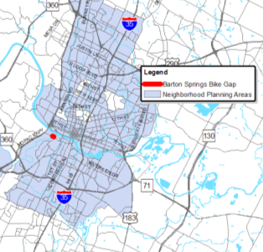
Neighborhood Coordination & Connectivity
1 |  | 2 |  | 3
Supports an Adopted Neighborhood Plan |  | Connection to Nearby Amenities |  | Connection to Area Beyond Neighborhood
"Yes" if: |  | "Yes" if project is within 1/2 mile of: |  | "Yes" if project is within 500ft of:
Project is within or partially within a neighborhood planning area; or, |  | Cultural Services |  | Apartments/Condos
 |  | Educational |  | Duplexes
Project is within or partially within the CAMPO Growth Areas |  | Government Services |  | Group Quarters
 |  | Hospital |  | Large-Lot Single Family
 |  | Meeting & Assembly |  | Mixed Use
 |  | Mixed Use |  | Mobile Homes
 |  |  |  | Retirement Housing
 |  |  |  | Semi-Institutional Housing
 |  |  |  | Single Family

Slide 13
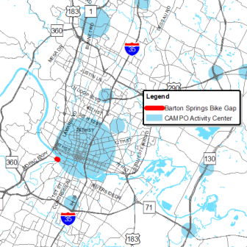
Regional Integration
1 |  | 2 | 3
Project is in the CAMPO 2035 Plan |  | Compatibility with Regional Growth Planning Efforts | Projects Ability to Leverage Regional, State or Federal Funding
 |  | "Yes" if project is
"Yes" if project is within or partially within 50ft of the CAMPO 2035 planned projects |  | within or partially within the CAMPO Growth Areas; or, | "Yes" if project is within or partially within 50ft of the CAMPO 2035 planned projects; or,
 |  | within or partially within the DDZ; or, | "Yes" if it is a City of Austin project
 |  | within or partially within an area with Sustainable Development Patterns

Slide 14
Safety
1 |  | 2 |  | 3 | 4
Number of Crashes |  | Severity Index of Crashes by Mode |  | Safety of Non-automobile Modes of Transportation | Safety concerns Expressed About Location
VERY LOW | 0 - 3 Crashes | VERY HIGH | Fatality | "Yes" = if crash relationship included a bike or pedestrian | Safety concerns expressed in project comments by citizens or staff
LOW | 4 - 20 Crashes | HIGH | Serious Injury
MEDIUM | 21 - 35 Crashes | MEDIUM | Minor Injuries
HIGH | 36 - 50 Crashes | LOW | None
VERY HIGH | 50+ Crashes

Slide 15
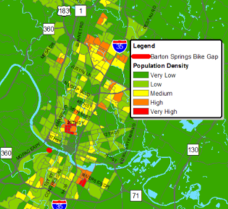
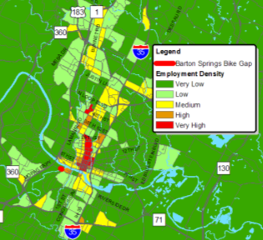
Sustainable Growth
1 |  | 2 |  | 3 | 4
Existing Population Density within 1/2 mile |  | Existing Employment Density within 1/2 mile |  | Project is Inside or Within a CAMPO Growth Center | Project is Inside or Within 1/2 mile of an Economically Challenged Area
VERY LOW | 0 - 5 | VERY LOW | 0 - 5 | "Yes" if project is within or partially within a CAMPO Growth Center | "Yes" if project is within or partially within a zipcode with median income of less than $30,000
LOW | 6 - 10 | LOW | 6 - 10
MEDIUM | 11 - 15 | MEDIUM | 11 - 25
HIGH | 16 - 30 | HIGH | 25 - 50
VERY HIGH | 31+ | VERY HIGH | 50+

Slide 16
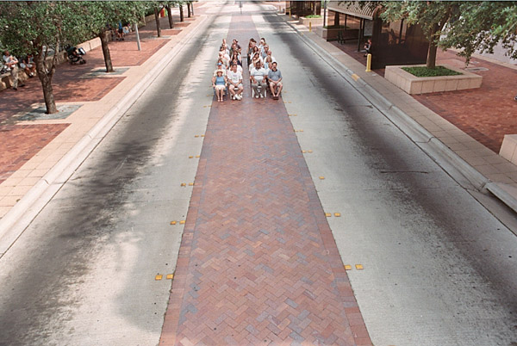
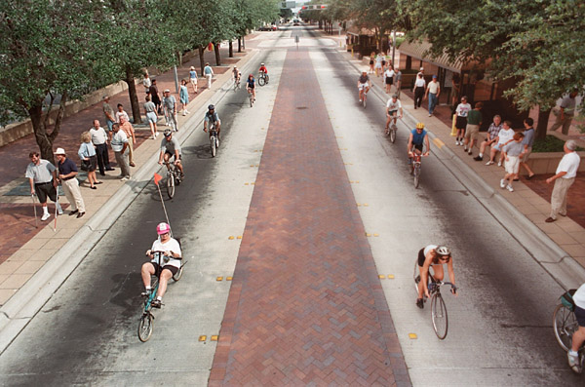
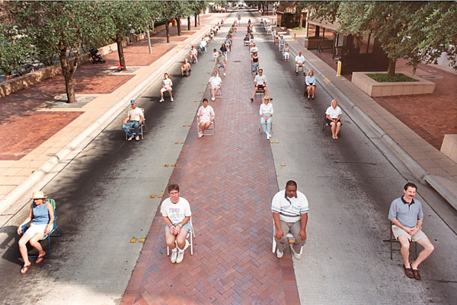
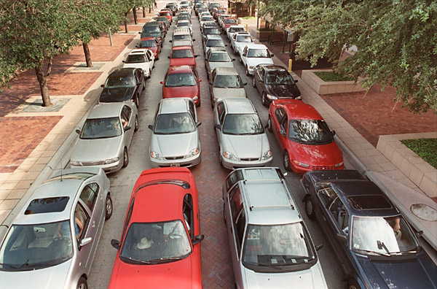
The best way to move 35 people?
…

Slide 17
Process Results
Ranked 700+ System Gaps
Grouped by grade into A, B, and C
Avenue forward for each A gap
  Partnership Projects
    TxDOT
    Travis County
  Studies
  Construction

Slide 18
Building the Package
Named projects vs Buckets (43% program funds)
System Preservation vs New Capacity (31% ATD, rest PW)
Geographic Distribution (22% Downtown)
Modal Distribution (57% Roads)
Design vs Construction (16% Design)
-----
How much information would we be allowed to provide?

Slide 19
Opposition
Not enough roadway construction, does not relieve congestion
To many bicycle and pedestrian projects, too much on amenities
Not enough detail on what the money would be spent on, too much detail
Nose of the Camel – A vote for the bond is a vote for rail in 2012

Slide 20
Outcome
Citizen Task Force Positive Recommendation
7-0 City Council Approval
$90 Million Proposition Passed
  55% for, 45% against

Slide 21
Lessons Learned
50% plus 1 is a victory
Spend as much if not more time on the MOE’s as you spend on the Objectives
On Line Surveys need to be monitored for spamming
Communicate the constraints and the results of the evaluation as constrained
Check and double check project information

Slide 22
