Slide 1
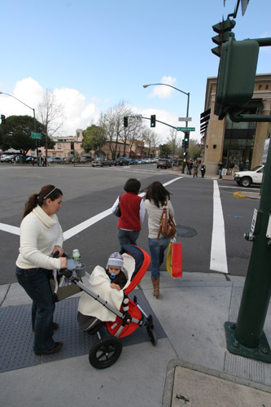
FHWA's Livability Initiative: Promoting Collaboration and Multimodal Planning
Gabe Rousseau
Federal Highway Administration
Office of Human Environment

Slide 2
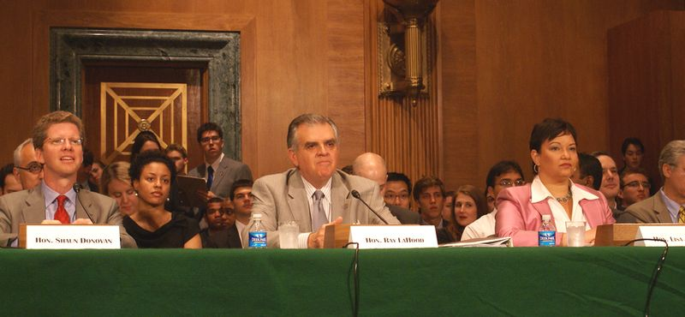
USDOT Supports Livable Communities
The Secretary formed the Interagency Partnership for Sustainable Communities with HUD and EPA to improve intergovernmental coordination.
The President’s budget for FY2012 would restructure the current federal aid program and would create a $4.1 billion Livability Program.

Slide 3
Partnership for Sustainable Communities
Transportation Choices
Equitable, Affordable Housing
Economic Competitiveness
Support Existing Communities
Align Federal Policies
Value Communities

Slide 4
What does this mean for transportation agencies?
It’s about considering all transportation modes and affordability
It’s about serving people of all ages, incomes, races, and ethnicities
It’s about improving access to work, services, and markets
It’s about making government more efficient
It’s about responding to community vision and values

Slide 5
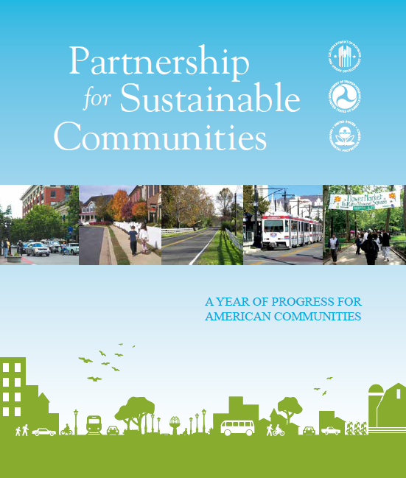
Partnership progress
Joint DOT TIGER II-HUD Community Challenge Grants
DOT Policy Statement on Bicycle & Pedestrian Accommodation
Regional Partnerships
www.epa.gov/smartgrowth/pdf/partnership_year1.pdf

Slide 6
Transportation planning
State and MPO Planning
23 CFR 450.200 and 450.300
…to carry out a continuing, cooperative, and comprehensive multimodal transportation planning process…that encourages and promotes the safe and efficient development, management, and operation of surface transportation systems to serve the mobility needs of people and freight (including accessible pedestrian walkways and bicycle transportation facilities) and foster economic growth and development, while minimizing transportation-related fuel consumption and air pollution…

Slide 7
FHWA’s Role
FHWA continues to support building livable communities through transportation-related projects and activities such as:
Context Sensitive Solutions,
Public Involvement,
and funding programs such as Transportation Enhancements, CMAQ, and Safe Routes to School.
We aid the planning and development of projects that may have:
Multimodal, multi- faceted dimensions
Non-Traditional Partners/sponsors
Inter-disciplinary elements
Selection and criterion outside of the regular process (e.g., TIGER 2 Discretionary Grants, National Scenic Byways Program)

Slide 8
FHWA’s Role
We support the development of traditional projects and operational improvements that improve:
access, mobility, and safety
the overall quality of transportation in urban and rural communities.
Livability is the current framework for transportation decision making that results in safe and convenient transportation options.
Options and approaches will vary by community.

Slide 9
How does FHWA help?
Supporting Division Offices:
Engaging in livability-related capacity building for our own staff and with our partners.
Helping States and MPOs forge relationships with new stakeholders to advance livability.
Ultimately, helping States leverage funding to deliver more cost effective projects.

Slide 10
How does FHWA help?
In 2011, FHWA held regional livability workshops with key stakeholders to identify opportunities and obstacles.
Locations
Sacramento, CA; Denver, CO; Kansas City, MO; Atlanta, GA; Boston, MA
National Association of Development Organization’s Peer Exchanges focused on rural livability.
Locations
Asheville, NC and Sacramento, CA

Slide 11
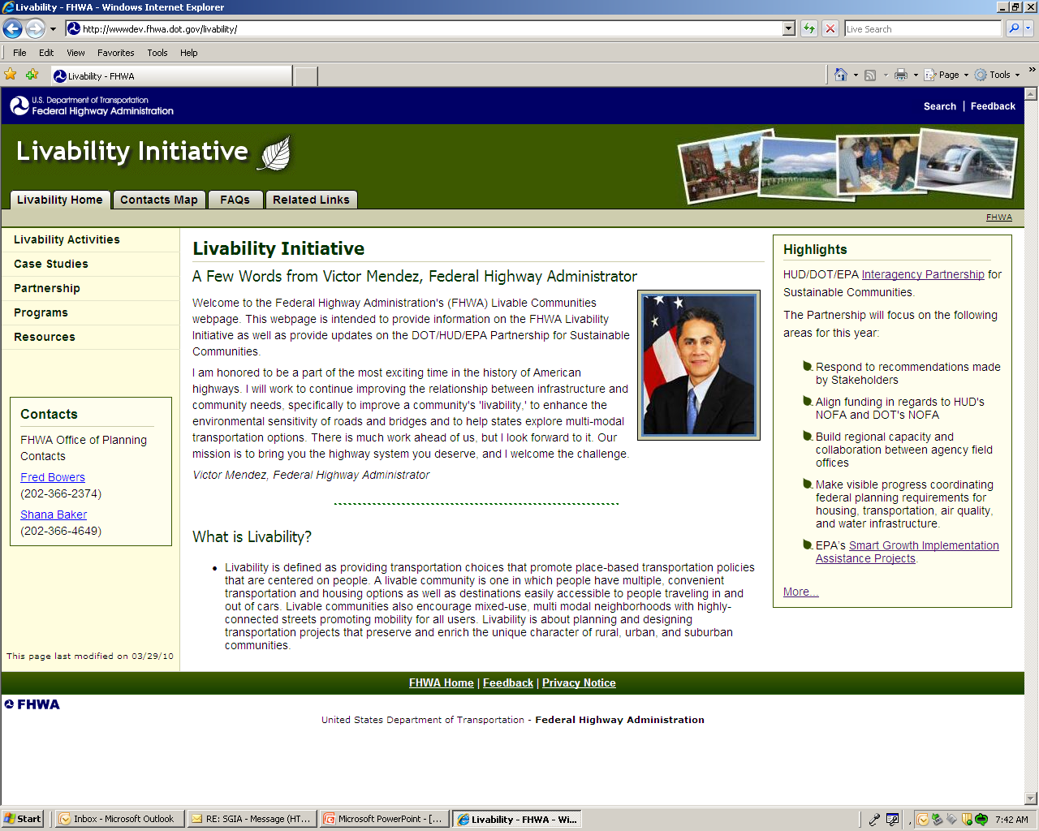
FHWA activities
Livability Web Site
Identifies existing funding sources to support livability
Division contacts
Case studies
Notes:
Here’s a look at the new, just released FHWA Livability Initiative web page. This page provides information on new and upcoming activities, including training and future workshops like this. We will also be highlighting Case Studies with information on how projects developed. This page will be a good place for staying up to date on Livability activities. Here’s the link
http://wwwdev.fhwa.dot.gov/livability/

Slide 12
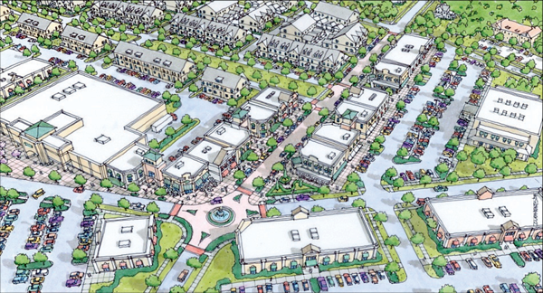
What does it look like?
FHWA’s Livability in Transportation Guidebook
Uses case studies to explore principles, practical strategies, design solutions, and applications that have been used to promote livability in transportation across the U.S.
www.fhwa.dot.gov/livability/index.cfm

Slide 13
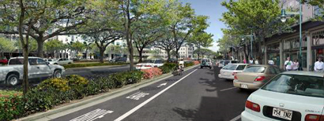
What does it look like?
The Role of FHWA Programs In Livability: State of the Practice Summary
Highlights the implementation of livability principles within the context of the Federal-aid highway program
www.fhwa.dot.gov/livability/state_of_the_practice_summary/

Slide 14
FHWA efforts advance important outcomes
Agencies have used livability to create safer, more balanced regional, multimodal networks using CSS and Scenario Planning.
e.g., Charlotte’s South Corridor Infrastructure Program, St. Louis Great Streets Initiative
Broader community goals are better served by projects planned to meet livable transportation plans.
Creating livable transportation systems require an interdisciplinary approach.
Differences in approaches in rural, urban and suburban areas but place-based approaches work in cities and small towns.

Slide 15
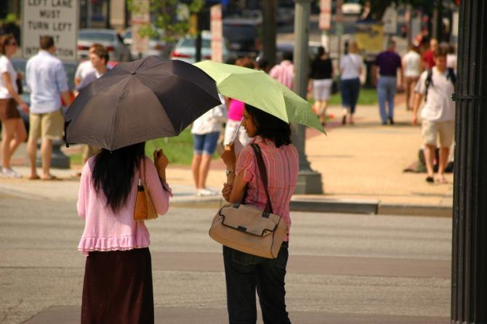
Upcoming activities
Livability Performance Measures Handbook
Possible metrics: Mode share, travel time reliability, transit options, safety, economic, social and environmental indicators
Livability and Economic Development Analysis Tool

Slide 16
Contact
Gabe Rousseau
FHWA
Livability Team Leader
Office of Human Environment
202-366-8044
Gabe.Rousseau@dot.gov
Shana Baker (Shana.Baker@dot.gov)
Sharlene Reed (Sharlene.Reed@dot.gov)
www.fhwa.dot.gov/livability

