Slide 1
USE OF TRIP TABLE ESTIMATION TO IMPROVE PROJECT TRAFFIC FORECASTS
13th TRB Planning Applications Conference
Reno, Nevada

Slide 2
Background
Estimate Future Project Traffic.
I-95 in Southeast Florida.
64 mile Corridor Feasibility Study with managed lanes.
Model results must be:
Carefully reviewed.
Adjusted.
Search for a Systematic Process.

Slide 3
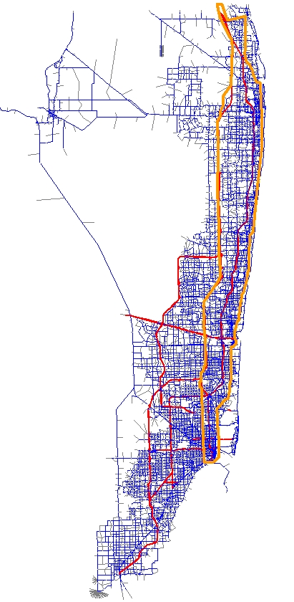
Study Area
Miami-Dade, Broward, Palm Beach Counties
Southeast Regional Planning Model
3 time periods
4,284 TAZs
Subarea with 2,123 TAZs
Subarea

Slide 4
Goals
Produce traffic estimates for morning and afternoon peaks.
Multiple target years: 2010, 2035, 2050.
Make systematic adjustments.
Minimize “post-processing”.

Slide 5
Method
Trip table estimation (Cube Analyst).
Corrects for systematic errors.
Productions and attractions not altered.
Future volumes based on:
Adjusted Base
+ Growth (unadjusted future-base)
Difference judged to be more reliable than factors.

Slide 6
Requirements
4,284 TAZs seemed too big for Analyst.
Subarea of 2,123 TAZs worked.
Analyst worked better as an iterative process (20), on a sample of traffic counts.
Freeway counts chosen for every iteration.
Arterial counts chosen randomly (about 10% used, each time).

Slide 7
Effectiveness

Slide 8
Changes in the Trip Table

Slide 9
Conclusions/Caveats
Weigh against ad hoc or NCHRP 255-style adjustments.
Changes the average trip length, so some concern about the overall impact on traffic patterns.
Dramatic reduction in link-by-link assignment error.
Careful review of results still required.
Post-processing adjustments still needed.

Slide 10
Acknowledgements
Florida Department of Transportation, District 4
Shi-Chiang Li, AICP
Derek Miura

