Slide 1
Buffer-based Area Type Determination for Travel Demand Model Network Links
Lee Klieman, P.E., PTOE

Slide 2
Traditional Highway Link Area Type
Use
Combined with functional classification
Capacity
Free-flow speed
Determination
Surrounding TAZs
Manual

Slide 3
Traditional Highway Link Area Type Determination
Problem
Link borders TAZs with differing area types
Traditional Solutions
Hierarchy of TAZ area types
Direct spatial tagging
Manual

Slide 4
Traditional Solution limitations
Simplistic
Incorrect
Discontinuities
Labor-intensive

Slide 5
Area Type Determination with Buffer Analysis
GIS-based
Buffer collects proportional S-E data from TAZ
Area type algorithm applied to area within buffer only
Avoids bias from large TAZ
Sensitive to changes in land use
No discontinuities
Buffer size adjustable to meet needs

Slide 6
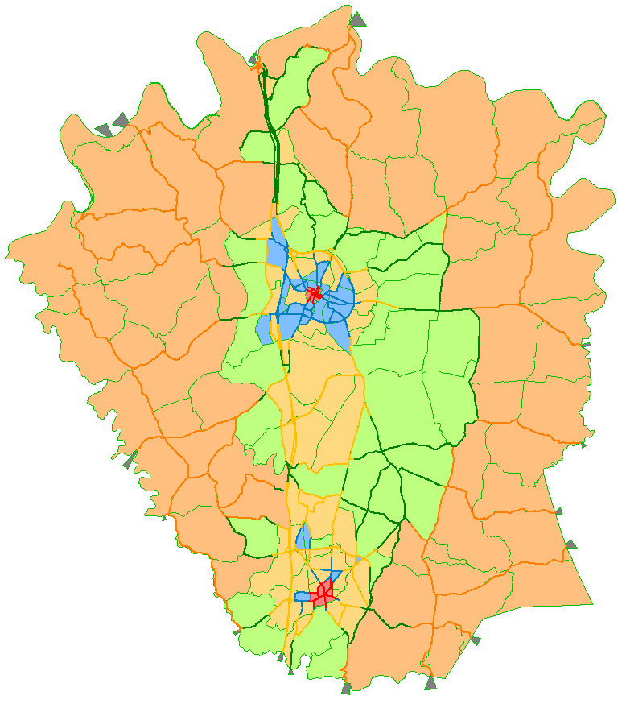
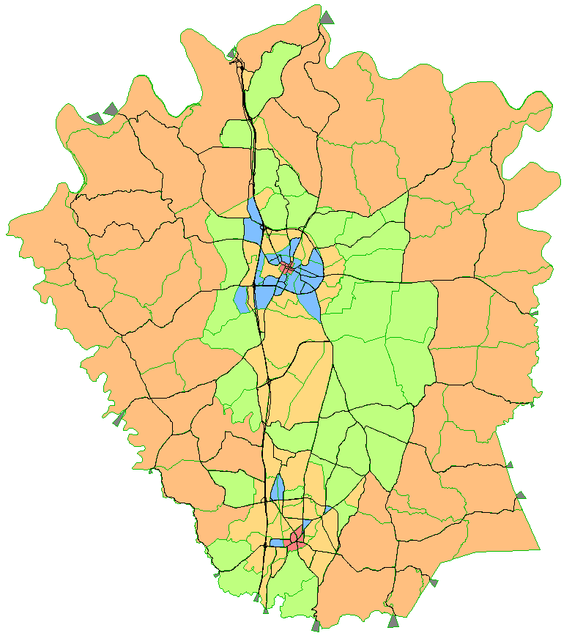
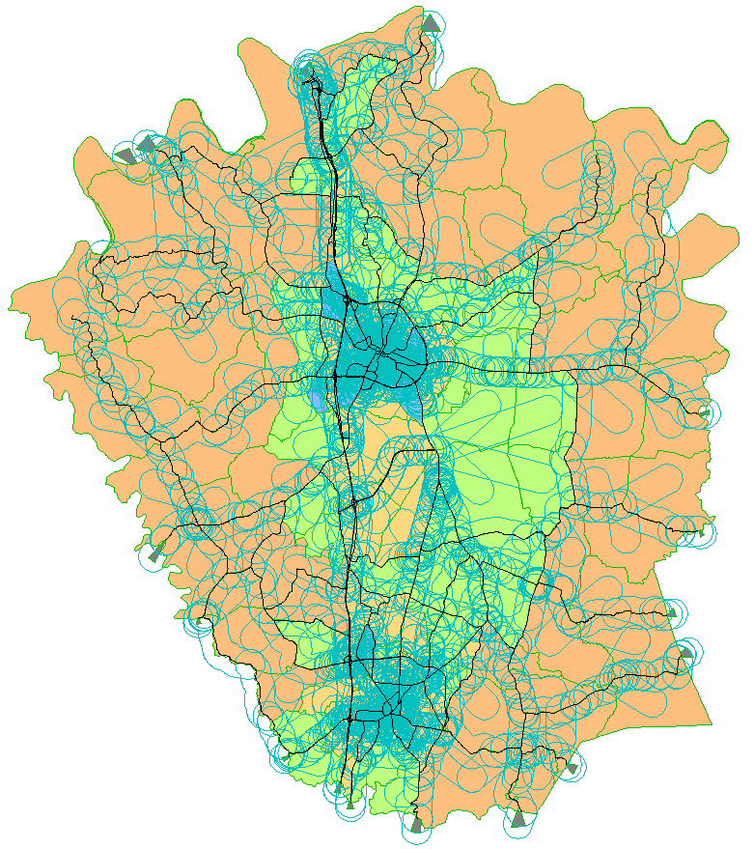
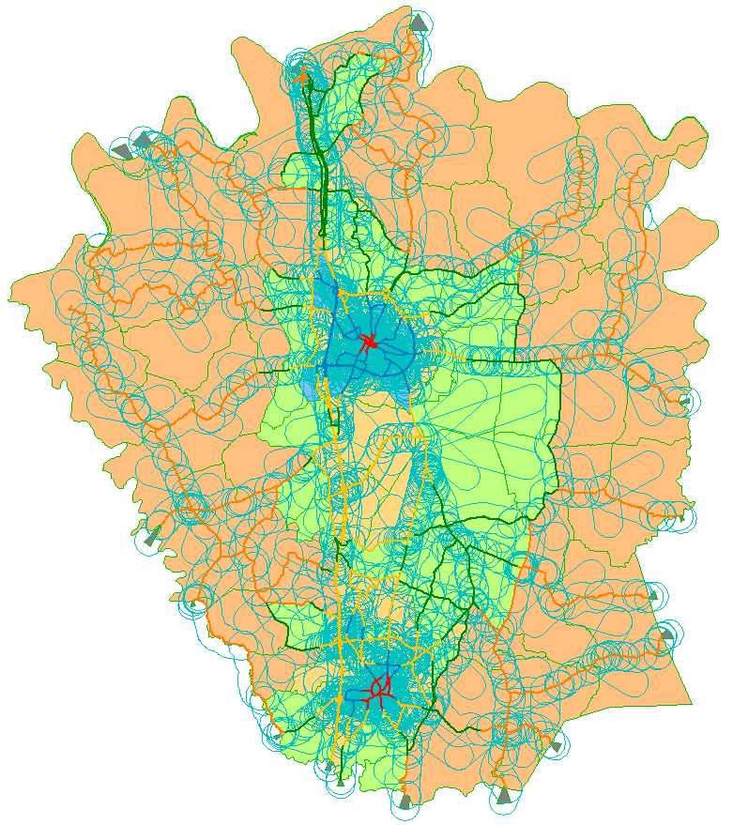
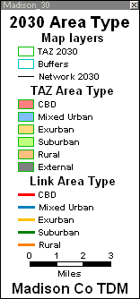
Area Type Determination with Buffer Analysis

Slide 7
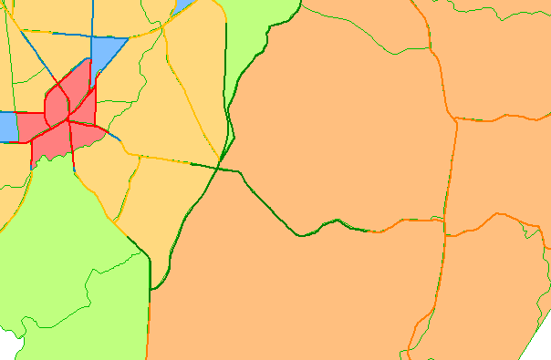
Area Type Determination with Buffer Analysis

Slide 8
Future Refinements
Apply to census blocks within buffer
Adjust buffer width according TAZ area type
Smaller width for urban area
Larger width for rural area
User-specified “minimum” area type

Slide 9
Thank you
Questions or Comments?

