Slide 1
Hybrid Mesoscopic-Microscopic Traffic Simulation Framework
Alex Torday, Jordi Casas and Josep Perarnau
torday@aimsun.com
September 2008
What’s coming in Aimsun: New features and model developments
1

Slide 2
Content
Background
Traffic Simulation Requirements
What model is the best, Meso or Micro?
One step forward: Hybrid model
Problems combining Mesoscopic and Microscopic models
Model Integration
Why?
How?
DTA as a key process
How DTA is included?
Hybrid Framework
Computational Results
Conclusions

Slide 3
Background
Traffic Simulation models Requirements
Large Complex Systems
Dynamic analysis
Real-time applications
Example:
Integrated Corridor Management Systems (ICM Systems)
Source: http://www.its.dot.gov
USDOT Intelligent Transportation Systems (ITS) program has launched a generation of initiatives aimed at improving transportation safety, relieving congestion and enhancing productivity.

Slide 4
Background: What model (Meso or Micro) is the best?
The question is not whether one approach is better or more appropriate than other
But which is the most appropriate use of each approach and how can then work together in a common framework
Or if there is a unique approach that can replace satisfactorily all others

Slide 5
Background: One step forward, Hybrid Model
Model decision: All or Nothing (black or white)
Mesoscopic model or Microscopic model?
Is a detailed representation of the vehicles necessary?
Is a detailed representation of detector measurements necessary?
What type of signal control as to be emulated?
What is the available data for calibration/validation?
What is the size of the network?
What is the required computation time?
What kind of outputs are required?

Slide 6
Background: One step forward, Hybrid Model
Model decision: The GREY exists
Previous answers could lead to the need of using both models!
The Hybrid model is an alternative for solve all requirements of a project
Unique Traffic demand
Split the network in two type of areas:
Mesoscopic areas
Microscopic areas
Unique Traffic Control
Unique DTA
Notes:
AFEGIR UNIQUE NETWORK REPRESENTATION

Slide 7
Background: Problems combining Mesoscopic and Microscopic models
Network representation consistency
Consistency problems in Route Choice
Communication and Exchange of information
Vehicle representation
Traffic dynamics at meso-micro boundaries
Model Integration
Hybrid Framework

Slide 8
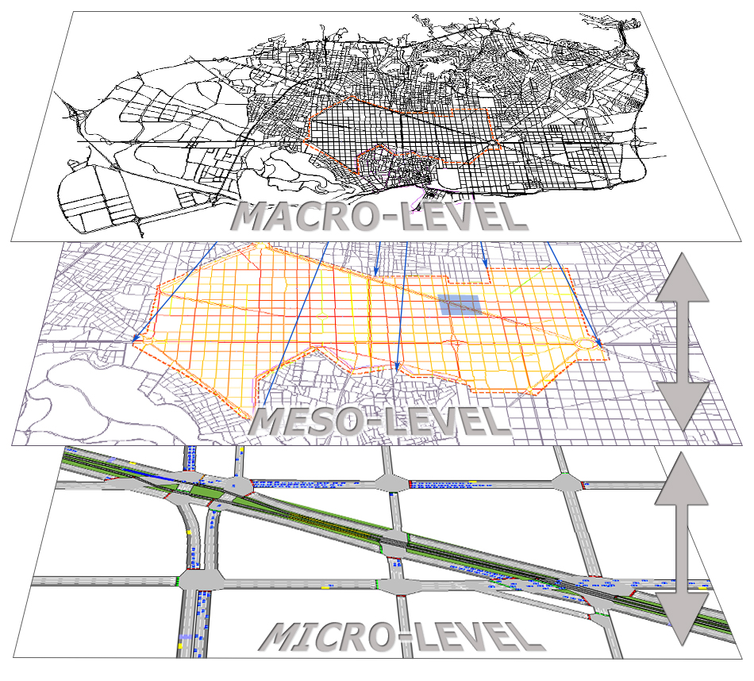
Model Integration, Why?
An integrated framework to support a transport analysis methodology that combines the three approaches, overcomes consistency and synchronization problems

Slide 9
Model Integration: How?
MACRO ASSIGNMENT MODEL
EXTENSIBLE OBJECT MODEL
MICROSCOPIC
TRAFFIC SIMULATOR
MODEL DATABASE
MESOSCOPIC TRAFFIC SIMULATOR
Micro
Meso
Macro
EXTENSIBLE OBJECT MODEL

Slide 10
Model Integration: DTA as a key process
Principles (Florian et al 2001)
Components of DTA models:
Method for determining path-dependent flow rates on the paths in the network
Dynamic equilibrium algorithm
Route Choice stochastic model
Dynamic network loading method
Simulation model
Mesoscopic
Microscopic
g_{i}(t)
s_{a}(v(t))
Network with performance functions
Time-dependent OD Matrices
(1) PATH CALCULATION AND SELECTION
a) Dynamic equilibrium algorithm
b) Route Choice stochastic model
Determine paths and time-dependent path flows
(2) DYNAMIC NETWORK LOADING
Load Network (network loading problem)Link flows, time, path times.
Yes
Convergence Criteria:
a) Analytical (Rgap)
b) All demand loaded?
No
STOP
Notes:
According to Florian et al. (2001), a dynamic traffic assignment model consists of two main components:
A method for determining path-dependent flow rates on the paths in the network.
A dynamic network loading method, which determines how these path flows give rise to time-dependent arc volumes, arc travel times and path travel times.
The diagram in Figure 3.1 depicts the logical, conceptual approach to dynamic traffic assignment models. Path flow rates depend on the emulation of drivers’ path choice behaviour, determining in this way which of the alternative approach is implemented:
Dynamic en-route assignment. At each time period, the corresponding fraction of the demand is assigned to the currently available paths for each origin-destination pair according to the probabilities estimated by a route choice model. Drivers can be allowed to dynamically change route en route if a better path from their current position to their destination becomes available.
Dynamic equilibrium assignment. Path flows are determined by an approximate solution to the mathematical model for dynamic equilibrium conditions (Florian et al., 2001), (Barceló et al., 2002).

Slide 11
Model Integration
Dynamic Traffic Assignment Server
Historical Link Costs
Network
Shortest
Path
Server
Link Cost Functions
MSA Module
RGap Evaluation
Calculated
Paths
Route Choice Models
Path
Statistics
Updated Link Costs
Path Flows
Time – dependent OD Matrices
Network Loading
Microscopic
Model
Mesoscopic
Model

Slide 12
Hybrid Framework
Dynamic Traffic Assignment Server
Historical Link Costs
Network
Shortest Path Server
Link Cost Functions
MSA Module
RGap Evaluation
Calculated Paths
Path Statistics
Route Choice Models
Updated Link Costs
Path Flows
Time – dependant OD Matrices
Hybrid Network Loading
META Event Oriented Simulator
Vehicle Manager
Microscopic Model
Mesoscopic Model

Slide 13
Hybrid Framework: New elements
META Event Oriented Simulator: syncronization between Mesoscopic and Microscopic models
Vehicle Manager:
Vehicle generation
Boundary conditions
Hybrid Network Loading
META Event Oriented Simulator
Vehicle Manager
Microscopic Model
Mesoscopic Model

Slide 14
Computational Results
Madrid Network
Mixed network: urban and urban freeway
Topology:
327 centroids
1375 intersections
3591 sections
Total length: 570 Km
Total length lane 1160 Km
Traffic demand: Morning Peak hour (6:15am – 9:30 am)
Time slice 15 minutes
Total number of trips: 409502
Public Transport: 172 Public Transport lines

Slide 15
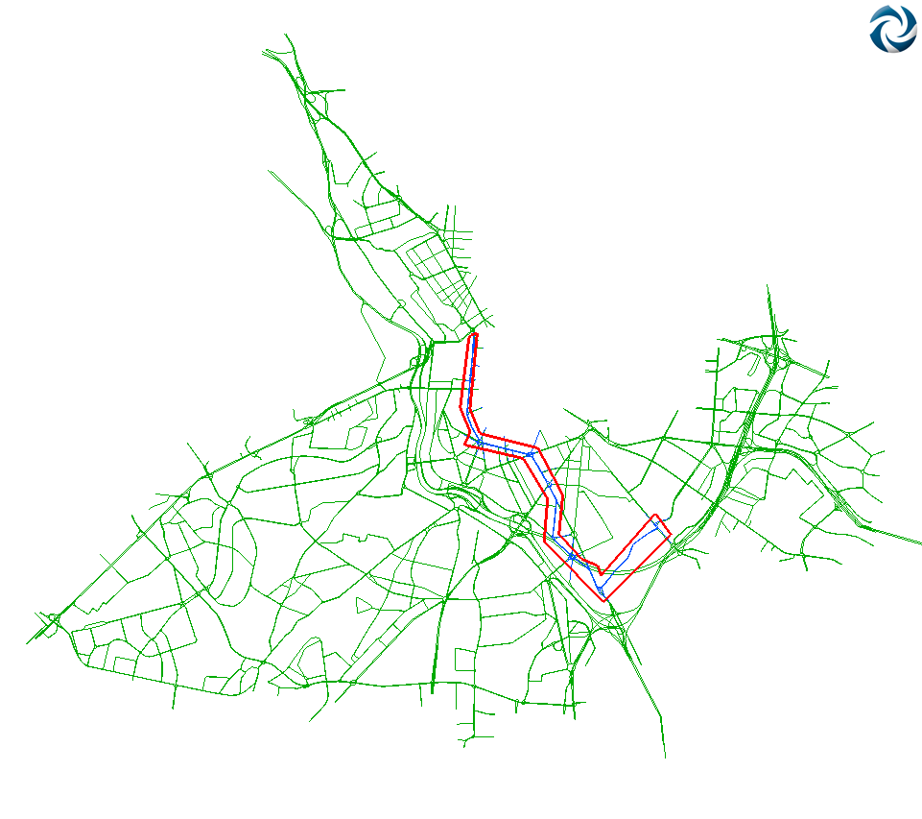
Computational Results
191 sections and 55 nodes considered as microscopic

Slide 16
Computational Results
Scenario Analysis
Using only Microscopic simulation (Micro)
Using only Mesoscopic simulation (Meso)
Using Hybrid (meso/micro) simulation (Hybrid)

Slide 17
Computational Results
Validation of the real data set compared with simulation outputs
MOE | Meso | Hybrid
Vehicles gone out | 365.159 | 345.396
Vehicles inside | 31.764 | 34.669
Vehicles waiting out | 20.318 | 36.935
Regression slope | 0,92 | 1,04
Regression intercept | 234,19 | -14,9
Regression R² | 0,90 | 0,86
Flow [veh/h] | 103.628 | 104.349
Density [veh/km] | 13,43 | 12,61
Speed [km/h] | 39,82 | 39,56
Travel time [sec/km] | 115,96 | 117,38
Delay time [sec/km] | 54,81 | 61,54

Slide 18
Computational Results
Consistency between Meso and Hybrid

Slide 19
Computational Results
Consistency between Meso and Hybrid (GEH)

Slide 20
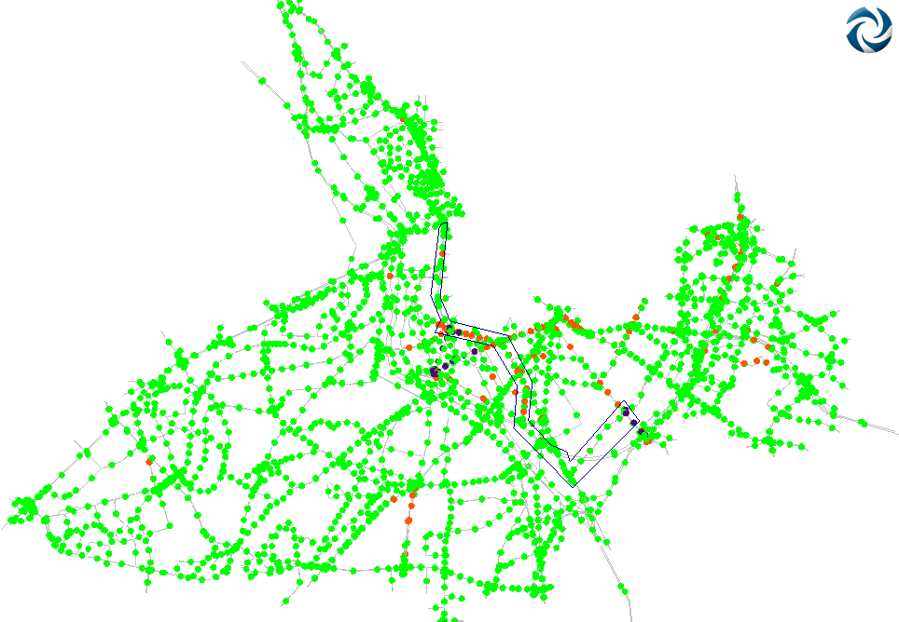
Computational Results
Consistency between Meso and Hybrid (GEH)

Slide 21
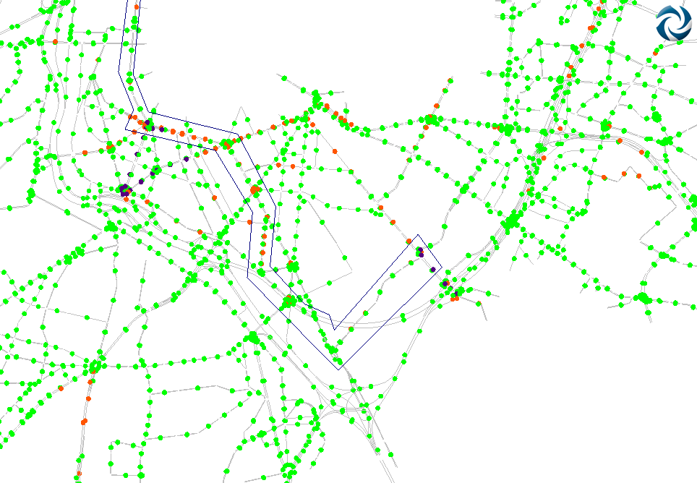
Computational Results
Consistency between Meso and Hybrid (GEH)

Slide 22
Computational Results
Computation Time
Micro: 2595 seconds
Meso: 259 seconds (10% of the Micro time)
Hybrid: 331 seconds (13% of the Micro time)

Slide 24
Conclusions
Equivalence of three models compared with the real data set
Consistency between Meso and Hybrid
Once the consistency is guaranteed, the performance becomes the critical point
The difference of computation time between meso and micro is significant
The difference of computation time between meso and hybrid is not significant. Obtaining a higher detail of the simulation outputs
Usability in large scale networks: 1 meso subnetwork + n micro subnetworks

Slide 25
20 West 22nd Street
Suite 612
New York NY 10010 Tel. 917 267 8534 mail: info@aimsun.com
web: www.aimsun.com

