Slide 1
Design and Specification of an Economic Land Use Forecasting System for the Twin Cities
Colby Brown, Citilabs
Dennis Farmer, Metropolitan Council
Todd Graham, Metropolitan Council
Francisco Martinez, Univ. of Chile, Santiago
Pedro Pablo Donoso Sierra, LABTUS

Slide 2
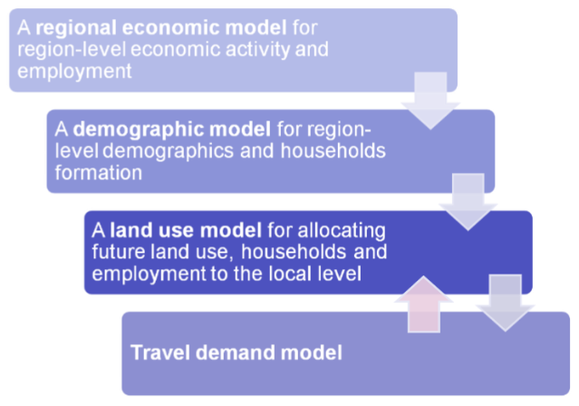
Overview of Model Architecture

Slide 3
Data Flows Between Sub-Models
Cube Land predicts real estate development and allocates total regional jobs by industry and households by type to TAZs in the region
Regional Economic Model
Total Jobs by Industry
Congested Accessibility
Cube Land
Cube Voyager
Regional Demographic Model
Total Households by Type
Job & Household Locations

Slide 4
Definition of Real Estate Units
One housing unit is the space occupied by a single household (equilibrium condition)
One non-residential unit is the space occupied by a single job (employment allocation)
 | Residential real estate type
1 | Single family detached Small Lot: 0.01 - 0.24 acres
2 | Single family detached Medium Lot: 0.25 - 0.99 acres
3 | Single family detached Large Lot or Rural: 1+ acre
4 | Townhome
5 | Duplex, triplex or small apartment building (2-4 units)
6 | Condominium (5 or more owner occupied units)
7 | Apartment (5 or more rental units)
8 | Mobile-homes
 | Non-residential real estate type
1 | Industrial
2 | Office
3 | Commercial
4 | Small Institutional
5 | Large Institutional
6 | Airport
7 | Park & golf courses
8 | Agricultural land
9 | Water, roads and transportation rights-of-way
10 | Other
Predefined by the user

Slide 5
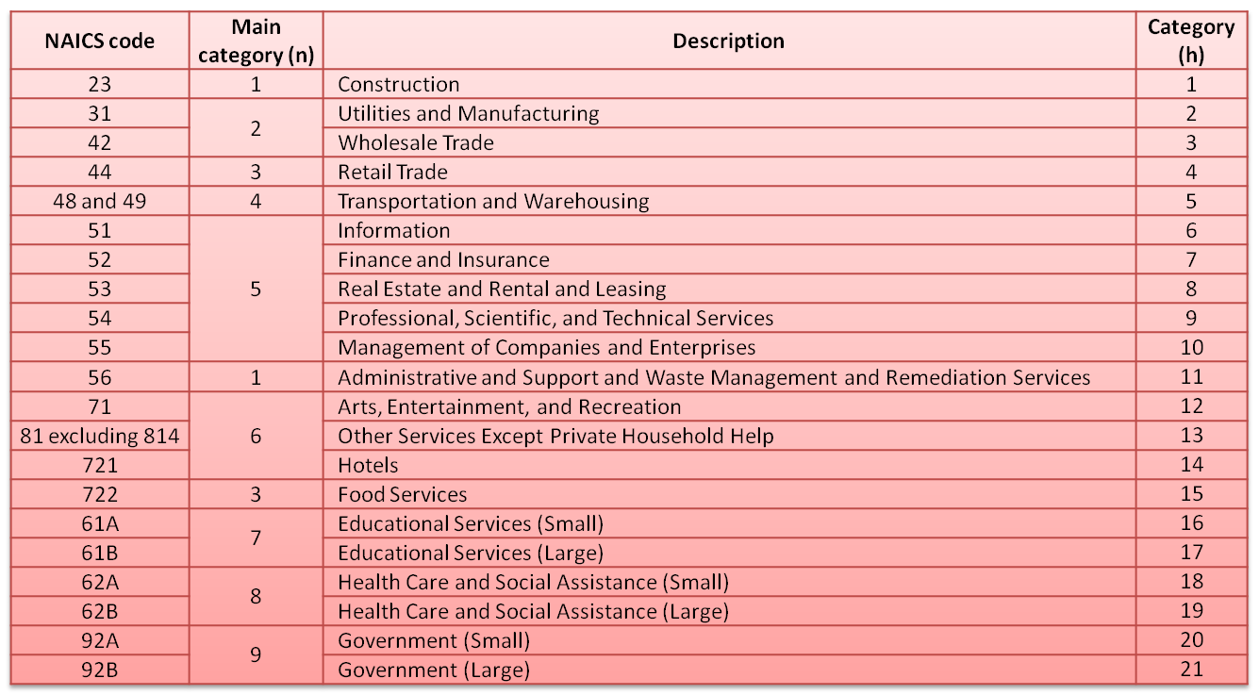
Initial Industry Classification Scheme

Slide 6
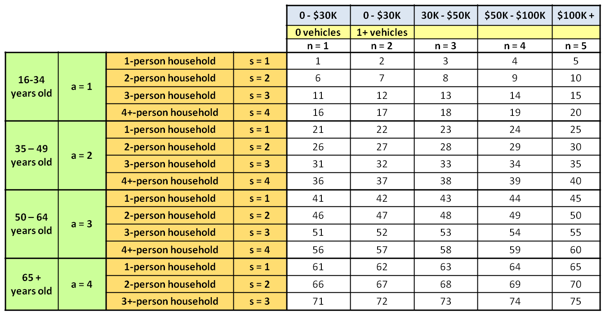
Initial Household Classification Scheme

Slide 7
Socioeconomic Travel Model Inputs
The current Twin Cities Regional Travel Demand Forecasting Model (RTDFM) trip generation model uses the following inputs:
Total zonal households
Average zonal household income
Total zonal population
Retail employment
Non-retail employment

Slide 8
Transportation Accessibility Measures
The RTDFM includes mode and destination choice sub-models which yield a logsum-based multimodal accessibility measure:
Prior research (Al-Geneidy & Levinson, 2006) used “cumulative opportunities” measures:

Slide 9
Zonal Variables
Percentage of zone within 0.5 mile walking distance buffer of any light rail station
Percentage of zone within 50-meter buffer of open water (lakes, rivers etc.); parks
Exogenous variables (land supply; fixed uses)
Endogenous variables
Total land consumed by allocated uses by type
Income-related endogenous variables

Slide 10
Neighborhood Effects
Spatial autocorrelation: correlation among nearby real estate properties or households
“Location externalities” are bid terms that depend upon cumulative choices of “others”
These are called “endogenous variables” because they are updated as the model runs
Creates some nonlinearity, yet also accounts for spatial autocorrelation to some extent

Slide 11
Preliminary Estimation Findings
Multiple different accessibility measures (congested logsum, cumulative opportunities, rail station proximity) were found to have significant & distinct effects on residential bids
An alternative household stratification system including race as well as income was tested and found to have better statistical fit to data
Re-grouping of industry categories needed in order to improve goodness of fit as well

Slide 12
Conclusions
Design and specification is a valuable exercise in integrated land use model development
The software shouldn’t have to completely determine your model’s data requirements
Some decisions can be made a priori while others benefit from empirical investigation
Thank you – any questions?

