Slide 1
Effects of Household Life Cycle Changes on Travel Behavior
Evidence from Michigan Statewide Household Travel Surveys
Ayvalik, C., Proussaloglou, K., Cambridge Systematics
Faussett, K., MDOT, Bureau of Transportation Planning
Wargelin, L., AbtSRBI
13th TRB National Transportation Planning Applications Conference, Reno 2011

Slide 2
Introduction
MI Travel Counts II in 2009 (MTC II)
Earlier survey in 2005 (MTC I)
Changes in household travel behavior
Evidence for reduction in traffic volumes, and
Impacts of changes in household socioeconomic characteristics
Notes:
The MI Travel Counts II (MTC II) program during the Fall of 2009 updated information on statewide household travel characteristics.
Changes in household travel behavior
Evidence to support the recent reduction traffic volumes, and
Impacts of changes in household socioeconomic characteristics on travel behavior.

Slide 3
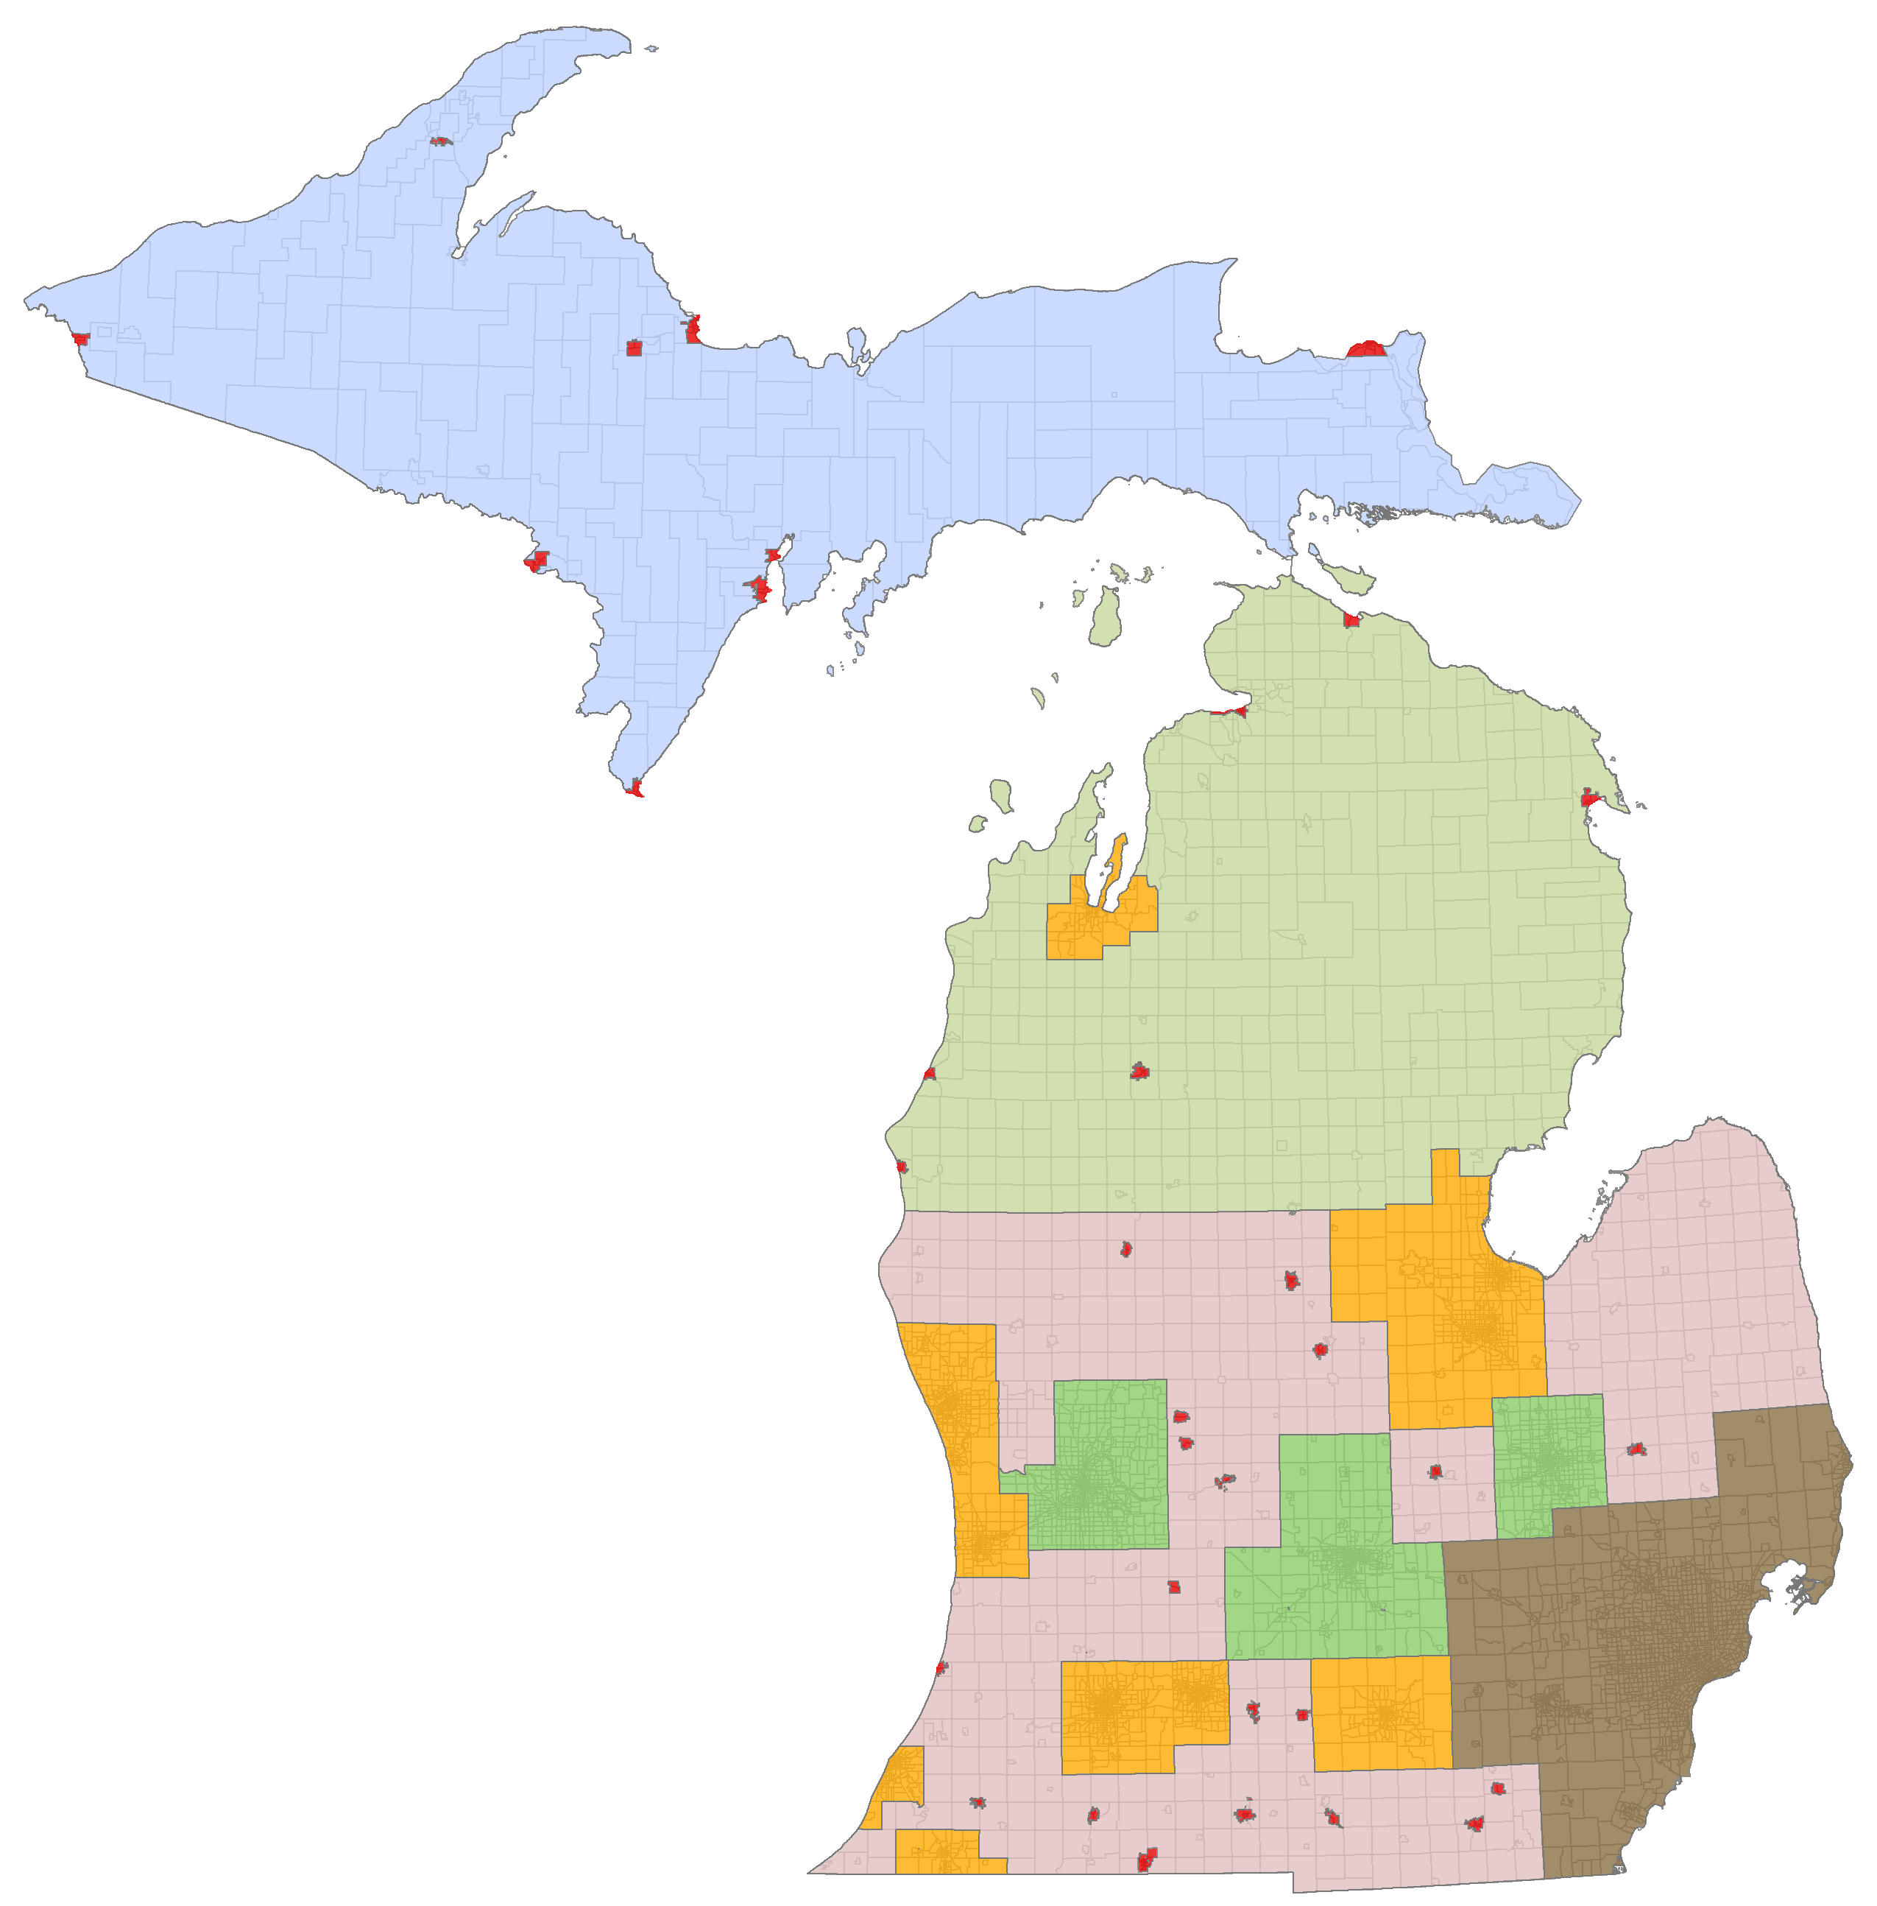
Introduction
Panel design.
Nearly 2,000 households.
MTC I and MTC II participants.
Sampling cells considered
geography,
household size,
number of workers and
vehicles available.
Upper Peninsula
Small Cities
Northern Lower Peninsula
Southern Lower Peninsula
Small Urban Model Areas
TMAs
SEMCOG

Slide 4
Background
Changes in household sizes
Age distribution
Employment Status

Slide 5
Research Objectives
Comparison of travel behavior: MTC I vs. MTC II
Evaluate the significance of observed changes
Nature of changes in travel behavior
Trip rates, trip lengths, peaking, and purpose
Factors that affect changes in travel behavior
Identify bias due to MTC II survey participation
Examine the explanatory power of key household level socioeconomic parameters.

Slide 6
Assessment of Bias
Comparisons focus travel behavior in 2005.
Are trip rates of the MTC II respondents in 2005 representative of the MTC I participants?
Are trip lengths of the MTC II respondents in 2005 similar to the rest of the MTC I participants?
Do the distributions of trips by time of day and purpose differ?

Slide 7
Bias – Trip Rates
Comparison of Trip Rates by MTC II Participation
Survey Participation | N | Mean | Std Dev
MTC I Only | 12,845 | 9.12 | 7.51
Both Surveys | 1,973 | 9.49 | 7.43
All | 14,818 | 9.17 | 7.50
ANOVA
No Substantial Difference

Slide 8
Bias – Travel Distances
8
Comparison of Travel Distances by MTC II Participation
Average Travel Distances
Survey Participation | N | Mean | Std Dev
MTC I Only | 10,975 | 12.18 | 26.8
Both Surveys | 1,783 | 12.88 | 34.1
All | 12,758 | 12.27 | 26.0
ANOVA
No Substantial Difference

Slide 9
Bias – Peaking Patterns
Comparison of Trips by Time of Day and MTC II Participation
TOD Periods |  | MTC I Only | Both MTC Waves
AM Peak | 6:00 AM – 8:59 AM | 19.40% | 18.60%
Mid-Day | 9:00 AM – 2:59 PM | 33.60% | 33.80%
PM Peak | 3:00 PM – 5:59 PM | 26.50% | 26.90%
Evening | 6:00 PM – 8:59 PM | 15.10% | 15.70%
Late Night | 9:00 PM – 5:59 AM | 5.50% | 5.00%
Chi-Square Test
No Substantial Difference

Slide 10
Bias – Trip Purposes
10
Comparison of Trips by Purpose and MTC II Participation
Trip Purpose | MTC I Only | Both MTC Waves
Home Based Work | 16.00% | 16.40%
Home Based School | 9.60% | 7.90%
Home Based Other | 41.30% | 41.30%
Non-Home Based | 33.20% | 34.40%
Chi-Square Test
No Substantial Difference

Slide 11
MTC Waves
Are trip rates in the MTC I similar to the MTC II?
Are trip length distributions in the MTC I similar to the MTC II?
Can changes in the household socioeconomics explain the observed changes in trip rates?
Focus is on the changes across waves.

Slide 12
MTC Waves - Trip Rates
Comparison of Trip Rates Across MTC Waves
Household Trip Rates | Mean | Std Dev
MTC I Survey | 9.17 | 6.92
MTC II Survey | 7.82 | 6.51
Paired t-test
Significant Difference
Δ = 1.34 trips/hh
Consistent changes across geography

Slide 13
MTC Waves – Travel Distances
13
Comparison of Travel Distances Across MTC Waves
Average Travel Times (minutes) | Mean | Std Dev
MTC I Survey | 11.17 | 13.86
MTC II Survey | 10.74 | 8.00
Paired t-test
Non Significant Difference

Slide 14
Changes in Socioeconomics
14
There is a significant difference in trip rates.
Can changes in socioeconomics explain these changes?
How can we control socioeconomic characteristics?
Survey sampling cell definitions are a function of household socioeconomic characteristics.
The sample was divided into two groups based on whether the survey sampling cell has changed across waves.
These groups analyzed separately.
 |  | MTC II
 |  | Cell 1 | Cell 2 | … | Cell n
MTC I | Cell 1
 | Cell 2
 | …
 | Cell n

Slide 15
Household Sizes
 | MTC II - Household Sizes
MTC I - Household Sizes | One-Person | Two-Person | Three-Person | Four-Person or More | All
One-Person | 472 | 37 | 9 | 4 | 522
Two-Person | 88 | 560 | 27 | 11 | 686
Three-Person | 26 | 125 | 139 | 37 | 327
Four-Person or More | 13 | 66 | 90 | 269 | 438
All | 599 | 788 | 265 | 321 | 1973
Percent Changed in MTC II | 21.2% | 28.9% | 47.5% | 16.2% | 27.0%
27 percent of the households had a change in size
The average household size was reduced by about 8.5 percent (2.44 vs. 2.23).

Slide 16
Household Workers and Vehicles
16
39 percent of the households had a change.
Zero-worker households grew substantially.
One-third of the households had a change in vehicle ownership level; no net gain or loss in the sample.
 | MTC II - Workers in the Household
MTC I - Workers in the Household | Zero-Worker | One-Worker | Two-Worker | Three-Worker or More | All
Zero-Worker | 426 | 32 | 5 | . | 463
One-Worker | 221 | 422 | 104 | 6 | 753
Two-Worker | 63 | 165 | 344 | 50 | 622
Three-Worker or More | 8 | 38 | 69 | 20 | 135
All | 718 | 657 | 522 | 76 | 1973
Percent Change in MTC II | 40.7% | 35.8% | 34.1% | 73.7% | 38.6%

Slide 17
Trip Rate Comparison
Same Cell Households
Trip Rates for Same-Cell Households | Mean | Std Dev
MTC I | 7.98 | 6.97
MTC II | 7.47 | 6.83
Small but detectable level difference between the MTC waves still exists.
Paired t-test
Statistically Significant Difference
(N=922, p=0.001)

Slide 18
Trip Rate Comparison
18
Different Cell Households
Source | F Value | Pr > F
HHSIZE + | 120.5 | <.0001
HHSIZE - | 95.6 | <.0001
HHWRKR - | 2.66 | 0.103
HHSIZE - * HHWRKR - | 5.53 | 0.019
Changes in the household size was a significant contributor.
Reduction in number of workers also had a marginal effect.
The effect was more prominent when coupled with reduction in the household size.
ANOVA
Statistically Significant Model (N=1018, R² = 0.18)

Slide 19
Life Cycle Cohorts
Sampling cell as a proxy still showed a detectable difference.
Household life cycle – to account for differences in trip rates.
13 distinct household level cohorts – to reflect various life cycle characteristics.
Sample divided into two groups – changes in life cycle.

Slide 20
Life Cycle Cohorts
20
1 Unemployed Singles
2 Professional Singles
3 Professional Young Couples
4 Professional Couples with Kids
5 Traditional Family – (One Worker Couples with Kids)
6 Professional Seasoned Couples (Two Worker Couples older than 55)
7 Homemaker-Breadwinner Couples (One Worker Couples)
8 Retired Couples
9 Retired Singles
10 Non-Traditional Structure with Kids (Single parents and/or presence other relatives)
11 Non-Traditional Structure with Kids No Workers
12 Non-Traditional Structure with Workers No Kids
13 Non-Traditional Structure No Workers No Kids

Slide 21
Analysis with Life Cycle Cohorts
Are the levels of change in trip rates equivalent across the life cycle cohorts ?
Can changes in life cycle cohorts explain differences in trip rates ?
What types of life cycle changes have the highest impact on household travel behavior ?

Slide 22
Same Life Cycle Households
Life Cycle and Demographic Variables | P-values MTC Only | P-values Full
MTC Wave | 0.0002 | 0.159
MTC*Non-Traditional Structure with Workers No Kids*Increase in HH Size |  | 0.001
MTC*Retired Couples |  | 0.009
MTC*Non-Traditional Structure with Kids*Decrease in HH Size |  | 0.028
MTC*Retired Singles*Decrease in Vehicle Ownership |  | 0.081
Life Cycle and Demographic Variables | P-values MTC Only
MTC Wave | 0.0002
Changes in household sizes and vehicle ownership explained substantial amount of the difference in rates.
For retired couples trips were reduced significantly potentially due to changes in mobility levels.

Slide 23
Households with Life Cycle Change
Life Cycle and Demographic Variables | P-values MTC Only | P-values Full
MTC Waves | <.0001 | 0.429
MTC*Kids Moving Out |  | <.0001
MTC*Separation |  | <.0001
MTC*Complex Changes*Increase in the HH Size |  | 0.0002
MTC*Complex Changes*Decrease in the HH Size |  | 0.005
MTC*Complex Changes |  | 0.011
MTC*Retirement |  | 0.017
MTC*Complex Changes*Decrease in the HH Workers |  | 0.019
MTC*Marriage |  | 0.034
MTC*Complex Changes*Kids Moving Out |  | 0.045
MTC*Lose Job |  | 0.059
Life cycle changes indicating variations in household size and workers explained differences in in trip rates across MTC waves.
Changes in non-traditional households had significant interaction effects with changes in household size and number of workers.
Life Cycle and Demographic Variables | P-values MTC Only
MTC Waves | <.0001

Slide 24
Conclusions
MTC II study design allowed to build a panel data at the household level.
There is a statistically significant reduction in household trip rates across waves (1.34 trips/hh).
Are the observed changes due to sampling bias, changes in household structure, or in economic climate?
Notes:
MTC II study design allowed to build a panel data at the household level.
Observed differences in household trip rates were compared statistically.
There is a statistically significant reduction in households trip rates across waves (1.34 trips/hh).
Trip distribution by time of day and purpose were equivalent.
Is the observed changes due to sampling bias, changes in household structure, or in economic climate?

Slide 25
Conclusions
No sampling bias found.
Main socioeconomic changes across the waves included slight increases in the shares of
smaller households
households with higher levels of vehicle ownership.
Higher shares for older age groups in MTC II.
Notes:
Sampling bias hypotheses is rejected since respondents to both waves exhibited similar behavior to the rest of the MTC I respondents.
Comparison of socioeconomic characteristics across the waves showed that MTC II had a slight increase in the shares of
small households
households with higher levels of vehicle ownership.
The MTC II and 2009 NHTS household profiles with respect to size, number of vehicles and workers were very similar.
Distribution of age groups in MTC II showed higher shares for older age groups, while school age children and young adults were underrepresented when compared to MTC I.

Slide 26
Conclusions
26
When changes in socioeconomics are accounted for, differences in trip rates were partially explained.
“Retired Couples” had a statistically significant difference in household trip rates across the MTC waves.
changes in the economic conditions,
deteriorating health, or
restrictions in mobility.
Changes in household life cycles improved the explanatory power.
Notes:
Tests that accounted for changes in socioeconomic characteristics of households revealed that differences in trip rates across waves can be primarily explained by changes in household size.
Inclusion of changes household life cycles improved the explanatory power of the statistical models.
“Retired Couples” seems was only household life cycle group that had a statistically significant difference in household trip rates across the MTC waves.
While changes in the economic condition may have contributed this observation, other changes at person level such as health can be among potential reasons.

Slide 27
QUESTIONS

