Slide 1
LEHD OnTheMap Data
Planning Applications Conference, Session 2
Bruce Spear, Cambridge Systematics
May 8, 2011

Slide 2
What is LEHD?
Longitudinal Employment Household Dynamics
Database on worker – employer interactions
Developed by U.S. Census Bureau
Based on administrative records
Includes all workers and employers subject to State unemployment insurance (UI) laws

Slide 3
LEHD Data Products
Quarterly Workforce Indicators (QWI)
Measures of total employment, job creation, wages, and worker turnover
State, county, metro area
Industry code (NAICS), employer type
Age of worker, gender, (race/ethnicity, education)

Slide 4
LEHD Data Products
OnTheMap (OTM)
Web-based mapping and reporting application http://lehdmap.did.census.gov/
Supports multiple analyses involving workplace and worker residence locations
Multiple levels of Census geography (Census Block Groups, urbanized areas, counties, States)
Selections by employer and industry type, worker age, and earnings.

Slide 6
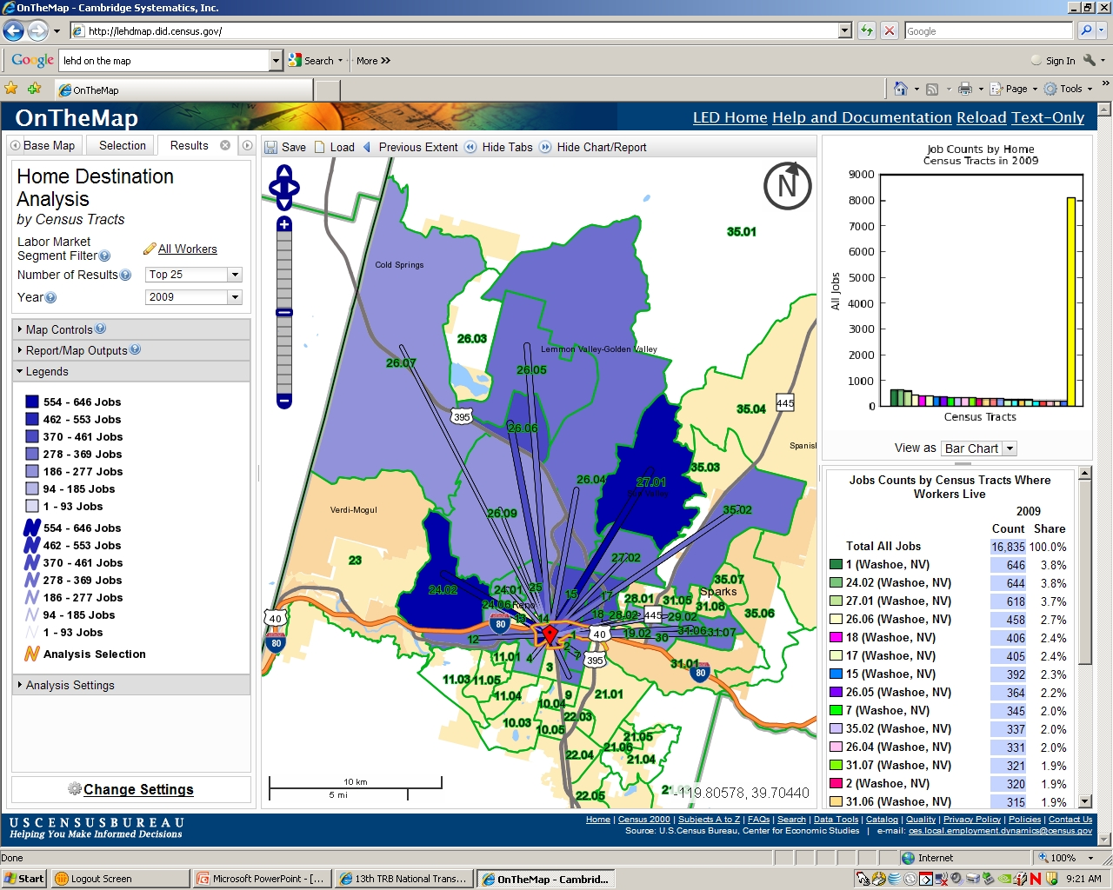

Slide 7
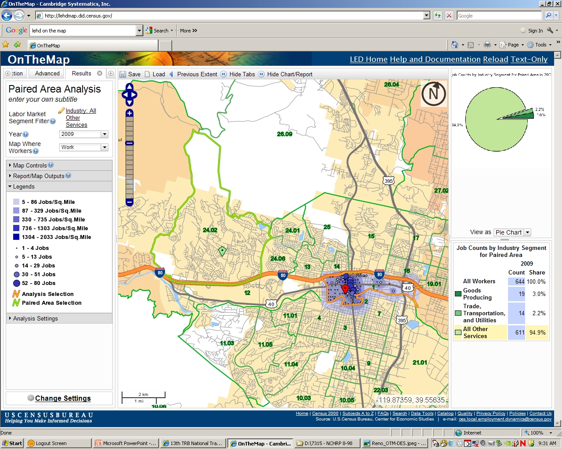

Slide 8
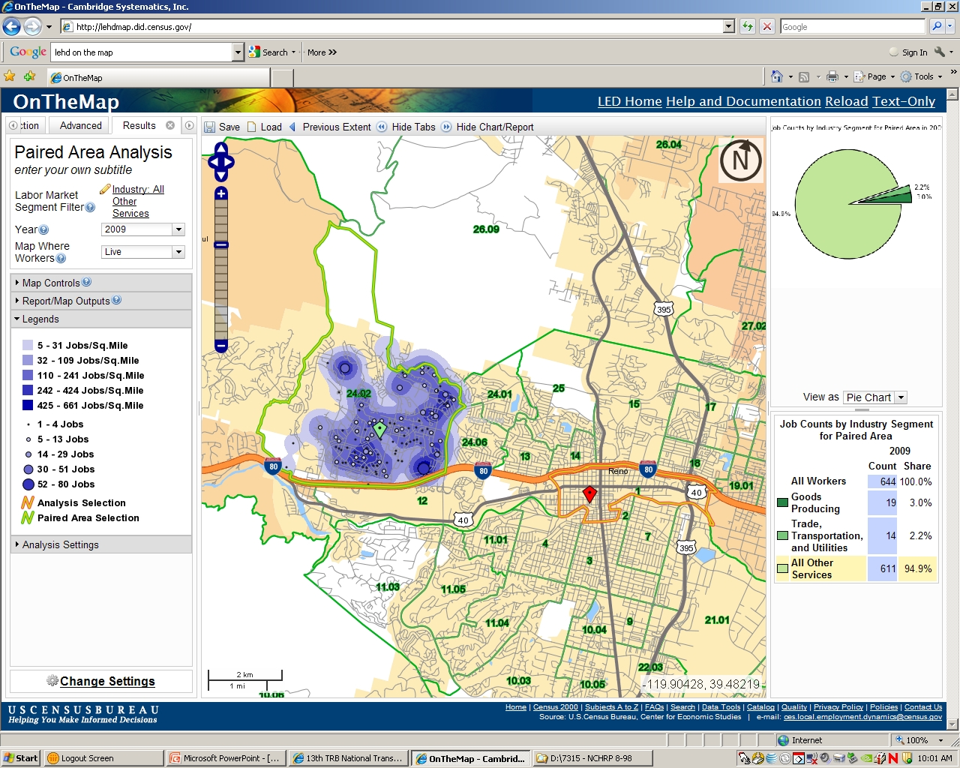

Slide 9
OnTheMap Data Files
Residence Area Characteristics (RAC) - Number and characteristics of jobs/workers summarized by place of residence and reporting year
Residence Geography – (Census Block)
Can be aggregated to other Census geography
Job/Worker Characteristics
Industry Code (20 2-digit NAICS sectors)
Job Type (all, primary job, all private, primary private)
Age of Worker (<30, 30-55, >55)
Monthly Earnings (< $1200, $1200-$3400, >$3400)

Slide 10
OnTheMap Data Files
Workplace Area Characteristics (RAC) - Number and characteristics of jobs/workers summarized by place of work and reporting year
Workplace Geography – (Census Block)
Can be aggregated to other Census geography
Job/Worker Characteristics
Industry Code (20 2-digit NAICS sectors)
Job Type (all, primary job, all private, primary private)
Age of Worker (<30, 31-54, >55)
Monthly Earnings (< $1200, $1201-$3400, >$3400)

Slide 11
OnTheMap Data Files
Origin-Destination Data (OD) – Number and summary characteristics of workers who reside in one location and work in another location
Origin/Destination Geography – (Census Block)
Can be aggregated to other Census geography
Residence location within vs. out of State
Job/Worker Characteristics
Industry Type (Manufacturing, Trade & Transportation, Services)
Job Type (all, primary job, all private, primary private)
Age of Worker (<30, 31-54, >55)
Monthly Earnings (< $1200, $1201-$3400, >$3400)

Slide 12
Development of OnTHEMAP Database

Slide 13
OnTheMap Data Sources
Employer Characteristics File (ECF)
ES-202 (employees, wages, establishments)
Reported quarterly by employers to State employment security agencies (SESA)
Multiple Workplace Reports (MWR) provide characteristics of employers with multiple workplace sites
Geocoded Address List (GAL)
Lat/Lon locations of employment sites

Slide 14
OnTheMap Data Sources
Individual Characteristics File (ICF)
Wage Records (wages by individual worker)
Reported quarterly by employers to State employment security agencies (SESA)
Employees identified by Social Security Number (SSN)
Personal Characteristics File (PCF)
Gender, DOB, Race, Citizenship (from SSN application)
Composite Person Record (CPR)
Multiple sources (IRS, Medicare, HUD) based on SSN
Worker place of residence

Slide 15
OnTheMap Processing Steps
SSNs are replaced by protected identification keys (PIKs) to protect privacy
Individual workers are matched to employers based on 1st quarter wage records
Workers assigned to multi-unit employers based on distribution model derived from Minnesota UI records.

Slide 16
OnTheMap Processing Steps
Combined records are subjected to “disclosure proofing” to protect worker/employer identities
Small amount of “noise” introduced into employer characteristics at establishment level
Worker characteristics at residence synthesized based on industry code, age and earnings
Some data suppression for small geographic units
Actual attribute distributions are retained at more aggregate levels of geography and industry groups

Slide 17
ONTHEMAP Data Limitations and Caveats

Slide 18
OnTheMap Data Limitations and Caveats
LEHD excludes some employment categories
Self-employed & Sole Proprietors – (6% - 17%)
Federal/Military/Railroad Workers – (1% - 20%)
Employment exempt from UI laws – (0% - 2%)
Data not currently produced for all States
States missing data include: CT, DC, MA, NH, PR, VI

Slide 19
OnTheMap Data Limitations and Caveats
Issues in matching workers with workplace establishments
Only half of the States require multi-site employers to file MWRs (including public agencies)
Little or no independent verification of MWR data
Only Minnesota requires employers to include workplace location on individual wage records
Assignment of workers to workplaces for multi-site employers is based on Minnesota distribution

Slide 20
Possible Implications for OnTheMap Data Accuracy
Employers with multiple workplaces may show all employees located at primary employer address:
Large corporations (GM, Harrah’s)
Public agencies (state government, school districts)
Multi-site commercial (McDonalds, Sears)
Distribution of employees to workplaces in other states may not conform to Minnesota distribution.

Slide 21
LEHD/OTM vs. CTPP
 | OnTheMap | CTPP 2006-2008
Geographic Coverage | Excludes non-participating LED States (CT, DC, MA, NH) | Excludes counties with less than 20,000 population
Employer/Industry Categories | Excludes employers not subject to State UI laws | All employers and industry sectors in sample universe
Job Categories | Includes all jobs by workers in covered employment categories | Excludes second jobs by workers with multiple jobs
Sample Size | Full enumeration for covered employment categories | ~ 8 percent of households in 3-year ACS sample

Slide 22
NCHRP 8-36, Task 98 Improving Employment Data for Transportation Planning
Prepare a guidebook for transportation agencies comparing current sources of employment data:
Census Transportation Planning Program (CTPP)
Census Bureau
Quarterly Census of Employment and Wages (QCEW)
Bureau of Labor Statistics
Longitudinal Employer Household Dynamics (LEHD)
Census Bureau

Slide 23
LEHD/OTM vs. CTPP General Research Findings
Both LEHD/OTM and CTPP under report total work flows by 15 – 17 %, nationally and by state
LEHD – excluded employer categories & non-LED states
CTPP – secondary work trips and suppressed data
CTPP 2006-2008 reports significantly more trips than either LEHD/OTM or CTPP 2000, but distributes them over many fewer county pairs.

Slide 24
LEHD/OTM vs. CTPP General Research Findings
LEHD reports fewer total work flows within the same county, but more work flows from/to other counties within the same state and to other states.
Absence of self-employed in LEHD (may work at/near home)
Multi-site employer issue in LEHD
CTPP sample size misses flows from lower incident O/D pairs
LEHD reports lower trip rates between distant counties, but includes many more O/D pairs than CTPP.

Slide 25
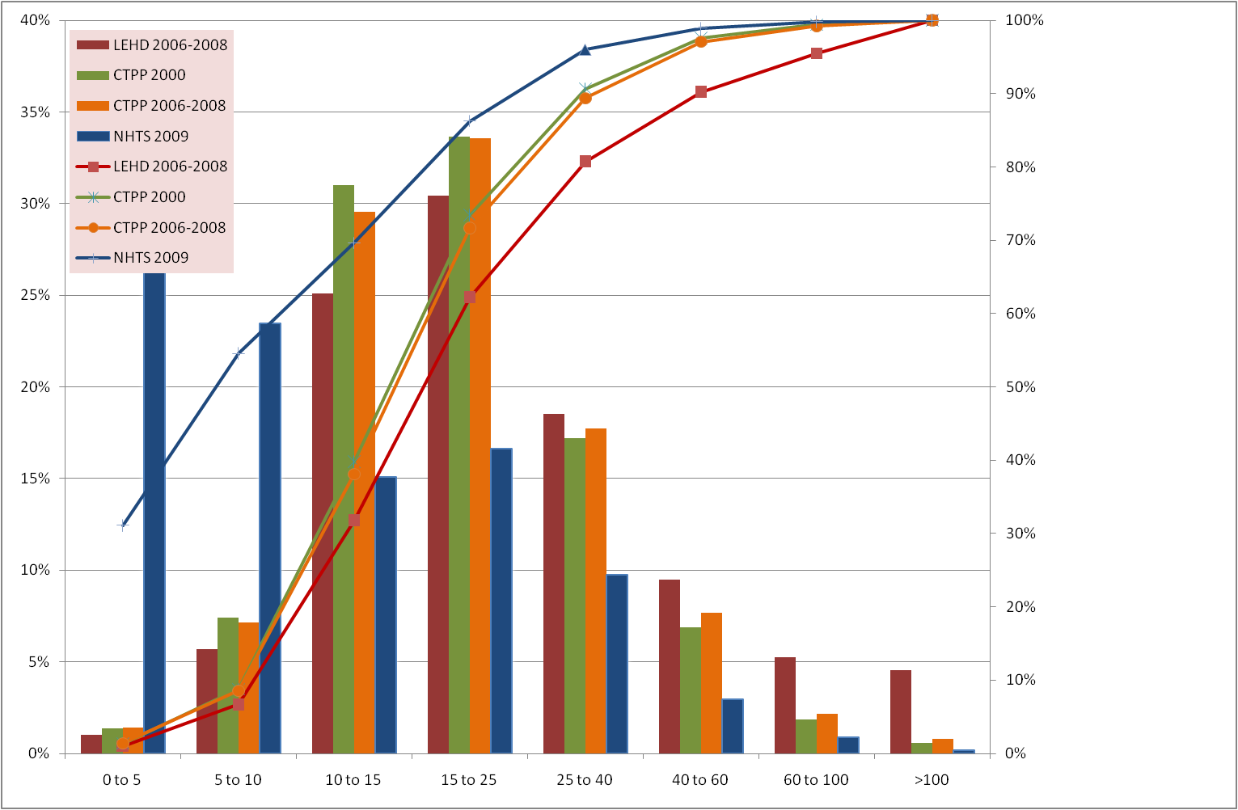
Work Trip Length Distributions

Slide 26
Project Schedule
Month/Year
2010
2011
Task
A
S
O
N
D
J
F
M
A
M
J
J
Review of QCEW and LEHD Data Products
Develop and Implement Data Analysis Plan
Interview State DOLs and DOTs on QCEW data access
LEHD OTM County to County Flow Data
LEHD, CTPP, and ACS Flow Comparisons
Tract Level Origin-Destination Matrix
7. Guidebook Development
Interim Deliverable
Task Duration
Final Deliverable
NCHRP Review

Slide 27
Remaining Tasks
Survey State ESAs and transportation agencies to answer unresolved data collection questions.
Complete LEHD-OTM and CTPP Census Tract level comparisons for three metro areas
Prepare Guidebook based on research findings

