Slide 1
2010 Census
Elaine Murakami
FHWA Office of Planning
Elaine.murakami@dot.gov
Notes:
Thank you to Census Bureau staff who helped me put these materials together.

Slide 2
2010 Census
PL-94-171
Using American FactFinder 2
Summary File 1
TIGER files with 2010 Census geography
Urbanized Areas

Slide 3
Schedule of Product Release
TIGER files with 2010 census geography | Completed in February 2011
PL-94-171 (2010 Census block data) | Completed by April 1, 2011
Summary File 1 | Summer 2011
Urbanized Area Final Criteria | Summer 2011
Urbanized Areas List: names and population | Spring 2012
Notes:
First, let me talk about what’s already happened earlier this year, and what happens next.

Slide 4
PL-94-171
Total pop
Total voting age pop (18+)
Limited race and Hispanic origin
Voting age pop (18+)
Housing units
Occupied and vacant
http://www2.census.gov/census_2010/01-Redistricting_File--PL_94-171/

Slide 5
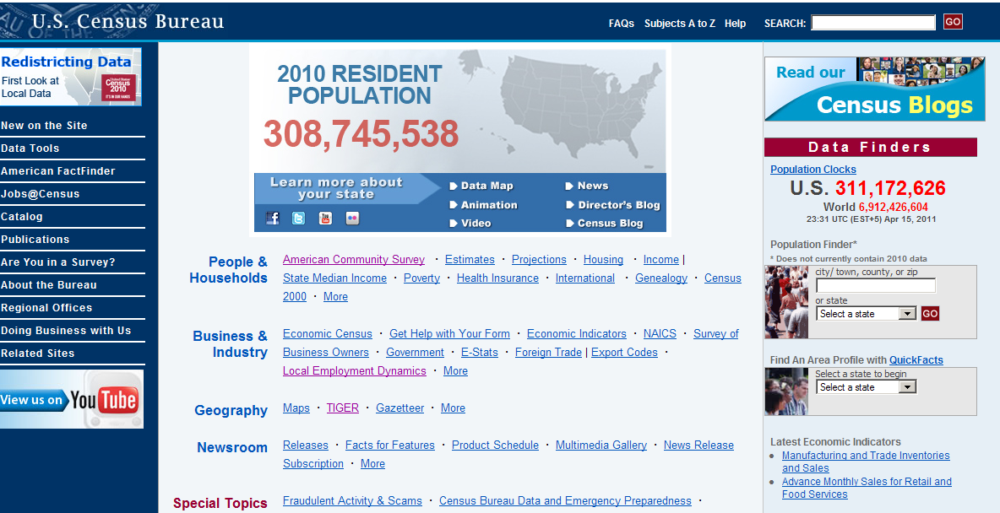
Notes:
Another way to get the 2010 Census data is to use the Census Bureau’s ftp site for downloading files.

Slide 7
Download from the CB FTP site
Notes:
You will want to read this document!

Slide 8
File_structure.pdf on the FTP download
Notes:
Here are the directions for saving the data into MS Access. HANDOUT in your folder.
There are also directions for using the data with SAS.

Slide 9
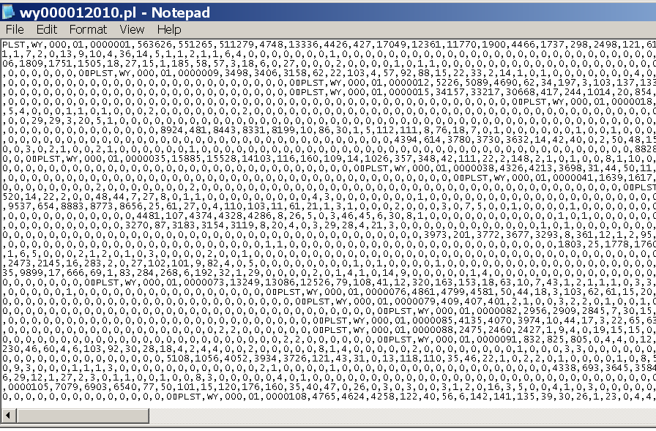
Comma delimited text file, by summary level

Slide 10
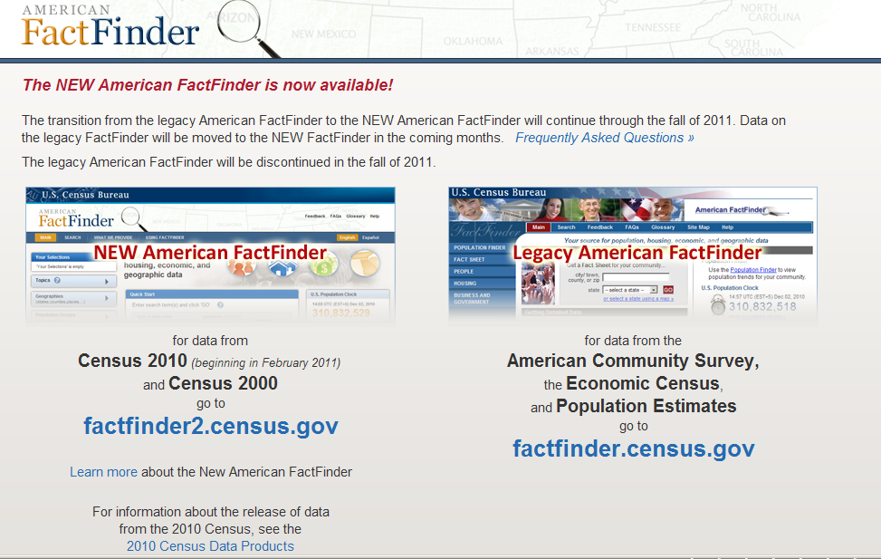
Use American FactFinder2 to access the data

Slide 11
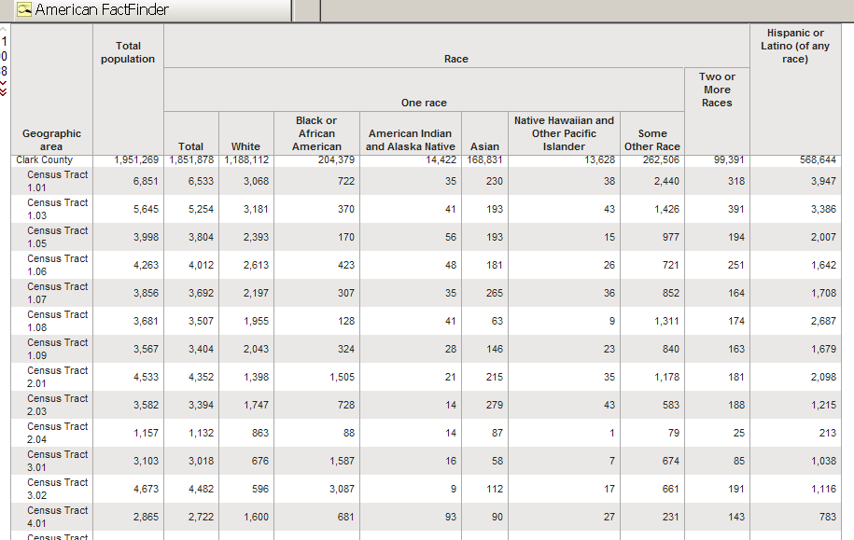
GCT-PL1
Notes:
Here is GCT-PL1 table by census tract. It looks pretty useful. Let’s go through the steps to get this table.

Slide 12
Notes:
First select the Dataset. Click on the “+” to get the drop down list.

Slide 13
Notes:
Select the 2010 Redistricting data.

Slide 14
Notes:
Here is the FIRST NON-INTUITIVE selection. To get to the GCT-PL1 or the GCT-PL2 tables, After you get the drop down list in “product type”, select “Geographic Comparison Table”
I do not know why this is.
I do know that if you don’t select this, then these 2 tables often do not show up in the 2010 Census PL-94-171 results.

Slide 15
Notes:
Now, we are ready to select “Geography”

Slide 16
Notes:
You want to STAY in the GEOGRAPHY FILTER Options. Do NOT go to the RIGHT side “Geography Results”) until the very end.
Here is the SECOND NON-INTUITIVE selection. You need to select “County” if you are interested in Census TRACT data.

Slide 17
Notes:
Now, select “Within State” . For this example, we’ll select “Nevada”

Slide 18
Notes:
Now, when you click on “Within County” you can select “Clark” County either in the Filter Option or the Geography Results.

Slide 19
Notes:
If you make a selection in Geography Results, don’t forget to select “Add” to see the selection in the Filter Box.

Slide 20
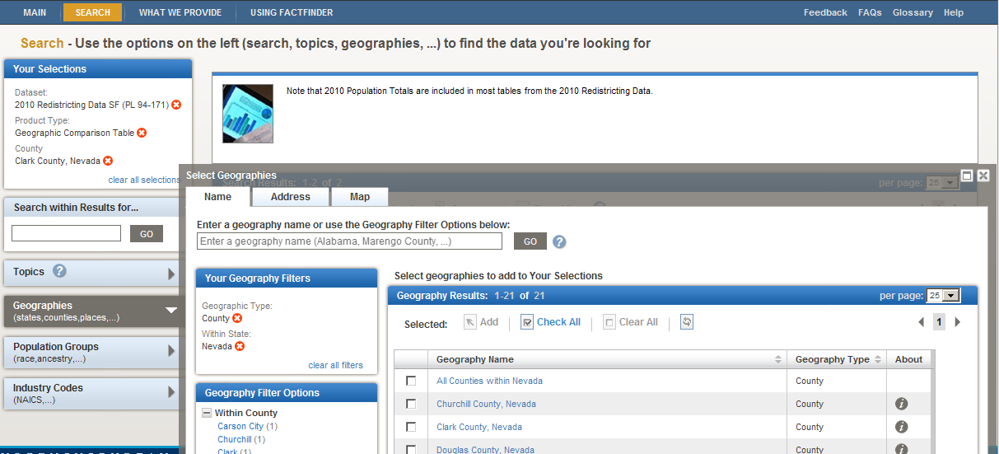
Notes:
Once everything shows in the Filter box, you can close the Geography Selection (X), and then VIEW your table.

Slide 21
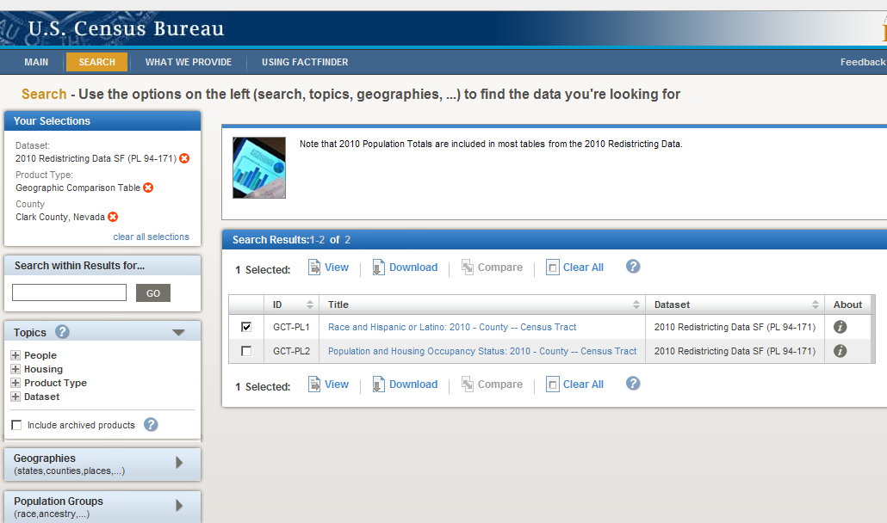
Notes:
Now, you can VIEW your table.

Slide 22
GCT-PL1
Notes:
Here is GCT-PL1 table by census tract. It looks pretty useful. Let’s go through the steps to get this table.

Slide 23
Notes:
You can also download the file.

Slide 24
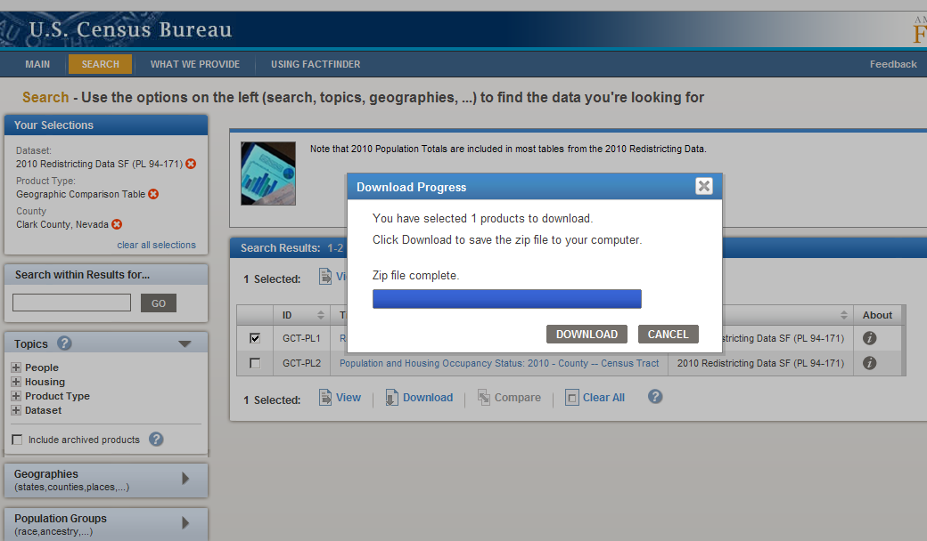
Notes:
You can choose a comma-delimited .csv; .xls, or .pdf. Save the .zip file to your computer, and then unzip it.

Slide 25
GCT-PL2
Notes:
Here is an example of the GCT-PL2 table looks like. Use the same steps, but select a different table. This is example was selecting Place data for California.

Slide 26
2010 Census Summary File 1
Table | Table number | Number of cells
Sex by Age | P12 | 23 age categories
Sex by Age (under age 20) | P14 | Single years 0-19
Household size and type by presence of children | P19 | 19 cells
Household type and Household size | P28 | 16 cells
Group Quarters by GQ Type (institutional or non-institutional) | P42 | 10
Housing Units (Occupancy) | H3 | 3
Average Hhld Size by Tenure | H12 | 3
Notes:
Paper handout with a complete list of the Summary File 1 tables.
This Summary File 1 table will be in high demand by the staff who do the demographic forecasting at your MPO. Some of the specific tables of interest are high-lighted in this table, including household size, household type (presence or absence of children), and average household size.
We are trying to schedule a webinar with the Census Bureau staff on using AFF2 with the Summary File 1 for this summer, after the Summary File 1 data have been released.

Slide 27
TIGER files
http://www.census.gov/geo/www/tiger/tgrshp2010/tgrshp2010.html

Slide 30
Urbanized Areas
Unit | Current Threshold | Possible threshold
MPO | Urbanized Areas with 50,000 or more population | 50,000 100,000 200,000
TMA | Urbanized Areas with 200,000 or more population | 200,000 500,000 1,000,000
Mega-Region | UA or MSA with 1+ million population | 1,000,000
Notes:
Waiting for transportation re-authorization

Slide 31
Census-defined Urbanized Areas
Population density 1000 ppsm as starting point
Impermeable surfaces: YES add
JUMP distance: maintain at 2.5 miles
Use the Urbanized Areas from 2000 as a baseline and keep each as a separate Urbanized Area, even if it touches another Urbanized Area using the 2010 Census results. The boundaries of the two adjacent Urbanized Areas might change.
Harlan Miller, FHWA: continue to use 50,000 as the population threshold for MPOs until otherwise notified.

