Slide 1
Session 13B: Positions and Ambitions about Non-Traditional Modes Quantifying Non-Motorized Demand – A New Way of Understanding Walking and Biking Demand
May 10, 2011

Slide 2
Presentation Outline
Travel Demand Modeling
The Beginning, Forecasting Methods, Today’s Process
Forecasting Non-Motorized Demand
Factors Influencing Non-Motorized Travel & Methods for Modeling Non-Motorized Demand
The Parcel-Based Approach – A New Approach
Overcoming Impacts of Distance, Forecasting for Various Trip Types, Data Requirements, Assumptions, & Applications
Notes:
Presentation Outline
A Little Background
- Modeling (e.g. in general - setting the stage)
- Travel Behavior (e.g. Aggregate & Disaggregate Methods)
- Traditional Four-Step Modeling Process (Today's general transportation practice)
Focusing on Non-Motorized Modes
- Factors Influencing Non-Motorized Travel (Perceptions, Demographics, Environment, etc.)
- Methods for Modeling Non-Motorized Demand (1999 Study - Comparison, Sketch Plan, etc.)
Parcel Based Approach
- Impacts on Trip Types & Distance (draw on the impacts of distance and the pros over a TAZ structure, trip types)
- Data Requirements (use of GIS, NHTS data, Census data, ITE Trip Generation)
- Assumptions (Facilities, etc.)
- Applications (I'll give a couple of examples - regional, sub-regional)

Slide 3
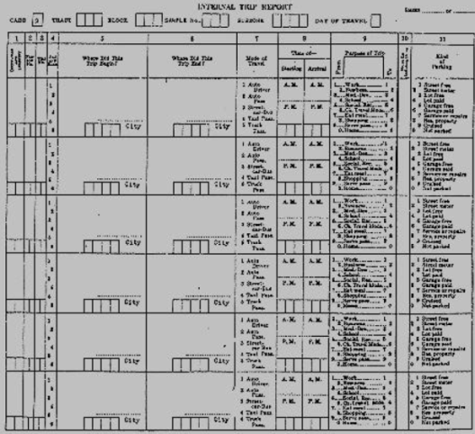
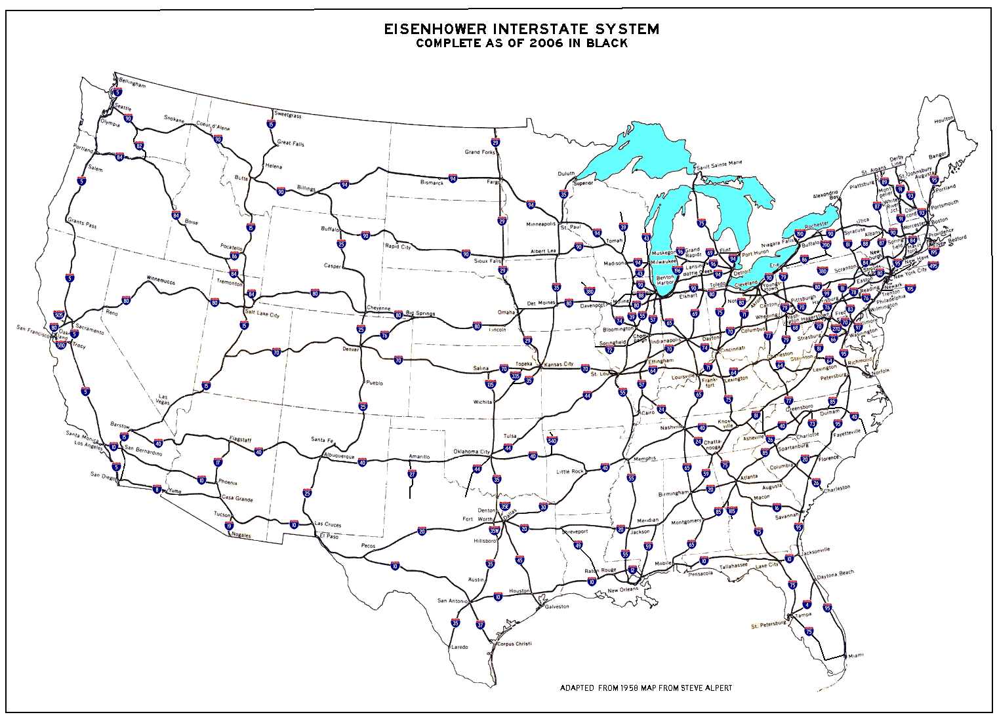
Travel Demand Modeling
Prior to 1950s – Travel Surveys and Forming of Travel Theory (without computers)
Automobile Production Jumped from 70,000 in 1945 to 2.1 Million in 1946 & 3.5 Million in 1947
Federal-Aid Highway Act of 1956 - Construction of the Interstate Highway System
Notes:
Today about 5.7 million autos are produced in the US (Total worldwide – 60 million annually)

Slide 4
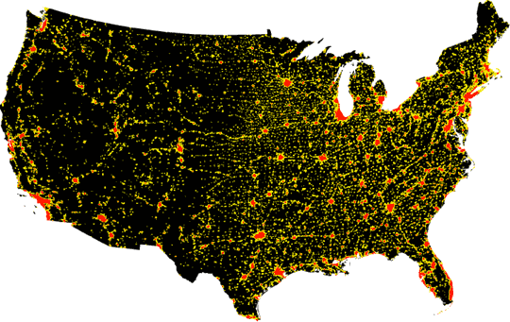
Travel Demand Modeling
Advent of the Computer Early 1950s
1962 Metropolitan (MPO) Planning Process Created
Notes:
Federal Aid Highway Act of 1962
Today over 380 MPOs

Slide 5
Travel Demand Modeling
70s, 80s, & 90s – PCs Established & Reshaped Information
Early 1980s first Commercial GIS Applications Emerge
Notes:
1.6 Sq Miles – Average TAZ Size
26 Sq Miles – Largest TAZ Size
2,100 TAZs

Slide 6
Travel Demand Modeling
Simplified Look at the Evolution of Travel Demand Modeling
Prior to 1950 | Early Explorers | Non-Computer Era User Surveys Estimating
1950 1960 1970 | Pioneers & 1st Generation Users | Mainframes MPO Process Full Model Use
1980 1990 2000 | 2nd Generation Users | PCs GIS
2010 20 - - 20 - - | 3rd Generation Users | _ _ _ _ _ _

Slide 7
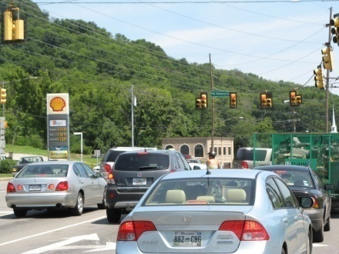
Travel Demand Forecasting
The objective of travel demand forecasting is to predict changes in travel behavior and transportation conditions as a result of proposed transportation projects, policies, and future changes in socioeconomic and land use patterns.
Notes:
Some background on non-motorized estimating…
Agg = available data, sacrifice some accuracy (turn camera)
Disagg = costly to assemble data, difficult to use, usually better accuracy
We are an agg procedure

Slide 8
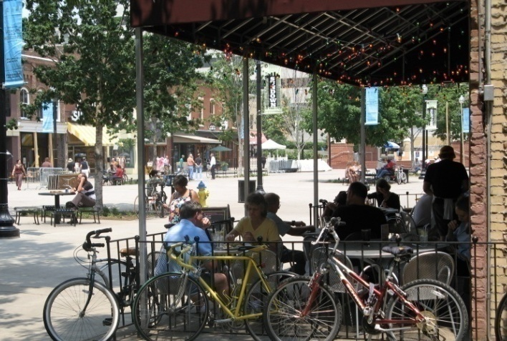
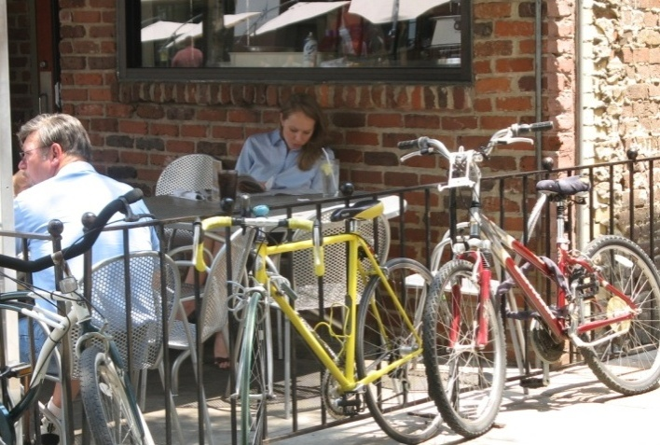
Modeling Travel Behavior
Aggregate Methods – look at travel from an areawide perspective. They attempt to relate characteristics of an area (e.g., population, employment, etc.) to travel characteristics of that area (e.g., average number of trips per household).
Disaggregate Methods – look at travel decisions from the perspective of the individual. The individual's personal characteristics (e.g., age, gender, etc.) interact with the travel options available to them (e.g., time, cost, etc.).
Notes:
Some background on non-motorized estimating…
Agg = available data, sacrifice some accuracy (turn camera)
Disagg = costly to assemble data, difficult to use, usually better accuracy
We are an agg procedure

Slide 9
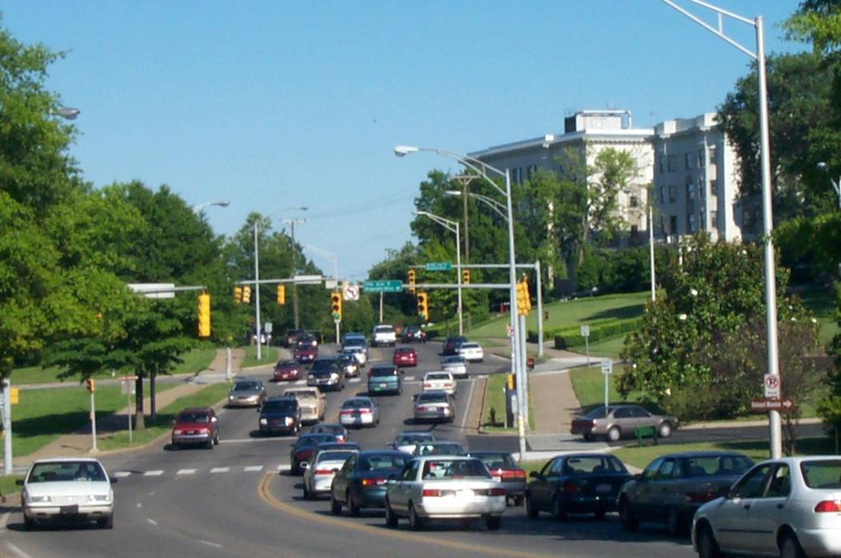
Traditional Four-Step Modeling Process
Trip Generation
- How many trips will be made
Trip Distribution
- Where are trips coming from and going to
Mode Choice
- What mode will be used
Trip Assignment
- What route will be chosen
Notes:
Traditional Four-Step Modeling Process
The four-step urban transportation modeling system (UTMS), first developed in the 1950s to forecast automobile travel and now applied in urban areas throughout the world is an example of such a framework. To predict how travel patterns will change as a result of future changes in land use patterns and the transportation system, this framework integrates models of various aspects of travel behavior (e.g., trip-making or mode choice) with spatial information on land use patterns and the transportation network.
The traditional four-step travel demand model includes trip generation, trip distribution, mode choice, and trip assignment. These four stages address the corresponding questions: how many trips will be made (generation), where are trips coming from and going to (distribution), what mode will they use (mode choice), and what route will they choose (assignment). The UTMS uses traffic analysis zones (TAZs), which typically correspond to census boundaries (e.g. block, block group, or tract) and a network of transportation facilities (e.g. roadways, transit routes) connecting the zones.
While the traditional four-step travel demand model is the most universally accepted modeling process used throughout the world very few urban areas actually use or have the capabilities to forecast non-motorized demand using these models. This is largely because factors that could influence the decision to walk or bike are not usually included in the traditional four-step model process. Standard travel demand modeling procedures generally predict total trip-making and mode choice based on a limited number of variables, such as household characteristics and the time and cost of competing modes. However, these factors only partially explain the decision to walk or bicycle.

Slide 10
Traditional Four-Step Modeling Process
Transportation Network
(Major Roads, Etc.)
Links
(Road or Facility Segment)
Traffic Analysis Zones (TAZs)
(Population & Employment)
Notes:
Traditional Four-Step Modeling Process
The UTMS uses traffic analysis zones (TAZs), which typically correspond to census boundaries (e.g. block, block group, or tract) and a network of transportation facilities (e.g. roadways, transit routes) connecting the zones.
While the traditional four-step travel demand model is the most universally accepted modeling process used throughout the world very few urban areas actually use or have the capabilities to forecast non-motorized demand using these models. This is largely because factors that could influence the decision to walk or bike are not usually included in the traditional four-step model process. Standard travel demand modeling procedures generally predict total trip-making and mode choice based on a limited number of variables, such as household characteristics and the time and cost of competing modes. However, these factors only partially explain the decision to walk or bicycle.

Slide 11
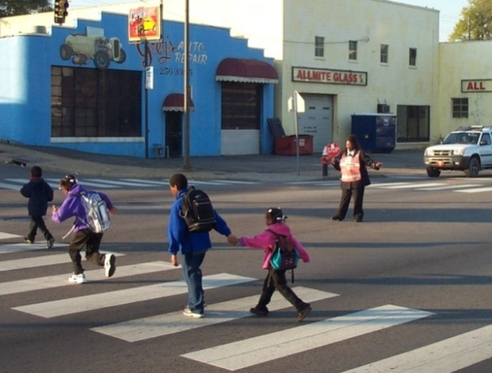
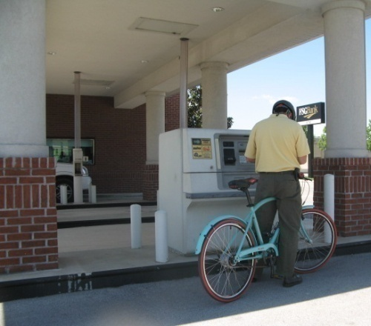
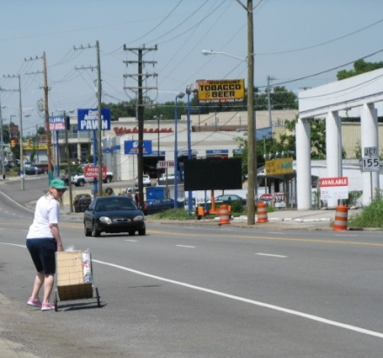
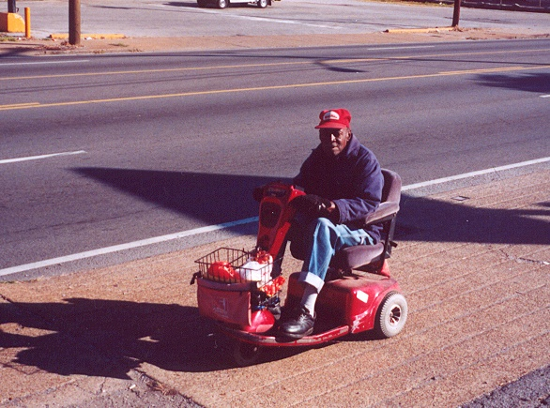
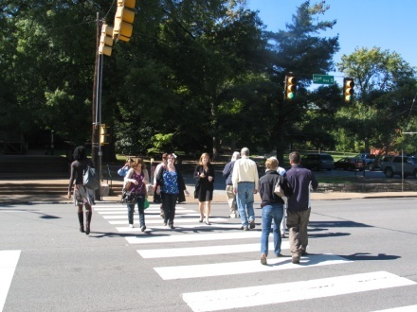
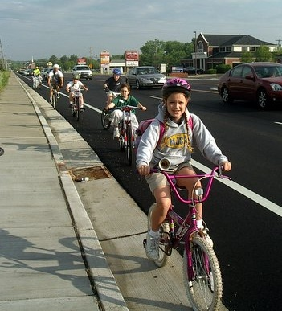
Forecasting Non-Motorized Demand
Notes:
Pedestrian trips are generally shorter than bicycle trips.
A large percentage of pedestrian trips are actually trips to access other modes
The decision to ride a bicycle involves a greater conceptual leap than the decision to walk
Since most bicyclists are comfortable riding less than 3 miles and most pedestrians are comfortable walking less than 0.25 miles, it is more beneficial to perform the analysis on a smaller scale. Where TAZs are any larger than approximately 0.25 square miles (160 acres), the accuracy of these walking and biking trips becomes severely compromised.

Slide 12
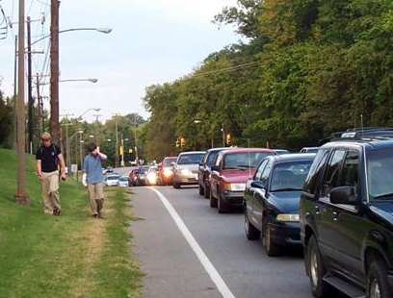
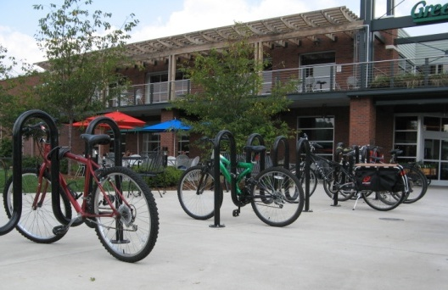
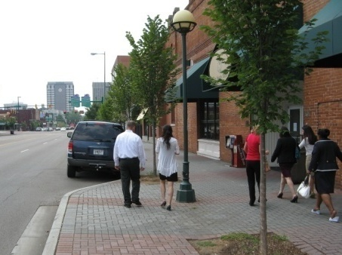
Factors Influencing Non-Motorized Travel
Perceptions & Attitudes – Safety, Convenience, Time
Socioeconomic & Demographic Characteristics – Age, Sex, Race, Income
Trip Characteristics – Trip Distance, Presence and Quality of Facilities
Environment – Land Use and Land Use Pattern, Topography

Slide 13
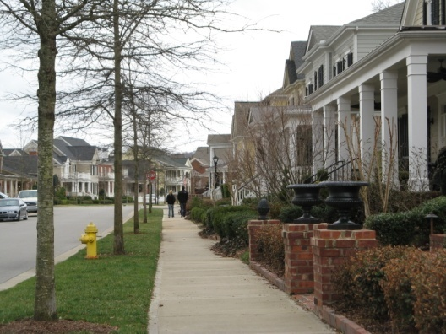
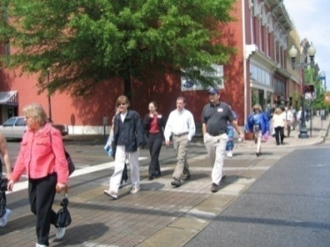
Factors Influencing Non-Motorized Travel
Perceptions & Attitudes – Safety, Convenience, Time
Socioeconomic & Demographic Characteristics – Age, Sex, Race, Income
Trip Characteristics – Trip Distance, Presence and Quality of Facilities
Environment – Land Use and Land Use Pattern, Topography
DISTANCE IS KEY

Slide 14
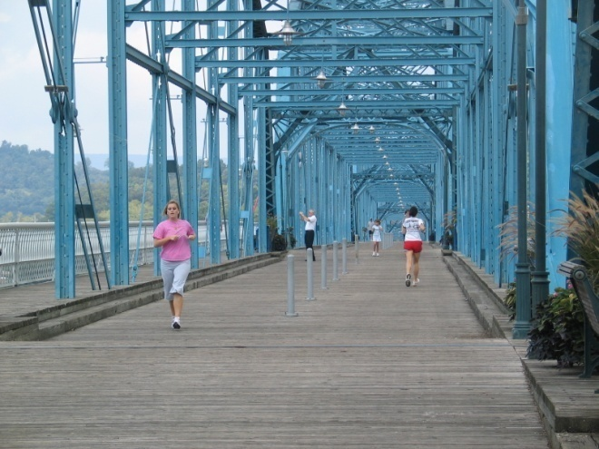
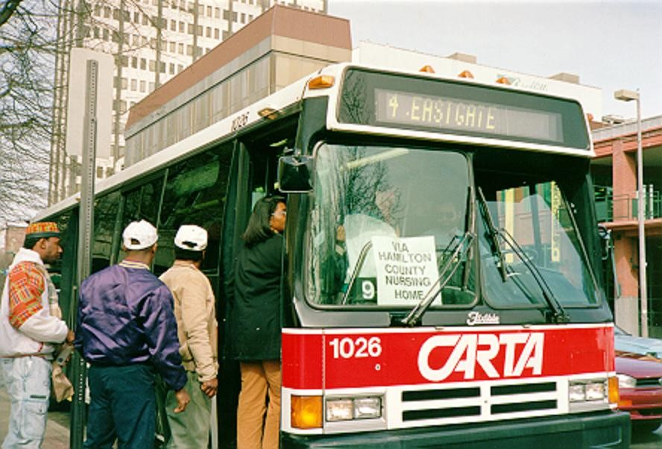
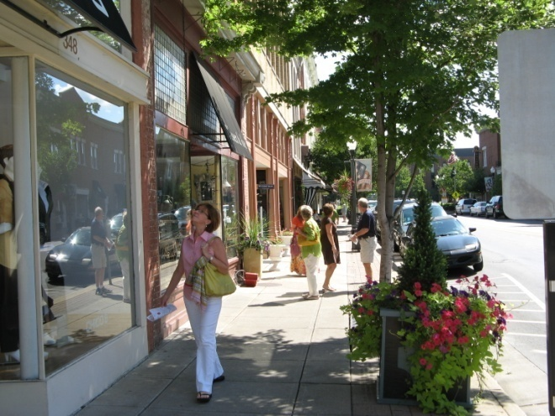
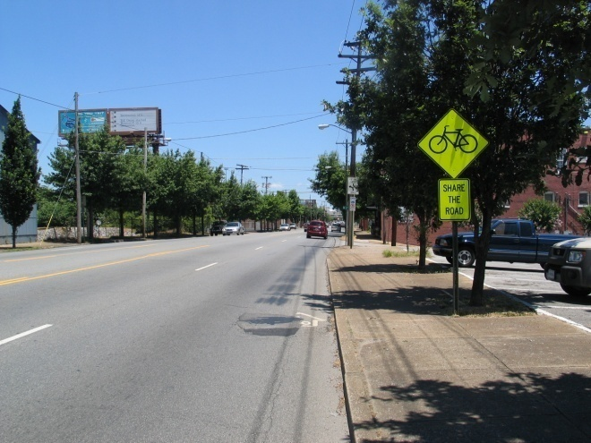
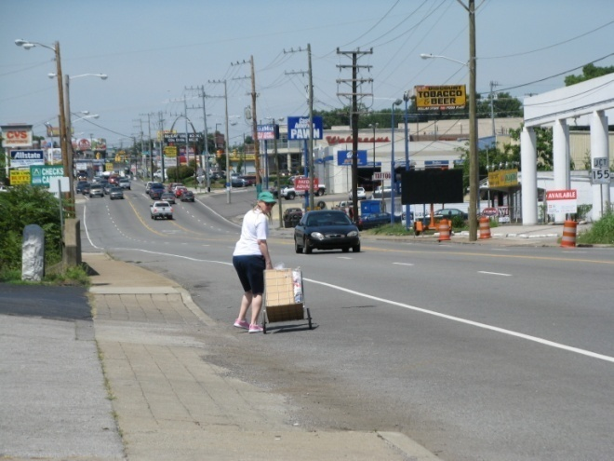
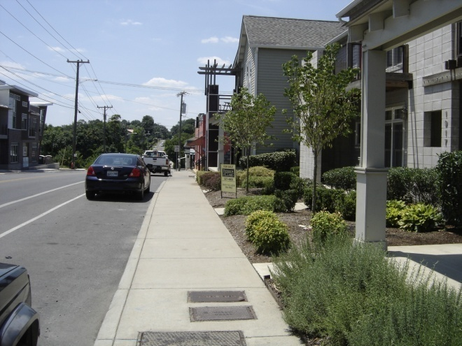
Parcel-Based Approach

Slide 15
Types of Travel Estimating Techniques
Comparison Studies
Aggregate Behavior Studies
Sketch Plan Methods
Discrete Choice Model
Regional Travel Model
Notes:
1999 FHWA guide id’s 11 quantitative methods to forecast.

Slide 16
Parcel-Based Approach
Comparison Studies
Aggregate Behavior Studies
Sketch Plan Methods
Discrete Choice Model
Regional Travel Model
Notes:
1999 FHWA guide id’s 11 quantitative methods to forecast.

Slide 17
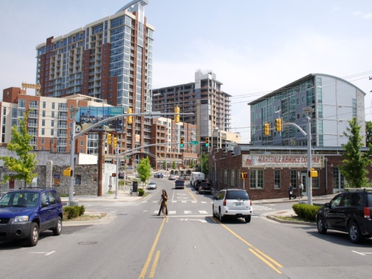
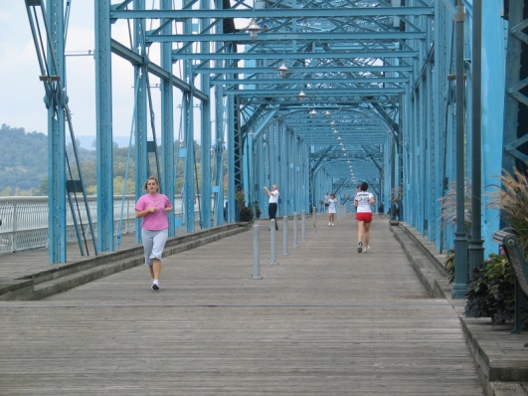
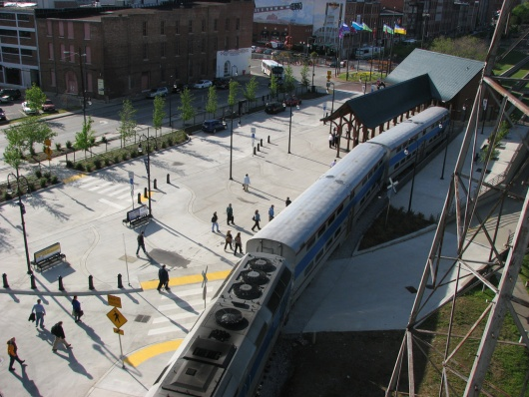
Major Aspects of the Non-Motorized Demand Procedure
Parcel basis
Determines daily, one-way trips
Assumes ideal facilities and connectivity
Specifies multiple trip types
Origin (generator) driven
No real assignment after generation
Adaptable to changing land uses
Adaptable to emerging and/or local data
Can be run on existing data
Walk/bike trip reporting is variable (by parcel, street, neighborhood, etc)

Slide 18
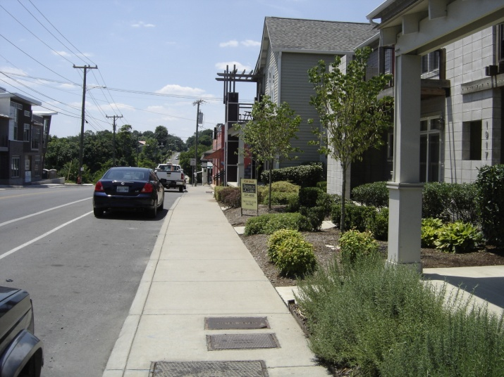
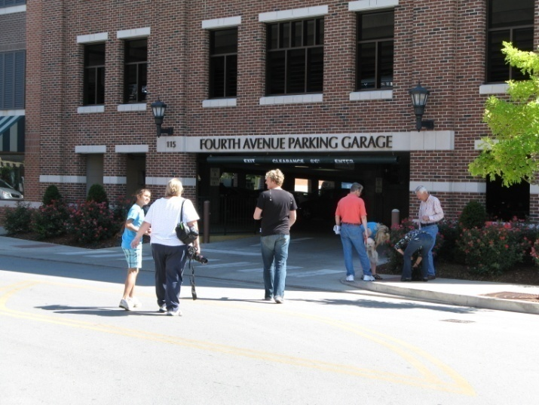
General Non-Motorized Trip Generation Equation
Typical residential trip producing characteristics by trip type (ITE, NHTS, place-specific data)
(#HH in parcel) x (factor series)¹ x
(probability statement)²
Usually 3-5 factors adjusting per-parcel walking/biking trip generation.
Resulting probability-from-proximity from impedance curves – based on 2001 NHTS data.
Notes:
Most trip equations looks like this one.

Slide 19
Travel Impedance Curves
Travel to School
Relationships predicting probability of trip-by-mode given proximity between land uses (based on 2001 NHTS data)
Travel to Shop
Travel to Recreation
Travel to Work
Travel to Errand

Slide 20
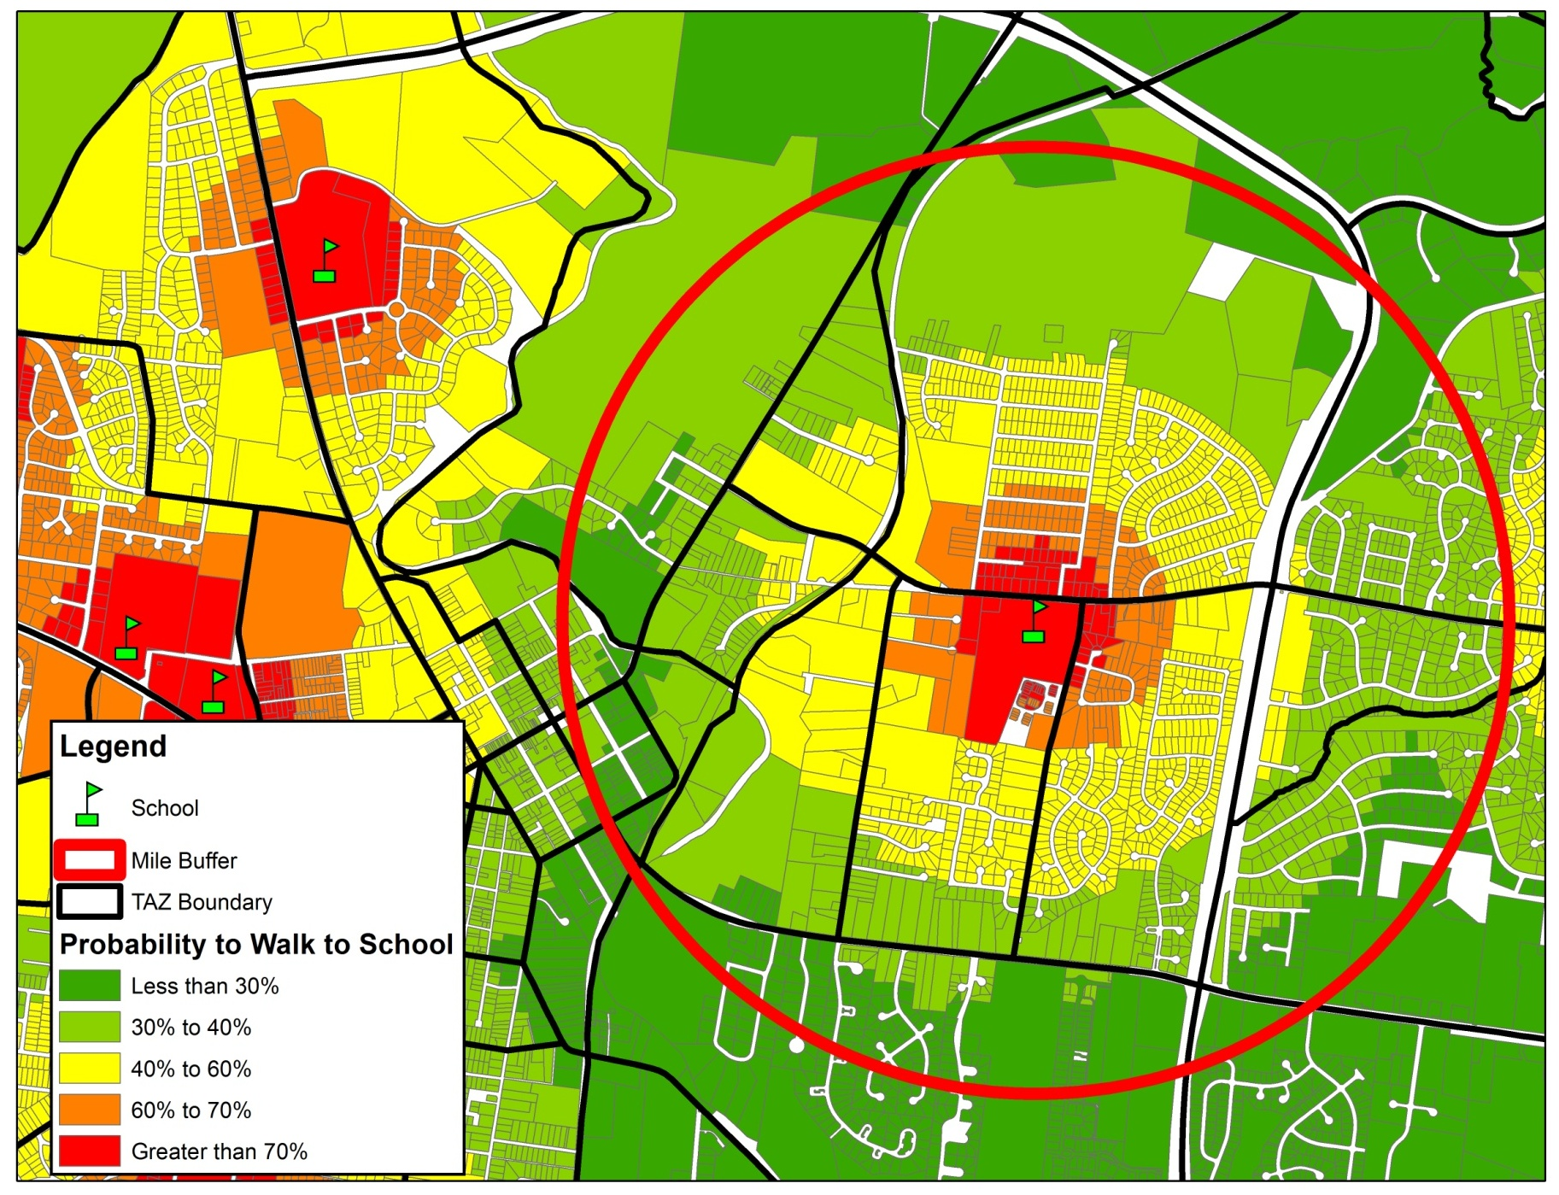
Probability – Walk to School

Slide 21
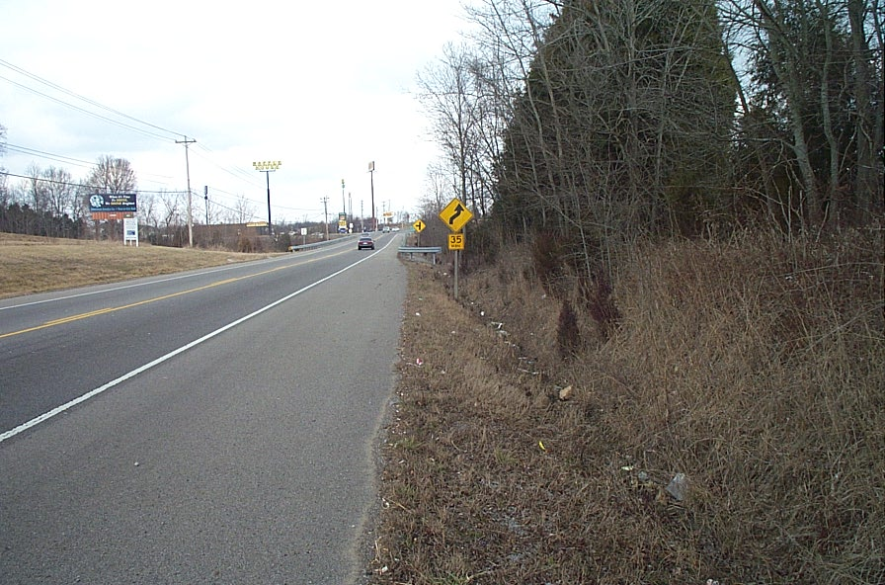
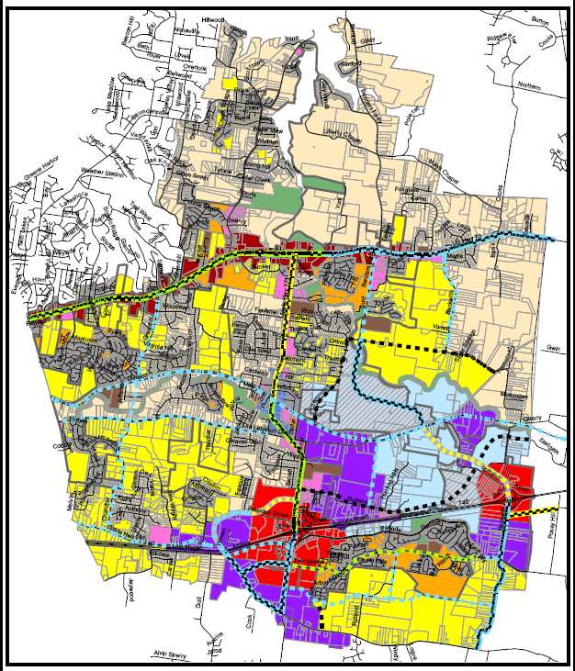
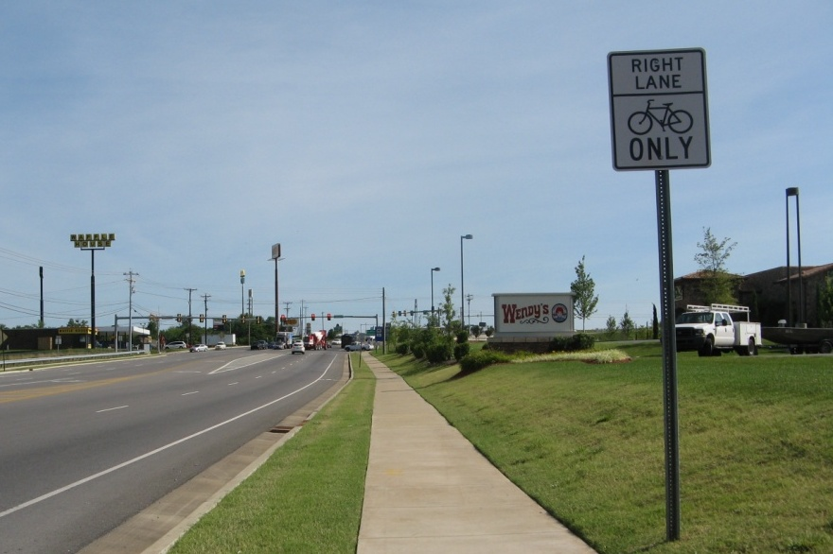
Parcel Driven
Linked to Parcel Land Use Data
Existing
Land Use
Future
Land Use

Slide 22
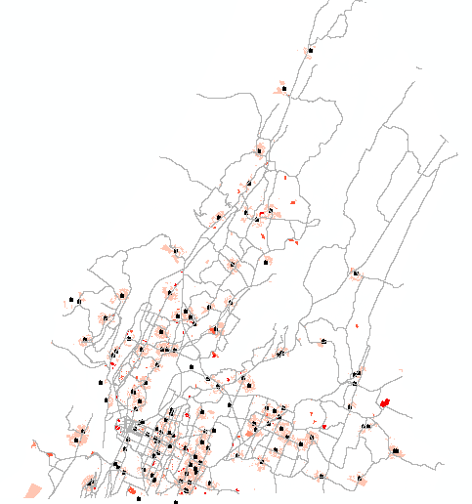
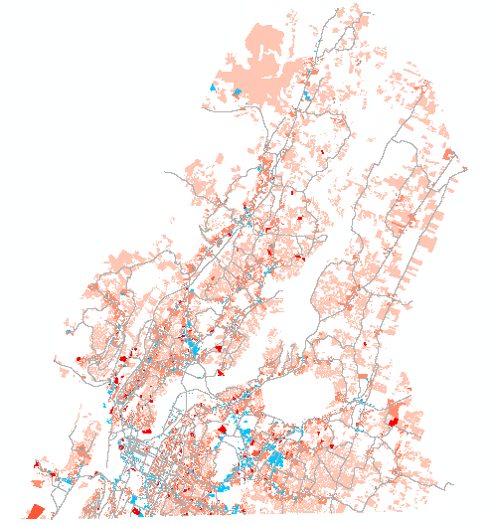
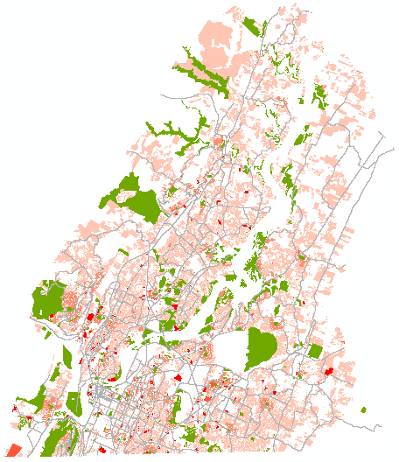
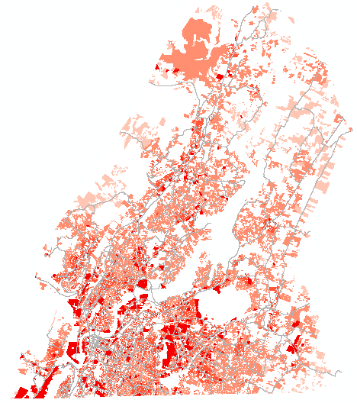
Trip Types Analyzed in Non-Motorized Demand Procedure
Walk/Bike to
School
Walk/Bike to Shop
Walk Trips
Bike Trips
To School
To Work
To Recreation
To Shop
To Errand
To Transit
From Transit
From Parking
To School
To Work
To Recreation
To Shop
To Errand
Walk/Bike to Recreation
All Walk/Bike Trips
Notes:
Data Required for 8 Walking Trip Types Data Required for 5 Bicycle Trip Types
No. of households per parcel No. of households per parcel
No. of employees per parcel No. of employees per parcel
No. of employees within 1.5 miles of parcel No. of employees within 3 miles of parcel
No. of parking spaces (major lots or garages) Distance to the nearest recreational space
Distance to the nearest recreational space Distance to the nearest retail area
Distance to the nearest retail area Distance to the nearest school
Distance to the nearest school
Distance to the nearest transit stop

Slide 23
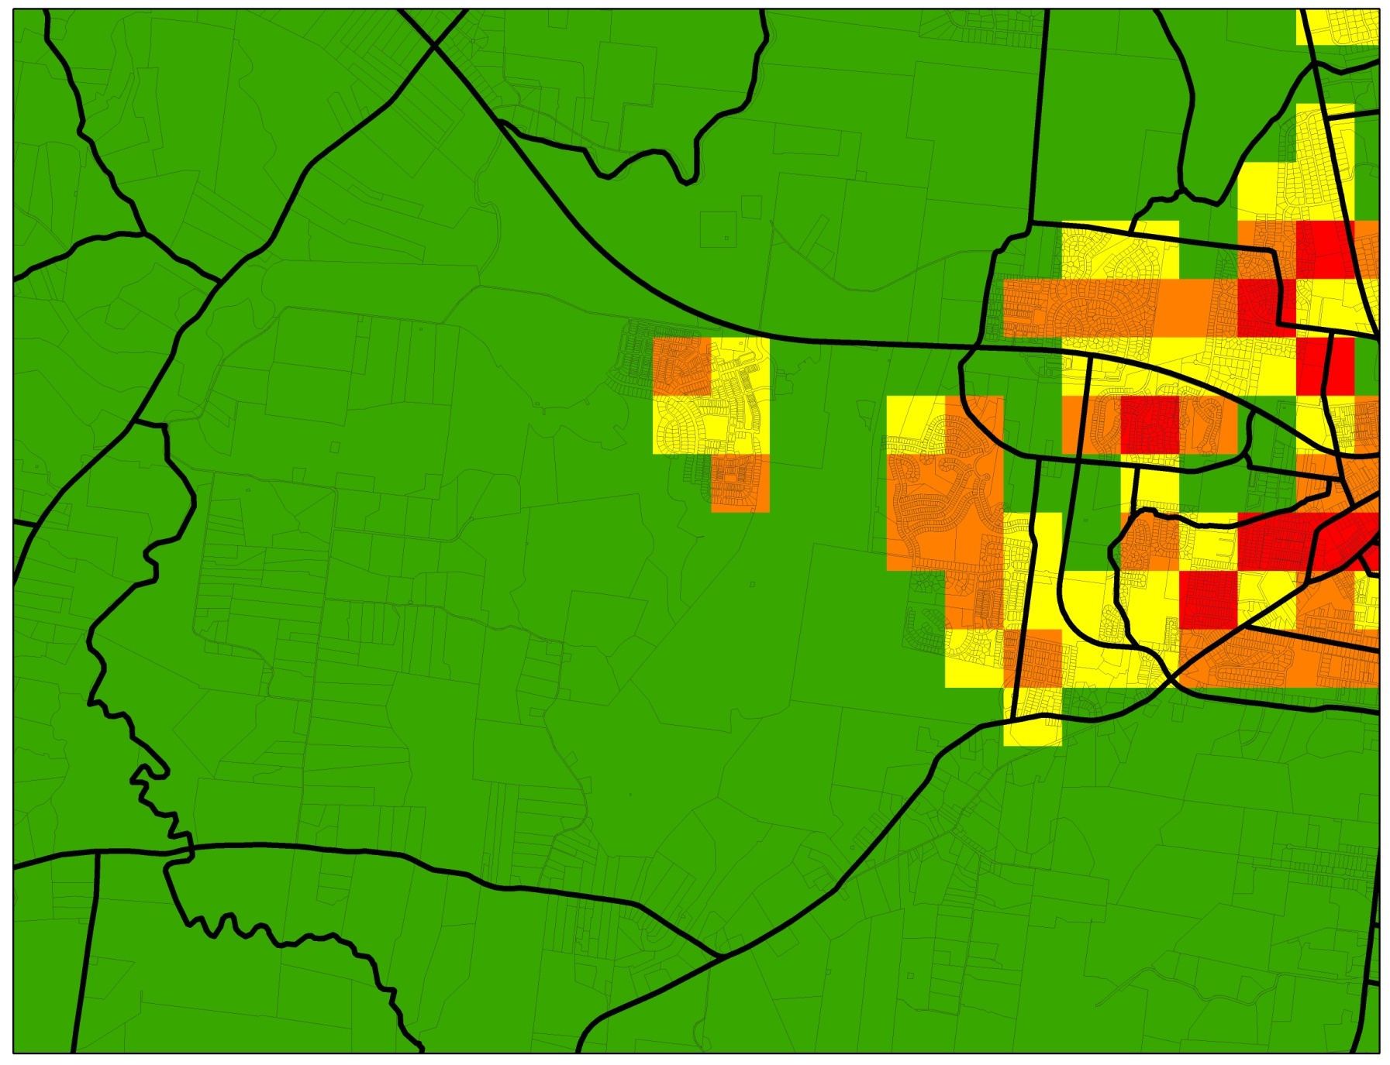
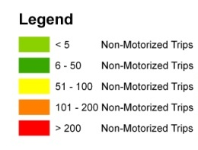
Parcel-Based Versus TAZ
TAZ 9.6 Square Miles
Notes:
Since most bicyclists are comfortable riding less than 3 miles and most pedestrians are comfortable walking less than 0.25 miles, it is more beneficial to perform the analysis on a smaller scale. Where TAZs are any larger than approximately 0.25 square miles (160 acres), the accuracy of these walking and biking trips becomes severely compromised.

Slide 24
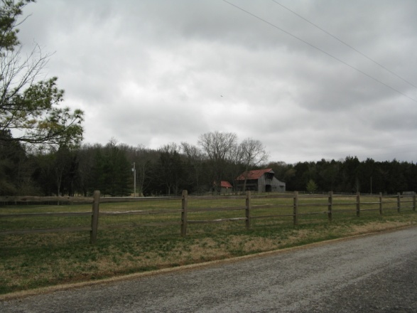
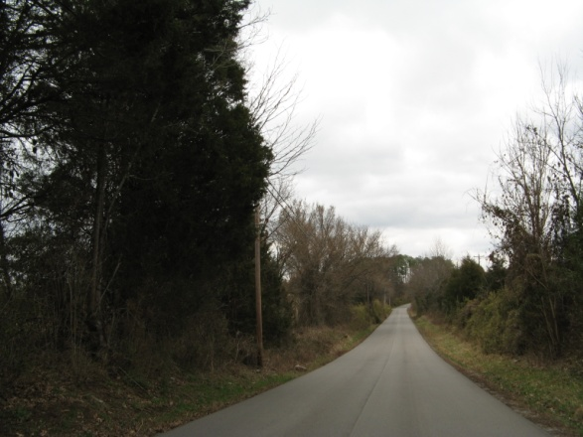
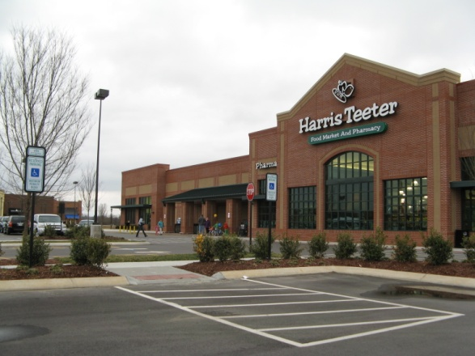
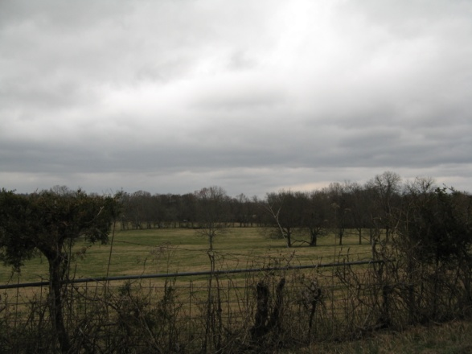
Parcel-Based Versus TAZ

Slide 25
Parcel-Based Versus TAZ
1 Mile

Slide 26
Parcel-Based Versus TAZ
1 Mile
New School Site

Slide 27
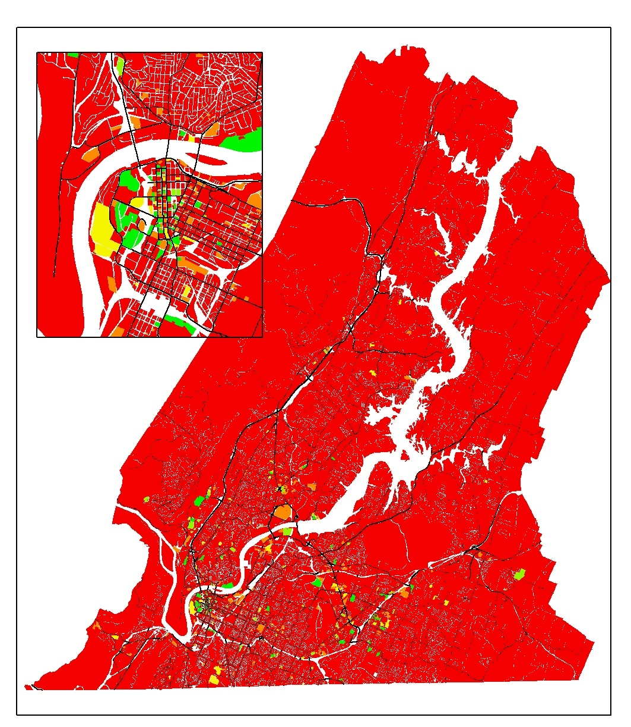
Non-Motorized Trips by Parcel
Useful for:
Large generators
Grouping into areas (neighborhoods)

Slide 28
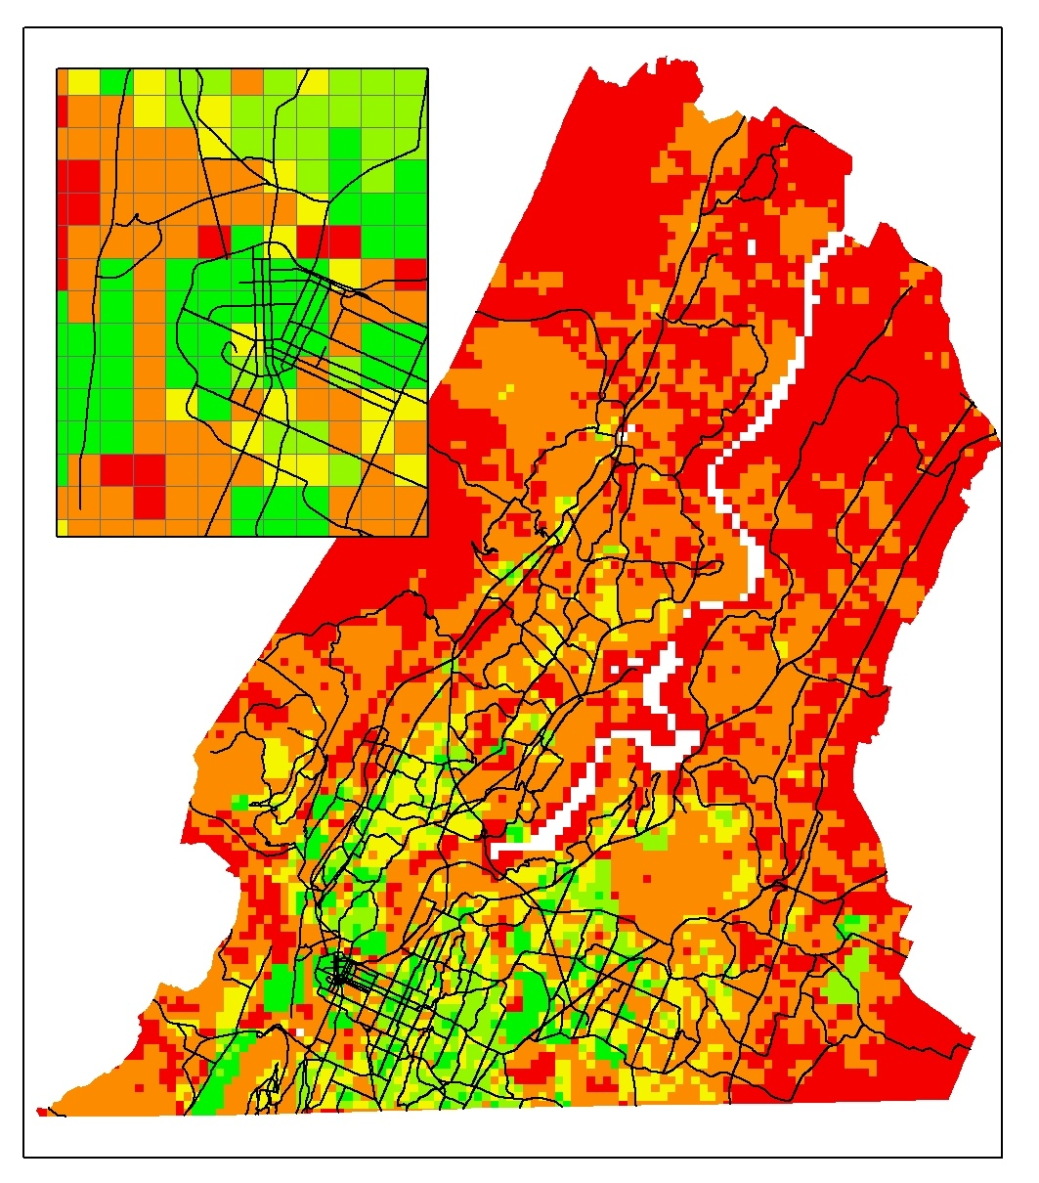
Non-Motorized Trips by Grid
Useful for:
Analyzing large areas
Walk/bike “hotspots”
Identifying priority corridors

Slide 29
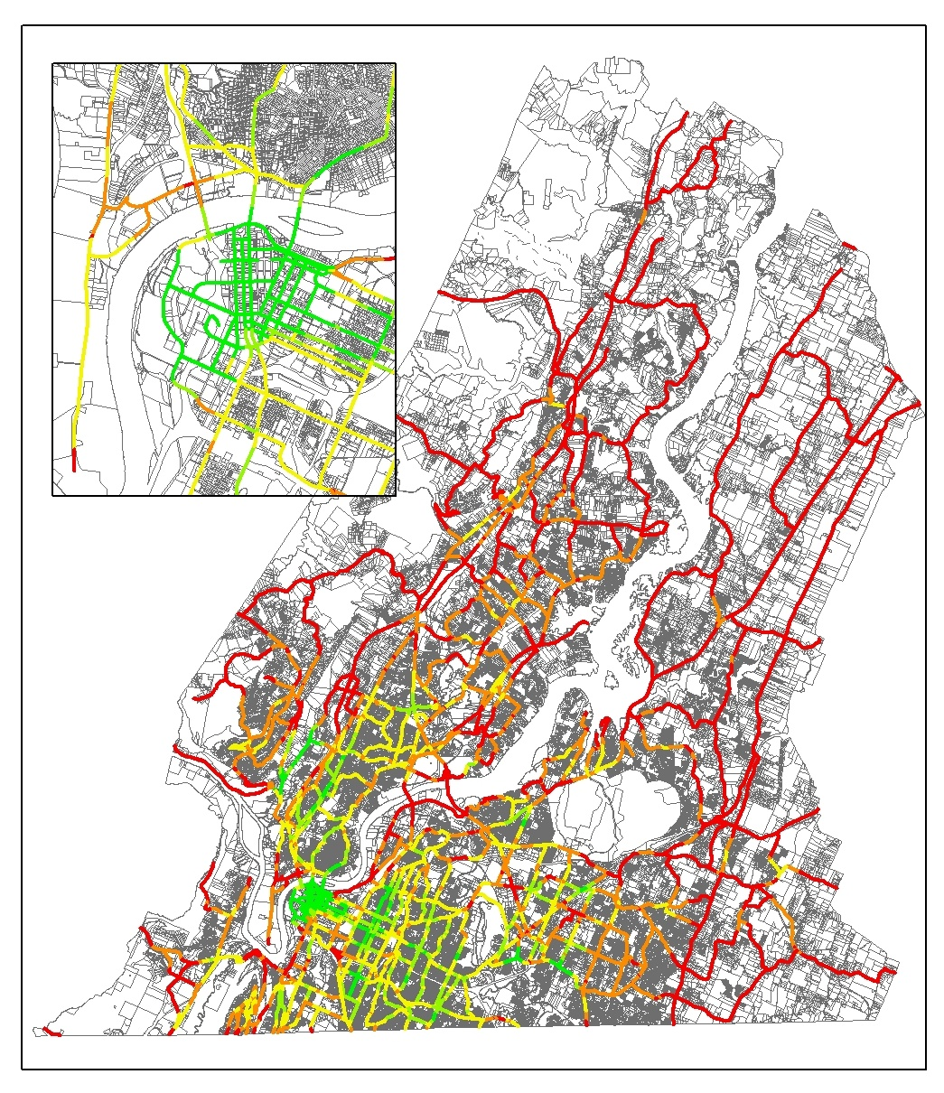
Non-Motorized Trips by Link
Useful for:
Indentifying key segments
“What could be” scenarios
Estimate future usage of bike/ped facilities

Slide 30
Applications of the Model
Bicycle & Pedestrian Plans (Regional & Local)
Project Prioritization Tool
Safe Routes to Schools and School Siting Planning
Land Use Policy & Sustainability Testing
Transit Ridership Estimating

Slide 31
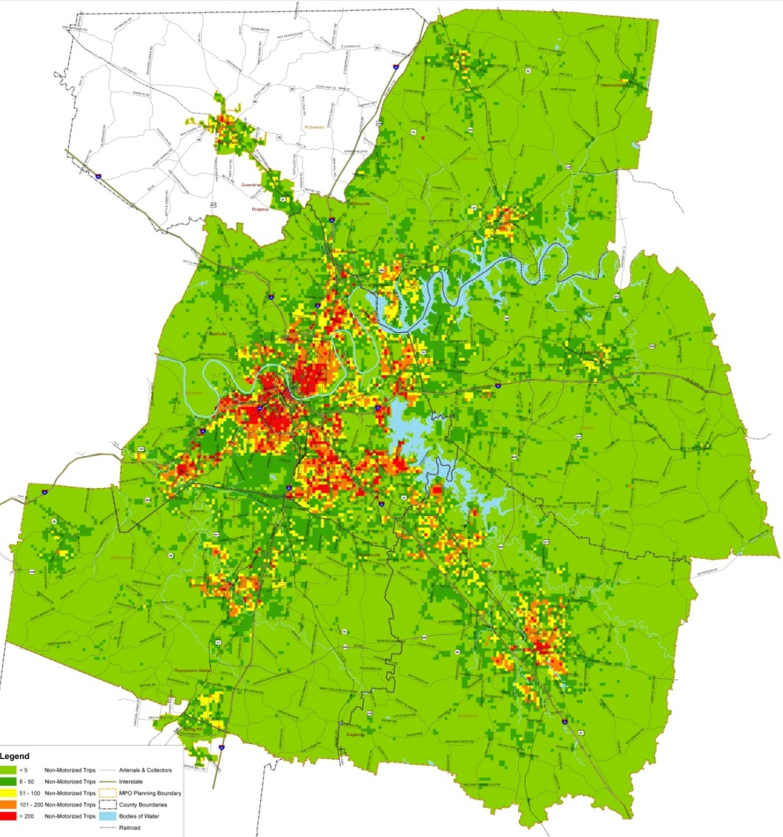
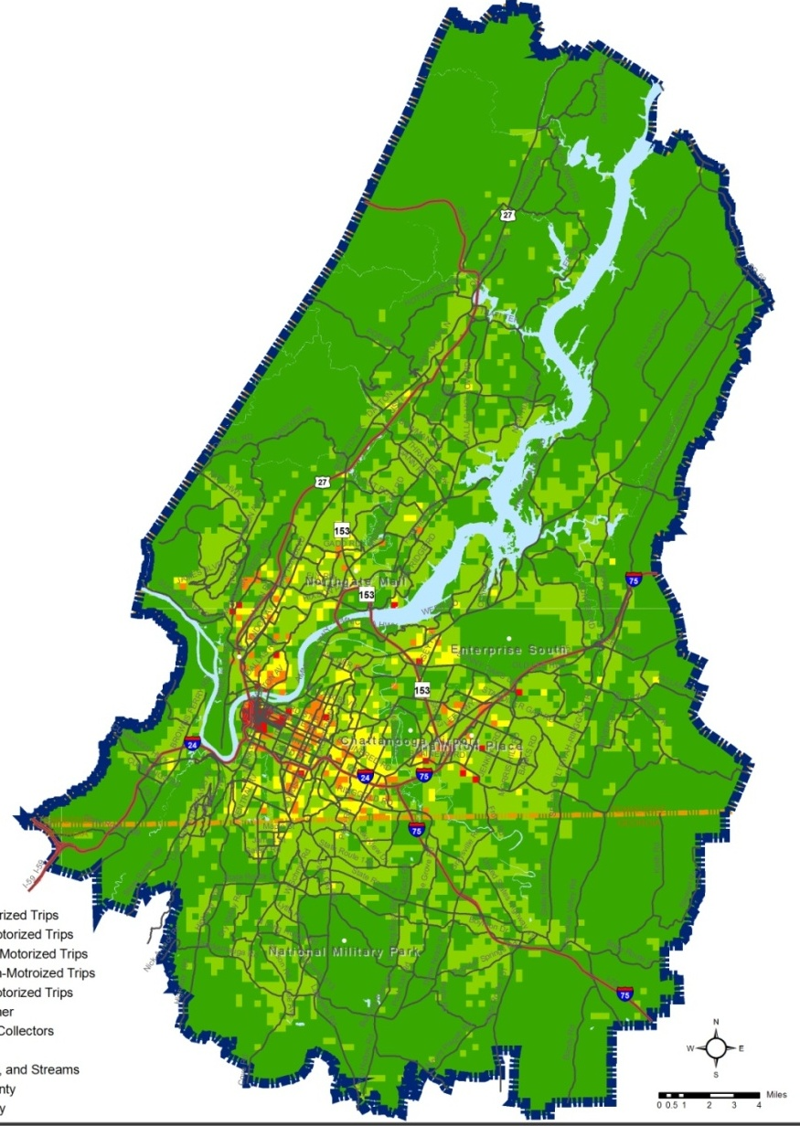
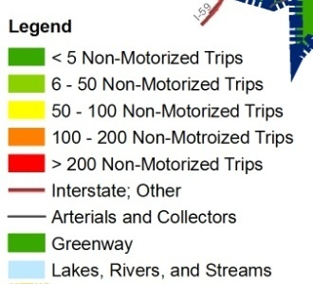
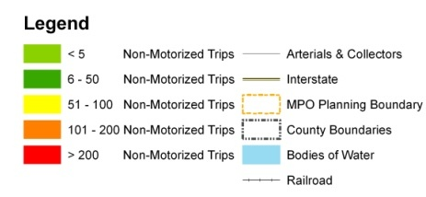
Successfully Applied In Two Large MPOs
Notes:
Nashville Region – 524,000
Chattanooga Region – 190,000
____________
1.6 Sq Miles – Average TAZ Size
26 Sq Miles – Largest TAZ Size
2,100 TAZs

Slide 32
Citywide Level Planning
Demand
Assessment
Pedestrian Recommendations
Notes:
Goodlettsville

Slide 33
Project Prioritization
Nashville MPO’s Criteria
Bicycle & Pedestrian Level of Service (BLOS/PLOS)
Non-Motorized Demand
Connectivity
Safety
Congestion Mitigation
Community Goals
Health Impact
Segments Under Evaluation
for Bikeway Needs
Park
Park
Existing Sidewalks
Existing Bike Lanes
Avenue C
Avenue D
Existing Sidewalks
Avenue A
Avenue B
High Health Impact Area
All 3 Categories
Existing Bike Lanes
Segments Under Evaluation
for Pedestrian Needs
School
Major Residential

Slide 34
Safe Routes to School Planning & School Siting

Slide 35
Land Use Policy Testing – Pedestrian Scale
Land Use Assessments
Impact of Mixed Use Development
Impact of Low Density Development

Slide 36
Transit Planning
Probability to Walk to Transit
Notes:
Nashville TN – MTA Transit Routes

Slide 37
In Summary
A fine-grained parcel-based analysis of non-motorized demand is possible
The Non-Motorized Model approach represents improvements to the traditional modeling practice
Opportunities to better predict non-motorized demand continues to exist & has expanded applications

Slide 38
Session 13B: Positions and Ambitions about Non-Traditional Modes Quantifying Non-Motorized Demand – A New Way of Understanding Walking and Biking Demand
Preston Elliott, AICP
RPM Transportation Consultants, LLC
Prestonelliott@rpmtraffic.net
www.rpmtraffic.net

