Slide 1
Generating Household and Employment XY Points in Disaggregate Models
TRB Planning Applications Conference
Tuesday, May 10, 2011
Erik Sabina
Suzanne Childress
Robert Spotts
Denver Regional Council of Governments

Slide 2
Denver Regional Council of Governments (DRCOG)
9+ County Area
2010
  Pop 2.9m
  Emp 1.6m
2035
  Pop 4.5m
  Emp 2.6m
Planning Goals
  Urban Centers
  Urban Growth Boundary
  New, regional light rail
  TODs

Slide 3
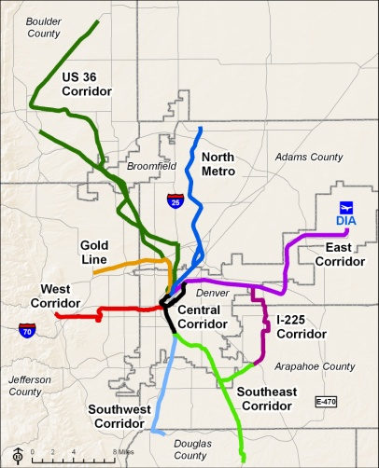
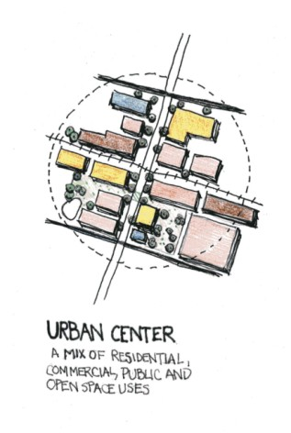
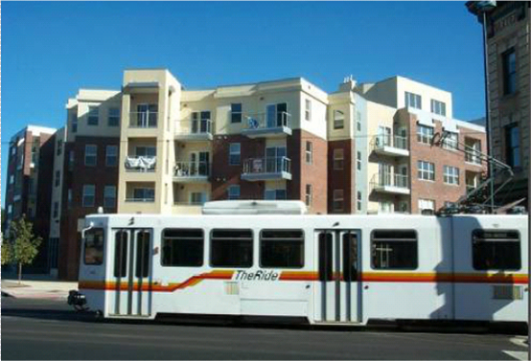
Focus Model
State-of-the-art travel model
  Disaggregate, activity-based
  Better, smaller scale analysis- particularly of alternative travel modes
  Tours instead of trips
Transit Oriented Development (TOD)
Urban Centers

Slide 4
DRCOG Traffic Analysis Zones (TAZs)
Notes:
These are the TAZs, they act kind of like census tracts. The old way of doing it.

Slide 5
Notes:
Zoomed in on some TAZ with centroids, how they used to be represented. But we know what’s really there is… (click)

Slide 7
Notes:
Points represent HH better.

Slide 8
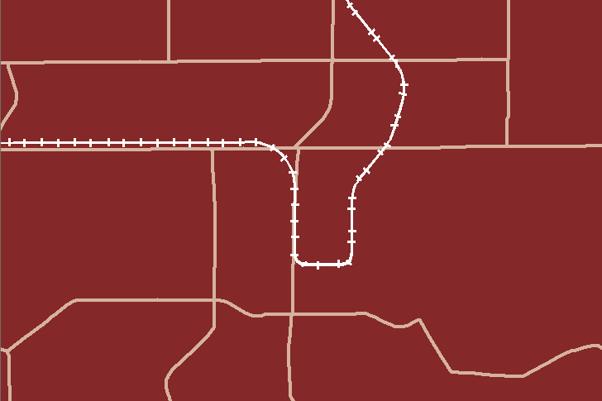
Challenges of modeling walk and transit trips: TAZs

Slide 9
Challenges of modeling walk and transit trips: TAZs

Slide 10
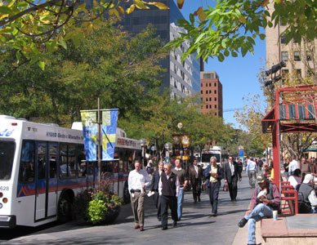
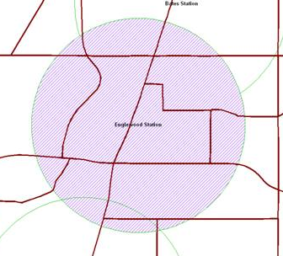
Why we need points
No advanced land use model (yet)
Density Variables
Mixed-Use Variables
Bike/Ped Trips
Transit Access
Custom Geographic Analysis
  Useful in recent TIP
Fully Disaggregate Data

Slide 11
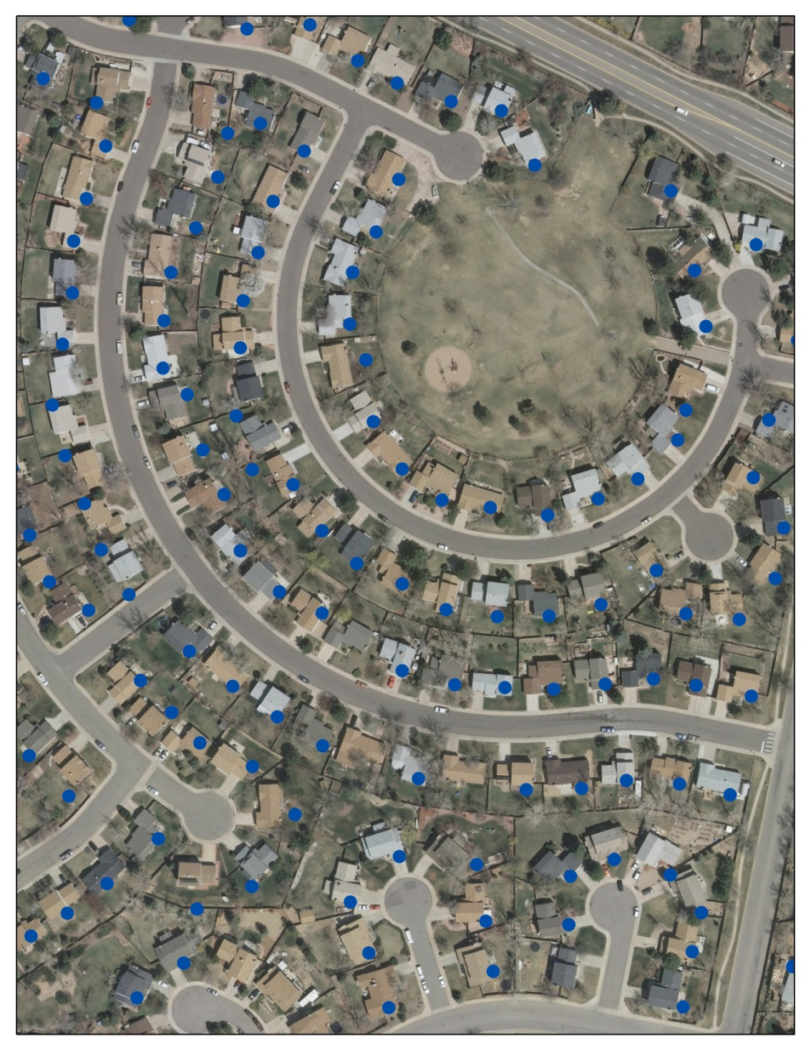
Existing Points
Households represent utility meter points from Xcel Energy
Jobs geocoded from Quarterly Census of Employment and Wages (QCEW)
Notes:
We have point data for the base year collected from these sources, but we don’t have it for forecast years.

Slide 12
How to Forecast Point Location?
DRCOG Staff developed a process to generate a defined number of random points at the parcel-level.
Parcels subdivide our TAZ boundaries and are consistent with future development trends in terms of ownership and zoning regulations.
The process:
  Define density
  Define household growth
  Locate parcels in TAZs and existing households
  Eliminate undevelopable land uses.
  Assign development utilities
  Randomly generate household points

Slide 13
Future Land Use Data
Parcel-based
Gathered from 56 DRCOG jurisdictions using their future land use plans
Reclassified into standardized, regional categories
Notes:
Very fortunate to have this data, complied by DRCOG staff

Slide 14
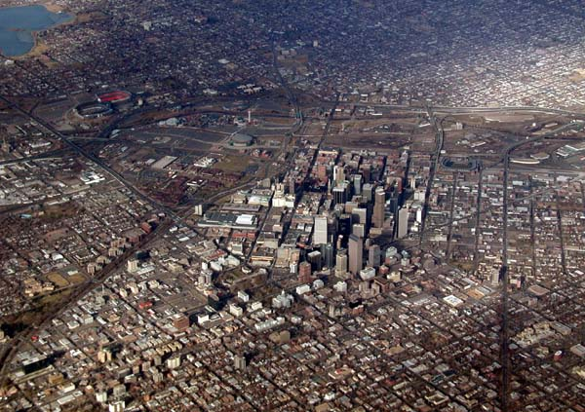
Parcel Household Densities
Future Land Use | Density (Units/Acre)
Very high density | 50
High density | 35
Medium density | 10
Residential Mixed Use | 8
PUD residential | 8
General Mixed Use | 8
Commercial Mixed Use | 8
General Mixed Use PUD | 8
Low Density Residential | 4
Semi-Urban Residential | 0.25
Semi-rural | 0.067
Rural | 0.025
Civic | 0
General Commercial | 0
Open Space | 0
Agriculture | 0
Low Density Office | 0
Retail Commercial | 0
Schools & Campus | 0
Socioeconomic team identified approximate, average densities by land use type.

Slide 15
Define Household Growth
TAZ-based model
Intersect parcels with TAZs
Find delta between base year and forecast year in households.
Count existing household points in each parcel
Based on density and existing households, find remaining “capacity” in each parcel
Notes:
Intersected so that each parcel- even split- was in a specific TAZ.
Don’t want to add points where the capacity is already met with existing households.

Slide 16

Eliminate Undevelopable Land Uses
Erased out of Future Land Use dataset:
  Slope greater than 30%
  Flood plains
  100 ft buffer from rivers
  Protected open space
  Right of Way
Notes:
We basically created this shapefile of all undevelopable land uses and “erased” it from the parcel layer so no points would be generated in those areas.

Slide 17
Utility of a Parcel
Utility is defined by the proximity of nearby amenities
  Consistent with TAZ-based land use model
Measure distance from the centroid of each parcel to various positive land uses
  e.g. Distance to light rail station
High utility automatically given for parcels in Urban Centers and Urban Growth Boundary
Distance = 0.54 miles
Notes:
Stress the urban center and UGB variables. We used PostGIS because this was so data intensive, millions of parcels and millions of points.

Slide 18
Reclassify Utility of a Parcel
Amenities scored 0-10 based on distance:
  Parks and Open Space
  Major Roads
  Civic Land Uses (designated by Future Land Use Parcel Data)
  Entertainment, Retail and Restaurant Jobs
  Light Rail Stations (New and Future)
  K-8 Schools
Sight Distance
Walk
Distance
Bike Distance
No Effect
Notes:
Click through animation to add why the distances mattered

Slide 19
Random Point Generation
Only 6 of 12 because TAZ capacity met
Randomly generate points in each parcel
  Starting with highest utility parcel descending
  Fill each parcel to capacity until total TAZ growth is met
Capacity
Utility
General
Commercial
1.5 Acres*0 DUPA = 0 Capacity
Mid-Density Residential
1.5 Acres*10 DUPA =
15 Capacity – 2 Exist
= 13 possible
13
0
63
Existing HH
94
Highest utility parcel with capacity
TAZ Boundary
0
0
0
1
0
10
Parcels
89
62
Example:
  Existing HH= 10
  Total TAZ HH 2035 = 35 HH
  TAZ Growth = 25 HH
83
80
79
78
18
83
Notes:
Animation to click through. Make sure to set up the scene before clicking the next animation.

Slide 20
Jobs
 | FAR | SF/Emp
Residential
Mixed-Use Residential | 0.6 | 675
Commercial
Mixed-Use Commercial | 1 | 675
Retail | 0.75 | 1246
PUD
Commercial | 1 | 434
General | 0.6 | 434
Mixed Use
Commercial | 1 | 675
Office
Low Density Office | 1 | 434
High Density Office | 3 | 434
Industrial
Extraction/Disposal Utilities | 0.4 | 2306
Light Industrial | 0.5 | 2306
Heavey Industrial | 0.6 | 2306
Institutional
Utilities | 0.5 | 2306
Schools & Campus | 0.4 | 791
Civic | 1 | 434
Other
Airport Influence | 0.5 | 2306
Essentially the same process
Use FAR and SF/Emp instead of DUPA
Requires 6 job types
  Retail
  Restaurant
  Entertainment
  Service
  Production
Different utilities for each job type

Slide 21
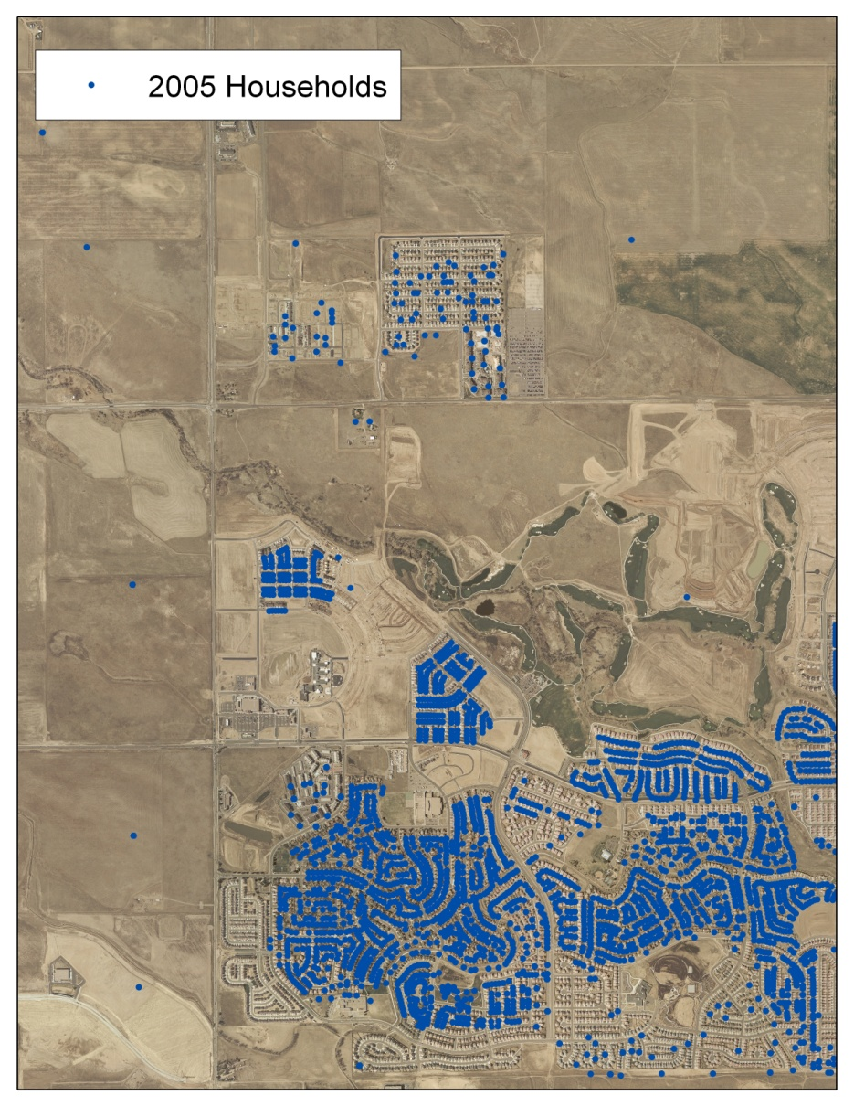
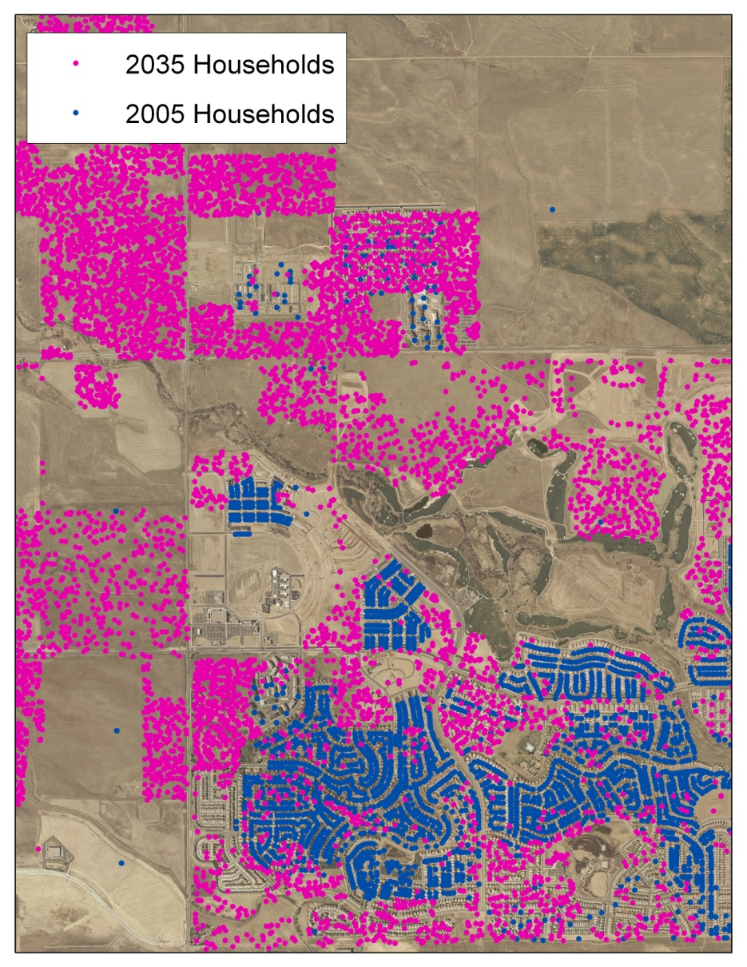
The Good
Passes the “Laugh-test”
Significant improvement over TAZ-level forecasting
Customizable process
Can manually change density or utility for “known” developments
Easy to understand

Slide 22
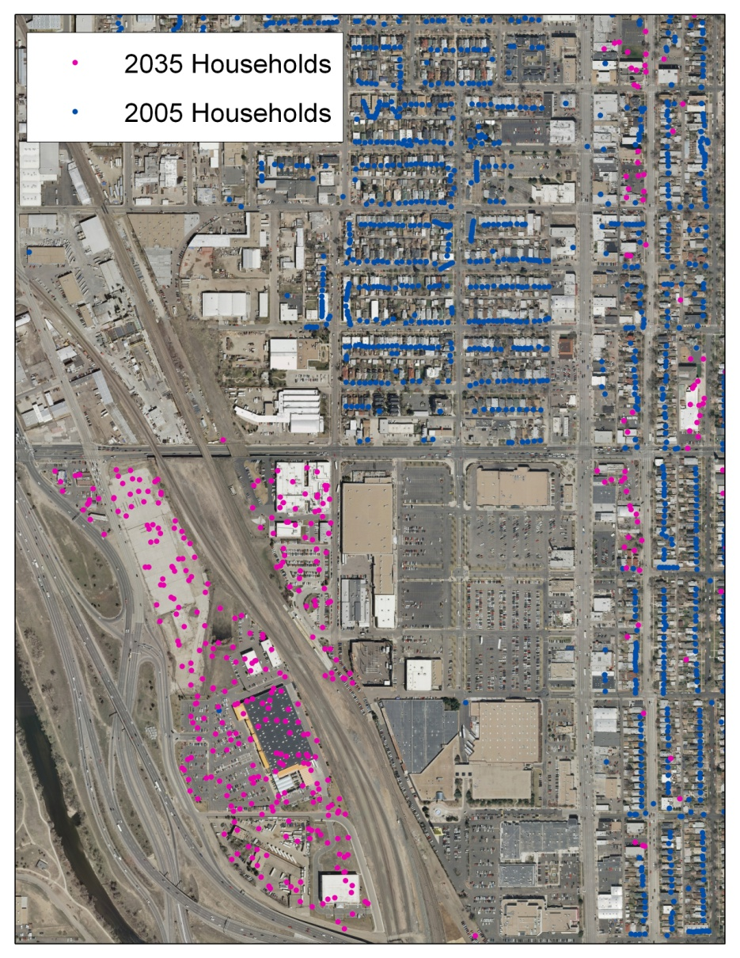
The Bad
Very basic
Utilities untested
No cost signals
Incorrect existing point data
Occasionally strange results
Compatibility between TAZ model, future land use, existing point data, and density estimates
Labor/data intensive

Slide 23
Schools
Simple, raster model
Combined two rasters for each county
  Reclassified raster with score 3-30 of TAZ growth
  Reclassified raster with score 1-10 of distance to existing school
County-wide cohort data from the state demographer
  Find the current ratio of student-age/schools and assume that ratio will be the same in the future.
    E.g. 1,000 high school aged students per high school in base year
  Determine the number of new schools that will be built within a given county, based on growth within that age cohort.
Randomly generate new school points, weighted by combined raster, in each county

