Slide 1
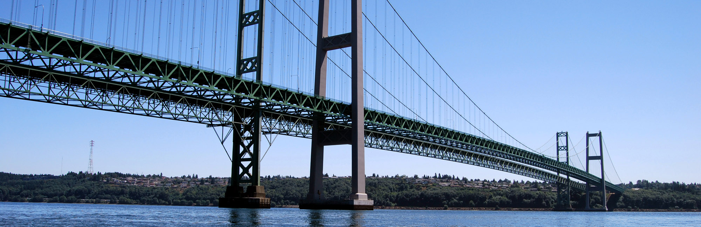

Transportation 2040
Building a Better Plan:
The Costs and Benefits of Transportation Alternatives
The 13th TRB National Transportation Planning Applications Conference
May 8-12, 2001
Reno, NV

Slide 2
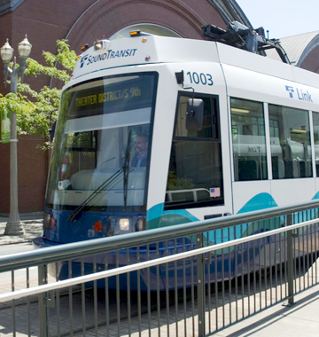
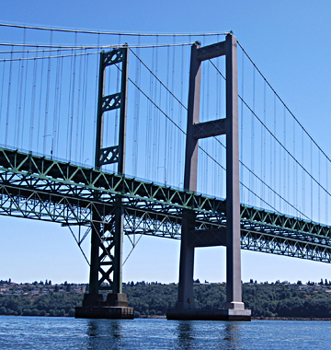
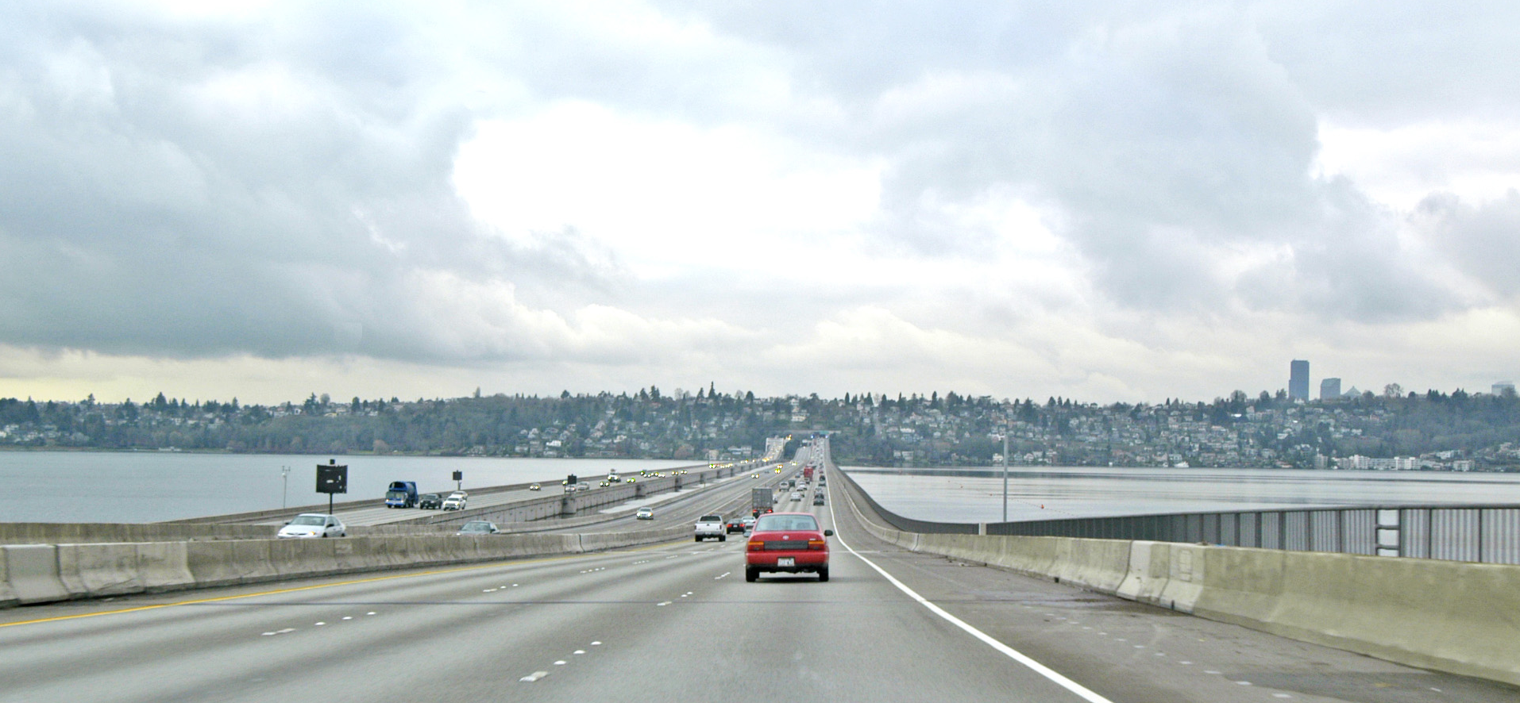
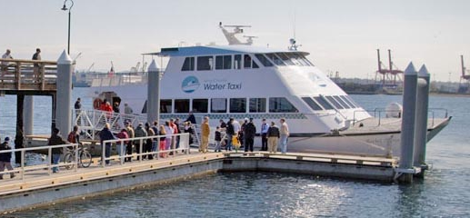

2
Presentation Overview
Background
Analysis Methods
Portfolio Optimization
Treatment of Tolls
Conclusions
Notes:
Today I will give a quick:
history of the how the region has begun to link land use and transportation planning,
how that was applied to the development of Transportation 2040 the regions long range transportation plan and
what we are working on now.

Slide 3
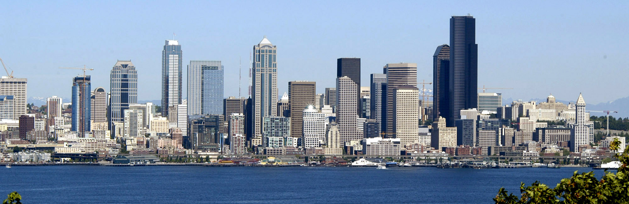
Background
Notes:
Introduction:
This could easily be a 1 hr. and half presentation:
Not enough time
Quickly walk through the slides to give you a high level look at the process and issues that have been addressed in the PSRC’s growth and transportation programs.

Slide 4
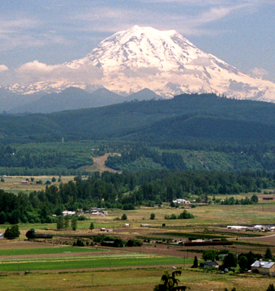

Puget Sound Regional Council
Puget Sound Regional Council (PSRC)
  Federal (MPO), & State (RTPO) designated planning organization
  Regional Growth, Economic
  and Transportation Planning
  Federal transportation
  funds to priority projects
  Regional data and forecasts
Our Members
  Cities, Counties, Ports and Transit
      4 counties
      82 municipalities
  State Agencies and Tribal Governments
Notes:
4
How many of you are familiar with the work of the Puget Sound Regional Council? (if not many ad lib extra about the agency)
The Puget Sound Regional Council works with local government, business and citizens to build a common vision for the region’s future, expressed through three connected major activities:
VISION 2040, the region’s growth strategy;
Transportation 2040, the region’s comprehensive long-range transportation plan; and
Prosperity Partnership, which develops and advances the region’s economic strategy.
We do all of this under authority embodied in state and federal laws.

Slide 5
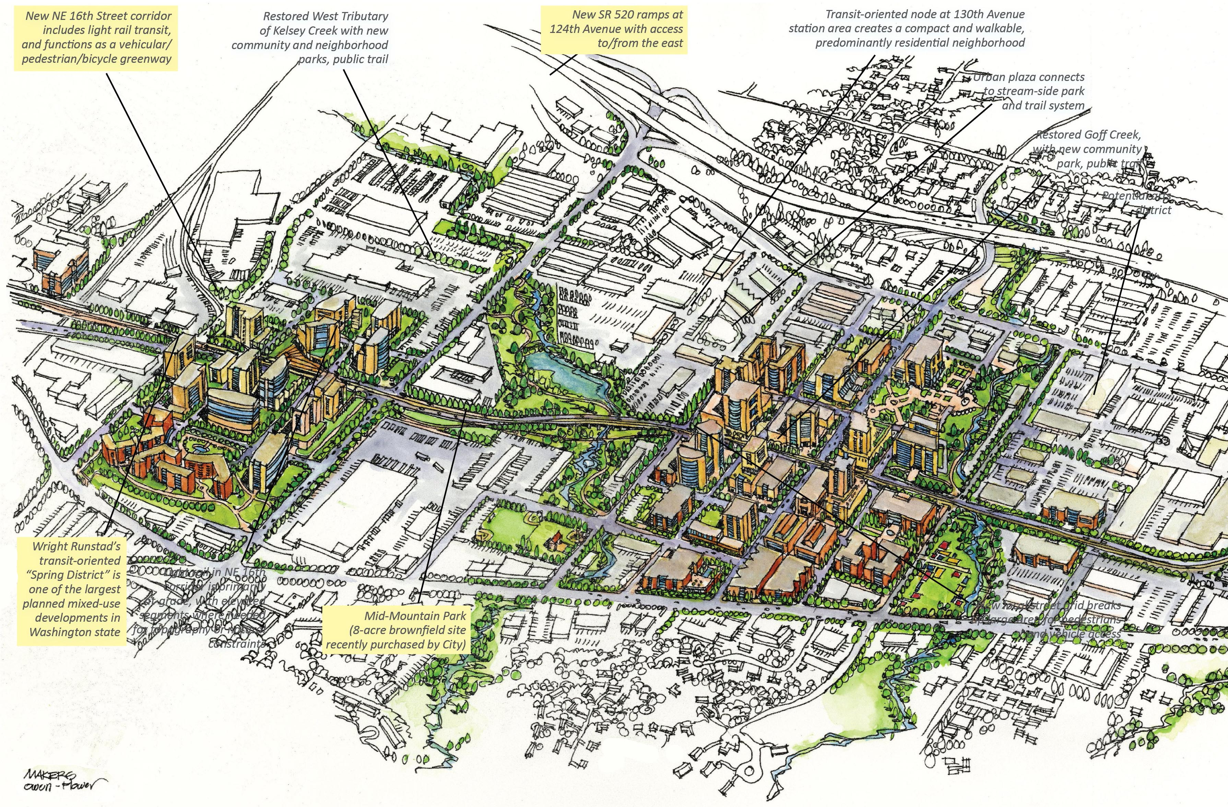
Transportation 2040: Four Integrated Strategies
Land Use
Supporting a more concentrated development pattern that is more walk-able, bike-able, easier to support with transit, and that balances jobs and housing.
Efficiency
Efficient transportation starts with fully maintaining and operating a system that is safe, secure and manages facilities to achieve their optimum performance.
Pricing
Begins moving from traditional forms of funding to a more sustainable user based funding that improves mobility and the environment.
Strategic Investments
Moves the region from single focused investments to integrated strategies that are more cost effective and support all forms of travel.
Notes:
The plan that was adopted in May of this year relies on four strategies:
Improving land use to be more concentrated (Vision 2040) and balance job and housing per Vision 2040
Being more efficient starting with preserving what we have, improving safety and security in our communities and doing things that improve the operations of our current infrastructure-like signal coordination.
Being smarter about out investments.
Beginning the movement of transportation funding from traditional sources to more user based funding that improves mobility and the environment at the same time.

Slide 6
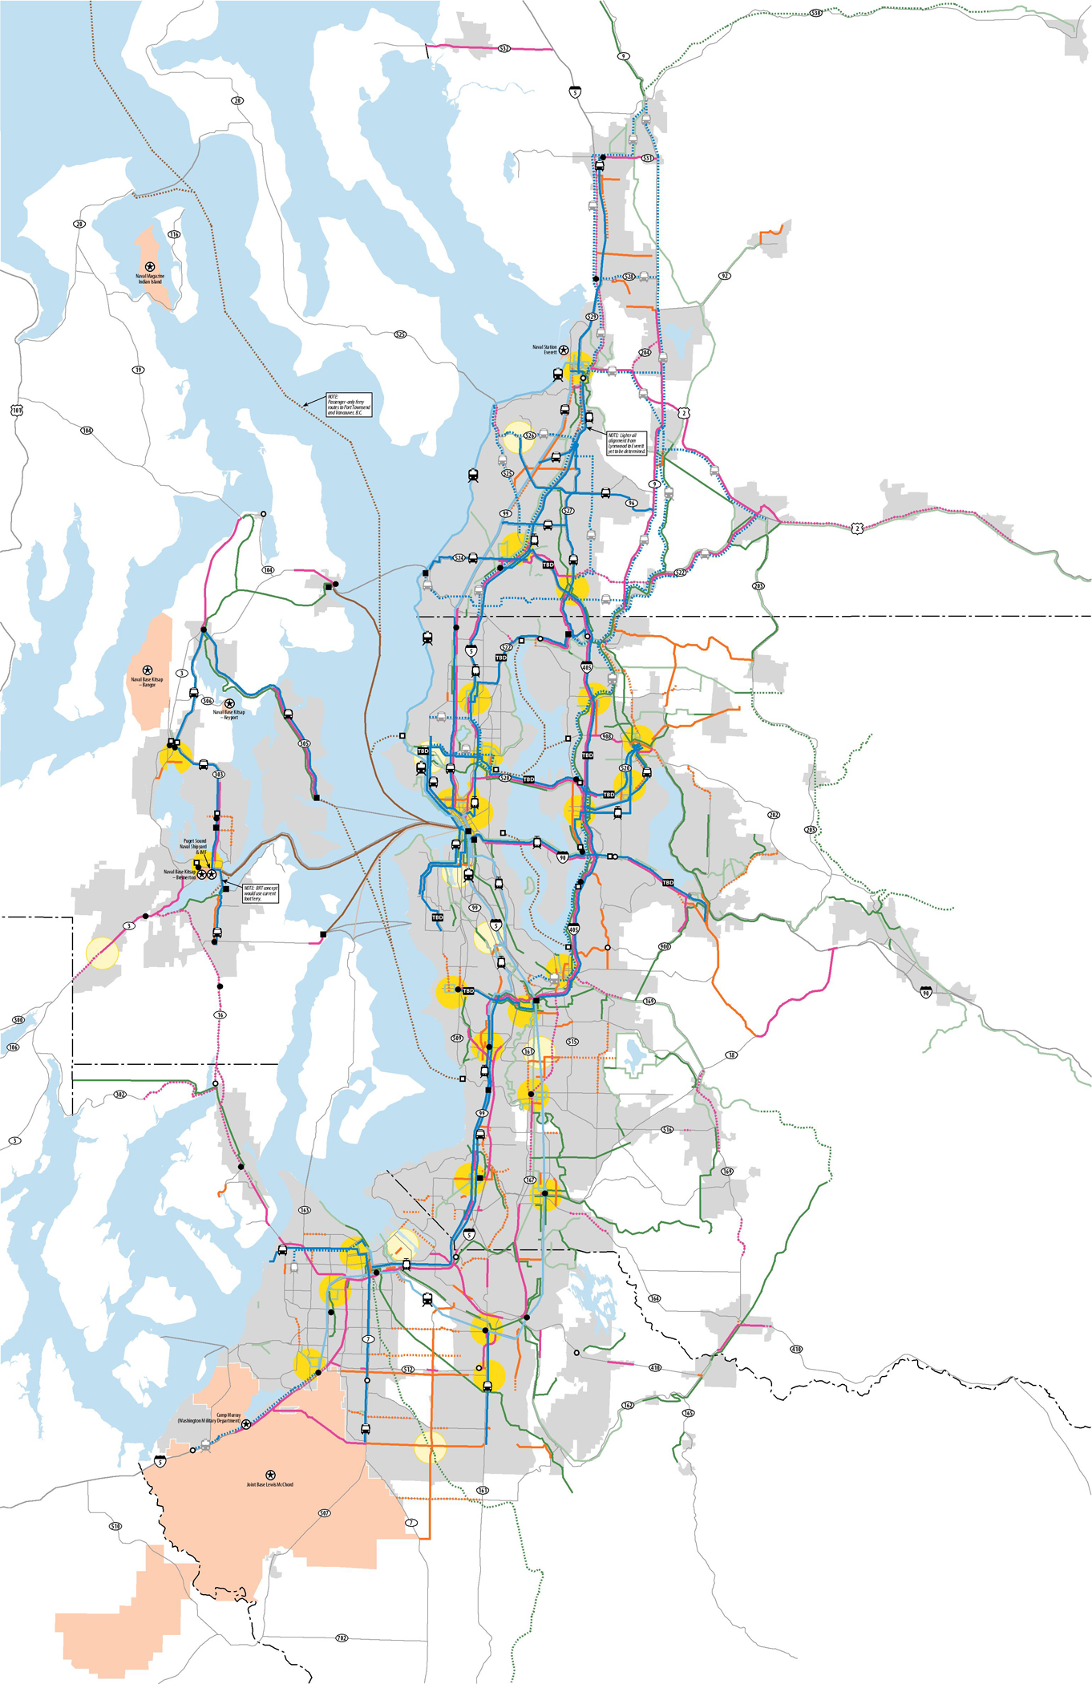
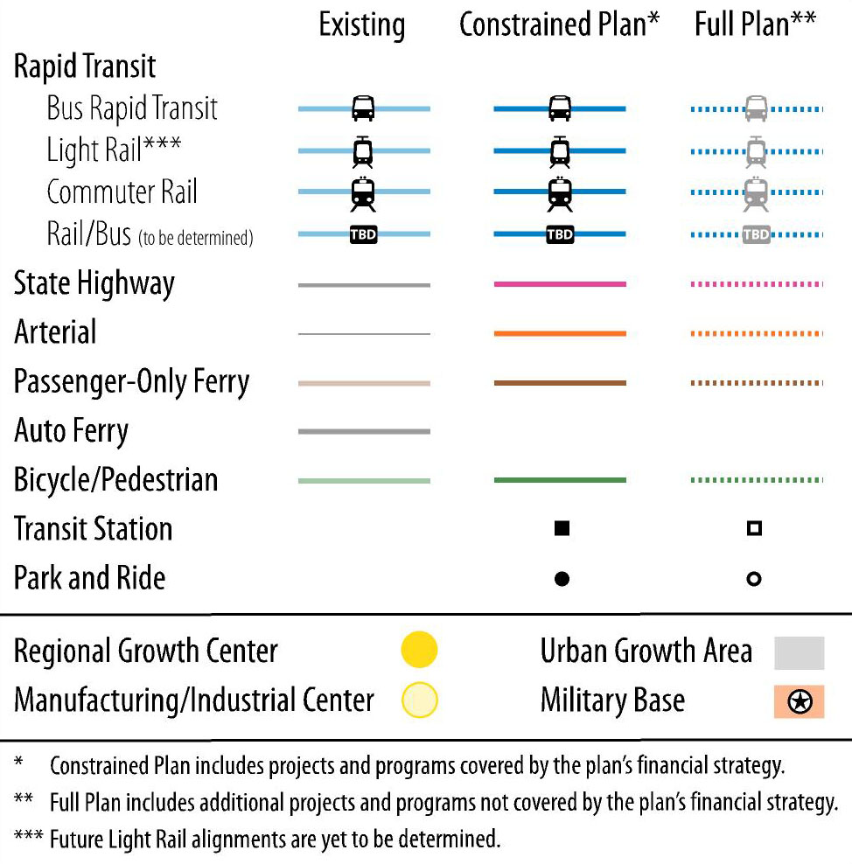
Strategic Investments
Transportation 2040
Notes:
The adopted plan includes over a 1000 projects and programs involving:

Slide 7
Aligns with VISION 2040
The transportation plan supports the adopted growth strategy:
Typology of regional places
Growth focused in urban centers
Addressing historical trends including:
Population and employment growth
Real income growth
Increasing vehicle ownership, commute distance, time and roadway congestion
Declining household size, vehicle operating costs and transit modal share
Increasingly polycentric urban form
Decline in economies of agglomeration
Notes:
7
These investments are designed to support VISION 2040s framework for balancing competing interests and upholds a shared vision for the future,
Vast majority of road, transit and bicycle pedestrian investments support metropolitan and core city access.

Slide 8
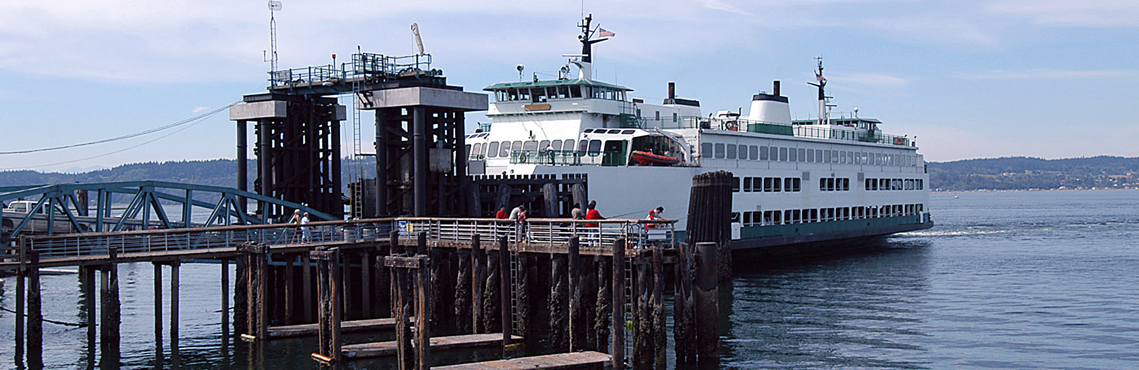
Analysis Methods

Slide 9
Challenge: Scenario Development
Developing Plan Scenarios is Harder Than it Might Seem
  Built up from constituent elements (100’s) with unknown performance characteristics
  Uncertainty around element/project interactions
  Need to avoid fallacy of construction problems
Our General Approach
  Multiple design steps with modeling at each stage
  Start with major policies that influence the scale of demand
  Layer in short run investments that address changes in demand
  End with larger capital programs that are expected to be justified

Slide 10
Planning Analysis Tools
Integrated models simulating
persons and vehicles at a parcel level
PSEF
Geodatabase
Regional Economic Forecasts
Transport System
Urbansim
Land Use Forecasts
Travel Forecasts
Hybrid activity-based
EPA Moves
Benefit Cost Analysis
Air Quality Analysis
Economic Appraisal
Notes:
10
We developed six new sets of tools that are integrated to simulate persons and vehicles at a parcel level and link level. Including UrbanSim (benefits of this tool) and new air quality model to allow us to better analyze CO2 emissions
The remaining five of these represent a number of significant changes to the overall PSRC system shown here –
We have built a new tool to forecast changes in land use forecasts at a parcel level of detail.
We have begun the process to build a new activity-based model to estimate travel.
All transport systems are developed and maintained in a new geodatabase.
We are working toward adopting a new emissions model for air quality.
We have built a new benefit-cost analysis tool.
I am going to highlight the new tools in the remaining presentation.

Slide 11
Unique Features of the PSRC BCA Tool
Direct link to regional travel model methods and data
Correct accounting of consumer surpluses
Flexibility to incorporate GHG analysis
Explicit treatment of travel time reliability through the use of certainty equivalents for travel time risk
A user interface allowing control of key features of the analysis
Regional analysis (default), or sets of origins and destinations
Three points of user control:
  Travel demand modeling inputs and assumptions
  User defined BCA assumptions and values (discount rate, VOT)
  Spreadsheet based summary output (cash flows, cost details)

Slide 12
BCA Mechanics
Post processing of travel model results
  Must model a base case and at least one build case
  Travel demand models represent markets and transportation prices
  Long-run changes are partially captured in the land use models
  More tightly bound economic models are a future development
Disaggregate results
  11 vehicle classes
  5 time-of-day traffic assignment periods
  1 million zone-pairs (spatial disaggregation)
  5 consumer surplus categories
  In total 275 million consumer surplus calculations

Slide 13
Data Flow
Notes:
Followed by a technical analysis involving the 7 criteria categories and 26 technical measures.

Slide 14
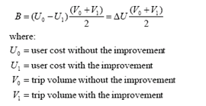
Consumer Surplus
Cost
Trips

Slide 15
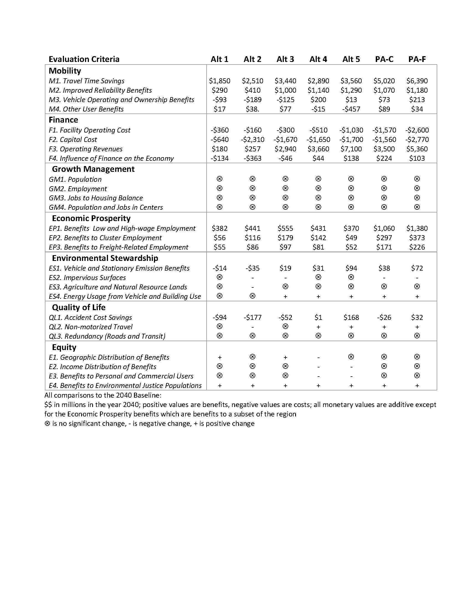
Measuring Benefits
Measures Handled by BCA
  Travel Time Savings*
  Improved Reliability*
  Vehicle Operating Cost Savings*
  Toll/Fare Cost Savings*
  Accident Cost Savings*
  Facility Operating and Capital Costs
  Emission Cost Savings
Measures Partially Handled by BCA
  Distribution of benefits across users and geographic location of benefits
Measures Requiring Other Methods
  Equity: relative importance of various groups
  Impacts on unique environmental assets
  Plan compliance benefits
  Others
*consumer surplus measure

Slide 16
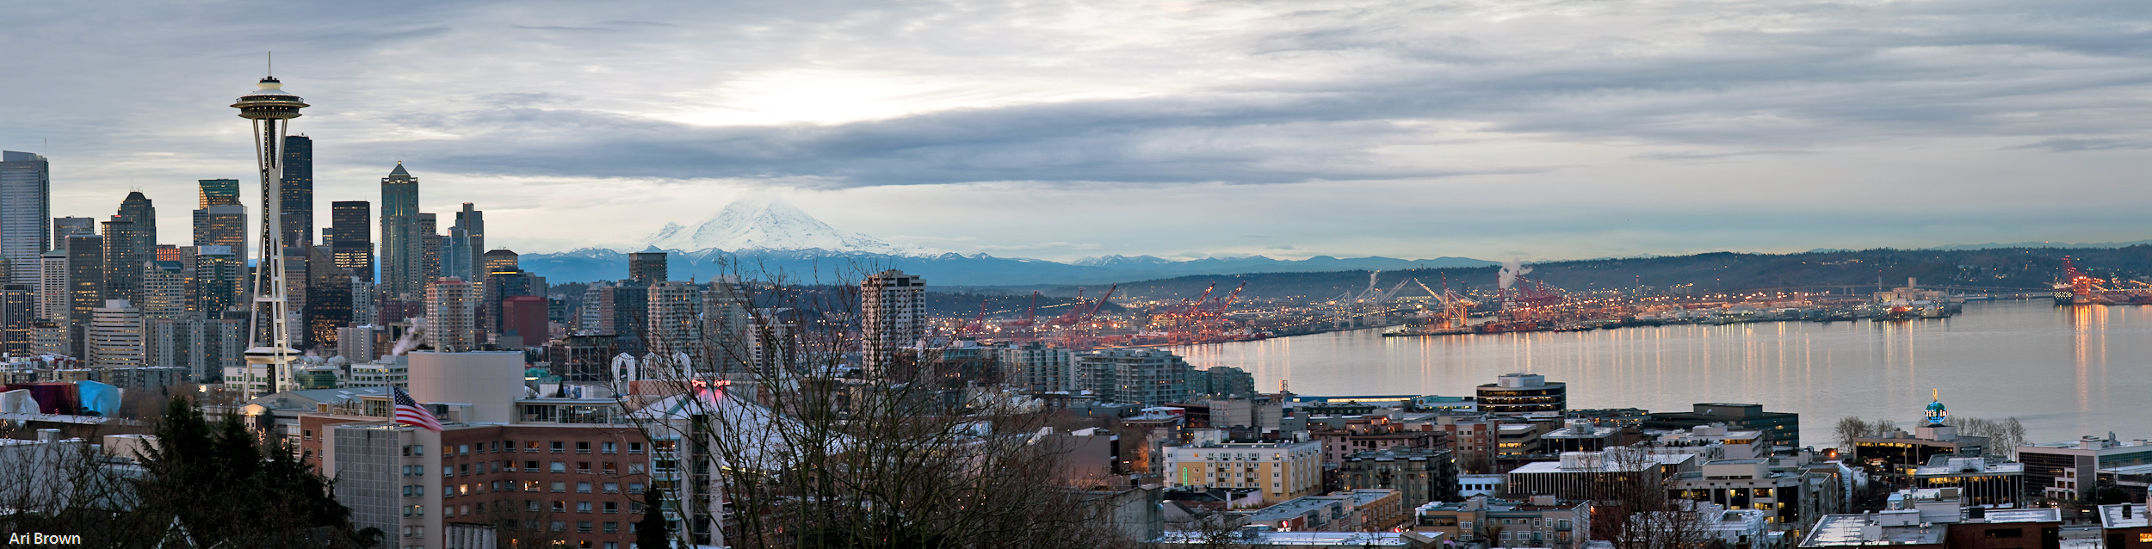
16
Portfolio Optimization
Notes:
16
Does anyone have any questions for me?

Slide 17
Portfolio of Investments
Maybe a Plan Alternative is Like a Portfolio
  Comprised of project investment and policy elements
  Individual project and policy “performance” is uncertain
  Elements may have complex dependencies
  True portfolio optimization is a potentially costly and demanding exercise
  Can Portfolio Optimization be Approximated Ad Hoc? William Vickrey (Nobel Laureate) suggested that the efficient pattern of decision making would:
  establish a pricing policy to be followed in the future;
  plan adjustments to fixed capital installations according to a cost-benefit analysis based on the predicted demand patterns and predicted application of the pricing policy;
  subject to whatever financial constraints may be applicable...

Slide 18
Optimization Space
Diminishing returns
Target region
To be avoided
Area of high productivity
Notes:
This is not a new issue in the region or state.
Vision 2020 ( our regional plan) was adopted in 1990 before the Growth management act and set the stage for:
Focusing growth in the urban areas and centers
Supporting that growth with multimodal transportation system.

Slide 19
How did we do?
Financially Constrained Plan
Diminishing returns
Target region
To be avoided
Area of high productivity
Notes:
This is not a new issue in the region or state.
Vision 2020 ( our regional plan) was adopted in 1990 before the Growth management act and set the stage for:
Focusing growth in the urban areas and centers
Supporting that growth with multimodal transportation system.

Slide 20
Did we get better over time?
Low capital emphasis on system management
Tolling (various levels of capital and system management)
Refinement focus on toll optimization
High capital emphasis (rail and road)
Alternative Development Phase
Refinement Phase
Size of circle indicates scale of net benefits
Notes:
This is not a new issue in the region or state.
Vision 2020 ( our regional plan) was adopted in 1990 before the Growth management act and set the stage for:
Focusing growth in the urban areas and centers
Supporting that growth with multimodal transportation system.

Slide 21
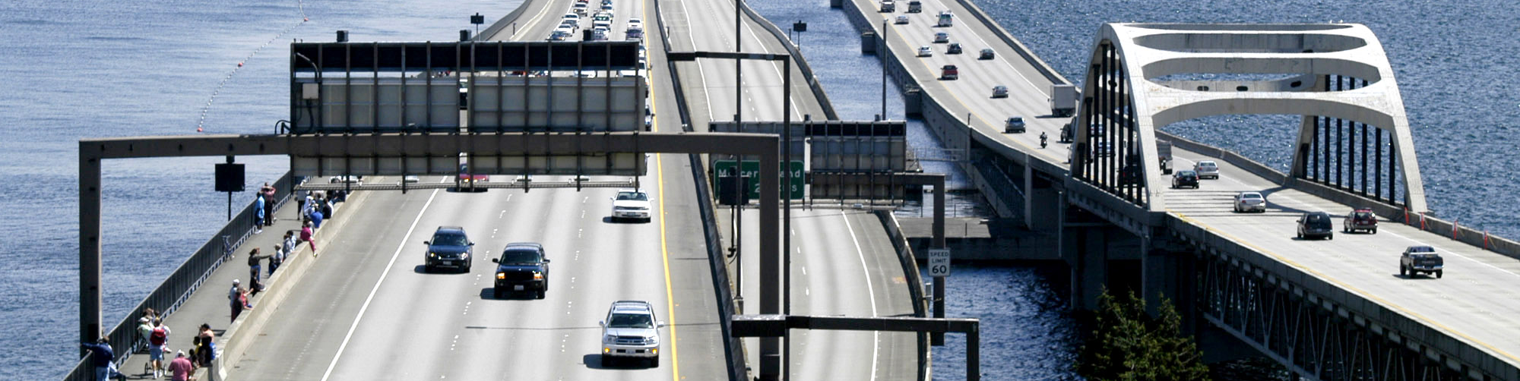
21
Treatment of Tolls
Notes:
21
Does anyone have any questions for me?

Slide 22
Tolls and BCA: Payments Are a Transfer
Time savings from toll management are a benefit to users
Toll payments are a cost to the user and a benefit to the operator
If toll revenues are recycled into projects then taxpayer costs are avoided
Taxes have a distortionary effect on markets; toll financing can reduce these costs
Notes:
This is not a new issue in the region or state.
Vision 2020 ( our regional plan) was adopted in 1990 before the Growth management act and set the stage for:
Focusing growth in the urban areas and centers
Supporting that growth with multimodal transportation system.

Slide 23
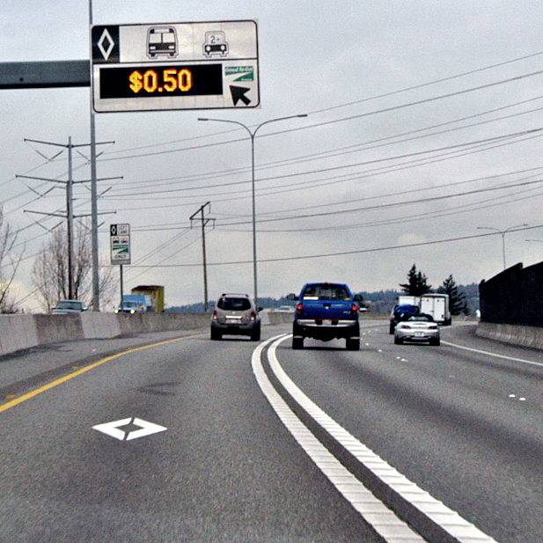
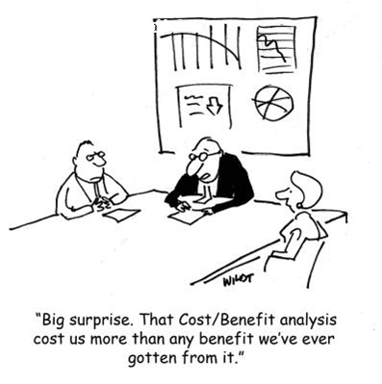
Conclusions
The regional transportation planning process was aided by the use of standard economic appraisal methods.
Benefit-cost analysis tools provided useful information to decision-makers, but also helped to guide analysts in the plan alternative design process.
The comparison across plan alternatives (portfolios) is inherently unsatisfying on its own.
There is a process underway to assess the constituent elements of the adopted plan and set investment priorities.
The appraisal of price policies (tolls, fares, etc.) are straightforward enough, but…
Notes:
This plan has taken a major step in:
Mobility-moving people and goods
Environment-focusing on climate change and water quality
Sustainable Funding- recognition of that the heavy reliance we have on the gas tax at both the federal and state level is not sustainable.
We will be updating it this plan:
Learn from the projects and programs currently in process-SR 520 tolling
3 programs PSRC is involved in:
Growth target work that in currently on going
Project prioritization work that we are currently conducting
HUD Sustainability work-looking at land use and transportation connections at HCT stations.

Slide 24
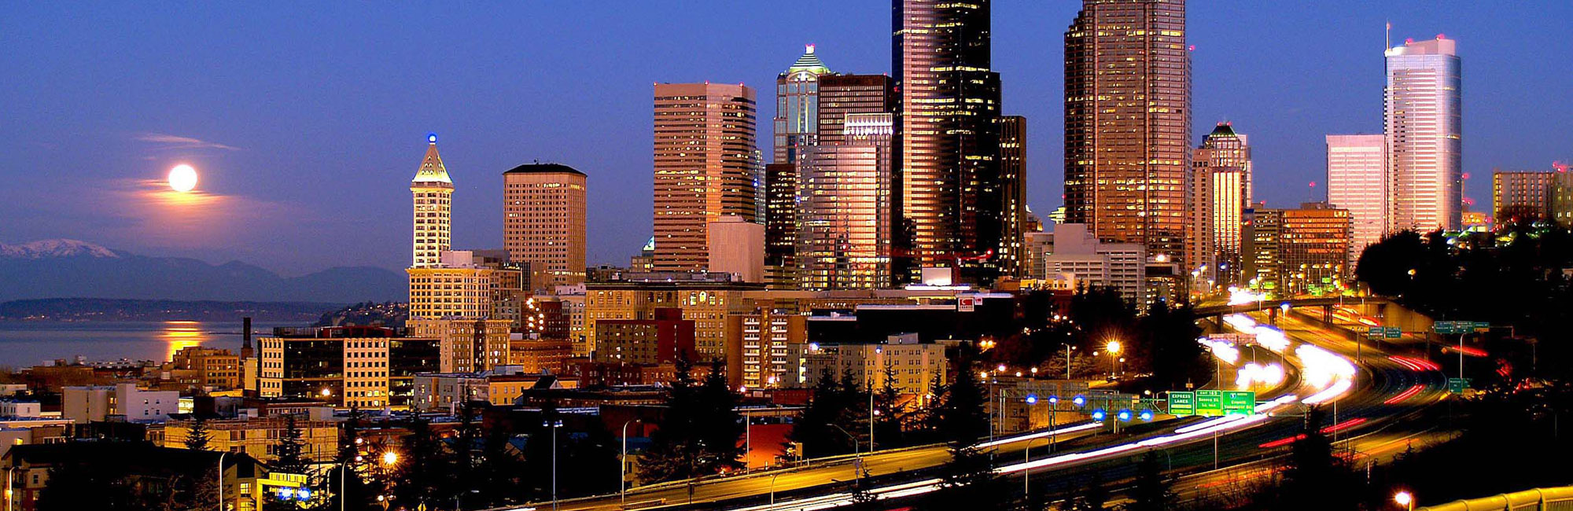
For More Information
Matthew Kitchen
mkitchen@psrc.org / 206-464-6196
Notes:
24
Does anyone have any questions for me?

